Slide 1
Introduction to Distance Education
Trends, Opportunities, and Challenges
Vangelis Tsiligkiris PhD, SFHEA
Professor of International Education
Co-Chair International Committee of Association of Business Schools

Slide 2
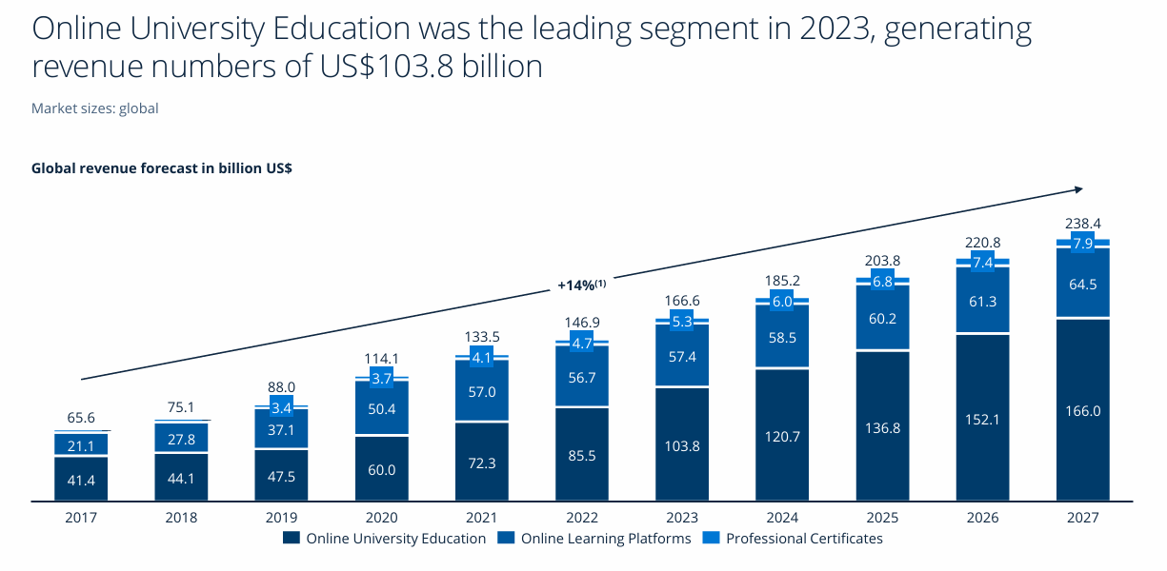
Source: Statista Digital Market Insights

Slide 3
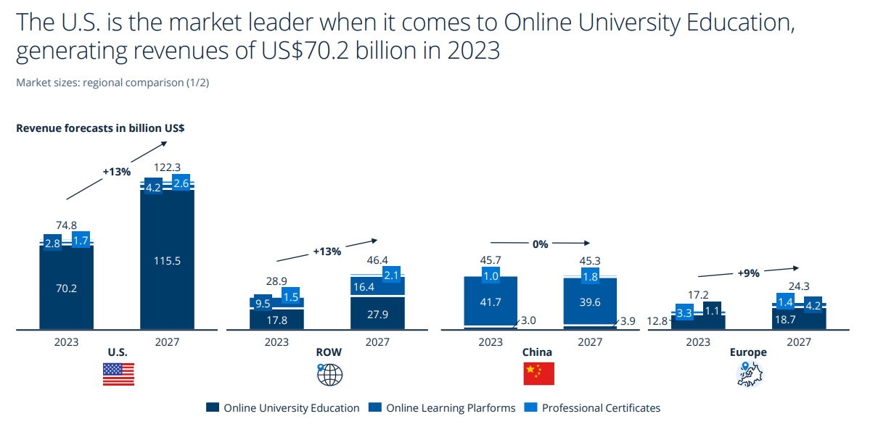
fees/subscriptions paid by learners and institutions in that country across Online University Education, Online Learning Platforms and Professional Certificates.

Slide 4
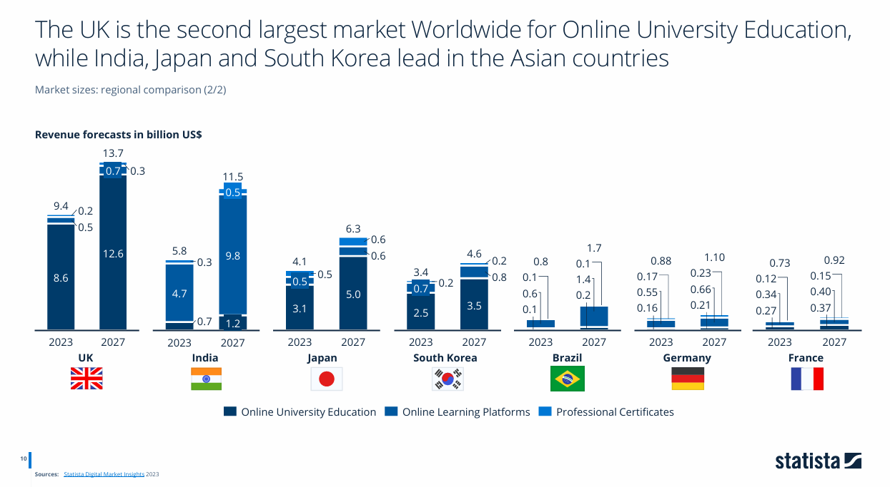
Source: Statista Digital Market Insights
fees/subscriptions paid by learners and institutions in that country across Online University Education, Online Learning Platforms and Professional Certificates.

Slide 5
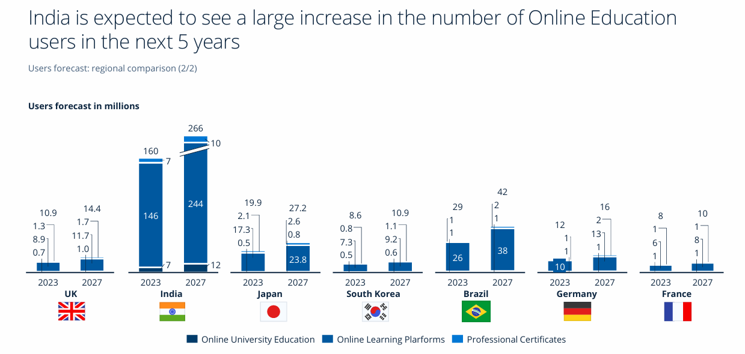
Source: Statista Digital Market Insights

Slide 6
Leading reasons for online college selection among students in the United States
Reasons for online college selection among students in the U.S. 2023
Share of respondents
Source: Statista Digital Market Insights

Slide 7
Concerns about online versus on-campus learning options according to online students in the United States
Concerns about choosing online education in the U.S. 2024
Share of respondents
Source: Statista Digital Market Insights

Slide 8
Trends / Developments
AI-Powered Personalization Revolution
  Embedded AI tutors
  Automated Administrative Tasks
Virtual And Augmented Reality
  Improved learning experience
  Collaboration / Blending of the real and digital world
  Experiential learning
Microlearning and Modular Education
Hybrid Learning Models “at Home”

Slide 9
Spectrum of Distance Education — Matrix Taxonomy
 |  | Temporal structure
 |  | Synchronous | Mixed (cohort-paced) | Asynchronous (self-paced)
Spatial Dependence | Campus-dependent | On-campus live (+streaming) Timetabled sessions delivered on campus; lecture capture/streaming optional for remote viewing. | Blended flipped on-campus Online preparatory materials; in-person seminars/labs; weekly paced milestones. | On-campus with self-paced components VLE-based independent study blocks supporting campus activity; minimal live requirements.
 | Mixed/site-flexible | HyFlex (simultaneous) Same session taught to on-campus and remote students live; students choose mode each week. | Blended block / intensive Short face-to-face residencies or workshops; paced online learning between blocks. | Distance-blended with residencies Mostly self-paced online study with occasional on-site exams, labs, or workshops.
 | Fully remote | Live online cohort Virtual classroom/webinars with scheduled contact hours and attendance expectations. | Online cohort-based Tutor-led weekly cadence with deadlines and discussion; limited live touchpoints. | Fully online self-paced Open/self-paced modules and micro-credentials; rolling enrolment; mastery-based progression.

Slide 10
Opportunities to explore
Explosive Market Growth
Widened access to good quality education (SDG4) without relocation; virtual international classrooms.
Joint/online degrees, COIL/virtual exchange, and global partnerships at lower marginal cost than physical TNE.
Lifelong learning markets: modular, flexible, work-aligned upskilling at scale.
Internationalised curricula and guest expertise via digital delivery.

Slide 11
Challenges to Address
Quality and credibility: equivalence of standards across modes; academic integrity in an AI-rich environment.
Faculty preparedness gap
Recognition across borders: aligning credentials with frameworks; preventing fragmentation.
Regulatory unevenness: legacy rules, data/privacy and authentication requirements, cross-border authorisation.
Digital inequality and student support at scale (advising, wellbeing, community).

Slide 12
Access & Equity Remain Central
Connectivity gaps constrain participation and quality in distance education, especially for low-income and rural learners.
In 2024, ~2.6 billion people were offline; urban–rural disparities remain stark (ITU 2024).
UNESCO highlights that many schools remain unconnected (e.g., ~60% of primary schools globally).
Implication: institutions need low-bandwidth design, offline options, and targeted support.

Slide 13

Urban-rural gaps in digital engagement in India in 2024, by type of internet activity
Urban-rural gaps in digital literacy in India 2024, by type of internet activity
9
Description: In 2024, engagement in digital activities in India was much higher in urban areas compared to rural areas. The rate of social media usage was 59 percent in urban areas, compared to 35 percent in rural areas. Digital payments were also more widely used in urban areas as compared to rural areas. Read more
Note(s): India; 2024
Source(s): Indian council for research on International Economic Relations

Slide 14
QA for Distance Education – What Good Looks Like
Equivalence: outcomes, workload and level consistent across delivery modes.
Learning design & interaction: clear structure; regular, substantive teacher–student interaction; peer learning.
Assessment integrity: authentic assessment; identity verification; academic integrity policies incl. AI use.
Student support: advising, libraries, accessibility, data privacy; analytics-informed enhancement.
Continuous improvement: monitor engagement/achievement; act on evidence; publish transparent information.

Slide 15
What to Do Next (Institutions & QA Agencies)
Update internal QA for online/micro‑credentials: policy on AI use, assessment integrity, accessibility, and data governance.
Design for inclusion: low‑bandwidth options; multilingual captions; targeted support for remote learners.
Map micro‑credentials to frameworks, issue verifiable digital credentials, and publish outcomes data.
Invest in staff development for digital pedagogy; evaluate AI‑enabled supports with rigorous evidence.

Slide 16
Closing
Distance education is now core, not peripheral. The task is to scale it with quality and equity.
QA must enable innovation while safeguarding standards, integrity and learner protection.

