Slide 1


Where are your problematic hand car washes and nail bars?
Some recent research updates
Rich Pickford, James Hunter, Ian Clark and Nidhi Sharma
Work, Informalisation and Place Research Centre,
Nottingham Trent University
Tuesday 27 June 2023

Slide 2
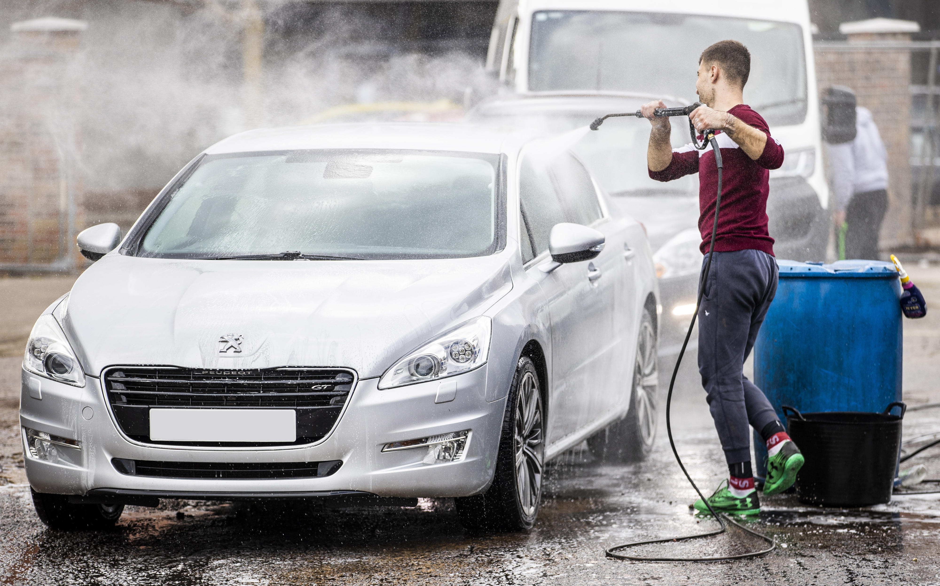
The WIP Research Centre: Our research focus
Informal Economy
Scale of the informal economy
(how many non-compliant employers are there?)
Nature of the informal economy
(what is the degree and impact of non-compliance?)
Location of the informal economy
(where is non-compliant employment located, and why does it appear within specific neighbourhoods?)
Links to labour abuse and modern slavery
How can we use our data and evidence base to inform strategic policy, and provided regulators and enforcement agencies (and their partners) with information that helps them to target and tailor their interventions?

Slide 3




The WIP Research Centre: Recent Projects, Current Research Bids, Our Funders and Partners
Impact of Covid-19
pandemic on the informal economy
Responsible Car Wash trial of licensing schemes and other approaches to tackle non-compliance in hand car wash sector
Understanding The Role Of Licensing To Tackle Modern Slavery And Labour Market Non-compliance In The Hand Car Wash Sector
Partners to whom we are a Critical Friend:
Migrant worker self-help groups;
The Director of Labour Market Enforcement;
The Gangmaster’s Labour Abuse Authority;
Responsible Car Wash Scheme;
Strategic analysts and police officers attached to the East Midlands, Greater Manchester and South East regional organised crime units.
Unseen; USDAW and GMB Trade Unions;
Independent Anti-Slavery Commissioner.
National Crime Agency - Mapping Exercise

Slide 4
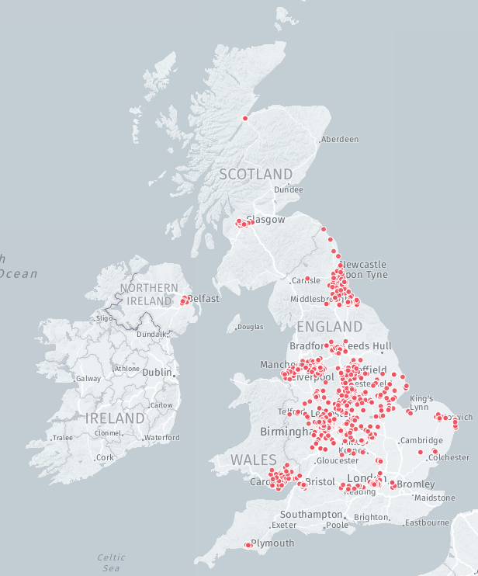
Extent of our search for HCWs across England and Wales:
WIP hand car wash locations identified, May 2022
1,958 HCWs identified to date across 30% of local authority areas (35% of neighbourhoods [LSOAs])
Mapping undertaken in all UK regions and every Core City of the UK
Comprehensive mapping of:
The North East,
West Midlands (excluding Herefordshire)
East Midlands
Greater Manchester Combined Authority
Merseyside
Cardiff city region

Slide 5
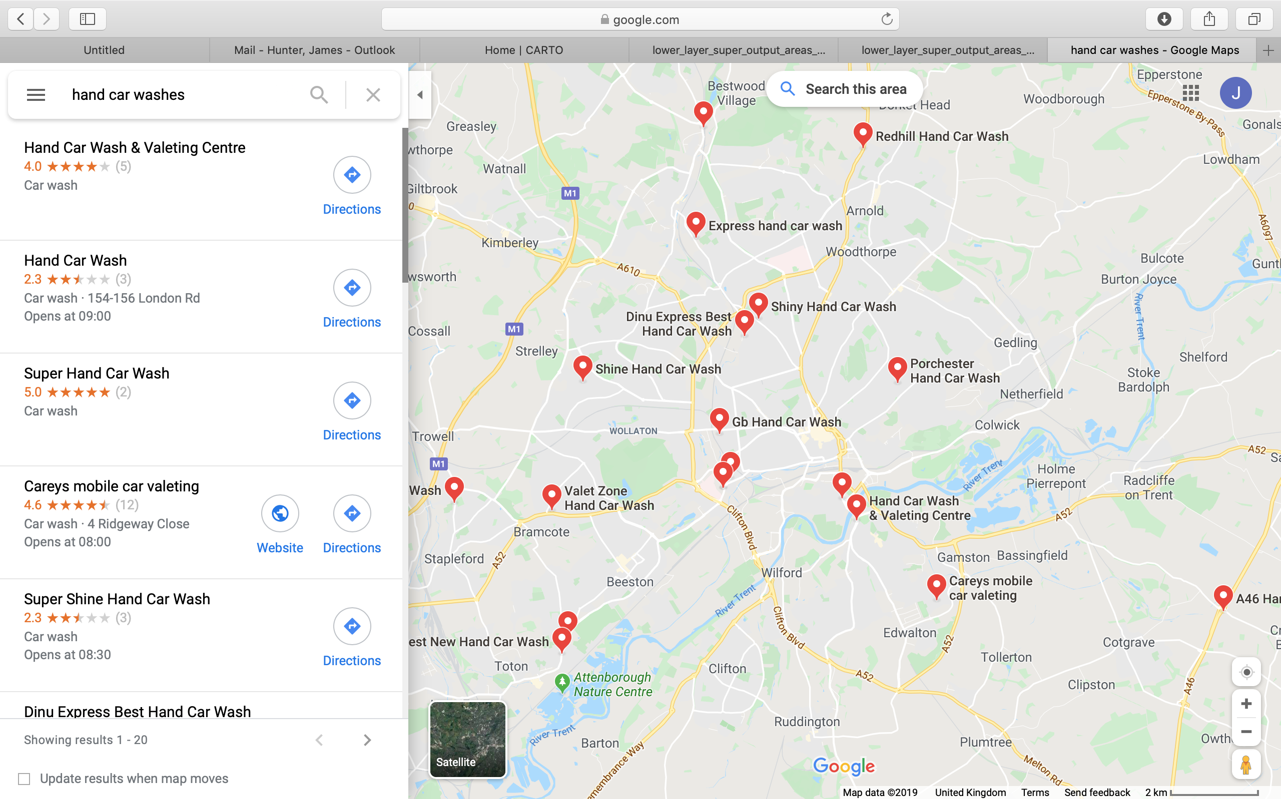


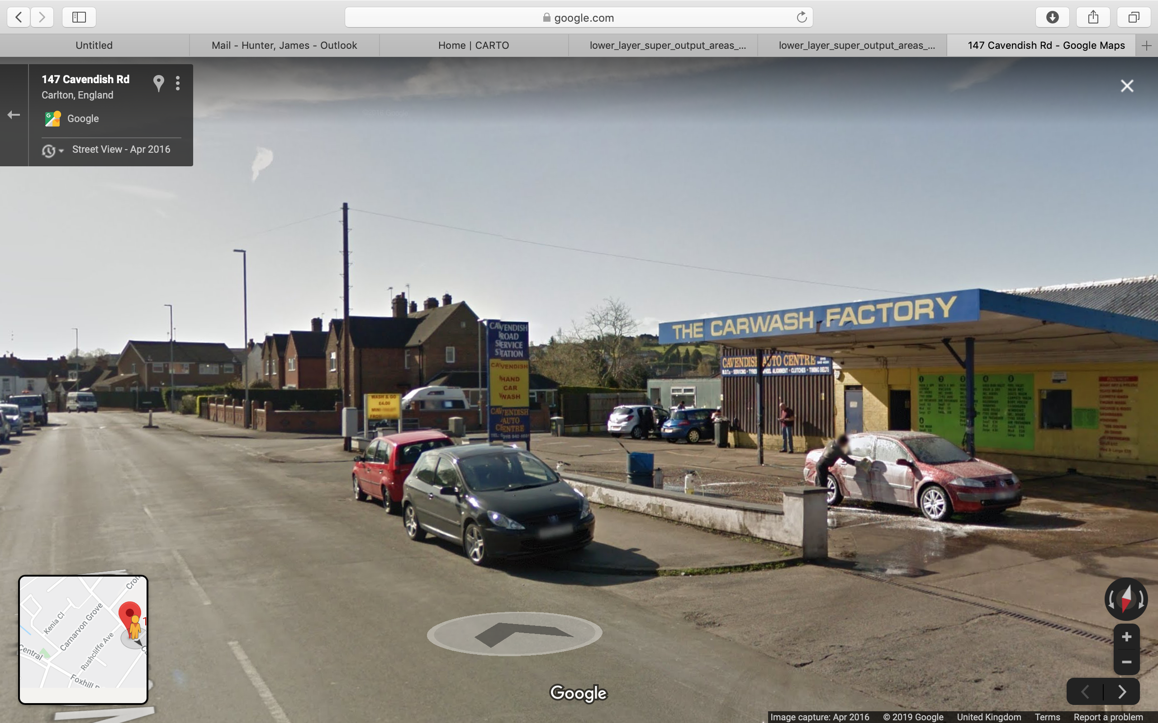
Estimating the total number of HCWs in England and Wales: Our methodology
1. Identifying the location of HCWs
2. Identifying the distribution of identified HCWs across similar local authority types
3. Identifying the mean rate of HCWs per 1000 population in each area type
Using Google Maps to identify advertised HCWs
4. Multiplying the mean rate of HCWs per 1000 population by the total population numbers in each area type across England and Wales to arrive at estimated number of HCWs in each area type.
Using Google Streetview to identify non-advertised HCWs
HCW rate:
Total population:
Identification of number of HCWs in similar types of local authority area using the 2011 ONS Area Classification Supergroups
0.079 x 7,308,521 = 577 HCWs
Drive through of streets not visible on Streetview
Business, Education and Heritage Centres

Slide 6
Identifying advertised HCWs in London Cosmopolitan areas – and boosting our sample in some other area types
2011 ONS Area Classification: | Mean rate of advertised to non-advertised HCWs | Standard deviation
Affluent England | 0.633 | 0.047
Business, Education and Heritage Centres | 0.582 | 0.118
Countryside Living | 0.582 | 0.130
Ethnically Diverse Metropolitan Living | 0.621 | 0.088
London Cosmopolitan | - | -
Services and Industrial Legacy | 0.628 | 0.211
Town and Country Living | 0.641 | 0.319
Urban Settlements | 0.687 | 0.131
All local authority areas | 0.632 | 0.215
Identification of advertised HCWs in London Cosmopolitan Boroughs (plus some additional Affluent England, Countryside Living, and Ethnically Diverse Metropolitan area types)

Slide 7
Estimate of total number of HCWs across England and Wales based upon revised mean rate of HCWs per 1000 population by area type across surveyed Local Authority areas (n=101)
2011 ONS Area Classification: | % of English LAs in each cluster we have surveyed | Mean rate of HCWs per 1000 population in surveyed LAs | Estimated number of HCWs
Affluent England | 11.8 | 0.052 | 339
Business, Education and Heritage Centres | 36.7 | 0.079 | 577
Countryside Living | 15.9 | 0.068 | 397
Ethnically Diverse Metropolitan Living | 21.1 | 0.088 | 524
London Cosmopolitan | 100.0 | 0.040 | 106
Services and Industrial Legacy | 55.8 | 0.084 | 616
Town and Country Living | 45.5 | 0.062 | 519
Urban Settlements | 41.8 | 0.093 | 884
All local authority areas | 29.2 | 0.079 | 3,962
Lower quartile = 0.053
Mean rate = 0.079
Upper quartile = 0.098
2,972 HCWs
4,430 HCWs
5,495 HCWs

Slide 8
Phase Three: Why are HCWs only located in certain neighbourhoods? Identifying some potential factors
Presence of potential locations for HCWs (petrol station forecourts and closed pubs)
Staff attractors (existing ethnic communities and cheap housing)
No hand car wash
Deprivation levels (overall deprivation, income deprivation, economic deprivation, educational deprivation)
Customer attractors (supermarkets, retail parks, sports stadiums, hospitals, etc.)
Customer facilitators (main highways and arterial routes)
Neighbourhood characteristics (demographics, neighbourhood function, community cohesion)
Hand car wash
Changes in daytime population (work, shopping, leisure)

Slide 9
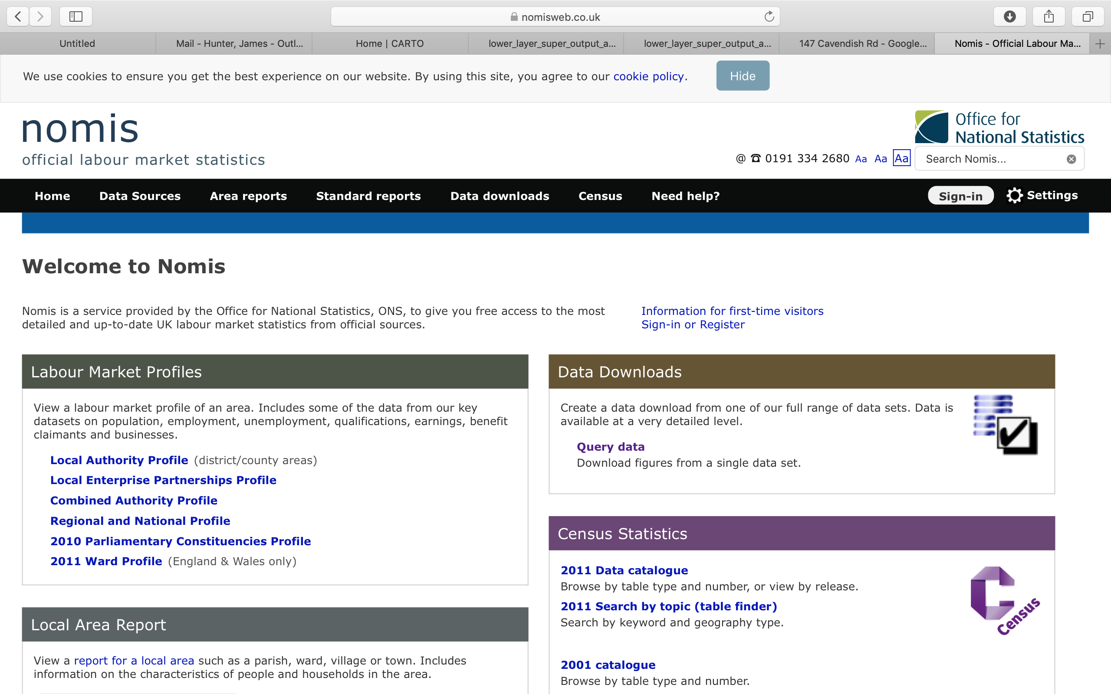
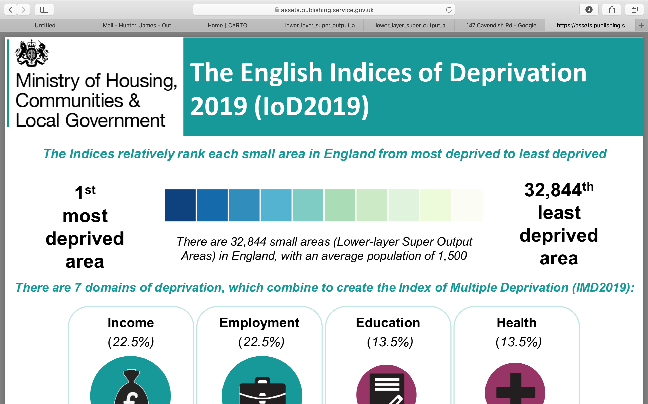
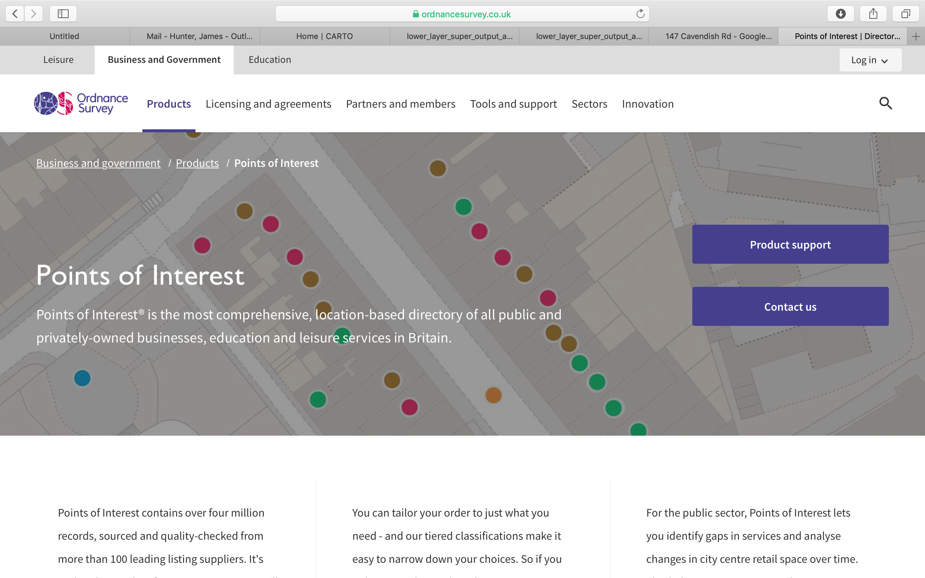

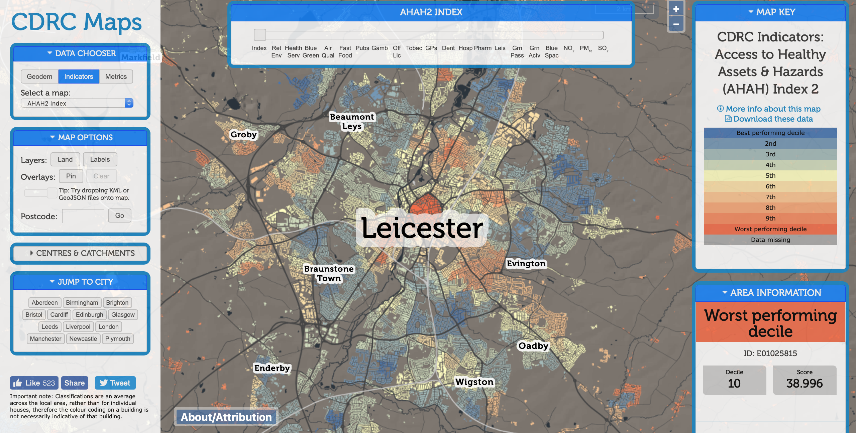
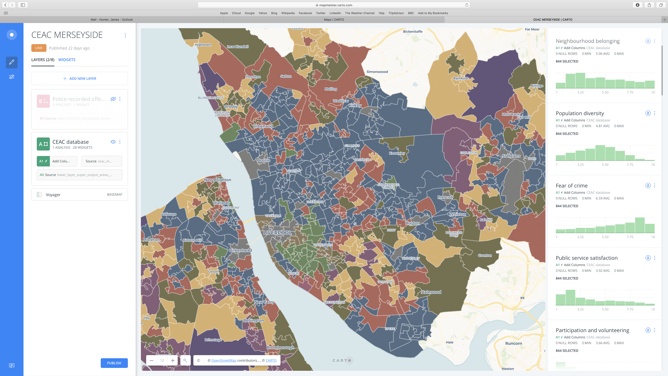
Phase Three: Modelling the location of HCWs – data sources for explanatory factors
Local economy
Scale and types of deprivation
Facilities within each neighbourhood
Population characteristics
AHAH Index: Access to health assets and hazards
Community Engagement Area Classification: neighbourhood belonging, fear of crime, satisfaction with public services, participation and volunteering

Slide 10





Phase Three: Identifying which factors explain the presence of HCWs in a neighbourhood
ODDS RATIO=2.36
PETROL STATION
Neighbourhood containing no HCWs
(CODED 0)
ODDS RATIO=0.93
What is different about the characteristics of these respective neighbourhoods?
OWNER OCCUPIERS
Binary logistic regression
Odds ratio <1
Protective factor
Odds ratio =1
Not significant
Neighbourhood containing one or more HCWs (CODED 1)
Odds ratio >1
Risk factor

Slide 11


What are the risk and protective factors that predict the presence of HCWs at the neighbourhood level?
2.564
2.364
2.225
1.545
1.316
1.01
0.989
0.959
0.958
0.929
0.920
0.914
Based upon binary logistic regression analysis of all LSOAs surveyed by WIP (n=11,490)
0.896
0.894
0.093
0.026
Decreasing chance of finding HCW
Increasing chance of finding HCW

Slide 12

Where are the nail bars – and why are they found in specific locations?
Generating an evidence base to inform non-compliance and modern slavery strategies and interventions
This research has been conducted by our Research Fellows Jack Barratt and Nidhi Sharma alongside Rich Pickford and James Hunter
It explores the location and makeup of nail bar units across three UK areas
It builds on our hand car wash research following regulator and police feedback about these businesses.
This research has been shared with the NCA and other bodies.

Slide 13
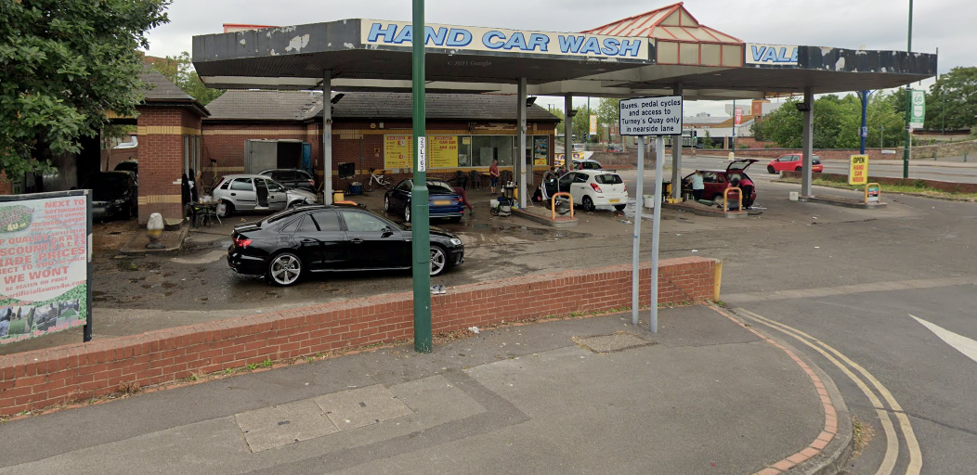
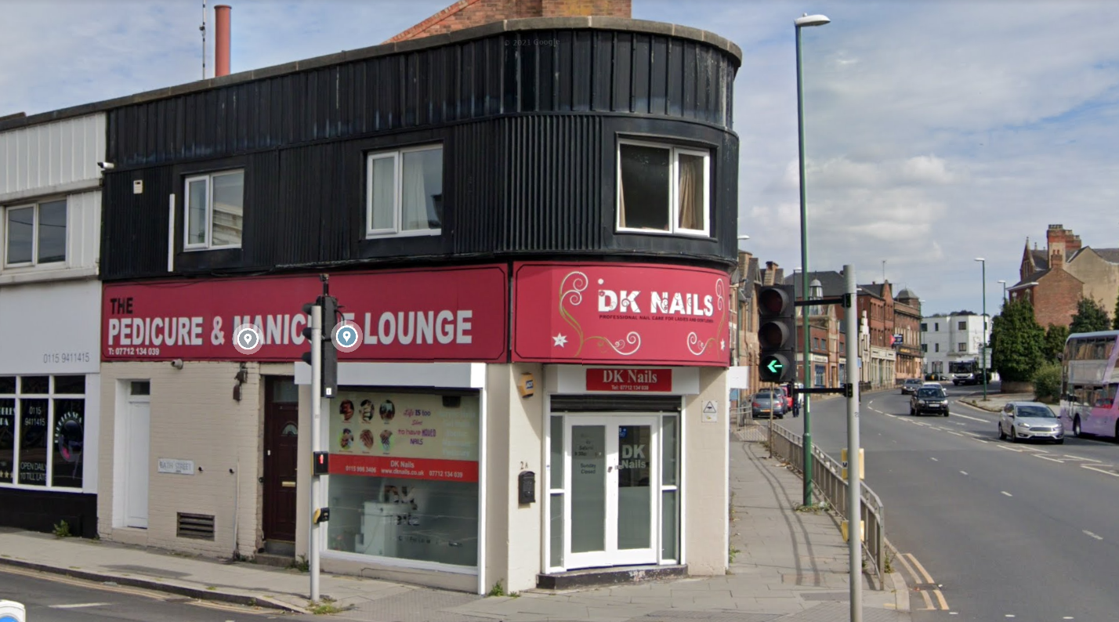
Adapting Methodology
WIP’s earlier work with Hand Car Washes (HCWs) created a methodology for classifying the quality and safety of the sites.
This methodology used Google Street View observations and applying a scoring matrix to produce a HCW risk ‘score’ combining ‘Place’, ‘Workers’ and ‘Environment’ elements.
As road access is a HCW prerequisite, Google Street View images showed large parts of the often open sites, with all the workers and tools of the trade visible.
Adapted the methodology to include additional Google and social media imagery. We also created a professionalism scale scoring system based on front shop appearance of the nail bars.
We also identified a set of rules to exclude beauty salons from our analysis – a process not required for HCWs where mechanised washes were more easily separated out.
For Nail bars, Google Street View images were not as definitive – and infractions with visible elements such as effluent leaking onto the road were less likely.

Slide 14
What are the risk and protective factors that predict the presence of nail bars at the neighbourhood level?
7.91
2.66
2.15
2.03
1.50
1.43
1.37
1.21
1.03
0.98
0.96
0.90
0.86
Based upon binary logistic regression analysis of all LSOAs surveyed by WIP (n=5,086 neighbourhoods)
0.78
Decreasing chance of finding nail bar
Increasing chance of finding nail bar

Slide 15
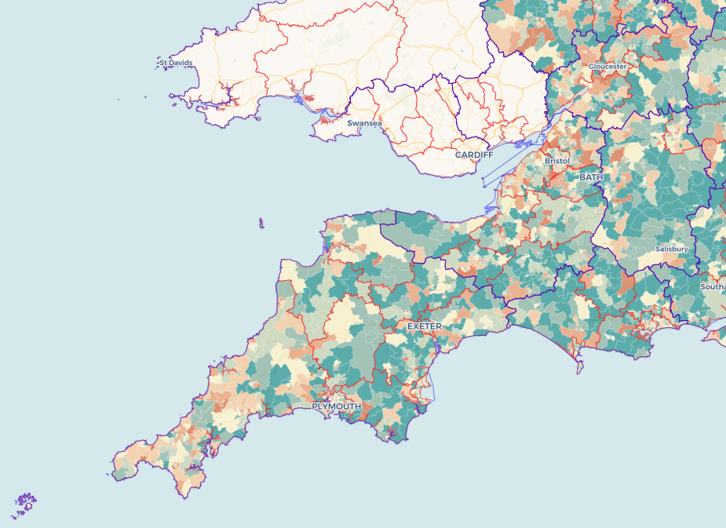
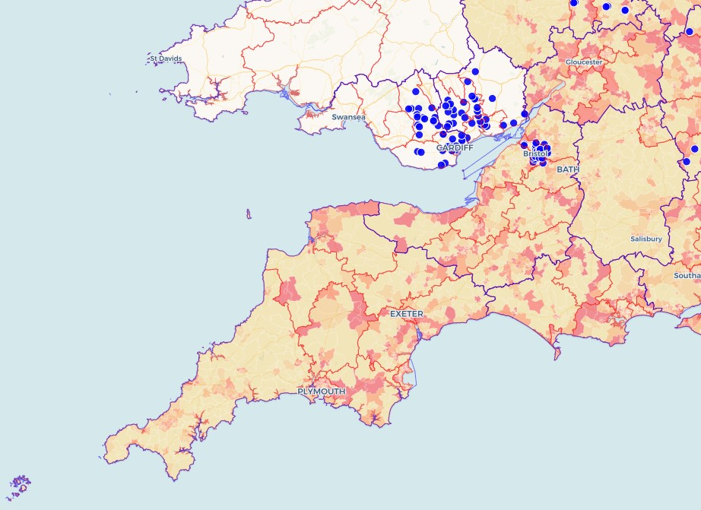
The picture of the South West region
The team have mapped hand car wash locations in Bristol but our predictive tools for hand car washes and nail bars can be utilised across the whole region.

Slide 16
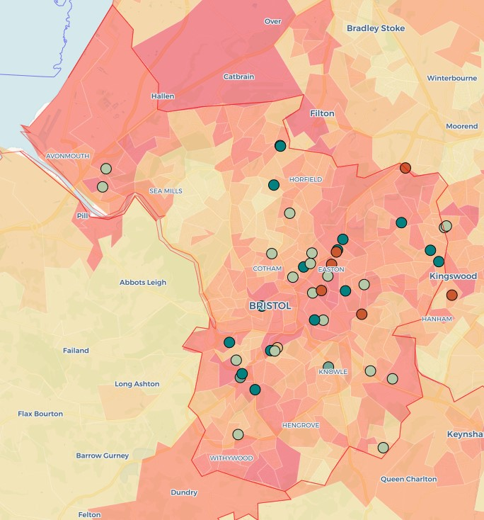
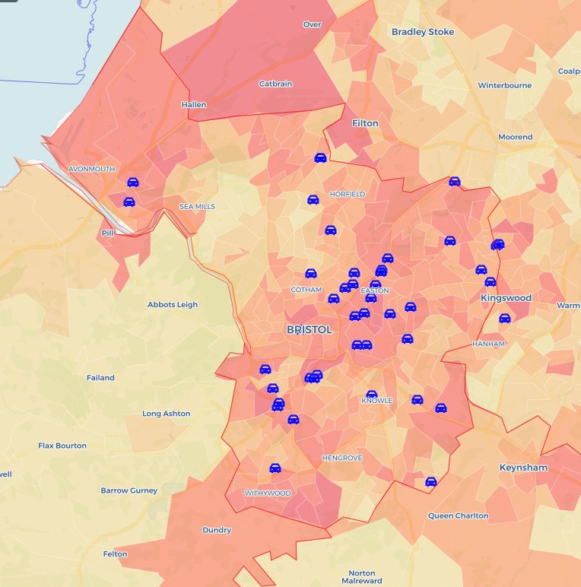
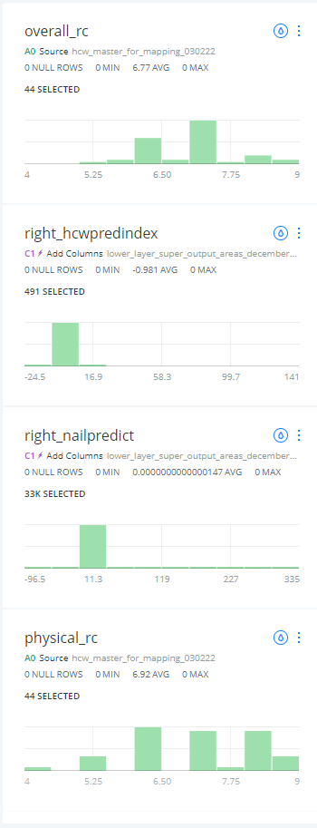

Bristol Sites
Sites in red of increased overall concern
Predictive Index that identifies the most likely location of HCWs
Location of HCWs in the Bristol area

Slide 17
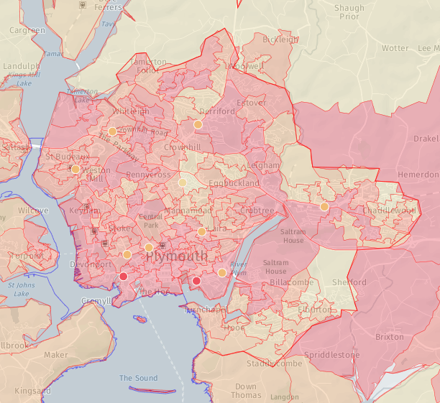
Plymouth Sites
Based on mapping undertaken in 2022

Slide 18
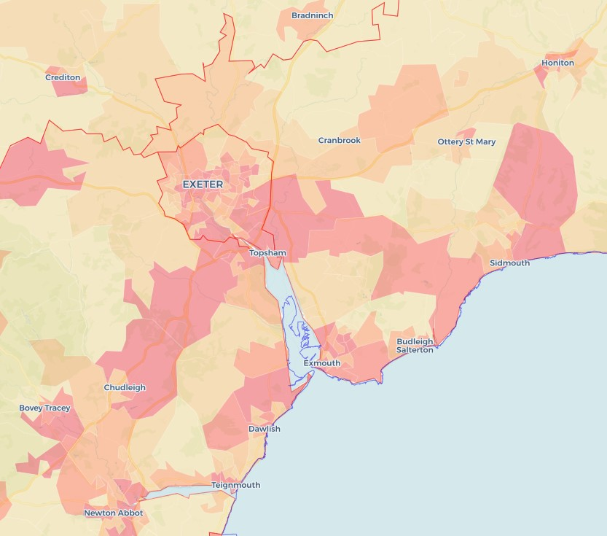
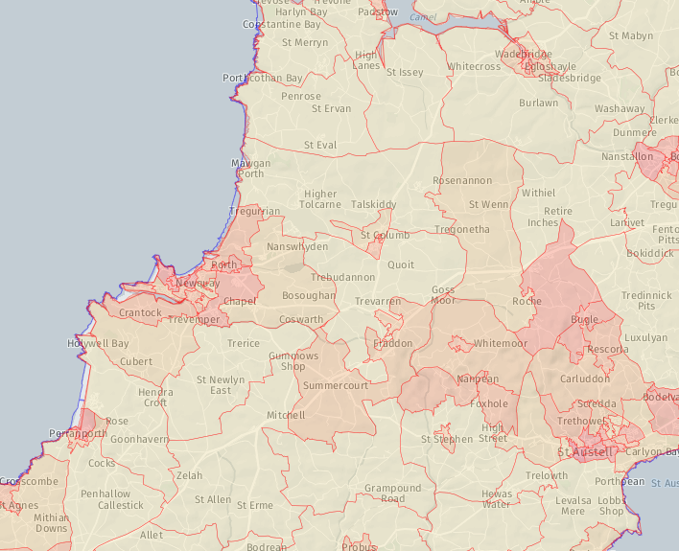
Across the rest of the region we see differential patterns for hand car wash locations

Slide 19
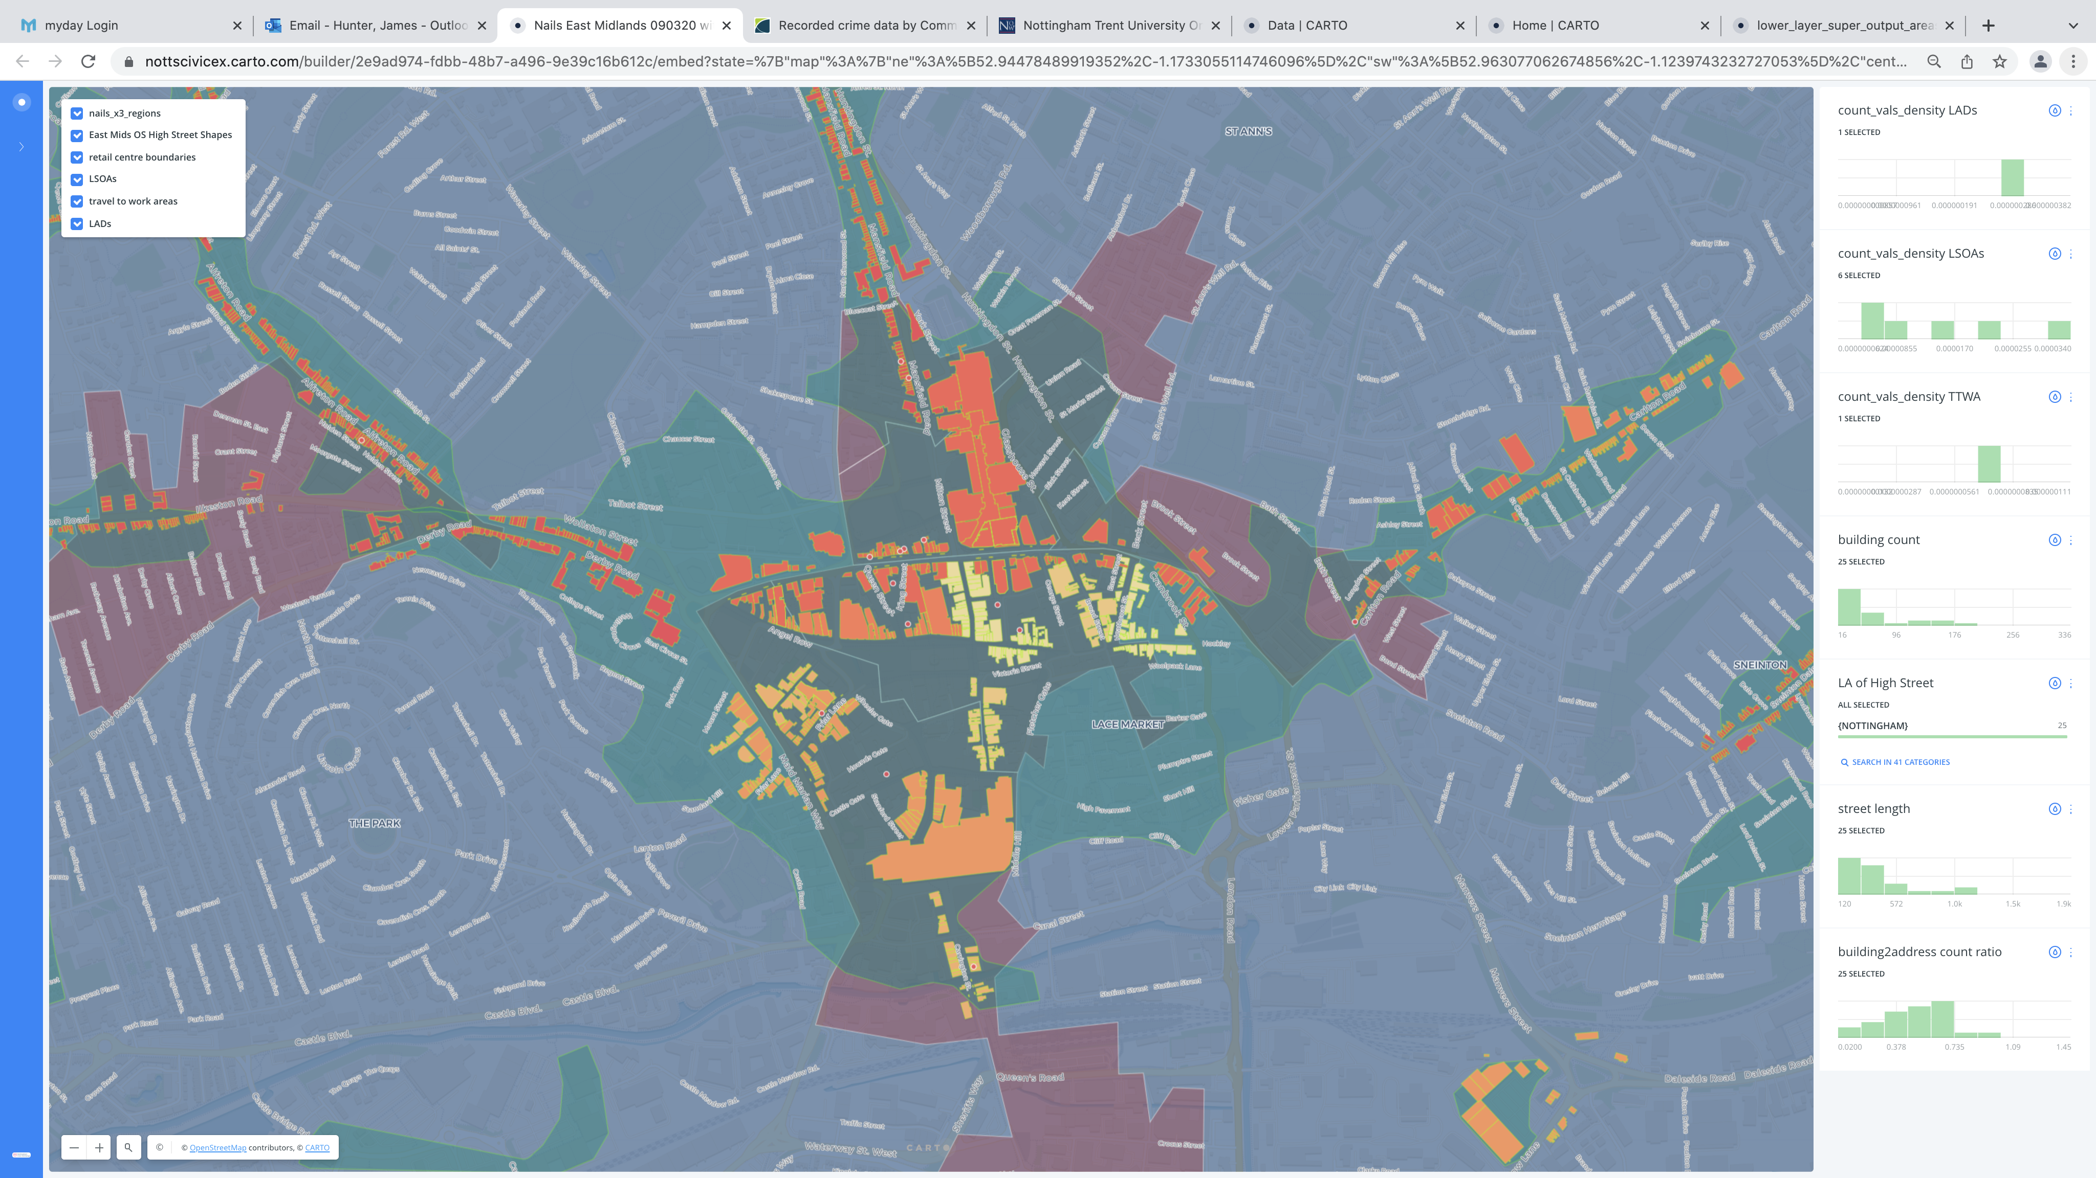
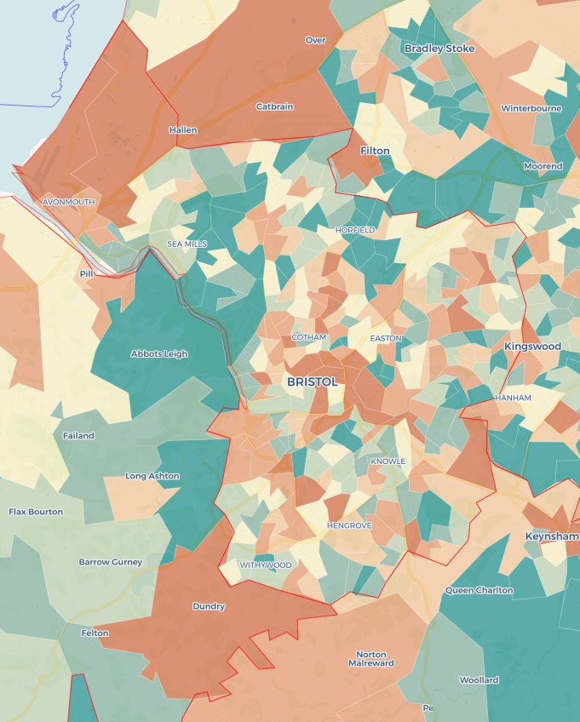
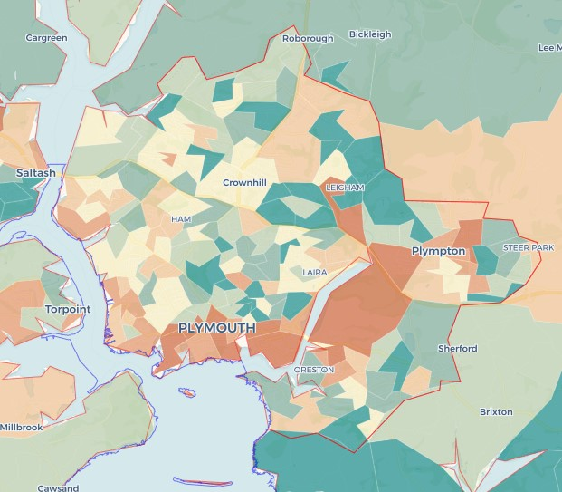
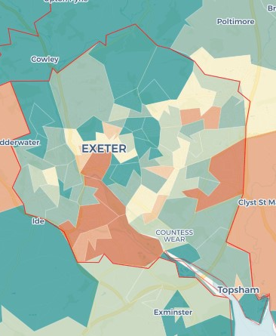
Nail Bars
WIP Nail Bar mapped data has to date focused on the East Midlands, GMCA and Birmingham exploring the spatial concentration of sites and the common characteristics of them. Nail Bars are a many urban phenomenon locating themselves on high streets across the UK. Building on our mapping across the three regions we have developed a second predictive tool that highlights the probable locations for nail bars.
Predictive locations for nail bars
Exploring the high street structure of nail bar locations

Slide 20

Where are the non-compliant employers? Predicting the presence of the informal economy at the neighbourhood level across England
Literature review to identify types of individuals over-represented amongst workers in the informal economy
Use of official data sources to identify under- and over-representation of each population characteristic at the Lower Super Output Area (LSOA) level across England
Combining individual population indicators into an index that predicts the presence of the informal economy within each neighbourhood based upon residential population characteristics
INFORMAL ECONOMY INDEX (IEI)

Slide 21
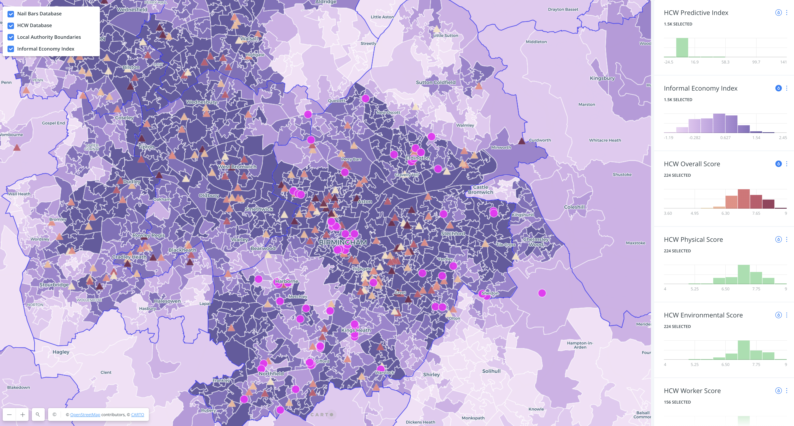
Risk classification of HCWs and location of nail bars in West Midlands urban conurbation
Predictive Informal Economy Index

Slide 22
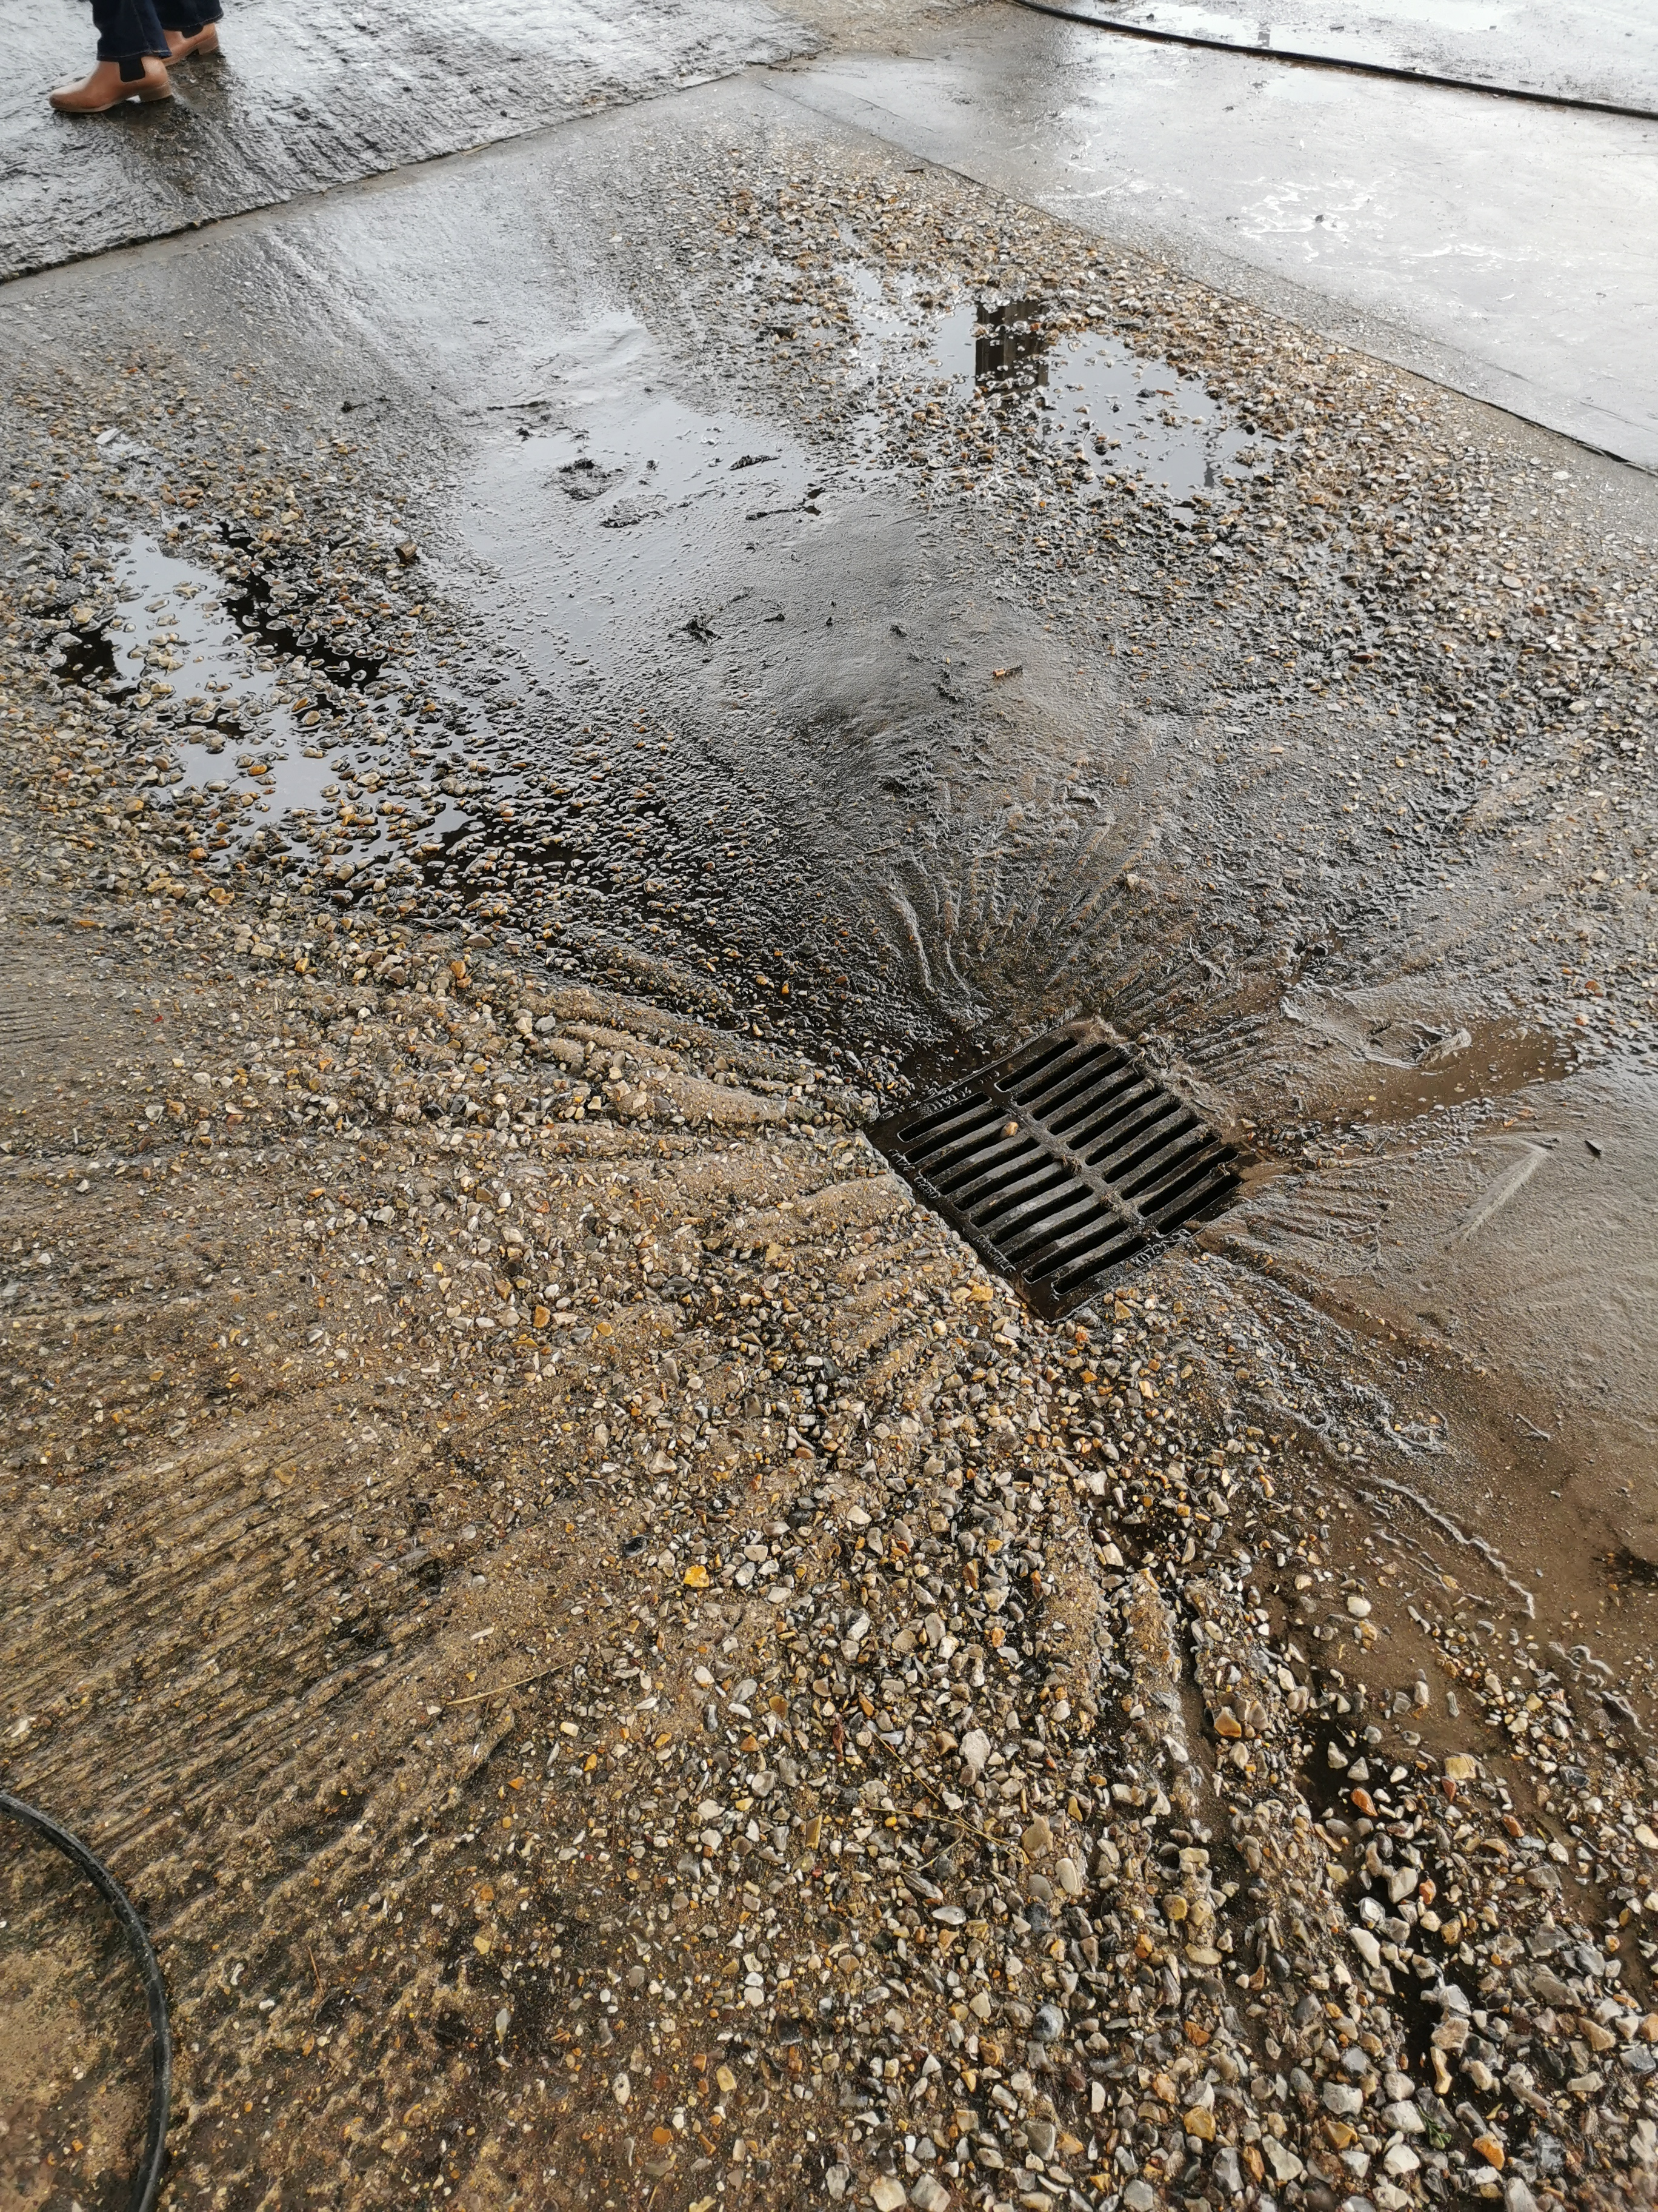
What next?
Potential for contribution to strategic and operational activity
Aim to extend focus to new sectors
Focus on inter-agency connections relating to the labour exploitation spectrum
We currently support a PhD study focused on communities and labour exploitation and on county lines. Upcoming work from August will also explore how a license to operate model may work

Slide 23
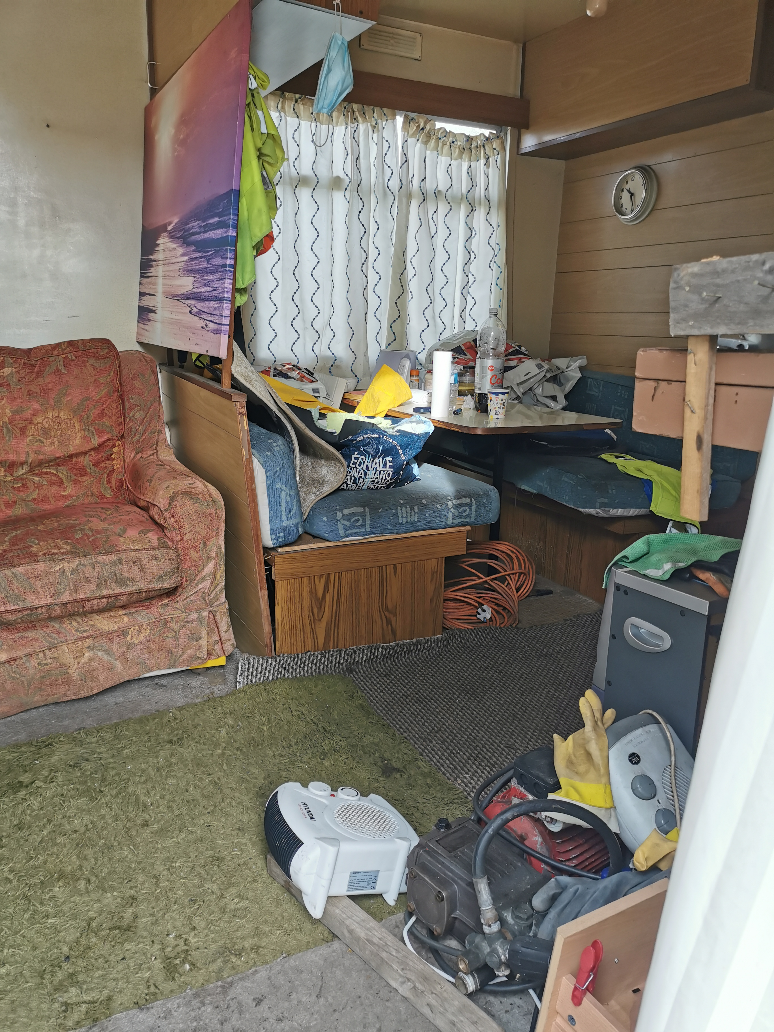
Why is this important to you?
Hand Car Washes and Nail Bars are sites of concern relating to labour abuse, exploitation and modern slavery with worker under-payment and poor conditions as the minimum.
What support and monitoring is occurring for at-risk individuals and communities in your region?
NCA and other agencies have flagged links between hand car washes and nail bars with Serious Organised Criminality.
Our research expertise could re-run the models using SOC insights to explore patterns.
Anecdotal evidence from our work with RCWS indicates the changes in UK migration rules are already affecting hand car wash businesses. Possible outcomes: businesses will be more likely to improve working conditions and pay, or they will seek more at-risk workers to exploit.
Which do you think will be more likely across the SW?
These data sets help identify areas of concern relating to the informal economy and illegal activity.
How might it connect with your strategic and operational plans?

