Slide 1
Raising your scholarship profile (and making time to do it well)
Professor Julie Hulme (she/her)
Julie.Hulme@ntu.ac.uk
Bsky: @JulieHulme-psyc.bsky.social
Notes:
Title: Raising Your Scholarship Profile (and making time to do it well)
Abstract: Making time for scholarship around a busy teaching and leadership schedule can be a real challenge. However, gaining reward and recognition for an education-focused role can only be achieved by growing your profile beyond your own classroom, department, or institution. How can we raise our profiles, manage our job requirements, and still make time for effective scholarship?
In this workshop, Julie will introduce us to her affectionately nicknamed ‘BOGOF’ scholarship model - how can we buy one, get one free? She’ll help us to explore how we can turn our teaching into outputs, why it’s important to ‘write to be read’, and how we can create high quality outputs and still have a life outside the higher education institution.
Find out more: https://higherpsyched.home.blog/2024/11/17/the-buy-one-get-one-free-bogof-model-of-scholarship-in-higher-education/
Bio: Julie Hulme is a Professor of Psychology Education at Nottingham Trent University, where she is proudly employed on the 'Teaching and Scholarship' career pathway. A former Chair and current member of DART-P, she is a Chartered Psychologist, Principal Fellow of the HEA, and a National Teaching Fellow. She enjoys applying her psychological skills and knowledge to making a difference in higher education, particularly around inclusion, and has a national reputation for championing education-focused academic careers. A self-described "positive disruptor", Julie is always willing to challenge the status quo.

Slide 2
What is scholarship?
Trigwell (2013) – scholarship (of teaching and learning / SoTL) has many (contested) definitions and many purposes. Generally:
Improving and enhancing teaching, learning, assessment, and more
Evaluating and determining ‘quality’
Evidence-based and systematic

Slide 3
Scholarship means “going meta”
IMPACT
Hutchings and Shulman (1999): “A scholarship of teaching is not synonymous with excellent teaching. It requires a kind of ‘going meta’, in which faculty frame and systematically investigate questions related to student learning—the conditions under which it occurs, what it looks like, how to deepen it, and so forth—and do so with an eye not only to improving their own classroom but to advancing practice beyond it.”
Shulman (1999): “An act of intelligence or artistic creation becomes scholarship when it possesses at least three attributes: it becomes public, it becomes an object of critical review and evaluation by members of one’s community, and members of one’s community begin to use, build upon, and develop those acts of mind and creation”

Slide 4

The BOGOF model of scholarship – what are you already doing that can gain more benefits?
Scholarship – the evidence that underpins the decisions you make
Scholarship – the products/resources you produce
Scholarship – the evaluation of the design, the development, the delivery, the products, the teaching, the outcomes…
Where can you share?
https://higherpsyched.home.blog/2024/11/17/the-buy-one-get-one-free-bogof-model-of-scholarship-in-higher-education/
Where’s your BOGOF opportunity?

Slide 5
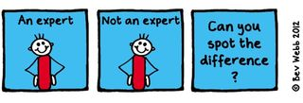
Thinking about BOGOF scholarship
Finding your own expertise – or turning your teaching into outputs
What are the ‘big questions’ for you at the moment?
What are the problems? (or what can improve?)
How do you find or develop solutions?
How do you know if your solution works?

Slide 6
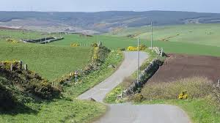
Purposeful planning for impact
How do you find the ‘BOGOF’ deal?
Topical issue - who shares the problem?
Resources – funding? time? students as researchers? collaborative networks?
Stakeholders – internal and external
Plan evaluation from the start – who has the skills?
Disseminate how? where?
How to assess reach, impact, value?

Slide 7
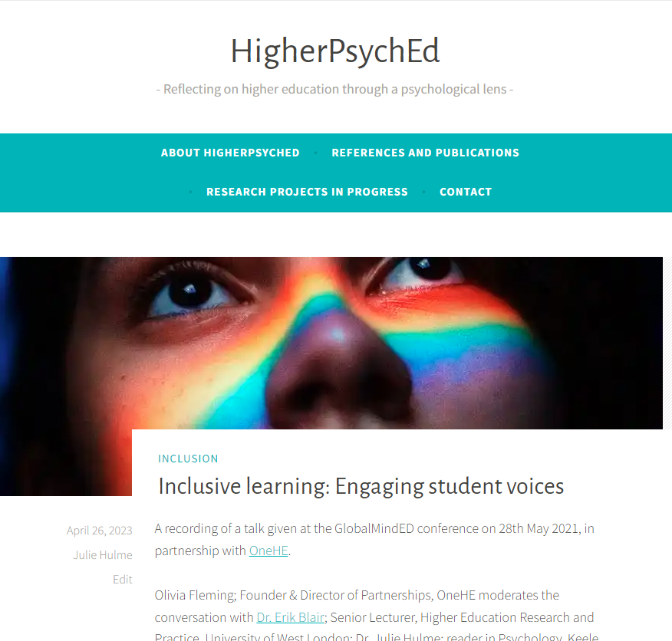
More BOGOF thinking
Hamilton, P., Hulme, J.A. & Harrison, E.D. (2023 – online 2021). Experiences of higher education students with chronic illnesses. Disability and Society. DOI: 10.1080/09687599.2021.1907549
Hulme, J.A., Hamilton, P., Lyons, S., Crabb, E., Cascone, C., Davis, S., Fahey, C., Holland, B., Hussain, M., & Knight, E. (2023). Students as researchers: Amplifying disabled student voices. In: Disability Evidence Review with TASO. https://taso.org.uk/wp-content/uploads/Uni-Lincoln-Disability-Evidence-Review-with-TASO.pdf
Hulme, J.A. (2022). Amplifying disabled students voices. ANTF blog, 25/03/2022. https://ntf-association.com/amplifying-disabled-student-voices/
Hulme, J.A. (September, 2021). Social identity and disability in the classroom. Changing States of Mind podcast. https://changingstatesofmind.libsyn.com/social-identity-and-disability-in-the-classroom-with-dr-julie-hulme.
Lyons, S.M. & Hulme, J.A. (June, 2021). Why are so many students locked out of their education? WonkHE (18/06/2021). https://wonkhe.com/blogs/why-are-so-many-students-locked-out-of-their-education/
Hulme, J.A., McDermott, H. & Kent, A. (2022). Truly inclusive education: Teaching qualitative methods in psychology to enhance inclusion in the higher education psychology curriculum. QMiP Bulletin, 34, 22-29.

Slide 8
Networks
Profs in Prep – email me on Julie.Hulme@ntu.ac.uk
UK Teaching-Focused Higher Education Network – sign up to our JISCmail list, HETEACHINGNETWORK@JISCMAIL.AC.UK, via https://jiscmail.ac.uk
National Teaching Repository
T-FΨN (Teaching-Focused University Network - Psychology)
Start your own?
Networks enable you to disseminate your work (reach), to see it being implemented and evaluated (impact), open up new opportunities, raise your profile, provide a pool of peer reviewers, referees and assessors.

Slide 9

Where are your strengths?
Where can you grow?
Where can you collaborate?
How can you develop reach, impact, value?
What do you still need to know?

