Slide 1


Designing studies to examine effectiveness
Richard Remedios
Associate Professor in Student Motivation and Engagement, Psychology.
Chair: Student Motivation and Engagement (TILT Group)
Chair: Education, Motivation and Learning Research Group (EDMAL, Research Group)
Email: Richard.remedios@ntu.ac.uk
@rremediosva
Notes:
Reason for this event twofold. Firstly, working in educational effectiveness @ Durham Uni, Secondly, Advance HE conference in 2022.

Slide 2
Plan for the day

Slide 3

Time | Session name |  | Content
9.15-9.30 | Introduction | TILT | Plan for day
9.30 – 10.30 | Assessing what works in pedagogy | Dr. Richard Remedios | A discussion of some of the ways we can optimise the design of our studies to ensure we are capturing what really works.
10.30-10.50 | Coffee break
10.50-12.20 | Examples of assessing what works | 10-50 -11.10 | Sarah Broadberry (CADQ/ARES)- Assessing what works in Team-Based Learning
 |  | 11.10 – 11.30 | Iain Wilson (Psychology) – Assessing Reflective Practice
 |  | 11.30 – 11.40 | Comfort Break
 |  | 11.40 – 12.00 | Eleanor Turpin (Learning Analytics Manager) – What can we assess?
 |  | 12.00 – 12.20 | Sarah Buglass (Psychology) – Assessing Hyflex – more learning analytics
12.20 – 1.30 | Lunch and discussion sessions
Notes:
For the talks, we deliberately kept them all very short. The 5-10 minutes for questions doesn’t really work so if you take notes, then at lunch, we will sit on different tables and you can come and talk to us so you get a proper discussion.

Slide 4
What I’ll be covering - Problems
The problem
Single-Group Research Designs
The Concept of Maturation and
… why we need control groups
The functional relevance of outcomes
Notes:
It is not useful just to highlight problems so everything I suggest has a solution. But of course, we need to be aware of the problem in the first place!!!

Slide 5
What I’ll be covering – the solutions
The Solutions
Using NTU resources to make our studies more robust.
Using our TILT group to help you design your studies and get the right measures
Using NTU resources to create your control groups
Using NTU resources to find some good measures
Notes:
It is not useful just to highlight problems so everything I suggest has a solution. But of course, we need to be aware of the problem in the first place!!!

Slide 6
Single-Group Research Designs
The problem of cohorts (and how to solve them)

Slide 7
Single-Group Design – Post-test
Time 1
e.g., throughout the module
Time 2
e.g., End of module
Sample e.g., students on your module/course
Intervention
e.g., Wearing a hat in class
Outcome
e.g., measure of motivation, engagement or skill development

Slide 8



Single-group design
Teaching Innovation
Student Post module rating
Conclusion
Enjoyment = 4 out of 5

Slide 9
Single-Group Design – Cohort effects
Time 1
e.g., throughout the module
Time 2
e.g., End of module
Sample e.g., students on your module/course
Intervention
e.g., Wearing a hat in class
Outcome
e.g., measure of motivation, engagement or skill development
The problem is here. You might just have a very strong/motivated cohort

Slide 10


Slide 11

Why we need pre-post designs
Every group of students you teach are different.
This means that on whatever measure you are assessing them on (in terms of your intervention), they will all be starting at different places.
Having a single measuring point is highly problematic.
But there is a solution ☺

Slide 12


Using a pre-post design - No change
Nett Enjoyment
0
Pre-module
How much do you think you will enjoy this module?
Enjoyment = 4
Enjoyment = 4
Remedios, R. & Lieberman, D.A. (2008). I liked your course because you taught me well: The influence of grades, workload, expectations and goals on students' evaluations of teaching. British Educational Research Journal, 34, 91-115.
Remedios, R., Lieberman, D. A., & Benton, T. G. (2000). The effects of grades on course enjoyment: Did you get the grade you wanted? British Journal of Educational Psychology, 70, 353-368.

Slide 13
Using a pre-post design – Improvements over time
Nett Enjoyment
+2
Pre-module
How much do you think you will enjoy this module?
Enjoyment = 2
Enjoyment = 4
Right, so we run our study, and we see changes in our outcome measure over time. Must be because of the intervention, right?

Slide 14
Maturation
The importance of control groups

Slide 15
Maturation and the counterfactual
The concept of maturation is that even if we did nothing special, the students will have learned something.
When we use an intervention, we are making the claim that our intervention leads to better outcomes than if we did things the way we always did them.
However, the problem of proving counterfactual is that we can never know what would have happened if we did not use our intervention because we cannot not use it and use it at the same time.
Notes:
Let’s talk about maturation – hands up anyone who would like to explain broadly what the concept of maturation is?
Richard – Reading to my daughters.

Slide 16
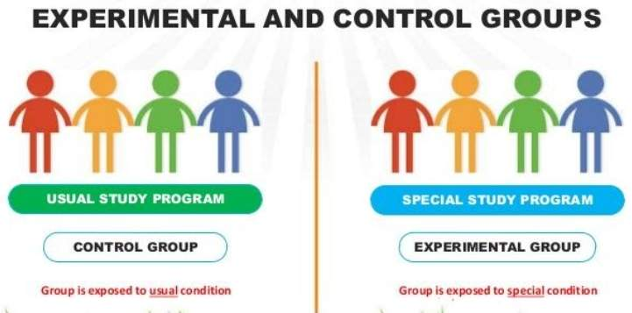
Control/Comparison Groups

Slide 17
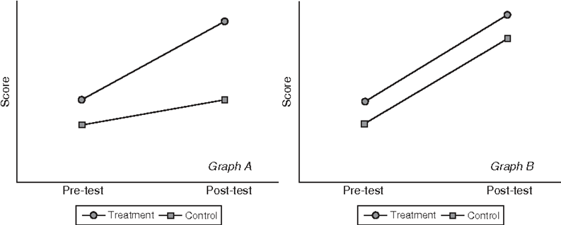
The importance of control/comparison groups
Here we have an example of what happens graphically when we observe changes over time
In this example, your intervention clearly improved students (outcome) from the start of the module to the end

Slide 18
Luckily, one of your colleagues also took a group of students from your module, taught them the same material, but did NOT use your intervention
Not You
Now when you compare outcomes, it seems that your intervention was no better than just teaching in some other way
You
Not You
You

Slide 19
Even worse, maybe your intervention was less effective than business-as-usual
Not You
You
Not You
You

Slide 20
Even worse, maybe your intervention was less effective than business-as-usual
So, although students improved using YOUR intervention, they actually improved more when they didn’t use your intervention
Not You
You
Not You
You

Slide 21
Your intervention worked if .. (and only if)
You
I just swapped whose line is whose
Not You
Not You
You

Slide 22
Summary
Single-Group Post-test Only Designs are highly problematic in terms of knowing if any outcomes are related to your intervention.
Single-Group Pre and Post-test are better because you can control for cohort effects.
But any form of single-group only design cannot show whether what you are doing is better than not-doing your intervention.
A key to any intervention design is having a Control or Comparison group, at least if you interested in examining effectiveness.
Can NTU solve a control group problem?

Slide 23
Control groups
Data analytics and adding control to your design

Slide 25
I don’t have time to organise a control group
You sometimes don’t have to ☺
For example, if you interested in engagement with your module analysis, this data is sitting on NOW for a data analyst to compare page visits year on year.
You can also compare performance data for that student in your module cf. their other modules or across your module year on year or performance for other classes within the same module.
Neither comparison method is flawless, but you at least have a point of comparison.

Slide 26
I do have time to organise a control group
Then make sure whatever you ask students in your module (intervention) group, the other students in the control group are asked the same questions at the same time.
If possible, to avoid enthusiastic teacher effects i.e., the effects of you! – try and get someone else to use your intervention and take similar measurements as you did.
But in all cases, I would strongly urge you to have some sort of useful comparison.
Ok, let’s now have a look at measuring outcomes.

Slide 27
Measuring Outcomes
Student Motivation and Engagement TILT group
Education, Motivation and Learning (EDMAL) group
https://www.ntu.ac.uk/research/groups-and-centres/groups/education,-motivation-and-learning-research-group

Slide 28
Thinking about outcomes
A key to a good study is having measures that are functionally relevant to your intervention.
For example, if you think your intervention improves conceptual learning, then make sure you measure conceptual learning!
Let’s look at some examples of functional relevance

Slide 29
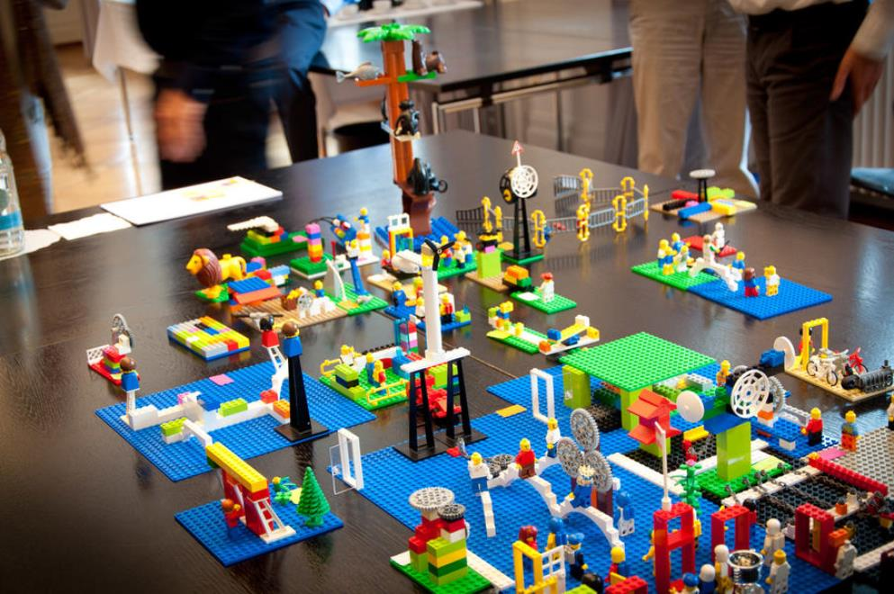
Functional relevance - Operationalisation
Claim
Measures
Lego Serious Play
Interest, enjoyment
Self-report
Improves engagement
Time on task, Visits to NOW learning room
Behaviour
Anxiety, Worry, Belonging
Self-report
Improves well-being
GSR, heartrate
Behaviour
Improves confidence
Self-efficacy, self-concept
Self-report
Improves meta-cognition i.e., How students think about thinking
Self-regulation (of learning behaviours)
Self-report
Improves Performance
Grades, performance on formative assessments
Behaviour

Slide 30

Which measures should I use?

Slide 32
The Student Motivation and Engagement
TILT group
If we have time, listen to this https://web.microsoftstream.com/video/b340651f-0b7b-4421-9266-e0753b0ce05a
https://www.ntu.ac.uk/c/tilt/practice-and-scholarship-groups/practice-and-scholarship-group-list
Our group was set up mostly as a service-type group to collaborate on scholarship/practice projects where there were questions re design and how to measure motivation and engagement.

Slide 33
Getting the (theoretically) right measure
For example, if you are interested in employability, you really want to be assessing (changes in) utility value and relative to intrinsic value.
That way get a measure of how much students are engaging in modules for utility reasons. We can also provide the up-to-date measures and theorising. (Wigfield & Eccles, 2000; Eccles & Wigfield, 2020)
REFERENCES
Wigfield, A., & Eccles, J. S. (2000). Expectancy–value theory of achievement motivation. Contemporary Educational Psychology, 25(1), 68–81. https://doi.org/10.1006/ceps.1999.1015
Eccles, J. S., & Wigfield, A. (2020). From expectancy-value theory to situated expectancy-value theory: A developmental, social cognitive, and sociocultural perspective on motivation. Contemporary Educational Psychology, 61, 101859. doi:10.1016/j.cedpsych.2020.101859.

Slide 34
Contemporary Theories
People in our group teach and supervise students interested in Motivation in Education.
We encourage students to examine the latest empirical evidence to work which theories work best in which contexts.
In other words, our TILT/Research Group specialises in identifying the best measures to use.

Slide 35
Good News, Better News

Slide 36
Good News
If you are panicking about all my suggestions because you have ONLY run or intend to run a single-group design study, no problem.
Single-group designs, often without pre-measures are common in scholarship projects that are relevant to the outputs you need for promotion.
Action Research is/can be an example of a single-group design study, and these are very popular and can tell us a lot.

Slide 37
Better News
There are many models of scholarship (for intervention studies) and one which I embrace is a REF-type approach to scholarship.
Here I look for Ref Quartile 1 level journals to publish scholarship work.
These types of journals tend to require strong theorising and design elements so I try and organise my studies to meet those criteria.
This does NOT mean I will take the T and R pathway, we want staff to keep on scholarship routes even if they are producing at REF level.
So, upping the quality of design is not required but if you can, maybe you can target some different publication outlets.

Slide 38
Final Thoughts

Slide 39
You couldn’t be at a better university for scholarship and practice
NTU really support scholarship so please get involved and get your colleagues involved.
There are many routes to support which will help you when you are heavily workloaded; use your support systems.
Never be worried about asking or trying out your ideas; colleagues are very supportive.
And of course, do consider joining our TILT group ☺

Slide 40


