Slide 1

The adaptation and validation of the Parents Motivational Messaging Scale (PMMS) in higher education
Dr Erika Spray, University of Newcastle
Prof Richard Remedios, Nottingham Trent Uni
Dr Emily Freeman, University of Newcastle
Dr Tegan Bradley, University of Newcastle

Slide 2


Teacher Motivational Messages
If you don’t work hard, you won’t get into college
Putwain, D. W., Symes, W., Laura J. Nicholson, L. J., & Remedios, R. (2020). Teacher motivational messages used prior to examinations: What are they, how are they evaluated, and what are their educational outcomes? Advances in Motivation Science, Elsevier. https://doi.org/10.1016/bs.adms.2020.01.001.

Slide 3

Parents' Motivational Messages (PMM)
If you don’t work hard, you won’t get into college
Remedios, R., Putwain, D. W. & Symes, W. (in prep). How do parents motivate their children?

Slide 4
The PMM scale
Please think about what your parent(s) or carer(s) tell you about your A-levels and circle the number that indicates your opinion. (5-point scale; Never = 1, Most of the time = 5)
Consequence: How often did your parents tell you that you need good A-level results help to be able have a good life in the future?
Reassurance: How often did your parents tell you that A-level results are not the be all and end all?
Pride: Did you want to try hard to do well in your A-level so your whole family will be pleased with you?
Changing Behaviour: When your parents reminded you to revise for upcoming A-levels, did it make you want to stop doing your schoolwork?

Slide 5
Qualitative study with students in HE
Students less likely to be influenced by parents’ messages if parents did not go to university themselves
“Psychology is a topic which he doesn't know anything about It's harder for him to do so. I think he doesn't instruct me as much anymore"
"they don't know what a degree is, I believe they don't know the true value of it and the effort that goes into attaining a degree, so I think they can’t, I think they don't have the knowledge and experience to tell me "
" it's not like they would say something by themselves kind of like because they never went through University, they don't really know what it entails"
Remedios, R., & Baikousi, V. (2023). Out of sight, out of mind: Individual differences in students’ experiences of their parents’ motivational messages in higher education. Presentation at BPS psychology of Education Annual Conference, Oxford (September).

Slide 6
Items for a new construct
Value of parents' advice
How often do you listen to your parent’s advice regarding your education?
How often do you go to your parents for advice regarding your higher education?
How often would you say you trust your parent’s advice on your education?
How often do you ask for help from your parent’s before making a decision that will affect your education?

Slide 7
Further Research needed
The PMM has been successfully validated with students in high school in UK.
Interviews with students in HE suggest a fifth construct i.e., the value of parent advice, might be a useful addition.
Be useful to run a study in HE to assess scale appropriateness and add in the additional scale.

Slide 8
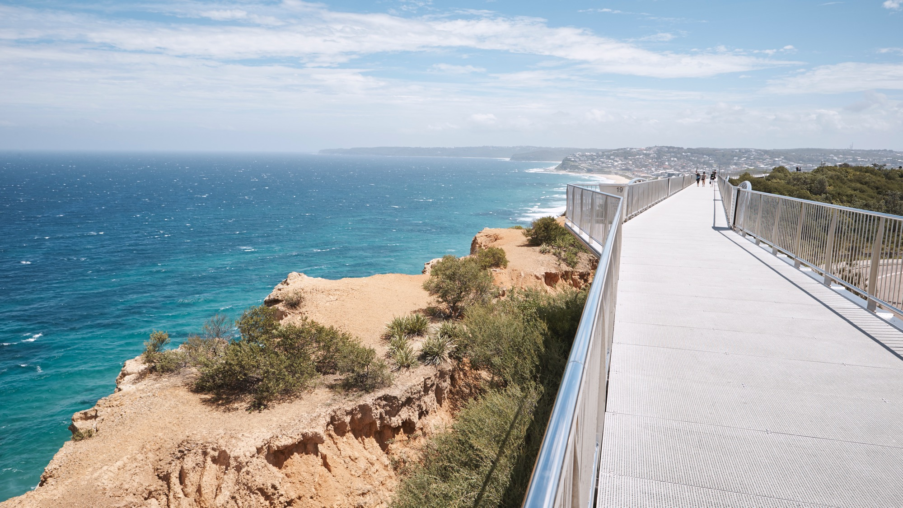
2024 Validation in Australia
PMMS integrated into an existing dispositional survey
Online survey (SONA/QuestionPro)
2 credit points
Undergraduate psychology course

Slide 9
Adaptation of items
How often do your parents tell you that you need to get good grades in your GCSEs to go to college or 6th form or get an apprenticeship?
How often do your parents tell you that you need to get good grades at university to go on to a successful career?

Slide 10

The Australian Sample
315 visits to the site, 250 responses retained
95% domestic, 86% first year, 83% female
81% aged 18-21, 13% aged 22-29 (6% older)
45% Psychology, 16% Humanities, 11% Law

Slide 11
Best practice for scale validation
Dimensionality
Reliability
Validity
Scale development:
1) Item generation and assessment of validity
2) Scale Construction – pretesting, piloting, reducing
3) Scale Evaluation – dimensionality, reliability, validity
Boateng, G. O., Neilands, T. B., Frongillo, E. A., Melgar-Quiñonez, H. R., & Young, S. L. (2018). Best Practices for Developing and Validating Scales for Health, Social, and Behavioral Research: A Primer. Frontiers in public health, 6, 149. https://doi.org/10.3389/fpubh.2018.00149
Notes:
Maybe split this slide to show original scales and then those that were added to target epistemic emotions?
(too much text on here, plus the split would help tell the story of the research)

Slide 12
Dimensionality: Configural Invariance
Dimensionality
Notes:
Maybe split this slide to show original scales and then those that were added to target epistemic emotions?
(too much text on here, plus the split would help tell the story of the research)

Slide 13
Rotated Component Matrix with loadings <.3 suppressed | Consequence | Behaviour | Trust | Pride | Reassurance
Q37 - How often do your parents tell you that you need to get good grades at university to get a good job? | .899
Q37 - How often do your parents tell you that your university results determine your future? | .890
Q37 - How often do your parents tell you that you need to get good grades at university to go on to a successful career? | .869
Q37 - How often do your parents tell you that you need good university results to have a good life in the future? | .865
Q37 - When your parents remind you about revising for upcoming university exams, does it make you want to stop revising? |  | .933
Q37 - When your parents remind you to revise for upcoming university exams, does it make you want to stop doing your uni |  | .890
Q37 - When your parents remind you to study for upcoming university exams, does it make you want to give up? |  | .878
Q37 - When your parents remind you about upcoming university exams, do you stop listening to them? |  | .873
Q37 - How often would you say you trust your parent’s advice on university? |  |  | .898
Q37 - How often do you ask for help from your parent’s before making a decision that will affect your university study? |  |  | .880
Q37 - How often do you go to your parents for advice regarding university? |  |  | .865
Q37 - How often do you listen to your parent’s advice regarding university? |  |  | .793
Q37 - Do you want to try hard to do well at university to make your parents proud? |  |  |  | .883
Q37 - Do you want to try hard to do well at university to make your parents happy? |  |  |  | .833
Q37 - Do you want to try hard to do well at university so your whole family will be pleased with you? |  |  |  | .823
Q37 - Do you feel you need to well at university so that you do not let your parents down? | .399 |  |  | .744
Q37 - How often do your parents tell you that university results are not the be all and end all? |  |  |  |  | .837
Q37 - How often do your parents tell you that there are other options if you don’t do so well at university? |  |  |  |  | .834
Q37 - How often do your parents tell you that you don’t need to worry over your university study? |  |  |  |  | .745
Q37 - How often do your parents tell you they will always be there for you, no matter what your university grades are? |  |  | .402 |  | .639
Dimensionality
Notes:
Maybe split this slide to show original scales and then those that were added to target epistemic emotions?
(too much text on here, plus the split would help tell the story of the research)

Slide 14
Confirmatory factor analysis
Dimensionality
Loadings for all items on their intended scale:
Pride | Consequence | Behaviour | Reassurance | Trust
.890 | .918 | .940 | .810 | .852
.847 | .951 | .905 | .885 | .912
.923 | .948 | .948 | .787 | .910
.908 | .947 | .906 | .763 | .895
KMO & Bartlett’s test of sphericity were checked for each scale and indicated suitability of the data.
Notes:
Maybe split this slide to show original scales and then those that were added to target epistemic emotions?
(too much text on here, plus the split would help tell the story of the research)

Slide 15
Confirmatory factor analysis
Dimensionality
Following confirmation of factor structure and item loadings, scales means were calculated.
Notes:
Maybe split this slide to show original scales and then those that were added to target epistemic emotions?
(too much text on here, plus the split would help tell the story of the research)

Slide 16
Scale Correlations
Dimensionality
 | 1 | 2 | 3 | 4 | 5
1. Pride | -
2. Consequence | .486** | -
3. Behaviour | .329** | .457** | -
4. Reassurance | .224** | -.177** | .033 | -
5. Trust | .314** | .005 | -.041 | .490** | -
Mean | 3.74 | 2.48 | 2.33 | 2.96 | 2.99
Standard deviation | 1.12 | 1.33 | 1.25 | 1.06 | 1.16
Skewness | -.75 | .44 | .51 | -.13 | -.06
Kurtosis | -.16 | -1.15 | -.97 | -.68 | -.94
Cronbach’s alpha | .91 | .96 | .94 | .83 | .92
Notes:
Maybe split this slide to show original scales and then those that were added to target epistemic emotions?
(too much text on here, plus the split would help tell the story of the research)

Slide 17
Scale Correlations
Dimensionality
 | 1 | 2 | 3 | 4 | 5
1. Pride | -
2. Consequence | .486** | -
3. Behaviour | .329** | .457** | -
4. Reassurance | .224** | -.177** | .033 | -
5. Trust | .314** | .005 | -.041 | .490** | -
Mean | 3.74 | 2.48 | 2.33 | 2.96 | 2.99
Standard deviation | 1.12 | 1.33 | 1.25 | 1.06 | 1.16
Skewness | -.75 | .44 | .51 | -.13 | -.06
Kurtosis | -.16 | -1.15 | -.97 | -.68 | -.94
Cronbach’s alpha | .91 | .96 | .94 | .83 | .92
Notes:
Maybe split this slide to show original scales and then those that were added to target epistemic emotions?
(too much text on here, plus the split would help tell the story of the research)

Slide 18
Scale Correlations
Dimensionality
 | 1 | 2 | 3 | 4 | 5
1. Pride | -
2. Consequence | .486** | -
3. Behaviour | .329** | .457** | -
4. Reassurance | .224** | -.177** | .033 | -
5. Trust | .314** | .005 | -.041 | .490** | -
Mean | 3.74 | 2.48 | 2.33 | 2.96 | 2.99
Standard deviation | 1.12 | 1.33 | 1.25 | 1.06 | 1.16
Skewness | -.75 | .44 | .51 | -.13 | -.06
Kurtosis | -.16 | -1.15 | -.97 | -.68 | -.94
Cronbach’s alpha | .91 | .96 | .94 | .83 | .92
Notes:
Maybe split this slide to show original scales and then those that were added to target epistemic emotions?
(too much text on here, plus the split would help tell the story of the research)

Slide 19
Scale Correlations
Dimensionality
 | 1 | 2 | 3 | 4 | 5
1. Pride | -
2. Consequence | .486** | -
3. Behaviour | .329** | .457** | -
4. Reassurance | .224** | -.177** | .033 | -
5. Trust | .314** | .005 | -.041 | .490** | -
Mean | 3.74 | 2.48 | 2.33 | 2.96 | 2.99
Standard deviation | 1.12 | 1.33 | 1.25 | 1.06 | 1.16
Skewness | -.75 | .44 | .51 | -.13 | -.06
Kurtosis | -.16 | -1.15 | -.97 | -.68 | -.94
Cronbach’s alpha | .91 | .96 | .94 | .83 | .92
Reliability
Notes:
Maybe split this slide to show original scales and then those that were added to target epistemic emotions?
(too much text on here, plus the split would help tell the story of the research)

Slide 20
Reliability
Best practice: Reliability
Scale reliabilities for repeat sample
Cronbach’s alphas
.911 .957 .944 .826 .915
Test-retest – awaiting data – but may not be entirely consistent across time, could change with evolving circumstances.
Split-test reliabilities: Calculate scores for odd and even items, then correlate. Split-half correlation >.80 is acceptable.
Notes:
Maybe split this slide to show original scales and then those that were added to target epistemic emotions?
(too much text on here, plus the split would help tell the story of the research)

Slide 21
Reliability
Split-Test Reliability (odd/even)
 | Pride | Consequence | Behaviour | Reassurance | Trust
Cronbach’s alpha (all 4 items) | .911 | .957 | .944 | .826 | .915
Part 1 odd (2 items) | .897 | .899 | .933 | .656 | .824
Part 2 even (2 items) | .838 | .931 | .851 | .728 | .873
Correlation between forms | .799 | .922 | .892 | .718 | .833
Spearman Brown Coefficient* | .888 | .959 | .943 | .836 | .909
Guttman Split-Half Coefficient | .884 | .959 | .941 | .836 | .906

Slide 22
Validity
Validity
Face validity of items is good – they make sense in the context of university study, and participants clearly responded coherently
Predictive criterion validity – Significant negative correlations with GPA for Consequence (-.209**) and Behaviour (-.175*)
Concurrent validity – not possible because other survey scales measured other constructs. But can compare to the single item ‘overall, to what extent do you feel your parents influence the way you feel about your education?’
 | Pride | Consequence | Behaviour | Reassurance | Trust
Pearson Correlation | .911 | .957 | .944 | .826 | .915
Sig. 2-tailed | .897 | .899 | .933 | .656 | .824
Notes:
Maybe split this slide to show original scales and then those that were added to target epistemic emotions?
(too much text on here, plus the split would help tell the story of the research)

Slide 23
Validity
Convergent Validity
A range of correlations with dispositional variables – see other paper!
 | Pride
Prospective anxiety | .232**
Inhibitory anxiety | .285**
Regulation of cognition | .144*
Negative epistemic emotions | .260**
Feelings of shame | .310**
Performance avoidance | .302**
Notes:
Maybe split this slide to show original scales and then those that were added to target epistemic emotions?
(too much text on here, plus the split would help tell the story of the research)

Slide 24
Validity
Convergent Validity
A range of correlations with dispositional variables – see other paper!
 | Behaviour
Self efficacy | -.132
Need for cognition | -.369**
Knowledge of cognition | -.174*
Regulation of cognition | -.262**
Structure of knowledge | -.171*
Acquisition of knowledge | -.215**
Notes:
Maybe split this slide to show original scales and then those that were added to target epistemic emotions?
(too much text on here, plus the split would help tell the story of the research)

Slide 25
Validity
Validity in qualitative data
What do you think may have contributed to your beliefs and/or feelings about learning?
E.g. do you recall any influential events or people that may have impacted the way you think and feel about learning? If so, please briefly explain.
Over half of responses specified parents (32%) or family (21%) or as the main influence upon their beliefs and feelings about learning.
Notes:
Maybe split this slide to show original scales and then those that were added to target epistemic emotions?
(too much text on here, plus the split would help tell the story of the research)

Slide 26
Validity
Validity in qualitative data
What do you think may have contributed to your beliefs and/or feelings about learning?
E.g. do you recall any influential events or people that may have impacted the way you think and feel about learning? If so, please briefly explain.
“Definitely my upbringing and the people around me”
“Strong pressures in early childhood … to perform well”
“my parents are very motivational”
Notes:
Maybe split this slide to show original scales and then those that were added to target epistemic emotions?
(too much text on here, plus the split would help tell the story of the research)

Slide 27
Validity
Validity in qualitative data
Pride | I want to make my parents proud by being the first to go to university My parents have always been supportive regarding learning, but I have always felt anxious about making them proud or impressing them. my mother saying I would never be good enough or successful if I didnt get perfect scores for everything
Consequence | parents- they have been to university and say that it is the best option to acquire a high paying job My parents put the pressure on so I do not regret my grades or decisions My Parents have always put a lot of pressure on me to succeed which has led to high perfectionistic traits which provokes anxiety
Behaviour
Notes:
Maybe split this slide to show original scales and then those that were added to target epistemic emotions?
(too much text on here, plus the split would help tell the story of the research)

Slide 28
Validity
Validity in qualitative data
 | Examples from open-text responses
Reassurance | My mother never put pressure on me to go to uni. She was happy for me to do what made me happiest. My parents have always ensured that I knew that finishing high school was a must, but attending university was not 100% necessary. For majority of my life my parents have been supportive of whether or not i succeed in school or not, just that i tried my best. Therefore Im not so stressed about doing school so much as long as Ive tried my best. my parents have always been supportive through my education. they have not made me feel pressured to do well, I have just always tried my best.
Trust
Notes:
Maybe split this slide to show original scales and then those that were added to target epistemic emotions?
(too much text on here, plus the split would help tell the story of the research)

Slide 29
Conclusions
Supports the PMMS as a valid instrument for use in Higher Education settings
Strong psychometrics both internally and in relation to other constructs
A worthwhile focus for student support
Notes:
Ongoing data analysis, inc. qualitative
collection, including qualitative

Slide 30
Future directions
Develop understanding of how PMMS scales relate to other dispositional constructs and student-teacher relationships
Early profiling to inform intervention
Trial interventional options – awareness, support messages, groups/discussion opportunities, direct contact with external support people?
Notes:
Ongoing data analysis, inc. qualitative
collection, including qualitative

Slide 31


THANK
YOU
Dr Erika Spray
Erika.Spray@Newcastle.edu.au

Slide 32
Contextual items
54% both my parents
27% mother
8% father
4% partner
3% grandparents
38% yes, went to university
3.6% currently at university
40% no, has not been to university
Who are you thinking of?
Did they go to university themselves?

Slide 33
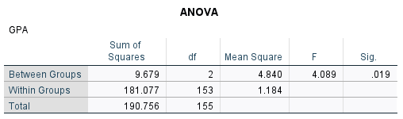
Differentiation between groups
The dispositional clusters identified vary significantly on Pride and Behaviour.
Male and female vary on Pride and Trust.
Can create PMMS clusters that show different motivational profiles.
These PMMS clusters differ in their GPA scores (ANOVA)
Notes:
Maybe split this slide to show original scales and then those that were added to target epistemic emotions?
(too much text on here, plus the split would help tell the story of the research)

Slide 34
Motivational Factors?
Rotated Component Matrixª
 | Component
 | 1 | 2
PMMS2_Consequence | .866
PMMS3_Behaviour | .752
PMMS1_Pride | .719 | .442
PMMS4_Reassurance |  | .850
PMMS5_Trust |  | .845
Extraction Method: Principal Component Analysis. Rotation Method: Varimax with Kaiser Normalization.
a. Rotation converged in 3 iterations.
Can get two factors out of these, which look roughly look like a negative, fear-framed, extrinsic motivational factor (I must do well because…) and a positive intrinsic one (It’s ok if I don’t do well):
Is the positive one associated with buoyancy, because of family support?

