Slide 1


Experiential Learning

Slide 2
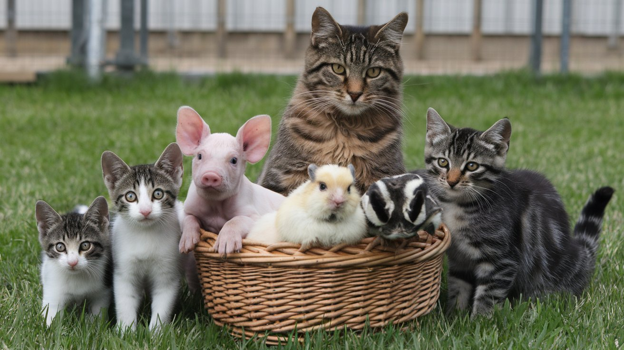
Inclusion & Hybridization

Slide 3

Setting the Scene

Slide 4
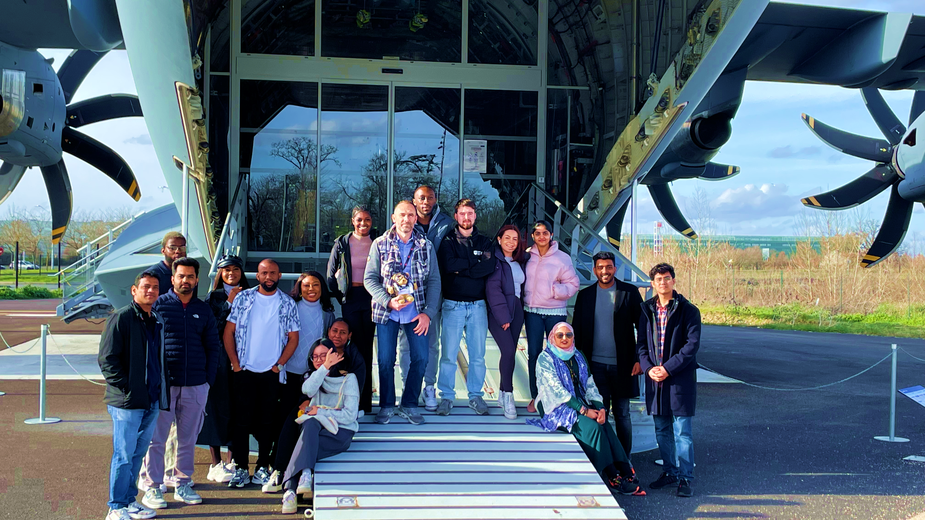
Multidisciplinary Loop

Slide 5

Remote Collaboration

Slide 6
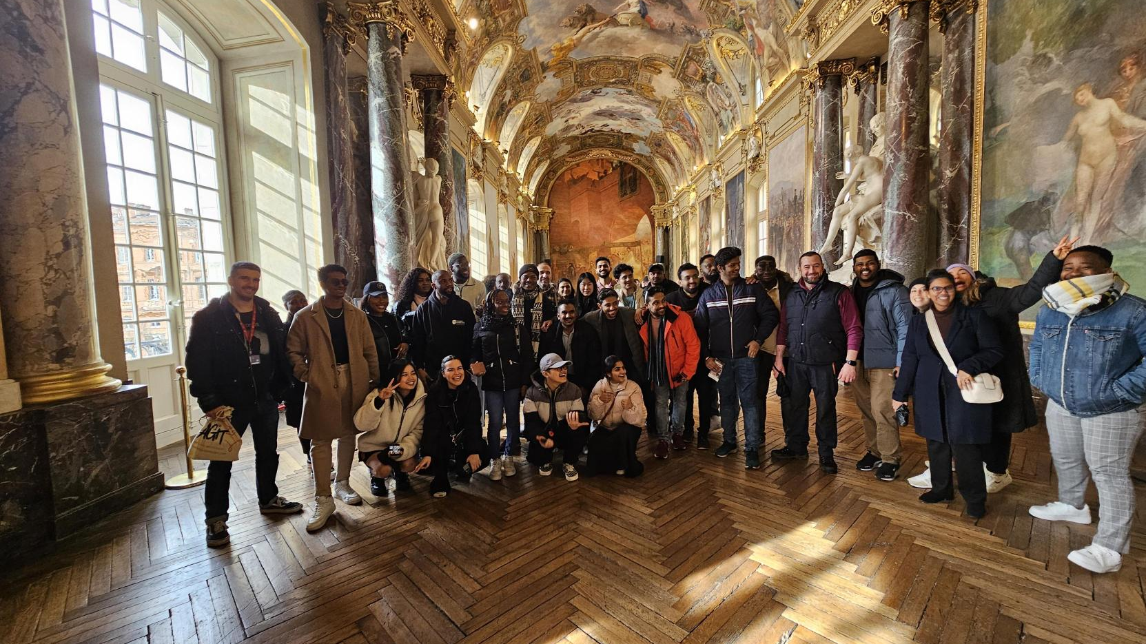
Initiatives Success

Slide 7

Transformative Learning

Slide 8
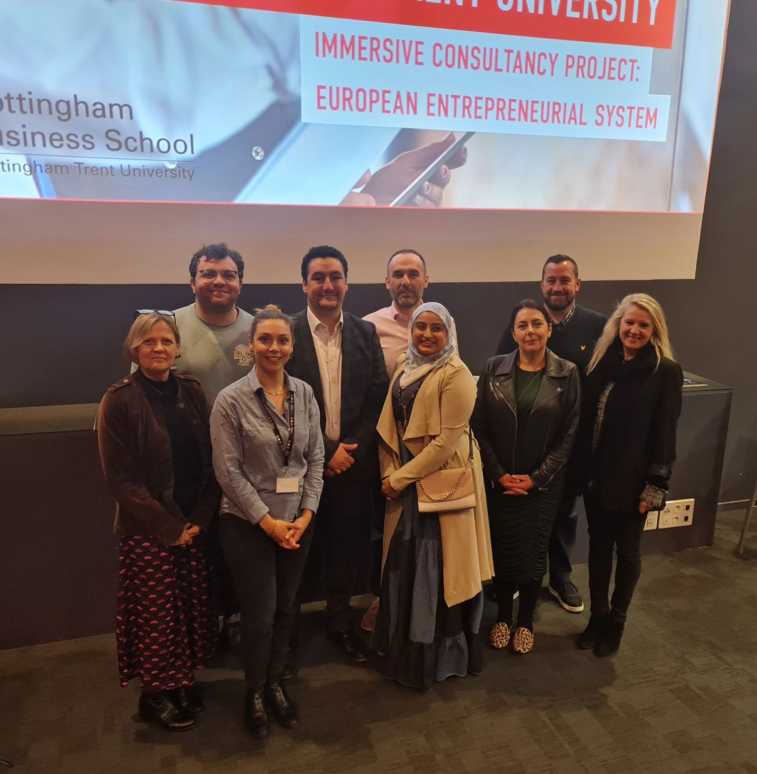
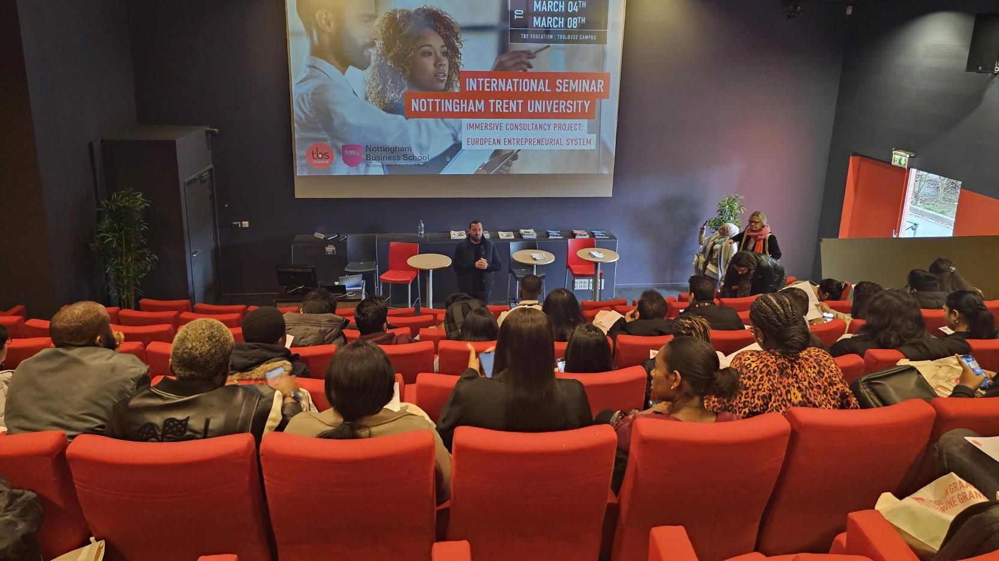
Program Takeaways

