Slide 1

SfA: Supporting transition into and through University
Jenny Sanders - Senior Lecturer in Social Sciences (Student Academic Experience)
Richard Machin – Senior Lecturer in Social Work and Health
Rachel Copestake and Phillip Aguilera – BA Health and Social Care students

Slide 2
Health and Social Care Students
 | Disability | Entry Qual | Ethnicity | Mature
2018/19 | 16% | 33% BTEC 21% Mix 26% Other | 16% Asian 26% Black 5% Mixed | 35%
2019/20 | 21% | 32% BTEC 24% Mix 23% Other | 16% Asian 25% Black 5% Mixed | 33%
2020/21 | 24% | 26% BTEC 22% Mix 28% Other | 17% Asian 23% Black 7% Mixed | 31%
2021/22 | 25% | 23% BTEC 17% Mix 33% Other | 14% Asian 22% Black 5.8% Mixed | 24%
What we know
Transition from FE to HE difficult
‘sophomore slump’
SfA students disproportionately affected
Nurture a culture of belonging
Focus Group feedback April 2018
Embed study skills
Like pre-course induction course idea
Themed/structured PT sessions
Info on L4-L5 jump
Info about future modules
www.ntu.ac.uk

Slide 3
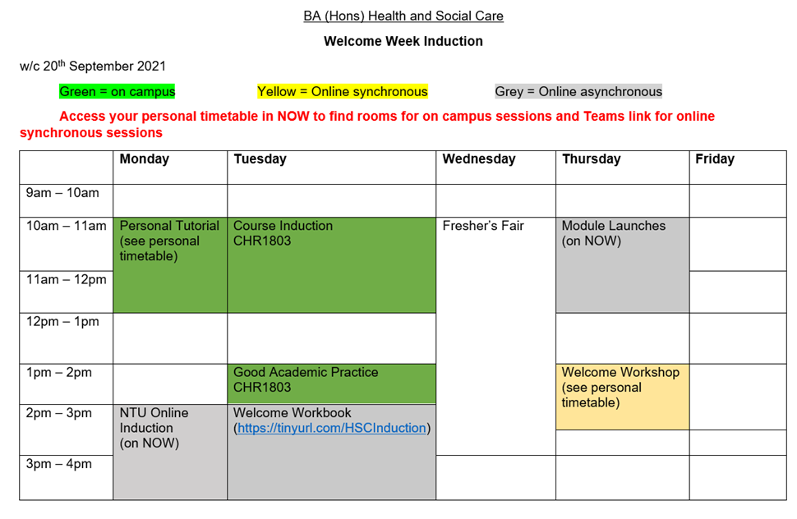
New starter Induction
Level 4 Induction Site
Existing Aug/Sept 2018
Existing #2 Aug/Sept 2019
Pebblepad Aug/Sept 2020
and ongoing
www.ntu.ac.uk

Slide 4
Returners Induction
Activity | When and how | Who leading/facilitating
Welcome Back webinar | Live via Microsoft Teams | Richard
Studying at Level 5 | Embed into Managing | Amy
Understanding GBAs | Embed into Managing | Amy
Professional values (respect, student charter, online etiquette) | Embed into PCI | Verusca
Academic Integrity and TII | Embed into Research Methods | Louise coordinating with Lee/Debra/Michelle facilitating/Jenny
Assessment plans and using feedback | Embed into Option Modules | Jenny coordinating with Lee/Debra/Michelle facilitating
Introduced Oct 2019
and ongoing
Activity | When and how | Who leading/facilitating
Welcome Back webinar | Live via Microsoft Teams | Richard
Searching databases Writing critically for your dissertation | Embed into Dissertation module Live via Microsoft Teams | Louise coordinating Lee/Debra/Michelle/Ian delivering
Academic Integrity and TII | Embed into Leadership module | Jenny
Understanding GBAs | Embed into Leadership module | Jenny with Amy delivering (async)
www.ntu.ac.uk

Slide 5
Transition Materials
Introduced June 2019 and ongoing
Level 5 Between-years Site
Level 6 Between-years Site

Slide 6
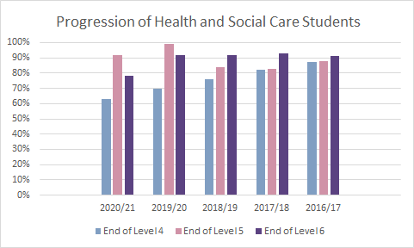
Success?
  Looked at progression for Level 4, Level 5 and Level 6 since 2016/17
2021/22
End of Level 4 – 75%
End of Level 5 – 89%
End of Level 6 – 85%
Notes:
NOT REALLY!
Increase in students progression at end of Level 5 since introduced transition materials (Level 5 between years site)
Progression at end of Level 6 stable until 2020/21, then dropped, but increased again for 2021/22
Decrease in Level 4 until 2021/22
COVID-19 impact 2020/21 outcomes

Slide 7
Success?
  Looked at degree outcomes since 2016/17
 |  | 1st | 2:1 | 2:2 | 3rd | Ordinary
No transition materials | 2016/17 | 5.6% | 56.5% | 22.2% | 7.4% | 4.6%
 | 2017/18 | 21.4% | 43.6% | 19.3% | 0 | 3.6%
 | 2018/19 | 10.6% | 37.2% | 33.6% | 4.4% | 1.8%
L6 transition materials | 2019/20 | 13.9% | 40.5% | 26.6% | 3.8% | 7.6%
All transition materials | 2020/21 | 20.7% | 34.1% | 18.3% | 6.1% | 6.1%
 | 2021/22 | 18% | 43% | 16% | 3% | 3%
Outlier?
COVID impact?
Notes:
MIXED PICTURE!
Questions:
17/18 an outlier?
COVID-19 impact 2019/20 and 2020/21 outcomes?
Don’t know how many fails and therefore whether there’s been an improvement (more students passing)?
Less 3rds a positive
Less 2:2s with all materials a positive
More 1st a positive

Slide 8
Success?
 | 2018/19 |  | 2020/21 |  | 2021/22
 | 1st | 2:1 | 1st | 2:1 | 1st | 2:1
Black | 0 | 44% | 12.5% | 37.5% | 0 | 100%
BTEC Mixed | 3% 17.6% | 45.5% 52.9% | 5.9% 30.8% | 47.1% 46.2% | 6.3% 15.4% | 62.5% 53.8%
Mature | 6.3% | 31.3% | 43.8% | 31.3% | 13.3% | 46.7%
Disabled | 7.7% | 46.2% | 38.5% | 38.5% | 18.2% | 54.5%
Notes:
MIXED PICTURE!
Increase in Black attainment when transition materials fully embed
Increase (mostly) for BTEC/Mixed entry qual when transition materials fully embed
Increase (mostly) for mature students when transition materials fully embed
Increase (mostly) for disabled students when transition materials fully embed

Slide 9
If you’d like to access the Pebblepads for own use please email me jenny.sanders@ntu.ac.uk
Do tell me if it’s inspired you at all!

