Slide 1

Long-term knowledge exchange
NBS with the Fire and Rescue Services
Institute for Knowledge Exchange
Practice Conference 2024 – Programme V1
Peter Murphy and Florian Biermann
The Emergency Services Unit of the Centre for Economics Public Policy and Management
Nottingham Business School.

Slide 2

Our Modus Operendi
We relate everything to the 3 research areas, (A basket of on-going projects at different stages of development), while being open to new collaborators
We constantly scan the landscape but focus on significant, contemporary and practical problems or issues, and strategic pathways to impact
We actively identify, network and cooperate with key stakeholders in our policy, delivery and assurance areas and escalate local outputs to national/international stage.
We ensure we attend practice as well as academic conferences, write in professional and media outlets as well as journals.
Small grants, KTPs (fantastic for impact), short and long research consultancies, regular collaborators from practice
Choose what goes into the Impact Case Studies late in the REF cycle

Slide 3
Background and context in 2010
NFRS engaged with NTU (primarily traditional PG and short course attendance) in 3 areas Fire Engineering; Psychology, and Business and Management since NBS was established 45 years ago.
In 2009 it started a KTP with Social Sciences/NBS on data and evaluation.
The 2010 general election ushered in austerity localism and in June 2010 the announcement of by a “Strategic Review of Fire and Rescue Services”.
The 2004 Fire and Rescue Services Act required all FRS to produce a new risk assessment for their Integrated Risk Management Plans based upon a comprehensive assessment of all risks in their areas.
The NFRS Chief Fire Officer (an alumni) approached NBS as, by that time, no service had been able to produce the new assessment for its whole administrative area.

Slide 4
Risk Management and Service Reconfiguration (REF 2014)
The approach to risk management NBS advocated was based on the twin principles of being ‘people-centred’ (i.e. assessing risk to life rather than being focused on risk to property or assets as in the past)………with strategy and delivery being ‘evidence-led’ (i.e. resting on robust, transparent, quality-assured, performance data that was systematically investigated and situational appropriate)
Commissioned to investigate the practical implications of implementing a people-centred evidence-led regime, establish good practice and make recommendations for improving policy and practice at both national and local levels
Published by NFRS as the “Fire Cover Review” it found the service facing different risks from those identified in the past, and requiring a significant reconfiguration of its services (Murphy, Greenhalgh and Parkin 2012)

Slide 5

REF 2014 Case Study : From Buildings to People
Designing, implementing and disseminating a new risk assessment for the performance management framework for Fire and Rescue Services
Service configuration in FRS is based upon the assessment of risk – traditionally based on buildings and premises but the 2004 Act said they also had to assess risks to people and communities
In 2011, NFRS formally commissioned NTU to assist the re-configuration of its ‘fire cover’ based on the new approach.
We demonstrated the benefits of the new people-centered approach to risk assessment
New approach implemented in England, Scotland, Wales, Ireland – other countries (Europe, N America, Australia) followed.

Slide 6
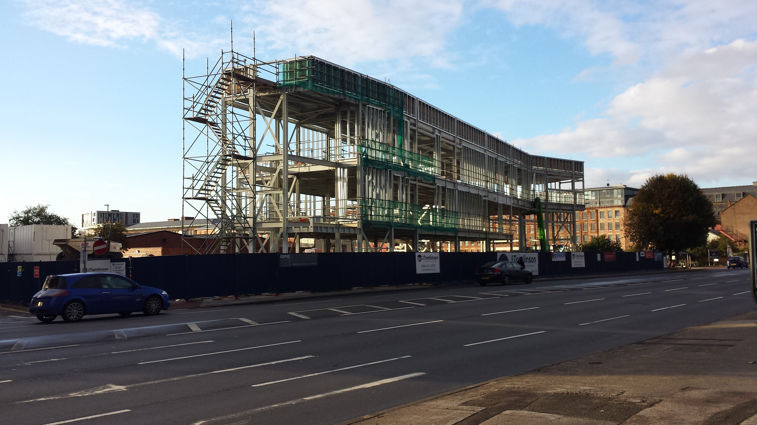
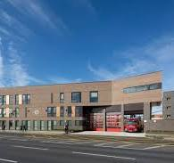
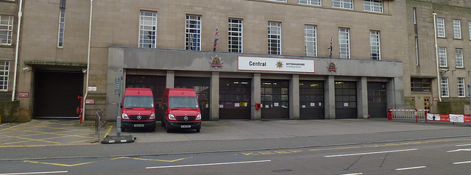
Local Evidence
Central Fire Station and London Road Fire Station in Nottingham

Slide 7
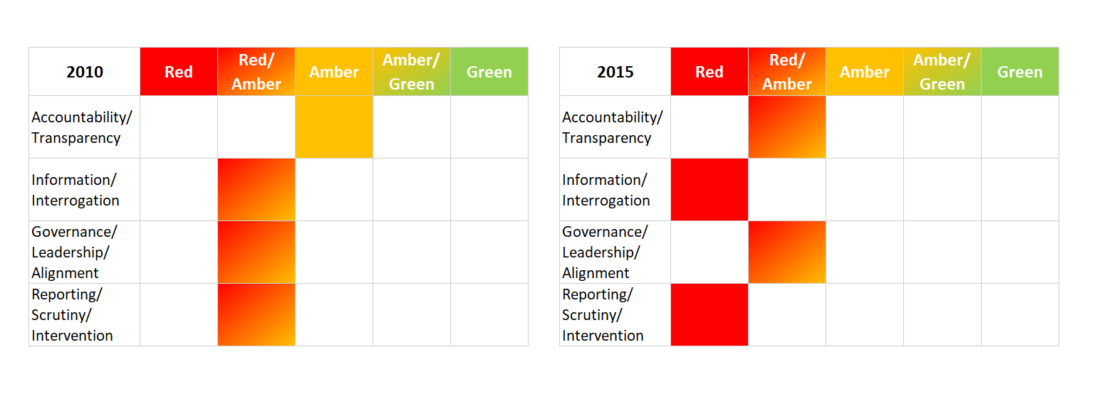
REF 2021: Improving policy, delivery and assurance in Fire and Rescue Services.
“Deteriorating Policy and Delivery of Fire and Rescue Services 2010- 2015 “

Slide 8
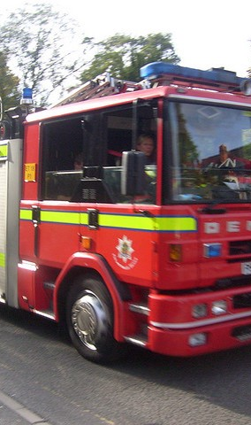
Deteriorating policy and delivery of Fire and Rescue Services (compromising the safety of the public) continued to 2020.
The organisation, configuration and delivery of F&R Services in England and the level of public assurance that citizens have the right to expect had all (collectively) significantly deteriorated.
2015 commissioned by the National Audit Office to assess the improvement progress of 4 public sectors (LAs, Health, Police and F&R services and then another report specifically on F&R Services
This led to chapters 2-4 of the 2017 Police and Crime Act A new national Framework for Fire and Rescue Services, A new external inspectorate (HMICFRS) all based on NBS work

Slide 9
REF 2021
(“Improving policy, delivery and assurance in Fire and Rescue Services”)
The organisation, configuration and delivery of F&R Services had been significantly changed by NTU research since 2010 with direct changes in
  Primary and secondary legislation; central and local public policy and government guidance explicitly (but not limited to) Chapters 2-4 of the Policing and Crime Act 2017 which relate to Fire Services.
  Public assurance, accountability and transparency arrangements within the sector, including (but not limited to) the creation of new national institutions, and a new national delivery framework.

Slide 10
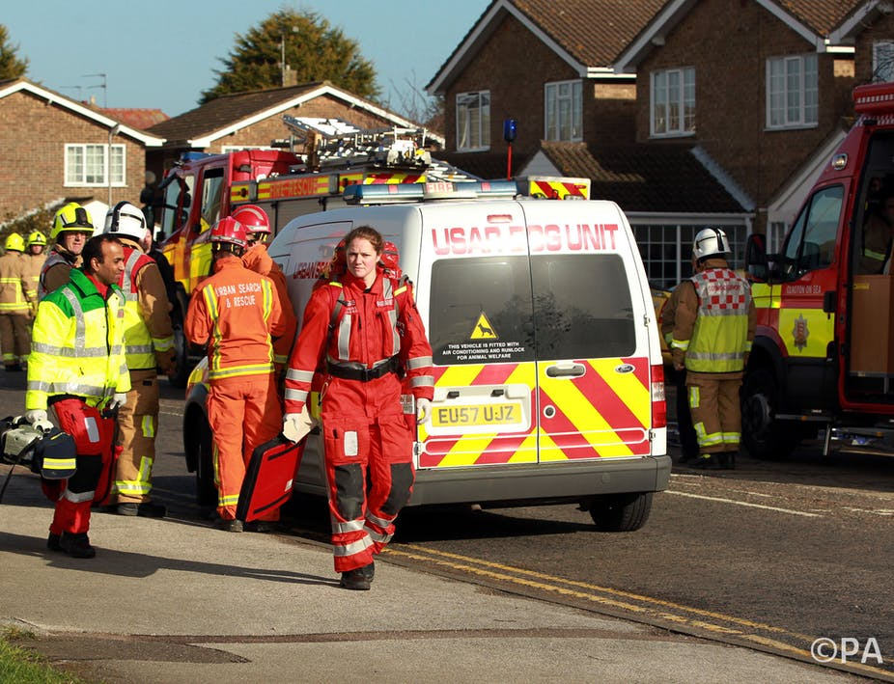
REF2029: Fire Service Reform in England 2021-2024
On-going research projects include
• The economic and social value of UK fire and rescue services.
• Recent and proposed changes to governance, leadership, and accountability of FRS
• Scrutiny and evaluation of the governments (post-2021) ‘Fire Reform’ agenda,
• The local public audit and assurance system (“no longer fit for purpose”).

Slide 11
The economic and social value of fire and rescue services
Two/Three slides from Florian

Slide 12


NBS predictions for reform in 2022
Change or issue | Yes | Partial | No
Role clarifications and operational Independence for CFO.
Joined up working and inter-agency collaboration
Revisiting Building Regulations and Enforcement
Improved Data, Information, and Standards
Restructuring of Financial support
New local public audit
Corporate or Governance Inspection added to inspection regime
National negotiating machinery reform
Mandatory PFCCs and Boundary Changes

Slide 13
Predictions changed by 2023.
Change or issue | Yes | Partial | No
Role clarifications/operational independence for CFO/clarify strategic and operational boundaries
Joined up working and inter-agency collaboration
Revisiting Building Regulations, Fire Safety Order and Fire Enforcement
Improved Data, Information, and Standards
Restructuring of Financial support
New local public audit arrangements
Corporate or Governance Inspection added to inspection regime
National negotiating machinery reform
Discretionary rather than mandatory PFCCs but an increase in boundary changes (with more Combined Authority Mayors)

Slide 14
Strategic
Omissions
Funding and Resourcing:
  Financial Support from HMG in short, medium and long-term
  Concepts of financial sustainability and resilience
Review of organisational landscape responsibilities and inter-relationships.
  National
  Local
Improvements to internal and external scrutiny
  Improved internal scrutiny requirements
  Government Intervention
  External Inspection

Slide 15

Questions
Contact
Peter.murphy@ntu.ac.uk

