Slide 1
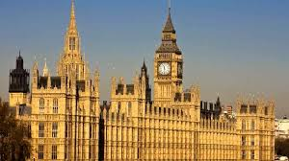
NBS
Annual Research Conference
11th June 2024
Public assurance and the efficient and effective delivery of public services by Central and Local Government.
Pete Murphy
Public Policy and Management
A sub-group of CEPPM
An Impact Case Study
attempting to change
Government Policy

Slide 2
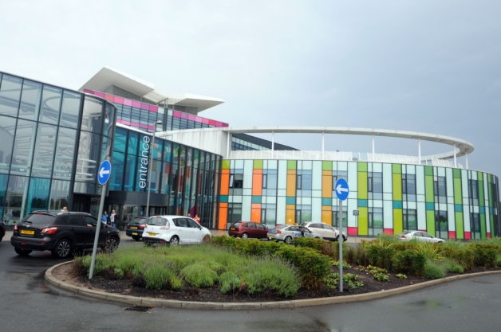

Public Policy and Management Research Interests
We are interested in 3 general research areas
  Local and Central Government (including this Impact Case Study)
  Health and Social Care
  Emergency Services (Fire Police and Ambulance Services).

Slide 3

PPMs’ Modus Operandi
We relate everything to the 3 research areas, (We have a basket of on-going projects at different stages of development), while being open to new collaborators
We constantly scan the landscape but focus on significant, contemporary and practical problems or issues, and on strategic pathways to impact
We actively identify, network and cooperate with key stakeholders in our policy, delivery and assurance areas and escalate our outputs to the national/international stage wherever possible.
We attend practice as well as academic conferences, write in professional and media outlets as well as journals.
Small grants, KTPs (fantastic for impact), short and long research consultancies, regular collaborators from practice
Choose what goes into the Impact Case Studies late in the REF cycle

Slide 4
Local and Central Government
Public assurance and effective delivery of public services
The Local Public Audit System (a system “no longer fit for purpose”)
The Local Government Finance System for supporting LAs and LPEs.
Financial resilience and financial vulnerability of LAs in England and a toolkit for authorities to self-assess
Government Intervention in failing/bankrupt LAs

Slide 5
1. The Local Public Audit System
(The system that certifies financial propriety)
Public Audit is the foundation for accountability, public assurance, and the financial systems and arrangements by which public bodies spend the publics’ money (i.e. it certifies financial propriety).
Local Public Audit was deteriorating up to 2013 but inter alia NBS have demonstrated that the Local Accountability and Audit Act 2014 made the system significantly worse.
By 2028 the government commissioned the Independent Redmond Review (2019, 2020) which found the system no longer ‘fit for purpose’ with 34 recommendations for its radical overhaul.
The government (and opposition) have both accepted these recommendations but implementation to date has been limited.

Slide 6

2. The Local Government Finance System
(The financial system that supports Local Authorities and Local Public Entities).
Our Key Objectives:
To demonstrate the inadequacy, unfairness, inequity, and unsustainability of the existing system of government financial support to local authorities.
To demonstrate how it could be improved as a collection and distribution system
To provide Local Authorities with a self-assessment toolkit to enable them to improve their short, medium, and long-term financial resilience.

Slide 7

3. The financial resilience and financial vulnerability of LAs and, a toolkit for authorities to self-assess
The long-term financial resilience of LAs has been severely compromised and significantly reduced by the implementation of austerity-localism policies between 2010 and 2024.
This research is based on a detailed long-term database that covers all services in all local authorities in England and Wales.
It involves the development of a qualitatively based analytical tool for the UK version of a cross-European initiative (supported by CIPFA, CIMA, and the LGA) to enable LAs to assess their financial resilience. It complements the current CIPFA Financial Resilience Index which is a quantitively based analytical tool.
It has been favourably received by the LAs and the professional bodies in 2 rounds of content testing by volunteer LAs. Translations of the toolkit into Austrian, German and Italian together and a web-based version of the model are currently being designed and constructed for dissemination.

Slide 8
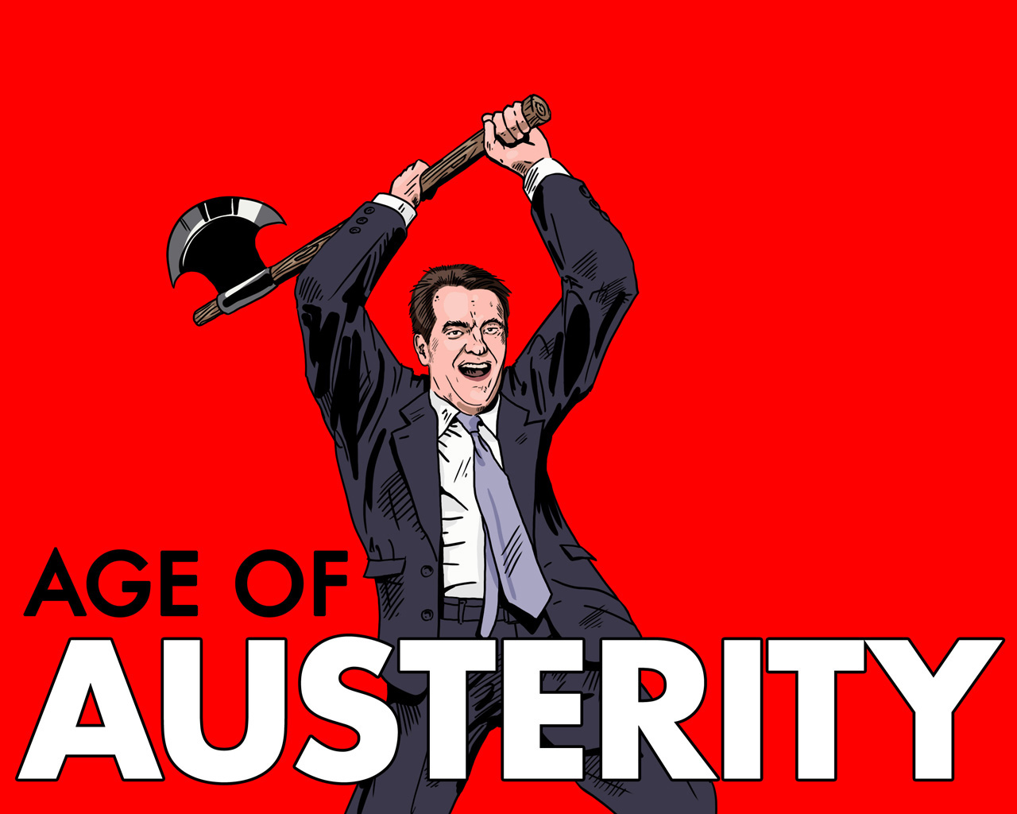
4. Government
Intervention and Monitoring
(How the UK government responds to financial, service and corporate failings in local authorities).
Projects
Corporate Intervention 2000-2010
Financial Intervention 2018-2024
Case Studies:
  Northamptonshire,
  Birmingham,
  Nottingham

Slide 9
Northamptonshire County Council
The background, the ‘trigger’ and a conundrum.
In 2018 NCC issued two Section 114 notices acknowledging it could not balance its budget in 2018/19 or 2019/2020
The government appointed an independent external consultant (Max Caller) to undertake a Best Value Review of the council
The report concluded that NCC had “failed to comply with its duty to provide best value ” primarily because it had “lost budgetary control and appeared to abandon strong and effective budget setting scrutiny” (Caller 2018 p1).
Although the inadequate financial controls were entirely the responsibility of NCC, the report also suggested that local government across Northamptonshire should be re-structured and two new unitary councils created from the County Council and the 7 district councils.
Why was their little public or political opposition to this radical intervention in local democracy, when previous interventions and local government reorganisations have usually been highly contested and strongly resisted

Slide 10
Nottingham City Council
Initially monitoring but upgraded to intervention.
In August 2020 Eternal Auditor issued a Public Interest Notice relating to Robin Hood Energy – led to initial government monitoring by an external Improvement and Assurance Board, with a Recovery and Improvement Plan established in 2021.
In December 2021, the council acknowledged unlawful accounting practices associated with its ring-fenced Housing Revenue Account going back six years and totalling £15.86m. (DLUHC gave more power to the commissioners)
29 November 2023, the Section 151 officer issued another 114 notice but this time it blamed long-term structural factors – “A rising tide of costs including Children and Adults Social Care costs, rising homelessness presentations, and inflation”.
Government formal Intervention: Appointed New Commissioners because “there has been a distinct lack of urgency in tackling the necessary change”. Need to increase the pace of change in governance, finance, transformation, corporate planning, companies and workforce culture and performance outcomes.

Slide 11
Birmingham City Council goes ‘bankrupt’
As the largest LA in Europe this was international news
What was its background and ‘trigger’ for action?
Long-term background
Long-term real fall in LAs Spending power (31%) due to reductions in central government grants
Demand for services increasing as a result of demographic changes, inequality and austerity particularly Adult and Childrens’ Social Care.
More recently - rises in inflation
Trigger
“On 5 September 2023, BCC issued a ‘section 114 notice’… as the council anticipated a gap of £87 million between income and expenditure for the (current) 2023/24 financial year. In addition to this gap, the council estimated that it would have to pay £650 million to £760 million in backdated equal pay claims, following a court judgment in 2012.

Slide 12
Why is this unsustainable?
.. and why we need to change Government policy!
Government 5-year spending plans 2014-2029 are based upon continuous reductions in LA support
Increases in the demand for services are already baked into the future because of rising inequalities and aging demographics
The rising levels of LA debts is unsustainable (Spelthorne and Woking have debts 88 and 62 times their annual turnover).
Recent “exceptional financial support” via capitalisations for local authorities are masking the seriousness of problem

Slide 13

Questions
Contacts
peter.murphy@ntu.ac.uk
martin.Jones@ntu.ac.uk
peter.eckersley@ntu.ac.uk
katarzyna.lakoma@ntu.ac.uk
bernard.dom@ntu.ac.uk

