Slide 1

Preventing fires and meeting targets: tensions between transactional and relational approaches to measurement in UK fire prevention
Charlotte Pell, PhD candidate
Postgraduate Researcher, Centre for Economics, Policy and Public Management at Nottingham Business School at Nottingham Trent University

Slide 2
Purpose of presentation
To share the results from a case study at Nottinghamshire Fire and Rescue Service (NFRS)
To explore possible interpretations of these results
To discuss the relationship between central government control, public service motivation and data use

Slide 3

Safe and Well visits at Nottinghamshire Fire and Rescue Service

Slide 4
Motivation
…helping people, you know it’s now the sort of like ultimate job to be able to do that (INT 47)
It’s just something that appealed to me, working with the community, you know, saving people’s lives basically. (INT 13)
What motivates me? Doing a good job. (INT 06)

Slide 5
Impact
… the focus needs to go back on what impact have you had to your communities…And how can you … how have you measured that and improved that?
Interviewee 18
…it would be nice to know that you’ve … made a difference by referring them, definitely, but it would also be nice to sometimes know what the end outcome was.
Interviewee 29
And it’s … you know rather than thinking, oh I’ve got to cram another three in this week to hit my target, I’d rather be in a position to think the ones that I have seen already, you know is absolutely everything I can do for that person done? …Interviewee 10

Slide 6
Data used in Safe and Well visits
…targets can create a problem, certainly when it’s number based…what I don’t like to think is that someone’s rushed to do a case and … put it in a box, and move on to the next one. I would rather them see it through properly and close the loop and all the loose ends … to make sure we’ve done everything we can do. (INT 15)
…you don’t want performance management just being a stick to beat people with because that’s where the chasing of targets comes and the quality decreases. (INT 47)
But it’s very numbers orientated. So we’re very kind of obsessed with how many safe and well visits we’ve done (INT 42)

Slide 7
Data used in Safe and Well visits
…… if I wanted a job chasing figures and targets, I’d have gone and got a job in a shop as a sales assistant, you know. I don’t want to do that, I want to do the job properly and make sure it’s done to the best of my ability. (INT 13)
Because it’s somebody’s life, the other side of that and … referrals that we can make, they can change that person’s wellbeing and day to day life quite quickly, which is great, but we need to keep in mind as a priority that you know these are people and these aren’t targets. (INT 19)

Slide 8
Findings
A clear commitment to purpose
Strong public service ethos
Staff want to make a difference
NFRS has ‘too much data’
There is pressure to ‘chase the numbers’
Some say this pressure is causing low morale
Staff describe the pressure as coming from HMICFRS
Some unverified reports of gaming to meet targets

Slide 9
How, why and for what purposes does NFRS use data?
Moynihan’s 4 Ps | Use of data | Staff motivation | Drivers
Purposeful | To learn and improve. Relational. | High | Public service ethos
Political | To achieve HMICFRS outstanding To hit the numbers | High/medium | Control, extrinsic motivation
Passive | To collect data for the sake of it and not use it | Low | Bureaucratic disillusionment
Perverse | To hit the numbers by gaming | Low. Demotivated | Blame avoidance Self-preservation

Slide 10
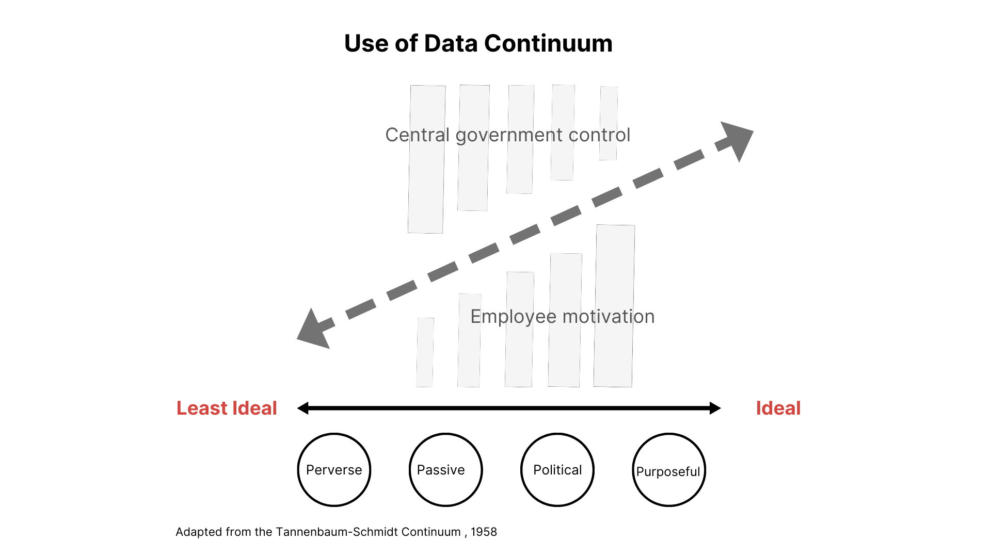
Conceptual Framework

Slide 11
Questions raised
Is there a relationship between central government, public servant motivation and data use?
Can there be purposeful use of data in UK fire prevention at the same time as sustained pressure from HMICFRS to meet targets?
How else could fire and rescue services measure whether their prevention activities are achieving the purpose?

