Slide 1



Suicide in adults under supervision of probation services: Causes, risk factors, and opportunities for prevention
Based on a paper under review with Health and Justice
Professor Karen Slade
Dr Lucy Justice, Frederica Martijn and Prof Thom Baguley
NTU Psychology &
HMPPS Strategic Lead for deaths under supervision

Slide 2
Background
Probation in England and Wales (E&W) supervise people subject to a court ordered community sentence or post-custody supervision/licence.
They provide risk management related to offending behaviour and responsible for enforcing Orders of the court
At any point in time around 168,000 people are subject to community supervision in E&W.
Very few jurisdictions publish data on probation deaths and far more limited research internationally around suicide in this population – and almost none on the community sentenced.

Slide 3
Prevalence
People on probation supervision are 9-13 times more likely to die from suicide than the general population
[systematic review, Sirdifield et al., 2020]
32% of people on probation had attempted suicide at some point in their lives.
[Pluck & Brooker, 2014]
Rates of current suicide ideation (USA) are between 10-13% of people on probation
[Carderelli et al, 2015; Yu and Sung, 2015]
People under probation supervision are at increased risk of premature mortality – at least as great as people in custody.
Non-natural causes of death account for 50-80% of deaths in this population

Slide 4
Understanding Risk
There is an acute elevation of mortality in the first month after release from prison (Pratt et al., 2006) – dominated by drug-related deaths but suggestions also of suicide.
Why?
Around 44,000-64,000 people are released from custody in E&W each year (MoJ, 2022) with many facing difficulties during the return to the community associated with premature mortality e.g., homelessness or temporary housing, debts, difficulties in accessing healthcare, and unemployment (Gelsthorpe et al., 2010; Social Exclusion Unit, 2002).
Pre-existing risk factors do not fully explain the acute elevation of mortality risk in this population. Being sentenced may itself increase risk, for instance through elevated stress levels (Kinner et al., 2013)
Evidence is also emerging that actions undertaken by the CJS may act as risk markers for suicide, such as a breach or violation of supervision requirements leading to enforcement actions by the CJS (Borrill et al., 2017; King et al., 2015).
People on probation have to access general community services – but may be declined/rerouted/complex

Slide 5
Aims
Whether specific factors are uniquely related to suicide compared with other causes of death.
Whether there are differentials in the time to death post-custody or post-sentencing, dependent on the cause of death.
Which factors uniquely associate with suicide, within a partial correlation network, and whether there are different partial correlations based on type of sentence (post-custody release versus a community sentence).

Slide 6
Method
This study is a retrospective cohort study, analysing the records of all people whose death was recorded while under supervision in the community in E&W between 01 April 2019 and 31 March 2021
Data were drawn exclusively from the Probation electronic case management system where demographic, offence, and other characteristic information is routinely reported by probation staff. Some data were recoded into pooled variables to create the variables.
NOTE:
Data is only as provided to probation staff not official outcomes
Suspected suicide is only as relate to two common methods and all others are in ‘Other’ or ‘drug overdose’ and so either excluded or in another cause.

Slide 7
Sample
A total of 2448 deaths under supervision were recorded during the study period [2019/20 = 999; 2020/21 = 1449]. 52.2% were post-custody releases and 47.8% were serving community sentences.
748 were excluded from the sample because the specific cause of death was unspecified or still under investigation: ‘Awaiting further information’ (n = 564) and ‘Self-inflicted: Other or Unspecified’ (n = 184).
A total of 1700 people were included in the sample.
All | Natural cause % (N) | Drug overdose | Suicide | Accident | Homicide
(n = 1700) | 51.4% (873) | 48.6% (440) | 10 % (170) | 7.9%(135) | 4.8% (82)
 |  |  | Male = 90% (153) Female = 10% (17)
The average annual number of people under community probation supervision during this period was 168,914 (MoJ, 2022a).

Slide 8
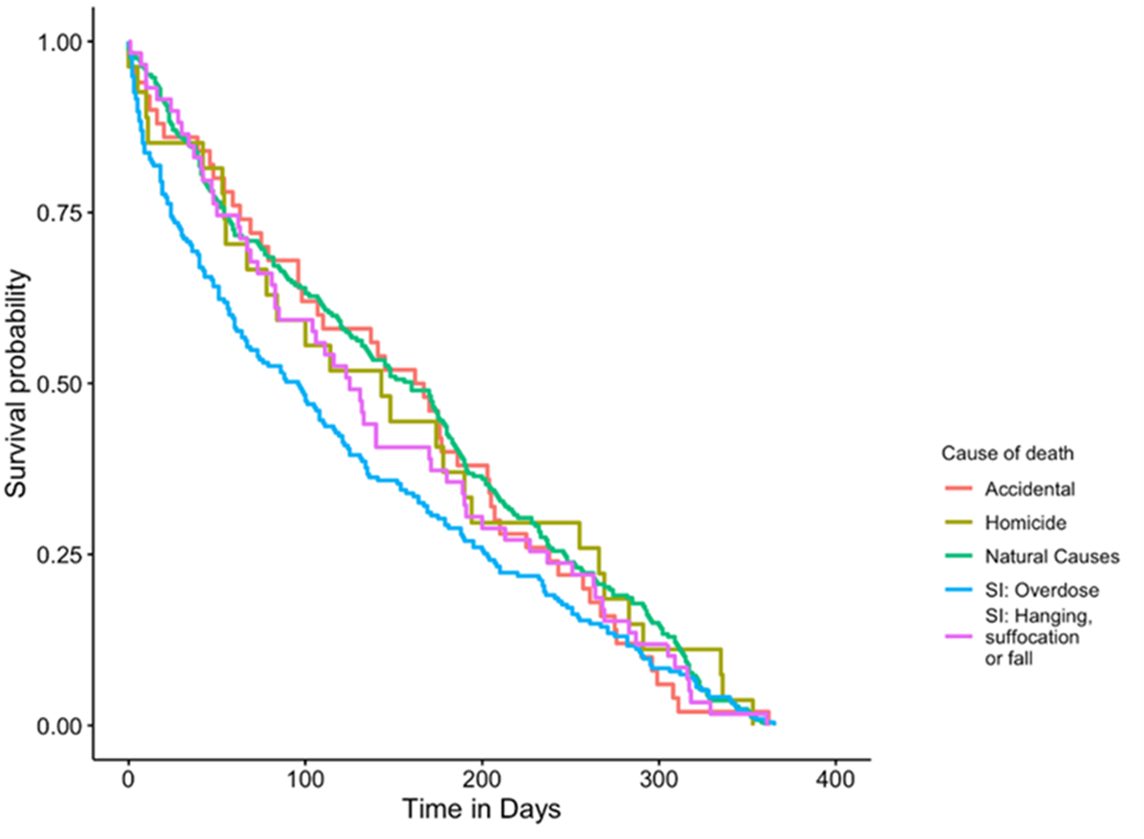
Survival analysis
Kaplan-Meier method, and probability analyses, were used to calculate the relative probability of survival over a 28-day and a 365-day period.
Neither the post-custody release (n = 599) nor the community sentence group (n = 614) demonstrated a statistically significant difference between cause of death and probability of surviving across all time points (p = .11 and p = .15, respectively).
Drug overdose was the only cause which had a notably lower survival rate (12% lower).
Figure: Community sentence survival analysis

Slide 9
Linear model for suspected suicide
Significantly more likely to be:
Full or self-employed
Have known suicide risks
Domestic violence (or abuse) perpetration risk markers.
Unlike in the general population where men are 3 times more likely to die from suicide, men and women under supervision are at more even risk (women only slightly less)
Similar patterns for ethnic backgrounds

Slide 10
Exploratory network analysis, a Gaussian Graphical Model (GGM)
As factors related to an increased risk of death are rarely singular and often interrelate, GGM analysis was performed to examine the unique partial relationships between the variables and the causes of non-natural death (i.e., accidental, drug overdose, suspected suicide, and homicide) when compared with deaths by natural causes.

Slide 11
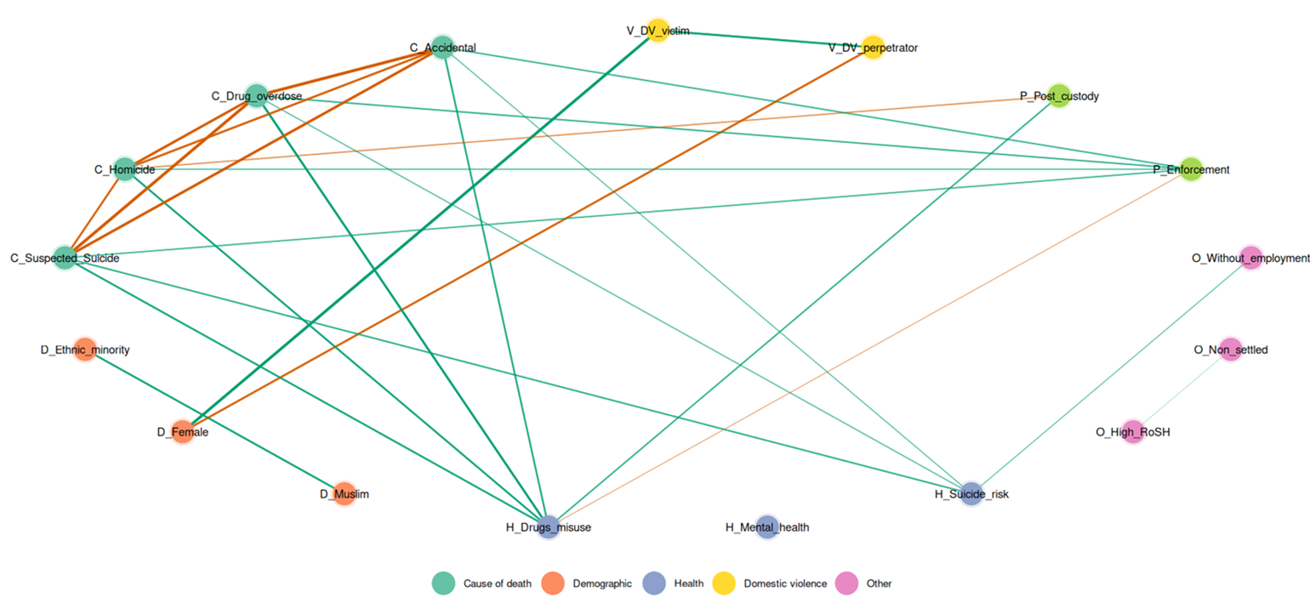
Graphical summary of the partial correlation network for full sample causes of death.

Slide 12
Suspected suicide
Three main factors were linked with suspected suicides:
Drug misuse [All groups]
Suicide/self-harm risk [All groups]
  Full sample - Furthermore, strong associations were identified for this factor with most non-natural deaths: Drug overdose (r = .334465), suspected suicide (r = .461), and accidental deaths (r = .325). Having a known suicide/self-harm risk was also associated with unemployment, r = .308.
  Post-prison release - Suicide/self-harm risk was related to suspected suicide (r = .364), as well as unemployment (r = .385) and domestic violence perpetration (r = .287).
  Community sentence - Suicide self-harm risk had a strong association with deaths by suspected suicide (r = .461) and unemployment (r = .298) and negatively with non-settled accommodation (r = -.286).
Enforcement action [Full and community sentence]

Slide 13
Discussion I
Within this population, at least 10% die from suicide (an under-estimation). This is a far greater rate than general population & demonstrates the hugely elevated risk.
A previous suicide or self-harm risk was identified in 33% of suspected suicides but also 28% of drug-related deaths. This reflects consistent evidence of the interlink between drug use and suicide.

Slide 14


Discussion II
More likely if a perpetrator (36.5%) or victim (4.7%) of domestic/family violence or abuse
Emerging evidence is strong of the relevance of perpetration as a risk factor for suicide
Compared to average
More likely to have recently initiated enforcement action or recall to prison (20.6%)
Likely a risk marker of rising risk and need for intervention/priority by wider services
This Photo by Unknown Author is licensed under CC BY-NC

Slide 15
Limitations
The data in this study reflect the information as inputted by probation staff into a single system, and the data provided was not complete
All health data e.g., mental health problems or drug use, was only that provided and recorded by probation services.
Approximately 25% of cases were not classified, resulting in a high number of exclusions from the analysis and we recommend that figures be viewed as trends rather than absolute rates.
Future research would benefit from using data from confirmed causes of death & multiple data sources which would allow for more nuanced analysis

Slide 16
Conclusion
Probation services do not hold the same statutory duty of care as prisons hold for people in custody and relies on other statutory and partner agencies to deliver many key services to those under supervision (e.g., health and social care, housing, education).
This study emphasises the importance of joint working between health and justice, including reassessing an array of policies, training, and services to ensure they are responsive to the needs of those under probation supervision, and encompass those serving community sentences.

Slide 17
Future avenues
We aim to repeat the study next year using the official outcomes over additional years to confirm findings.
Further research is needed to explore the clear and repeated finding of domestic/familial violence perpetration and suicide.

Slide 18

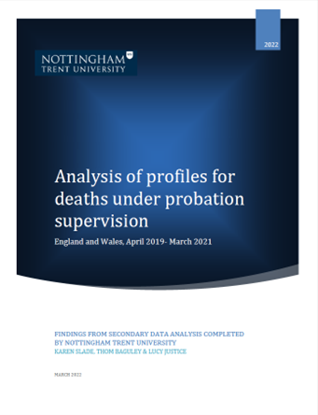
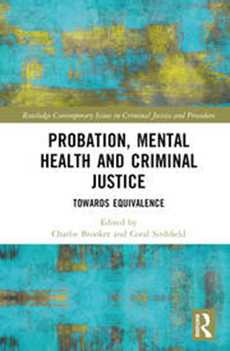
For further information on suicide prevention on Probation
Recent official figures on deaths under supervision
A new (2022) policy framework on deaths under supervision.
Ctrl + Click to access report
Chapter 10:
New approaches to suicide prevention in Approved Premises

Slide 19

Thank you
Please do get in touch if interested in exploring in own areas.
For further information contact:
Karen.slade1@justice.gov.uk or karen.slade@ntu.ac.uk

