Slide 1
IRSPM Annual Conference
Panel 42: New Researchers’ Panel
Delivering Local Authority Cultural Services in the Era of Austerity
Bernard Dom, Alan Collins, Martin Jones, Peter Murphy

Slide 2
Paper in Summary
The Global Financial Crisis (GFC) had a significant impact on central and local gov’t, particularly English Local Authorities (LAs). e.g. continuous significant reductions throughout the long-term study period.
Cultural and Related Services (CRS) arguably may be considered ‘a relatively easy’ target for reduction by LAs.
Even without the GFC, LAs are under pressure because of other statutory services in high demand (e.g. social care).
The study investigates how English LAs have treated CRS in relation to other expenditure areas.
From an assembled data set of English LA funding, we used data visualisation and a ‘financial resilience framework’ to assess the treatment of CRS before and in the early and late eras of austerity.
Notes:
Statutory services - LAs have the obligatory responsibility of providing these services
Why CRS? Because …
(a) CRS is one of the very few service areas that all LA type have an obligation to provide throughout all jurisdictions (geography)
(b) Data on CRS has been consistent throughout the study time series (2008/09 to 2019/20)
Methods
Quantitative using data visualisaton:
The time series is divided into three eras, namely pre-austerity (2008/09 to 2009/2010), early austerity (2010/11 to 2014/15), and late austerity (2015/16 to 2019/20).
Qualitative
Semi Structured Interviews were used to gain a deeper understanding of findings from the data visualisation.

Slide 3
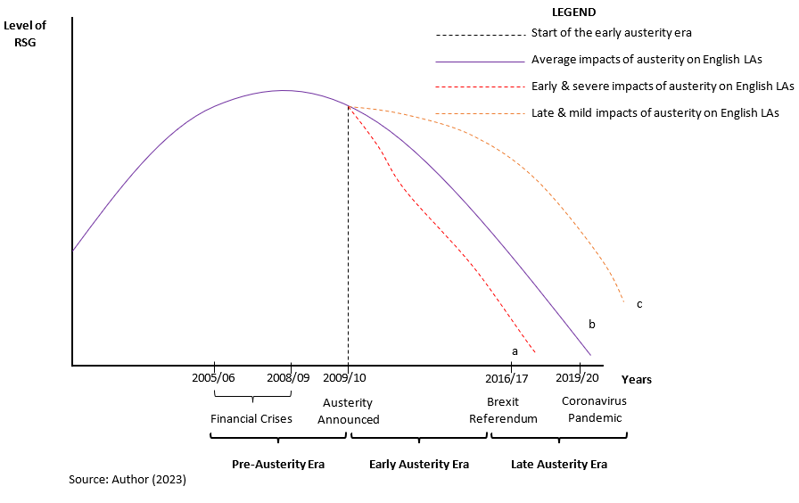
The state of English LA Funding during Austerity
(a) Even in the early austerity era, a few LAs were unable to meet their financial obligation to maintain a balanced budget (e.g. NCC – 2017).
(b) Despite being increasingly vulnerable, most English LAs continued to meet their statutory responsibilities with indications they would ‘bounce back’.
(c) In the late austerity era, there were some clear signs of some authorities ‘bouncing forward’.
Notes:
Revenue Support Grant (RSG) represents the largest share of grants that LAs receive from the central government.
The loss of RSG was partly compensated by structural changes in the way business rates were retained locally.
Explain the context,

Slide 4
Literature Review

Slide 5
Methods: Explanatory approach using case study
Case Study of LAs in England (314 LAs)
By type ➔ six types; and geography ➔ nine regions
Classified the longitudinal time series (15 years) into three distinct eras:
  pre austerity (2005/6 to 2009/10)
  early austerity (2010/11 to 2014/15)
  post austerity (2015/16 to 2019/20)
Two analysis frames:
Data visualisation ➔ Impacts of CRS during austerity era
  A trend analysis to understand the impact of austerity on cultural services to English LAs by type and region in the three distinct eras.
Thematic analysis ➔ Relationship between Impacts of austerity on PV Levels of LAs
A thematic analysis that used evidence from primary data
  to categorise impacts of austerity into three distinct categories (i.e. Financial, Structural, and Service Pressures)
  to understand the relationship between austerity impacts and perceived vulnerability levels of LAs
Using the GDP deflator with 2010/11 as the base year

Slide 6
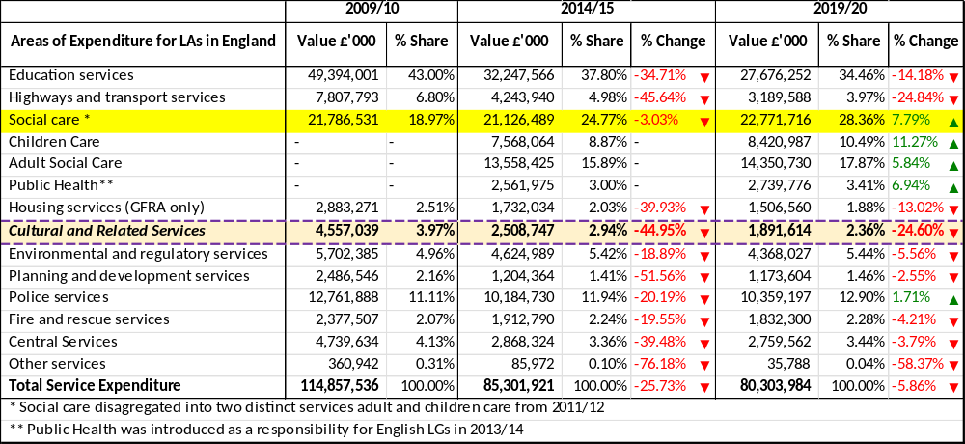
Impact on CRS during the austerity era (2009/10 -19/20)
Notes:
How much green is on there?
Real term values
Change is in the actual values
Total spending reduced by 25.73% and a further 5.86% across the three eras
Social care actually increased by nearly 8% (excluding public health) by 2019/20, following a small reduction (compared to other services ) of 3% by 2014/15
All other services saw a reductions
Of these CRS took one of the largest overall reductions in spending and also reduced in terms of the proportion of spend across all services (although some of this may have been due to the introduction of public health

Slide 7
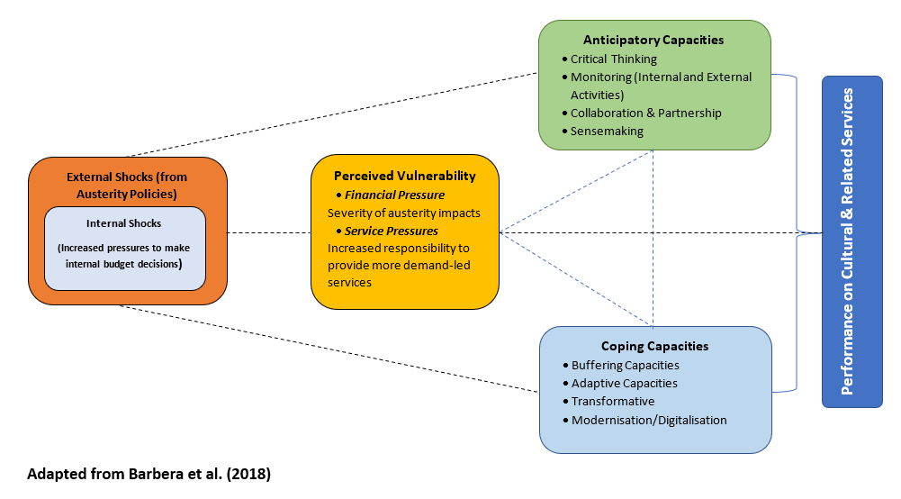
The Financial Resilience (FinRes) Framework
Notes:
The framework explains how internal and external incidents (such as GFC) could lead LAs to be more or less vulnerable (perceived vulnerability) , thereby exposing them to continuous increase in financial and service demand pressures. In response, LAs either apply coping, anticipatory or a combination of both capacities to withstand these pressure to provide cultural and related service.
Anticipatory capacities
Monitoring internal and external activities
Information sharing
Information exchange
Critical thinking
Sensemaking
Coping Capacities
Buffering
Adapting
Transforming

Slide 8
Quantitative Findings: Impact on CRS for English LAs
CRS was subject to significant reductions in funding within LAs as a response to the reductions in central government funding.
Within this continuous decline, and within CRS, most English LAs shifted priority from spending on library services (during pre/early austerity) to spend more on parks and open spaces in the late austerity era.
By Type: Shire Districts (SDs) and London Boroughs (LBs) prioritised expenditure on theatres & public entertainment over heritage, and arts developments & support throughout the time series.
By Region: LAs in (and around) London prioritised more funds for services in the ‘culture & heritage’, and ‘recreation & sports’ categories than those unspecified (e.g. library services, tourism, parks & open spaces). The reverse was a common pattern for the other LA types throughout the time series. (Capital city bias?)
Notes:
The largest proportion of resources allocated to library services was an average of 67%, recorded by Shire Counties. SCs spent an increasing proportion on library services from at least 65% (during pre-austerity) to a high 70% in the late austerity era.
CRS received both less money from a reducing pot of money, but also a smaller share of that reducing pot, ie the cuts were more severe for CRS than some other service.

Slide 9
Qualitative Findings: Responses using ‘FinRes’ Framework
Financial Shocks: Despite the occurrence of disruptive events (Brexit, Covid-19), austerity appears to continually ‘exist in the background’, and LAs expect this to continue in the foreseeable future.
Perceived Vulnerability: Austerity policies had ripple effects on service delivery – it compounded pressures on LAs to adopt retrenchment measures e.g. by applying cutback strategies to discretionary services (such as CRS).
Coping Capacities: LAs adopted one or more of the three ‘coping capacities’ (strategies) and expected to withstand pressures from austerity in the early austerity era, which were initially anticipated to be short-lived but actually extended into the late austerity era.
Anticipatory Capacities: LAs increasingly adopted a more ‘forward-looking’ approach (bounce-forward) when grants continued to decline in the late austerity era.
Notes:
Financial Shocks
The Study found that while LAs have struggled to maintain CRS components, the continuous occurrence of disruptive events (such as Brexit and the covid pandemic) intensified the impacts of austerity on LAs’ financial resilience.
Perceived Vulnerability
For example, growing perceived vulnerability levels compelled some LAs to reduce some demanded CRS components, such as library service, whilst allocating the resources saved to (re)prioritised services (e.g. social care). LAs may continue to struggle to maintain CRS components, especially in the current economic recession and growing uncertainty that exists in the post-covid era.
Coping Capacities
In their pursuit to ‘bounce back’ to an original (normal) state, LAs engage more in adaptive. In contrast, a few others implemented transformative strategies on CRS, intending to shed the growing pressure to maintain service delivery. While coping capacities were short-term oriented, LAs benefitted by drawing lessons from adopting such capacities to shape strategies for their medium-term financial plans.
Anticipatory Capacities
Anticipatory capacities were adopted to enable LAs to ‘bounce forward’ to a position enabling LAs to identify ways of building capacities and capabilities to withstand adverse conditions during crises and shocks. The study identified critical thinking, sense-making, and collaboration & partnership as the three main strategies that could boost LAs’ capacities to minimise perceived vulnerability levels to enhance their financial/non-financial performance

Slide 10
What it means going forward (beyond 2020…)?
For CRS:
This was before Covid, and it is much worse now!
For English LAs:
Is there a minimum level of CRS for English LAs – Is it zero? Should there be a statutory minimum like some other expenditure areas?
If zero, what will be the effect on the wider economy, and also in terms of LA political-economic cycle.
Given we expect CRS to decline further post-Covid (relative to other expenditure areas), we can expect a much more fragmented distribution of cultural amenities – perhaps biased to London, SE and some other major cities? (retrenchment?)
Has central and Local government actively considered wipe-out of CRS in most of England?
Is this privatisation/full marketisation by stealth from the current UK central government?

