Slide 1
IRSPM Annual Conference
Panel 41: Accounting and Accountability Perspectives in Public Governance and Management
Local Government, austerity localism, financial resilience, and perceived vulnerability in England
Bernard Dom, Peter Murphy, Martin Jones, Alan Collins
17 April 2024

Slide 2
Background and Context
Austerity policies implemented since 2010 have contributed to higher perceived vulnerability levels for LAs.
LAs have been exposed to twin long-term pressures – reduced funding and increased demand for service (especially, children and adult social care).
They have been increasingly vulnerable to shocks and twelve Section 114 notices have been issued since 2018.
It looks like more are imminent, as “79% of section 151 Officers feel that their organisations are now unprepared to address the financial implications of external events” (EY Section 151 Confidence Barometer, 2023)
This paper investigates the impacts of austerity policies and their relationships to perceived vulnerability, using English LAs as a case study.
Notes:
Austerity is an interesting shock because it is ideally expected to be a response to remedy the shocks that emerge from other disruptive incidents/events, but has become a shock in itself. This is what makes it a wicked problem and/or a tempting solution.
External factors including austerity have left LAs increasingly exposed to “twin pressures” – thus the continuous reduction in central funding to LAs, and an increase in expectation and demand for services (especially social care). The average LAs spends more than 60% of their revenue income on social care. This percentage rises continuously and is predicted to reach a record high of 90% by 2025.
12 LAs ( Northamptonshire CC 2, Croydon BC 3, Slough UA, Thurrock, Northumbland, Woking, Birmingham CC, Nottingham CC 2). So, although not desirable, it is almost expected that a few LAs would have issued a Section 114 notice, meaning that they are unable to meet their obligatory expenditure requirements for the upcoming budgetary period.
This smells like trouble, especially when at least half the population of English LAs are speculated to be in a similar vulnerable state, and just a matter of time.
Then, we there wouldn’t be a better time to explore the impacts of this wicked problem or tempting solution (in austerity) and how this relates to the perceived vulnerability levels of LAs, using England as a case study.

Slide 3
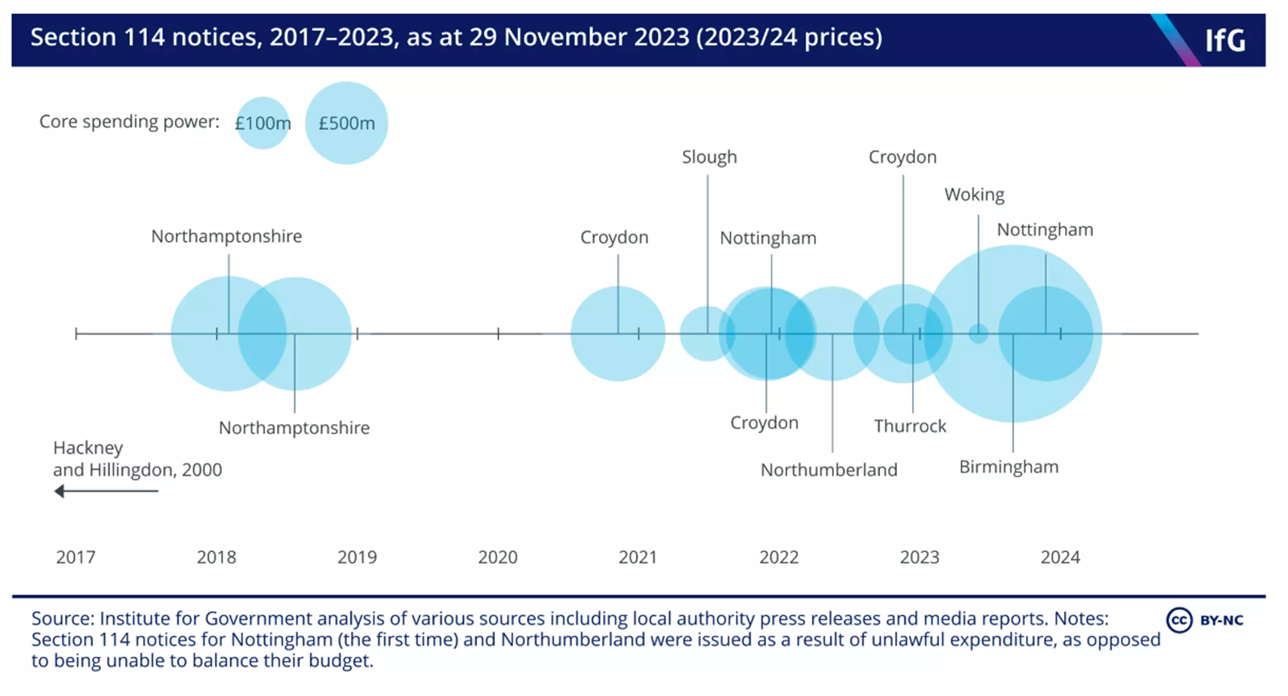
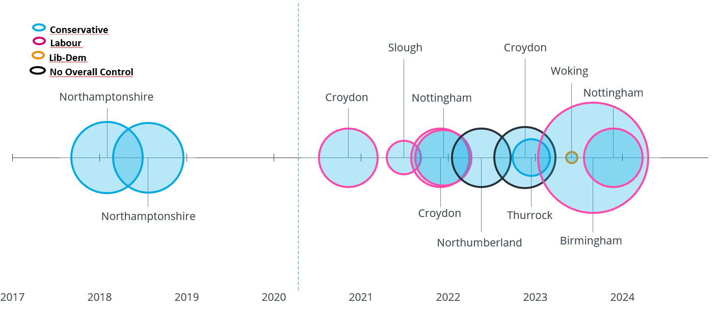
Vulnerable LAs – Section 114 Notices
Notes:
The diagram shows a timeline of Section 114 notice issues from 2017 to 2023.
NCC issued two Section 114 notices (February and July, 2018) making it the first LA to issue one after 2 decades. This intensified the need to conduct my study. Since then, there have been 12 Section 114 Notices from 9 English LAs. The fact that all these LAs were England, provided even more scope to consider English LAs as a case study.

Slide 4
Methods: Explanatory approach using case study
Case Study of LAs in England (314 LAs)
By type ➔ six types; and geography ➔ nine regions
Classified the longitudinal time series (15 years) into three distinct eras:
  pre austerity (2005/6 to 2009/10)
  early austerity (2010/11 to 2014/15)
  post austerity (2015/16 to 2019/20)
Two analysis frames:
Data visualisation ➔ Impacts of austerity on LG Finance
  A trend analysis to understand the impact of austerity on English LAs by type and region in the three distinct eras.
Thematic analysis ➔ Relationship between Impacts of austerity on PV Levels of LAs
A thematic analysis that used evidence from primary data
  to categorise impacts of austerity into three distinct categories (i.e. Financial, Structural, and Service Pressures)
  to understand the relationship between austerity impacts and perceived vulnerability levels of LAs
Using the GDP deflator with 2010/11 as the base year

Slide 5
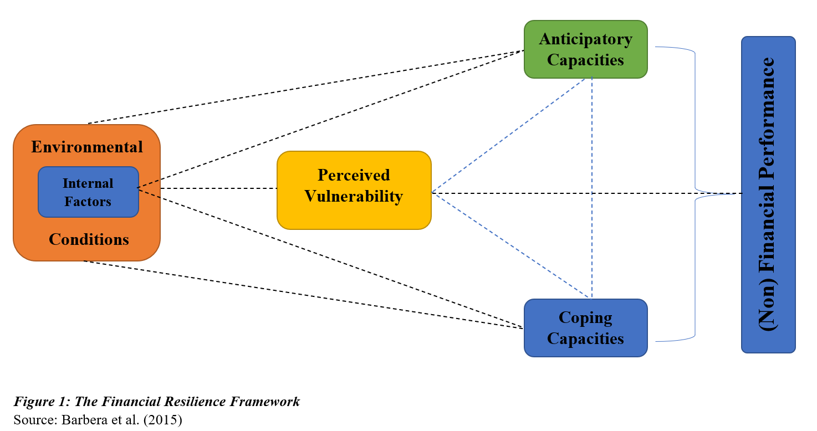
The Financial Resilience Framework
Perceived Vulnerability (PV)
PV levels make LAs either robust or vulnerable to shocks.
PV levels of organisations determine their response strategies when faced with shocks.
Resilience
Individual ➔ resilience of individuals
Community ➔ ability of organisations to cope with stressful and unexpected conditions.
Organisational ➔ the development of the abilities of an organisation to keep up with changing dynamics.
Financial resilience ➔ organisations’ capacity to anticipate, absorb, and react to shocks affecting their finances over time a dynamic combination of four interrelated dimensions namely FS, PV, AC, and CC .
The shock - Austerity Policies as a ‘wicked problem’
Other disruptive events (e.g. GFC, Brexit, Covid, CoL crises, challenges from wars in Ukraine/Gaza)
Tempting solution ➔ once activated/implemented, it is largely irreversible
Wicked problem ➔ symptoms of other problems that are mostly inevitable
Notes:
The framework explains how internal and external incidents (such as GFC) could lead LAs to be more or less vulnerable (perceived vulnerability), thereby exposing them to continuous increase in financial and service demand pressures. In response, LAs either apply coping, anticipatory or a combination of both capacities to withstand these pressure to provide cultural and related service.
The shock – Austerity policies as a wicked problem
Aside austerity, LAs have been, and continue to be exposed to other ‘disruptive events’ (legacy ones = GFC, Brexit, covid, and more recent ones = CoL crisis, frequent change in policies due to unstable gov’t, and challenges from wars).
While austerity policies were activated/implemented to remedy the impacts from these disruptive events (i.e. a tempting solution), they are creating an additional problem as they increase the perceived vulnerability levels of LAs, making it a wicked problem
Perceived Vulnerability ➔ this is how organisations (LAs) themselves perceive their vulnerability to shocks.
Move to next…
organisations associated with high levels of perceived vulnerability tend to rely on short-term coping capacities to ‘bounce back’ whilst others with perceptions of lower vulnerability tend to utilise anticipatory capacities to withstand shocks and ‘bounce forward’.
Resilience ➔ this is a measure of resistance and recovery.

Slide 6
Financial Pressures
“… councils have always received less money from central government but were expected to cover the demands placed them”. Phi
Reduction in central funding
  LAs had mobilised funds from other sources to cover expenditure equivalent to £16.5 billion in 2019/20, this had stood at £1.4 billion in 2012/13 (Sandford, 2021).
Widened funding gap
  The funding gap has increasingly widened since the introduction of austerity, causing LAs to have to mobilise funds from other sources to balance their budgets.
Adverse impact on financial autonomy
  Some central governments, including the UK adopted austerity measures by delegating more tasks to the local authorities (Ladner, 2017).
“We believed we would face a cut of about £150 million to our core funding over a four or five period. Everybody thought that was mad and too high, but it was an under-estimate quite frankly.” Upsilon
“LGs are in an interesting position because we’ve all got a financial gap, we’re all struggling to make ends meet, are under massive pressure because for us to balance the books.” Delta
“… there was concern every year about local authorities being able to manage and set a balanced budget, which they have to do for the following year.” Upsilon
… social care is the killer but that’s the thing that people spend all the money on; we’re in an affluent area where [there are] a lot of people who pay for their own care [self-funders], which makes a big difference [in our levels of spending power].” Delta
Notes:
Financial Pressures are significant impacts that reduced funding from implementing austerity policies has on operational performance of an organisation or government. So they extend beyond changes that promote or hinder the financial performance of an organisation.
Reduction in central funding
LAs have been increasingly vulnerable to reductions in central funding (RSG), which compels them to allocate limited resources to increasing expenditure on a year-to-year basis.
Widened Funding gap ➔ Funding gap is the difference between estimated local authorities’ income and the estimated total cost of expected spending at a particular date in the (then) future.
This has made LAs even more vulnerable to issue Section 114 notices.
Adverse impact on financial autonomy
This affected their spending power to reduce, considerably.

Slide 7
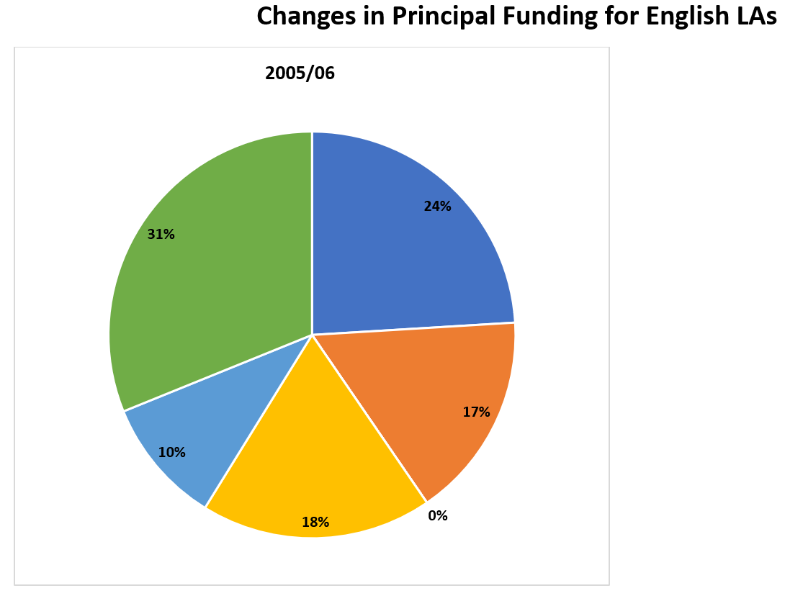
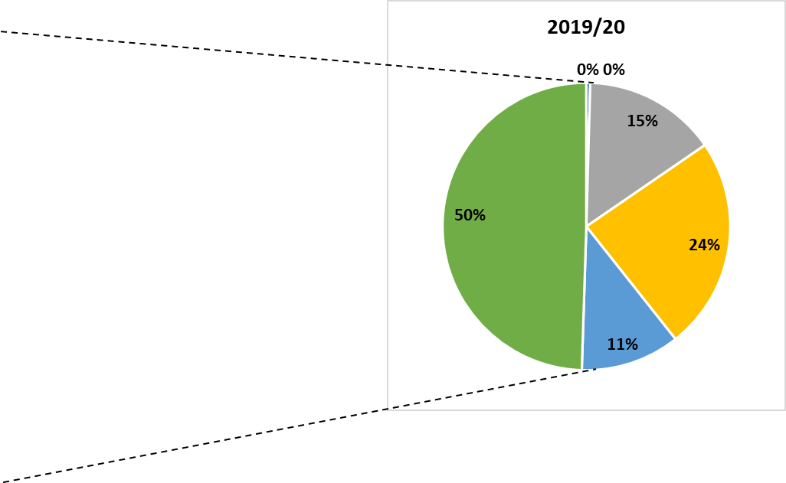

Local Gov’t Finance (2005/06 – and 2019/20)
Source: DCLG/MHCLG (2005/06-19/20)
Total = £92.43bn
Total = £115.9bn
Notes:
The figure demonstrates the severity of austerity on the level of central funding (RSG) received by LAs
The austerity period has been characterised with two major changes
(i) the removal of RSG almost entirely by 2019/20, which is seen to have been posted to School Grants (in Other Grants) and
(ii) The introduction of the business rates retention scheme (BRRS) to replace the Redistributed Non-Domestic rates
LAs lost increasing proportions of RSG since 2005/06, even though the government introduced some short-term interventions to enable LAs alleviate the financial pressures that they faced.

Slide 8
Structural Pressures
(Re)prioritisation of resources
  LAs prioritise statutory (e.g. social care) over discretionary services.
Local Autonomy
  LAs also identified that pressures emerged from the uncertainty that accompanied initiatives such as the Spending Reviews.
Changes in Tax Regimes
  Increased reliance on council tax and structural pressures arising from the frequent changes in tax regimes and the uncertainty accompanying them, presented persistent challenges for LAs.
“… there was also an attempt to try and test out the limits of what providing the statutory service meant, so we saw that with libraries, because the law I think says they’re required to run a library service, but it doesn’t give any idea about the nature or level of what that means.” Theta
“… we didn’t know - each time there was a spending review - what was going to hit us because it was so unpredictable, really unpredictable. They [the central government] started [announcing the spending review for] three years and then they changed partway down to two years and then … I reckon it was around 2014/15 that we’ve just had one year one since … since then.” Gamma
“… we would have been recommending not to take that Council Tax freeze grant because financially it isn’t the best in the long-term, you know, you will have less money over a four, five, ten-year period if you take it, compared to if you don’t.” Omega
Notes:
Structural pressures arise from the consequences of austerity that shrinks the capacities and capabilities (Structural) of LAs as they attempt to address the continuous reduction in financial resources and growth expectation and demand for services.
(Re)prioritisation of resources for service delivery
Increasing financial pressures compelled LAs to engage in (re)prioritisation of resources to services.
Upper-tier LAs therefore, transferred resources to social services, which meant less expenditure on other services, including cultural & related services (leisure, libraries, and sports centres) and environmental and regulatory services (highways, waste management & refuse collection).
Local Autonomy
Changes in Tax Regimes
This affected their spending power to reduce, considerably.
The introduction of austerity policies for LAs required some intervention from the central government to help minimise LAs’ exposure to financial shocks. Aside the introduction and changes in policies to empower LAs, central governments in developed countries made slight changes to their tax regimes to allow some financial autonomy for LAs.
There were opposing views of cases where LAs regret taking the CT Freeze Grant, whilst others regretted not taking it.

Slide 9
Service Pressures
Closure/Cutback in Services
  (Re)prioritisation of limited resources to fund increasing demands on statutory services meant cutbacks in discretionary services.
    Social Care referred to as “the killer of all services” Delta, “the bad boy who always got bailed” Eta, and “the service that is being tied together with bits of string and sticky tape” Chi.
Changes in unemployment levels
  LAs cut back staff numbers to save costs and increase their operating efficiency through various schemes.
Changes in levels of inequality
  Levels of inequality influenced the levels of demand for and expectations of services (both statutory and discretionary) from citizens in the community.
“2014/15 to 2016/17 was where we really went through some relatively cuts to services. There was some back-office staff as well, but most of that had been taken in the early years as part of low-hanging fruit. From that period onwards, we started to go into really deep service reductions.” Epsilon
“We’ve also seen big cuts in senior management in local authorities, which impacts on the ability to be proactive about additional things that local authorities might be able to do because they’ve become very, very focused on just the day-to-day provision of statutory services.” Omicron
“… you had all those demand pressures which were causing us a big problem! And to combat that, we did do quite a lot of work around how we can modernise those services, how we can manage demand in those services, but as I say nothing’s particularly been a golden bullet to sort that out.” Chi
Notes:
Service pressures are unwanted and unforeseen complications that hinder a local authority’s ability to provide quality public services in the community/municipality. The implementation of austerity has continuously made it very complicated for LAs to provide and deliver services to their citizens.
Closure/Cutback in Services
Fitzgerald and Lupton (2015) found for instance complete closures of youth centres and cutbacks in parks, allotments, libraries and leisure centres by the Birmingham City Council.
Changes in Unemployment levels
There were fewer operational staff to cover statutory or obligatory services, and there was a reduced capacity of senior employees with appropriate skills and experience.
Adverse impact on financial autonomy
As the central government restricted public funds to LAs, they in turn struggled to provide services as expected or demanded by their citizens.

Slide 10
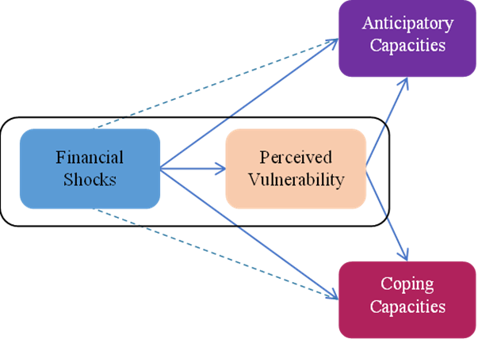
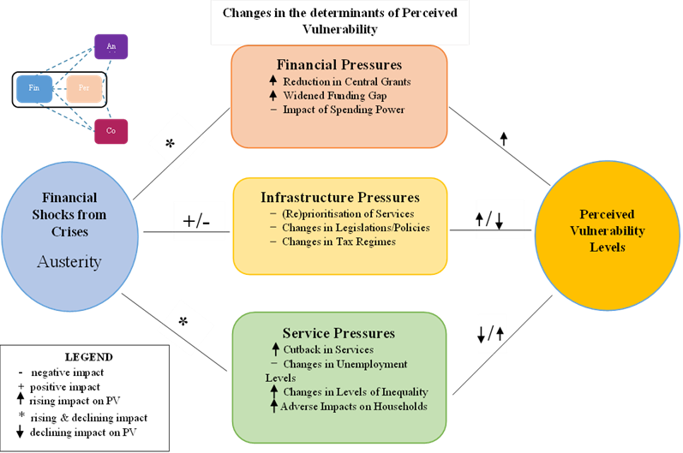
Relationship between Austerity and Perceived Vulnerability
Notes:
The original conceptual model for this paper was adapted from the financial resilience framework developed by Barbera et al. (2014) and Steccolini et al. (2015),
Throughout the study period, LAs were consistently susceptible to unexpected events and crises.
Perceived vulnerability, in this context, is where organisations (LAs) consider themselves to be susceptible to the adversities of unforeseeable events and uncertain incidents with limited or no resources to recover (bounce back) or rebuild (bounce forward)
We adopted the model’s dimensions of financial shocks and perceived vulnerability and applied these to English LAs in a longitudinal study to help understand how pressures from shocks such as economic and social austerity affected the perceived vulnerability of LAs in England.
We found a clear general relationship between the impacts of austerity and the perceived vulnerability of English LAs, however, some impacts of austerity were concurrent, and others had consecutive impacts on the levels of perceived vulnerability.
This is a list of factors that LAs should consider when assessing their perceived vulnerability.
The figure provides an expanded set of factors that apply to the sector, however, at the individual level, how LAs assess their perceived vulnerability varies according to their unique characteristics. In practice, it appears the impacts within the three broad themes (financial, structural, and service pressures) affected vulnerability levels quite differently.

Slide 11
“this year our [Revenue Support Grant] RSG is zero, we don’t get any core grant from Government. So, if somebody said to you, where’s that Council Tax grant of £1.4 million if it’s all rolled in? Well, it’s nowhere, it doesn’t exist anymore.” Delta
Financial Pressures and Perceived Vulnerability on LAs
In addition to austerity, contextual and path-dependent factors have contributed to each individual council’s predicament.
Structural Pressures and Perceived Vulnerability on LAs
Pressures including changes in tax regimes, and changes in service prioritisations affected the PV levels of LAs during the early and late austerity era.
Service Pressures and Perceived Vulnerability on LAs
Increased effects of the twin pressures meant that LAs got increasingly vulnerable, and had to run their reserves down to a minimum.
“… the bit that worries me moving forward is if the Government takes off the limit, then that will put local authorities in a really interesting position because we’ll all be saying we’ve all got a financial gap, we’re all struggling to make ends meet.” Delta
“you don’t lose lives where there are potholes on the highway, but you certainly lose lives when social care systems are not in place for the elderly and vulnerable people”. Taurus
“at that time, we have seen significant changes in service demand, particularly on social care, adults and children’s, in particular, become increasingly prevalent as massive service pressures”. Kappa
Notes:
Financial Pressures and Perceived Vulnerability on LAs
While austerity was a significant and common contributor to all these cases, it should be recognised that contextual and path-dependent factors may also have contributed to each individual council’s predicament.
English LAs became more susceptible to shocks, limiting their ability to bounce back to their original state, let alone bounce forward.
Structural Pressures and Perceived Vulnerability on LAs
Changes in tax regimes ➔ the introduction of CT Freeze Grant, and changes in caps on CT rate, as well as the introduction of the Business Rates Retention Scheme (BRRS)
Service Pressures and Perceived Vulnerability on LAs
Social care is still dominant ➔ a continuous rise in demand for social care means that LAs have limited resources available for other core and discretionary services.

Slide 12
Conclusions
English LAs almost universally struggled to address increasing pressures that emerged throughout the early and late austerity eras.
Some LAs were then proactive in devising innovative strategies to help them better understand and deal with shocks and bounce forward.
Correctly perceiving vulnerability was fundamental to organisations’ response, and misperceiving vulnerability levels led ultimately to sub-optimal decision-making for the organisation.
Nevertheless, the continuing increase in the twin pressures has now led to the issuing of 12 Section 114 notices.
Some recent 114 notices in Birmingham CC and Nottingham CC have referred primarily to long-term structural challenges, rather than short-term specific shocks.
This suggests that there will be more Section 114 notices issued unless the government addresses these long-term structural challenges, which the recent Autumn Statement ignored.
Notes:
Although pressures from internal and external factors (including austerity) were continuous and ever-present, English LAs in the early austerity era initially responded to the challenge by adopting strategies to ‘bounce back’ before later identifying and developing better ways of anticipating long-term disruptive events and realising the potential to ‘bounce forward’.
… although a growing number of authorities found themselves in a position of significant financial stress, which led them to issue Section 114 notices. although a growing number of authorities found themselves in a position of significant financial stress, which led them to issue Section 114 notices.

