Slide 1

IRSPM
Intervention or Monitoring:
How the government responds to financial, service and corporate failings in local authorities in the UK
Professor Pete Murphy
Nottingham Business School
Nottingham Trent University

Slide 2
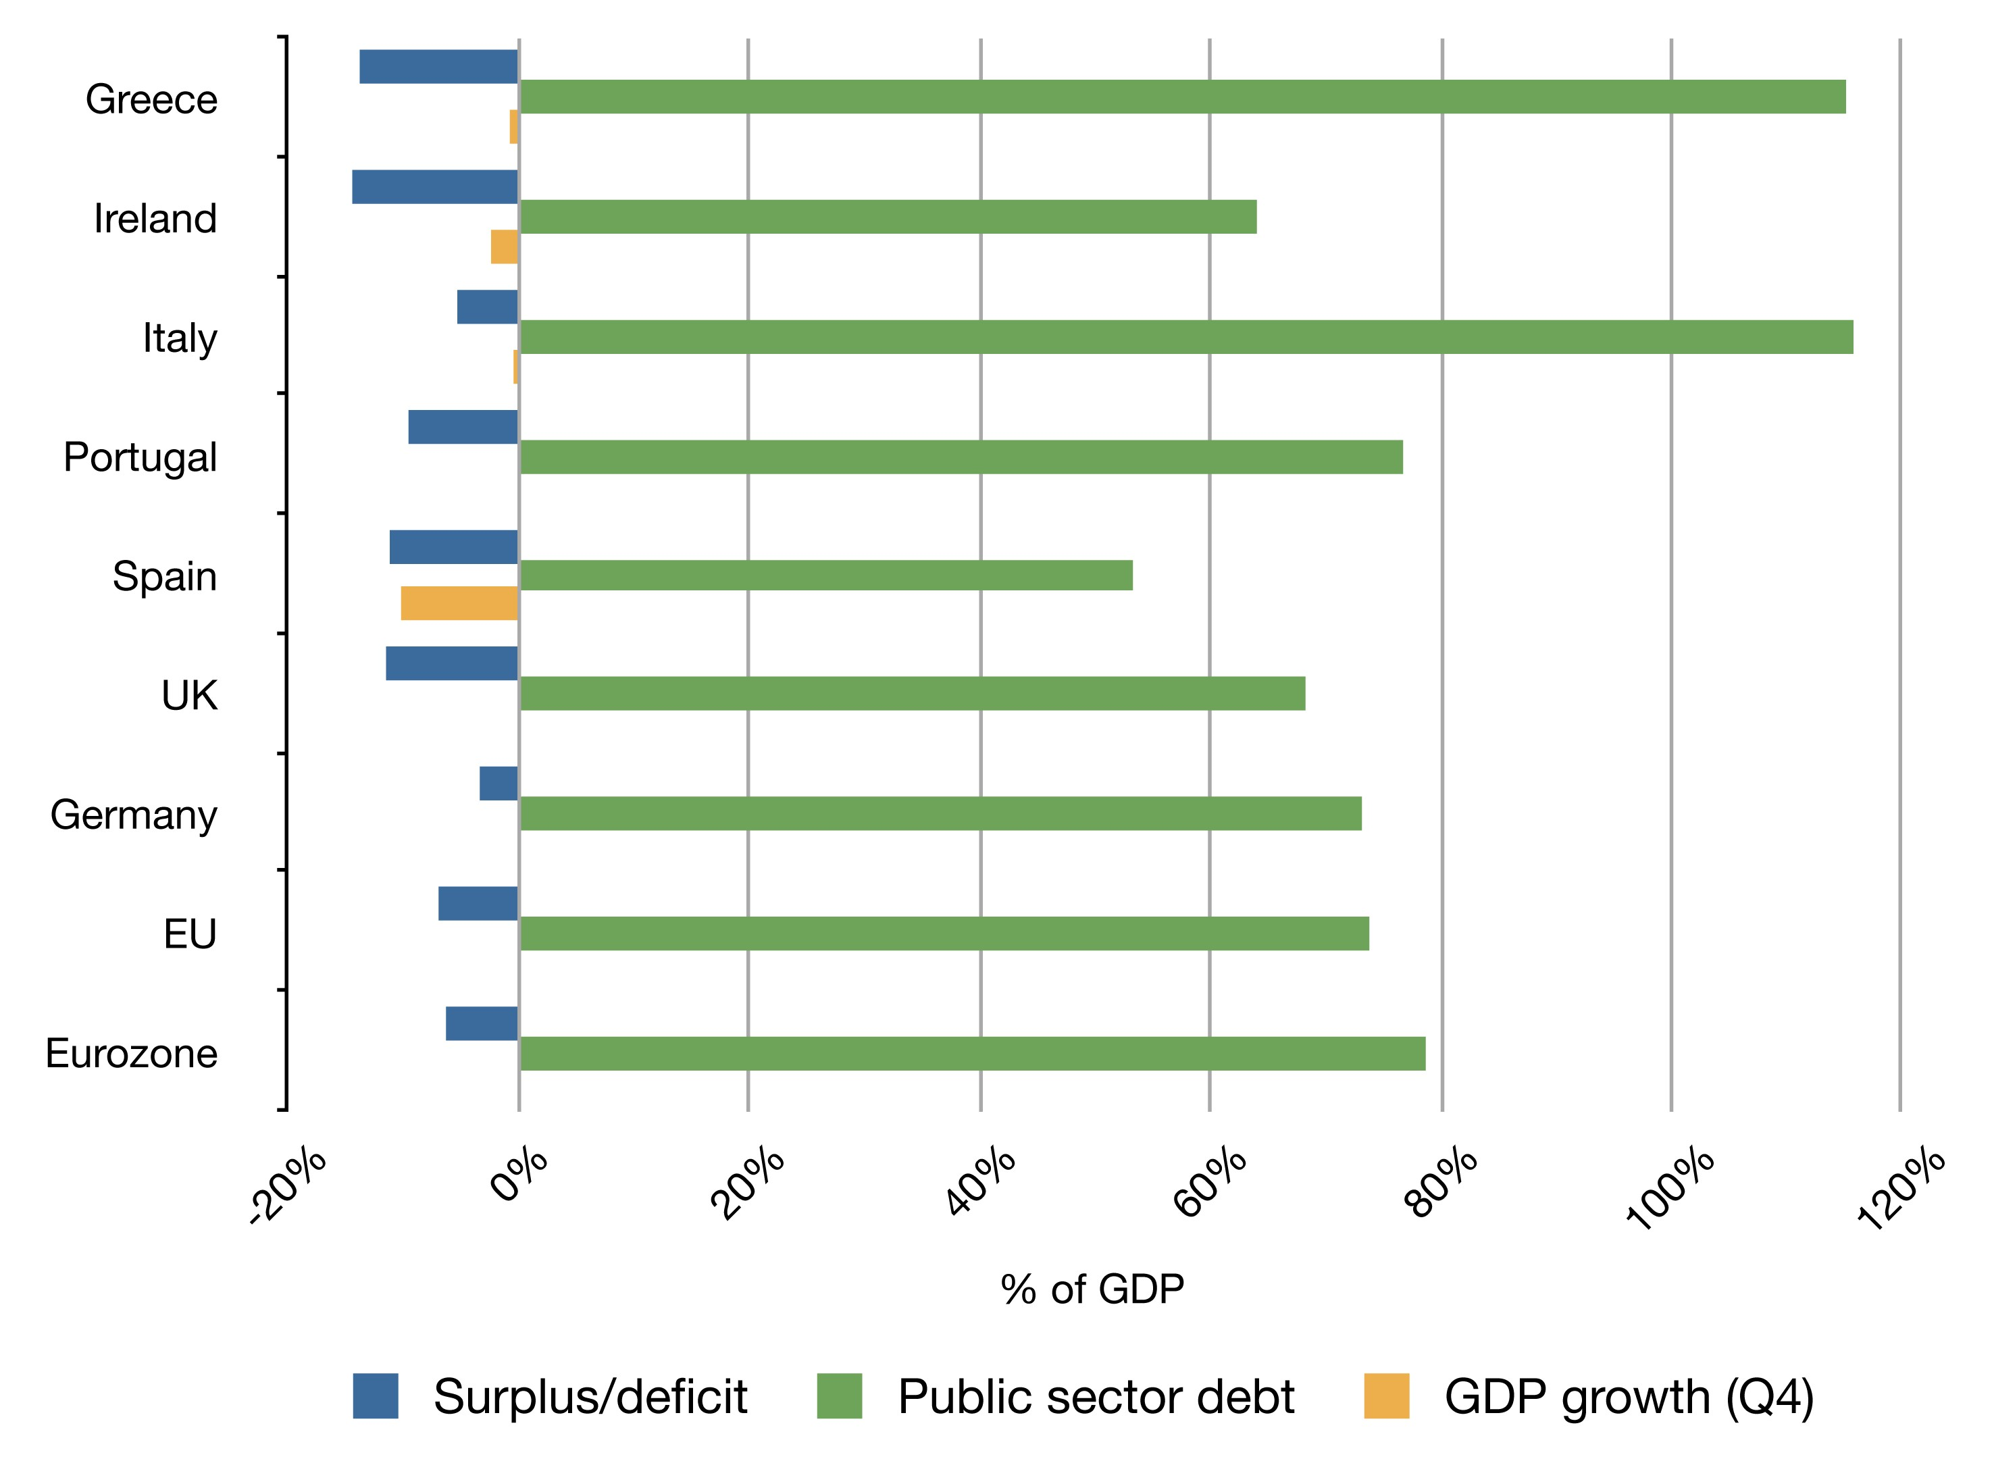
Putting local government financial failure in context – national bankruptcies
Legal Context: Local Public Entities in Distress (Coordes, Marique & Vacarri, INSOL 2022)
Portugal Ireland Greece and Spain in 2009 (Troika interventions)
EY Porto Rica Case Study 2017-2022 Puerto Rico Financial Turnaround
By Rannpháirtí anaithnid - Own work, CC BY-SA 3.0, https://commons.wikimedia.org/w/index.php?curid=10200348Portugal, Ireland Greece Spain (PIGS) intervention

Slide 3

UK Historical Antecedents
Financial Irregularities – Internal and External Audit, (Independent Auditors and District Audit established in 1868), Audit Commission in 1983. Public Interest Reports (PIRs), Corporate Failures and near misses e.g.,
  Rate capping rebellion in 1985
  LB Hammersmith and Fulham 1982 (Ultra-Vires speculating on stock market)
  Islandic Banks (108 Local Authorities lost £1billion in 2008)
Service Scandals and Corporate Failures –, External Service Inspections (HMI Schools 1839, HMI Constabulary 1856,) Performance Audit (Audit Commission 1983) and Improvement and Development Agency Peer reviews (1998).

Slide 4
UK Legislative basis
The Local Government Act 1999 introduced
  The duty to achieve ‘Best Value’
  A new requirement to facilitate the continuous improvement of all services and activities.
  External Best Value Inspections
  Interventions (following service and corporate failings) were piloted in 2002, a number were challenged under Judicial Review, but all challenges failed.
Local Government Act 2003 (Part 8 sections 99 and 100) clarified both performance categories and the exercise of powers in relation to performance.
All subsequent interventions have been based on a failure to achieve or be achieving Best Value.
In July 2023 the government issued a consultation on “Best Value, Standards and Intervention” – really an ex-post facto tidying up exercise.

Slide 5
4 previous distinguishable regimes/periods
Pre-1997 - External Audit, Public Interest Reports and External service inspections of some LA services (Schools, Police and Social Services – partial coverage with weak intervention powers.
1997-2010. Best Value, Comprehensive Performance Assessments. Co-ordinated by Audit Commission. Inspection covered all services and activities 3 pilots, and the first CPA results led to 13 new cases of intervention (in addition to the 3 pilots).
2010-2018. Audit Commission abolished, sector led improvement meant inspections were limited, despite strong intervention powers they were triggered by service scandals (Doncaster 2010, Rochdale 2011, Birmingham 2014, Rotherham 2014, Tower, Kensington & Chelsea 2017).
2018-2023. Limited inspections, strong intervention powers but used almost entirely for financial issues. Now only a partial and weak evidence base for service or non-financial intervention and 144 notices. Northamptonshire, Nottingham, Croydon, Slough, Thurrock, Woking, Northumberland, Birmingham with others reported to be considering 114s e.g., Middlesborough, Coventry, Somerset, Hasting). DLUHC Select Committee reported a “systemic” financial problem

Slide 6
Intervention approach under Best Value/CPA.
The nature and philosophy behind the government’s response – strategic turnaround and recovery “we will not reward failure, but we will support progress and success”.
It dealt with both corporate and service performance as well as governance, managerial and community leadership inadequacies with all-party support and party-political involvement (a collaborative approach).
Included formal intervention and more informal monitoring with an excellent and improving evidence base (147 National reports and 7000+ inspections) which also became an effective ‘early warning’ system for.
Criteria for coming out of intervention – clear bespoke benchmarks for individual cases and robust positive trajectory of improvement, validated though performance indicators and inspection reports.

Slide 7
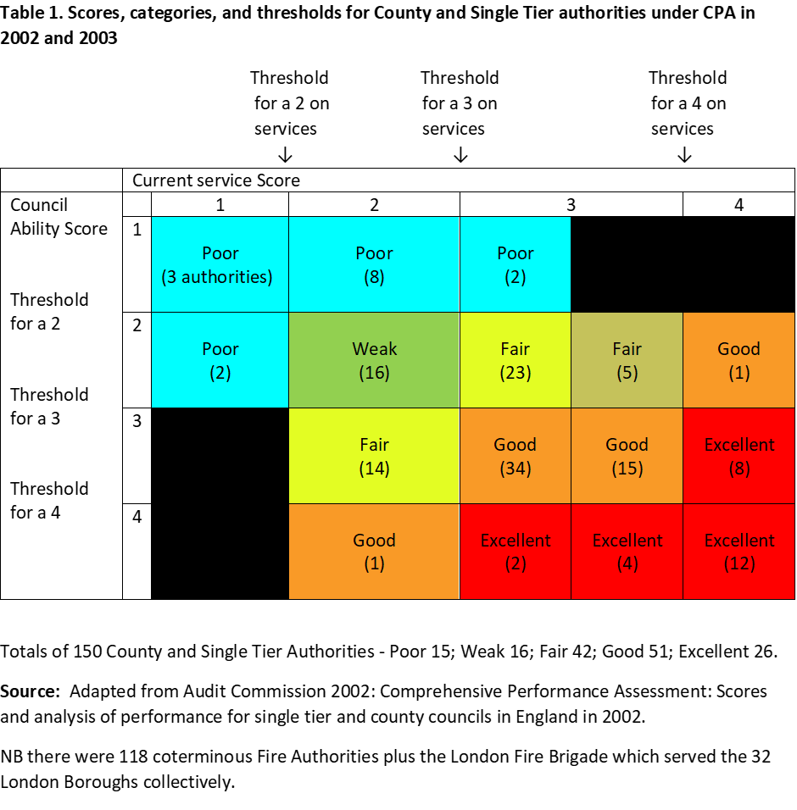

Slide 8
After 2010 a sea change in policy
The UK government and England reverted to New Public Management and policies aiming to ‘Reduce the (local) state and particularly thelocal state’
The Coalition government in England abolished the Audit Commission, abandoned external assessments and inspections, (replaced with sector-led improvement), and significantly reduced the data information and evidence base available.
Local Audit and Accountability Act 2014 – outsourced Local Public Audit, changed the audit regime, reduced the scope of audit and reporting requirements for Local Public Audit. (Short-term purely financial reports).
The devolved administrations in Scotland and Wales continued developing their response based upon the principles of Public Value and New Public Governance but were subject to UK wide austerity policies

Slide 9
This created long term structural issues
Long-term reductions in central government support funding and caps on LAs raising council tax
Increasing demand for social care, housing and welfare services (Dom 2023) because of austerity-localism, demographic changes, and increasing inequalities.
Reductions in strength, quality and quantity of scrutiny e.g., only 9% of Local Public Audits signed formally off on time by September 2023 (for 40 years it was 100%)
CIPFA Financial Resilience Index, and EY Section 151 Confidence Barometer, (“72% of LAs are reducing funding in areas that are long term priorities, to meet short term budget pressures”. EY 2023)

Slide 10
By 2018 it is clear .. more section 114 notices!
In 2019 Sir Tony Redmond was appointed to produce an Independent Review into the Oversight of Local Audit and the Transparency of Local Authority Financial Reporting. “Not fit for purpose”
In his evidence to the 2019 Spending Review inquiry, Sir Amyas Morse of NAO said “a combination of reduced funding and higher demand has meant that a growing number of authorities have not managed within their service budgets and have relied on reserves to balance their books. These trends are not financially sustainable over the medium term”
Institute for Fiscal Studies (Ogden & Phillips 2020) updated and assessed the 2021/22 Local Government Finance Statement (LGFS) plans for both core funding and top-ups for ongoing COVID-19 related costs.
In simple terms, all these sources indicate that the scale of the problem is significant, will continue to increase and the number of councils under financial stress will almost inevitably rise (2023 DLUC Select Committee Chair called it a “systemic” problem).

Slide 11
What are Section 114 Notices
UK local authorities cannot go bankrupt. A section 114 notice indicates that, in the opinion of the Statutory Section 151 officer the council’s forecast income is insufficient to meet its forecast expenditure in the next financial year and it can see no way of doing so.
The current and forecast allocations for service delivery and other activity must continue to meet the statutory requirements needed to attain Best Value
Not all 114s have led to monitoring or intervention.
Between 2020 and 2024 government provided some temporary additional funding to all LAs in the UK for Covid-related impacts as the number of reports about possible 114s increased.

Slide 12
Birmingham City Council S114 Report (5th Sept)
(International News)
The Section 151 Officer is of the opinion that:
  The Council is currently in a negative General Fund position. That is because of the cost of providing for Equal Pay claims, that the Council is now legally obligated to recognise, will result in exceeding the financial resources available to the Council. This means that spend due within that period exceeded the financial resources available to the Council in that same period.
  The Council has insufficient resources to meet that expenditure and the Council is not currently able to agree a solution that will allow suitable funding or financing to be obtained for this liability

Slide 13
Birmingham City Council
The background and the ‘trigger’
Long-term background
Long-term real fall in LAs Spending power (31%) due to reductions in central government grants
Demand for services increasing as a result of demographic changes, inequality and austerity particularly Adult and Childrens’ Social Care.
More recently - rises in inflation
Trigger
“On 5 September 2023, BCC issued a ‘section 114 notice’… as the council anticipated a gap of £87 million between income and expenditure for the (current) 2023/24 financial year. In addition to this gap, the council estimated that it would have to pay £650 million to £760 million in backdated equal pay claims, following a court judgment in 2012.

Slide 14
On 15th Sept gov’t appoints external commissioners
6 Commissioners! led by Max Caller with 2 political advisers “to support the BCC leaders as they take difficult decisions”
Leader of the Council Cllr Cotton and CEO Deborah Cadman (both relatively new to their positions) vowed to work constructively and collaboratively with the commissioners
Response required from BCC
  Sales of Assets
  Raising the level of Council Tax (10% agreed for next two years)
  Reductions in services or the quality of statutory services.
  Withdrawal of discretionary services (and potentially statutory services)
  Possible dismissal of Political Leaders and Senior Officials
  and as the last resort borrowing from Central Government.

Slide 15
Nottingham City Council
The background and the ‘trigger’
2020 Section 114 – relating to the arms length company “Robin Hood Energy” - an Improvement and Assurance Board, and Recovery and Improvement Plan established in 2021.
In December 2021, the council itself found acknowledged unlawful accounting practices associated with its ring-fenced Housing Revenue Account going back six years and totalling £15.86m. (DLUHC threatened commissioners)
29 November 2023, the Section 151 officer issued another 114 notice but this time it was long-term structural factors – “Children and Adults Social Care costs, rising homelessness presentations, and inflation” – a rising tide of costs.
Government: “there has been a distinct lack of urgency in tackling the necessary change”. Need to increase the pace of change in governance, finance, transformation, corporate planning, companies and workforce culture and performance outcomes. New Commissioners

Slide 16
Comparison cases under the two systems and responses
Evidence: extensive
Scope: broad - wicked problems and service delivery
Objectives: organisational recovery
Emphasis: collaboration
Focus: organisational development
We know these were successful
Evidence: robust but….
Scope: narrow essentially financial
Objective: balancing the budget
Emphasis: coercion
Focus: reducing services and transferring assets
Likelihood of success?

Slide 17
Two barriers to success?
The governments future 5-year spending plans 2024-2029 outlined in ‘Autumn Statement’ in Nov 2023
The rising level of Local Authority Debt

Slide 18
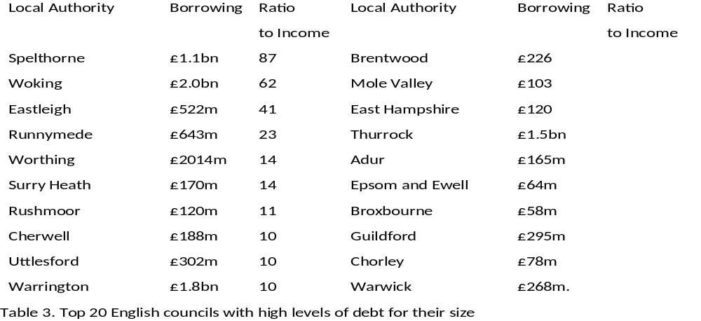
Moody’s (2023) Top 20 councils’ debt.

Slide 19
Birmingham and Nottingham’s Section 114s attracted international publicity but this didn’t
Exceptional financial support for local authorities (Capitalisations)
2020-21 | 9 | £78.2m | Bexley, Croydon, Eastbourne, Lambeth (100m in 2017/18), Luton, Nottingham, Peterborough, Redcar & Cleveland, Wirral
2021-22 | 4 | £63.3m | Copeland, Croydon, Eastbourne, (Bexley, Luton, Nottingham and Peterborough “withdrew requests”)
2022-23 | 4 | £356.5m | Copeland, Croydon, Kensington & Chelsea, Slough (2018-23) (Bournemouth “withdrew request”)
2023-24 | 19 | £,3051.bn | Birmingham (2020-24) Bradford (2022-24) Cheshire (East 2022-24) Croydon, Cumberland, Eastbourne (2022-24), Havering, Medway, Middlesborough, N Northants, Nottingham, Plymouth, Slough, Somerset, Southampton, Stoke-on-Trent, Thurrock, W Northants, Woking.

Slide 20
What happened to Improvement, Support and Infrastructure?
Audit Commission run down and abolished 2010-2015
Improvement and Development Agency closed 2010
Government Regional Offices closed April 2011.
Local Audit regime privatised and weakened by Local Audit and Accountability Act 2014
Distributional model of LG funding support frozen
Financial support 2010-2023 reduced by 30%-40% in real terms by successive Spending Reviews.
Dec 2022 announcement that funding review and reset of business rates retention will not take place for at least two years.

Slide 21

Some interesting aspects
Austerity has applied to all LAs in the UK but there have been no section 114 notices in Scotland, Wales or Northern Ireland (yet!)
The first step in any improvement journey is to cease ‘denial’ of the problem/causes and work with the intervention board.
In Birmingham there is unlikely to be a local government re-organisation (as in Northamptonshire or Cumbria).
July 2023, the Office for Local Government (Oflog), a new local government information and performance body for England was announced inter alia. to improve the performance statistics.
As a result of recent cases Sector-led improvement is likely to be toughened but should be replaced.

Slide 22
Questions?
Contact: peter.murphy@ntu.ac.uk

