Slide 1


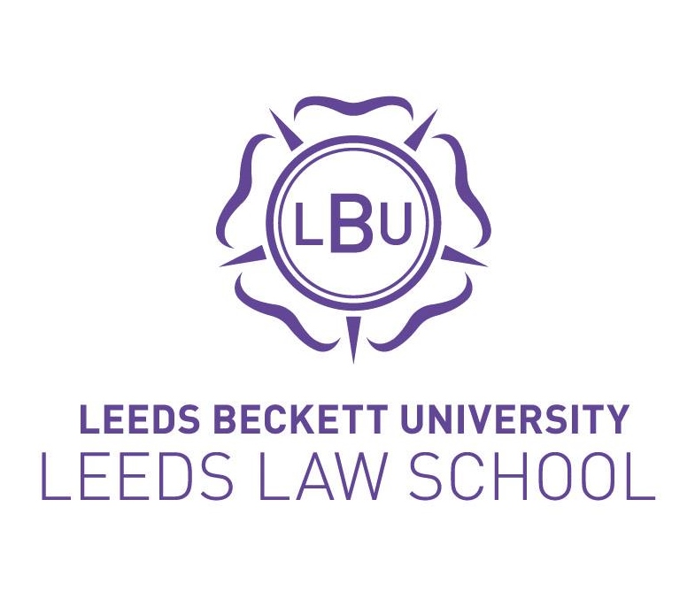
Policy clinics – Why and how?
Liz Curran (Nottingham Law School)
Lyndsey Bengtsson and Siobhan McConnell (Northumbria Law School)
Rachel Dunn (Leeds Law School, LBU)

Slide 2
Overview of our Policy Clinics:
Collaboration skills, awareness of legal problems in the context of other problems, and interpersonal skills are increasingly important. Clinical programs are one way in which such skills can be developed. Students in clinics can have a role in helping other professions realise the relevance of justice responses to resolving client problems. (Curran, 2021).
The reality is that, on leaving law school, students require more than just technical knowledge of laws and case law. They must work with uncertainty, different client groups and behaviours and, to gain good client outcomes, they will need to go beyond options of litigation and case law (Payton, 1985). They will need to work with other professionals to problem solve and find resolutions to issues not always disclosed in a legal textbook (Curran, 2021).

Slide 3
Policy Clinics: Why?
Students learn through conducting an authentic collaborative inquiry with potential for impact.
‘…students have defined their task as grasping and applying current law, they resist considering, foreseeing, or working towards different legal rules and practices in the future.’ (O’Connell and DiFonzo 2006, 538). Encourages students to think of how they can influence the law.
Carolin argues that lawyers and legal clinics ‘have a role to play in movements for social change’ (2014, 109) and one way to do this is through policy work.
Lady Hale has identified that work as a Law Commissioner taught her valuable skills for becoming a Supreme Court Judge. This included being able to take a synoptic view of the area being researched; to use empirical research to understand both what law is and how it works, in addition to understanding where reforms may be required (Lady Hale 2019).
Exposure to a wide variety of clients and issues means that students, as noted by Curran, ‘have more choices about the areas of law they may wish to practice in and if they decide not to practice, they realise there is a whole realm of activities that a law degree will give them opportunities in’ (2004, 174).
Offers some students greater flexibility, particularly in the online PC, where students can work asynchronously at a time and place to suit them.

Slide 4
Overview of our Policy Clinic: Northumbria
Northumbria Student Law Office (SLO) has been running for over 20 years - we have on average 250 students in the SLO every year, supervised by 30 members of staff
The Policy Clinic (PC) was introduced in the academic year 2018-19
60 credit, year-long module
The goal of the PC is to undertake research for individuals and organisations, with the aim of influencing policy/law reform
We have some ‘pure’ PC firms and other firms working as a ‘hybrid’ doing live client/simulated work. Students are in firms of up to 10 students
The work done depends on the firm/supervisor
Assessed by a portfolio of work, an essay on law reform and a reflective presentation

Slide 5
Policy Clinics: How?
What do students do?
Meet clients
Conduct literature review
Design methodology
Apply for ethical approval
Recruit appropriate participants
Carry out the research, e.g. interviews or desk-based research
Analyse the data
Write a report and potentially present the results orally

Slide 6
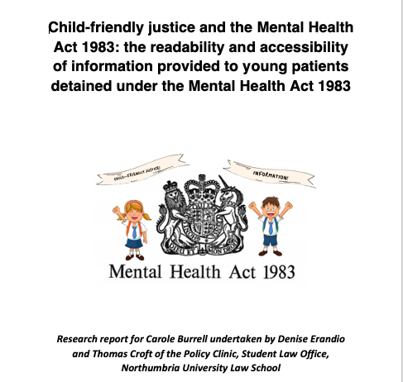
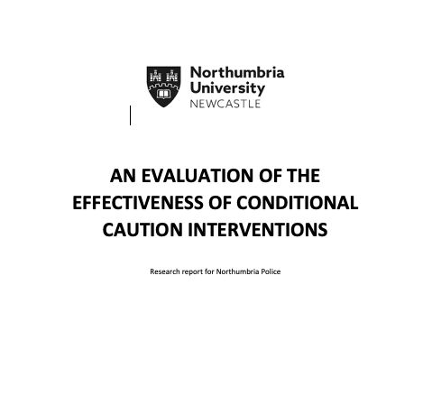
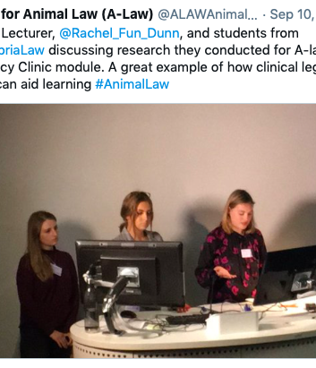
Project Examples
The effectiveness of gaining protection through the Family Court from domestic abuse – project for Northumbria Police
Child-friendly Justice and mental health law – project for academics in Northumbria Law School
Access to Justice during the Covid-19 pandemic in the UK and online court hearings – presented to the All Party Parliamentary Group for Legal and Constitutional Affairs

Slide 7
Policy Clinics: How?
In the light of your institutional/ clinical aims and cultural needs, what would your ideal clinic project look like?
Spend 30 minutes designing a project for your students in a Policy Clinic. The subject matter of the project doesn’t matter so much, we are thinking about pedagogical aims!

Slide 8
Designing a Project: What to Consider
Who would the ideal client be?
What would the relationship with the client look like?
What would the students do?
What skills would the students develop?
What would the students produce?
How would you measure the success of the project?
How would you assess the students?

Slide 9
Thank you!
CURRAN, L. , 2021. Better law for a better world: new approaches to law practice and education. Abingdon: Routledge. ISBN 9780367180423
References
Carolin, J. (2014) When Law Reform is Not Enough: A Case Study on social Change and the Role that Lawyers and Legal Clinics Ought to Play. Journal of Law and Social Policy, 23, 107
Anna E Carpenter, 'The Project Model of Clinical Education: Eight Principles to Maximize Student Learning and Social Justice Impact' (2013) 20 Clinical L Rev 3
Curran, L. (2007). University Law Clinics and their value in undertaking client-centred law reform to provide a voice for client’s experiences. International Journal of Clinical Legal Education, 12, 105
Curran, L. (2004). Innovations in an Australian Clinical Legal Education Program: Students Making a Difference in Generating Positive Change. International Journal of Clinical Legal Education, 6, 162
Curran, L. (2022). Better law for a better world: new approaches to law practice and education Chapter 12, 2011-219. Abingdon: Routledge. ISBN 9780367180423, doi.org/10.4324/9780429059254
Lady Hale, President of the Supreme Court of the United Kingdom, (11th June 2019) Impact in the Courts. Impact and Law Reform Conference 2019 (Institute of Advanced Legal Studies, London)
Dunn, R, Bengtsson, L. and McConnell, S. (2020). The Policy Clinic at Northumbria University: Influencing Policy/Law Reform as an effective Educational Tool for Students. International Journal of Clinical Legal Education 27(2)
O’Connell, M.E. and DiFonzo, J.H. (2006), THE FAMILY LAW EDUCATION REFORM PROJECT FINAL REPORT. Family Court Review, 44: 524-570

