Slide 1
Net Zero and Decarbonisation:
How can we contribute?
Prof Dr Petra Molthan-Hill
Co-Chair UN PRME Working Group on Climate Change & the Environment
Professor of Sustainable Management and Education for Sustainable Development
Nottingham Business School, Nottingham Trent University, UK

Slide 2
Halve CO₂ emissions by around 2030
In order to limit global warming to 1.5°C, the IPCC stresses that the world needs to halve CO₂ emissions by around 2030 and reach Net Zero CO₂ emissions by mid-century.
In addition, the IPCC emphasises the need for deep reductions in non-CO₂ emissions across the economy to achieve this limit.
CDP (2020) Foundations for science-based net-zero target setting in the corporate sector: https://sciencebasedtargets.org/resources/files/foundations-for-net-zero-full-paper.pdf p5

Slide 3
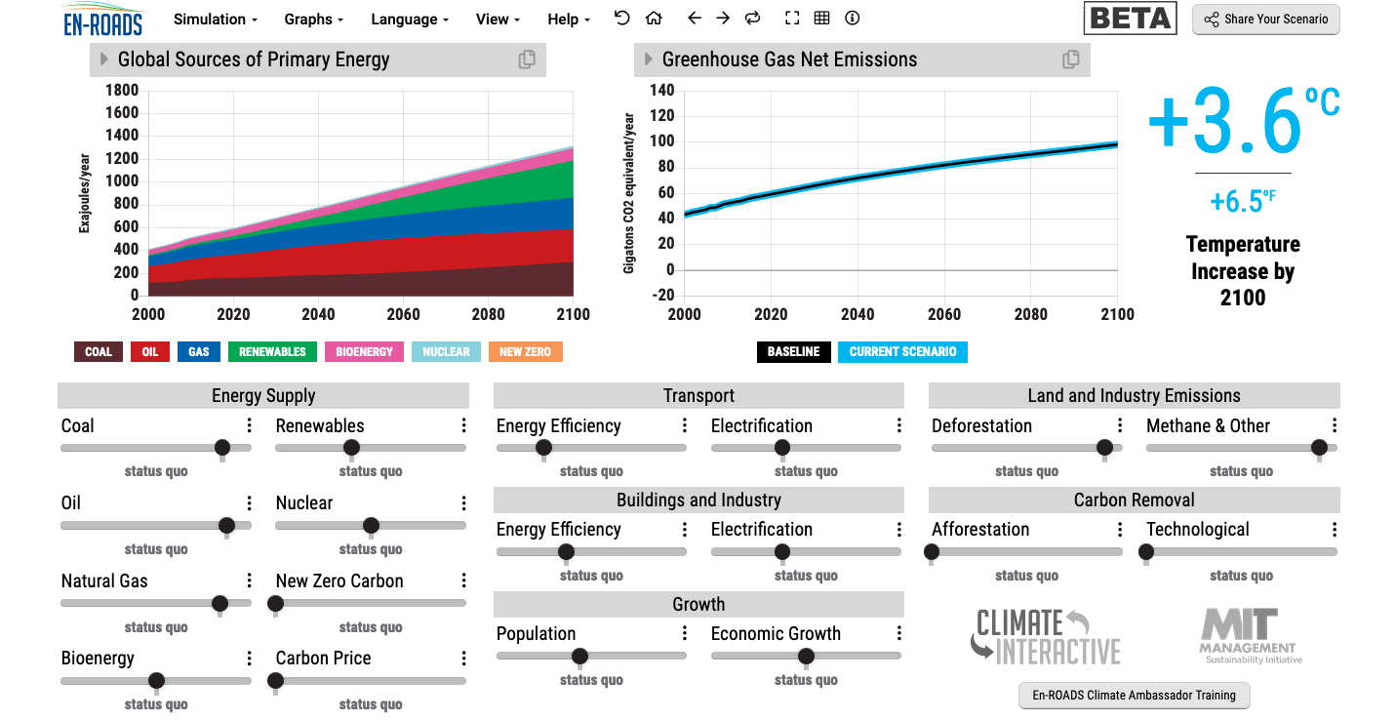
En-ROADS is a cutting-edge simulation model used to test climate solutions and generate climate scenarios for the future.
Our key challenge: How to get to 1.5°C?
Notes:
This is our current situation as demonstrated by En-ROADS which was developed by MIT Climate Interactive so that everyone can understand the high impact solutions and which impact they would have.

Slide 4
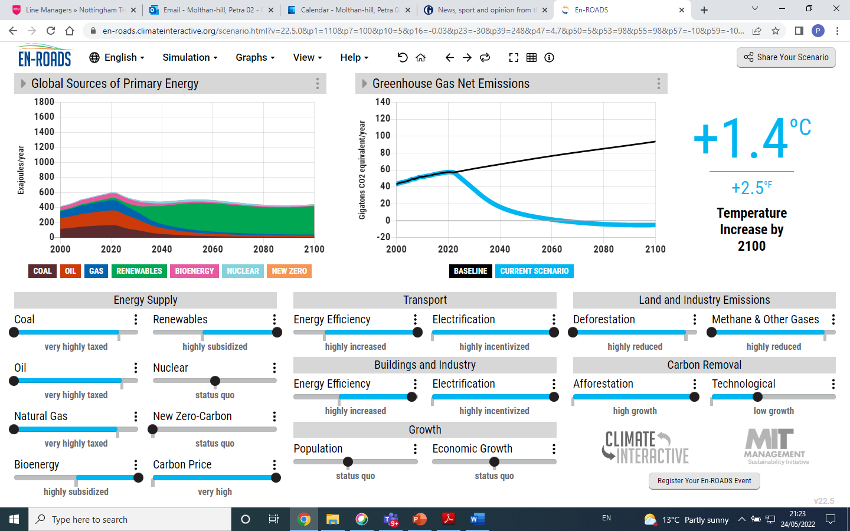

Slide 5
Solutions from En-ROADS
Big changes will be achieved by:
Increasing energy efficiency and electrification in transport, buildings and industry.
Reducing Methane e.g. by reducing food waste.
Increasing natural carbon capture as much as possible, including stopping deforestation and increasing afforestation.
Agreeing on a carbon price.
Notes:
After going through this slide, end with: We will now have some examples for the first three and how everyone on every level can do their bit..

Slide 6
So one solution is to buy electric cars?!
To travel 412 miles or 663 km
Bike 30 kg CO₂e
Coach 40 kg CO₂e
Train 64 kg CO₂e
Small electric car (driver only) 148 kg CO₂e
Small efficient petrol car (driver only) 237 kg CO₂e
Plane 368 kg CO₂e
Large SUV (driver only) 1.02 tonnes CO₂e
Embodied carbon of 25 tonnes CO₂e Range Rover Sport HSE (Calculation by Mike Berners-Lee (2020) How bad are bananas? Page 145)
High emitting countries: Canada uses 15.50 tonnes of CO₂ emissions per capita (EU 6.42; US 15.24)
Low emitting countries: Bangladesh at 0.51 tonnes of CO₂ emissions per capita (Brazil 2.04; Kenya 0.36)
Solutions:
Buy SMALL electric car!
Replace car with bicycle or/and public transport
Car Sharing
Research needed: Improve carbon accounting for electric cars; Climate communication; Climate Literacy Training

Slide 7

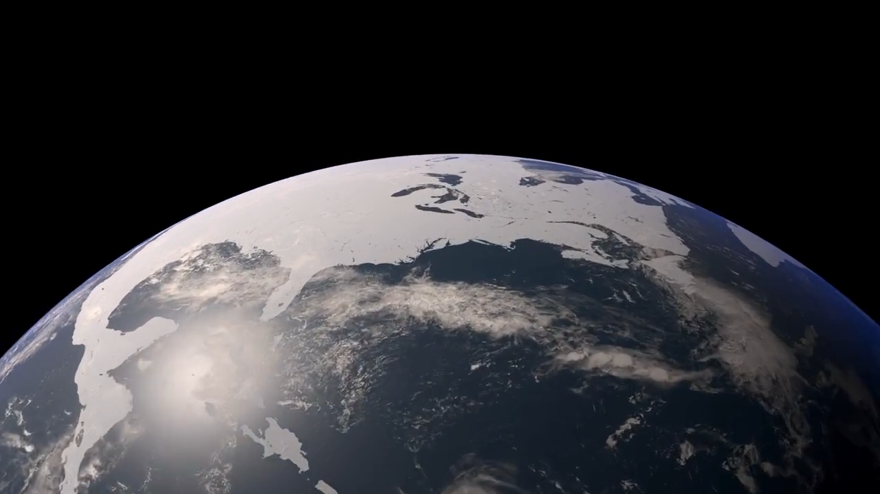
How much is too much?
Notes:
Carbon Dioxide equivalent gives us a level playing field to understand the effects of various activities

Slide 8
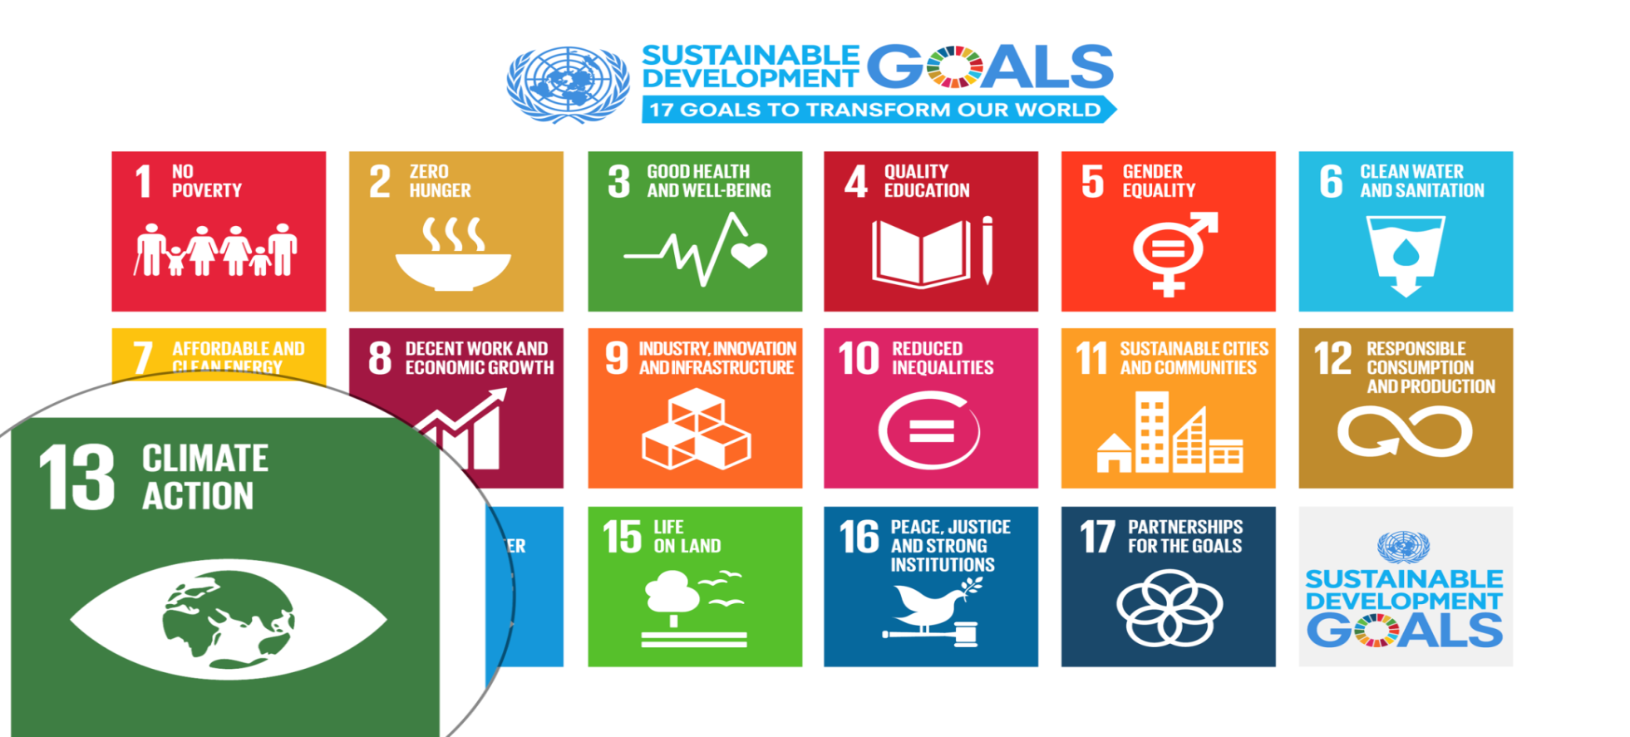
UN Sustainable Development Goals
Notes:
Carbon Dioxide equivalent gives us a level playing field to understand the effects of various activities

Slide 9
Every business school student needs one hour of Climate Change Science Education
Knowledge and understanding of a broad range of scientific concepts and processes related to climate change (e.g. climate, deforestation, habitat loss, water cycle, soil erosion, air pollution), its causes and its consequences, ecologically, socially, economically and politically.
Knowledge and understanding of the dynamics of climate change impact across time and space (e.g. delayed consequences, reducing the quality of life, security and development options of future generations).
Awareness of strategies and technologies to address the negative impacts of climate change (e.g., reducing carbon consumption, encouraging low-carbon development, reducing deforestation through sustainable forest management, improving water and waste management).
Ability to distinguish critically between certainties, uncertainties, projections and risks associated with climate change, and evaluate messages about and public interpretations of climate change science.
Table published in: Molthan-Hill, P et al (2021), Climate change education at universities: Relevance and strategies for every discipline. in: Handbook of Climate Change Adaptation and Mitigation (3rd edition), Springer: Cham, Switzerland. Adapted from definitions provided by Mochizuki Y, Bryan A (2015) Climate change education in the context of education for sustainable development: Rationale and principles. Research 9(1): 4-26.
Notes:
We need to distinguish between three areas of climate change education, the first one is the science: Every Graduate need to understand the climate change science enough to make informed decisions and integrate high impact solutions into their life and work. This basic understanding is also necessary for anyone studying business.

Slide 10
Climate Change Mitigation Education into the core curriculum of every discipline
Developing values, knowledge and skills required to make choices and decisions that minimize the use of natural resources, emissions, waste and pollution; while contributing to the development of new solutions to the climate crisis (e.g., rethinking the way we live, buy and consume, how our daily lives are organized, how we socialize, exchange, share, educate and build identities).
Taking individual and/or collective action with the potential to have immediate, direct impact (e.g., reducing energy consumption, using non-polluting and renewable energy sources, environmental conservation, re-forestation and re-greening).
Contributing to policy development with long-term positive impact on societal behaviour by examining economic systems, social structures, cultural patterns, lifestyle expectations, consumerism, wealth distribution, aspirations and value systems and their underlying responsibility for excessive greenhouse gas production.
Table published in: Molthan-Hill, P et al (2021), Climate change education at universities: Relevance and strategies for every discipline. in: Handbook of Climate Change Adaptation and Mitigation (3rd edition), Springer: Cham, Switzerland. Adapted from definitions provided by Mochizuki Y, Bryan A (2015) Climate change education in the context of education for sustainable development: Rationale and principles. Research 9(1): 4-26.
Notes:
The second one is Climate Change Mitigation Education: Every Graduate needs to know how to best mitigate climate change- what are the best strategies and tools in operations, supply chain management, economics, investment to reduce carbon emissions?

Slide 11
3. Climate Change Adaptation Education
Building capacity to apply these strategies in future situations, when the delayed impacts of climate change make themselves felt.
Knowledge and understanding of tools and methodologies to respond promptly and effectively in areas that have been negatively impacted by climate change, including Disaster Risk Reduction (DRR) strategies such as community disaster committees, community evacuation and rescue plans, and local first-aid training.
Knowledge and understanding of tools and methodologies to rebuild and restore areas that have been negatively impacted by climate change (e.g., seashores, flood prevention measures).
Implementing measures that reduce the vulnerability of natural and human systems to the impacts of climate change.
Advocating for appropriate channelling of resources at a global level to protect negatively affected natural and human systems in a just and equitable way.
Table published in: Molthan-Hill, P et al (2021), Climate change education at universities: Relevance and strategies for every discipline. in: Handbook of Climate Change Adaptation and Mitigation (3rd edition), Springer: Cham, Switzerland. Adapted from definitions provided by Mochizuki Y, Bryan A (2015) Climate change education in the context of education for sustainable development: Rationale and principles. Research 9(1): 4-26.
Notes:
In many countries Graduates need to learn how to adapt to climate change now, however in the UK and other high emitting countries the focus should be on mitigation: Is it not better to mitigate against the flooding of London so that major floods will not happen in the near future than to build higher flood defences now?

Slide 12
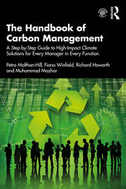
Integrated into every discipline/function
The Handbook of Carbon Management: A step-by-step guide to high-impact climate solutions for every manager in every function (Routledge)
Procurement and Supply: pushing the boundaries to remove carbon emissions
Marketing for a better climate
Pension funds, accounts and other investments
GHG emissions accounting
Climate communication and reporting to internal and external stakeholders
https://www.routledge.com/The-Handbook-of-Carbon-Management-A-Step-by-Step-Guide-to-High-Impact-Climate/Molthan-Hill-Winfield-Howarth-Mazhar/p/book/9781032227603

Slide 13

In your own time….
Free online course:
https://www.futurelearn.com/courses/climate-literacy-and-action-for-all

Slide 14

Inspired by Carbon Literacy Training in:
Chapple, W., Molthan-Hill, P., Welton, R., Hewitt, M.
Lights Off, Spot On: Carbon Literacy Training Crossing Boundaries in the Television Industry.
J Bus Ethics 162, 813–834 (2020).
https://doi.org/10.1007/s10551-019-04363-w

Slide 15



Carbon Literacy Training for Business Schools
What if every recruit in every organisation from the world’s business schools were qualified as Carbon Literate?
Developed by Nottingham Business School (Nottingham Trent University) in collaboration with the UN PRME Champions, Oikos International and the Carbon Literacy Project.
The aim is to ensure that academics, students and others are Carbon Literate within a short time frame, to ensure that as many people as possible are actively involved in embedding climate solutions in their own life and work.
To do this, we have chosen a train-the-trainer approach, where we offer regional events inviting all the universities and business schools in the vicinity to train academics and students there, so they can become trainers in their own institutions and/or get involved in training in other parts of the world.
Notes:
In our Carbon Literacy Training for Business Schools we have a strong focus on these high impact solutions so that everyone in a business school, whether in teaching, research or operations would know the best actions to take.

Slide 16
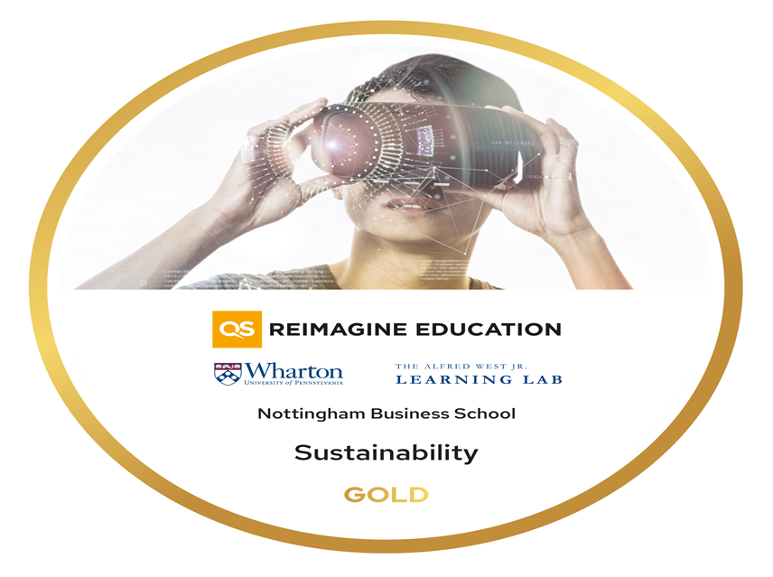
Get the certificate and be part of a community….
Take our free Climate Literacy & Action Training in September and October (on fixed days, virtual, interactive):
On behalf of the UN PRME Working Group on Climate Change & Environment and QS World Merit charity, we would like to invite you to join our upcoming Climate Literacy & Action Training CLT-ECOS.
Please register here:
https://www.unprmeclimate.org/events/climate-literacy-action-training-for-educators-communities-organizations-and-students-2

Slide 17
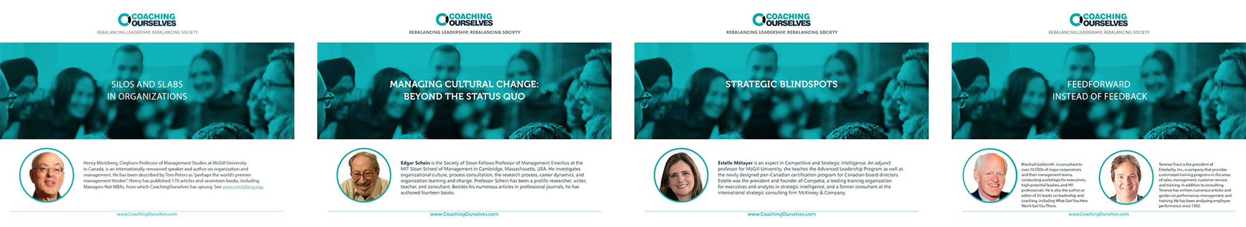
CoachingOurselves is…
a company co-founded in 2008 by Professor Henry Mintzberg and Phil LeNir.
a library of ~100 peer learning discussion guides available on important organizational and management themes.
small groups of employees getting together, live or virtually, for 90-minutes of self-directed or facilitated learning and insight sharing.
a collaboration with 60+ management and business school thinkers across the globe who author our peer learning discussion guides based on their own research, seminars, and workshops.
www.coachingourselves.com

Slide 18
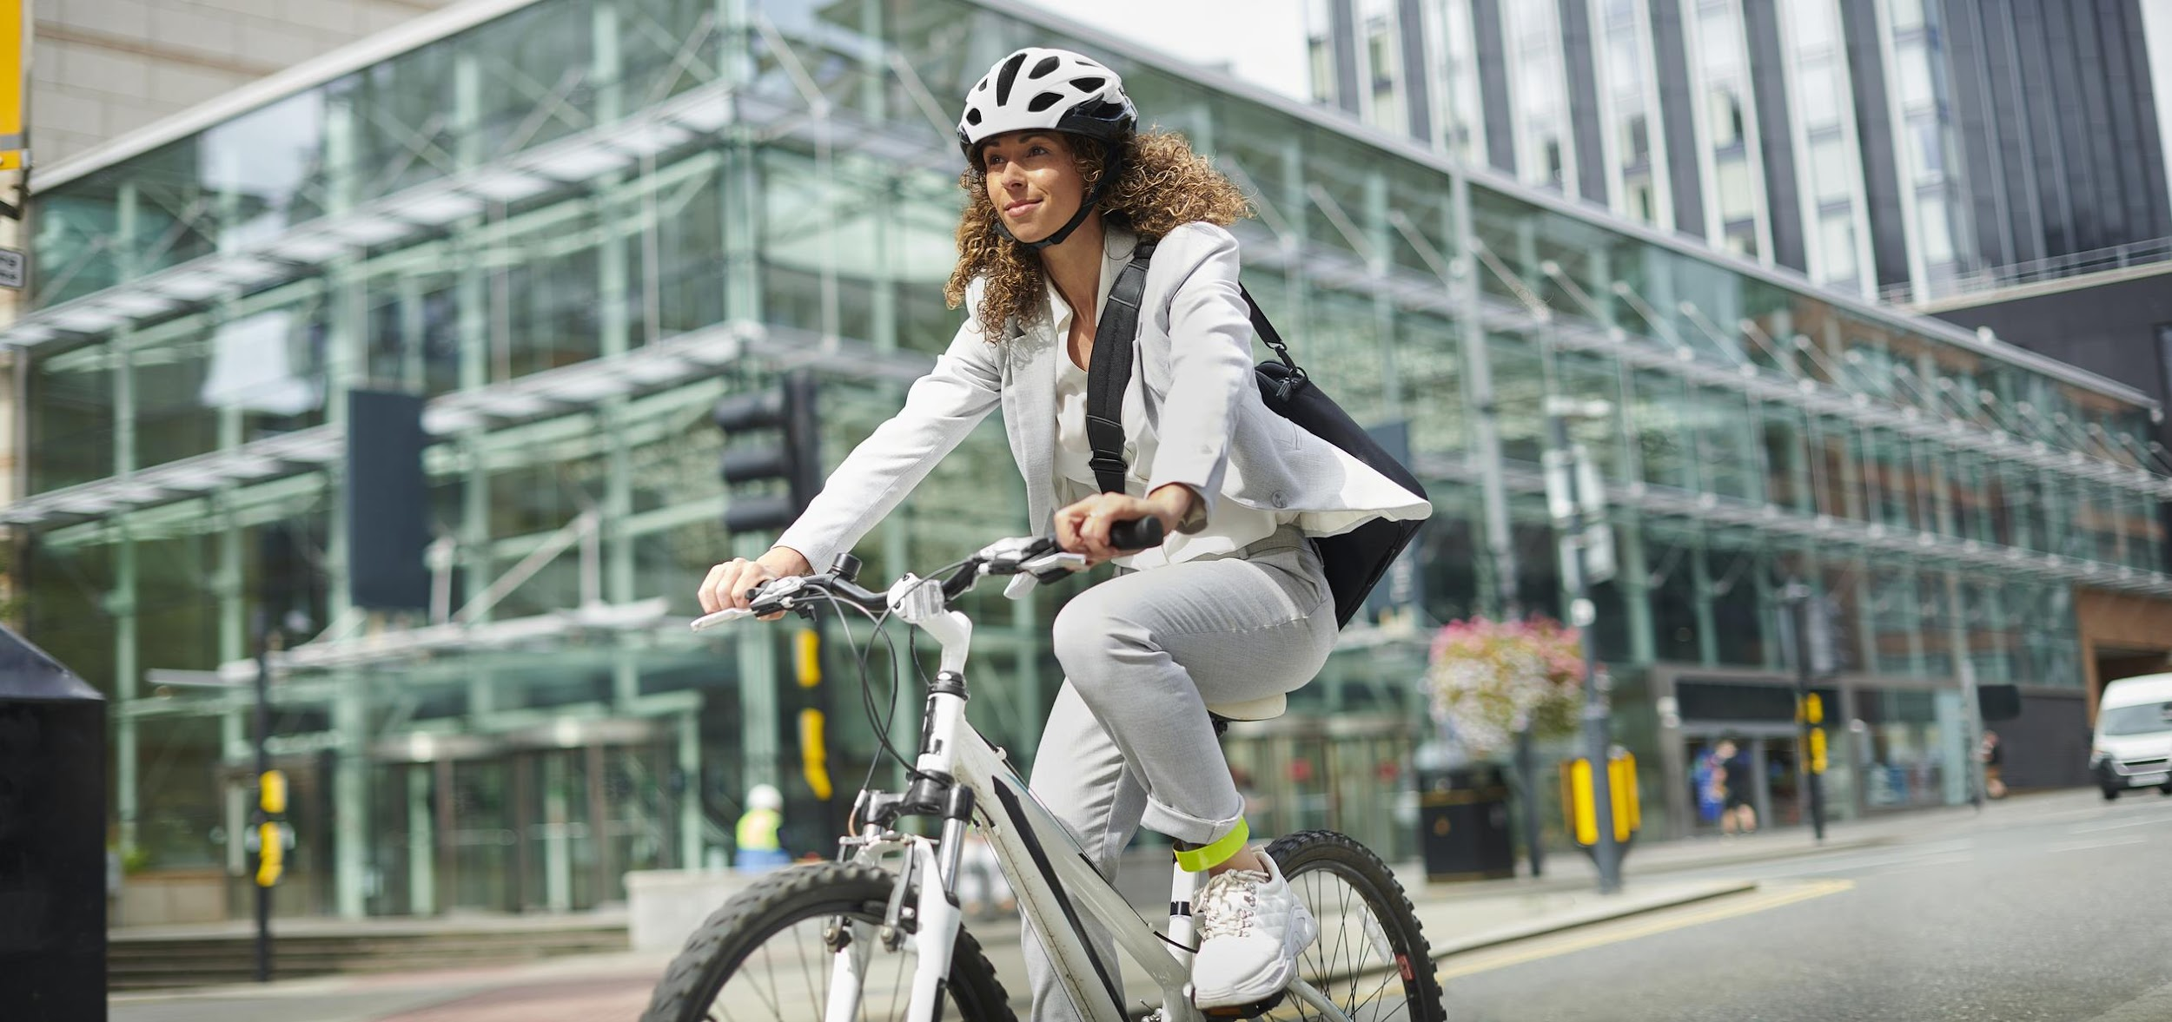
CoachingOurselves Topic:
Climate Actions for Every Employee
Awareness of sustainable development issues with environmental and social impacts is now integral for quality organizational leadership.
Use the CoachingOurselves peer learning discussion guide “Climate Actions for Every Employee” in your peer learning programs to help your leaders, managers, and individual contributors understand how their small individual actions have multiple benefits for their workplace, home, and communities. Catch the message of possibility and get all employees involved in actively supporting your organization’s sustainability goals.
Theme areas: transportation, energy, food, coffee, and natural carbon capture options.
Contact Warren@coachingourselves.com for more details.

Slide 19

https://charteredcertifications.com/learning/courses/ccml
Please send this Referral Code to anyone who might be interested, so they will enjoy a special 10% discount when registering to this program with this Coupon Code:
Referral Code / Coupon Code is: C9034FAC
Certified Carbon Management Leader (CCML)
Petra Molthan-Hill and Stephen Snider

Slide 20

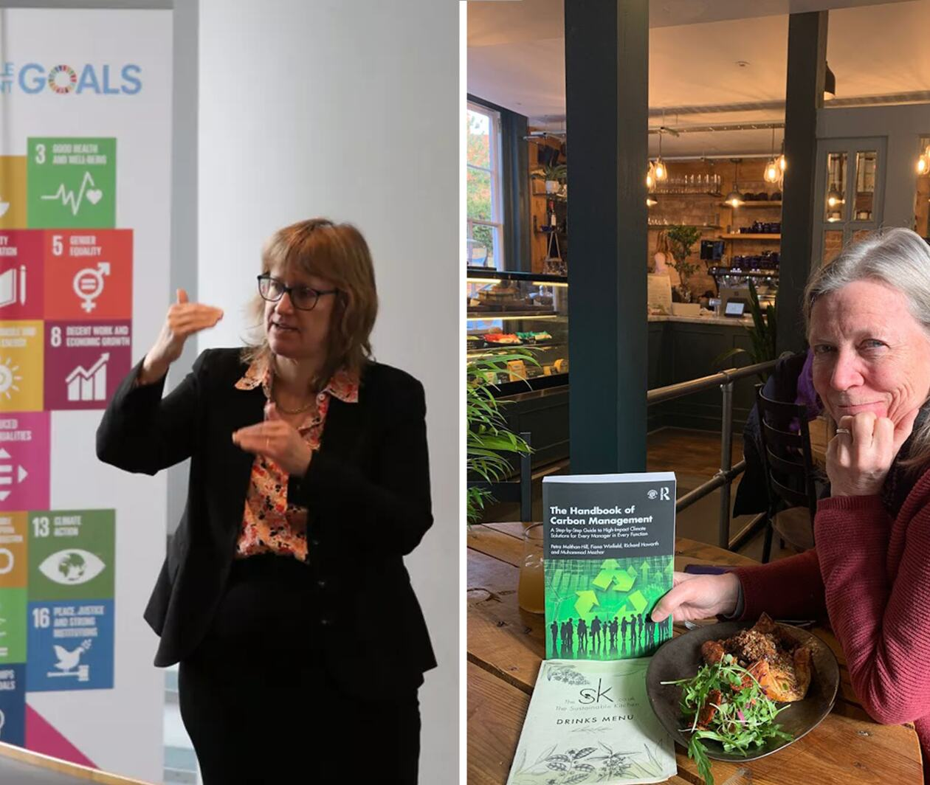
Get expertise through a master’s module
Climate Solutions for a Net Zero Future
Discover climate solutions you can implement in your industry, workplace, or household to help achieve a net zero future.
Master’s level, 100 hours, 10 credits
More info here:
https://www.futurelearn.com/courses/climate-solutions-for-a-net-zero-future
Notes:
NBS to offer three microcredentials (each worth 10 cp) that can be used towards a PG certificate (with 30 cp from elsewhere)

Slide 21

UN PRME Working Group on Climate Change
Please join us https://www.unprmeclimate.org/
Register as a member
Get the newsletter
Join our Working Group as a trainer when you get your certificate – send us your photo and a short profile
Share your research in a webinar

Slide 22
What is your idea to achieve Net Zero (Research/Project/Action)?
Please put your ideas in the chat
Transforming society
How can we nurture climate entrepreneurship in technology and innovation for climate action?
What made organisations change in the past?
Analysing the changes made by the fossil fuel industry in the past decades
Organisational transformation of the fossil fuel industry

Slide 23

Pass it on

Slide 24
Want to find out more?
Please contact Prof Dr Petra Molthan-Hill
petra.molthan-hill@ntu.ac.uk

