Slide 1








PRME Sustainable Travel and Events Guidance
2023 PRME Global Forum
European Quality Improvement System (EQUIS)
Notes:
1) Welcome

Slide 2
Agenda
Recap of Five Fundamentals and additional resources mentioned
Virtual First (Discussion in breakout room/table)
Panel (presentation of results from each table/breakout room)
Geographic Flexibility (Discussion in breakout room/table)
Panel (presentation of results from each table/breakout room)
All Five Fundamentals and general feedback (Discussion in breakout room/table)
Panel (presentation of results from each table/breakout room)

Slide 3
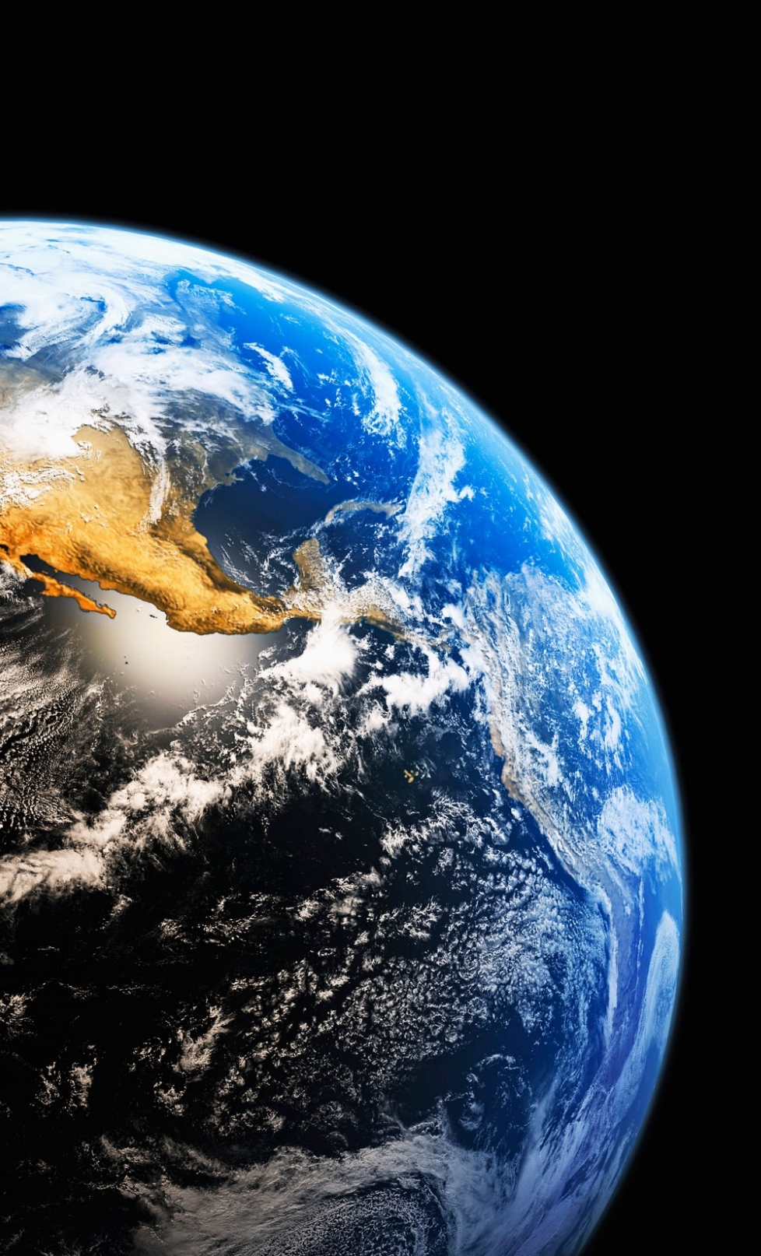





Five Fundamentals
Virtual First
Geographic Flexibility
Travel Methods
Event Sustainability
Continuous Enhancement

Slide 4
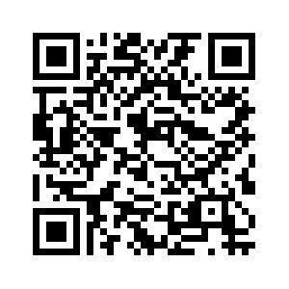


Next Steps
Continuously improving the guidance by sharing best practices…
INSERT QR CODE HERE
WEBPAGE and EMAIL
WWW.UNPRME.ORG/SUSTAINABLE-TRAVEL-AND-EVENTS-GUIDANCE
CLIMATE@UNPRME.ORG
WORKING GROUP
WWW.UNPRMECLIMATE.ORG
CONSULTATIONS
JOIN US TODAY!

Slide 5
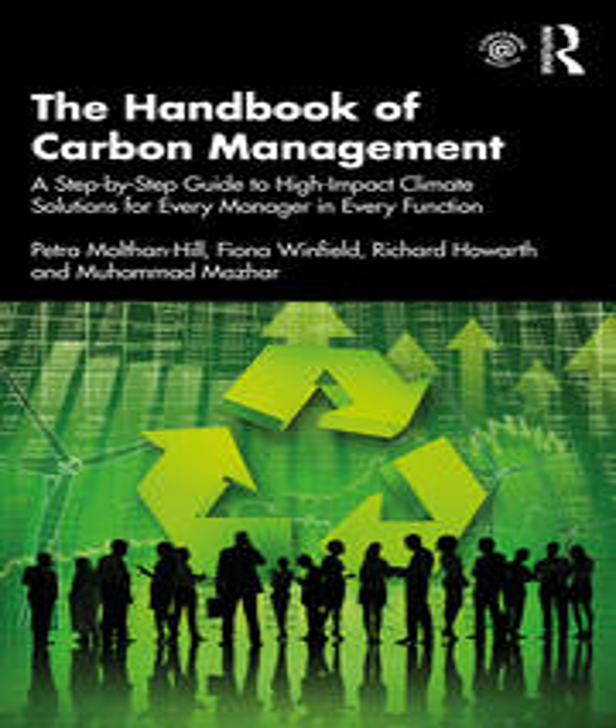
Read more about transport and food
The Handbook of Carbon Management: A step-by-step guide to high-impact climate solutions for every manager in every function (Routledge).
Chapters about transport and food but also:
Procurement and Supply: pushing the boundaries to remove carbon emissions
Marketing for a better climate
Pension funds, accounts and other investments
GHG emissions accounting
Climate communication and reporting to internal and external stakeholders
NET ZERO ON CAMPUS (SDSN)
https://irp.cdn-website.com/be6d1d56/files/uploaded/Net-Zero-on-Campus_interactive.pdf

Slide 6
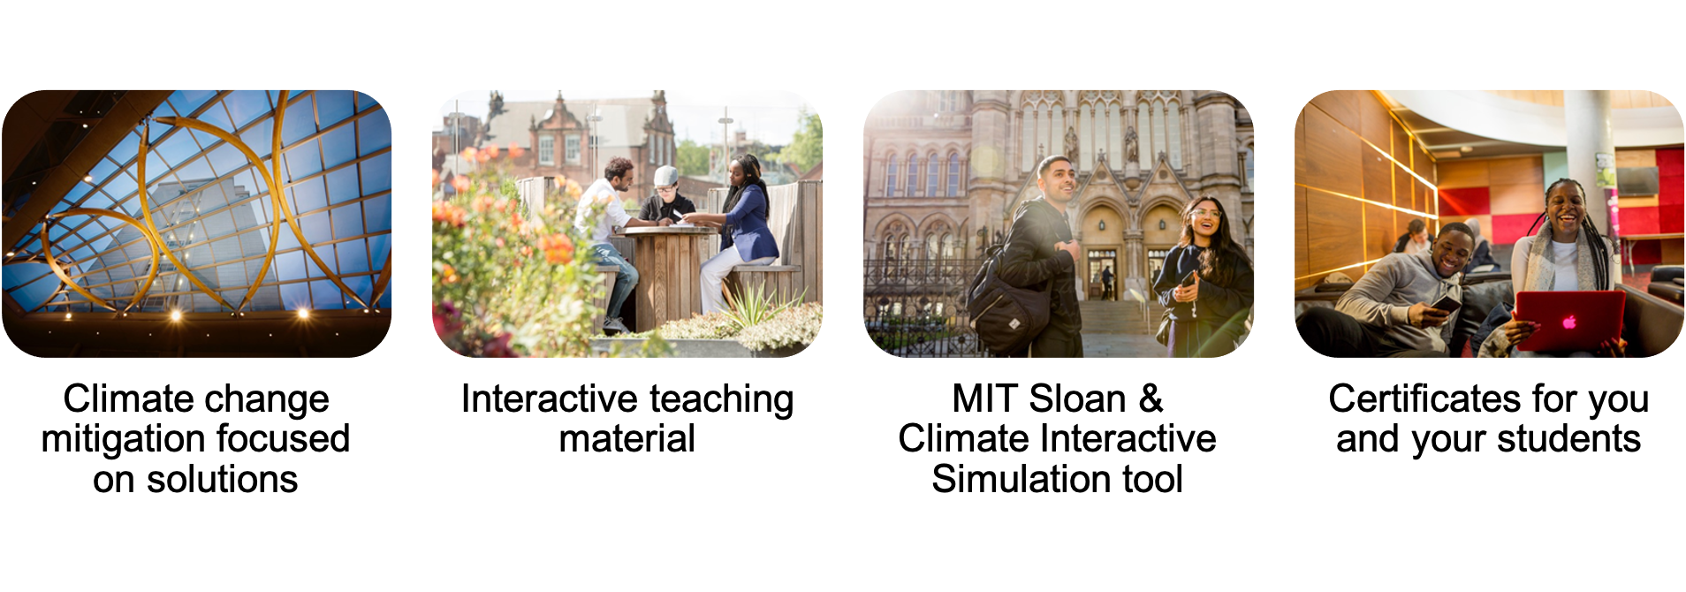
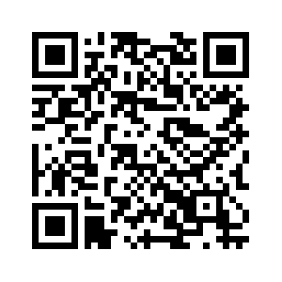
The Climate Literacy Training
Next cycle starts on 22 June 2023
REGISTER NOW!
www.unprme.org/prme-climate-literacy-training
clt@unprme.org

Slide 7
Virtual First
Discuss in your groups and note down so that you can present the results of your group:
Endeavor to organize meetings in a virtual setting whenever feasible, particularly if attendees would need to engage in lengthy air travel. Strive to make these online events as engaging and dynamic as possible.
.
Which was the best virtual conference you have experienced? What were the key features that you liked about this conference?
Which was the best hybrid conference you have experienced? Again, please summarize what made it good?
Blue sky thinking: Collect your ideas for an engaging online event

Slide 8
Geographic Flexibility
Rotate locations for international in-person conferences and make them hybrid to aid inclusion and diversity, reduce carbon and promote of equitable participation.
Discuss in your groups and note down so that you can present the results of your group:
Could you imagine the global forum or other international events taking place on a different continent each time?
How could the need for in-person conferences be achieved while reducing travel?

Slide 9
Five Fundamentals
Virtual First: Endeavor to organize meetings in a virtual setting whenever feasible, particularly if attendees would need to engage in lengthy air travel. Strive to make these online events as engaging and dynamic as possible.
Geographic Flexibility: Rotate locations for international in-person conferences and make then hybrid to aid inclusion and diversity, reduce carbon and promote of equitable participation.
Travel Methods: Consider air travel as a final option and promote the use of public transportation for all face-to-face meetings. Emphasize the importance of in-person attendance particularly at more localized gatherings. Encourage travel by train where possible.
Event Sustainability: Institute sustainability guidelines to ensure your conference or meeting is as sustainable as possible. Consider being ‘default veg’, ask attendees to report their travel carbon footprint, offer drinks in reusable bottles/cups/glasses and consider the contents of any goodie bags.
Continuous Enhancement: Strive for improvement and excellence in all endeavours. Learn from both successes and failures and utilize these insights to inform future actions. Foster a culture that values feedback, encourages learning, and adapts to change.

Slide 10
Five Fundamentals
Virtual First
Geographic Flexibility
Travel Methods
Event Sustainability
Continuous Enhancement
Discuss in your groups and note down so that you can present the results of your group:
Any general comments about the Five Fundamentals? Anything you would like to improve/change?
We want to provide additional resources for each of the fundamentals, what would you find helpful?
Any other comments?

Slide 11
Please share your best resources with us and everyone else!
Send to
CLIMATE@UNPRME.ORG

Slide 12






Thank you!

