Slide 1
Climate solutions for a net zero future: how to engage everyone in your organisation
Prof Dr Petra Molthan-Hill
Co-Chair UN PRME Working Group on Climate Change & the Environment
Professor of Sustainable Management and Education for Sustainable Development
Nottingham Business School, Nottingham Trent University, UK

Slide 2
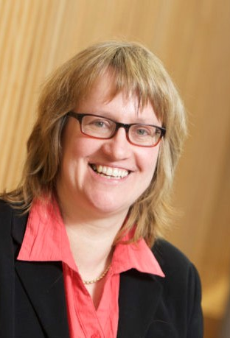
Introduction
Dr Petra Molthan-Hill is Co-Chair of the United Nations Principles for Responsible Management Education (PRME) Working Group on Climate Change and Environment and Professor of Sustainable Managment and Education for Sustainable Development (ESD) at Nottingham Business School, Nottingham Trent University, UK. She is an international multi-award-winning expert for Climate Change Mitigation Tools, Greenhouse Gas Management and ESD and leads the ‘Climate Literacy Training for Educators, Communities, Organisations and Students’ (CLT-ECOS) distributed worldwide. She has worked with organisations from SMEs to bigger organizations like the NHS on how to reduce GHG emissions and is lead author of the 'Handbook of Carbon Management. A Step-by-Step Guide to High-Impact Climate Solutions for Every Manager in Every Function ' https://www.routledge.com/The-Handbook-of-Carbon-Management-A-Step-by-Step-Guide-to-High-Impact-Climate/Molthan-Hill-Winfield-Howarth-Mazhar/p/book/9781032227603

Slide 3
Halve CO₂ emissions by around 2030
In order to limit global warming to 1.5°C, the IPCC stresses that the world needs to halve CO₂ emissions by around 2030 and reach Net Zero CO₂ emissions by mid-century.
In addition, the IPCC emphasises the need for deep reductions in non-CO₂ emissions across the economy to achieve this limit.
CDP (2020) Foundations for science-based net-zero target setting in the corporate sector: https://sciencebasedtargets.org/resources/files/foundations-for-net-zero-full-paper.pdf p5

Slide 4
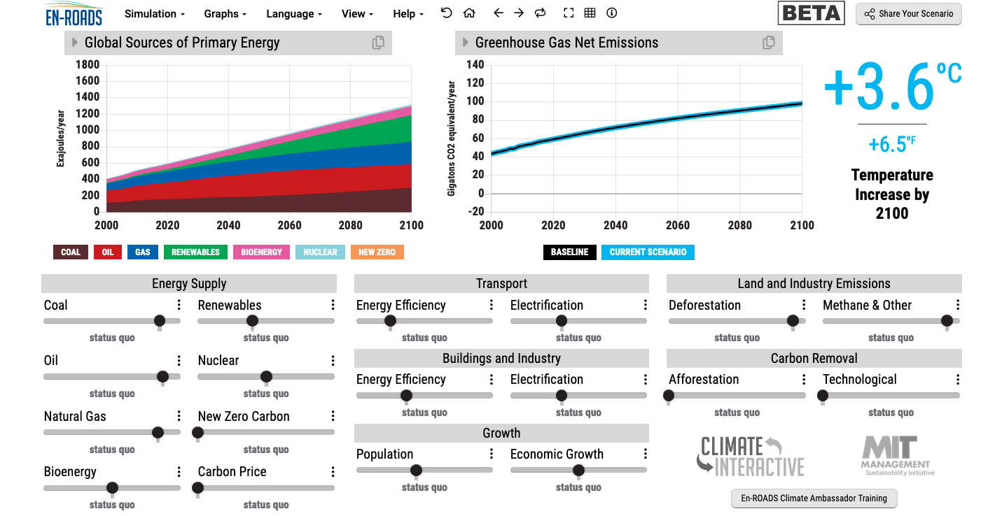
En-ROADS is a cutting-edge simulation model used to test climate solutions and generate climate scenarios for the future.
Our key challenge: How to get to 1.5°C?
Notes:
This is our current situation as demonstrated by En-ROADS which was developed by MIT Climate Interactive so that everyone can understand the high impact solutions and which impact they would have.

Slide 5
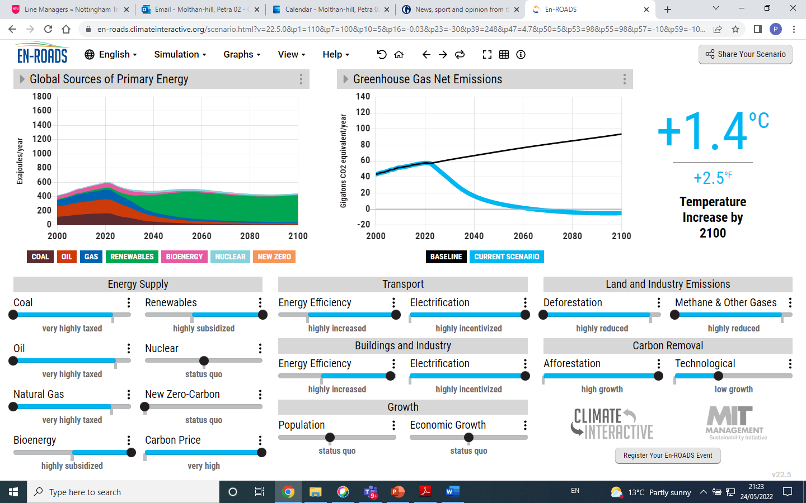

Slide 6
Solutions from En-ROADS
Big changes will be achieved by:
Increasing energy efficiency and electrification in transport, buildings and industry.
Reducing Methane e.g. by reducing food waste.
Increasing natural carbon capture as much as possible, including stopping deforestation and increasing afforestation.
Agreeing on a carbon price.
Notes:
After going through this slide, end with: We will now have some examples for the first three and how everyone on every level can do their bit..

Slide 7

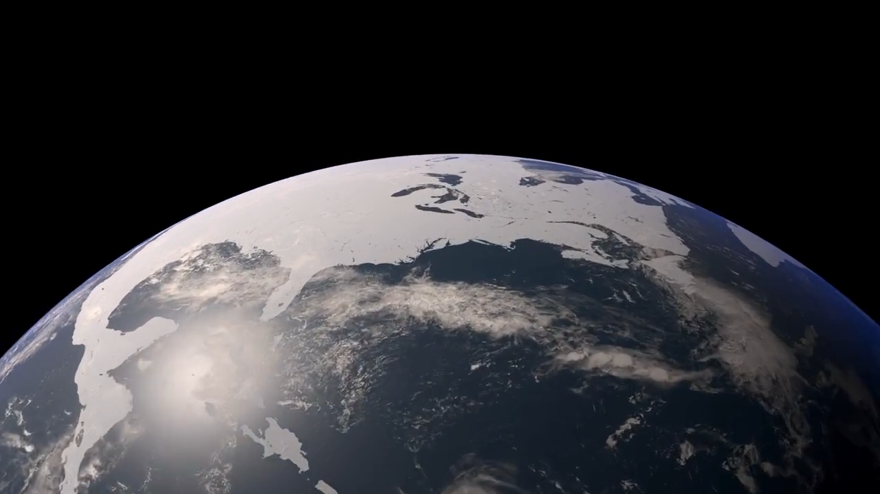
How much is too much?
Notes:
Carbon Dioxide equivalent gives us a level playing field to understand the effects of various activities

Slide 8
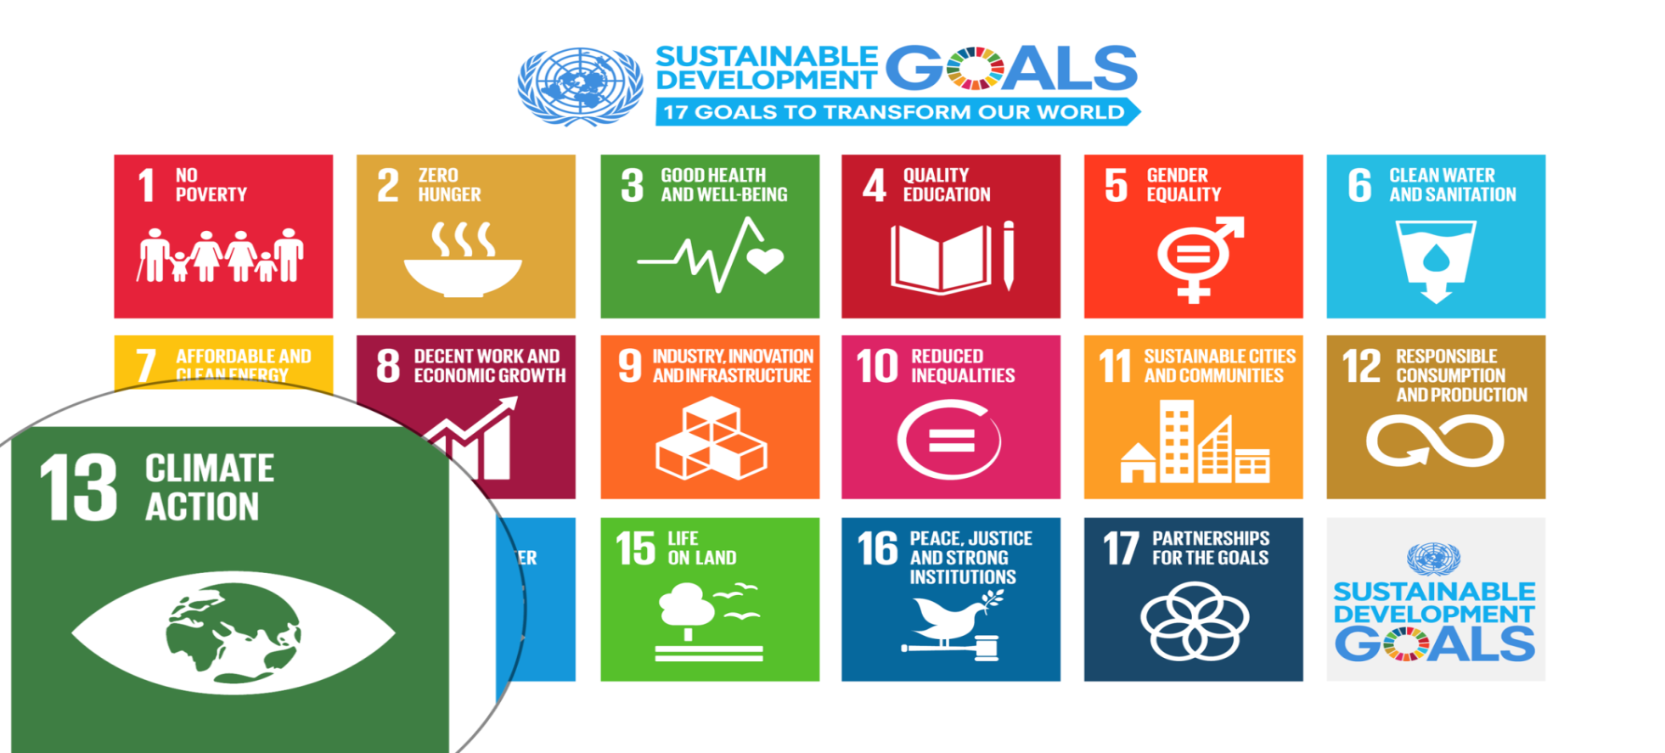
UN Sustainable Development Goals
Notes:
Carbon Dioxide equivalent gives us a level playing field to understand the effects of various activities

Slide 9
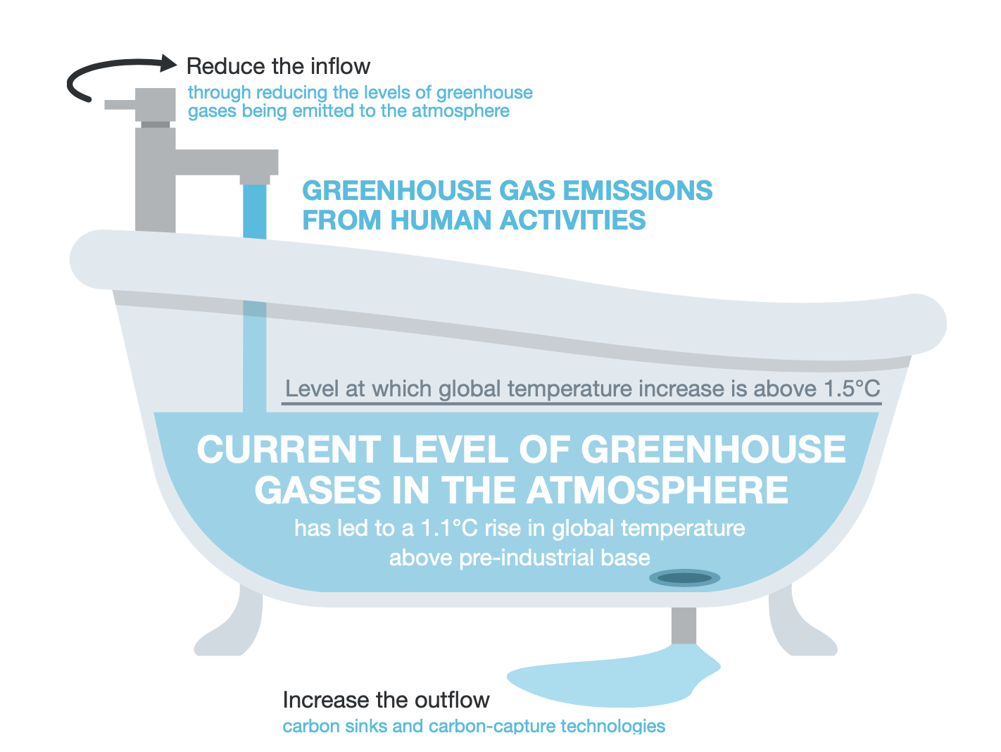
Net Zero
Net Zero on Campus Interactive, 2022

Slide 10
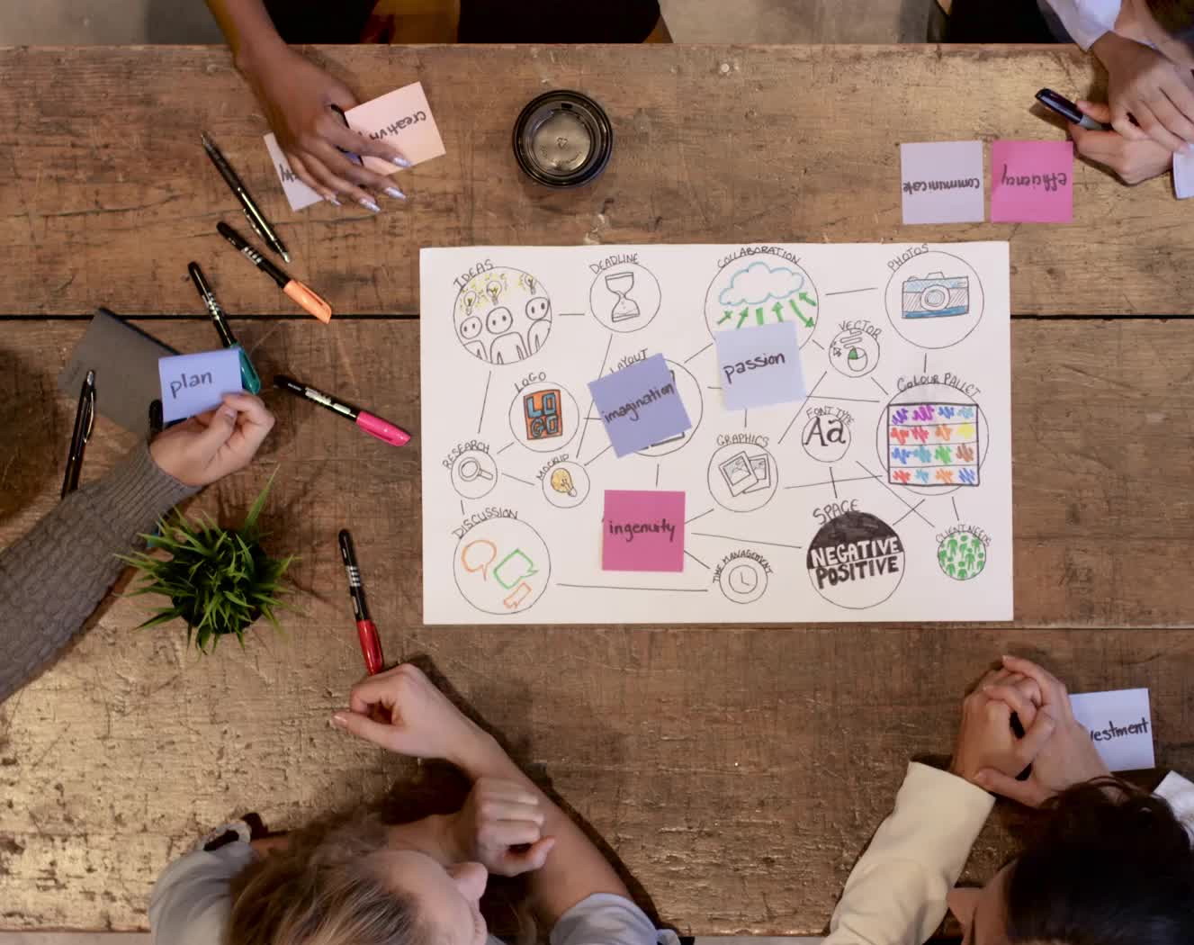
Project Drawdown
An excellent resource to familiarize yourself with the solutions and pathways to get us to Net Zero https://www.drawdown.org/
Their aim is to showcase the solutions that will help use to literally draw down the global temperature. In their own words, they describe themselves as conducting an: “ongoing review and analysis of practices and technologies that are able to reduce greenhouse gas concentrations in Earth’s atmosphere”
Project Drawdown focuses on solutions that are:
currently available, growing in scale, financially viable
able to have a net positive impact
Each solution reduces greenhouse gases by avoiding emissions and/or by sequestering carbon dioxide already in the atmosphere.
https://drawdown.org/solutions

Slide 11
Climate Change Mitigation Education into the core curriculum of every discipline
Developing values, knowledge and skills required to make choices and decisions that minimize the use of natural resources, emissions, waste and pollution; while contributing to the development of new solutions to the climate crisis (e.g., rethinking the way we live, buy and consume, how our daily lives are organized, how we socialize, exchange, share, educate and build identities).
Taking individual and/or collective action with the potential to have immediate, direct impact (e.g., reducing energy consumption, using non-polluting and renewable energy sources, environmental conservation, re-forestation and re-greening).
Contributing to policy development with long-term positive impact on societal behaviour by examining economic systems, social structures, cultural patterns, lifestyle expectations, consumerism, wealth distribution, aspirations and value systems and their underlying responsibility for excessive greenhouse gas production.
Table published in: Molthan-Hill, P et al (2021), Climate change education at universities: Relevance and strategies for every discipline. in: Handbook of Climate Change Adaptation and Mitigation (3rd edition), Springer: Cham, Switzerland. Adapted from definitions provided by Mochizuki Y, Bryan A (2015) Climate change education in the context of education for sustainable development: Rationale and principles. Research 9(1): 4-26.
Notes:
The second one is Climate Change Mitigation Education: Every Graduate needs to know how to best mitigate climate change- what are the best strategies and tools in operations, supply chain management, economics, investment to reduce carbon emissions?

Slide 12

Inspired by Carbon Literacy Training in:
Chapple, W., Molthan-Hill, P., Welton, R., Hewitt, M.
Lights Off, Spot On: Carbon Literacy Training Crossing Boundaries in the Television Industry.
J Bus Ethics 162, 813–834 (2020).
https://doi.org/10.1007/s10551-019-04363-w

Slide 13



Carbon Literacy Training for Business Schools
What if every recruit into corporations from the world’s business schools was qualified as Carbon Literate?
This training was developed by Nottingham Business School (Nottingham Trent University) in collaboration with the UN PRME Champions, Oikos International and the Carbon Literacy Project.
The aim of this project is to get academics, students and others Carbon Literate within a short time frame and to get as many people as possible actively involved in embedding climate solutions in their own life and work. In order to do so we have chosen a train-the-trainer approach, so we will offer regional events inviting all the universities and business schools in the vicinity to train academics and students there so that they can become trainers in their own institution and/or get involved in training others in other regions of the world.
Notes:
In our Carbon Literacy Training for Business Schools we have a strong focus on these high impact solutions so that everyone in a business school, whether in teaching, research or operations would know the best actions to take.

Slide 14
Get expertise: Take CLT-ECOS
Climate change mitigation focused on solutions
Interactive teaching material
MIT Sloan & Climate Interactive Simulation tool
Certificates for you and your students
Please contact petra.molthan-hill@ntu.ac.uk for more info on this or the more specific training for business schools mentioned earlier.
www.ntu.ac.uk
Notes:
And if you are interested in the wider perspective on how to get everyone in the university carbon literate, NTU has made one of the two open-source tool kits for all staff and students at universities.

Slide 15
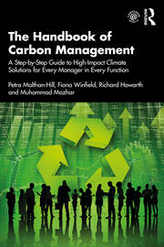
Integrated into every discipline/function
The Handbook of Carbon Management: A step-by-step guide to high-impact climate solutions for every manager in every function (Routledge)
Procurement and Supply: pushing the boundaries to remove carbon emissions
Marketing for a better climate
Pension funds, accounts and other investments
GHG emissions accounting
Climate communication and reporting to internal and external stakeholders
https://www.routledge.com/The-Handbook-of-Carbon-Management-A-Step-by-Step-Guide-to-High-Impact-Climate/Molthan-Hill-Winfield-Howarth-Mazhar/p/book/9781032227603

Slide 16

In your own time….
Free online course:
https://www.futurelearn.com/courses/climate-literacy-and-action-for-all

Slide 17

UN PRME Working Group on Climate Change
Please join us https://www.unprmeclimate.org/
Register as a member
Get the newsletter
Join our Working Group as a trainer when you get your certificate – send us your photo and a short profile
Share your research in a webinar

Slide 18
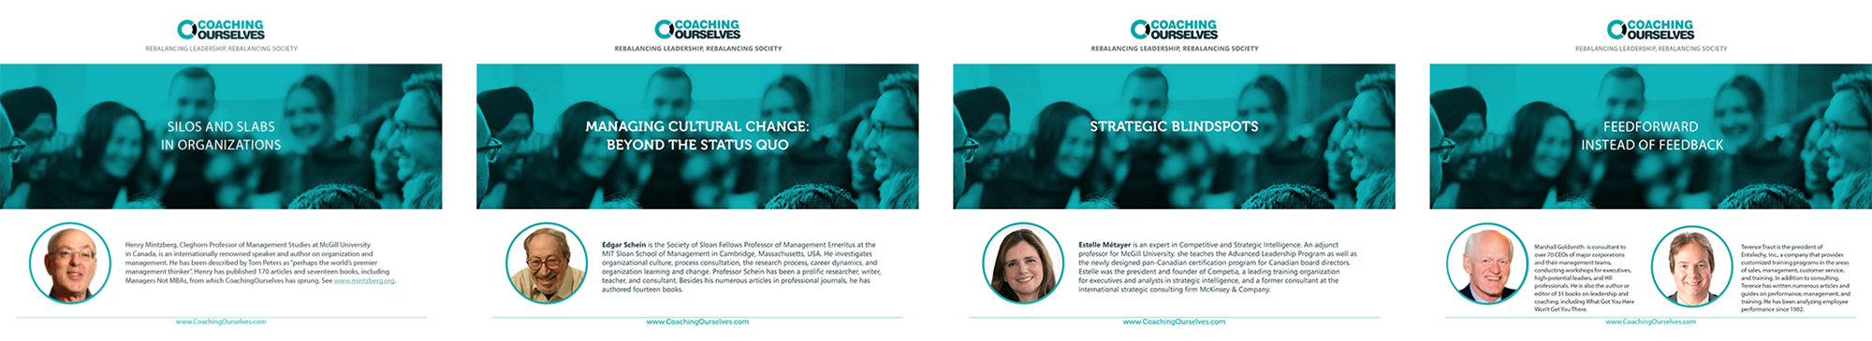
CoachingOurselves is…
a company co-founded in 2008 by Professor Henry Mintzberg and Phil LeNir.
a library of ~100 peer learning discussion guides available on important organizational and management themes.
small groups of employees getting together, live or virtually, for 90-minutes of self-directed or facilitated learning and insight sharing.
a collaboration with 60+ management and business school thinkers across the globe who author our peer learning discussion guides based on their own research, seminars, and workshops.
www.coachingourselves.com

Slide 19

CoachingOurselves Topic:
Climate Actions for Every Employee
Awareness of sustainable development issues with environmental and social impacts is now integral for quality organizational leadership.
Use the CoachingOurselves peer learning discussion guide “Climate Actions for Every Employee” in your peer learning programs to help your leaders, managers, and individual contributors understand how their small individual actions have multiple benefits for their workplace, home, and communities. Catch the message of possibility and get all employees involved in actively supporting your organization’s sustainability goals.
Theme areas: transportation, energy, food, coffee, and natural carbon capture options.
Contact Warren@coachingourselves.com for more details.

Slide 20

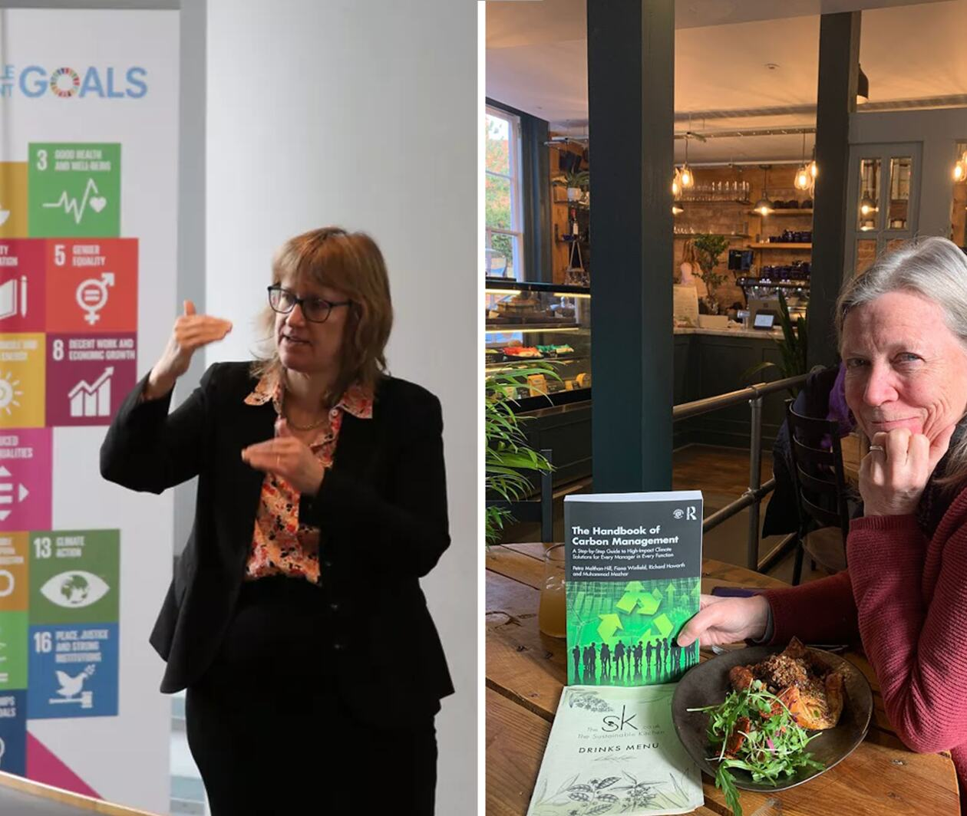
Get expertise through a master’s module
Climate Solutions for a Net Zero Future
Discover climate solutions you can implement in your industry, workplace, or household to help achieve a net zero future.
Master’s level, 100 hours, 10 credits, starting in May!
More info here:
https://www.futurelearn.com/courses/climate-solutions-for-a-net-zero-future
Notes:
NBS to offer three microcredentials (each worth 10 cp) that can be used towards a PG certificate (with 30 cp from elsewhere)

Slide 21

Coming soon……
https://charteredcertifications.com/
Certified Carbon Management Leader (CCML)
Petra Molthan-Hill and Stephen Snider

Slide 22

Pass it on

Slide 23
Want to find out more?
Please contact Prof Dr Petra Molthan-Hill
petra.molthan-hill@ntu.ac.uk

