Slide 1



DIRECTED INTEGRATION OF UNIVERSITY-WIDE ESD INTO CHEMISTRY DEGREES AT NTU
Mike Coffey, Aldilla Dharmasasmita and Petra Molthan-Hill
Nottingham Trent University
michael.coffey@ntu.ac.uk

Slide 2
Overview
1. University-wide ESD (Sustainability in Practice Certificate)
2. Chemistry module integrated with SiP
3. Student participation and views
Conclusions

Slide 3


University-wide ESD at NTU
Sustainability in Practice Certificate (SiP)
Additional award to degree
Open to all 25000+ undergraduates, postgraduates and staff at NTU
Concept: apply a common theme to individual’s own specific discipline
Theme: “Food for Thought”
Promoted to students at induction with Student Union support. Open to students at any level of study.
http://www4.ntu.ac.uk/sustainability/sustainable-learning/index.html
http://www4.ntu.ac.uk/sustainability/sustainable-learning/sustainability-in-practice/index.html

Slide 4
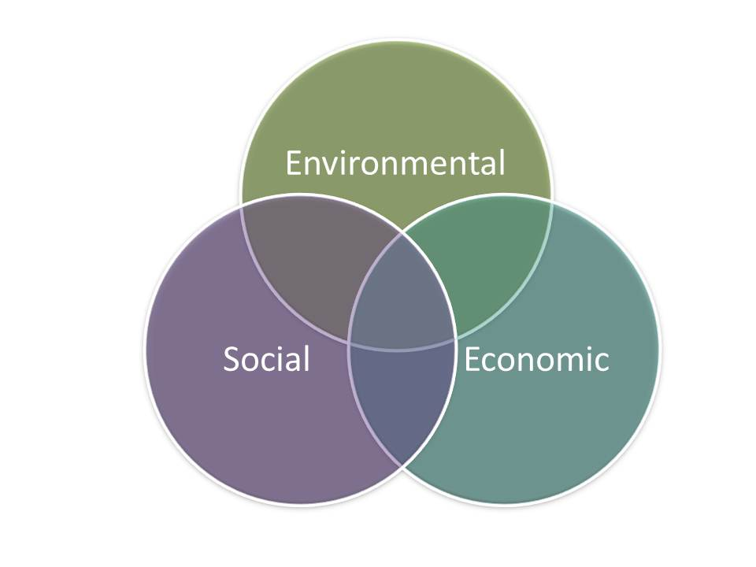

Five stages to SiP Award
Introduction to sustainability concepts
  Brief post on (food) sustainability issue
Links between food, sustainability & discipline
  Reply to peer’s post with reference to own subject
Quiz – video followed by MCQ quiz
Solutions to the food sustainability challenges
  Research & post on potential solutions to (food) sustainability issue
Sessions 1-4 online, automated assessment, staged progress
5. Individual submission: poster, video, mood-board
Manually assessed
Award ceremony
Best submission winners

Slide 5




SiP evolution
Standard 5-step process to Award
Themes developed: topics better suited for different disciplines
now possible to take SiP more than once

Slide 6
SiP evolution
Standard 5-step process to Award
Themes developed: topics better suited for different disciplines
now possible to take SiP more than once
Alternative route to Award:
(practical) “challenge day”

Slide 7
1. University-wide ESD (Sustainability in Practice Certificate)
2. Chemistry module integrated with SiP
3. Student participation and views
Conclusions

Slide 8
Why the need for direct integration of SiP in Chemistry degrees?
Chemistry students find difficulty in seeing the need to study sustainability:
Unpopular “Sustainable Chemistry” optional module
Discussions at staff-student consultative committee
Relevance to subject of chemistry questioned by students
Other driving factor:
University-wide curriculum review: inclusion of taught aspects of sustainability specifically considered (along with employability, internationalisation, etc.)
CONTEXTUALISE FOR THE CHEMISTRY STUDENTS

Slide 9
Where to fit the SiP?
Year 1 (L4) | Organic chemistry | Inorganic chemistry | Physical chemistry | Analytical chemistry | Professional development | Option
Year 2 (L5) |  |  |  |  |  | Option
Year 3 (L6) |  |  |  | Project |  | Option
Materials (I)
Pharmaceutical (O)
Chemical Technology (P)
Applied Instrumental Analysis (A)
Novel techniques | Analytical lab file
Radiochemistry lab file | PBL

Slide 10
Integrating SiP in Applied Instrumental Analysis module
Align module coursework directly with two of the more time-consuming SiP stages (sessions)
SiP Quiz (Session 3) replaced by comprehension test on primary literature related to instrumental analysis of food
MCQ - automatically marked;
Open answer manually assessed
SiP final submission replaced by poster submission for module – manually graded
“Create a poster explaining your studied technique(s) to a non-specialist audience and include the context of how analysis can apply to a wider context of food supply, safety or sustainability.”
Kept optional – some additional work required for SiP
Applied Instrumental Analysis | SiP
 | Session 1
 | Session 2
Journal comprehension test | Session 3
 | Session 4
Poster | Session 5
Student view
Direct relevance to rest of chemistry studies
Soft skill development alongside sustainability awareness being raised

Slide 11
 | Author/title | Category (Technique)
NT1 | NMR-spectroscopy of nontargeted screening and simultaneous quantification of health-relevant compounds in foods: the example of melamine D.W. Lachenmeier et al. (2009) J. Agric. Food Chem. 57, 7194-7199. DOI: 10.1021/jf902038 | Adulteration (HRMAS-NMR)
NT2 | Analysis of lysozyme in cheese samples by on-line combination of capillary zone electrophoresis and mass spectrometry Kondekova et al. (2014) Food Chemistry 153, 398-404. DOI: 10.1016/j.foodchem.2013.12.078 | Preservative (CE-MS)
NT3 | Application of NMR spectroscopy and LC-NMR/MS to the identification of carbohydrates in beer Duarte et al. (2003) J. Agric. Food Chem. 51, 4847-4852. DOI:10.1021/jf030097j | Composition (LC-NMR/MS)
NT4 | Evaluation of a fast and simple sample preparation method for polybrominated diphenyl ether (PBDE) flame retardants and dichlorodiphenyltrichloroethane (DDT) pesticides in fish for analysis by ELISA compared with GC-MS/MS Y.Sapozhnikova et al. (2015) J.Agric.Food Chem. 63, 4429-4434. DOI: 10.1021/jf505651g | Contamination (ELISA)
NT5 | Evaluation of the character impact odorants in fresh strawberry juice by quantitative measurements and sensory studies on model mixtures P. Schieberle & T.Hofmann (1997) J.Agric.Food Chem. 45, 227-232. | Taste (IDMS)
NT6 | Sensory-guided decomposition of roasted cocoa nibs (Theobroma cacao) and structure determination of taste-active polyphenols T. Stark et al. (2005) J.Agric.Food Chem. 53, 5407-5418. | Taste (GPC-HPLC-MS)
NT7 | Radiochemistry | Environment (radiochemical)

Slide 12
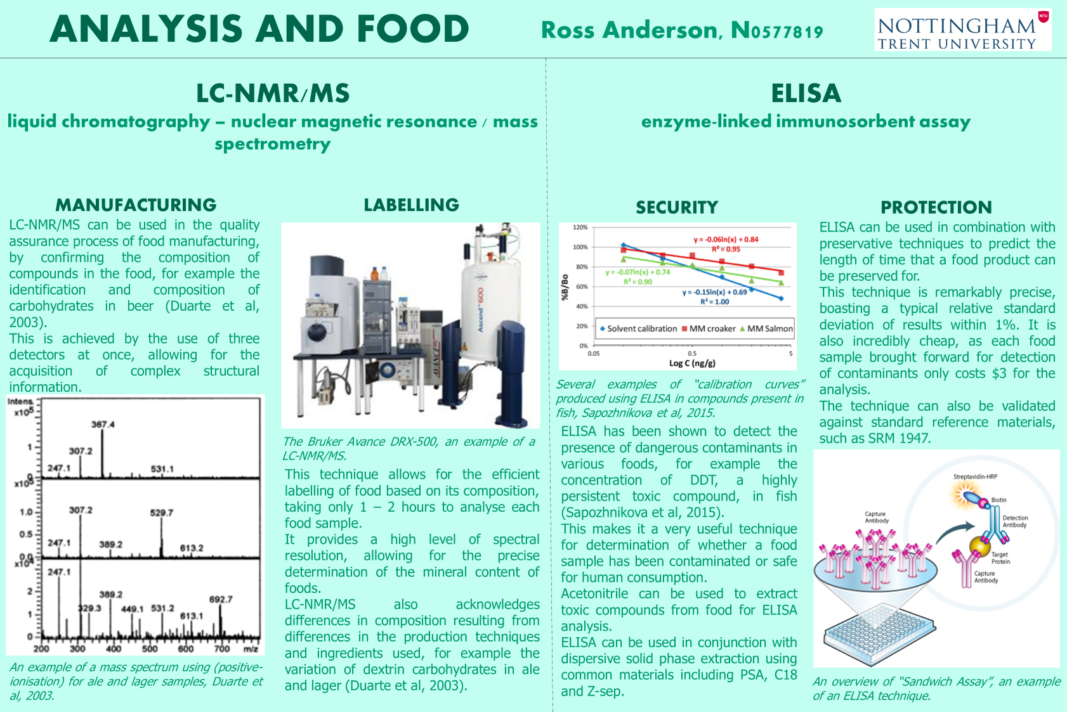

Slide 13
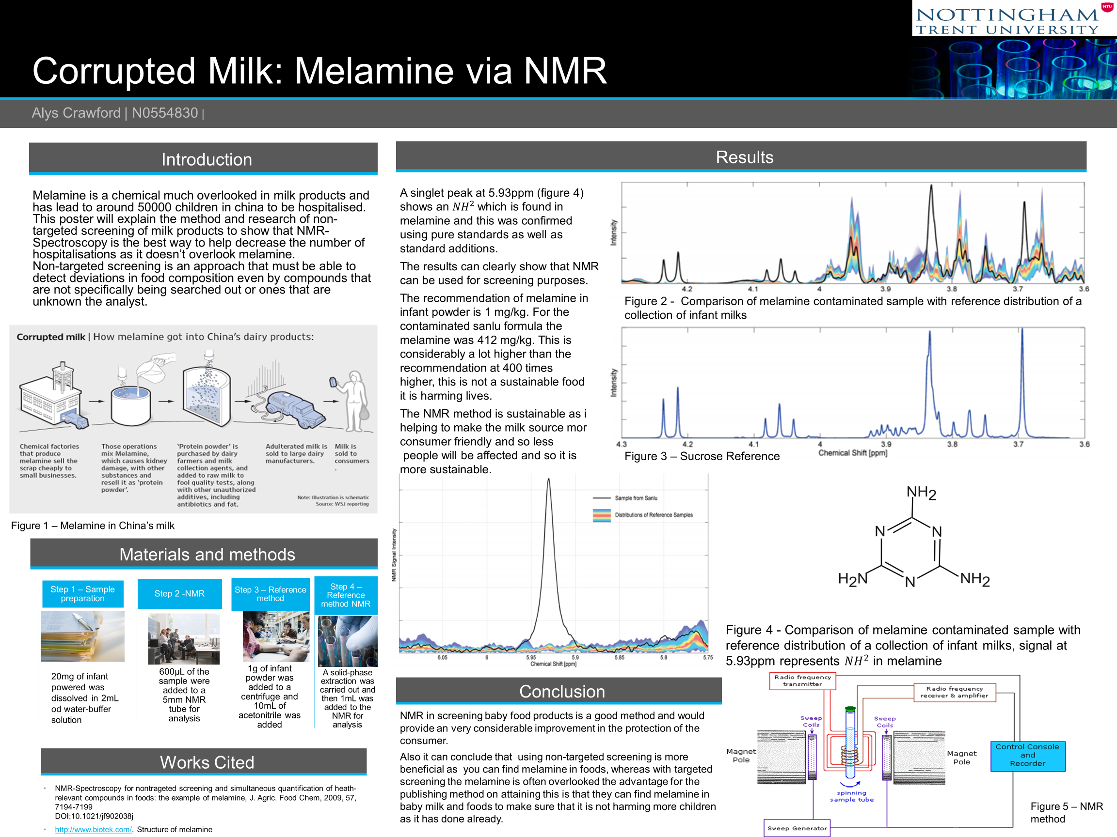

Slide 14
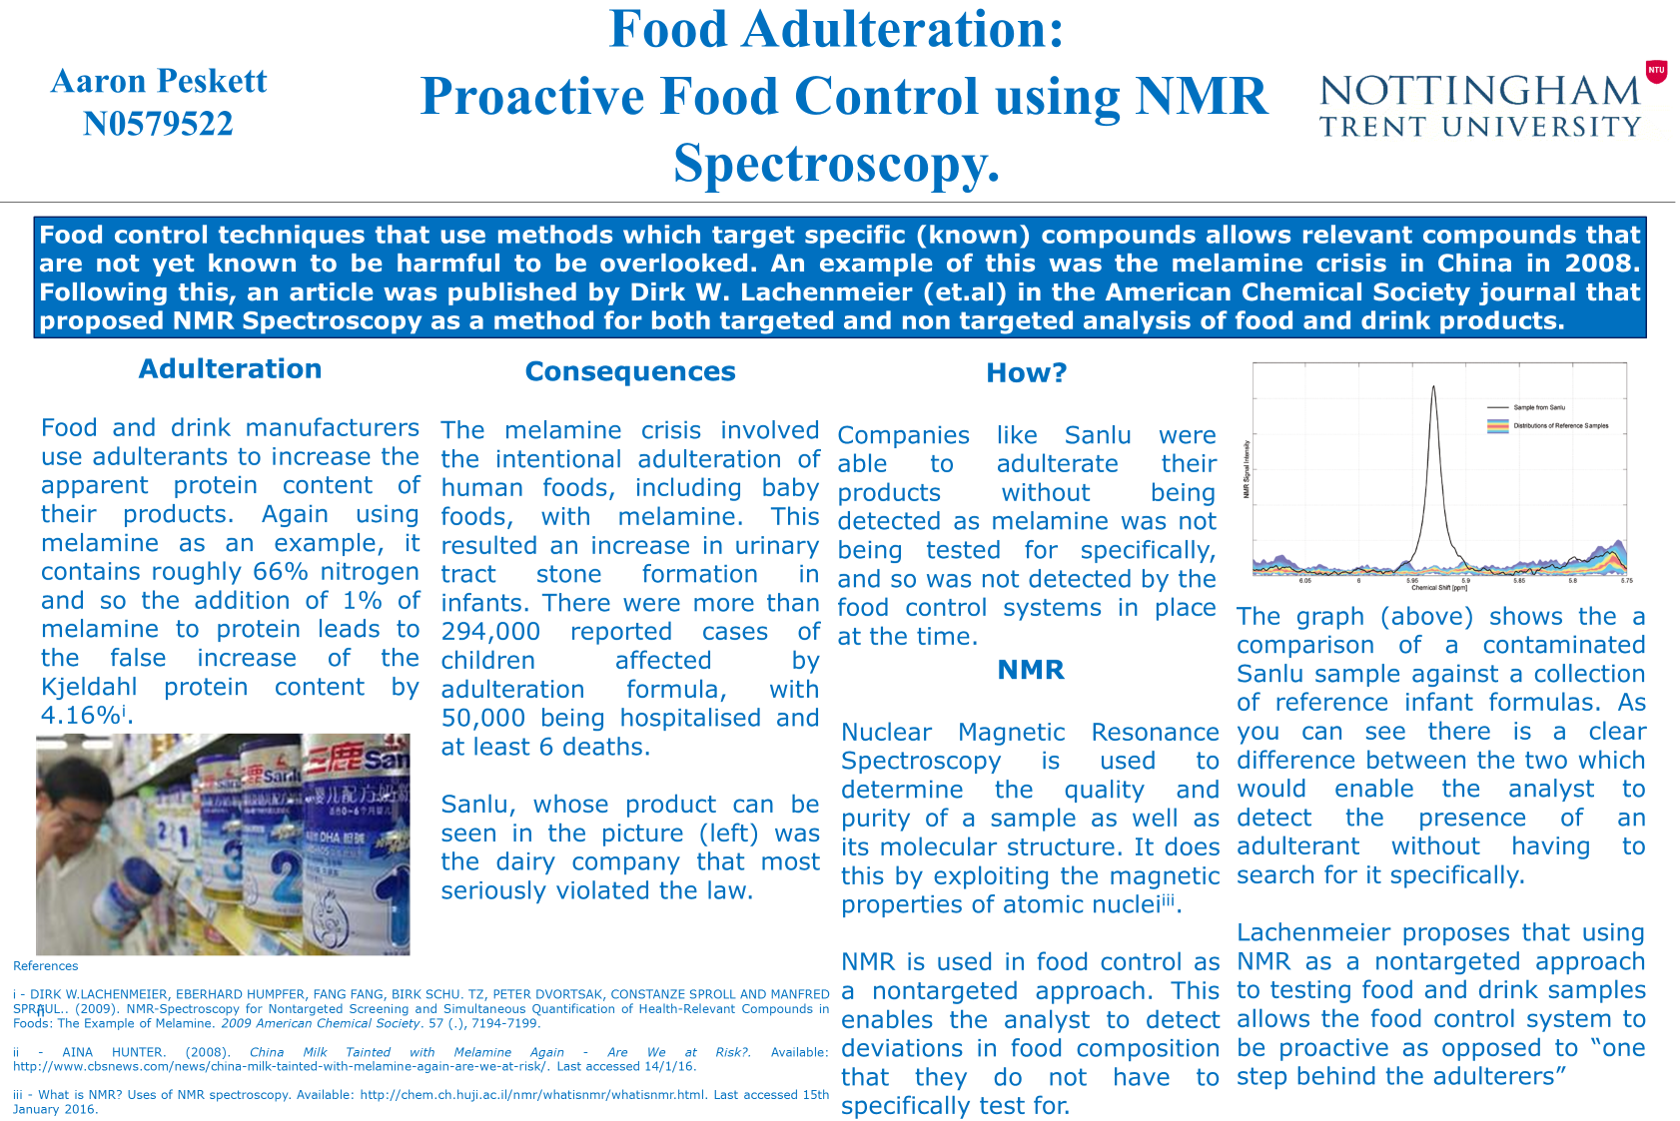

Slide 15
Alignment of Learning Outcomes: module & SiP
K4 (GA6) …….present scientific material and arguments clearly, both written and orally, as appropriate to the target audience.
K5 (GA5; GA12) Acquire, interpret and analyse chemical information from a variety of sources to inform judgements on scientific, social and ethical issues including sustainability.
S2 (GA7; GA12) Communicate effectively in spoken, written and visual media.
S5 (GA4) develop enthusiasm for self- directed learning and the study skills needed for continuing professional development and informed career management choices.

Slide 16
Alignment of Learning Outcomes: module & SiP
demonstrate engagement with sustainability as a concept
interpret the theme of their choice (Food, Clothing, or Energy) for thought and contextualise this through the subject of their degree, and devise an interesting, innovative, creative or perceptive means of displaying this concept to a wide audience

Slide 17
1. University-wide ESD (Sustainability in Practice Certificate)
2. Chemistry module integrated with SiP
3. Student participation and views
Conclusions

Slide 18
SiP Participation data
Aldilla
NTU starting SiP numbers by year
S&T starting numbers
C&F starting numbers

Slide 19
Development of Applied Instrumental Analysis module and SiP
Currently optional module:
FdSc compulsory (better related to employability)?
- greater student exposure to SiP
- compulsory participation in SiP for FdSc cohort?
- risk of compulsory vs optional “resistance”
Topic coverage of SiP includes food, energy & clothing.
- opportunities to integrate contextualised SiP into other modules in chemistry course (e.g. materials)
- challenge to engage other teaching staff

Slide 20
Conclusions
NTU instigated a supplementary award focussing on ESD (Sustainability in Practice certificate)
Idea to facilitate student engagement with sustainability issues within their discipline and to appreciate cross-disciplinary aspects of ESD
NTU chemistry students lukewarm to ESD: SiP integrated and contextualised, and (currently) kept optional
Better engagement with contextualised SiP, but room for improvement
As SiP topics developed, development of chemistry contextualised SiP also under consideration

Slide 21
Acknowledgements
Kelly Osbourne and Seraphina Brown
(formerly at NTU Green Academy) for their significant help, particularly in setting up the on-line work-space.
References
Jones, P., Trier, C.J. and Richards, J.P. (2008). Embedding education for sustainable development in higher education: a case study examining common challenges and opportunities for undergraduate programmes. International Journal of Educational Research, 47 (6), 341-350.
Molthan-Hill, P., Dharmasasmita, A. and Winfield, F. (2015). Academic Freedom, Bureaucracy and Procedures: The Challenge of Curriculum Development for Sustainability. In Leal Filho, W. and Davim, J.P. (Eds.), Challenges in Higher Education for Sustainability. (pp. 199-215). Cham, Switzerland: Springer.
Puntha, H., Molthan-Hill, P., Dharmasasmita, A. and Simmons, E. (2015). Food for thought: a university-wide approach to stimulate curricular and extra-curricular ESD activity. In Leal Filho, W., Azeiteiro, U.M., Caeiro, S. and Alves, F. (Eds.), Integrating Sustainability Thinking in Science and Engineering Curricula, World Sustainability Series. (pp. 31-48). Cham, Switzerland: Springer.
Zeegers, Y. and Clark, I.F. (2014). Students’ perception of education for sustainable development. Journal of Sustainability in Higher Education, 15 (2), 242-253.

