Slide 1

CONTEXTUALISED INTEGRATION OF UNIVERSITY-WIDE ESD INTO CHEMISTRY DEGREES AT NTU
Dr. Mike Coffey
Senior Lecturer in Analytical Chemistry
michael.coffey@ntu.ac.uk

Slide 2
Overview
1. University-wide ESD (Sustainability in Practice Certificate, SiP)
2. Chemistry modules integrated with SiP
Conclusions

Slide 3




University-wide ESD at NTU
Sustainability in Practice Certificate (SiP) Additional award: HEAR
Open to all 25000+ undergraduates, postgraduates and staff at NTU
Concept: apply a common theme to individual’s own specific discipline
Theme: “Food for Thought” – developed later with other themes
Promoted to students at induction with Student Union support. Open to students at any level of study.

Slide 4


Five stages to SiP Award
Introduction to sustainability concepts
  Brief post on (food) sustainability issue
Links between food, sustainability & discipline
  Reply to peer’s post with reference to own subject
Quiz – video followed by MCQ quiz
Solutions to the food sustainability challenges
  Research & post on potential solutions to (food) sustainability issue
Sessions 1-4 online, automated assessment, staged progress
5. Individual submission: poster, video, mood-board
Manually assessed
Award ceremony
Best submission winners

Slide 5
1. University-wide ESD (Sustainability in Practice Certificate)
2. Chemistry module integrated with SiP
Conclusions

Slide 6
Why the need for direct integration of SiP in Chemistry degrees?
Chemistry students find difficulty in seeing the need to study sustainability:
Unpopular “Sustainable Chemistry” optional module (2014)
Discussions at staff-student consultative committee -relevance to subject of chemistry questioned by students
CONTEXTUALISE FOR THE CHEMISTRY STUDENTS

Slide 7
Where to fit the SiP? (2015 – 2019)
Year 1 (L4) | Organic chemistry (O) | Inorganic chemistry (I) | Physical chemistry (P) | Analytical chemistry (A) | Professional practice | Option
Year 2 (L5) |  |  |  |  |  | Option
Year 3 (L6) |  |  |  | Project |  | Option
Materials (I)
Pharmaceutical (O)
Chemical Technology (P)
Applied Instrumental Analysis (A)
Novel techniques | Analytical lab file
Radiochemistry lab file | PBL

Slide 8
Integrating SiP in Applied Instrumental Analysis module
1. Align module coursework directly with two of the more time-consuming SiP stages (sessions)
2. SiP Quiz (Session 3) replaced by comprehension test on primary literature related to instrumental analysis of food
MCQ - automatically marked;
Open answer manually assessed
SiP final submission replaced by poster submission for module – manually graded
“Create a poster explaining your studied technique(s) to a non-specialist audience and include the context of how analysis can apply to a wider context of food supply, safety or sustainability.”
Kept optional – some additional work required for SiP
Applied Instrumental Analysis | SiP
 | Session 1
 | Session 2
Journal comprehension test | Session 3
 | Session 4
Poster | Session 5
Student view
Direct relevance to chemistry
Graduate skill development alongside sustainability awareness being raised

Slide 9
 | Author/title | Category (Technique)
NT1 | NMR-spectroscopy of nontargeted screening and simultaneous quantification of health-relevant compounds in foods: the example of melamine D.W. Lachenmeier et al. (2009) J. Agric. Food Chem. 57, 7194-7199. DOI: 10.1021/jf902038 | Adulteration (HRMAS-NMR)
NT2 | Analysis of lysozyme in cheese samples by on-line combination of capillary zone electrophoresis and mass spectrometry Kondekova et al. (2014) Food Chemistry 153, 398-404. DOI: 10.1016/j.foodchem.2013.12.078 | Preservative (CE-MS)
NT3 | Application of NMR spectroscopy and LC-NMR/MS to the identification of carbohydrates in beer Duarte et al. (2003) J. Agric. Food Chem. 51, 4847-4852. DOI:10.1021/jf030097j | Composition (LC-NMR/MS)
NT4 | Evaluation of a fast and simple sample preparation method for polybrominated diphenyl ether (PBDE) flame retardants and dichlorodiphenyltrichloroethane (DDT) pesticides in fish for analysis by ELISA compared with GC-MS/MS Y.Sapozhnikova et al. (2015) J.Agric.Food Chem. 63, 4429-4434. DOI: 10.1021/jf505651g | Contamination (ELISA)
NT5 | Evaluation of the character impact odorants in fresh strawberry juice by quantitative measurements and sensory studies on model mixtures P. Schieberle & T.Hofmann (1997) J.Agric.Food Chem. 45, 227-232. | Taste (IDMS)
NT6 | Sensory-guided decomposition of roasted cocoa nibs (Theobroma cacao) and structure determination of taste-active polyphenols T. Stark et al. (2005) J.Agric.Food Chem. 53, 5407-5418. | Taste (GPC-HPLC-MS)
NT7 | Radiochemistry | Environment (radiochemical)

Slide 10


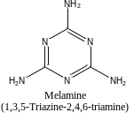
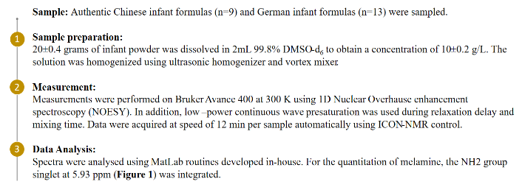

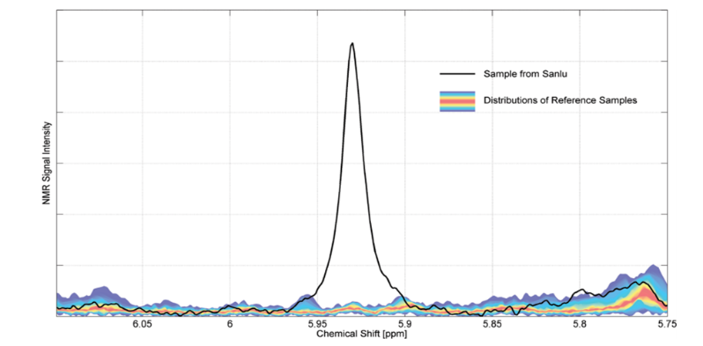
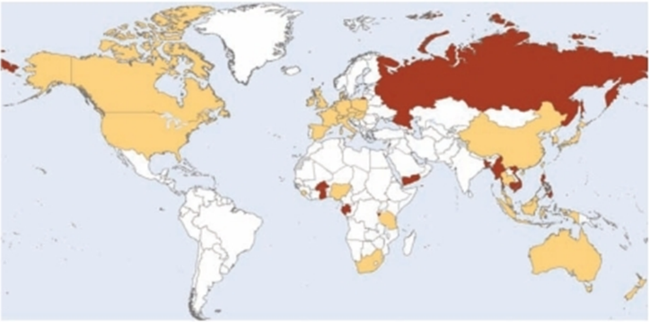
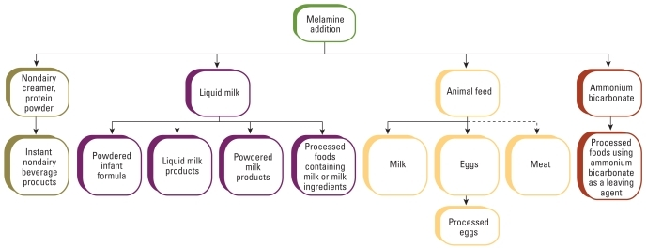
NMR Spectroscopy for control of protein Adulteration by Melamine in Foods, especially infant formulas.
Aim
Explain the potential of the Nuclear Magnetic Resonance (NMR) for Non-targeted screening and Quantitative analysis as well as the importance of adulteration control in the world.
Full Paper Here
Method
Comparison with other techniques
In comparison with Near IR spectroscopy, NMR can provide much richer information, selectivity and sensitivity is more advance too.^{1,3} Although, 400 MHz NMR has sufficient Limit of Detection (LOD), more expensive 700 MHz NMR (HRMAS), have LOD of nearly 0.69 mg/kg in the matrix, this is exceptional in comparison with 400 MHz NMR’s LOD of 33.26 mg/kg. However, SPE-LC/MS/MS has even better LOD of 0.005 mg/kg, but more laborious sample preparation is necessary.¹
Conclusion
In conclusion, the 400 MHz NMR method was developed and used for non-targeted screening and quantification of infant formulas. Obtained results of melamine were much higher than safety recommendations of WHO.⁵ Method required only simple sample pre-treatment. Analysis of abnormal peaks in spectra and overall quality of infant formula was also possible using this method. Therefore, to protect the health of the people and safety of the food, World Health Organization urges for the global control system which should be developed against intentional adulteration.⁵
Introduction
Melamine is an organic compound (CAS # 108-78-1) used as fire-retardant or for production of melamine-formaldehyde resins (thermoset) for many industrial applications.
Because of its 67% nitrogen by mass content, it is used as Adulterant in Milk, Infant formulas, candies and other food products(Figure 1).^{1,2} Addition of 1% of melamine can falsely increase protein content by 4.16%.¹
Although short-term lethal dose is comparable to table salt, it can cause urinary tract stones⁴ and be fatal for infants in some cases. In 2008, nearly 50 000 people were hospitalized in China during a safety incident of adulteration in infant formulas.^{1,2}
Adulteration of food should be stopped with regards to Sustainability Development Goals (2, 3) and this will be only possible with global partnership (17) based on Figure 3.
WHO pressures for new methods for food control⁵, therefore, ¹H NMR at 400 MHz method provided on this poster was developed and it can straightforwardly distinguish melamine-contaminated foods and provide quantitate measurements using integration.
Figure 2-Comparison of melamine-contaminated sample from Sanlu (China) with the reference distribution of collection of infant formulas (measured in DMSO-d₆ at 400MHz). The signal at 5.93 ppm derives from the NH₂- groups of melamine
Results and Discussion
Melamine recommendation of the WHO for infant formulas was set to 1mg/Kg in 2010.⁵ After evaluation of the method, its sensitivity was sufficient for screening purposes(Figure 2). However, it could have been improved by optimized sample extraction or preconcentration. Melamine concentration in contaminated infant formula was determined to be 412 mg/kg, this was a lower result than measured by the reference method (SPE-LC/MS/MS). The precision of the method showed a 3.2% variation (n=9).
In addition, richness of data made it possible to determine higher sucrose content or lactose free infant formulas from the screening measurement.
Considering all facts, 400 MHz NMR in the current form has sufficient results to be used as a screening method for Melamine contamination as a very low amount of melamine is admissible.
Figure 3-Global distribution of melamine-contaminated products as published on national official web sites. Light shading indicates countries that reported melamine findings in products. Dark shading indicates countries to which import of contaminated products occurred.²
Reference List:
1. D. W. Lachenmeier, E. Humpfer, F. Fang, B. Schütz, P. Dvortsak, C. Sproll and M. Spraul, J. Agric. Food Chem.,2009,57,DOI: https://doi.org/10.1021/jf902038j ,7194-7199
2. C. M. E. Gossner, J. Schlundt, P. B. Embarek, S. Hird, D. Lo-Fo-Wong, J. J. O. Beltran, K. N. Teoh and A. Tritscher, Environ. Health Perspect.,2009,117(12), DOI: 10.1289/ehp.0900949,1803-1808
3. P. F Scholl, M. M. Bergana, B. J. Yakes, Z. Xie, S. Zbylut, G. Downey, M. Mossoba, J. Jablonski, R. Magalletta, S. F. Holroyd, M. Buehler, J. Qin, W. Hurst, J. H. LaPointe, D. Roberts, C. Zrybko, A. Mackey, J. D. Holton, G. A. Israelson, A. Payne, M. S. Kim, K. Chao and J. C. Moore, J. Agric. Food Chem.,2017,65(28),DOI: https://doi.org/10.1021/acs.jafc.7b02083 ,5799-5809
4. International Labour Organization,Melamine ICSCs, https://www.ilo.org/dyn/icsc/showcard.display?p_lang=en&p_card_id=1154&p_version=2 ,2017,(accessed 8th January 2021)
5.WHO, International experts limit melamine levels in food, https://www.who.int/mediacentre/news/releases/2010/melamine_food_20100706/en/,2010,(accessed 8th January 2021)
Figure 1-Melamine contamination chain from Adulteration. Solid line indicates contaminated products, dashed line indicates possible contamination.²

Slide 11
Where to fit the SiP? (2020-present)
Year 1 (L4) | Organic chemistry (O) | Inorganic chemistry (I) | Physical chemistry (P) | Analytical chemistry (A) | Professional practice | Option
Year 2 (L5) |  |  |  |  |  | Option
Year 3 (L6) |  |  |  | Project |  | Option
Materials (I)
Pharmaceutical (O)
Chemical Technology (P)
Applied Instrumental Analysis (A)
Compulsory module:
2020-21 Optional SiP
2022 Compulsory SiP

Slide 12
Conclusions
NTU-wide supplementary award focussing on ESD (SiP certificate)
- to facilitate student engagement with sustainability issues within their discipline and to appreciate cross-disciplinary aspects of ESD
NTU chemistry students lukewarm to ESD (<5 SiP awards for Chemistry students/yr):
SiP integrated and contextualised, and kept optional
- better engagement with contextualised SiP (ca. 20-25 Chemistry students/yr), but room for improvement
Current situation
Development of chemistry contextualised SiP broadened to be taken by all chemistry undergraduates (ca. 100/yr):
- contextualised with chemistry content and couched in terms of discipline development and development of study skills
Chemistry student “buy-in” to ESD now good

Slide 13
Acknowledgements
Vanessa Odell NTU Green Academy (also Kelly Osbourne and Seraphina Brown in early development), particularly in setting up on-line work-space.
References
Jones, P., Trier, C.J. and Richards, J.P. (2008). Embedding education for sustainable development in higher education: a case study examining common challenges and opportunities for undergraduate programmes. International Journal of Educational Research, 47 (6), 341-350.
Molthan-Hill, P., Dharmasasmita, A. and Winfield, F. (2015). Academic Freedom, Bureaucracy and Procedures: The Challenge of Curriculum Development for Sustainability. In Leal Filho, W. and Davim, J.P. (Eds.), Challenges in Higher Education for Sustainability. (pp. 199-215). Cham, Switzerland: Springer.
Puntha, H., Molthan-Hill, P., Dharmasasmita, A. and Simmons, E. (2015). Food for thought: a university-wide approach to stimulate curricular and extra-curricular ESD activity. In Leal Filho, W., Azeiteiro, U.M., Caeiro, S. and Alves, F. (Eds.), Integrating Sustainability Thinking in Science and Engineering Curricula, World Sustainability Series. (pp. 31-48). Cham, Switzerland: Springer.
Zeegers, Y. and Clark, I.F. (2014). Students’ perception of education for sustainable development. Journal of Sustainability in Higher Education, 15 (2), 242-253.

