Slide 1
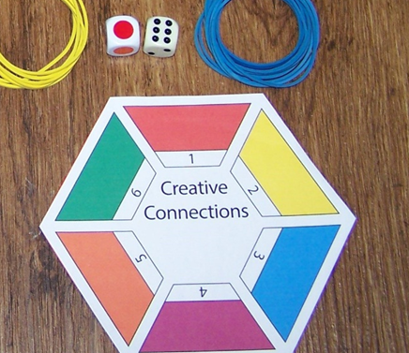


It does exactly what it says on the box: achieves higher levels of engagement and deeper learning - at any level on any topic
Dr. Mike Coffey – Chemistry & Forensics, SST
James Leinster – Nottingham Business School
Nottingham Trent University

Slide 2
Overview of this workshop
Introduction –
  - Why develop this resource?
  - Description of ‘Creative Connections’
How might ‘Creative Connections’ be used?
  Linking academic topics within a course – activity for participants #1
  Mix and change
  Linking course content with technical and graduate skills – activity #2
Your feedback
Conclusions

Slide 3



Why develop this resource?
Taught largely in modular systems
Students (u/g and p/g) – pragmatic
Tendency for “silo” learning
How can we do this?
Structured way to encourage the break down of silo learning
Help students recognise (common) skills
Encourage deeper thinking
Active GBL - engagement
Modular course content

Slide 4
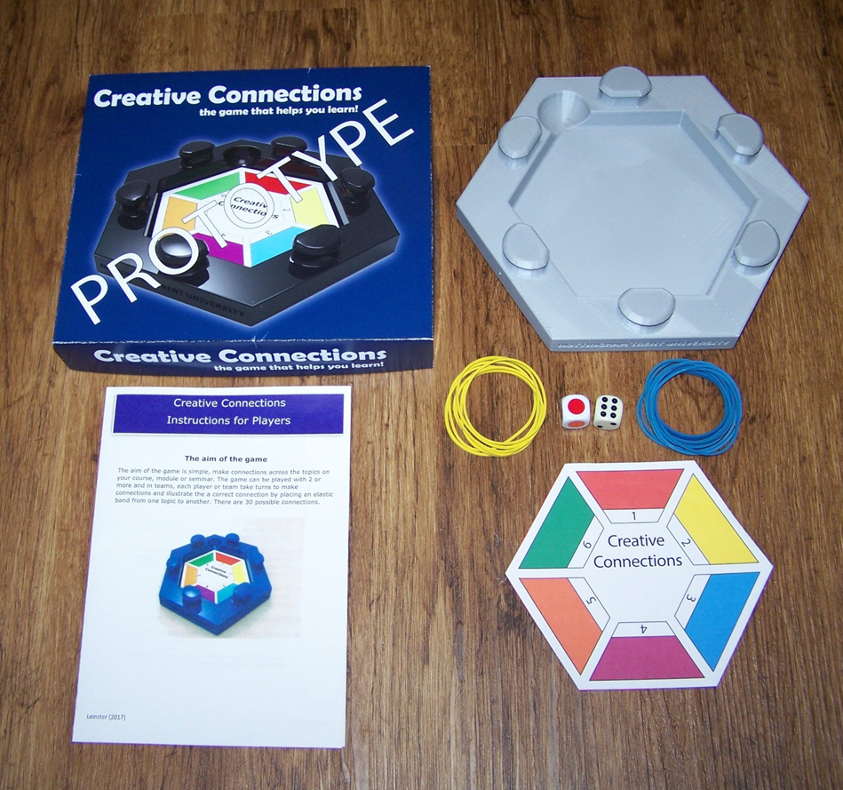
‘ Creative Connections’
Wanted a resource that is:
Flexible – adapt to different courses/ different levels
Easy to implement for the tutor
Please divide up into groups ca. 4-6 in size
Look at a copy of the resource
Cradle
Connection (rubber) bands
Connect dice
Adaptable topic insert
Rules/Tutor notes

Slide 5

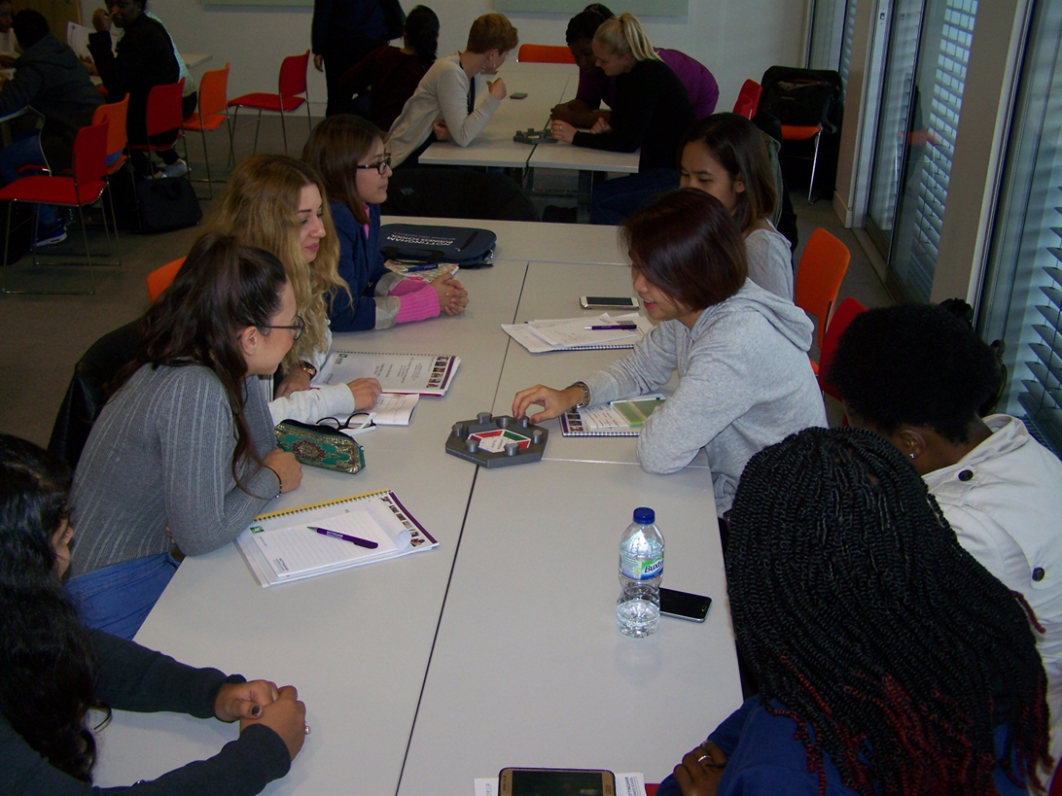
How to use………
Game-mode possibilities
Dice ‘choose’ topics to link
Small groups
Two-team competitive
Individual
Scoring system
Round-the hexagon
Engagement/active learning
Peer-learning

Slide 6
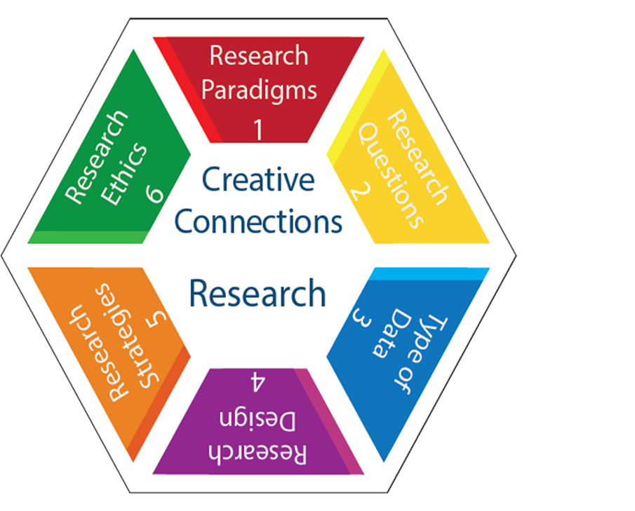
Session planning for ‘Creative Connections’
Tutor-defined:
Central topic and related concepts/ideas/subjects
(usually, not necessarily, six)
Technical/course modules/skills
Adaptable PowerPoint electronic file plus colour printing
Can laminate for durability/re-use
Blank laminated for in-situ generation of insert
Ease-of-use for tutor

Slide 7
Workshop Part 2:
Now it is your turn!
Linking academic topics within a course – activity for participants #1

Slide 8
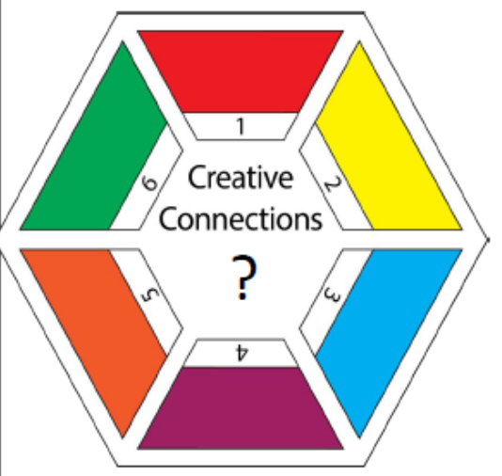
Take a blank insert:
As an individual think of a topic you are involved with delivering on your course.
This may be:
  a module;
  a topic within a module;
  A year of a course.
  This topic is at the centre of your Creative Connections insert

Slide 9
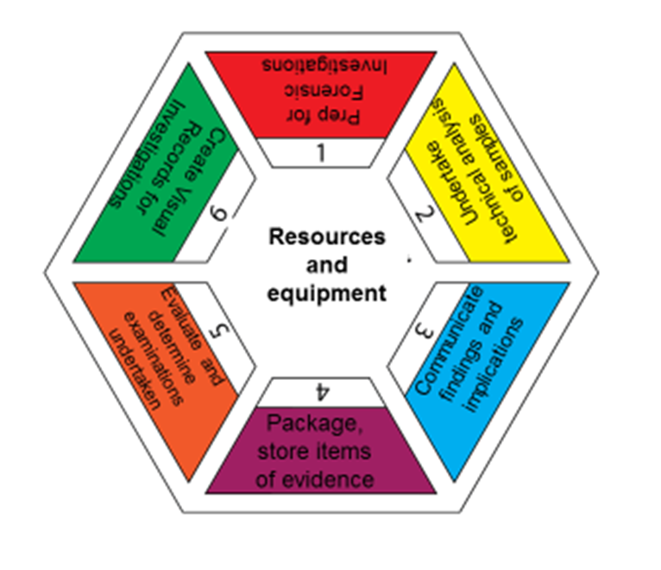
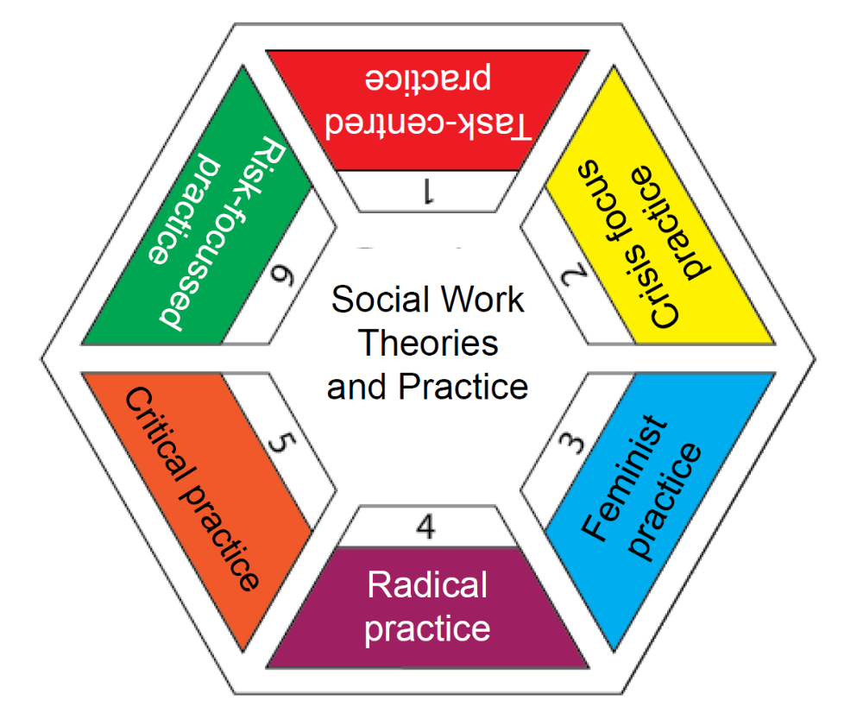
Example: Forensic science
Example: Social science

Slide 10
Designing your Creative Connections insert (ca. 5 minutes)
(Roughly) draft a set of six academically-themed sub-topics which relate to your central topic with which to populate the outer six coloured zones of the hexagon.
2. Now consider: do you expect connections to be made between these on an academic basis? Common theories? Common formulae; inter-relationships between the chosen topics?
3. If necessary, change your outer topics to enhance the possibility of students making academic links.
4. Now construct your Creative Connections insert.

Slide 11
In small groups (two’s/three’s)
Briefly explain your insert design to each-other
try to:
  Describe examples of some academic links you might anticipate students making
  Discuss how you might intervene to develop the ideas and make more complex links and/or deepen learning potential by broadening out themes and inviting more strategic-level thinking
  5 - 10 minutes

Slide 12
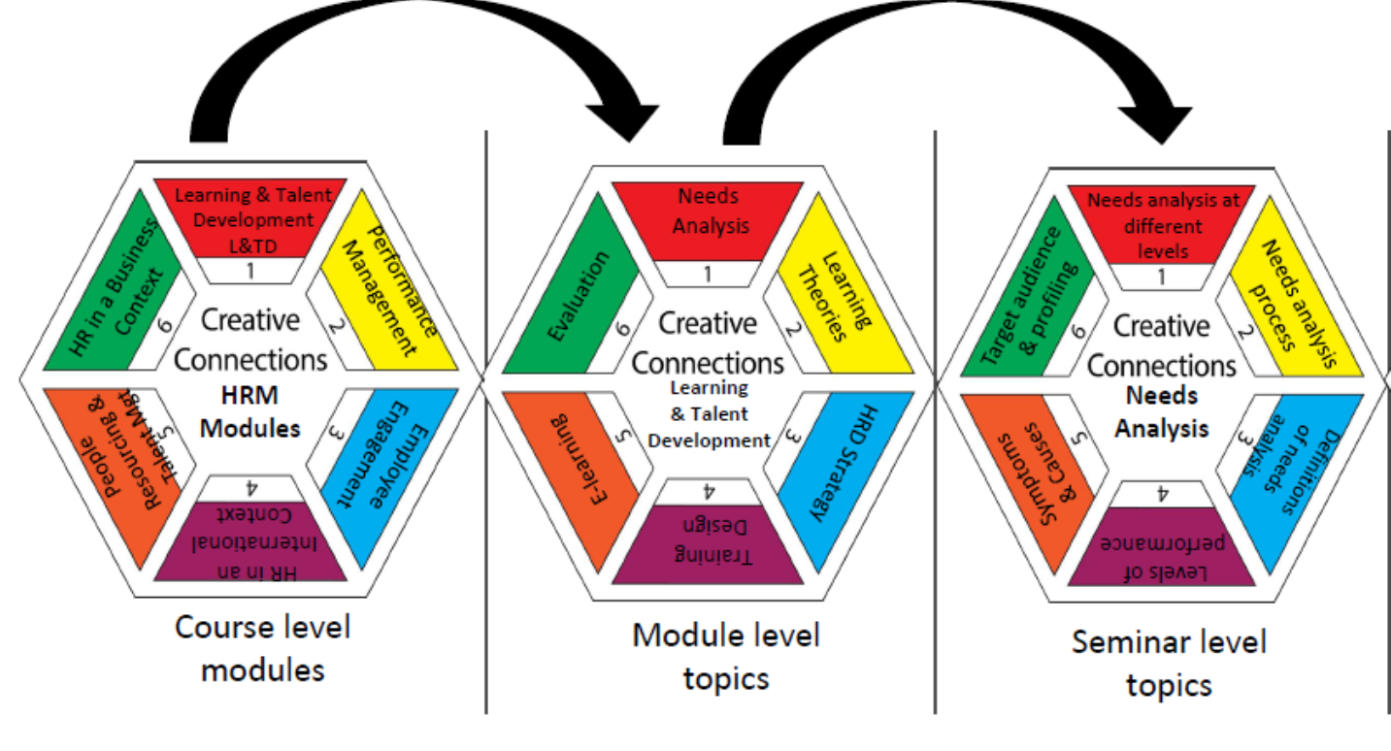
Academic connections on several layers

Slide 13
Workshop Part 2 (continued):
Please changes groups
Linking academic topics to technical and durable skills – activity for participants #2

Slide 14

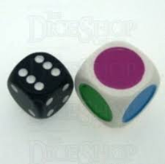
Two inserts used together
- link between
academic content/ skills / technical competencies
e.g. academic content to employability skills
Academic/module
Technical/soft skills

Slide 15
Designing your Creative Connections insert (ca. 5 minutes)
(Roughly) draft a set of six technical or graduate-skill sub-topics which are important in your subject area to populate the outer six coloured zones of a second Creative Connections hexagon.
2. Now consider: do you expect connections to be made between your academic and technical/skills topics?
3. If necessary, change your outer topics to improve the connectivity.
4. Now construct your technical/skills Creative Connections insert.

Slide 16
In small groups (two’s/three’s)
Briefly explain your insert design to each-other
try to:
  Describe examples of some academic-to-technical/skills links you might anticipate students making
  Discuss how you might intervene to help students recognise these technical/graduate-skills they are developing in their modules
  5 - 10 minutes

Slide 17

Also: multiple inserts to assist with thinking longidutinally
Year 1 modules
Year 2 modules
Year 3 modules

Slide 18

Your shared thoughts (whole group): anything you want to share more widely?
Potential for use in your course?
At what academic level do you think it may work best?
How long to use in a given session?
Potential for an active learning (part) session?
How might your students respond to using Creative Connections?
Potential for peer-learning?

Slide 19
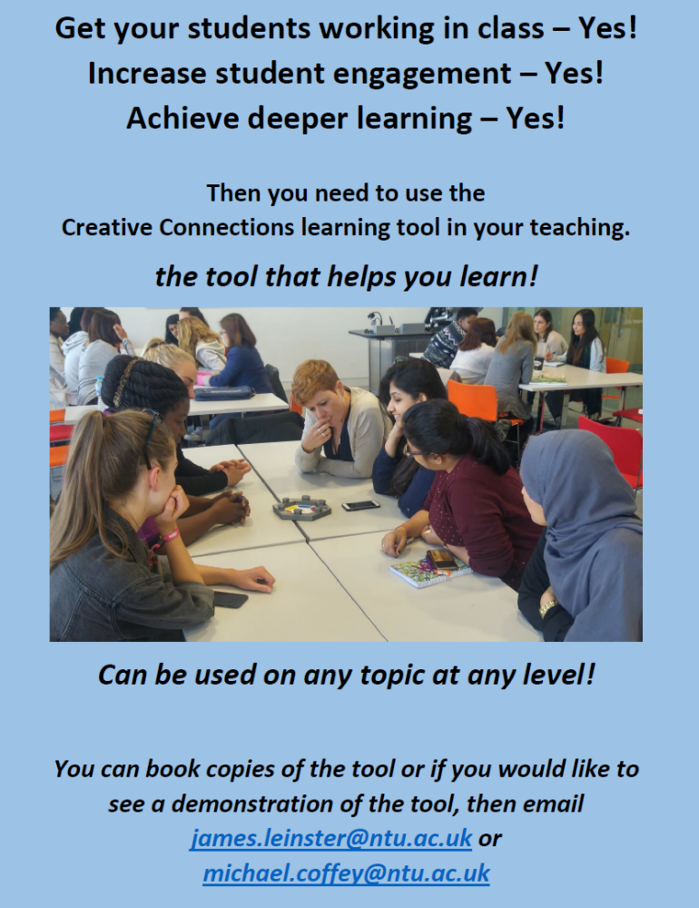
Conclusions
We have:
Been introduced to a learning resource: Creative Connections
Flexible/adaptable
Active learning tool
Easy-to-implement
Designed inserts:
Academically/module-content themed
Technical/skills themed
Discussed different approaches for class-room use:
Full/part session
Single/multiple inserts
Game-mode/directed discussion mode

Slide 20
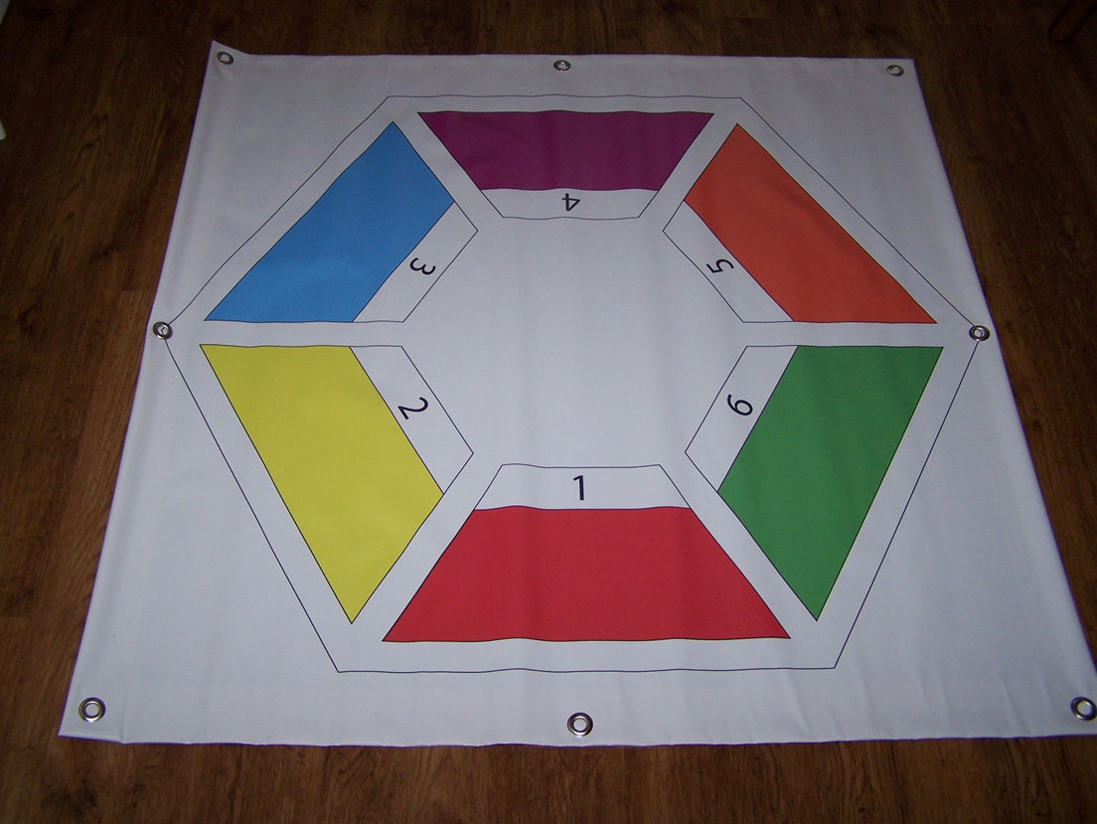


Thanks for your attention!
Interested in using Creative Connections in your class?
Contact:
michael.coffey@ntu.ac.uk
0115 8483149
james.leinster @ntu.ac.uk
0115 8488025
Supply insert template
Discuss structuring insert
Discuss ideas on classroom use
Option for pedagogic study on usefulness of resource

