Slide 1
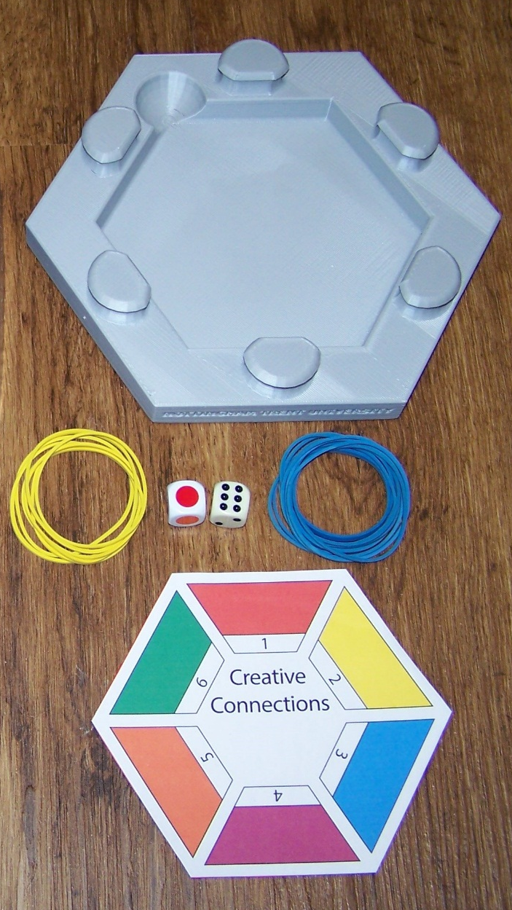




‘ Creative Connections’:
an adaptable resource to help students link ideas between topics
Dr. Mike Coffey – Chemistry & Forensics, SST
James Leinster – Nottingham Business School
Nottingham Trent University

Slide 2
Overview of this presentation
Why develop this resource? Desired objectives
Description of ‘Creative Connections’ What is it?
How might ‘Creative Connections’ be used? Examples of classroom use
Some views on outcomes Thoughts/experiences from user-trials
Future developments Invitation for those of you interested in trial
Conclusions

Slide 3


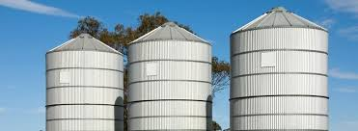
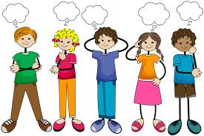
Why develop this resource?
Students (u/g and p/g) – pragmatic
Taught largely in modular systems
Tendency for “silo” learning
Structured way to break down this approach
Help students recognise (common) skills

Slide 4
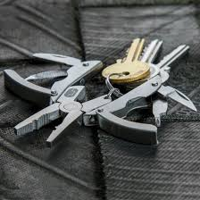

Aim to design resource that is ……….
Flexible – adapt to different courses/ different levels
Easy to implement
Active learning – engagement
Encourages wider/deeper thinking
A kind of educational “multi-tool”
Game-based-learning (GBL) Special Interest Group

Slide 5

The resource !
‘ Creative Connections’
Cradle
Connection (rubber) bands
Connect dice
Adaptable topic insert
Rules/Tutor notes

Slide 6
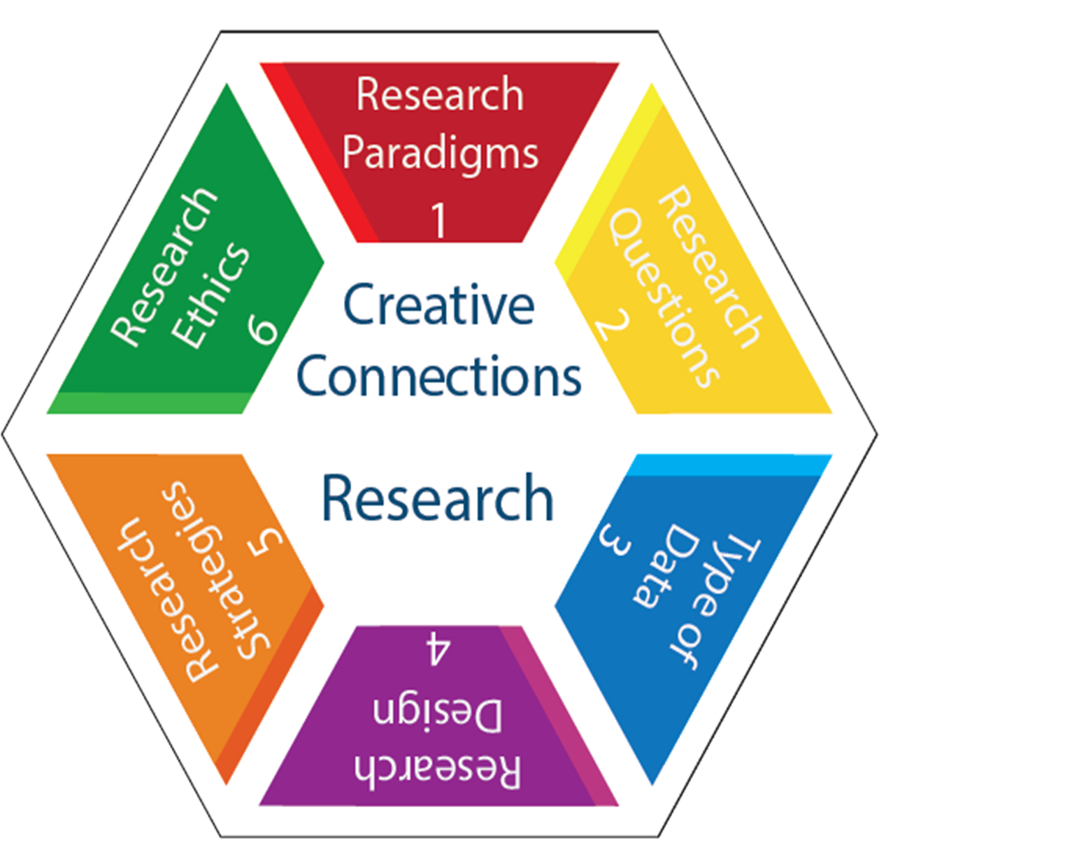
How to use ‘Creative Connections’
Pre-session planning
Tutor-defined:
Central Topic and
Related concepts/ideas/subjects (usually six)
Technical/course modules/skills
Adaptable PowerPoint electronic file plus colour printing
Laminate for durability/re-use
Blank laminated for in-situ generation of insert
Ease-of-use for tutor

Slide 7
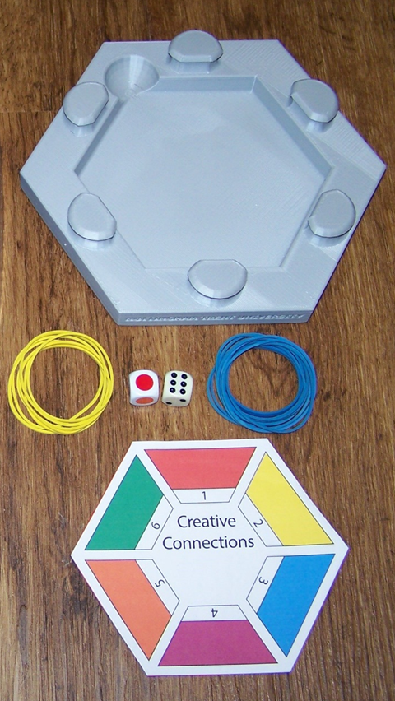
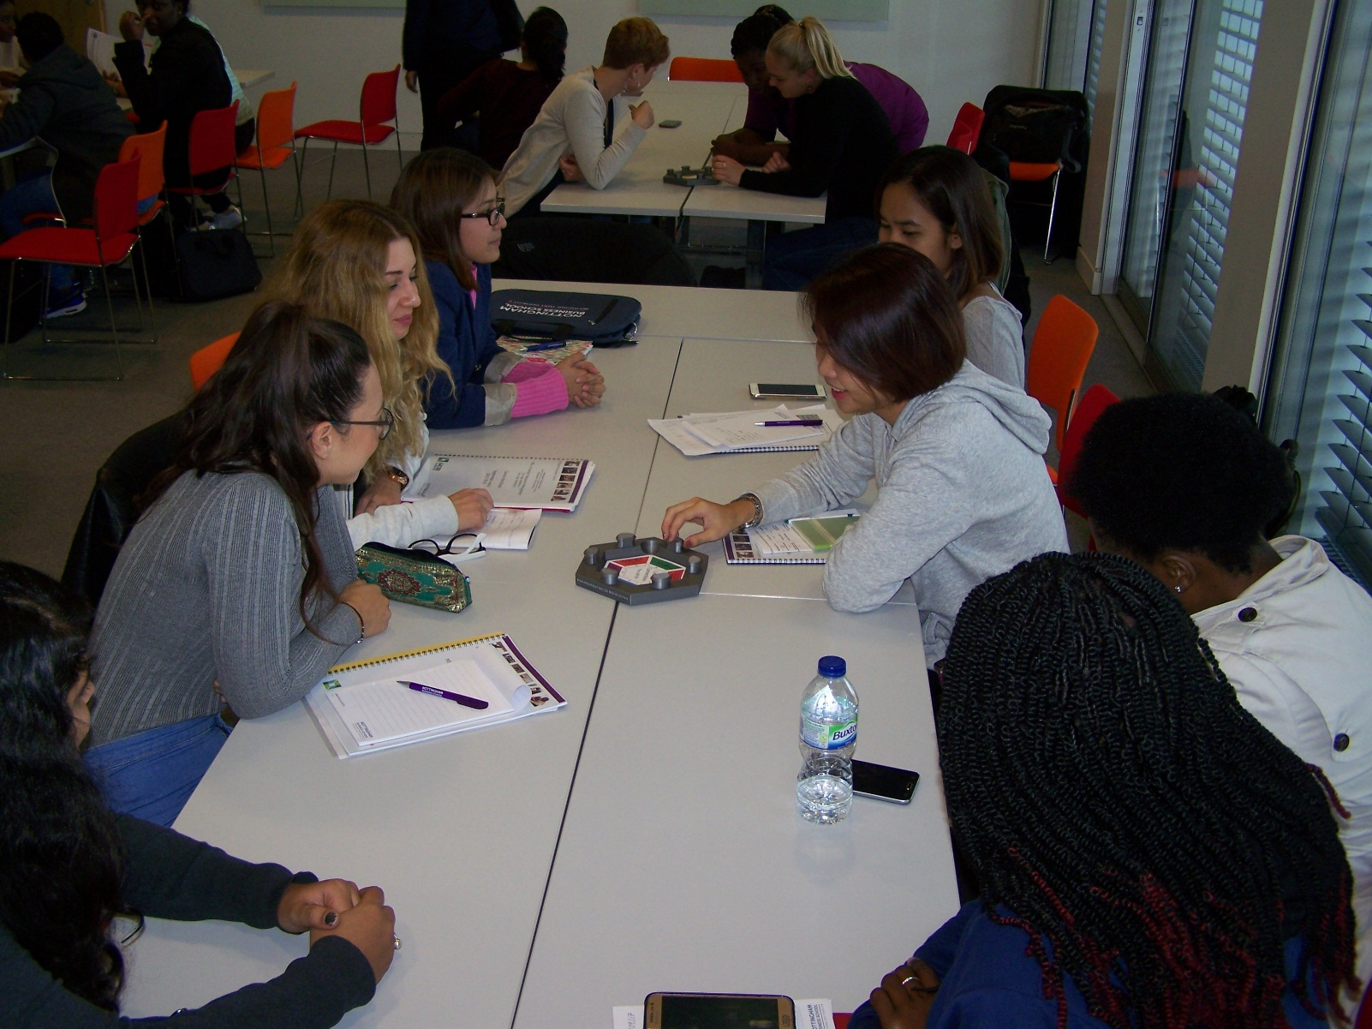
How to use………
Game-mode possibilities
Dice ‘choose’ topics to link
Small groups
Two-team competitive
Individual
Scoring system
Round-the hexagon
Engagement/active learning
Peer-learning

Slide 8
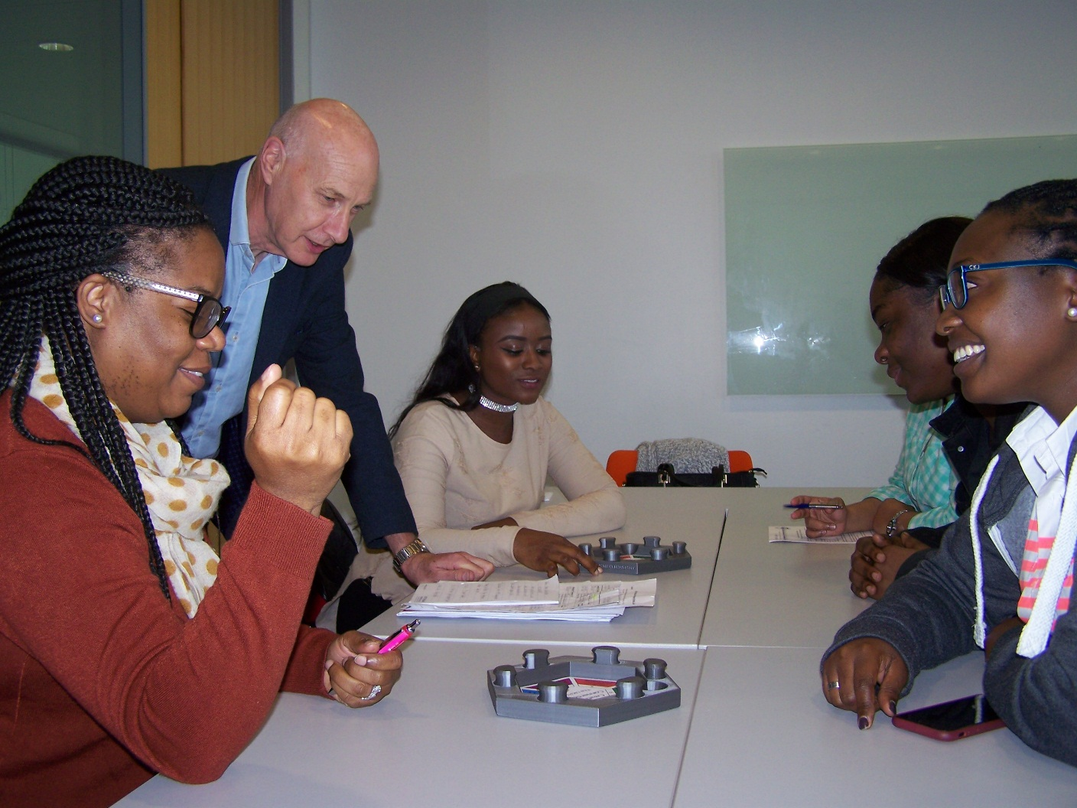
How to use………
Tutor mediated possibilities
Tutor chooses subjects to connect
Mediate discussion
Prompt for deeper thinking
surface link?
strategic link?
Use project PowerPoint without cradle
Structured discussion of links between topics

Slide 9
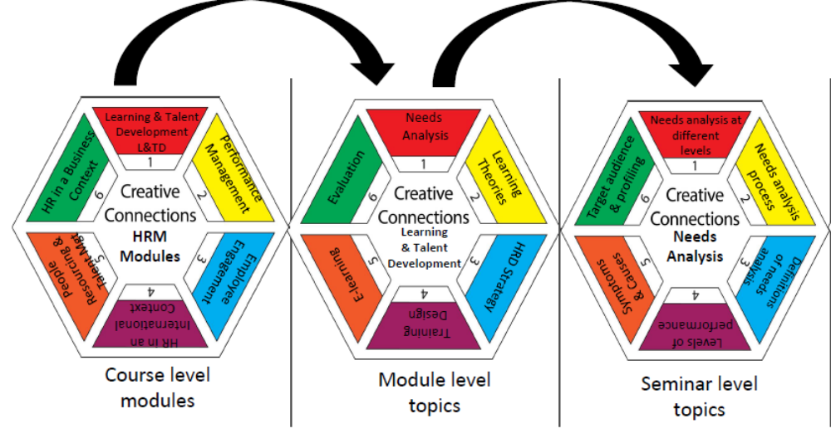
How to use……… Drill-down

Slide 10
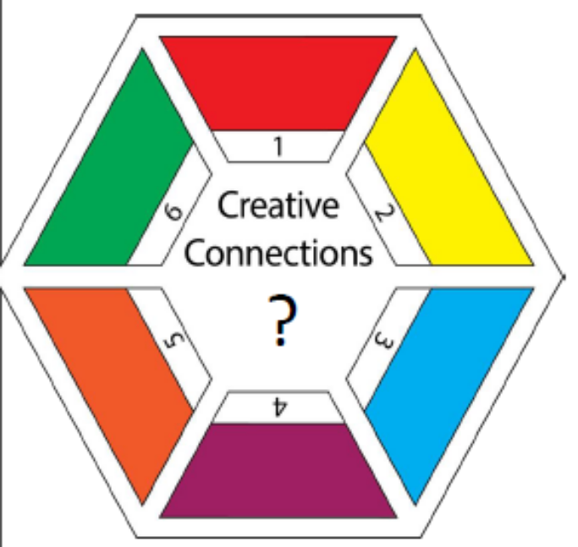
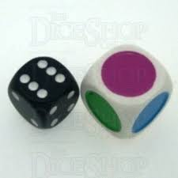
More ways to use……….
Hexagonal cradle:
- two cradles used together
- link variety
e.g. modules between academic years
e.g. course content to employability skills
- flexible to link between
content/ skills / technical competencies

Slide 11
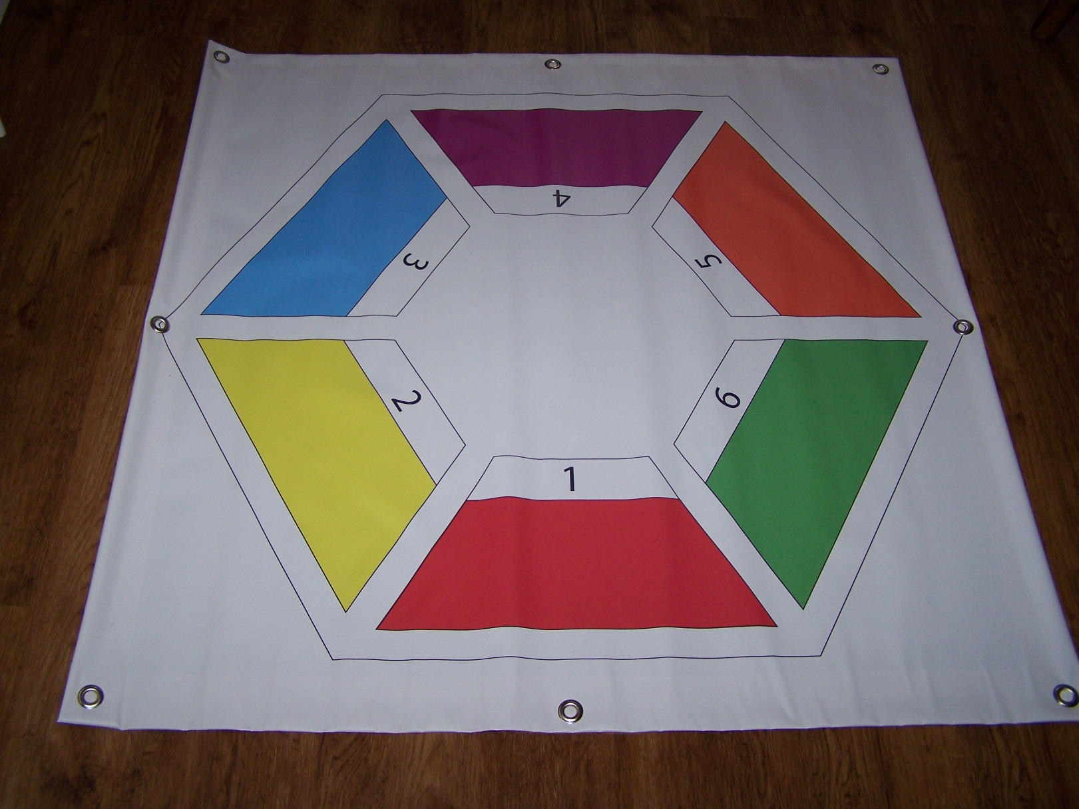
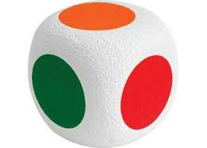
More ways to use………
Not quite “twister”:
Floor-version for active active-learning
- rope to indicate links
- giant foam dice

Slide 12


Where has the resource been used?
Phase 1: Preliminary trials
2015-8 Human Resource Management (HRM) courses, James Leinster & colleagues @ NBS
Student groups : Masters and u/g (Level 5)
5th International Educational Games Competition 2017, Graz, Austria - Finalist
Higher levels of engagement in class
Questions students’ to discuss application
It’s flexibility, to change topics and levels
Achievement of points in game mode, students’ get very competitive
Can be played at different levels, operational and strategic for example
Tutor views: encouraging

Slide 13

Can bring boring topics to life
It’s fun to play
Makes you think at a deeper level
Making connections across topics and modules
Really good game to help you revise for exams
Student opinion
very positive
“Students leave the session with a set of notes based on the connections and the follow-up discussions”

Slide 14
Nottingham Business School
HRM: Marketing: HRD
Science & Technology
Forensic Science: Chemistry
Social Science
Social Work
Animal, Rural & Environmental Studies
Employability
Arts & Humanities
Humanities at Work
Law
Art & Design
Four phases to test resource efficacy and versatility
Preliminary - opinion
Adaptability – use across subject areas
Robust pedagogical study
Extend to training (business) and/or practice
Student groups - mainly
Masters
Level 5

Slide 15
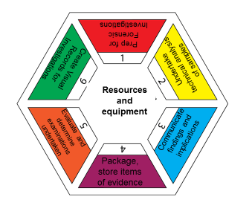
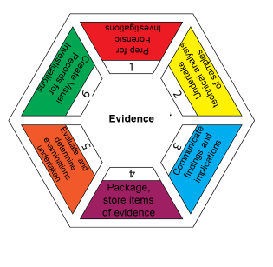
STEM example - Forensic Science
Level 5 module
Session for students to develop their portfolio
Link skills learned in course to national competency standards (NOS’s)
Tutor desired peer learning, brainstorming, active engagement, holistic thinking about taught course

Slide 16
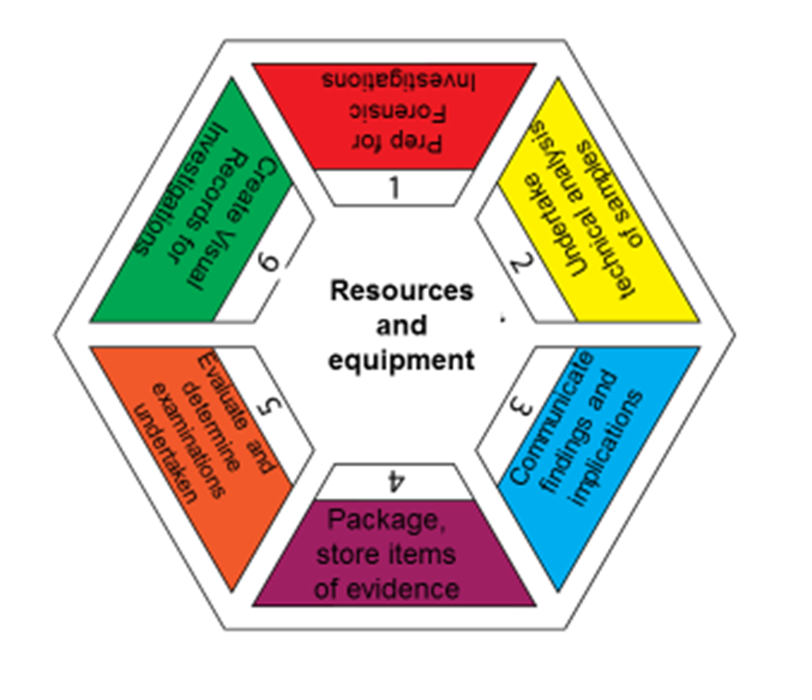

STEM example – Forensic Science
I have a better overall understanding of the areas my topic is broken into
More involvement looking at wide variety of subjects
Helped me keep concentrated for longer
Creative Connections did not help me improve my understanding

Slide 17
Future: Robust pedagogic testing of efficacy (Phase 3)
Current Phase 2
Simple pre-/post test (each @ 5 mins)
Simple learning gain metric
Opinions
4 Likert-scale Q plus three open answers
Not pedagogically robust
Emphasis on trialling versatility across courses and building body of tutor-users
Future Phase 3
Good size target groups
control sub-groups
age/gender/educational background
(multi-use) learning gain metric
learning behaviour change metric
Improved tutor support & advice
implementation methods of GBL resource

Slide 18
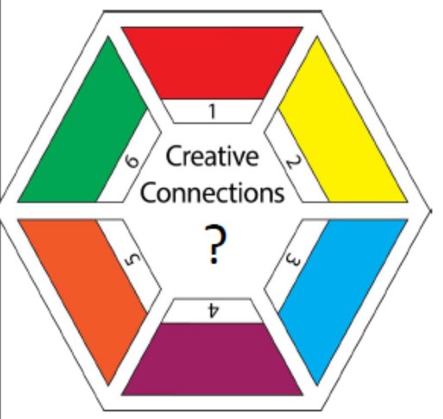

Future: extend use of ‘Creative Connections’ (Phase 4)
Other HE institutions
6th Form college/FE
Doctoral training
Workplace training

Slide 19

Conclusions
Described ‘Creative Connections’
versatile, adaptable, easy to implement GBL educational resource
Initial trials - positive feedback (tutor and student users)
“fun”, “engaging”, “helpful”
Extending range of courses across which the resource has been used
Seek to more robustly test efficacy as learning aid
Seek to test extent of versatility
wider range of HE institutions, FE, workplace

Slide 20
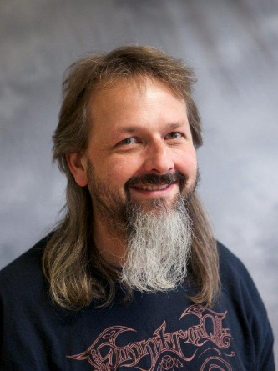
Thanks for your attention!
Interested in using Creative Connections in your class?
Contact:
michael.coffey@ntu.ac.uk
0115 8483149
james.leinster @ntu.ac.uk
0115 8488025
Supply insert template
Discuss structuring insert
Discuss ideas on classroom use
Option for pedagogic study on usefulness of resource

