Slide 1


Accentism at the Bar
Natalie Braber, Jane Ching, Jane Jarman, Jeremy Robson, Olivia Stevens
Linguistics advisory board: Rob Drummond, Sadie Ryan, Dominic Watt, Erez Levon, Devyani Sharma.
Law advisory board: HHJ Jason Reece, Lynda Gibbs KC, Samuel Coe, Michael Trevelyan, Lisa Hardy, Kerry Cockayne, Karl Hirst, Jas Dhaliwal, Claire Howell, Jamal Jeffers.
Notes:
Proposal:
In this paper we will discuss our pilot study into ‘accentism’ amongst barristers.
Accents are a marker of social class and different regional accents have different associations. Differentiating between individuals on the basis of accent amounts to discrimination on the basis of socio-economic background. The issue of accent as a possible barrier to progression at the Bar has been raised before but not studied. Law can only be used to achieve a public good if the legal professions represent the diversity of society. This project (funded by NTU’s Safety and Security of Citizens theme) aimed to collect preliminary data to establish whether this issue requires further investigation.
In the first strand of the project, participants were played a recording of a defence closing speech in a criminal trial delivered by male speakers with different English regional accents and a received pronunciation speaker. In an online survey completed by 99 members of the public, participants were asked to listen to the recordings and rate the speakers according to criteria including ‘professionalism’, ‘intelligence’, ’clarity’ and ‘confidence.’
The findings revealed significant variation in attitudes to speakers based on their accent. This paper will summarise these findings which indicated that certain accents were regarded more favourably than others in respect of the key attributes likely to be seen as positive in a barrister.
In the second part of this study, semi-structured interviews were conducted with seven practitioners and two students. A thematic analysis was conducted of their responses. Common themes emerged from the interviews regarding experiences of their treatment as people with accents and how they had seen the issue of accent treated in practice. The contents of these interviews will be discussed, along with their implications for diversity within the legal professions, implications for practice and directions for future research.

Slide 2

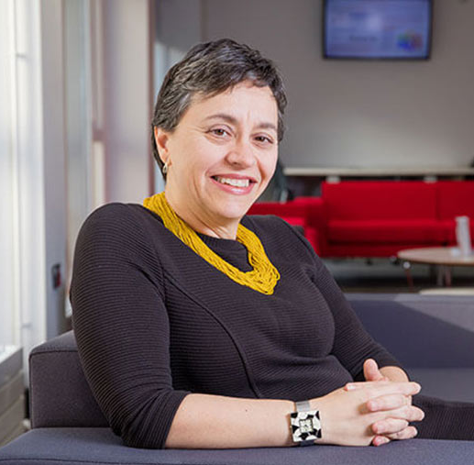
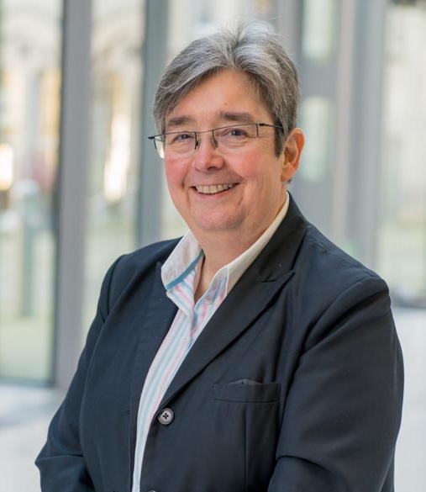


Prof. Natalie Braber
Prof. Jane Ching
Prof. Jane Jarman
Assoc. Prof. Jeremy Robson
Olivia Stevens

Slide 3
What is accent bias at the Bar?
Received Pronunciation (RP) has been long considered the ‘appropriate’ way for barristers to speak.
Fluency in RP is more likely in privately educated individuals, excluding those from lower socio-economic backgrounds and English regional accents.
So are English regional accents judged – both by the public and the profession itself?

Slide 4
“
When I started, of course, I had much more of a Liverpool accent than I do now… in those days …. when I went to my grammar school, we had elocution lessons. But nevertheless, what passed for talking properly in Liverpool, when I came down to London … I was instantly recognisable as a Northern lass. I still say “bath” and “laff”, as you may notice.
Cherie Booth KC
”

Slide 5
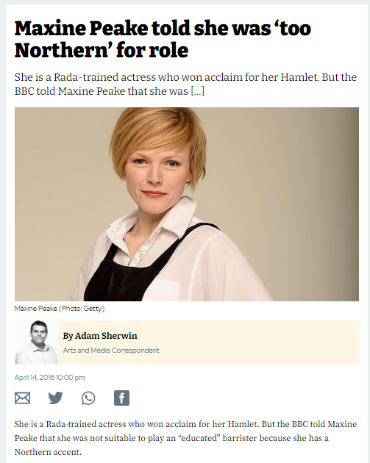
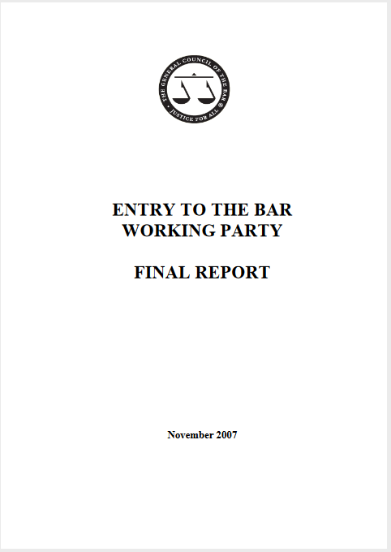
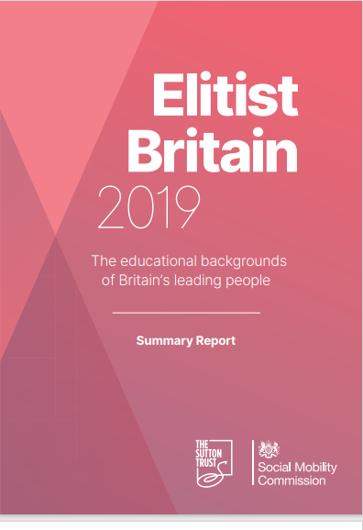
Why does it matter?
Accent prejudice prevents upwards social mobility for people within the UK. By investigating barriers in accessing the legal professions, we can improve their representativeness.
Accent is not protected under the Equality Act 2010 and can form a basis on which to discriminate, particularly in the elite professions.
But the Bar Standards Board has an obligation to encourage “an independent, strong, diverse and effective legal profession” (Legal Services Act 2007, s 1(10(f))
Notes:
From interviews: “Sometimes it's hard to know which one’s disadvantaging you really, is it my accent that's holding me back here or being commented upon or is it my social class? “

Slide 6
Our research questions
Do people respond more favourably to RP than other linguistic varieties in legal settings?
Do barristers believe that this is true – thereby suggesting that being well-spoken is a competence for barristers?
Is accent a factor in recruitment because it is believed that RP is part of the hidden social capital of this group of professionals?
What is said/done about this issue during pre-pupillage education for the Bar?

Slide 7
The Professional Statement for Barristers (E&W)
Exercise good communication skills
Speak fluent English
[B]e articulate and able to speak with fluency
[B]e able to adapt their language and communication to suit their audience, which may be clients, colleagues and others, from any background
Adapt language and non-verbal communication taking into account the message and the audience
Exercise good English language skills
Speak articulately and fluently
Notes:
Also
Promote diversity in the workplace and where appropriate challenge others if their behaviour does not comply with the spirit of the law relating to equality, diversity and discrimination
Be aware and active in the pursuit of equality and respect for diversity

Slide 8
The survey

Slide 9
Speakers with eight different English regional accents (including RP) read aloud a set statement similar to a barrister’s closing defence statement
Participants evaluated each recording on a Likert scale against set characteristics
Notes:
99 participants in total.
20 men, 76 women, 3 other.
32 = 18-30 years, 44 = 31 - 50 years, 23 = 51+ years.

Slide 10
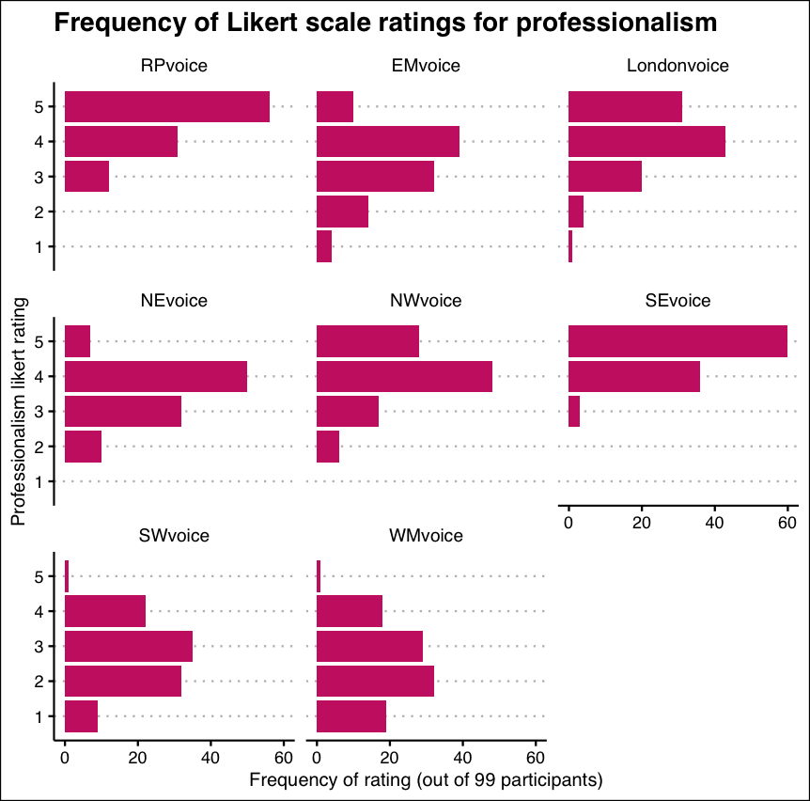
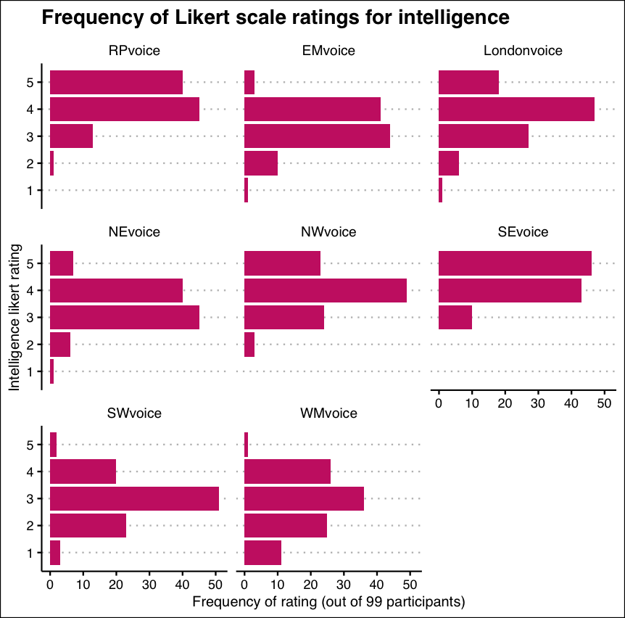
Professionalism and intelligence
Notes:
Professionalism
All accents apart from the SE voice were scored significantly lower in professionalism compared to the baseline RP accent.
The WM accent scored the worst in intelligence, professionalism and clarity.
Age and gender had no main effect on professionalism scores.
Accent similarity was significant – the more similar the respondent’s accent to the speaker the higher scores afforded in these traits.
No statistically significant improvement in the model when including two-way interactions – no further investigation.
Intelligence
All accents apart from the SE voice were scored significantly lower in intelligence compared to the baseline RP accent.
The West Midlands accent scored the worst in intelligence.
Age and gender had no main effect on professionalism scores.
Accent similarity was significant – more similar the respondent’s accent to the speaker the higher scores afforded in these traits.
Significant two-way interaction between accent type and gender. Gender other rated EM, NE, SW and WM sig higher than the RP voice compared to the baseline gender category female, where WM accent was rated the highest.

Slide 11
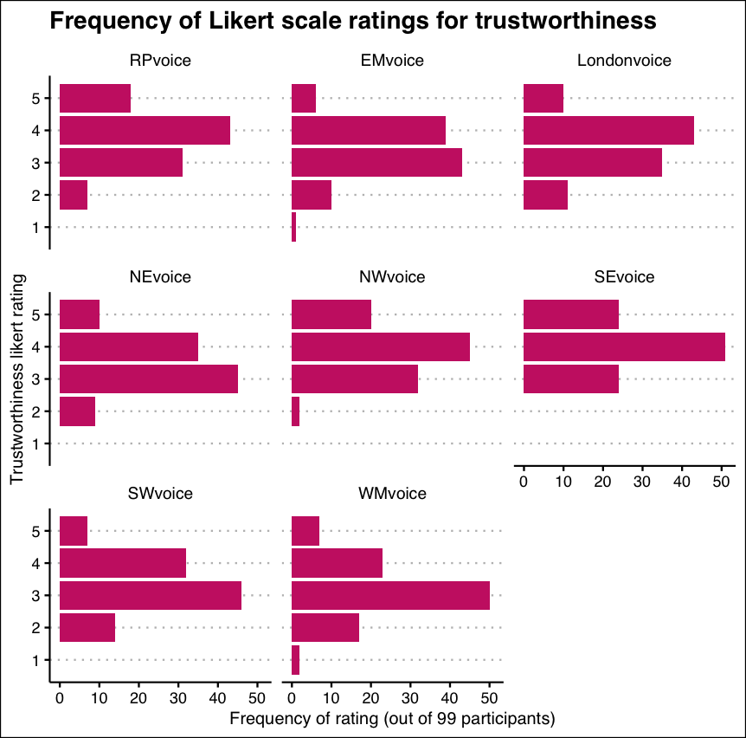
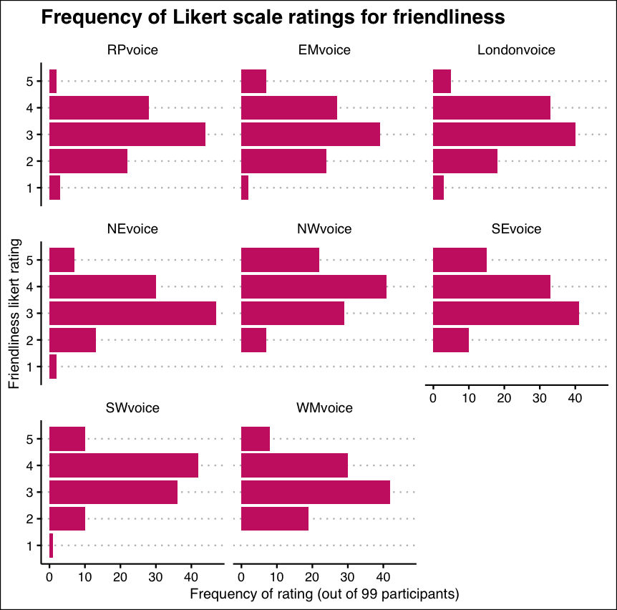
Trustworthiness and friendliness
Notes:
Trustworthiness
All accents apart from NE and NW (non-sig) scored significantly lower than RP baseline accent in trustworthiness (with WM being poorest scorer).
SE voice scored significantly higher than the RP voice in trustworthiness
Age and gender had no significant main effect on trustworthiness scores.
Accent similarity was significant – the more similar the respondent’s accent to the speaker the higher scores afforded in trustworthiness.
No statistically significant improvement in the model when including two-way interactions – no further investigation.
Friendliness
Every accent apart from EM and London (non-sig) were rated as significantly more friendly than the RP baseline voice.
The NW accent was rated as the friendliest.
Age and gender had no significant main effect on friendliness scores.
Accent similarity was significant – the more similar the respondent’s accent to the speaker the higher scores afforded in friendliness.
No statistically significant improvement in the model when including two-way interactions – no further investigation.

Slide 12
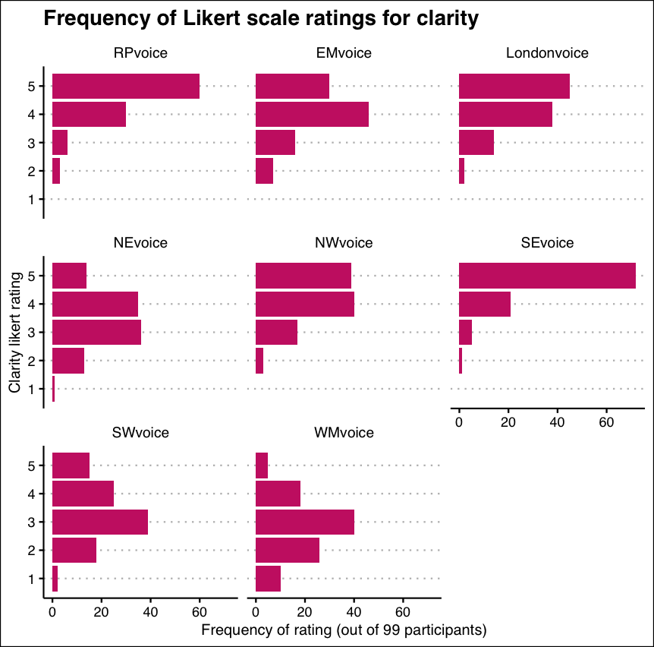
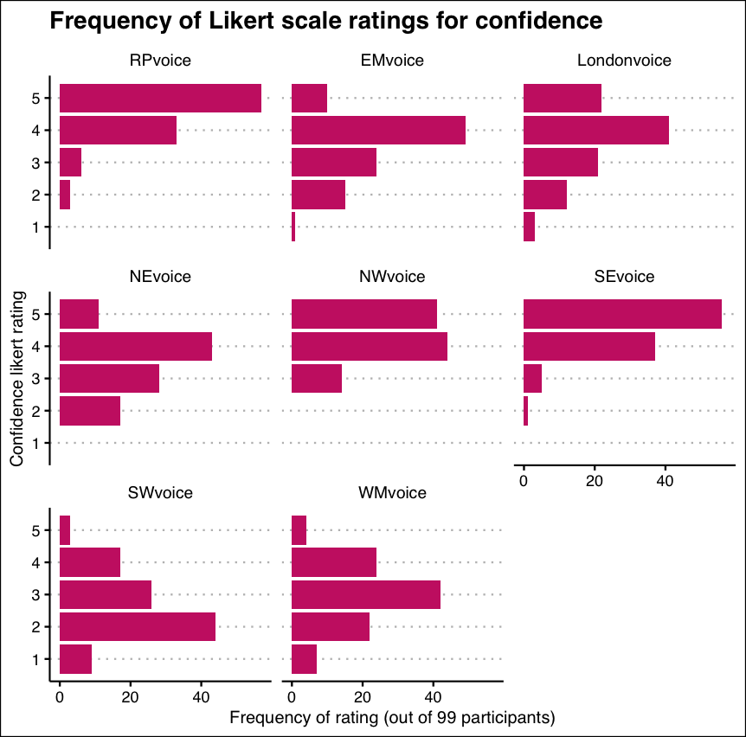
Confidence and clarity
Notes:
Confidence
Every accent apart from SE and NW (non-sig) was rated significantly lower in confidence compared to the RP baseline voice.
The SW accent was rated as the least confident.
Age and gender had no significant main effect on confidence scores.
Accent similarity was significant – the more similar the respondent’s accent to the speaker the higher scores afforded in confidence.
No statistically significant improvement in the model when including two-way interactions – no further investigation.
Clarity
All accents apart from the SE voice (non-sig) were scored significantly lower in clarity compared to the baseline RP accent.
The WM accent scored the worst in clarity
Age and gender had no significant main effect on clarity scores.
Accent similarity was significant –the more similar the respondent’s accent to the speaker the higher scores afforded in these traits.
No statistically significant improvement in the model when including two-way interactions – no further investigation.

Slide 13
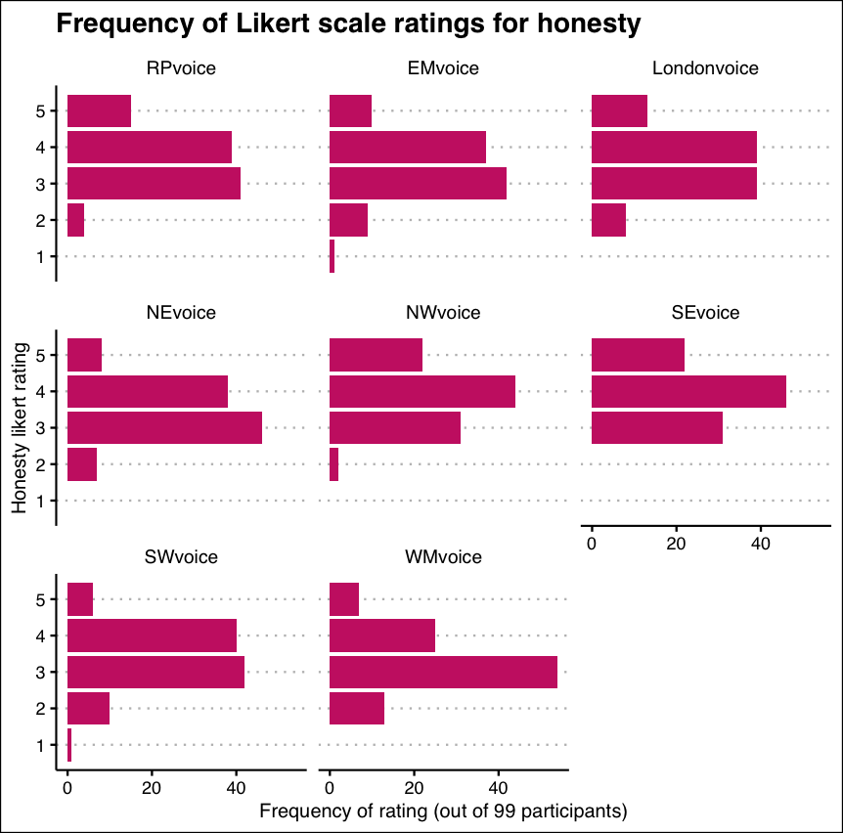
Honesty
Notes:
NW and SE scored significantly higher than the baseline RP accent in honesty.
The NW accent scored highest in honesty.
WM was the only accent to score significantly lower than RP and therefore was the lowest scorer in honesty.
Age and gender had no significant main effect on honesty scores.
Accent similarity was significant - the more similar the respondent’s accent to the speaker the higher scores afforded in honesty.
Significant two-way interaction between accent type and age:
The 31-50 age group rated the NE accent significantly lower in honesty than the RP baseline compared to the baseline 18-30 age group.
Significant two-way interaction between gender and age:
Gender other aged 31-50 years rated all accents significantly lower in honesty compared to the baseline gender female and baseline 18-30 age group.

Slide 14
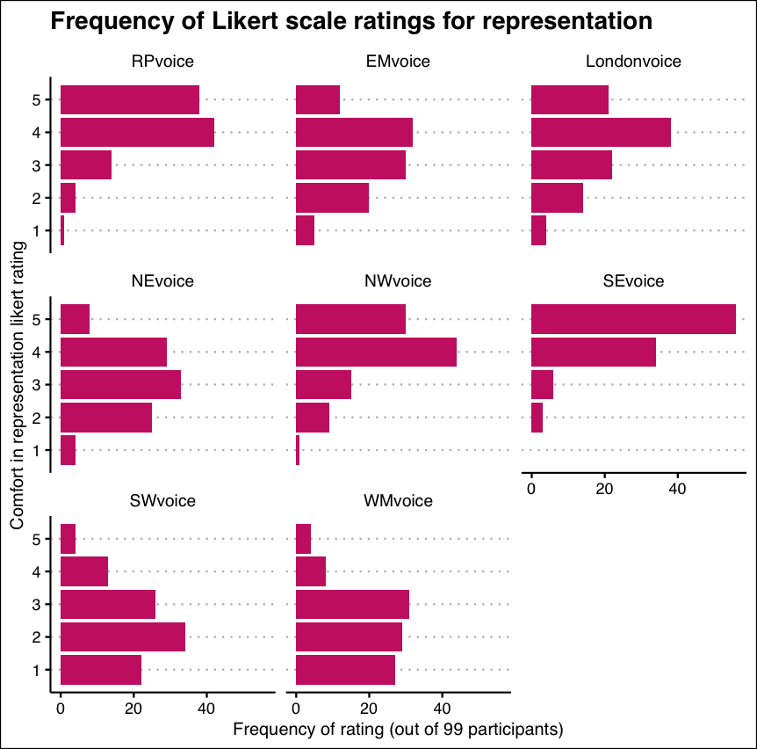
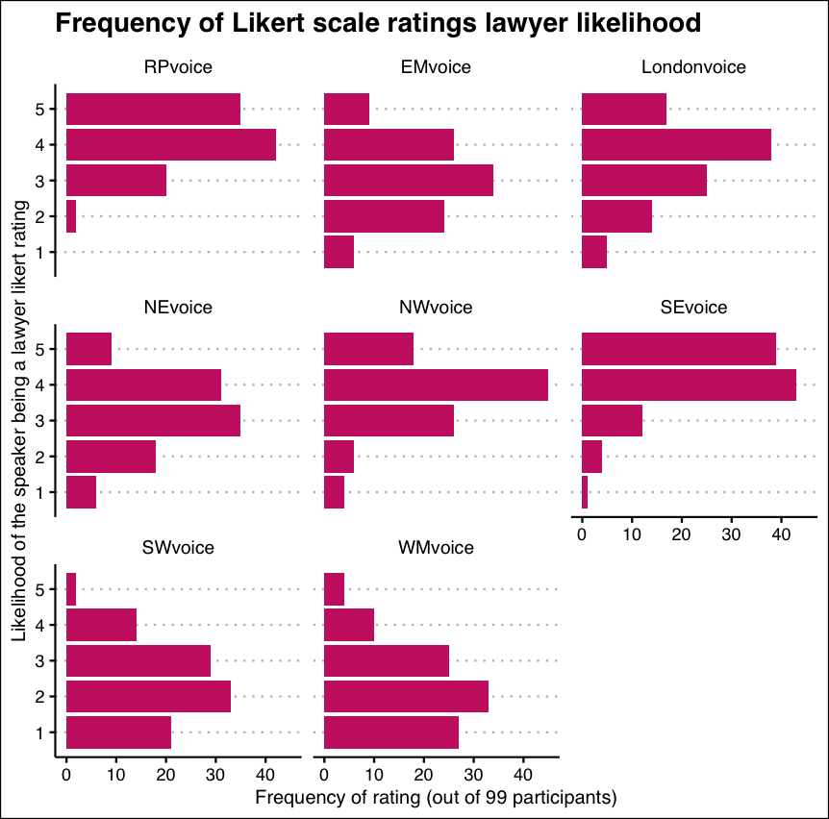
Representation and likelihood of being a lawyer
Notes:
Representation
All voices apart from NW (non-sig) significantly lower on representation than the baseline RP voice. WM scored the lowest.
SE voice scored significantly higher in representation than the baseline RP voice.
Age was significant - those aged 51+ gave lower representation scores across all accents compared to the baseline 18-30 age group.
Gender had no significant main effect.
Accent similarity was significant - the more similar the respondent’s accent to the speaker the more comfortable they would feel being represented by the speaker in court.
Significant two-way interaction between accent type and gender:
Men rated the London and SE accent significantly higher than RP compared to the baseline gender, females, with SE being the highest scorer for men.
Gender other rated EM, NE, NW, SW and WM accents significantly higher than RP compared to the baseline gender, female, with WM being the highest scorer.
Likelihood of being a lawyer
All accents apart from SE (non-sig) scored significantly lower than the baseline RP accent in likelihood of being a lawyer. The least likely to be perceived as a lawyer was the WM voice.
Age was significant as a main effect where those aged over 51 in general gave lower lawyer likelihood scores across all accents compared to the baseline 18-30 age group.
Gender had no significant main effect.
Accent similarity was significant - the more similar the respondent’s accent to the speaker the higher the likelihood they perceived the speaker to be a lawyer.
Significant two-way interaction between accent type and gender:
Men rated the SE accent significantly higher than RP compared to the baseline gender female.
Gender other rated the WM accent significantly higher than RP compared to females.

Slide 15
The interviews
Notes:
Semi-structured interviews with current members and those intending to join the Bar:
Students training for the Bar
Early career barristers (second six and up to 2 years post-pupillage experience)
Senior barristers (7+ years call or QC)
Experiences of accent bias.
Does accent play a role in recruitment?
Does accent facts into training?
Has accent bias changed over time?
There were some challenges in recruiting during the limited time period of the project but interviews were carried out with two Bar students (S1 and S2), two early career barristers (second six months of pupillage to two years post pupillage: EC1 and EC2) and five senior barristers who were at least seven years post call or QCs (Sen1 – Sen5). Despite the small size of the sample, interviewees represented a range of regions and nations: Yorkshire, the East and West Midlands, the South-East, Ireland and Wales.
At the time of interview: now KCs.

Slide 16
Historical accent discrimination at the Bar
“
‘If you ever want to practise at the Chancery Bar, you will have to lose your Yorkshire accent.’
[a comment by a judge in a moot]
[a] very senior silk, who’s actually now a High Court judge, … said something about how he could never countenance these regional accents at the Bar.
[senior barrister]
”
Notes:
Senior barrister: Most barristers used to be posh and historically the Bar was limited. [It was] very insular and people felt free to comment about others.
Historically, it was much more common to discuss barristers’ accents and there could be mockery.
People tended to recruit others ‘like them’ (affinity bias).
Many judges are still seen as being ‘old school’ and slow to change.
‘Jokey’ comments were common – from judges, barristers and in court.

Slide 17
Times have changed
“
I'd say about twenty per cent of judges maybe might be going with their normal regional accent. Most are still RP.
[early career barrister]
I'd like to think that no one in any pupillage committee I know would make those kind of comments these days. Certainly if any of myself or my friends or peers heard them, I think we'd stomp them out very quickly.
[senior barrister]
”
Notes:
A number of comments from across the groups were that the Bar is now much more inclusive and has changed over the past few decades.
Commented that younger people coming in don’t consider accent an issue. Also, one senior barrister said: ‘we tend to leave our juniors just to get on with it and do their own thing, accents as well’.
Learning materials stress that accent is not an issue and this is often conveyed in classes. While in training, there are more likely to be people who sound more like you do, but pupillage (esp in London) changes that.
There is quite a wide variety of discussion about how things have changed and improved – followed by mention of discrimination and preconceived ideas.

Slide 18
There is still accent discrimination
“
And it might just be one sort of comment from one person and it's not representative of the Bar, but when you are already conscious of the fact that you sound different, hearing comments like that definitely creates a barrier, I think.
[student]
[B]e aware that some people will judge you on the basis of that and there are still barriers, … I don't mean you should change your accent, I just mean to be aware of it and be able to deal with it, really.
[early career barrister]
[S]ometimes it was, …. used like a tactic to just kind of maybe knock my confidence as a young barrister.
[early career barrister]
[Y]ou never know juries might like it and it …might well appeal to someone who's also from the local area and it might be easier to persuade them, for example, than someone who's got ... a London accent or something like that.
[early career barrister]
”
Notes:
A number of comments from across the groups were that the Bar is now much more inclusive and has changed over the past few decades.
Commented that younger people coming in don’t consider accent an issue. Also, one senior barrister said: ‘we tend to leave our juniors just to get on with it and do their own thing, accents as well’.
Learning materials stress that accent is not an issue and this is often conveyed in classes. While in training, there are more likely to be people who sound more like you do, but pupillage (esp in London) changes that.
There is quite a wide variety of discussion about how things have changed and improved – followed by mention of discrimination and preconceived ideas.
Many barristers still don’t have regional accents ([It is] ‘hard to have an accent in court’). Some training includes actors with accents.
There is much comment on ‘teasing’, ‘joking’ and ‘banter’ that can be barbed and make people very conscious of their accent (‘people from Redcar going to university now?’).
A pupil said that they did not receive pupillage at one chambers because of the way they spoke (‘too many fillers’) and worried their accent may affect their prospects.
Another pupil said their friend from Yorkshire was told they needed to change their accent.
Several references to the fact that if you sound different, this can be pointed out in court as an aside without specifically mentioning accent, but ‘othering’ barristers.
A senior barrister said that having a strong accent might make judges and juries question what you are saying more, ‘there is no camouflage’.
Many interviewees mentioned that they know ‘a judge’ with a regional accent, but these are rarities.
Unconscious bias
Another senior barrister said ‘People with strong regional accents do not have authoritative body language that people brought up with words will have – they won’t have the facility with language’.

Slide 19
Changing your accent?
“
[A] number of very, very senior barristers and judges who we know come from the regions and were brought up there, who do not speak as if they were brought up there and so you've got to wonder how their accents have developed to the way that they have or in the way that they have.
[senior barrister]
[T]here are there are shifts and tones throughout the day quite regularly, yeah, probably quite subtle ones, but quite regularly.
[early career barrister]
”
Notes:
Soft’ accents are often seen as acceptable, as are non-native English speakers.
Many urban accents are not seen as desirable – Birmingham and Liverpool.
It is often seen that those moving up in their career get ‘plummier’. Certain fields of law differ, business law prefers ‘more professional sounding barristers’.
References to clients feeling that certain accents may produce a ‘better outcome’ but others are ‘more trustworthy’.

Slide 20
Feedback in training
“
[T]hey were quite good about making sure that people didn't feel there was a standard accent for barristers, … just sound like yourself… they were always very good at telling us to be honest with that.
[early career barrister]
I remember there were some people who were slightly concerned about it and obviously asking questions to their tutors about “will my accent be a hindrance?” and the general response was no.
[early career barrister]
I've been told that I need to work on … my tonality because it's quite flat, but I've sort of explained to them that … where I'm from, … that's how we talk. So, I get kind of what they're saying and they're trying to help me improve. But at the same time, no one else is getting that criticism.
[student]
I think they sort of frame it as the way that your tone of voice is and you know, don't say this, don't put it like that. But I think definitely there is that undertone of like you need to change the way that you sound a bit. They don't sort of explicitly say that …, but you can sort of tell that that's what they are getting at.
[student]
[T]he more comments I’ve heard have actually been from the robing rooms and more older senior members of the Bar not so much actually during my training.
[early career barrister]
”
Notes:
Also “had a London tutor for a seminar and they literally told her … ‘You need to change your accent’”.

Slide 21
Career decisions are made about being able to ‘fit in’
“
I do stand out when I’m at [one of the inns]. But you know what, I think that's the best part about it 'cause in the past as you probably know, the Bar was less diverse, now it's very diverse. … I feel like the more I do to keep changing my accent, it's not benefiting anybody. Probably I’m fitting in more, but then really … you’re not changing anything
[student]
I don't think I had any specific comments at my accent during interview. But sometimes you do. You do… get things like, oh, you know, “We're not sure you're [the] right fit” or whatever that means.
[early career barrister]
[There are] a lot of chambers [in London] I’ve not gone for. I’ve got the grades for it. I know straight away I won’t fit in, so I’m not. I’m not going to.
[ student]
”
Notes:
Discussions about other aspects of language being important – clarity, speed, colloquialisms, technical language.
A pupil commented that they have avoided certain chambers as they would not fit in, ‘not posh enough’.
A senior barrister felt they stood out as a junior lawyer and moved back north.
Another senior barrister said they felt their accent helped their chambers with a tick box – different, but not too different.
Language can be a performance and some judges don’t like certain accents.

Slide 22
Perceived discrimination is problematic
“
I’ve met barristers with accents and that’s great, but they tend to have this sort of like proper English accent, so I think it is worrying if you’re trying to break into the profession to not hear anyone that sounds the way you do.
[student]
I’ve never met a barrister who sounds like me.
[early career barrister]
”
Notes:
Several comments, specifically from pupils and early career barristers that they would like role models who look and sound like they do.
A pupil said ‘I’ve never met a barrister who sounds like me’.
Talk of imposter syndrome.
An early career barrister said ‘Some people self-select not to join’ – they feel their accent or background would stand in their way.
A senior barrister said ‘There is leg pulling but is it barbed criticism?’
Many mentioned at all levels that some people feel they don’t belong in this field.

Slide 23
Conclusions
Can accent bias ever fade unless people retain their natural accents and rise through the system?
Accent is still a barrier – but this is hard to prove as it is often hidden (‘face doesn’t fit’).
There is often a subtext that certain accents are not acceptable in court (Manchester, Birmingham, Liverpool).
Barristers are still supposed to look and sound a certain way.
It may not be said as explicitly as it used to, but it seems accent is still an important aspect of being a barrister.

