Slide 1

Preventing fires and meeting targets: tensions between transactional and relational approaches to measurement in UK fire prevention
Charlotte Pell, PhD candidate
Postgraduate Researcher, Centre for Economics, Policy and Public Management at Nottingham Business School at Nottingham Trent University

Slide 2
Purpose of Presentation
To explore the tension between a transactional and relational approach to fire prevention
To share emerging results from a case study at Nottinghamshire Fire and Rescue Service
To ask for feedback from you on further relevant academic literature

Slide 3
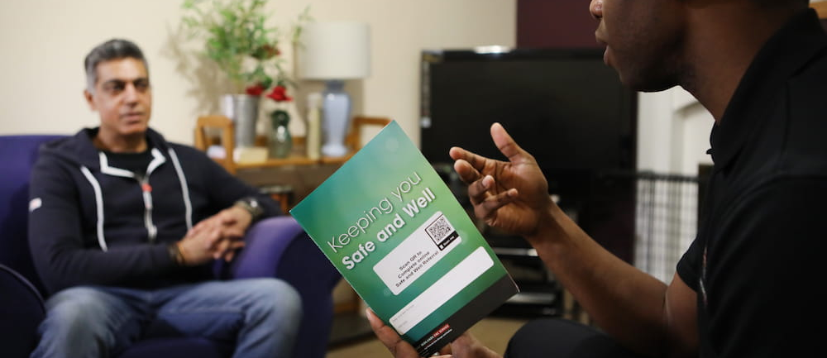
Safe and Well visits

Slide 4



Context

Slide 5
NFCC Person Centred Framework
“Being person-centred means being enabling. The starting point for being enabling is seeing people as assets, not burdens and seeking to support them to recognise, engage with and develop their sense of resourcefulness, and to build on their unique range of capabilities.”
“Being person-centred means offering personalised support. Because we are all different, person-centred support is tailored to the needs and aspirations of each individual, not standardised to their condition or circumstances.”
“Being person-centred means offering coordinated support. It’s not just individual encounters that matter – services should offer or be part of coordinated support across multiple episodes and over time if needed. “

Slide 6
Literature
Fire Prevention literature
Public services literature with a relational theme
Systems thinking literature
Literature critical of New Public Management
Broader literature on the measurement of public services
Literature on public service ethos and public value
Public service motivation theory

Slide 7
Methodology
A qualitative case study at Nottinghamshire Fire and Rescue (thirty six semi-structured interviews, meeting observation and following the data)
Initial literature review of academic, grey and policy literature

Slide 8
Emerging Themes
A strong, shared purpose
A genuine desire to help people
A debate about quality versus quantity
Supportive leadership?

Slide 9
A Strong, Shared Purpose
…think it does come down to the purpose of NFRS is community safety and keeping those at risk safe. It’s probably , a cliché answer, it’s the corporate answer but it is the answer. (INT 15)
I suppose morally, we’re here to create safer communities, which is our strapline. (INT 56)
I suppose there is that strapline of creating a safety community. But … it is a strapline but that is what we’re about, is making sure people are safe, whether they live here or travel through the county. So it is a strapline, but I think that’s what it is. (INT 16)

Slide 10
Helping People and Doing a Good Job
…it probably sounds really cheesy(!) but it’s just keeping the community safe. (INT 19)
…helping people you know it’s now the sort of like ultimate job to be able to do that (INT 47)
It’s just something that appealed to me, working with the community, you know, saving people’s lives basically. (INT 13)
And I suppose I joined to make a difference in my community (INT 56)
very much led … led by improvement. And that’s what motivates me. I also … if my action is going to have a positive outcome of that improvement and that development, then I’m very motivated. (INT 15)
What motivates me? Doing a good job. (INT 06)

Slide 11
Quality Versus Quantity
…so not being numbers driven would help in terms of focusing and targeting resource where it would make most difference (INT 28)
…that targets can create a problem, certainly when it’s number based. Although we have targets for everyone to reach in terms of numbers of safe and wells carried out, in certain areas, particularly in my team, I see it as a problem, because what I don’t like to think is that someone’s rushed to do a case and … put it in a box, and move on to the next one. I would rather them see it through properly and close the loop and all the loose ends … to make sure we’ve done everything we can do. (INT 15)
…you don’t want performance management just being a stick to beat people with because that’s where the chasing of targets comes and the quality decreases. (INT 47)
But it’s very numbers orientated. So we’re very kind of obsessed with how many safe and well visits we’ve done, … and how many business safety checks we’ve done. (INT 42)

Slide 12
Quality Versus Quantity
…… if I wanted a job chasing figures and targets, I’d have gone and got a job in a shop as a sales assistant, you know. I don’t want to do that, I want to do the job properly and make sure it’s done to the best of my ability. (INT 13)
Because it’s somebody’s life, the other side of that and … referrals that we can make, they can change that person’s wellbeing and day to day life quite quickly, which is great, but we need to keep in mind as a priority that you know these are people and these aren’t targets. (INT 19)
So you’ll always get the behaviours of people going for the path of least resistance and they’ll say, well if it’s a numbers thing, then we’re just going to try target all the low ones and do them as fast as we can and satisfy the numbers. But our core role is to help people and create safer communities and doing that is not doing that. (INT 47)

Slide 13
Supportive leadership?
No, we just do what we feel is right, we stick … we do three a day. (INT 13)
I’ve never really been one to be sitting looking at the numbers and going, am I achieving, I just work as hard as I can and the results come anyway… (INT 47)

Slide 14
Early Conceptual Framework
Type of decision making | Used predominantly by | Data used
Reputation-based decision-making | Senior managers and the Fire Authority | HMIFRS inspection reports Political capital Performance indicators (largely based on numbers) Benchmarking data Government legislation Consultancy reports Anecdotal data from staff
Evidence-based decision-making | Middle managers | Incident data, demographic data and feedback from service users, person-centred data A strong emphasis on the quality of services to the public
Situation-based decision-making | Frontline staff | ‘What it says on the form/system’ Targets from their managers What they see and hear on the ground Informal intelligence from colleagues/partners/managers Dynamic/visual data coming from vulnerable people/community. ‘Doing the right thing’

Slide 15
Initial Findings
A clear commitment to purpose
Strong public service ethos
Support at every level for quality (‘doing it properly)
Numerical targets talked about as a ‘only a guide’
Target culture (in this one case study) isn’t as I expected (based on studies carried out in UK police and ambulance services)
There be may be pressure to ‘chase the numbers’ in the service, but no one interviewed has said they change what they do to meet targets
Person-centred, relational approach appears to be taken in Safe and Well visits
Staff know that Safe and Well visits prevent fires and keep people safe, but they don’t appear to collect data to measure achievement of this purpose

Slide 16
Questions Raised
Is there a ‘targets culture’ in UK fire and rescue services? How does this compare to other emergency services? If it is different, why?
If there is pressure on UK fire and rescue services to ‘chase the numbers’, and if so, where is this coming from?
What impact is the National Fire Chief Council’s Person Centred Framework having on fire prevention practice?
What kind of qualitative measures are being used by fire and rescue services (and could be used in the future) to understand whether Safe and Well visits are achieving their purpose, in a way that is truly person-centred?

