Slide 1




Strategic CPD Masterclass
Corporate Governance
16 March 2023

Slide 2
Facilitator: Susannah Hancock: NFCC Chief Operating Officer
Diana Melville, FCPFA, Governance Advisor CIPFA
Peter Murphy: Professor of Public Policy and Management at Nottingham Business School
Cllr Frank Biederman: Chair of LGA Fire Services Management Committee & Devon and Somerset Fire and Rescue
Susannah will open and introduce the masterclass
Today’s Speakers
Notes:
Susannah to open and welcome attendees to the masterclass. Great to see so many online. Please can we ask you to keep your cameras off and put yourself on mute, thank you.

Slide 3
Susannah will provide an overview
Purpose of the Masterclass
What does good governance look like, and how can it be achieved?
Developing good governance across your organisation
Understanding different governance structures and roles – locally and nationally (The primary governance responsibilities of fire and rescue authority members and the Statutory Officers to support them)
The LGA/FSMC responsibilities of FRA Members.
This is one of many masterclasses within the NFCC Leadership Programme.
I will share my screen once Susannah hands over to you, Diana.
Notes:
Susannah to open and welcome attendees to the masterclass. Great to see so many online. Please can we ask you to keep your cameras off and put yourself on mute, thank you.

Slide 4
Good Governance
Diana Melville FCPFA, CIPFA

Slide 5

What is the Governance Framework?
Delivering Good Governance in Local Government, Framework 2016
A set of principles that should underpin an authority’s:
Planning, priorities, and objectives
Decision making
Policies & procedures
Culture, values, ways of working
Set by CIPFA and Solace
Based on the International Framework Good Governance in the Public Sector

Slide 6
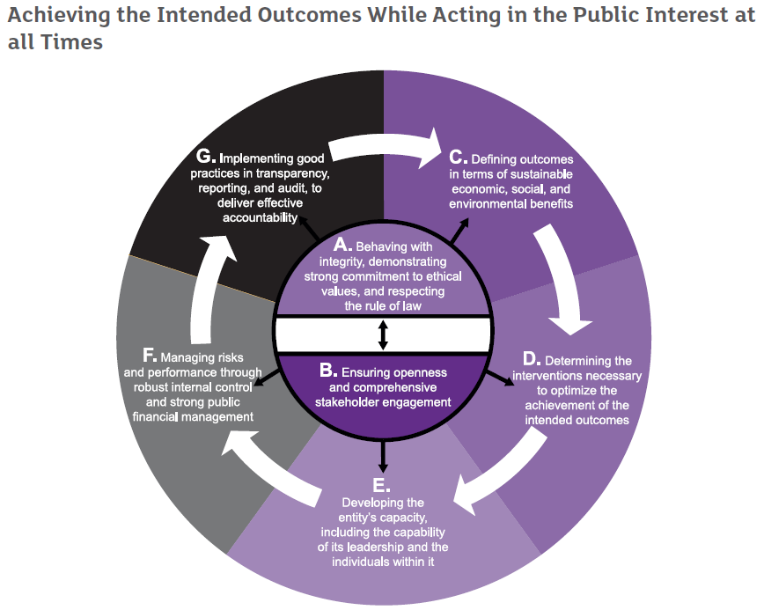
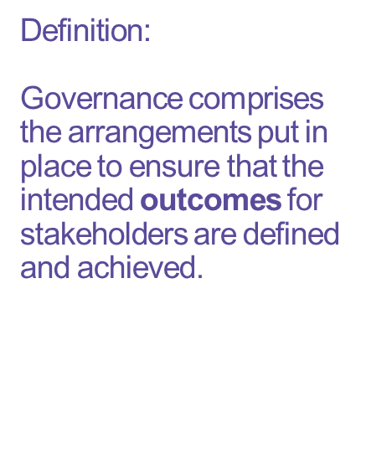
Definition:
Governance comprises the arrangements put in place to ensure that the intended outcomes for stakeholders are defined and achieved.
Delivering Good Governance in Local Government, Framework

Slide 7
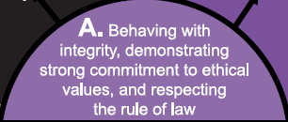
Why is Principle A so important?
Underpins the overall goal of ‘acting in the public interest’
How matters as much as what
Covers culture as much as compliance
Build and maintain public trust
Links to Principles on Standards in Public Life

Slide 8
Principle B - Ensuring Openness and Comprehensive Stakeholder Engagement
A range of stakeholders
  Institutional stakeholders, individual citizens, and service users
How matters as much as what
Understanding the full range of views
Building engagement

Slide 9
Good Governance in Practice
Going beyond policies and procedures
Hearts and minds
  Understanding
  Leadership – setting an example
  Shared values
  Reinforcing the right behaviours
  Addressing problems

Slide 10
Principles C and D
Determining the interventions necessary to optimise the achievement of the intended outcomes
Defining outcomes in terms of sustainable economic, social, and environmental benefits
Gets to the heart of an organisation’s purpose
Vision and leadership
Recognises long-term impact
Recognises the need for sustainability
  Environmental, Financial, and Social
Plotting the path
Plans and projects
Commissioning
Working in partnership
Quality and performance management

Slide 11
Principle E – Capacity and Capability
E. Developing the entity’s capacity, including the capability of its leadership and the individuals within it:
Capacity essential for the delivery of:
  workforce
  assets
  collaborative arrangements
Capability essential for:
  leadership
  decision making
  advice, guidance, and delivery.

Slide 12
Principle F – Risks, Performance, Controls
Managing risks and performance through robust internal control and strong public financial management
Managing risk
Managing performance
Robust internal control
Managing data
Strong public financial management
Underpin decisions
Supports outcomes
Effective delivery
Efficiency
Public accountability
Scrutiny and positive internal challenge

Slide 13
Principle G
Implementing good practices in transparency, reporting, and audit to deliver effective accountability
Putting it into practice
Support transparency
Meaningful public reporting
Support comparative information
Openness to challenge and recommendations
Protect clear access and accountability during organisational change or collaborations
Take responsibility – show leadership
Being responsive to audit and inspection (external audit, internal audit, HMICFRS, peer reviews)
Copyright © CIPFA 2023 protected under UK and international law

Slide 14
Bringing it all together
Local code of governance (recommended by CIPFA)
  Summary of how you put the principles of good governance into practice
Annual Governance Statement (required by statutory regulations)
  Annual review of the effectiveness
  Opinion of whether governance is ‘fit for purpose’
  Identifying improvements
  Public accountability

Slide 15
Concluding thoughts
What does your assurance tell you about your governance?
That the rules are being followed?
The rules are helping you to deliver your sustainable outcomes?
OR

Slide 16

Your thoughts and questions
diana.melville@cipfa.org
www.cipfa.org/
Linkedin
Twitter @DianaMelville

Slide 17
Corporate Governance, Accountability and the Development of National Frameworks
Peter Murphy
Professor of Public Policy and Management at Nottingham Business School

Slide 18
Structure of the Presentation
Overlapping concepts
  Governance, Leadership, Management
  Strategic and Operational Governance
Complexity and dimensions of Public Service Accountability
National frameworks and a generic evaluative model
Current arrangements in UK Fire and Rescue
Recent English Legislation - the 2017 Act and introduction of PFCCs
The Fire Reform White Paper to improve Accountability and Transparency
Key current issues - personal views and predictions

Slide 19
Accountability in the Public Sector is Complex
(It works at both individual and systemic levels and has 3 dimensions)
Types of accountability
(Romzec & Dubnick 1987)
Directions of accountability
(Bovens 2007)
Temporal
(Local Government Act 1999 and Best Value (Murphy et al 2019))
  Political
  Legal
  Bureaucratic
  Professional
  Vertical
  Horizontal
  Diagonal
Retrospective (backward looking accountability)
Prospective (Forward looking accountability)

Slide 20
UK Performance Management Regimes and National Frameworks in Public Services
Central Government (Spending Reviews and PSAs)
Local Authorities (Best Value, CPA, CAA, SLI)
Schools and Education (Ofsted inspections CPA Safeguarding)
Health and Social Care (Standards 4 Better Health; World Class Commissioning, NHS operating mandate)
National Parks (National Assessments and Peer Reviews)
Regional Development Agencies
Criminal Justice HMIC; HMIP; HMIP; HMI Courts; CPS and HMICFRS
Universities REF 2021

Slide 21
The Purposes of the Generic Model
Identify the underlying principles and assumptions of working in and operationalising the delivery of public services in the public interest
Helps to identify the situational or contextual constraints which may be short term parameters to action (although they may be variable in the medium to long term)
Illustrates the relationships between different parts of a performance regime or framework and help understand any omissions, dependencies and reciprocities
Facilitates the evaluation, analyses and comparison of individual performance regimes or national frameworks

Slide 22
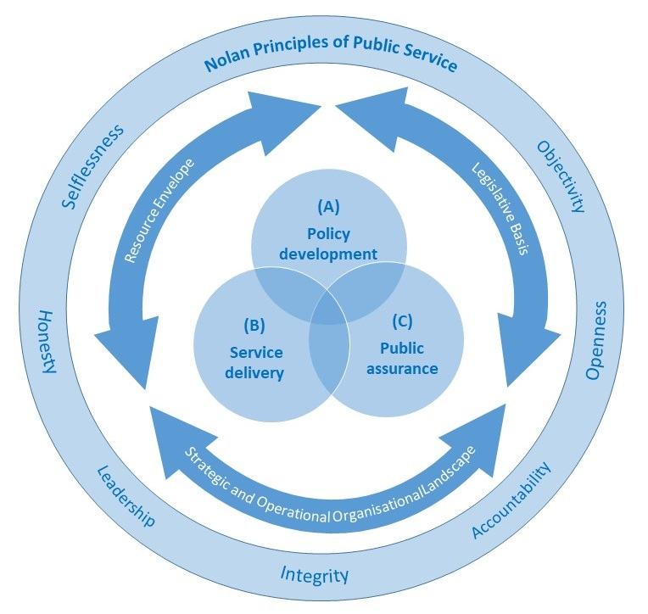
The Model for
National Frameworks and Performance Regimes
The context, the parameters, the agencies, and the relationships operating within the three domains of policy development, service delivery, and public assurance in public services.
Principles of Public Service
  7 ‘Nolan’ Principles
Situational or contextual constraints
  Legislative framework
  Resource Envelope
  Organisational Landscape
Core areas or domains
  Policy development
  Service delivery
  Public assurance

Slide 23
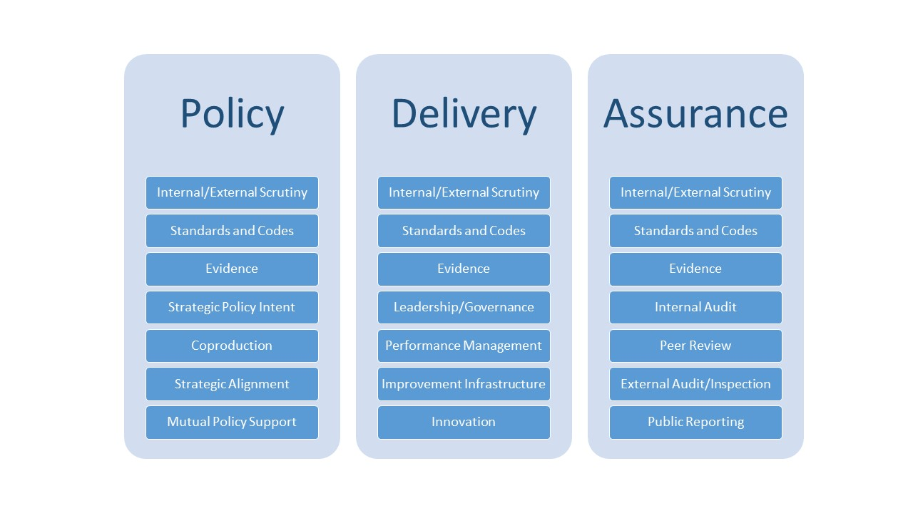
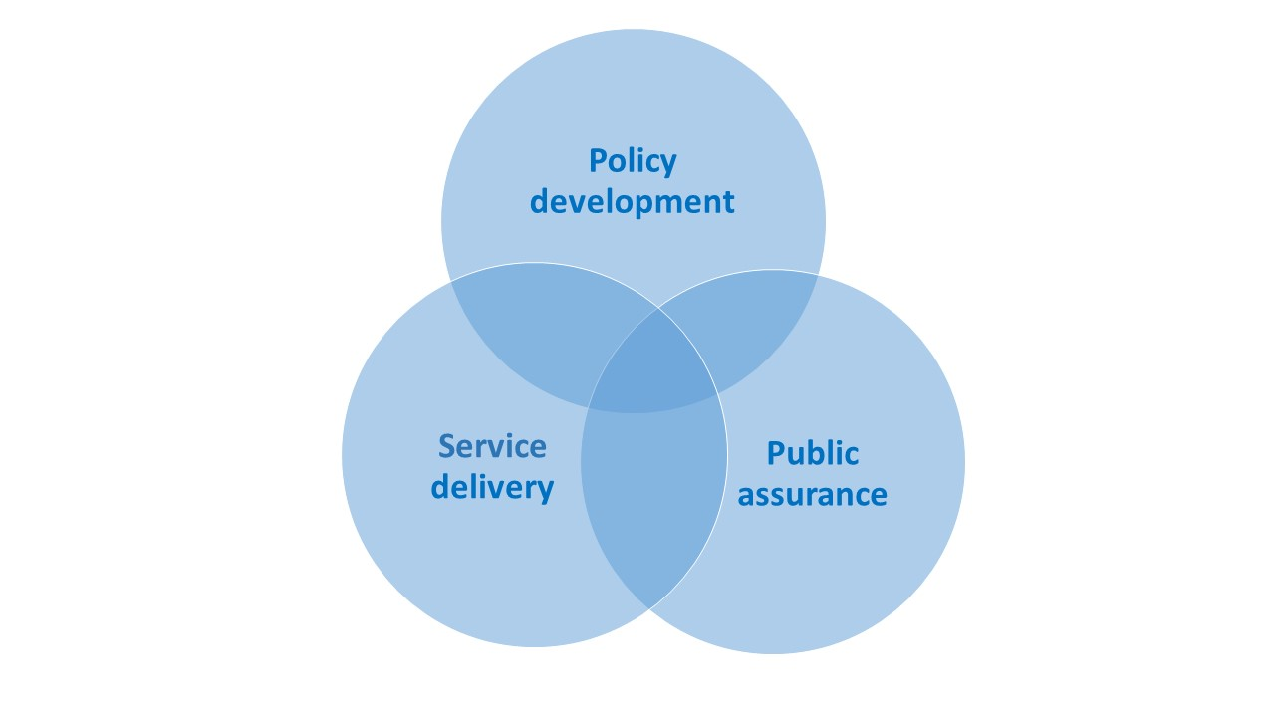
Details of the Core Areas

Slide 24
The Evaluative and Analytical ‘Lens’ Adopted
The duty to facilitate continuous improvement in public authorities
A redefinition of Value for Money to be measured by a combination of economy, efficiency and effectiveness (equality? Sustainability?)
Encouragement of partnership/collaborative working and multiple and several organisational responsibility for addressing wicked problems or issues

Slide 25
The National Frameworks since 2004
2004/2005
Modernisation and an implementation plan for the 2004 Acts? (July and December 2004)
2006
People, communities and fire safety - the development of a longer-term perspective.
2012
Austerity-Localism, cutback management and abdication of central government responsibility
2008
Collaborative place-making as the new strategic intent with a more focused and strategic plan
2018
Revisionism - mea culpa (T. May) but is it as comprehensive or fit for purpose as it claims?

Slide 26
2017 Act
Government’s ambitions for FRAs and PFCCs
Improved Governance, Accountability, Transparency, Scrutiny
Improved leadership and collaboration across blue light services
Improved national and local resilience
If PCC wishes to change governance arrangements, Act requires an assessment
is in the interests of economy, efficiency, and effectiveness, or
is it in the interests of public safety

Slide 27
The 2018 Framework
Strengths | Weaknesses
New national bodies (NFCC, Standards Board) | Lack of central government engagement, leadership responsibility
Attempts to address performance inadequacies | Resource reduction still the key strategic intent
Re-introduces external inspection | No inspection of governance or strategic decision making
New duty to collaborate with other emergency services | Duty limited to emergency services
Promises of improved evidence | Promises undelivered or under-delivered
Potential new governance arrangements | No response to Grenfell or Hackitt included

Slide 28
Fire and Rescue: National Governance models in the UK
(all have national frameworks and section 25 duties)
Northern Ireland (since 2006) National Service (currently under direct rule) Dept Health Non-Departmental Public Body (Stakeholder Board Model) – Chair and 10 NEDS (4 District Councillors 2 Lay) and CFO (it commissions inspections externally)
Scotland – Safer Communities Directorate – Accountability Framework (Expert Board Model) – Chair and ‘up to’14 NEDS competitively appointed by ministers. HMFSI (Independent)
Wales – Housing and Local Government – 3 Local Services (Combined LA Governance Model) Chief Fire and Rescue Adviser and Inspector for Wales. Semi-independent.
England – Home Office 44 services in 5 governance models (county, combined, metropolitan, PFCC, Mayoral). Semi-independent inspectorate

Slide 29
The White Paper
Phase 2 “Governance, People and Professionalism”
Governance and Leadership: Consultations on mandating the transfer of FRS functions to PFCCs across England/Operational independence for Chief Fire Officers/Delineation of strategic and operational planning for F&R and separate budgets in the PFCC model.
People – Poorest aspects in the Inspection reports; long term issues with EDI, workforce planning, training and development and organisational cultures.
Professionalism - Combination of poor communication and poor procedures leading to sub-optimal collaborative working (at Manchester Arena and Grenfell). Inadequate and inconsistent risk information. Professional Standards Board
Plus new external audit and financial reporting arrangements from Redmond Review.

Slide 30
Omissions
Funding and Resources
Short medium long-term
Macro-economic challenges Brexit, Climate COVID Ukraine
Financial resilience
Data and Intelligence in a poor data environment
Piecemeal improvements
Improvements to internal and external scrutiny
Corporate inspection
Themed inspections
Building Regulations and Fire Safety Order

Slide 31
Some key issues: my views/predictions
Role clarifications and operational Independence for CFO/CE
Joined up working and inter-agency collaboration
Revisiting Building Regulations and Enforcement
Improved Data, Information, and Standards
Restructuring of Financial support
New local public audit
Corporate or Governance Inspection added to inspection regime
National negotiating machinery reform
Mandatory PFCCs and Boundary Changes.

Slide 32

Any Questions?
Contacts
Pete Murphy
peter.murphy@ntu.ac.uk

Slide 33
NFCC Strategic CPD Masterclass - Corporate Governance
Cllr Frank Biederman
Chair of LGA Fire Services Management Committee & Devon and Somerset Fire and Rescue
www.local.gov.uk

Slide 34
The Local Government Association
The LGA is the national membership body for local authorities and we work on behalf of our member councils and FRAs to support, promote and improve local government.
Fire Services Management Committee (FSMC)
Fire Commission
National Joint Council (NJC)
Improvement and support function
www.local.gov.uk

Slide 35
Fire Service Management Committee Priorities
People
Professionalism
Governance
Sector-led improvement
Climate change

Slide 36
Primary Governance Responsibilities of FRA Members
Determining the strategic policy agenda for their FRS
Setting a budget to fund delivery of the policy agenda
Undertaking performance oversight & scrutiny to ensure intended outcomes are being achieved efficiently, effectively and in accordance with statutory requirements and Chief Fire Officers are held to account for the service delivered.
These should be exercised with the support & advice of senior officer colleagues in a ‘professional partnership’ characterised by openness, honesty, mutual respect, and high levels of trust.

Slide 37
Primary Governance Responsibilities of FRA Members
Determining the strategic policy agenda for their FRS
Setting a budget to fund delivery of the policy agenda
Undertaking performance oversight & scrutiny to ensure intended outcomes are being achieved efficiently, effectively and in accordance with statutory requirements and Chief Fire Officers are held to account for the service delivered.
Under the Fire and Rescue Services Act 2004 Members are the ones who are legally accountable for the provision of services
These should be exercised with the support & advice of senior officer colleagues in a ‘professional partnership’ characterised by openness, honesty, mutual respect, and high levels of trust.

Slide 38
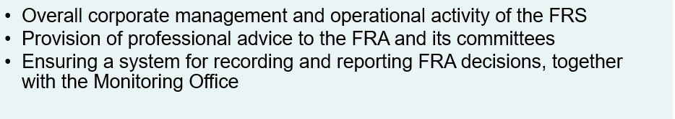
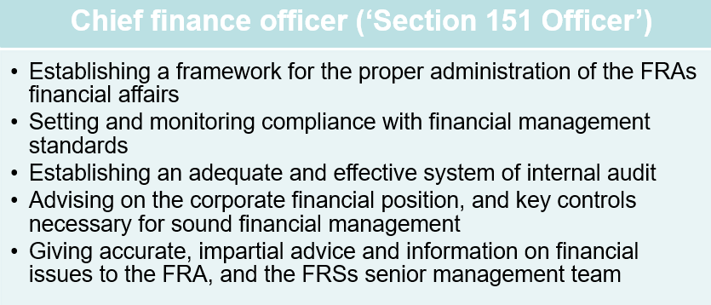
Statutory Officers that Support FRA Members

Slide 39
Statutory Officers that Support FRA Members cont.
Monitoring officer
Standards of conduct for members of the FRA
Maintaining the FRAs constitution
Ensuring a system for recording and reporting FRA decisions, together with the Head of Paid Service
Together with the Chief Finance Officer, advising the FRA when their decisions are not in accordance with the policy and budget framework
Ensuring that no action of the FRA contravenes any legislation or code of practice, or may lead to a charge of maladministration
Preparing a formal report for the FRA, after consultation with the Head of Paid Service and Chief Finance Officer, where they consider that any proposal, decision or omission will give rise to unlawfulness or maladministration.

Slide 40
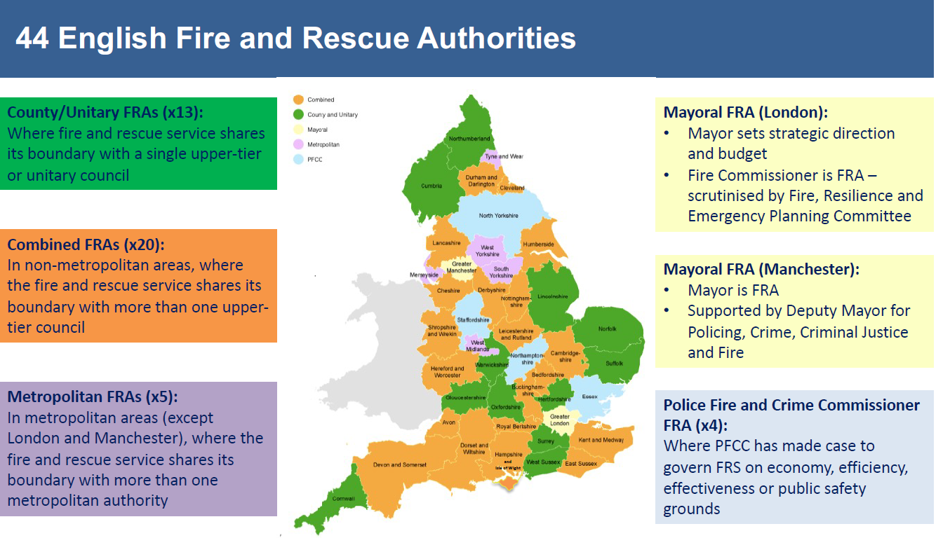

Slide 41
Relationship between FRA members and senior officers
Relationship between FRA members and senior officers
A professional partnership characterised by openness, honesty, mutual respect and high levels of trust
‘Critical friendship’ so includes a degree of constructive challenge – reassurance vs assurance
Members will therefore seek assurance on issues such as:
  The accuracy of advice and information provided by officers
  The quality and focus of delegated decision-making
  Progress in delivering FRA’s policy agenda

Slide 42

Reflections as an FRA member

Slide 43
Contact Details of the Speakers
Good Governance
Diana Melville FCPFA, CIPFA
diana.melville@cipfa.org
www.cipfa.org/
Linkedin
Twitter @DianaMelville
Pete Murphy
peter.murphy@ntu.ac.uk

Slide 44
Thank you for attending
Susannah…and finally your feedback is important to us
How was the masterclass? Did it meet your expectations?
We’d really like to hear your views to help us learn and improve.
Please do take the time to complete a short survey which will be sent directly to you via e-mail after this masterclass.

