Slide 1

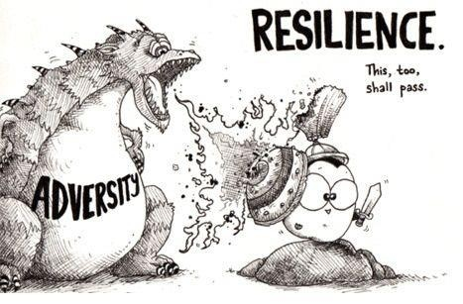
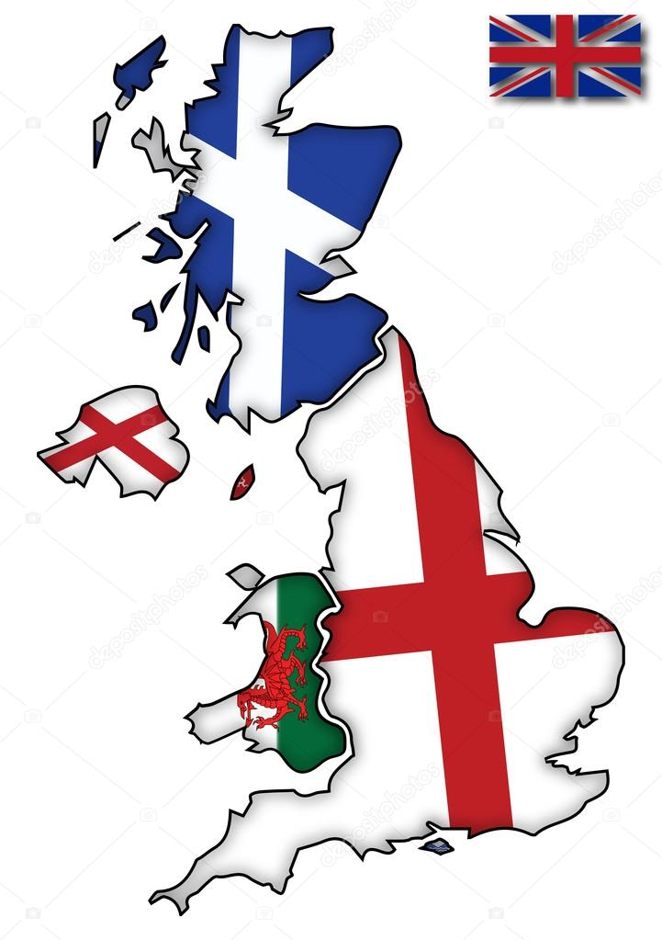
Governmental Financial Resilience
RoundTable Discussion on the Toolkit
Wednesday, 09 February 2021
Ileana Steccolini, University of Essex, UK
Andre Lino, University of Essex, UK
Bernard Kofi Dom, Nottingham Trent University and University of Essex, UK
Rebecca McCaffry, AICPA-CIMA UK
Omicron?
Project funded by ESRC- Impact Acceleration Account, at the
Hosted by:
Notes:
Rebecca

Slide 2
Agenda
Welcome & Introductions – (5 mins)
The FR Toolkit Project: Journey so far … (10 mins)
Review of Summary from previous RoundTable(s) – (15 mins)
Responding to the Toolkit (10 mins)
Discussions (45 mins)
How would you use this Toolkit in your Local Government (Organisation)?
How would you adapt this toolkit in making decision from a UK LG context?
Next Steps: Developing the Toolkit
How can we develop this toolkit to be used in future?
Would you be interested to or know someone who’d participate in testing the Toolkit in your Organisation/in other organisations?
Closing remarks (5 mins)

Slide 3
The FR Toolkit Project: The Journey so far…
Financial Resilience (FR) Toolkit Survey - 108 Responses collected from CEOs/ DoFs of LGs, and practitioners from England, Scotland Wales and NI
FR Workshop in June 2021 – Received useful feedback from 25 participants (from senior members of LGs, CIMA, CIPFA, other stakeholders)
Feedback was used to improve the Toolkit to its current state (version)
FR Roundtable in December 2021 - Received useful feedback from 4 participants (from 2 LGs, LGA, NAO)
FR Roundtable in February 2022 -

Slide 4
The conceptual model on financial resilience
Tools and capabilities to (better) identify and manage vulnerabilities and to recognize shocks in advance
Tools and capabilities to understand the nature, likelihood, timing, scale and potential impact of shocks
Scanning (awareness) and interpretation of the crisis (threat, opportunity)
Staff’s emotional reaction and mental framing
Retrospective interpretation (perception of controllability, powerlessness, and dependence on decisions by others)
Prospective interpretation (estimate of the organization’s future condition and possible sources of negative impact)
Anticipatory Capacities
Sensemaking
Financial
Shock
Vulnerability
Patterns of Resilience
  Perceived level of exposure to external shocks that may affect organizazional finances
  External and internal factors contributing to the level of vulnerability
Coping Capacities
  Resources and abilities that enable local governments to face shocks and manage their vulnerabilities
  These capacities lie dormant in times of order and become visible in times of disruption (shock) through coping strategies
  Three main types of CCs: Buffering, Adapting, Transforming
Adapted from Carmela Barbera, Martin Jones, Sanja Korac, Iris Saliterer, Ileana Steccolini, “Governmental financial resilience under austerity in Austria, England and Italy: How do local governments cope with financial shocks?”, Public Administration, DOI: 10.1111/padm.12350
Notes:
Ileana
The survey you have filled out is
the self-assessment part of the toolkit
a further development of the Financial Resilience Toolkit
developed and refined based on qualitative and quantitative research,
in an international collaborative effort,
Partly funded by CIMA Charitable Trust Fund
Sensemaking thus involves not merely interpretation and meaning production but the active authoring of the situations in which reflexive actors are embedded and are attempting to comprehend
People engage in partially overlapping processes in which they construct ‘realities’ and then retrospectively make sense of them in a continuing dialogue of discovery and invention. Sensemaking occurs in three sets of interweaving processes: (i) the perception of cues (noticing), (ii) making interpretations and (iii) engaging in action (Maitlis & Christianson, 2014)

Slide 5
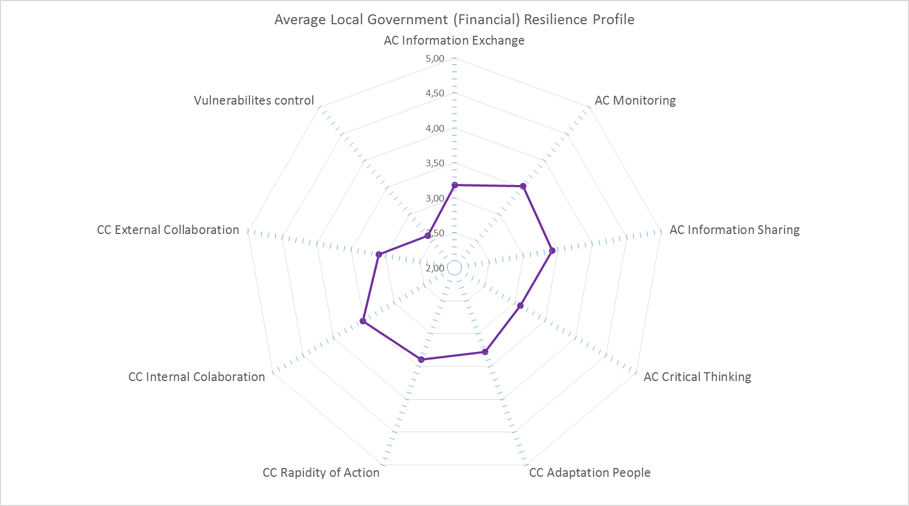
The Financial Resilience Toolkit
Translating the findings of our research (and our framework) into a tool to be used as a support for
  Assessing anticipatory and coping capacities, and perceived vulnerability
  Identifying possible critical areas or strengths
Vulnerability
Anticipatory Capacities
Financial resilience
Coping Capacities

Slide 6
Review of Summary from previous RoundTable(s)
1. Potential Users/Uses of the Toolkit
Users - Potentially useable by other public firms, not limited to LGs only.
Uses - A (self-)assessment tool for internal use (internally focused)
- A decision making tool useful for horizon scanning
- An assessment, communication and benchmarking too (externally focused)
2. Content, adaptability and timing of the Toolkit
Content - content requires further clarity to enhance useability.
Adaptability - adaptability of toolkit varies among LGs by type & size (of responsibility)
Timing – use of Toolkit comes crucial at specific times for different LGs
3. Next Steps
A “nice” challenge to co-produce a practice-oriented Toolkit. All volunteered to contribute to co-producing the toolkit

Slide 7
Responding to the Toolkit
Please click the link in the chatbox to complete the Financial Resilience Toolkit
Please bear the following discussion points in mind whilst completing the Toolkit.
Useability of the Toolkit by LG practitioners
Adaptability of the Toolkit in decision making to stay resilient and less vulnerable
(Possible) Next steps of the current version of this Toolkit

Slide 8
Discussion - Broad Theme 1: Useability
How would you adapt this toolkit in making decision from a UK LG context?
Vulnerability
Anticipatory Capacities
In an LG context, who is this likely to be most useful to?
How will you expect them to use it?
What other similar tools are used to measure financial resilience in your organisation?
Sensemaking
Different patterns of Financial resilience
Coping Capacities
Carmela Barbera, Martin Jones, Sanja Korac, Iris Saliterer, Ileana Steccolini, 2018, Local government financial resilience: Germany, Italy and UK compared, CIMA executive report www.cimaglobal.com/FinancialResilienceToolkit
Notes:
Bernard
Please leave your answers in the chat box, while we listen to contributions from other participants.

Slide 9
Discussion - Broad Theme 2: Adaptability
How would you adapt this toolkit in making decision from a UK LG context?
Vulnerability
Anticipatory Capacities
Local Governments
Policy makers (including CIPFA, LGA)
Government
Sensemaking
Different patterns of Financial resilience
Coping Capacities
Carmela Barbera, Martin Jones, Sanja Korac, Iris Saliterer, Ileana Steccolini, 2018, Local government financial resilience: Germany, Italy and UK compared, CIMA executive report www.cimaglobal.com/FinancialResilienceToolkit
Notes:
Bernard
Please leave your answers in the chat box, while we listen to contributions from other participants.

Slide 10
Discussion - Broad Theme 3: Next Steps
  How can we work on this in the future?
Are you interested in continuing this conversation?
(How) would you like to be involved?
  A «control room» for developing the toolkit further?
  Next meetings?
  Providing feedbacks and
  inputs in developing the
  toolkit further
  …
Vulnerability
Anticipatory Capacities
Sensemaking
Different patterns of Financial resilience
Coping Capacities

