Slide 1
Partition, agency and entrepreneurship:
A case study of migrant-led economic diversification in a developing country
Will Rossiter, David J. Smith, Navjot Kaur
william.rossiter@ntu.ac.uk

Slide 2
Introduction
Paper is a bye-product of research on craft production in the UK and India
Initial focus was on resurgent (rural) craft production in the UK
Project extended to India and became a comparative study
Now undertaken fieldwork in 7 UK firms and 3 Indian manufacturers
It was during Indian fieldwork in 2018/19 that we identified the story that is the basis of this paper…

Slide 3
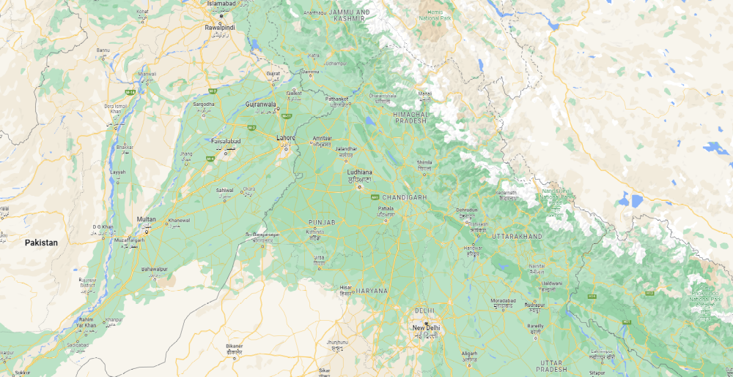
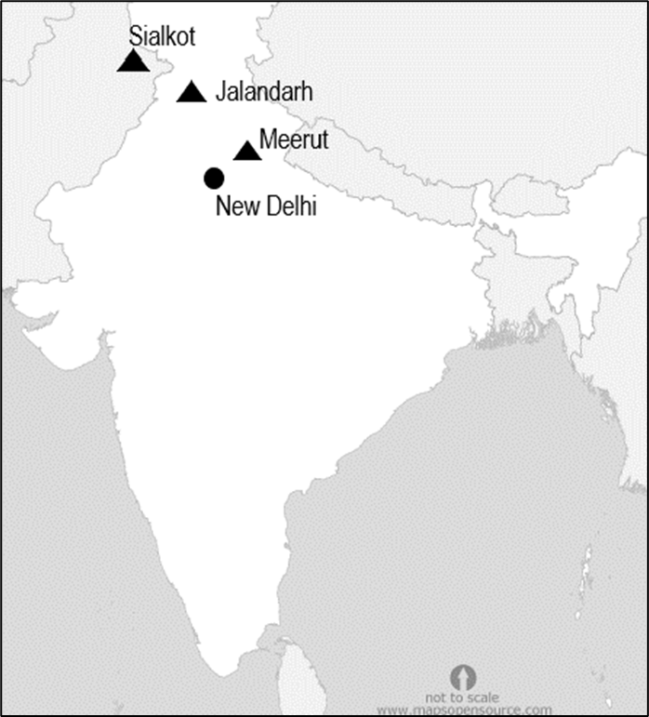
Regional concentration in India and Pakistan
Sialkot (Pakistan)
Jalandhar (Punjab)
Meerut (Uttar Pradesh)
Map data copyright Google 2022

Slide 4
Mapping the clusters today
India currently manufactures nearly 300 types of sports goods
India is the dominant global producer of some of these e.g. cricket bats
Value of production of sports goods in India ₹2380.7crores in 2018-19
India exports around 60% of this production
Exports from India in 2019-20 were US $278.9 million
Roughly 70-75% of these exports are from Jalandhar & Meerut
Source: Export Import Bank of India, July 2021

Slide 5
Jalandhar & Meerut Sports Goods Clusters
250 export active units
1000 units producing for domestic market
4,000 micro enterprises
20,000 household units in and around the cities
Source: Sports Goods Manufacturers and Exporters Association

Slide 6
The origins of sports goods industry in India
Initially in Sialkot in modern Pakistan
Indian partition in 1947 the Sikh and Hindu entrepreneurial families migrated to independent India;
Industrial clusters established in the ‘artisan towns’ of Meerut and Jalandhar (Chattha 2016);
Not a product of state planning/policy – resettlement support was provided
Migrant agency fundamental – kinship, religious and cultural ties also important in explaining location choices

Slide 7
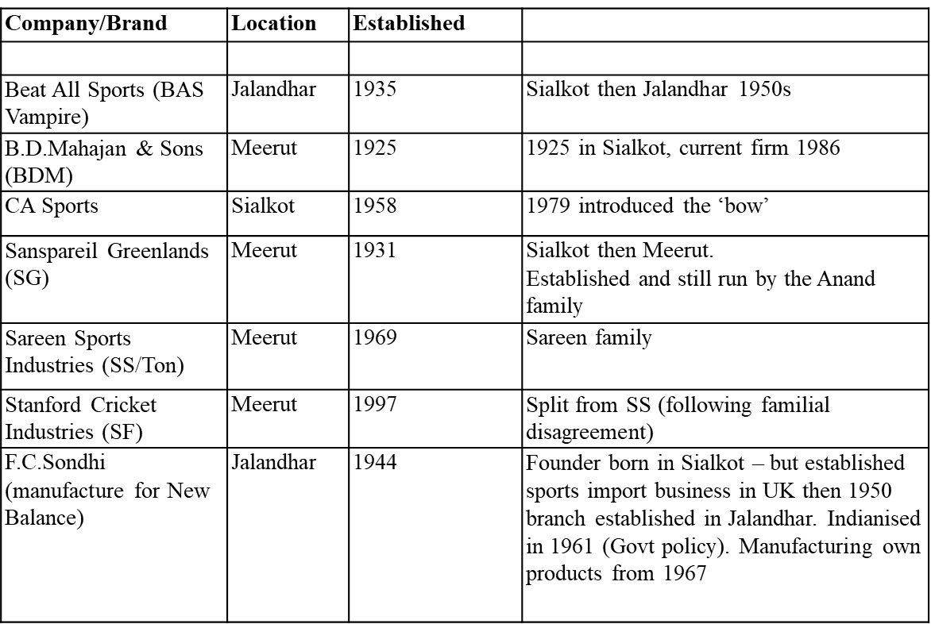
Selected companies

Slide 8
Timeline – cricket bats
Pre-1947 Colonial India | 1947-65 Planning and ‘licensing raj’ | 1965-91 Socialism | 1991+ Liberalization | 2000s Indian cricket explosion
Migration
Rise of artisan cities Meerut & Jalandhar
Sialkot
Growing English willow exports
Offshoring
Upgrading

Slide 9
Conclusions
Meerut and Jalandhar are ‘transplanted clusters’ (UNIDO 2009)
Part of a diversification of the (rural) economy of Northern India
Migrant agency is fundamental - often at odds with national and state government policy
State provision of land and compensation for assets lost was important – but in no sense are these clusters a direct result of state policy
The importance of policy ‘working with the grain’ of migrant aspirations and agency

Slide 10
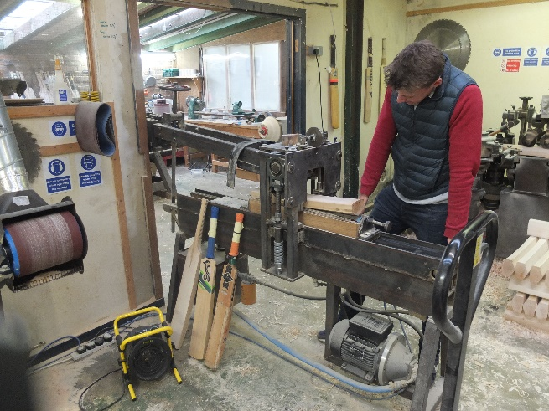
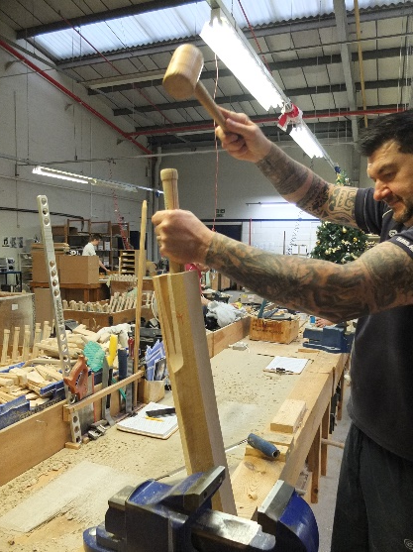
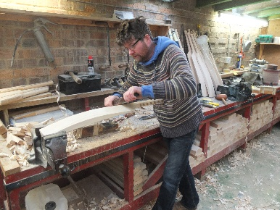
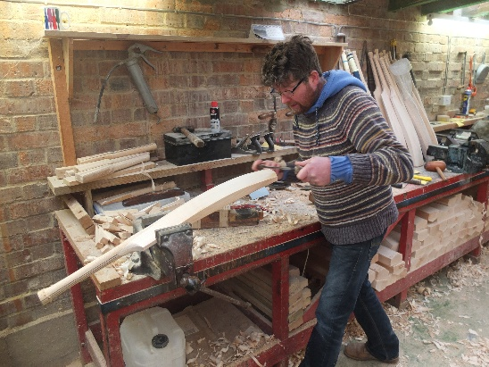
Tasks in bat manufacture
1
‘rounds’ of willow split into ‘clefts’
2
‘clefts’ sawn into ‘blades’
3
‘blades’ graded
4
5
‘blades roughed out’
‘blades’ pressed
6
8
Handles ‘blended’ into blades
10
Binding handle with twine
11
Finishing – sanding/waxing
Rubber grip/ transfers/ branding added
9
Fine shaping and balancing of bat
7
Handles joined to ‘blades’

Slide 11
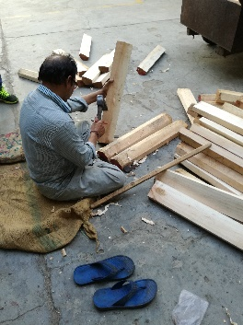
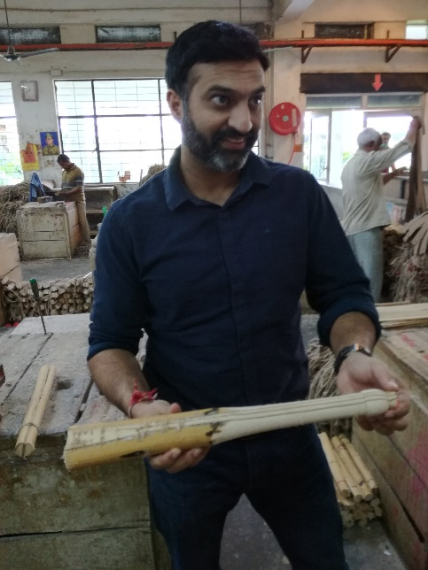
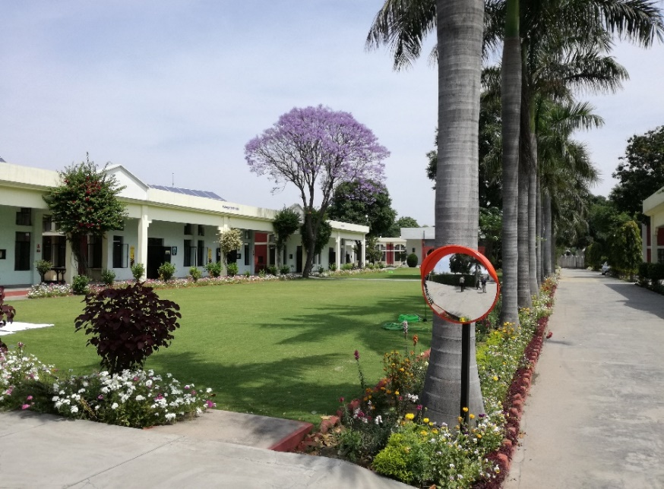
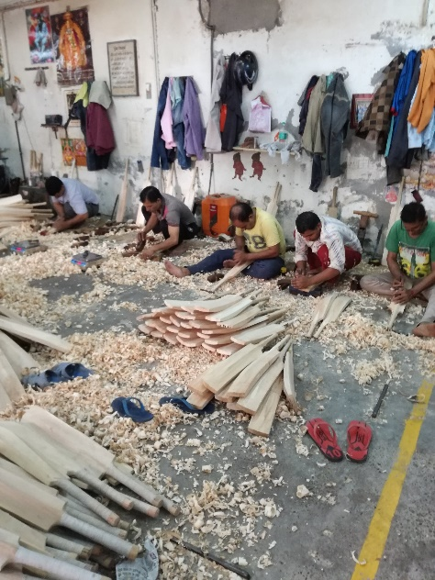
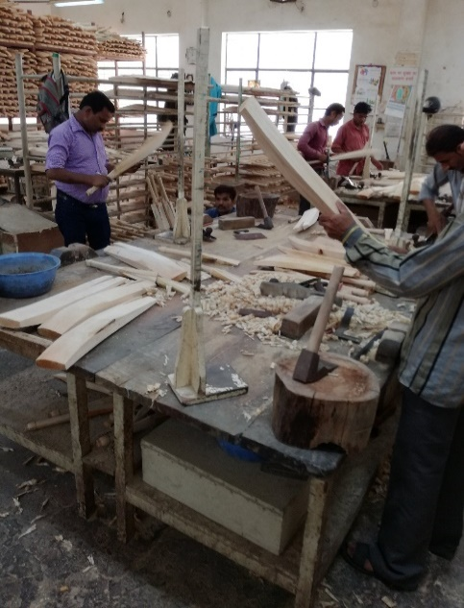
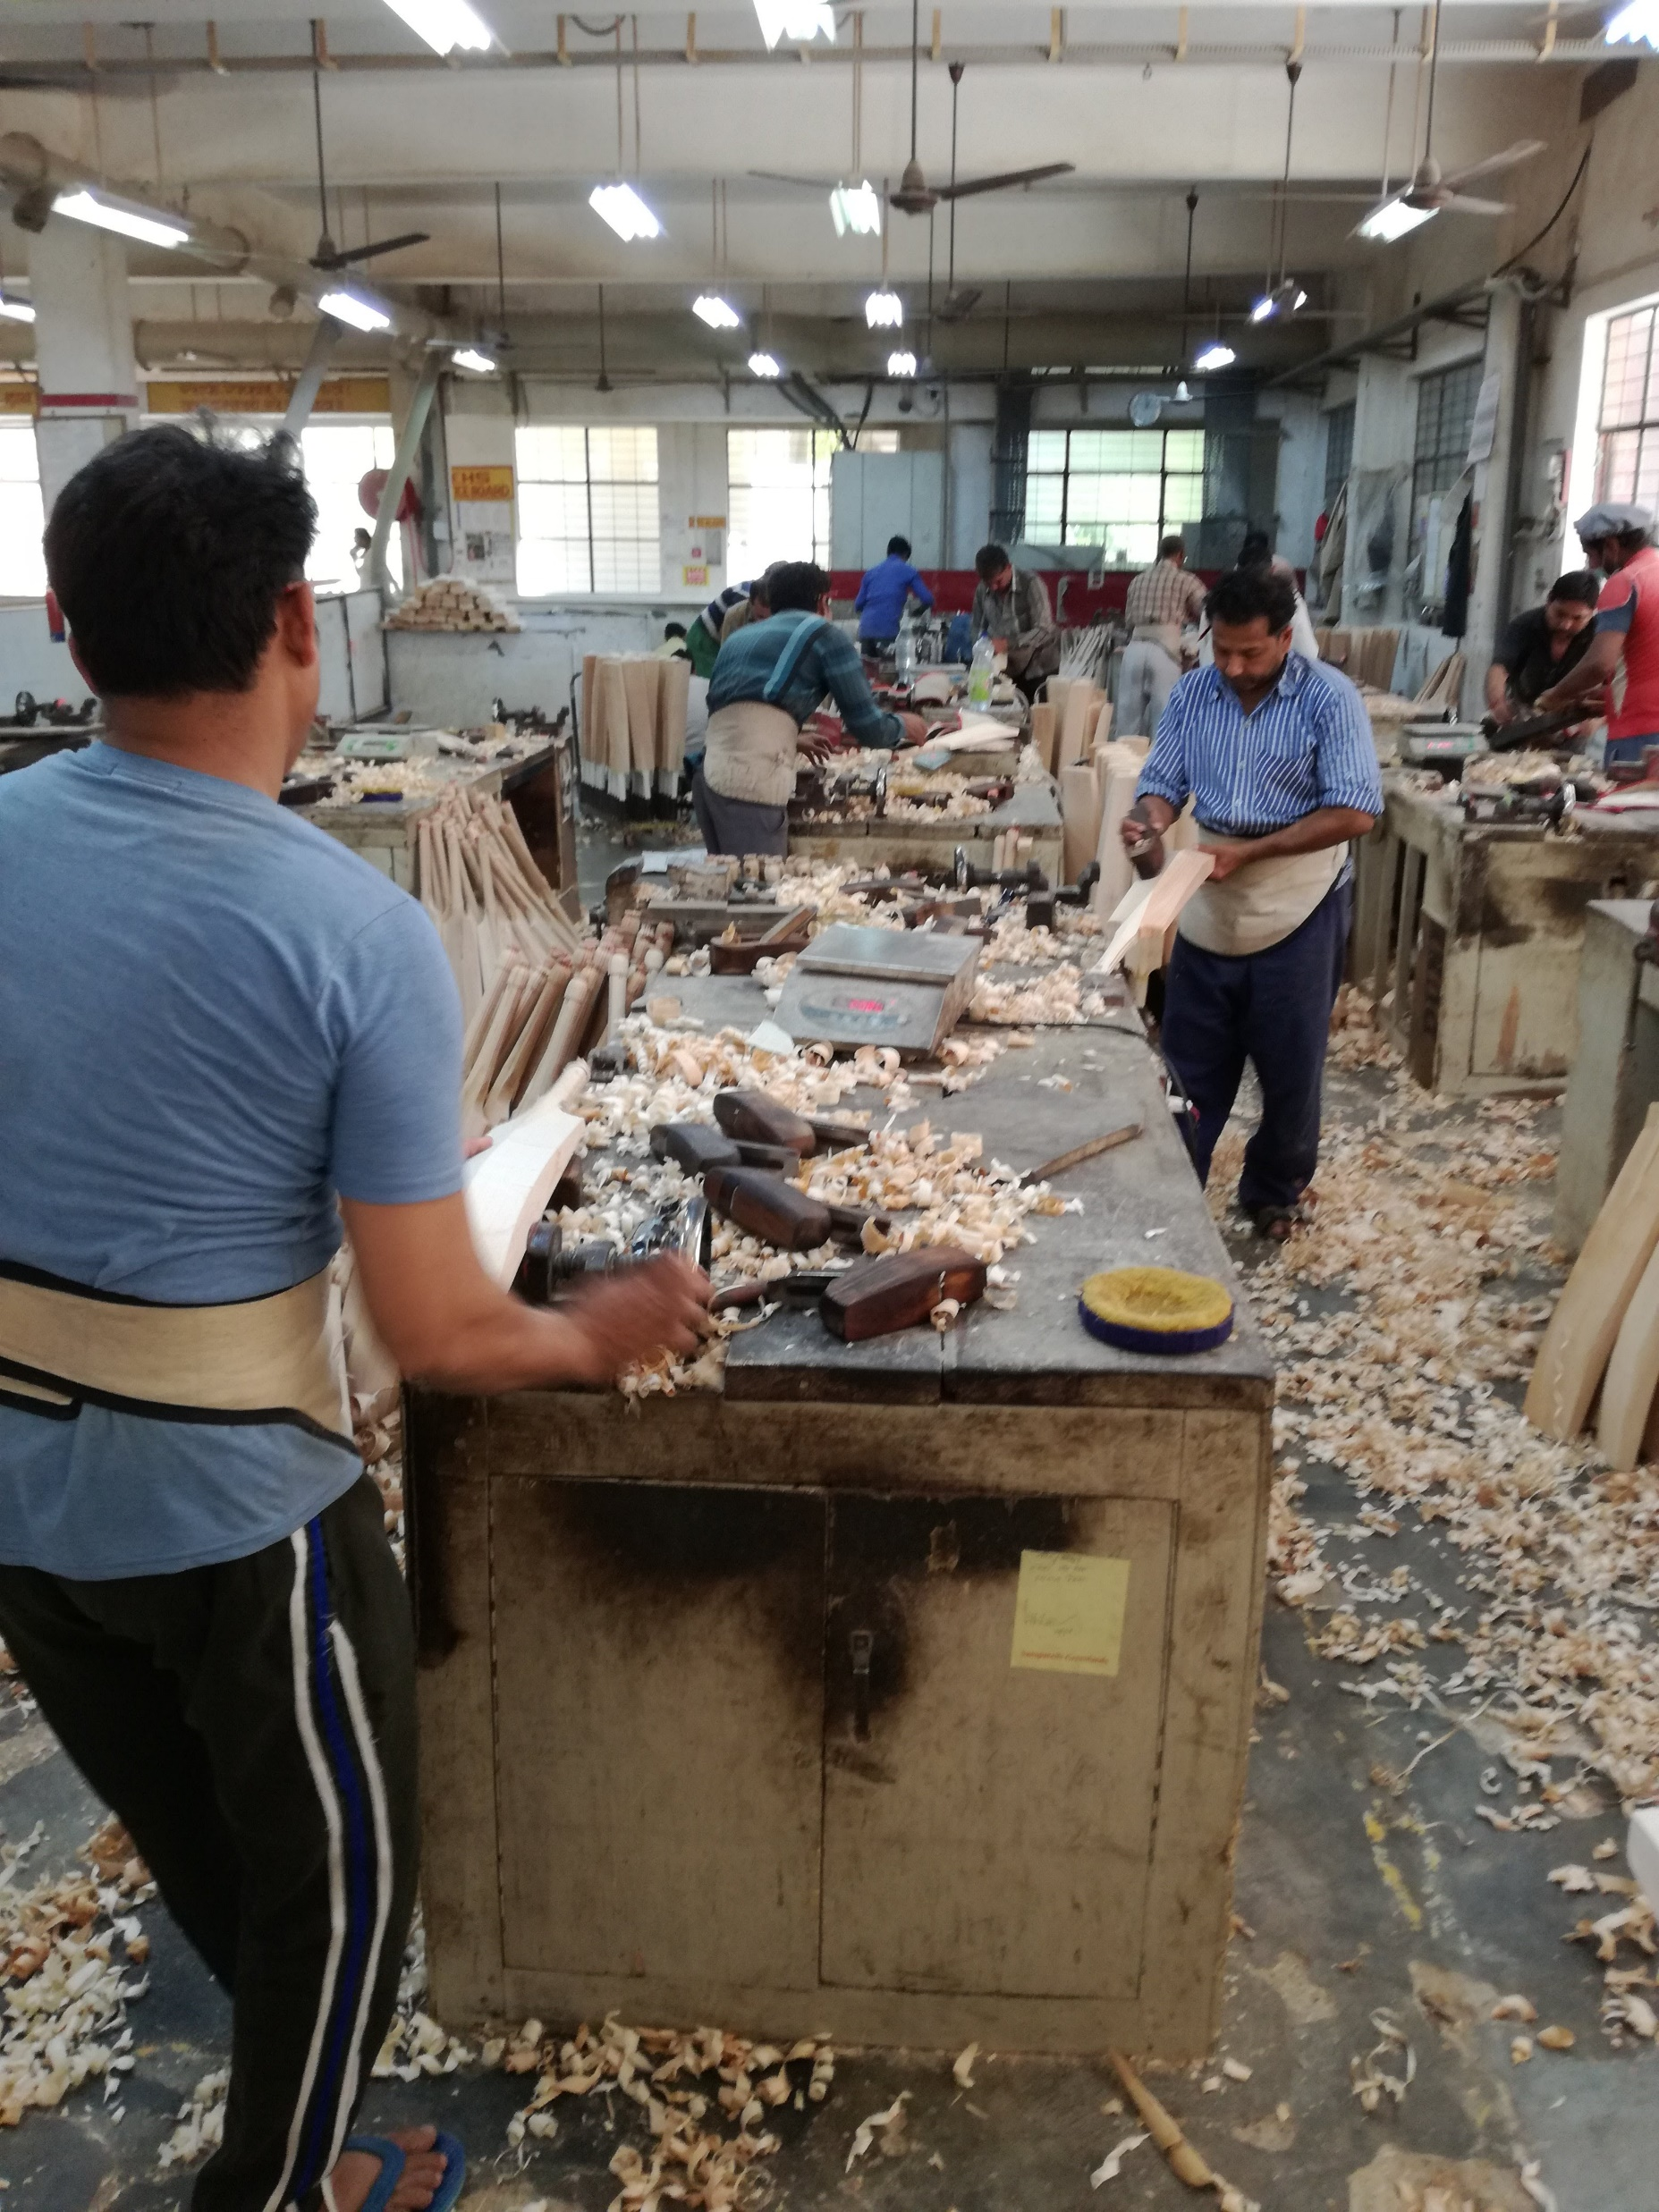
Indian manufacturers

Slide 12
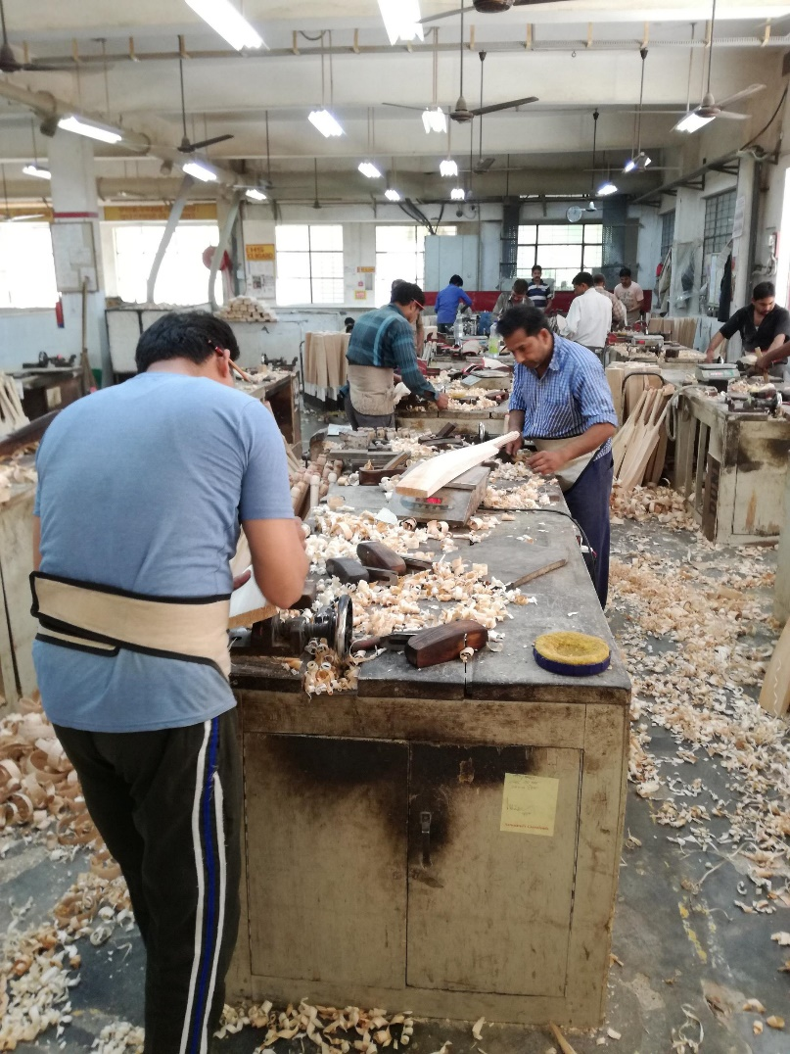
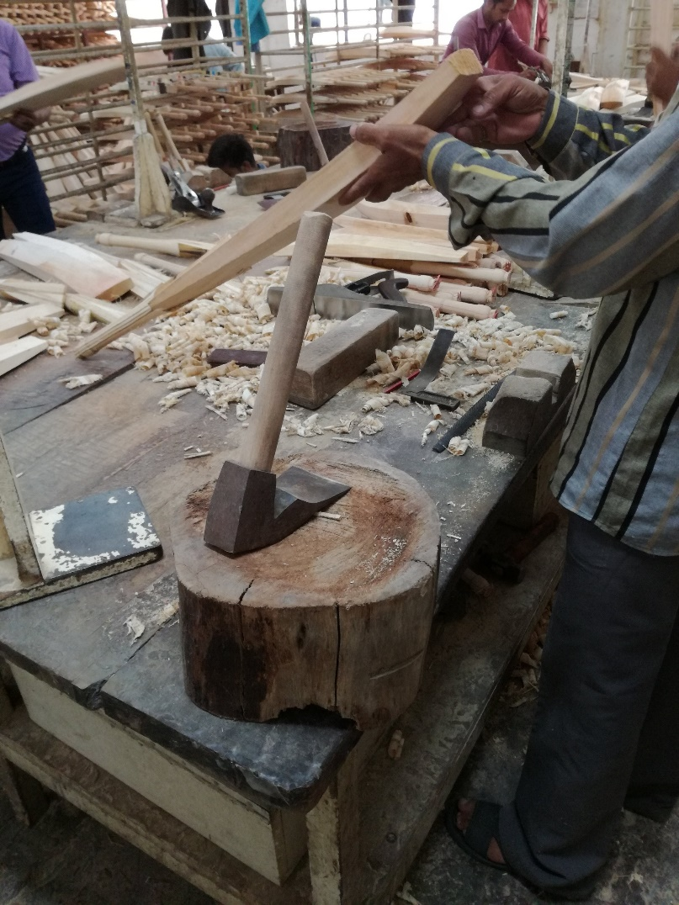

Manufacturing in India

Slide 13
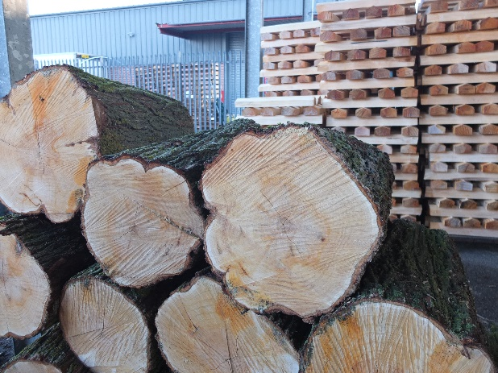
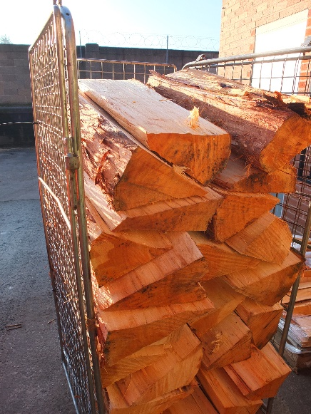
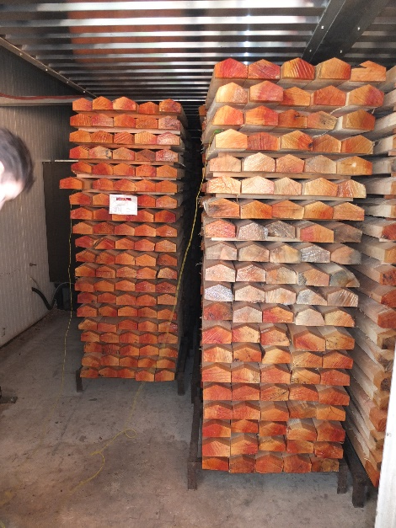
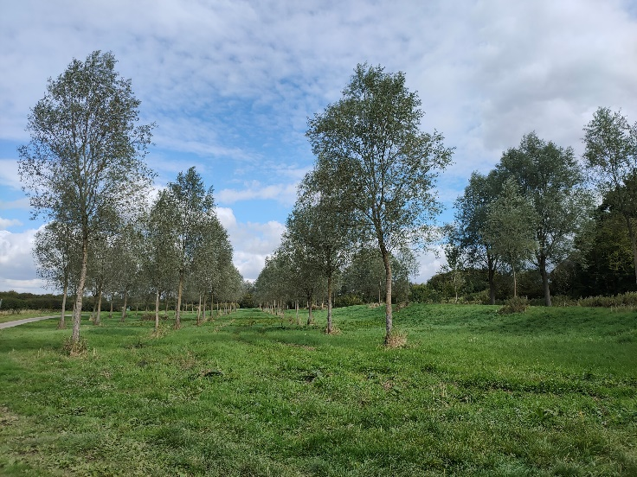
The importance of English Willow
Willow ‘rounds’
Split ‘clefts’
‘Blades’
Willow plantation, Leicestershire

