Slide 1
Contribution to EAA Working Group Intangibles
Chaired by Prof. Stefano Zambon, University of Ferrara, and vice-chaired by Prof. Jan Marton, University of Gothenburg EFRAG’s Discussion Paper Better Information on Intangibles – Which is the best way to go?
28 January 2022
Associate Professor Dr Janice Denoncourt
BA, LLB, LLM, PhD
Solicitor England & Wales
Barrister & Solicitor, Western Australia

Slide 2

Intangibles and IPRs increasingly at the epicentre of corporate governance in technology companies

Slide 3
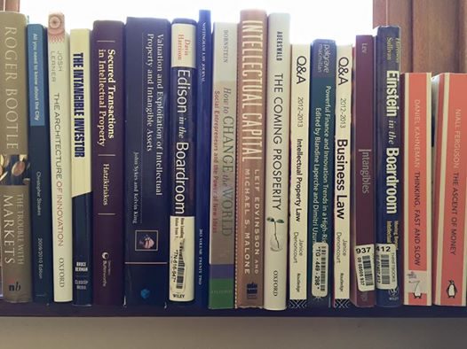
Interdisciplinary
IP, Corporate Governance & Accounting Research
This Photo © J Denoncourt 2019

Slide 4
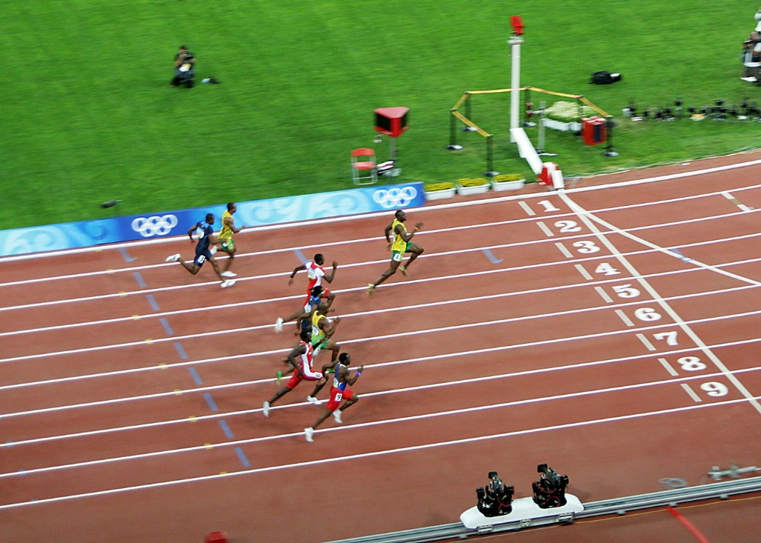
Investment in intangibles overtakes tangibles
This Photo by Unknown Author is licensed under CC BY-NC-ND
©J Denoncourt 2017-2018

Slide 5

Burden of IP Ownership Power:
Accountability through
Corporate Reporting
Responsibilities
Obligations
Foundation for transparent decision-making
Sustainable profit
Stakeholders beyond SHs
Benefit sharing
©J Denoncourt 2017-2022

Slide 6

Good governance & IP to protect technology supports growth to maturity
A strong portfolio of exclusive monopolistic IPRs have the potential to be ‘unique core strengths’ and one of the foundations for corporate longevity in the 21st century business environment.
IP ownership is positively associated with future growth and survival in the long term.
Source: B. Hall ‘Is there a role for patents in the financing of new innovative firms?’ (May 2018) Max Planck Institution for Innovation and Competition Research Paper No 18-06
Shareholders, employees, customers, suppliers, communities and governments all beneﬁt from company longevity.

Slide 7
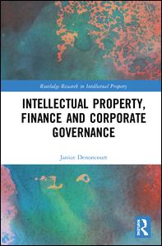
My research...
IP, Finance and Corporate Governance 12 April 2018
©J Denoncourt 2014-2018

Slide 8
IP, Finance and Corporate Governance
Table of Contents
Part One The Corporate Intellectual Property Landscape
1 Corporate governance and IP assets
2 Corporate governance: the IP and patent ecosystem
Part 2 The IP finance dimension: corporate governance and transparency
3 Bridging the gap between corporate finance and corporate governance
Part 3 Accounting for IP: corporate IP assets and transparency
4 True and fair patent valuation: a corporate governance issue?
Part 4 The Corporate Governance Dimension
5 Transparency in corporate IP asset reporting
6 International initiatives in corporate narrative IP asset disclosure
7 Substance and form: developing a normative practice for corporate narrative IP asset disclosures
8 A triage-style ‘materiality evaluation model’ for IP and patent disclosures
9 Corporate governance and IP value creation reporting: reflections, conclusions and recommendations
Bibliography
©J Denoncourt 2014-2018

Slide 9
Chapter 7 Substance and Form:
Developing a Normative Practice for
Corporate Narrative Reporting IP Asset Disclosures
See GlaxosmithKlein (GSK) Annual Report 2012
See 7.2.3 GSK's financial statements (my book at pp186-189)
Figure 7.3 GSK Consolidated Balance Sheet at a 31 December 2012
Non-current Assets Notes 2012£m 2011£m
OTHER INTANGIBLES 19 10,161 7,802
Between 2011-2012 the GSK 'Other Intangibles Assets' figure increased by 27% which is significant - yet there is no meaningful commentary in Note 19.
© J Denoncourt 2015-2022

Slide 10
Chapter 7 Substance and Form: Developing a Normative Practice for Corporate Narrative Reporting IP Asset Disclosures
Note 19 on page 146 of the GSK 2012 Annual Report is boilerplate and doesn't explain the reason for the 27% significant positive increase in intangibles.
Note 19 focuses on amortisation issues for intangibles (which are affected by patent expiry dates, for example).
While the 'Other Intangibles Figure' is positive and increasing, SHs and stakeholders are not especially concerned, but what if GSK had reported a loss involving these intangibles ? The level of interest would be much higher in my view (such a loss is likely to be a ‘material fact’).
SHs and other stakeholders e.g. lenders would need to look further into the narrative report to identify any additional information that supports the reason for the significant positive change the values of GSK’s intangibles.
© J Denoncourt 2015-2021

Slide 11
Chapter 2 Companies Act 2006 (UK):
Accounting Records
Section 386
Company law drives the legal requirement for firms to keep ‘Accounting Records’ at the company’s registered office for a period of at least three years from the date on which they are made (in the case of a private company) or six years (in the case of a public company).
© J Denoncourt 2015-2021

Slide 12
Chapter 2 Companies Act 2006 (UK):
Accounting Records Section 386
386Duty to keep accounting records
(1)Every company must keep adequate accounting records.
(2)Adequate accounting records means records that are sufficient—
(a)to show and explain the company's transactions,
(b)to disclose with reasonable accuracy, at any time, the financial position of the company at that time, and
(c)to enable the directors to ensure that any accounts required to be prepared comply with the requirements of this Act F1....
(3)Accounting records must, in particular, contain—
(a)entries from day to day of all sums of money received and expended by the company and the matters in respect of which the receipt and expenditure takes place, and
(b)a record of the assets and liabilities of the company.
(4)If the company's business involves dealing in goods, the accounting records must contain—
(a)statements of stock held by the company at the end of each financial year of the company,
(b)all statements of stocktakings from which any statement of stock as is mentioned in paragraph (a) has been or is to be prepared, and
(c)except in the case of goods sold by way of ordinary retail trade, statements of all goods sold and purchased, showing the goods and the buyers and sellers in sufficient detail to enable all these to be identified.
(5)A parent company that has a subsidiary undertaking in relation to which the above requirements do not apply must take reasonable steps to secure that the undertaking keeps such accounting records as to enable the directors of the parent company to ensure that any accounts required to be prepared under this Part comply with the requirements of this Act.
© J Denoncourt 2015-2021

Slide 13
Chapter 2 Companies Act 2006 (UK):
Accounting Records Section 386
Amend to include an equivalent legal requirement for companies to keep Records of Intangibles
We need to develop the legal requirement to keep ‘Intangibles Records’ from the date of creation, especially for inventions generated internally and recorded off-balance sheet – potentially for the duration of the intangible or IP right.
Such a legal requirement will ensure the integrity of the accounts relating to corporate intangible assets, thus improving the quality of and enhance transparency and accountability.
In addition, the foundation of corporate intangibles records would upport an IP Exchange, together with the use to Technology Readiness Levels (TRL) system to facilitate cross-discipline discussion between different professions and buyers and sellers and accountability.
These intangibles records would be confidential but available for inspection on request by relevant authorities under condition of confidentiality.
© J Denoncourt 2015-2022

Slide 14

Corporate Reporting underpins Accountability
Relying on accounting figures alone does not give
an accurate picture of corporate IP value, IP potential, corporate IP policy or its IP ethics.
It’s all a bit blurry.

Slide 15

Does the technology work?
This Photo by Unknown Author is licensed under CC BY-SA-NC

Slide 16
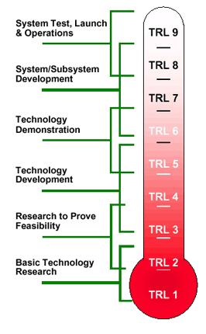

What stage is it at? NASA Technology Readiness Level (TRL) System

Slide 17

The TRLs
Principle (TRL 1)
Concept (TRL 2)
Proof (TRL 3)
Standalone (TRL 4)
Integrated (TRL 5)
Demonstrated (TRL 6)
Prototype (TRL 7)
Qualified (TRL 8)
Proven (TRL 9)
Claiming equivalent of TRL Level 7-8
Reality = TRL 1-2

Slide 18

The TRL System
Now widely used in public finance and by Horizon 2020 EU research funding program.
Since 2014, the European Commission adopted TRLs to guide Research, Development & Innovation in the EU’s Framework Programme for Research and Innovation
H2020 call topics require bids to reference TRL level to indicate which maturity of technologies to be funded. Also used to denote the difference between funding schemes and types of project, e.g. Research and Innovation Actions (RIA) or Innovation Actions (IA).

Slide 19
The TRL System and technology evolution
Well-established method to estimate maturity of critical technology elements on a scale of 1 to 9.
Originally developed by US National Aeronautics and Space Agency (NASA) in the 1980s to help with decision-making and allocation of public funding.
There is now bespoke TRL system for software.
TRLs can be tailored to the industry.
Useful approach for public communication and governmental bodies to clearly identify the overall technology maturity (though it may overlook the complexities of actual technology development).

Slide 20
Benefits of TRL reporting
Enables consistent uniform discussions of technical maturity across different types of technology.
An entrenched measurement tool to support the assessment of investment and funding risks in publicly finance technology.
Could be more widely used in private finance and corporate reporting.
Facilitates cross-sector communication regarding technology and could help to improve transparency and disclosure of intangibles in business reporting.

Slide 21
Publications
J. Denoncourt, ‘A Modern Role for Intellectual Property in Sustainable Finance, Prudential Banking and Capital Adequacy Regulation’ in: Rognstad and Orstavik (eds.) Intellectual Property and Sustainable Markets (24 July 2021) Edward Elgar Publishing
J. Denoncourt, Part IV Strategy, Chapter 22 ‘Corporate Intellectual Property Monopoly Rights and Technology’ In: C. Valeur and C. Fargeot (Eds.) Questions to Ask (24 September 2021) Routledge Taylor Francis, pp126-130
J. Denoncourt, Part I Chapter 4 ‘Company classification taxonomy and corporate intellectual property rights owners’ in: D. Gervais (ed.), The Future of Intellectual Property in ATRIP Intellectual Property Series (2021 Edward Elgar Publishers
J Denoncourt, Part II Economic Aspects of Fairness, Chapter 7 ‘Corporate Intellectual property, Governance and Board Effectiveness Reviews in Large and Premium Listed UK Companies’ In: D. Gervais (ed.), Fairness, Morality and Ordre Public in Intellectual Property (2020) ATRIP Intellectual Property Series, Edward Elgar Publishing, pp141-172
J. Denoncourt, ‘Corporate Intellectual Property Assets and UN 2030 Sustainability Goal 9 Innovation’ (2019) Journal of Corporate Law Studies, In press.
J. Denoncourt, Intellectual Property, Finance and Corporate Governance (12 April 2018) Routledge Taylor-Francis
J. Denoncourt, ‘True and Fair Intellectual Property Information: A Corporate Governance Issue’ (2016) Journal of Business Law

Slide 22




About me…
Associate Professor
Dr Janice Denoncourt
1988 BA McGill University
1995 LLB University of Western Australia
1996 Australian Barrister & Solicitor
Herbert Smith Freehills, Perth, WA
1997 Graduate Institute of Company Directors
1998 In-house Counsel Australian plc
2001 Senior Associate IP Minter Ellison, WA
Registered Trade Mark Attorney
2002 Chevening Commercial Law Scholarship
2003 Legal Affairs Manager, private UK company
2006 Solicitor England & Wales
2008 Senior Lecturer in IP, company, business law
2015 PhD, University of Nottingham
2018 Intellectual Property, Finance and Corporate
Governance (Routledge)

Slide 23

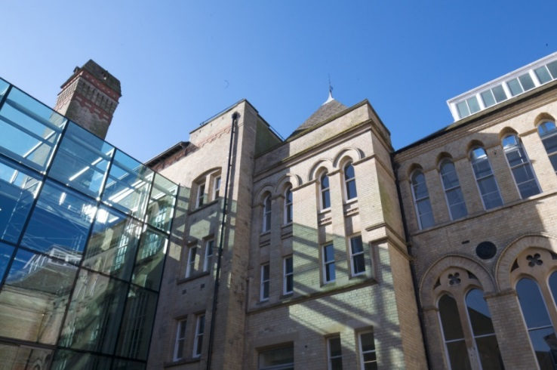

Intellectual Property Research Group
lead IP research within the East Midlands region and focusses on:
IP law and practice
IP law education
IP commercialisation
www.ntu.ac.uk/ipresearch
IP law and practice
IP law education
IP commercialisation

Slide 24


