Slide 1
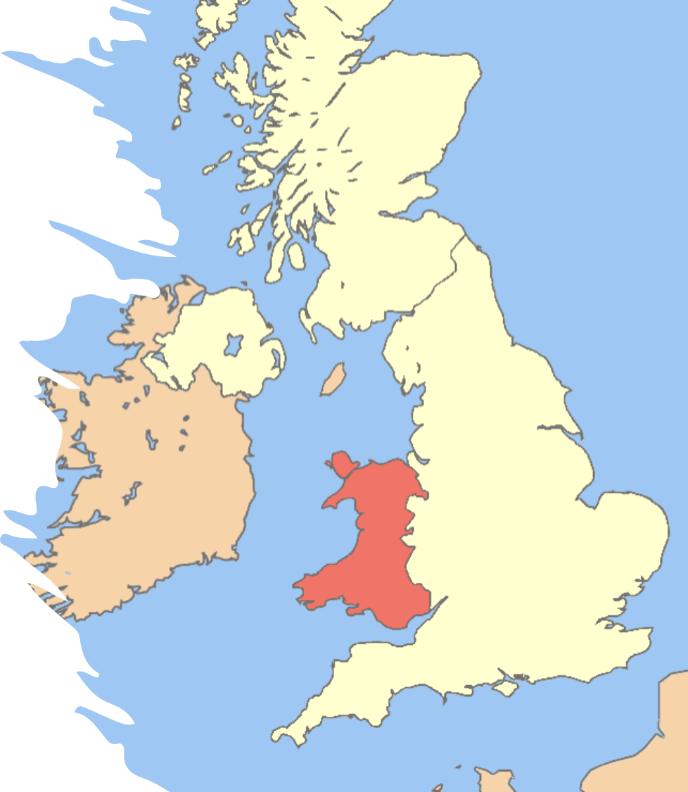
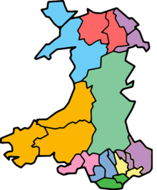
The 12th Annual EIASM Public Sector Conference
Public Service Accounting, Accountability and Management
Comilla Universidad Pontificia, Madrid, Spain
30th – 31st August 2022
Managing the twin pressures in Welsh Local Authorities during the Austerity Era
Bernard Kofi Dom, Martin Jones, Alan Collins, & Peter Murphy.
Nottingham Business School,
Nottingham Trent University.

Slide 2
RQ: How have Welsh Local Authorities managed the twin pressures (reduction in central funding and the continuous increase in demand for services) during the Austerity Era?
Structure of this Presentation
Research Aims and Why Welsh LAs
Welsh Government Income Spending
Welsh Context and Government Spending
Methods and Methodology
Results and Findings
Key Discussions
Final Thoughts

Slide 3
RQ: How have Welsh Local Authorities managed the twin pressures (reduction in central funding and the continuous increase in demand for services) during the Austerity Era?
Research Aims
To explore the nature and scale of impacts of austerity on the income and expenditure of Welsh LAs.
To investigate the financial strategies adopted by Welsh LAs to absorb or withstand the pressures faced during the austerity era.
Why Welsh LAs?
A devolved administration, offering an opportunity to study phenomena in a national context.
Unlike England, all 22 LAs in Wales are unitary authorities, which makes them more easily comparable.
Welsh LAs have some similarities with their English counterparts, which will ultimately allow for comparison between them at a later date.
This study forms part of a wider body of work looking at UK LA responses to austerity and the context of financial resilience (Barbera et al., 2017).

Slide 4



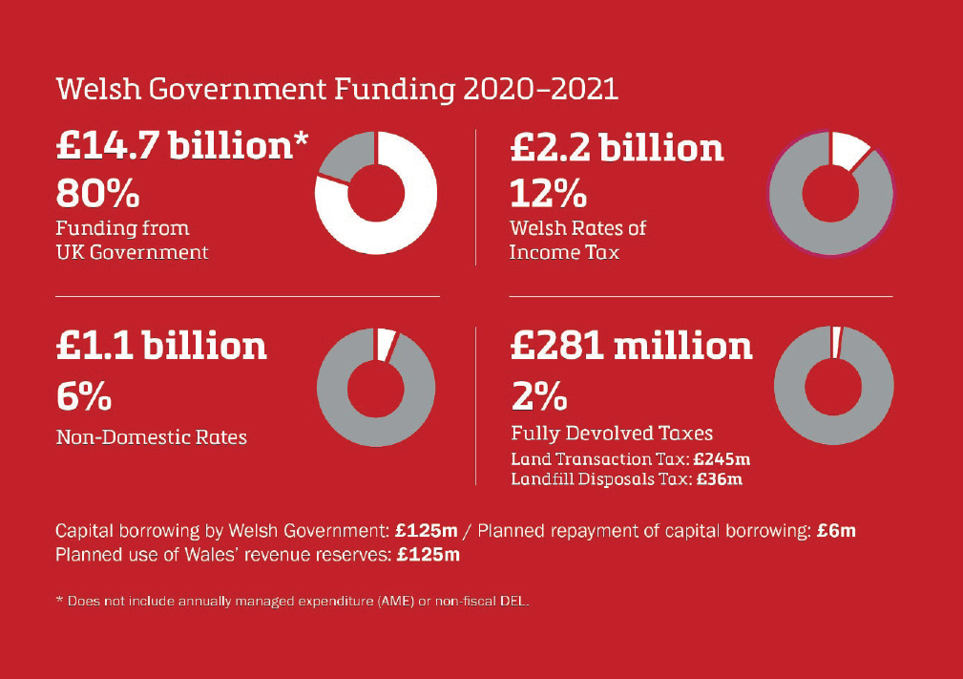
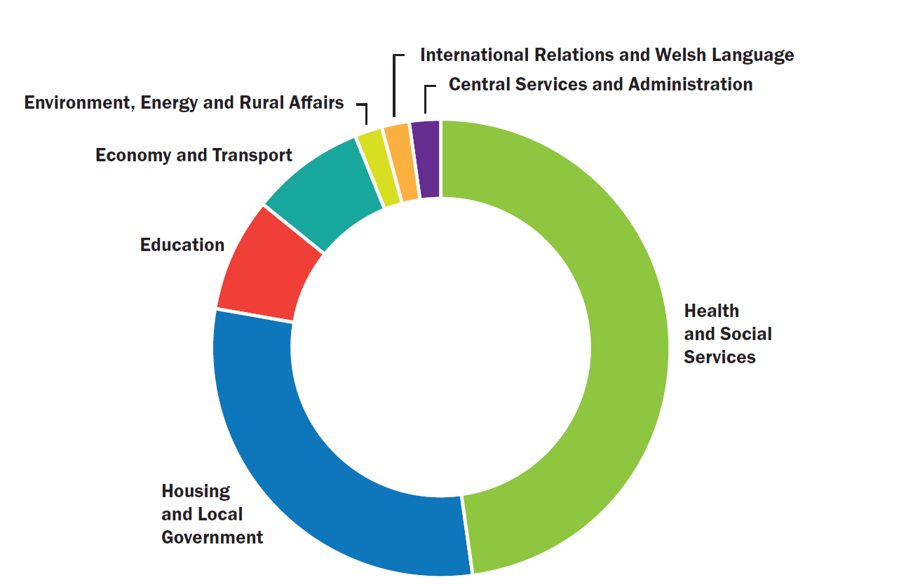
Context – Welsh Government Income & Spending
RSG (£3.3 Bn) and NDR (£1 Bn)
Barnett Formula £14.7 Bn
Other public expenditure
Twin Pressures?
- Reduction in funding (RSG) from the central Government
- Continuous increase in expectation and demand for core services
Notes:
Funds are distributed from Westminster to the Welsh Government using the Barnett Formula, then the WG distributes proportionately to all Welsh LAs.

Slide 5
Welsh LA context
Studies have explored the state of Local Government Finance in Wales:
Often practice-oriented (Ogle et al. 2017; Ifan and Sion 2019; Downes and Taylor-Collins, 2019), but a few academic-oriented (Dollery and Wijeweera, 2010)
Austerity was not as severe in Wales as in England (Ogle et al. 2017; Downes and Taylor-Collins, 2019)
Some similarities with England, but also some differences (Education/NDR)
Good relationship between LAs and Welsh Government (Hay and Martin 2014; Ferry et al. 2017)
But ….. difficult decisions still to be taken at the local level – efficiency, investment and retrenchment (Downes and Taylor-Collins, 2019)
Increases in council tax were not sufficient to meet the funding gap (Ifan and Sion, 2019)
Notes:
Education, Social Care, Council Fund Housing& Housing benefits, Environment, Roads and Transport, Culture and related services, Planning and economic development, Other revenue expenditure
The Valleys (9), The southern Cities (3), The East of Wales (3), The Rest of Wales (7)

Slide 6
Methodology and Methods
Exploratory approach – quantitative, disaggregated, secondary data (RS/RO Forms)
How Welsh LAs prioritised and re-prioritised service expenditure in response to austerity.
LAs were grouped into four distinct regions by similar characteristics – TV, TSC, NEW, and RoW, as per Crawford et al. (2012)
Classified the longitudinal time series into three distinct eras:
  pre austerity (2005/6 to 2009/10)
  early austerity (2010/11 to 2014/15)
  post austerity (2015/16 to 2019/20)
All expenditure was converted to the real-term values, using the GDP deflator, with 2010/11 as the base year.
Two analysis frames:
  a trend analysis was conducted to look at how various revenue streams were affected in the time series
  a proportionate analysis was undertaken to examine how Welsh LAs have (re)prioritised revenue sources in response to the funding pressures.

Slide 7
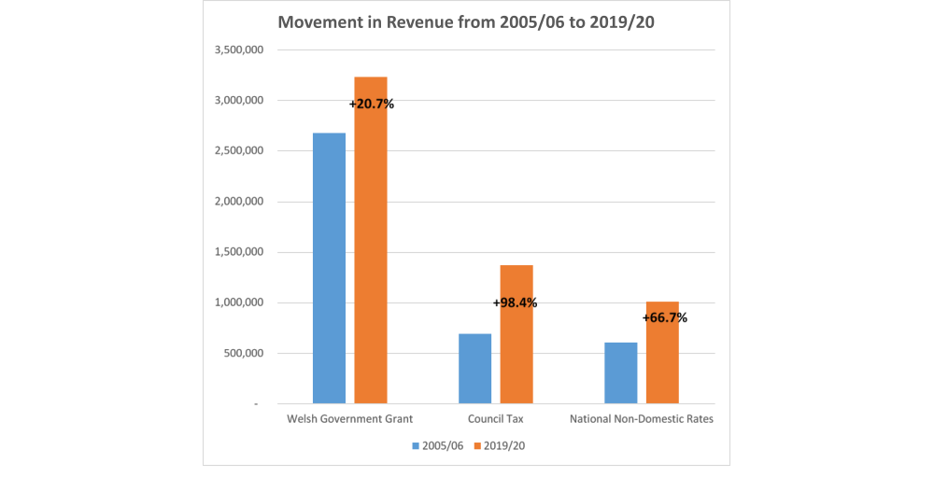
Welsh LA Income: An overview
 | LA Revenue (£'m) |  | Change (%)
 | 2005/06 | 2019/20
Welsh Government Grant | 2,674,963 | 3,229,481 | 20.7%
% of total revenues | 67.4% | 57.6% | -9.8%
Council Tax | 689,992 | 1,368,806 | 98.4%
% of total revenues | 17.4% | 24.4% | +7%
National Non-Domestic Rates | 604,800 | 1,007,950 | 66.7%
% of total revenues ( Adapted from Ifan and Sion, 2019) | 15.2% | 18.0% | +2.8%
Council tax is an increasingly important source of income for councils….. around the time of our interviews, the 2018-19 council tax rates had just been announced, with increases ranging from 3.3-12.5%. Discussion centred on whether councils were prepared to or had gone above the notional 5% ‘cap’ set by Welsh Government. Some councils told us that they couldn’t afford to keep below the cap, while others were critical of councils which had broken it. (Downe & Taylor-Collins, 2019)
Notes:
WGG seemed to have increased but fallen as a ratio of Total income
This has compelled LGs to mobilise funds through CT and NNDRs
Council tax is an increasingly important source of income for councils….. Downe & Taylor-Collins (2019) acknowledged this in their study – introduction of council tax increases ranging from 3.3-12.5%.
Discussion centred on whether councils were prepared to or had gone above the notional 5% ‘cap’ set by Welsh Government. They found that some councils could not afford to keep below the cap, while others were critical of councils which had broken it.

Slide 8
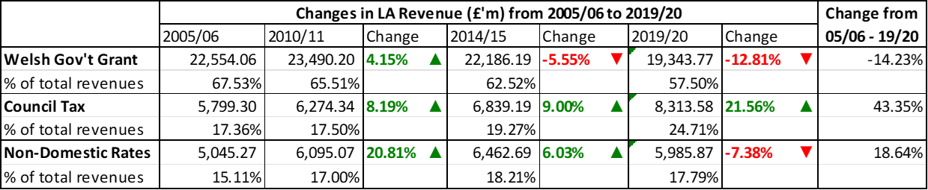
Welsh LAs Income: Scale of Austerity Impacts
Notes:
The table illustrates the changing trends in the principal sources of revenue to LAs by type and location over the period.
Research by the Centre for Cities (2019) found that Welsh and Scottish LAs were considerably more reliant on revenue grants than English LA. However, this reduced in the late austerity era

Slide 9
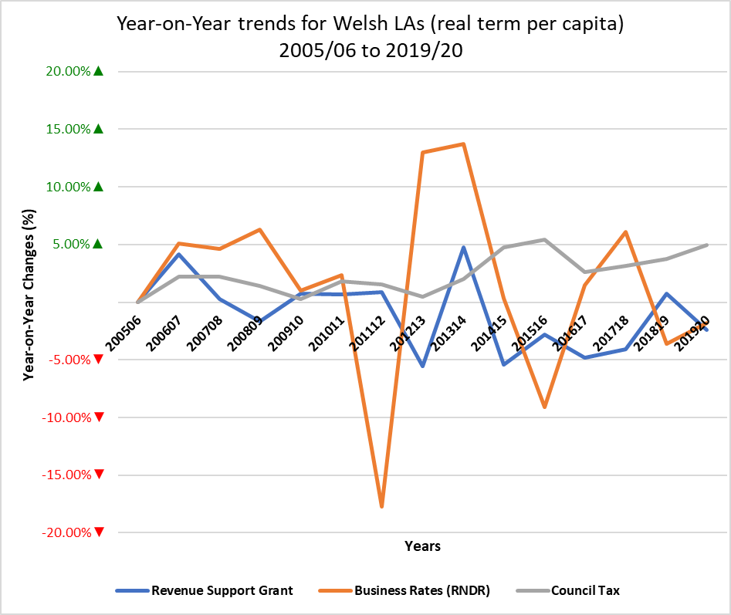
Welsh LA Income: Year-on-Year Changes
Council Tax per capita increased consistently for all Welsh authorities throughout the time series.
Revenue Support Grant: Although variable, it consistently declined.
Business Rates: Fluctuated considerably with a major drop in 2011/12 because of the rebound in 2012/13 and 2013/14 and another drop in 2015/16
TVs had the greatest share of grants; generated lower revenue from council tax throughout the time series.
Notes:
There is a very different pattern for the three different income streams:
Bullet Point 1: Authorities in the Rest of Wales (RoW) had the largest share of council tax, whilst authorities in TVs had lower council tax revenues.
Bullet Point 2: Authorities in TVs had the greatest share of grants during the time series, but they generated lower revenue from council tax throughout the time series.

Slide 10
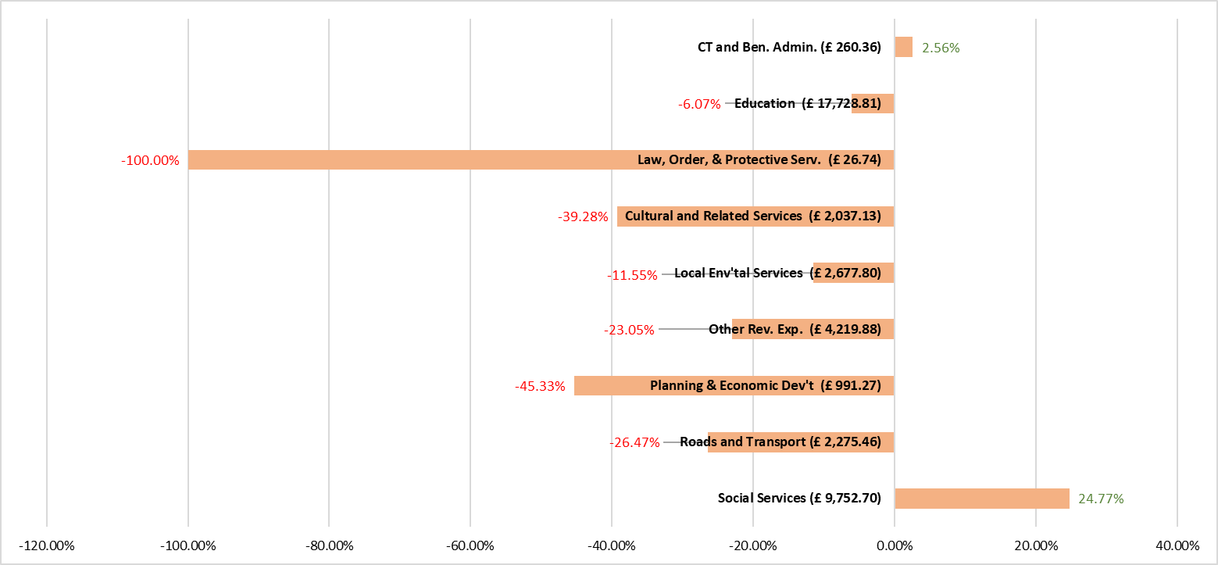
Impacts of Austerity on Service Expenditure
Notes:
The results of the subsequent analysis found that the major increase in service expenditure were recorded on (i) social services (24.77%), and (ii) council tax funding & housing benefit (CFHB) by 2.56%.
In contrast, there were reductions in the funding allocated to planning & economic development (-45.33%), cultural and related services (-39.28%), and roads and transport services (-26.47%).
The results also reveal that Welsh LAs overspent against their budgets on statutory services (education and social services), which affected the expenditure on non-statutory services like cultural & related services, and the non-statutory parts of planning & economic development.

Slide 11
Welsh LAs income: Trend Analysis
Growth in all revenue streams in the pre-austerity era begins to reduce in early austerity.
2011/12 saw a drastic reduction in non-domestic rates in all Welsh LA regions.
A reduction in grants in early austerity era continues to the late austerity era.
Council Tax continued to increase from Early Austerity to Late Austerity.
Notes:
Bullet point 3: Despite the volatile trends in council tax, Caerphilly in TVs was the only UA which sustained growth from council tax income throughout the early austerity era. Caerphilly and Monmouthshire (RoW) were the only Welsh authorities with high numbers of properties classed in bands A to D but with lower band D tax rates.
Bullet Point 4: Council tax income per capita continued to increase at a marginal rate and spiked in 2018/19 and 2019/20 for all LA groups. This increase was due to the pressure on councils to increase their council tax base above the notional 5% ‘cap’ set by the Welsh Government.

Slide 12
Results and Findings: Movement in Per capita spend by Service Area & Group - Pre-Austerity (2005/06 – 2009/10)
Notes:
What is also evident is that there is a degree of similarity in approach across the groups with, in the main, education and SS seeing small percentage reductions and PED and CFHHB seeing larger percentage increases. This suggests a need for investment in CFHHB and PED during this period and to complete the study we will look for underlying social, political or economic reasons why this should be the case. It is also useful to note at this point that the Education and SS budgets are far larger than the other budgets and therefore hold a gearing effect against the others whereby relatively small reductions in spend here can be used to fund relatively large percentage increases in smaller budgets. Of course this works in both directions as we shall see in other eras. It is somewhat surprising that education and social services have seen such reductions, small as they are given that they are two services that attract a lot of public attention and for this reason are often protected against such reductions. However, for social care at least, it may be a representation that social care was historically underfunded and is also a demand led service (meaning that LAs must provide services to those who need them). In this regard SS has often been seen as a problem child in budget terms as it can regularly overspend (Barbera et al, 2017; Jones, 2017), although this viewpoint was reversed as LAs worked through the strategic implications of dealing with austerity.
Highlights on Severity of Cuts to Service Areas
RoW
Had second largest growth rate in CFHHB, and LES.
Had the deepest cuts in PED, although there were marginal reductions in Social Services (SS) and CRS.
NEW
Had the highest and only positive movement in Education and SS. NEW LAs also had the largest movement for CFHHB, but there was growth in PED, LES, and R&T.
Made the deepest cuts in ORE than other regions.
TSC
Had the highest growth rates in PED and LES, but there was growth in CFHHB also increased.
Made the deepest cuts in Roads & Transport.
TV
Had the growth rates in PED and LES, and CFHB.
Made deepest cuts in SS than other regions.

Slide 13
Results and Findings: Movement in Per capita spend by Service Area & Group - Early Austerity (2010/11 – 2014/15)
Notes:
Again what is interesting is the consistent approach adopted by each local authority group, with all following a remarkably similar reprioritisation during the period, ie the same services being on the left or right of figure 4.4. It is interesting that, say, the big cities of the south behaved in a similar way to the valleys, having different population densities, geography, demography and socio/economic conditions. Also interesting is the consistent growth in per capita proportion for housing related services and benefits between this and the previous era across all four groups. The big change we see with the pre and late austerity era is the increase in social services proportionate spend per capita, which as mentioned previously may signal a recognition of the strategic nature of this service, especially at a time when austerity and the recession and negative/low growth experienced during this period, meant an increase in demand for such services..

Slide 14
Results and Findings: Movement in Per capita spend by Service Area & Group - Late Austerity (2015/16 – 2019/20)
Notes:
Continuing the theme form the previous eras, there is a very strong similarity regarding the movements in per capita spending across all services for all for groups.
Once again there is an increase in SS at the expense of other services in terms of priority, and in this era education also sees a increase in the proportionate spend per capita.

Slide 15
Impacts on Welsh LAs’ Income and Spending
Income
  Reduction in RSG and increases in CT and NDR
  Rebalancing of proportions, but RSG still dominates
  Increases in CT and NDR insufficient to alleviate the need for cuts
What is happening to service expenditure?
2005/06-2009/10 - five service areas out of seven moved to the right; two to the left. Note Social Services to the left
2010/11-2014/15 - four services areas moved to the left; three to the right, but increased expenditure to the right more narrowly focused on specific services
2015/16 -2019/20 - Social Services moved to the right, all other services to the left
i.e. gradually less and less variation/discretion (dominated by social services and education).

Slide 16
Impacts on Welsh LAs’ Income and Spending (Cont’d)
How do the 4 regions compare?
  Surprisingly consistent patterns across all 4 regions, again suggesting a reduction in variation/discretion
Social Services was often prioritised over other statutory/non-statutory services –“the problem child that other services had to bail”.
Only 2 Blocks had positive movements in the late austerity era – Education and Social Services. These are both statutory and demand-led. Non-statutory services were deprioritised.
North East Wales LAs had a positive movement in Roads and Transport – due to major increases for Flintshire and Wrexham during the late austerity era – it is not clear why from the figures.

Slide 17
Financial strategies to withstand the twin pressures
The ‘twin pressures’ increased during the early and late austerity eras.
Proactive and anticipatory strategies were adopted to sustain service delivery.
The continuous reduction in funding compelled all Welsh LAs to mobilise more resources from council tax than they received from business rates.
Unitary Authorities in North East Wales and the Rest of Wales collected more council taxes than non-domestic rates.
The Valleys and The Southern Cities received more from business rates than council taxes in the pre-austerity and early austerity eras.
Notes:
Bullet Point 2: The strategies adopted continue to have a significant ripple effect on the ability, capacity, and capability of Welsh LAs to respond to current demands and to prepare for any future shocks and uncertain incidents.

Slide 18
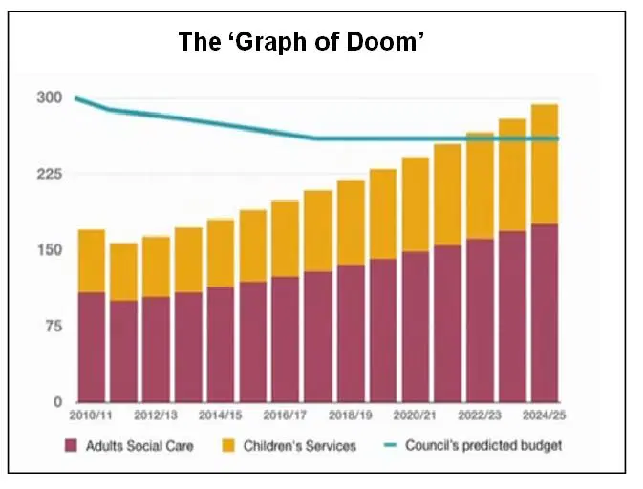
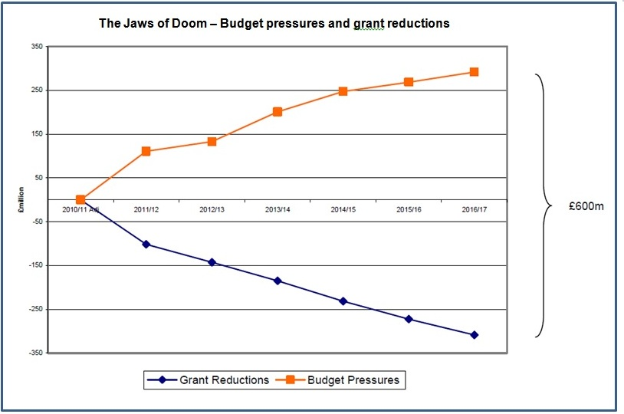
Final thoughts…….
Is devolution and discretion stopping in Cardiff?
Is Wales becoming Barnet? - The Barnet graph of doom from 2010 “a PowerPoint slide, showing that within 20 years, unless things change dramatically, Barnett Council will be unable to provide any services except adult social care and children’s services. No libraries, no parks, no leisure centres – not even bin collections”.

Slide 19
References
Barbera, C., Jones, M., Korac, S., Saliterer, I. and Steccolini, I., 2017. Governmental financial resilience under austerity in Austria, England and Italy: how do local governments cope with financial shocks? Public Administration 95(3): 670-697.
Crawford, R., Joyce, R. and Phillips, D., 2012. Local government expenditure in Wales: recent trends and future pressures.
Dollery, B. and Wijeweera, A., 2010. An assessment of rate-pegging in New South Wales local government. Commonwealth Journal of Local Governance, pp.56-76.
Downes, J. and Taylor-Collins, E., 2019. At the tipping point? Welsh local government and austerity. June 2019.
Ferry, L. and Eckersley, P., 2011. Budgeting and governing for deficit reduction in the UK public sector: act one 'the Comprehensive Spending Review'. The Journal of Finance and Management in Public Services, 10(1), pp.14-23.
Ferry, L., Combs, H. and Eckersley, P., 2017. Budgetary stewardship, innovation and working culture: Identifying the missing ingredient in English and Welsh local authorities’ recipes for austerity management. Financial Accountability & Management, 33(2), pp.220-243.
Hay, R. and Martin, S., 2014. Controlling local government spending: the implementation and impact of capping council taxes. Local Government Studies, 40(2), pp.224-239.
HM Treasury. 2010. Spending Review 2010. London, HM Treasury.
Ifan, G. and Sion, C. 2019. Cut to the bone? An analysis of Local Government finances in Wales, 2009-2010 to 2017-18 and the outlook to 2023-24. Cardiff, Wales Fiscal Analysis.
Ogle, Joseph, Daria Luchinskaya, and Michael Trickey. 2017. Austerity and Local Government in Wales: an analysis of income and spending priorities, 2009-10 to 2016-17. Cardiff: Wales Public Services 2025. Accessed December 02, 2018. Available at: http://www.walespublicservices2025.org.uk/2017/11/23/austerity-and-localgovernment-in-wales-an-analysis-of-income-and-spending-priorities-2009-10-to-2016-17/

