Slide 1


From Fire and Rescue Authorities to
Police, Fire and Crime Commissioners
A comparative study of governance structures on perceptions of accountability in England
@KatarzynaLakoma
Katarzyna Lakoma, PhD candidate
Nottingham Trent University
International Research Society for Public Management, April 2022
P18: New researchers panel

Slide 2

Governance and accountability in public services
Public sector organisations have increasingly been held accountable by a constellation of institutions and standards (Denhardt and Denhardt 2015).
Two main mechanisms in English local government – conformance and performance (Goddard 2005, Ferry and Eckersley 2015)
Governance in the form of governing boards has been widely prevalent in the public services literature
  health boards (Peck 1995, Exworthy and Robinson 2001, Addicott 2008),
  police authorities replaced with PCCs (Davies and Johnson 2016, Murphy et al. 2017, Cooper 2020) and
  school governing bodies (Farrell 2005, Farrell et al. 2017).
The desire to create more accountable public services through new governance structures in the UK (Murphy et al. 2019)
Little is known about the impact of changing governance structures on perceptions of accountability

Slide 3
Literature on fire services
Governance and accountability in fire and rescue services have received relatively little academic attention
Farrell (2018) reviewed governance arrangements, focusing primarily on fire and rescue authorities as governing bodies
Most studies emphasise the importance of performance management frameworks in assuring accountability (Carvalho et al. 2006, Kloot 2009, Taylor et al. 2021).
Other studies also emphasise the importance of financial reporting in delivering accountability (Spencer et al. 2019).
Changes in governance arrangements may affect the nature of accountability within fire and rescue services (Clarke 2018).

Slide 4
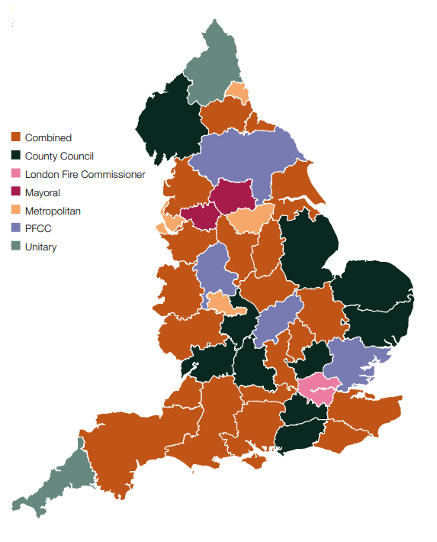
Research context
Traditional long-standing governance model of the local fire and rescue authority, made up of local councillors
Since 2017, an alternative governance model to improve accountability in practice (Policing and Crime Act 2017)
  Police and Crime Commissioners (PCCs) have been able to make a case to assume responsibility for the governance of fire and rescue services within their force areas and become Police, Fire and Crime Commissioners (PFCCs)
  Creation of a new inspectorate (for all fire services)
  Strenghtened focus on collaborative working across emergency services partners (for all fire services)
A patchwork of governance arrangements throughout England

Slide 5
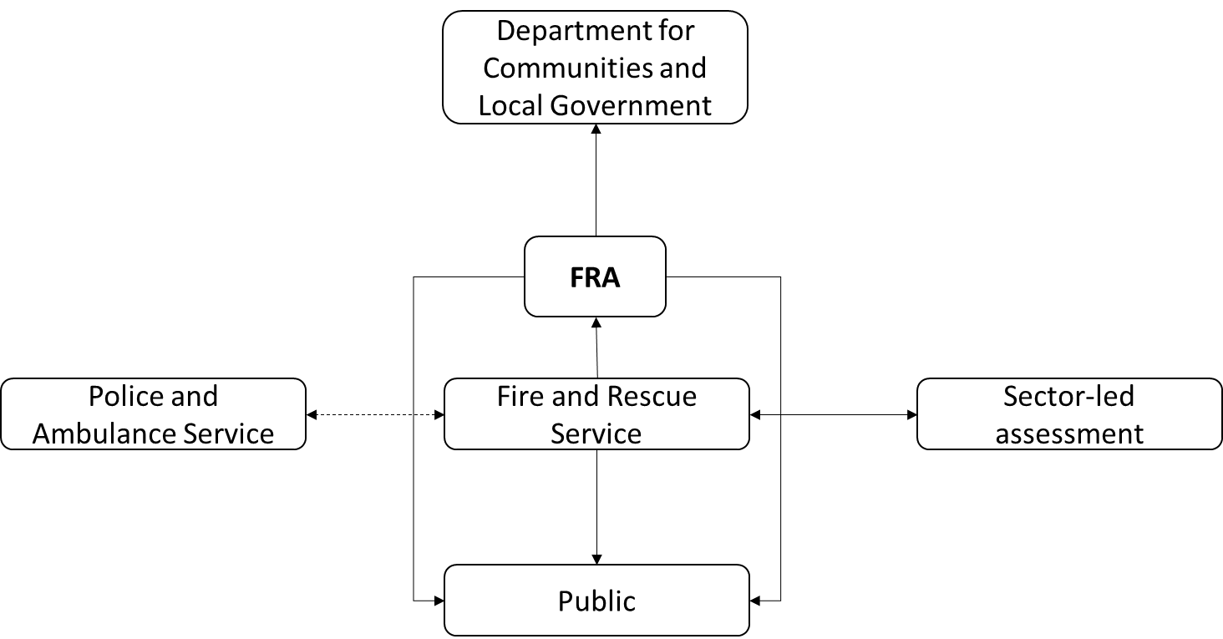
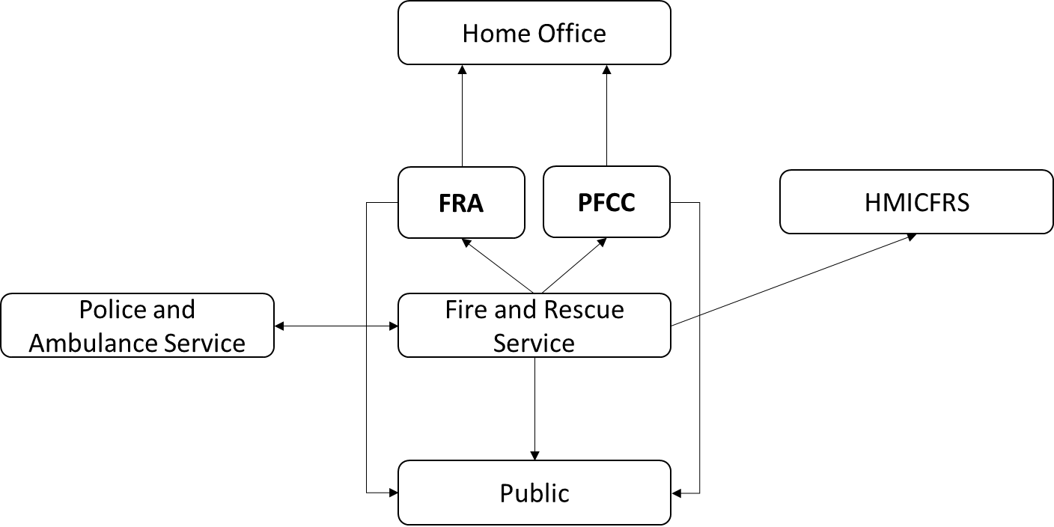
Research question:
How do internal stakeholders within the Fire and Rescue Services understand the notions of accountability in the context of the traditional governance arrangements and the new PFCC arrangements introduced by the Policing and Crime Act 2017?
Fig 1. Pre-Policing and Crime Act 2017
Fig 2. Post-Policing and Crime Act 2017

Slide 6
Methodology and methods
Qualitative approach | Understanding the concepts from the individuals’ viewpoints (Bevir 2009)
Multiple case studies | A comparative multiple case study of governance models within fire and rescue services (Yin 2015)
Sampling | 6 out of 45 services in England 3 traditional fire and rescue authority services and 3 new PFCC governance services
Data collection (March 2020 to June 2021) | 35 semi-structured interviews with senior management (CFOs, deputy CFOs, Assistant CFOs, Directors of Assurance, Directors of Finance, Directors of Prevention and Protection) 3 interviews and 5 focus groups with firefighters (3-5 participants), Publicly available online data (e.g. governance frameworks, senior organisational charts, and statements of assurance)
Data analysis | Thematic coding using NVivo software. A constant interplay between the data and the coding process to refine the themes and their subthemes.

Slide 7
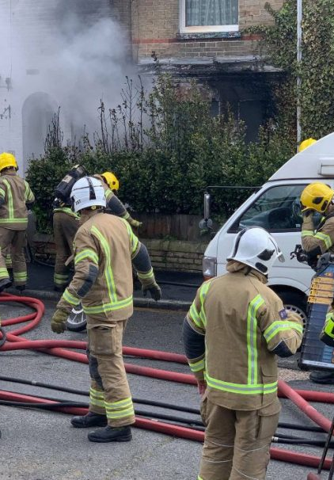
Findings
Public
  Performance accountability - emergency response (turning up on time at accidents), protection, and prevention
    “we’re accountable to the public for providing the fire services, responding to fires but also preventing them”
    (Director of Prevention and Protection)
  Financial accountability – how public’s money is being spent
    “what we’re doing is spending taxpayers’ money and the taxpayer has every right to come in and be able to ask it”
  (Area Manager)
  Political accountability – governing bodies are directly (new PFCC governance) or indirectly elected (traditional FRA governance)
    “if you don’t like them [PFCC], you can get rid of them at the end of the day, and you can vote for somebody else”
    (Chief Fire Officer)

Slide 8

Findings
Governing bodies (FRA/PFCC)
  Bureaucratic accountability- supervisory body
    “ultimately the authority are there to hold the organisation to account, they seek to assure our services on the public’s behalf”
  (Head of Governance and Strategy)
  PFCC – streamlined, single source of accountability, however, political
  “I think it’s speeded up some of the decision making processes. I think it’s removed some layers of bureaucracy. “
  (Deputy Chief Fire Officer)
  FRA – bureaucratic, slow decision-making, however, co-opted members bring extra scrutiny
  “I think that the PCC being involved, I think that’s put some scrutiny upon the fire authority and around the governance”
  (Area Manager)

Slide 9
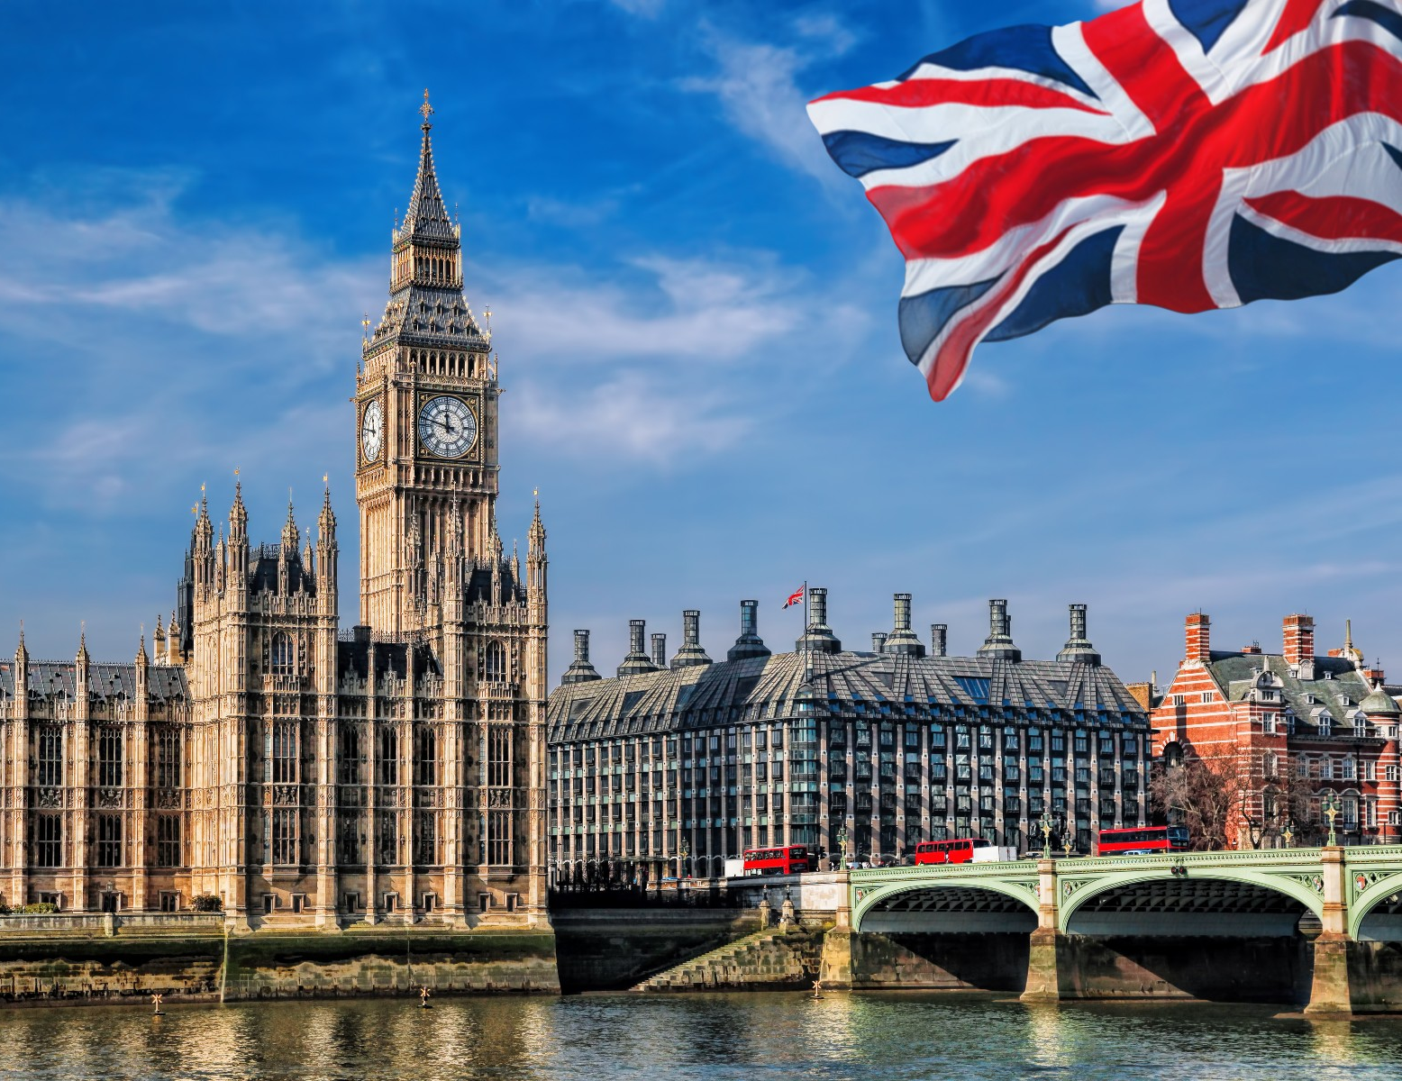
Findings
Central government
  Legal accountability- required by the Fire and Rescue Services Act 2004 to follow the National Framework “
    “[We are] directly [accountable] through to the fire minister, and things come from the national framework document, which is our sort of guiding light”
  (Firefighter)
  Performance accountability – the govt collects detailed information on incident data
  Financial accountability – government grants (so called “revenue support grants” and ”top-up” funds)

Slide 10

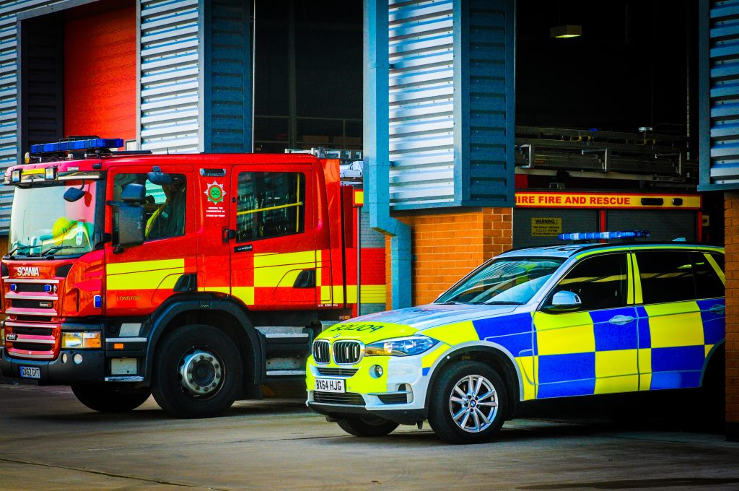
Findings
New inspectorate (HMICFRS)
  Performance accountability - an increased focus on performance measurement
    “HMICFRS have almost had a far greater impact than anything local”
  (Director of Response)
    “Previously if there wasn’t any improvement made, there was not really any accountability held against that”
  (Area Manager)
Other emergency services
(mainly police)
  Professional accountability - deference to professional expertise when responding to incidents
    PFCC “We’re scrutinised by the police and vice versa. The chief and the deputy chief constables, will question what’s happening in the fire and rescue service.”
  (Chief Fire Officer)
    FRA “We work in partnership with them [police], but we’re not accountable to them, unless it was a legal issue.”
    (Assistant Chief Fire Officer)

Slide 11
 | Dimension of accountability |  | Accountability mechanisms
 | Pre-2017 Act | Post-2017 Act | Pre-2017 Act | Post-2017 Act
Vertical downwards - Public | Performance, Financial (only stand-alone authorities), Political (indirect) | Performance, Financial (stand- alone authorities, including PFCCs), Political (direct) | Voting, Council Tax, Public consultation, FOI, Transparent records | Voting, Council Tax, Public consultation, FOI, Inspection reports, Co-opted members on FRA
Vertical downwards - Staff | Bureaucratic Professional | Bureaucratic, Performance, Professional | Supervision, Nolan Principles, Experts answerable for their actions | Supervision, Nolan Principles, Experts answerable for their actions
Vertical upwards – Central government | Financial, Legal | Financial, Legal, Performance | Data on incidents, National Framework (possible intervention) Government funding | Data on incidents, National Framework (possible intervention), Government funding,
Vertical upwards – Scrutiny bodies | Bureaucratic | Bureaucratic, Performance Political | Meetings, Statutory documents | Meetings, Boards, Panels, Statutory documents, One-to-ones
Horizontal – Emergency services | Professional | Professional, Performance | Response Sector-led assessments (peer review) | Response, Joint estates, Joint roles, Performance reporting
Diagonal - Inspectorate | N/A | Performance, Bureaucratic | N/A | Inspections

Slide 12
Conclusions
This study shows how public sector employees perceive accountability demands in an under-researched public service experiencing governance reforms.
Public governance structures shape accountability processes.
Examining situations where governance structures operate under changing and uncertain conditions can reveal how governance structures or institutions shape actors’ perceptions of accountability.
Directly elected individuals, such as mayors or commissioners, responsible for a public service can change accountability relationships in the following ways:
  can add a new scrutiny dimension,
  can enable the public to directly hold the politician to account in elections (however, they might be deeply ingrained in party politics),
  can result in a lack of increased accountability to local communities.

Slide 13

Thank you
Questions?/Comments?

