Slide 1



Why and how has prevention become the ‘Cinderella’ service in Fire and Rescue Services?
The 25th Annual IRSPM Conference
Facing the future: Evolving social-political-administrative relations and the future of administrative systems
19th – 22nd April 2021
@KatarzynaLakoma
Nottingham Trent University, Nottingham Business School
Katarzyna Lakoma and Pete Murphy
@PeterMPMurphy

Slide 2
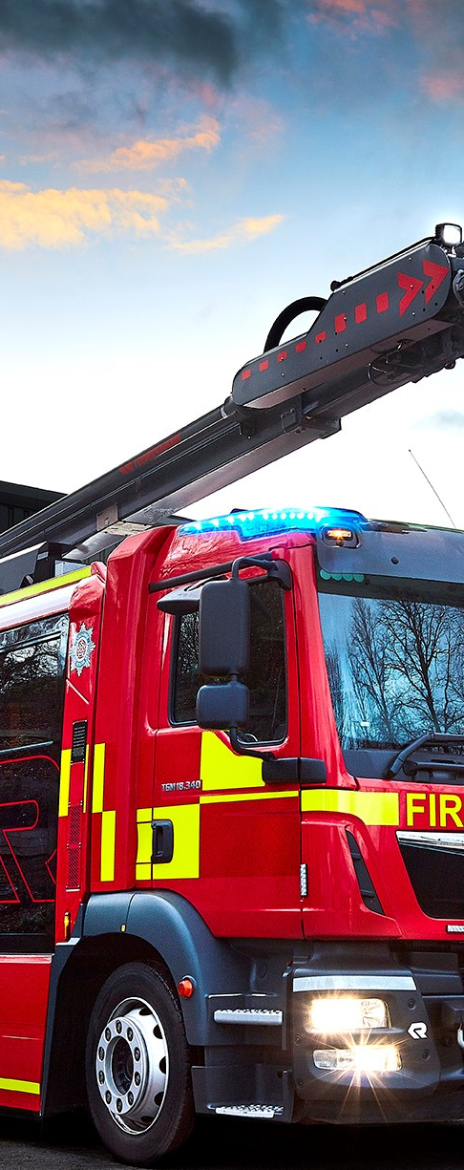
Background
Key FRS areas
  Response – operational response to incidents (speed and quality of response)
  Prevention – reducing the number of incidents occurring within people’s homes and communities (risk reduction)
  Protection – ensuring public safety in the wider built environment (non-domestic buildings)
Statutory duties for FRSs with the introduction of the Fire and Rescue Services Act 2004
Over the last decade, the level of resources directed into prevention and protection activities has disproportionately declined

Slide 3
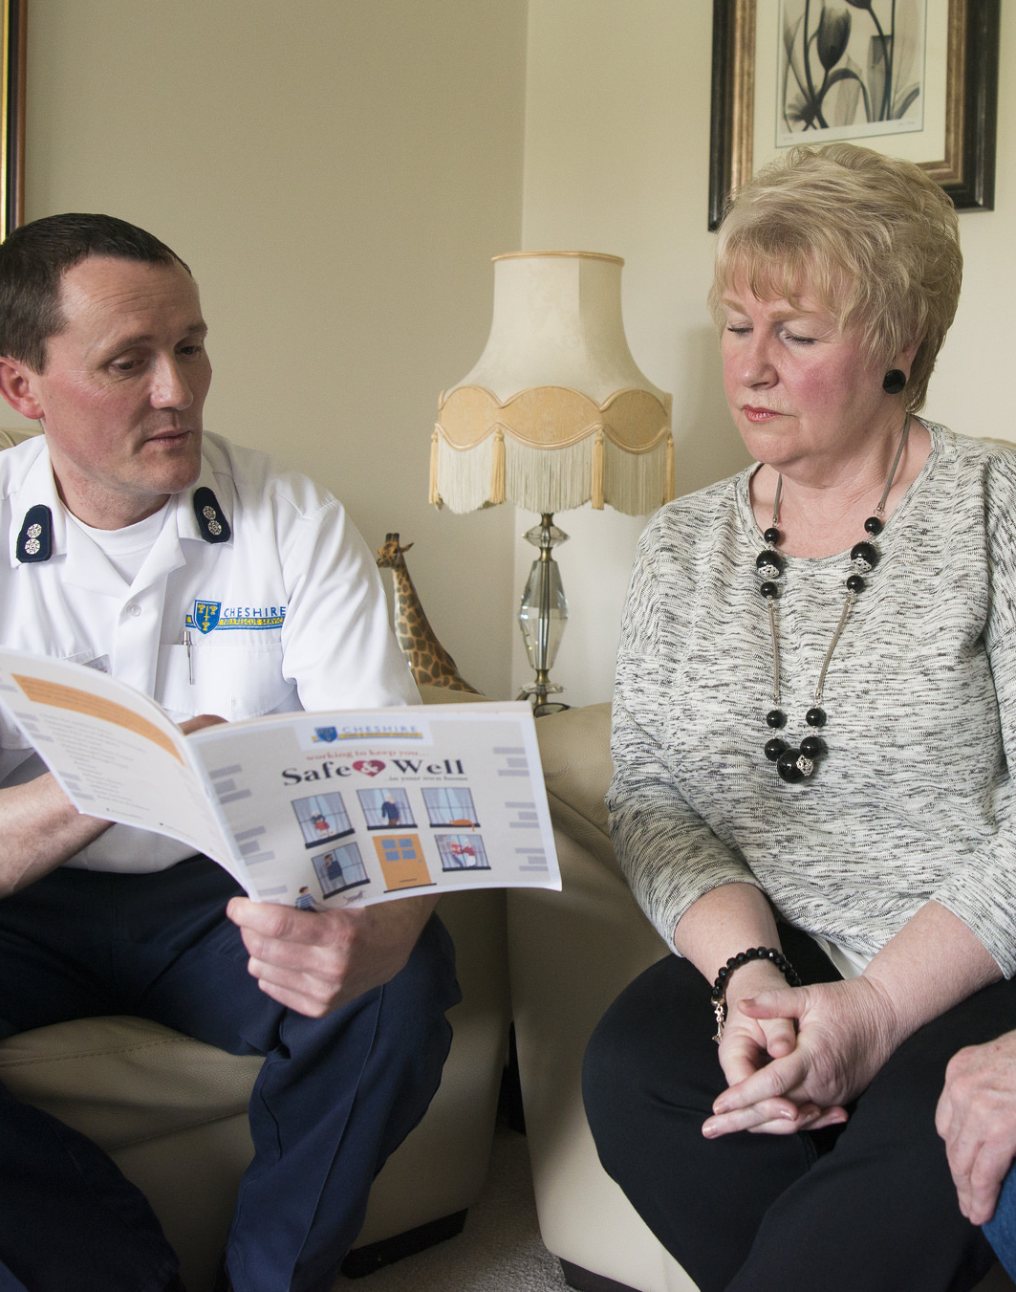
Prevention
Home Fire Safety Checks
  Identification and raising awareness of potential fire risks, install fire alarms and were appropriate review escape plans
Safe and Well Visits
  Build on existing good practice of Home Fire Safety Checks
  Target the most vulnerable members of the community
  Offer fire safety advice based on their household and lifestyle
    Falls risk assessment
    Smoking cessation
    Cold homes and fuel poverty
    Dementia
    Social isolation
  Responsibility to signpost and refer to partners
Home Fire Safety Checks (since 2004)
Safe and Well Visits (since 2018)

Slide 4
Prevention was a local issue
Nottinghamshire FRS Inspection 2019
“Nottinghamshire FRS should evaluate their prevention activities in order to understand the benefits of their activities to communities and the value of their investment”. (HMICFRS 2019).
“Nottinghamshire FRS has no performance management in place to ensure staff are making Safe and Well checks effectively… Nottinghamshire FRS has no targets for the completion of these checks, and the number carried out by each station varies considerably.” (HMICFRS 2019, p.12)

Slide 5
It was also a continuing national issue as shown by recent inspections
“Services aren’t giving prevention work sufficient priority” … “Levels of prevention activity are declining, and targeting is poor” … “It is unacceptable that some fire and rescue services don’t take a sufficiently targeted approach to their prevention work” (HMICFRS 2021, pp.59-60
“Most of the services we inspected had insufficient knowledge of what are the most effective interventions to mitigate the risk of fire. And only 3 of the 13 services we inspected (Cambridgeshire, Cheshire and Merseyside),had adequately evaluated their prevention activity.” (HMICFRS 2021 p.61)

Slide 6

Research aim
Nottingham Trent University’s contribution to the academic assessment of the Safe and Well programme (Arch and Thurston 2013, Williams and Manning 2016, Yannitell and Chatsiou 2019, Clarke 2020, Mahmood et al. 2020, Simcock 2020)
  Examine how Nottinghamshire FRS identifies vulnerable people and evaluate it’s vulnerability framework (‘CHARLIE’ profile)
  Evaluate the current the Safe and Well Visits initiative to perform an assessment of the social and economic value/social return on investment of Safe and Well Visits

Slide 7
Recommended improvements to NFRS vulnerability framework
Target the most vulnerable people – the elderly, the disabled and those with mental health and neurological conditions.
Address imbalance between ethnic groups receiving Safe and Well Visits
Examine the patterns across fire fatalities victims and fire injuries at home in Nottinghamshire
Continue working with partners to identify vulnerable people
Incorporate the following data into the model:
long-term health problems
disability
mental health data from NHS Digital,
living alone data
All referrals from external organisations should meet the service’s targeting profile

Slide 8
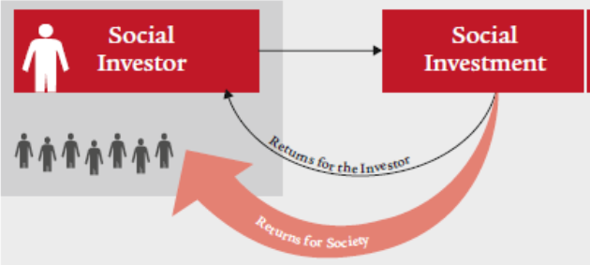
We tested a Social Return on Investment model
Key stakeholders | Outcome | Indicator | Data collection | Possible proxies
Recipients of Safe and Well visits | Increased awareness of fire risk at home and improved quality of life | Number of fire incidents experienced by participants after the visit, QALY | Evaluation and feedback survey (NFRS Safe and Well Visit Survey 2019/20 Report) | Cost of visiting private doctor clinic Cost of health insurance
Nottinghamshire Fire and Rescue Service | A reduction of fire risk and drop in demand for FRSs | Number of home fires, Number of deaths and injuries from accidental fires at home | Home Office/NFRS data | Value of a prevented fatality, Value of a serious injury, Value of a slight injury
Partner agencies (e.g. the NHS) | Increased number of identified vulnerabilities that become apparent during the visits | A number of referrals from and to partner agencies | Home Office/NFRS data
Local communities and central government | Safer communities, improved perception of the local area | Number of home fires , Number of deaths and injuries from accidental fires at home, Community Safety reports | Home Office/NFRS data Community Safety reports | Community Safety reports, Change in property prices, Amount spent on home improvements

Slide 9
But had to do a cost effectiveness evaluation that found:
Safe and Well Visits are the most resource intensive when completed by Response Delivery Team (at least 5 members of staff in a fire appliance, average £124.26 per visit) in comparison to the visits conducted by Prevention Team (1 member of staff, average £36.09 per visit)
Prevention specialists allocated the most challenging visits
 | 2017/2018 |  | 2018/2019 |  | 2019/2020
Wholetime Crews | 2636 | 69.7% | 3192 | 75.7% | 5270 | 68%
On-Call | 26 | 0.7% | 338 | 8.0% | 1441 | 19%
Prevention | 1122 | 29.7% | 689 | 16.3% | 1041 | 13%
Total | 3784 | 100% | 4219 | 100% | 7752 | 100%

Slide 10
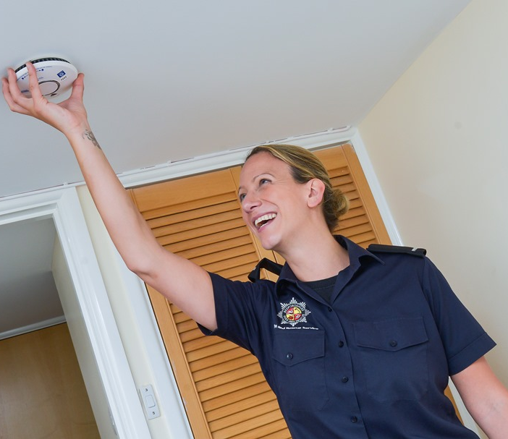
Lessons for NFRS
Optimise resource inputs to case mix
Quality assured delivery of Safe and Well Visits
  Pre and post intervention risk assessments
  Safe and Well targets for all stations based on delivery team type
  Pro-actively quality assurance of partner referrals
Regular review of performance data to understand how prevention activities can be more focused
Work with others to facilitate robust Social Return on Investment Model

Slide 11

2021 conclusions
Importance of partnership working in identifying vulnerabilities (wider emergency services sector)
Regular review of performance data, including the pattern of fire fatalities, to understand how prevention activities can be more focused (NFRS and other services)
Balancing response to incidents with prevention and protection (all FRS)
SROI analysis to benchmark against other services (NFCC)
Long-term economic and social impact of the Covid-19 pandemic on the future demand for emergency services (core emergency services)

Slide 12
Since IRSPM 2021
The National Fire Chiefs Council commissioned a Social Return on Investment model for the sector as a whole This includes a model for use by individual FRS (Hewitt and Biermann, 2020, 2022 forthcoming).
Nottinghamshire have improved their vulnerability framework and safe and well visits
Cheshire FRS have applied an SROI analysis to the evaluation of their new Safe and Well Initiatives (Clarke forthcoming)
NTU are developing a nearest neighbour model to improve benchmarking and facilitate a SROI model.

Slide 13
Since IRSPM 2021
Covid-19 has shown
  The benefits of adopting a Public Interest or Public Value approach (rather than NPM) to prevention services
  The need to evaluate the social determinants of health and the Sustainable Development Goals
  The efficacy of using a Social Return on Investment model pandemic on the future demand for emergency services (core emergency services)
  The importance of partnership working in identifying vulnerabilities and more generally in the wider emergency services sector
  The need to evaluate medium and long term impacts and outcomes and not just short-term impacts and outcomes

Slide 14
Why does prevention continue to be the ‘Cinderella’ service in FRS?
The sector and the government hasn’t correctly identified the full range of costs and benefits associated with it
Even if it had, the sector didn’t have the ‘tools’ to measure, assess and evaluate its impacts and outputs
The government have applied NPM approaches and techniques rather than a more appropriate approach based upon the Public Interest, New Public Governance and Public Value

