Slide 1
Exploratory Analysis of Retailers and Socio-economic Deprivation
Adeniyi, Oluwole; Whysall, Paul and
Brown, Abraham

Slide 2
Overview
Paper is the result of the phase 1 study of an on-going PhD research aimed at critical analysing the relationship between retailers (AASRs) and area socio-economic deprivation (SED) in England.
In this paper, AASRs are gambling and fringe banking (pawnshops, payday loans, and high yield interest lenders) and rent-to-own (RTO) retailers.
This research was informed as a result of he conflicting arguments of scholars on the location preference of these AASRs vis-à-vis SED in England.

Slide 3
Background
The prevailing landscape in an environment greatly impacts on the life experiences and health outcomes of its inhabitants (Macintyre et al., 1993).
Therefore, the contextual explanation for the continuous decline in the well-being of inhabitants of poor communities lies in the critical examination of the opportunities in these socially deprived areas.
Hence, attention of stakeholders interested in improving the circumstances of deprived communities has been drawn to the configuration of their environments.
In retail domain, there has been linkages between retail provisioning and area socio-economic deprivation (SED) and debates that some seemingly controversial retailers are in deprived communities.

Slide 4
Literature Review
In the food retailing environment, the notion of concentration of outlets in deprived neighbourhood has been an on-going debate.
In Canada and Australia, concentrations in deprived localities (Smoyer-Tomic et al., 2008; Pearce et al., 2007).
In the US, contrasting evidences -
- low and poor access in deprived areas (Baker et al., 2006; Shaffer, 2002) - better access in derpived areas (Sharkey and Horel, 2007).
In the UK, better access in socially disadvantaged neighbourhoods (Smith et al., 2009; Cummins and Macintyre, 2002).

Slide 5
Literature Review Cont’d
Scholars further allude that AASRs are concentrated in deprived areas (Wheeler et al., 2006;Graves, 2003; Ray et al., 2013).
Gambling Establishments - concentrated in deprived areas in North America, New Zealand, Australia.
In the UK, conflicting views on gambling
- high concentrations in deprived areas (Astbury, and Thurstain-Goodwin, 2015; Wardle et al., 2014),
- Whysall (2014) found no concentration of betting shops in England.
Fringe Banking Retailers - These retailers are present in areas with other mainstream financial organisations (Fellows & Mabanta, 2008; Fowler et al., 2014) and concentrated in deprived areas (Whysall, 2014; Graves, 2003).
RTO Retailers - Abundance in low socio-economic status communities (Graves, 2003; Hill et al., 1998; Whysall, 2014).

Slide 6
Literature Review Cont’d
Critics further allege that not only are these AASRs clustered in deprived communities, the concentrations are also targeted (Graves, 2003; Stegman and Faris, 2003; Townshend, 2017; Portas, 2011)
Due to the dangers inherent in frequent demand for these retailers, their deliberate concentration in deprived areas will further worsen the conditions in deprived communities.

Slide 7
Demand for AASRs
Increasing poverty.
Demand for gambling is fuelled by motives - 3 major categories i.e. financial, ego enhancement and thrill seeking (Fisher, 1993).
Fringe banking demand is driven by stringent regulations on access to credit facilities. Therefore, the poor and disadvantaged, who cannot meet the necessary condition have no other option but to patronize high interest lenders to survive (Graves, 2013)
RTO demand is fuelled by the ease of access, liquidity constraints and seemingly flexible repayment terms (Zikmund-Fisher et al., 1999).

Slide 8
Supply for AASRs
Factors that have influenced the present landscape includes;
Waves of decentralisation (Schiller, 1971; Schiller, 1988).
Planning Regulations - Sequential testing (Wood et al., 2006).
Demand Pull (Increasing poverty due to economic recession).
Gambling – High demand, marketing strategies, FOBTs, gaming regulation (failed to classify FOBTs). Marketing strategies.
Fringe Banking - Demand pull, government regulation (bank deregulation (Grave, 2003), failure to put policies in place to checkmate fringe banking activities).
RTO – Marketing models, poor government regulations.

Slide 9
Conceptual Framework
Vacant Premises
Consumer Behaviour
Demand for AASRs
Retail Location
Supply of Outlets
Socio-economic Characteristics
Laws, Policies and Regulations
Retailers’ Marketing Strategies

Slide 10
Research Gaps and Justification
No comparative analysis. A study which carried out a comparative analysis compared Ladbrokes to Asda and etc and not group distributions.
Most studies focus on the side effects of patronage of these AASRs in UK (Griffiths, 1994) rather than location preference.
No in-depth quantitative study on fringe banking and RTO.
Most studies on gambling in UK looked at availability of gambling machines (fixed odds betting terminals) as against actual shop location.

Slide 11
Research Questions and Research Aim
What is the relationship between the distribution of FGRs’ and AASRs’ outlets and SED?
Are there unique differences in the location preference of AASRs compared to FGRs and SED?
Research Aim
The research aims at carrying out a comparative analysis of relationship between AASRs and FGRs and SED.

Slide 12
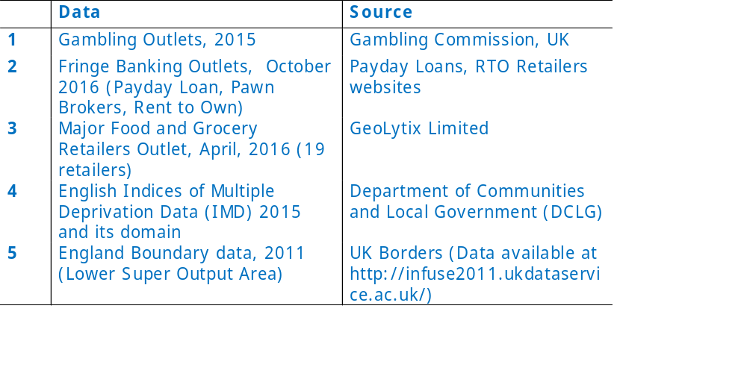
Data and Sources

Slide 13
Methods
All shop address (FGRS and AASRs) were geocode to lower super output area (LSOA) geography.
Shop outlets per LSOA for each group of retailers weighted with corresponding LSOA.
Hotspot technique (kernel density) to map FGRs and AASRs Outlet in ArcGIS to show concentration (GIS).
Deprivation index was compared to each group of retailers distributions.
Correlation and one way ANOVA was used to examine the relationship between the two groups of retailers and the IMD domains (income, employment and education)
NB: Casinos and amusement centres were excluded

Slide 14
Results
 | Outlets | LSOA | Minimum | Maximum | Mean | Std. Deviation
FGRs | 10,888 | 7634 | 1 | 24 | 1.43 | 0.891
AASRs | 12075 | 5533 | 1 | 39 | 2.18 | 2.804
Descriptive statistics for the 2 groups of retailers’ outlets
Figure 1 AASRs and Income, Employment and Education Decile
Figure 2 FGRs and Income, Employment and Education Decile

Slide 15
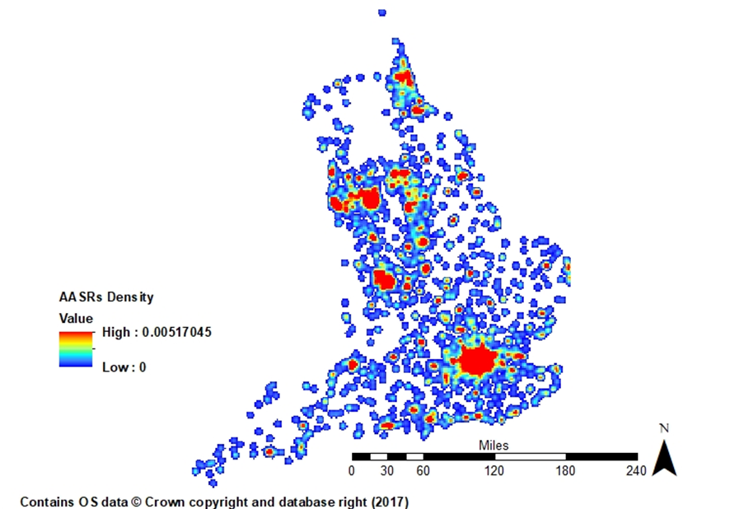
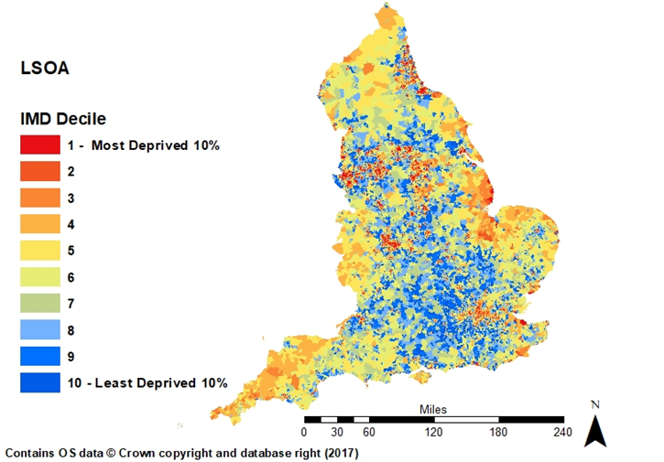
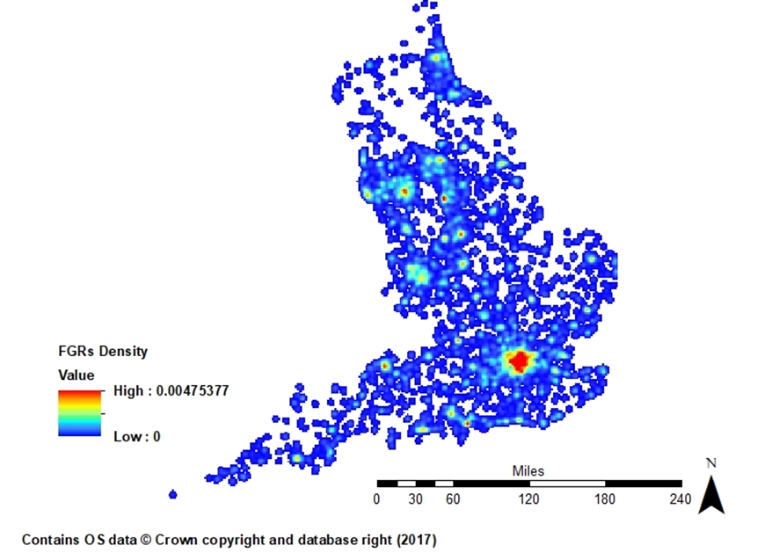
Figure A
Figure B
Figure C
Area Deprivation and retailers hotspot maps - AASRs (a), IMD(b) and FGRs (c)

Slide 16
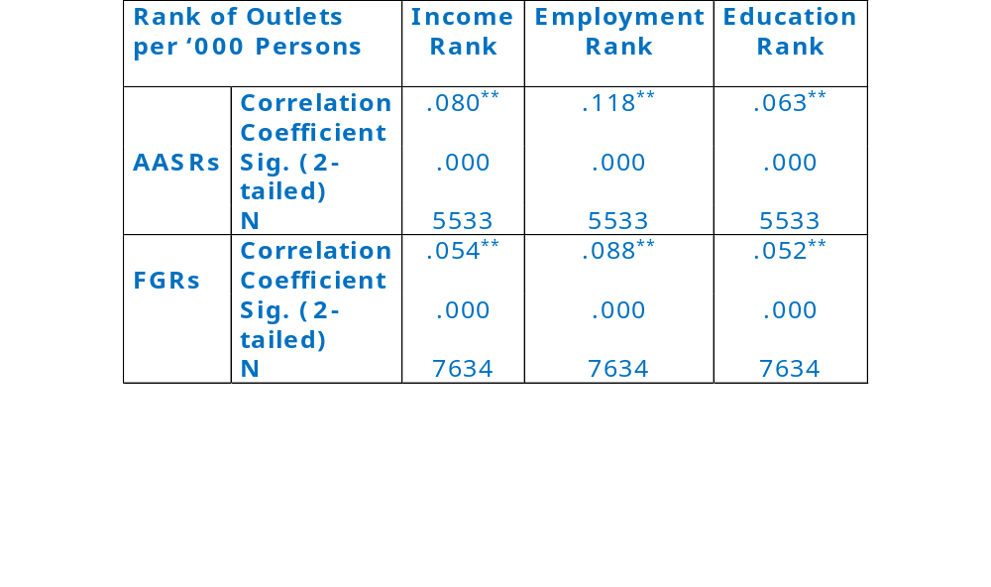
Spearman correlation between rank of AASRs and FGRs outlets per ‘000 persons and income, employment and education domain ranks.

Slide 17
Mean and standard deviation of AASRs and FGRs and area deprivation

Slide 18
Welch one-way ANOVA between the 2 groups of retailers’ outlets per ‘000 persons and employment deprivation domain deciles.
 | AASRs |  |  |  | FGRs
 | Statisticª | df1 | df2 | Sig. | Statisticª | df1 | df2 | Sig.
Employment Decile | 9.929 | 9 | 1820.151 | .000 | 10.175 | 9 | 3039.274 | .000
 |  | AASRs |  | FGRs
(I) Emp. Decile | (J) Emp. Decile | Mean Difference (I-J) | Std. Error | Mean Difference (I-J) | Std. Error
1 | 2 | .47566815** | .0929696 | .10834023* | .03030283
 | 3 | .45292429** | .09442477 | .10416345* | .03044469
 | 4 | .54153571** | .0916357 | .14145059** | .02895365
 | 5 | .63439851** | .09027992 | .15069656** | .02963271
 | 6 | .62432449** | .1018772 | .16680981** | .02971657
 | 7 | .68237601** | .09652248 | .19999773** | .02813237
 | 8 | .81351308** | .09452521 | .22375250** | .02799285
 | 9 | .62618200** | .1370763 | .20214845** | .03348207
 | 10 | .42507712 | .16953282 | .14032556 | .04561503
3 | 1 | -.45292429** | .09442477 | -.10416345* | .03044469
 | 2 | .02274386 | .07654102 | .00417678 | .02672716
 | 4 | .08861142 | .07491517 | .03728714 | .02518716
 | 5 | .18147422 | .07325056 | .04653312 | .02596492
 | 6 | .1714002 | .08714439 | .06264637 | .02606058
 | 7 | .22945171 | .08081936 | .09583429** | .02423861
 | 8 | .36058878** | .07842319 | .11958906** | .02407653
 | 9 | .1732577 | .12651124 | .09798500* | .03028413
 | 10 | -.02784717 | .16111039 | .03616211 | .04332217
**Mean difference is significant at .001 level *Mean difference is significant at .05 level
Games Howell multiple comparison table for employment deprivation deciles1 and 3 with other deciles for the 2 groups of retailers’ outlets per ‘000 persons.

Slide 19
Discussion
Our results show that there is a marked concentration of AASRs in deprived and poor communities in the England (Wardle et al., 2014; Astbury and Thurstain-Goodwin, M., 2015; Grave, 2003; Welte et al., 2004).
Likewise, there is also a concentration of FGRs in deprived (Cummins and Macintyre, 2002; Raja e al., 2008; Zenk et al., 2005; Baker et al., 2006).
There is the possibility that these areas offer the best opportunities in terms of good accessibility, population density, demand as well as affordable premises which is in turn driving the location preference of AASRs.
Therefore, as location pays a prominent role in the success or failure of any establishments, the presence of these AASRs in deprived areas might be a reflection of the abundance of opportunities, because these areas are the historical commercial hubs of England (Whysall, 2014).

Slide 20
Discussion/Conclusion Cont’d
On the other hand, results shows a higher significant positive relationship and higher concentration of AASRs to SED compared to FGRs.
FGRs are more than AASRs and have ubiquitous demand. Their locations reflect commercial centres in England. Consequently, for AASRs to be more concentrated, then it could mean these deprived areas offer AASRs other attractions. These attractions could be the hard-pressed area characteristics.
This further gives credence to the contention that these AASRs target deprived areas (Portas, 2011; Grave, 2003; Stegman and Faris, 2003).

Slide 21
Limitations
Catchment area – That of retail outlets differ. A convenience store is different from a superstore.
Does not incorporate distance.
Quantitative analysis alone cannot adequately address the deliberate motives of these retailers.
Future Research
Using raw socio-economic variables from the national census as opposed to multiple deprivation data, breaking the AASRs in to sub-groups
Moving from a England wide analysis to city wide
Leeds, Nottingham and Bristol

Slide 22
Thank you
Oluwole Adeniyi
Oluwole.adeniyi2015@my.ntu.ac.uk

Slide 23
References
Astbury, G. and Thurstain-Goodwin, M., 2015. Contextualising machine gambling characteristics by location-final report: A spatial investigation of machines in bookmakers using industry data. Prepared by Geofutures for The Responsible Gambling Trust.
Baker, E.A., Schootman, M., Barnidge, E. and Kelly, C., 2006. The role of race and poverty in access to foods that enable individuals to adhere to dietary guidelines. Preventing chronic disease, 3(3).
Cummins, S. and Macintyre, S., 2002. A systematic study of an urban foodscape: the price and availability of food in greater Glasgow. Urban Studies, 39(11), pp.2115-2130.
Fellowes, M. and Mabanta, M., 2008. Banking on wealth: America's new retail banking infrastructure and its wealth-building potential. Brookings Institution.
Fisher, S., 1993. The pull of the fruit machine: A sociological typology of young players. The Sociological Review, 41(3), pp.446-474.
Fowler, C.S., Cover, J.K. and Kleit, R.G., 2014. The geography of fringe banking. Journal of Regional Science, 54(4), pp.688-710.
Graves, S. M., 2003. Landscapes of predation, landscapes of neglect: A location analysis of payday lenders and banks. The Professional Geographer, 55(3), 303-317.
Hill, R.P., Ramp, D.L. and Silver, L., 1998. The rent-to-own industry and pricing disclosure tactics. Journal of Public Policy and Marketing, pp.3-10.
Macintyre, S., Maciver, S. and Sooman, A., 1993. Area, class and health: should we be focusing on places or people? Journal of social policy, 22(2), pp.213-234.
Pearce, J., Blakely, T., Witten, K. and Bartie, P., 2007. Neighbourhood deprivation and access to fast-food retailing: a national study. American journal of preventive medicine, 32(5), pp.375-382.
Portas, M., 2011. The Portas Review. An independent review into the future of our high streets. Department for Business, Innovation and Skills.
Raja, S., Ma, C. and Yadav, P., 2008. Beyond food deserts: measuring and mapping racial disparities in neighbourhood food environments. Journal of Planning Education and Research, 27(4), pp.469-482.
Ray,J.G., Boshari,T., Gozdyra,P.,Creatore, M.I.,and Matheson, F.I.,2013. Cheque cashing places: preying on areas with high crime. Sociology Mind, 3(04), 278.
Schiller, R.K., 1971. Location trends of specialist services. Regional Studies, 5(1), pp.1-10. Schiller, R., 1988. Retail Decentralization. A Property View. Geographical Journal, pp.17-19.
Schiller, R. K., 1988. Retail Decentralization. A Property View. Geographical Journal, pp.17-19.
Shaffer, A., 2002. The persistence of LA's grocery gap: The need for a new food policy and approach to market development.
Smith, D.M., Cummins, S., Taylor, M., Dawson, J., Marshall, D., Sparks, L. and Anderson, A.S., 2009. Neighbourhood food environment and area deprivation: spatial accessibility to grocery stores selling fresh fruit and vegetables in urban and rural settings. International journal of epidemiology, 39(1), pp.277-284.
Smoyer-Tomic, K.E., Spence, J.C., Raine, K.D., Amrhein, C., Cameron, N., Yasenovskiy, V., Cutumisu, N., Hemphill, E. and Healy, J., 2008. The association between neighbourhood socioeconomic status and exposure to supermarkets and fast food outlets. Health & place, 14(4), pp.740-754.
Stegman, M.A. and Faris, R., 2003. Payday lending: A business model that encourages chronic borrowing. Economic Development Quarterly, 17(1), pp.8-32.
Townshend, T.G., 2017. Toxic high streets. Journal of urban Design, 22(2), pp.167-186.
Wardle, H., Keily, R., Astbury, G. and Reith, G., 2014. ‘Risky places?’: Mapping gambling machine density and SED. Journal of Gambling Studies, 30(1), pp.201-212.
Wheeler, B.W., Rigby, J.E. and Huriwai, T., 2006. Pokies and poverty: problem gambling risk factor geography in New Zealand. Health and place, 12(1), pp.86-96.
Whysall, P., 2014. Retailers and deprivation: An exploratory study: In British Academy of Management Conference, Belfast, September, 2014.
Zenk, S.N., Schulz, A.J., Israel, B.A., James, S.A., Bao, S. and Wilson, M.L., 2005. Neighbourhood racial composition, neighbourhood poverty, and the spatial accessibility of supermarkets in metropolitan Detroit. American journal of public health, 95(4), pp.660-667.
Zikmund-Fisher, B.J. and Parker, A.M., 1999. Demand for rent-to-own contracts: a behavioral economic explanation. Journal of Economic Behavior and Organization, 38(2), pp.199-216.

