Slide 1


Where are your problematic hand car washes and nail bars?
Some recent research updates
Dr. James Hunter and Rich Pickford,
Work, Informalisation and Place Research Centre,
Nottingham Trent University
Tuesday 15 March 2022

Slide 2

The WIP Research Centre: Our research focus
Informal Economy
Scale of the informal economy
(how many non-compliant employers are there?)
Nature of the informal economy
(what is the degree and impact of non-compliance?)
Location of the informal economy
(where is non-compliant employment located, and why does it appear within specific neighbourhoods?)
Links to labour abuse and modern slavery
How can we use our data and evidence base to inform strategic policy, and provided regulators and enforcement agencies (and their partners) with information that helps them to target and tailor their interventions?

Slide 3




The WIP Research Centre: Recent Projects, Current Research Bids, Our Funders and Partners
Impact of Covid-19
pandemic on the informal economy
Responsible Car Wash trial of licensing schemes and other approaches to tackle non-compliance in hand car wash sector
Understanding The Role Of Licensing To Tackle Modern Slavery And Labour Market Non-compliance In The Hand Car Wash Sector
Partners to whom we are a Critical Friend:
Migrant worker self-help groups;
The Director of Labour Market Enforcement;
The Gangmaster’s Labour Abuse Authority;
Responsible Car Wash Scheme;
Strategic analysts and police officers attached to the East Midlands, Greater Manchester and South East regional organised crime units.
Unseen; USDAW and GMB Trade Unions;
Independent Anti-Slavery Commissioner;
Changes in working lives and power in workplace dynamics
Trajectories of degradation: Labour market non-compliance to modern slavery – a sectorial deep dive into hand car washes, nail bars and off-street sex work

Slide 4
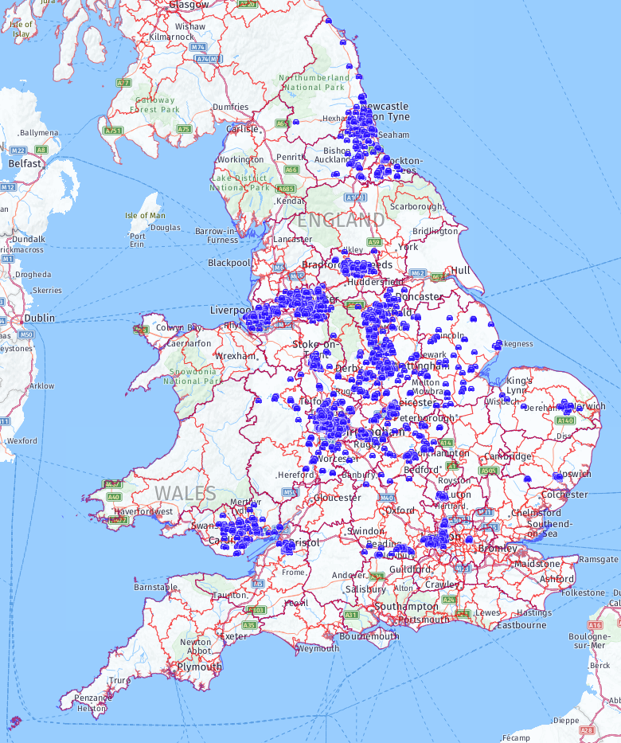
Extent of our search for HCWs across England and Wales:
WIP hand car wash locations identified, February 2022
1,820 HCWs identified to date across 30% of local authority areas (35% of neighbourhoods [LSOAs])
North-East;
Bristol;
Bradford and Leeds;
Greater Manchester;
Merseyside;
East Midlands;
Selected areas in the East of England;
West Midlands (complete for former Metropolitan County area);
Reading, Slough, Hillingdon, Watford and Luton;
Tower Hamlets
Cardiff and the South Wales Valleys.

Slide 5


What are the risk and protective factors that predict the presence of HCWs at the neighbourhood level?
2.564
2.364
2.225
1.545
1.316
1.01
0.989
0.959
0.958
0.929
0.920
0.914
Based upon binary logistic regression analysis of all LSOAs surveyed by WIP (n=11,490)
0.896
0.894
0.093
0.026
Decreasing chance of finding HCW
Increasing chance of finding HCW

Slide 6
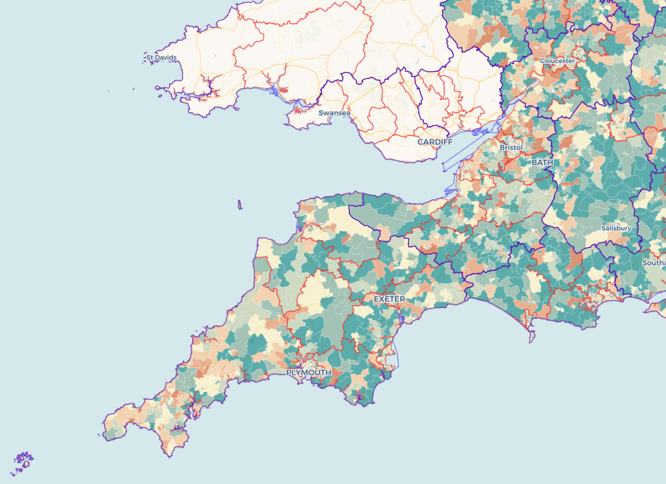
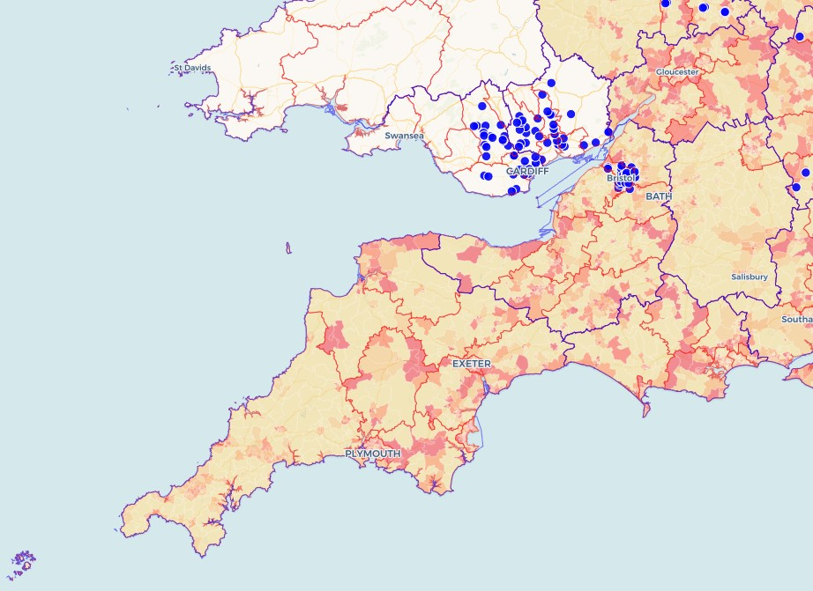
The picture of the South West region
The team have mapped hand car wash locations in Bristol but our predictive tools for hand car washes and nail bars can be utilised across the whole region.

Slide 7
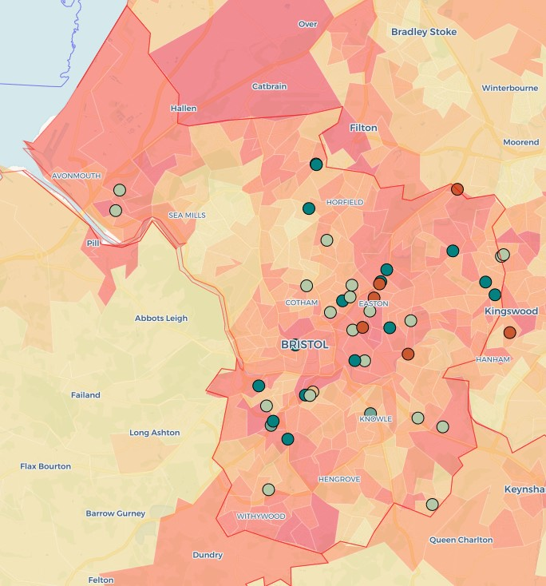
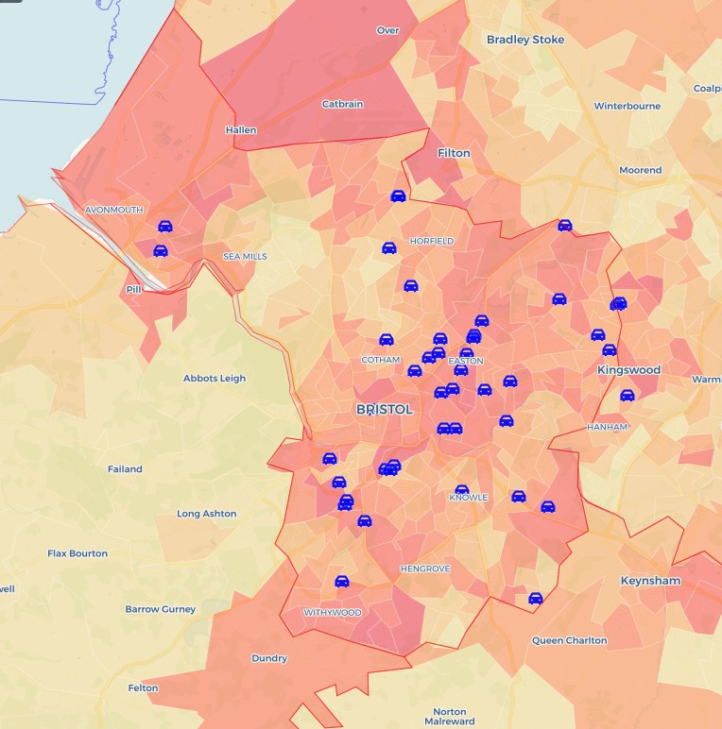
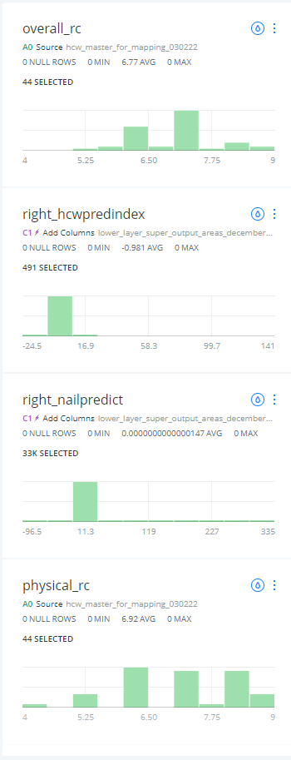

Sites in red of increased overall concern
Predictive Index that identifies the most likely location of HCWs
Location of HCWs in the Bristol area

Slide 8
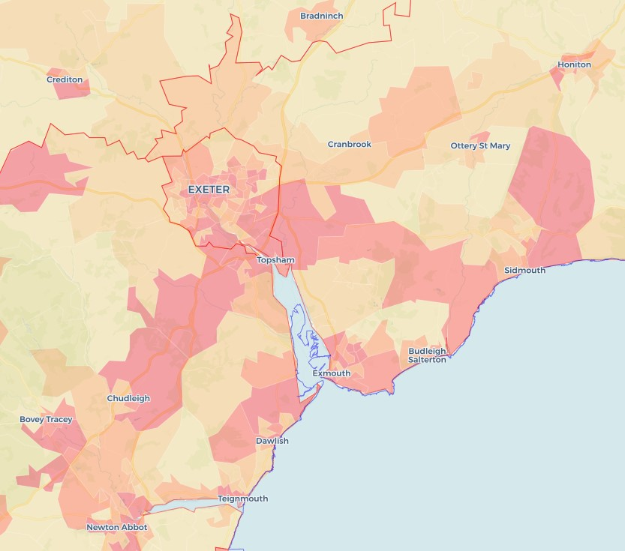
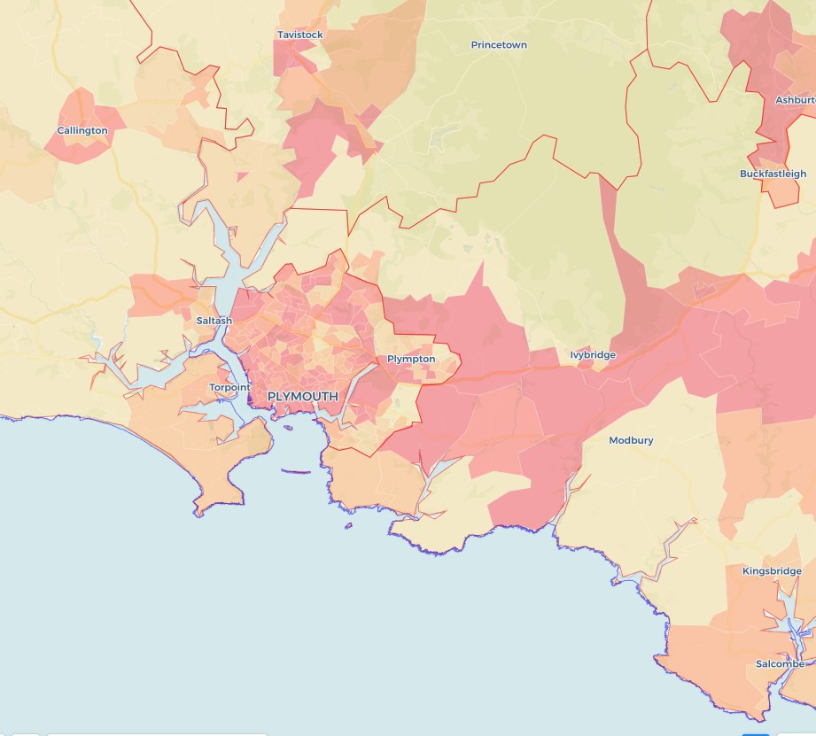
Across Exeter and Bristol we see differential patterns for hand car wash locations

Slide 9
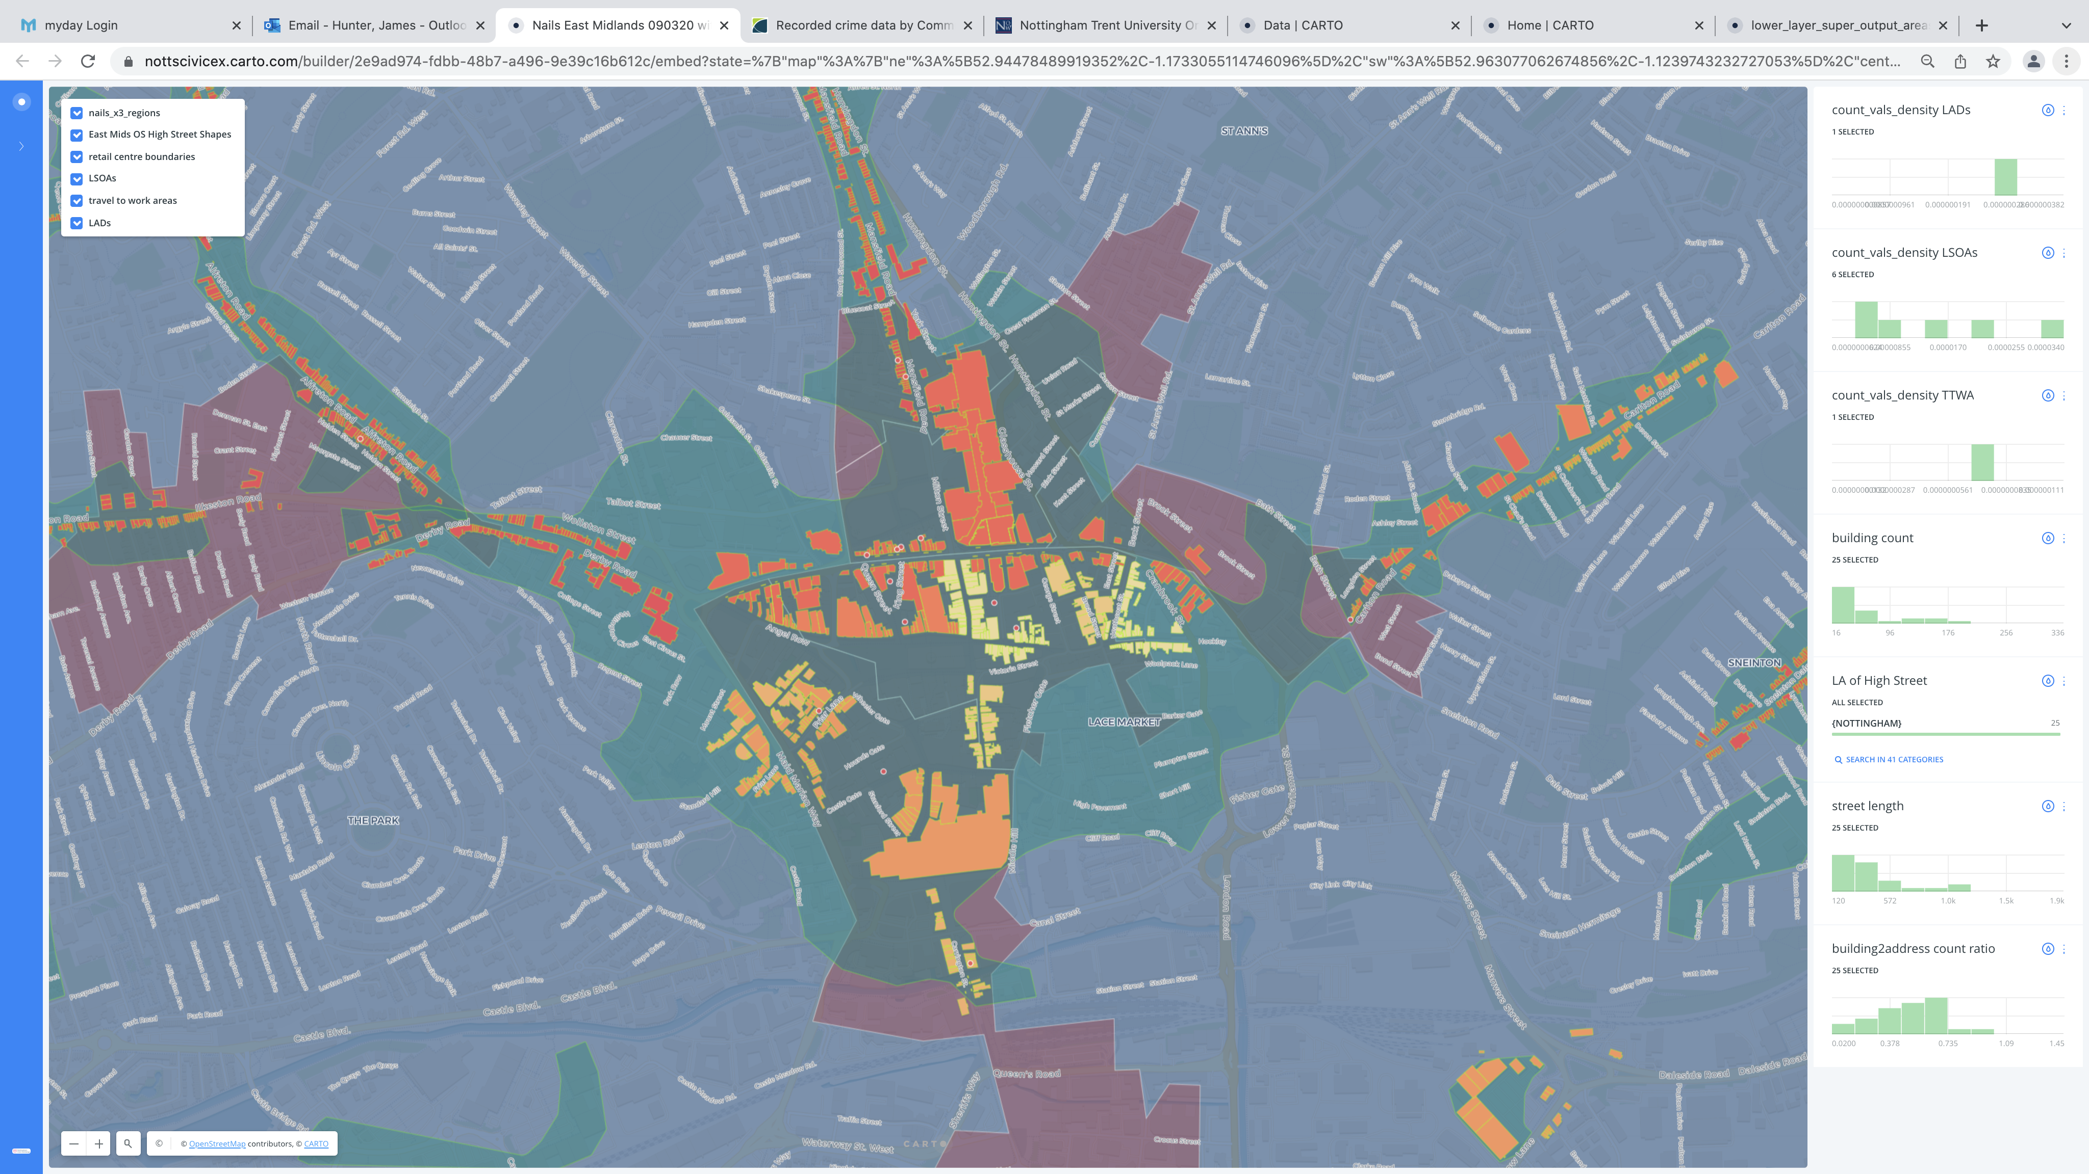
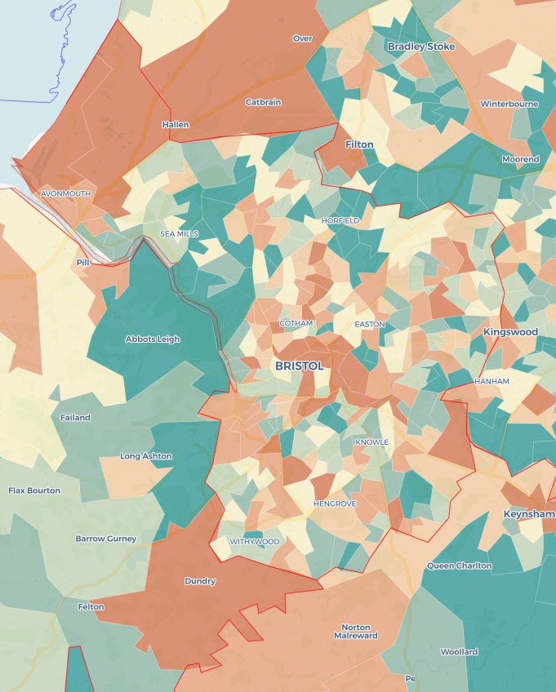
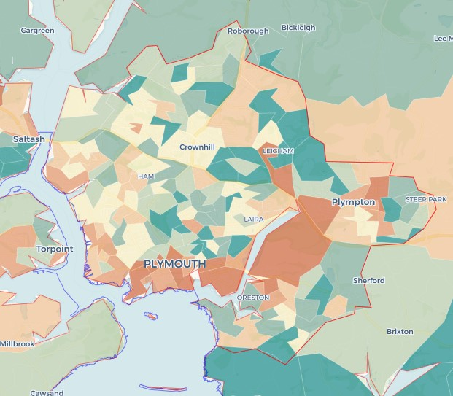
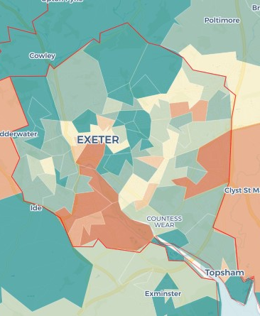
Nail Bars
WIP Nail Bar mapped data has to date focused on the East Midlands, GMCA and Birmingham exploring the spatial concentration of sites and the common characteristics of them. Nail Bars are a many urban phenomenon locating themselves on high streets across the UK. Building on our mapping across the three regions we have developed a second predictive tool that highlights the probable locations for nail bars.
Predictive locations for nail bars
Exploring the high street structure of nail bar locations

Slide 10

Where are the non-compliant employers? Predicting the presence of the informal economy at the neighbourhood level across England
Literature review to identify types of individuals over-represented amongst workers in the informal economy
Use of official data sources to identify under- and over-representation of each population characteristic at the Lower Super Output Area (LSOA) level across England
Combining individual population indicators into an index that predicts the presence of the informal economy within each neighbourhood based upon residential population characteristics
INFORMAL ECONOMY INDEX (IEI)

Slide 11
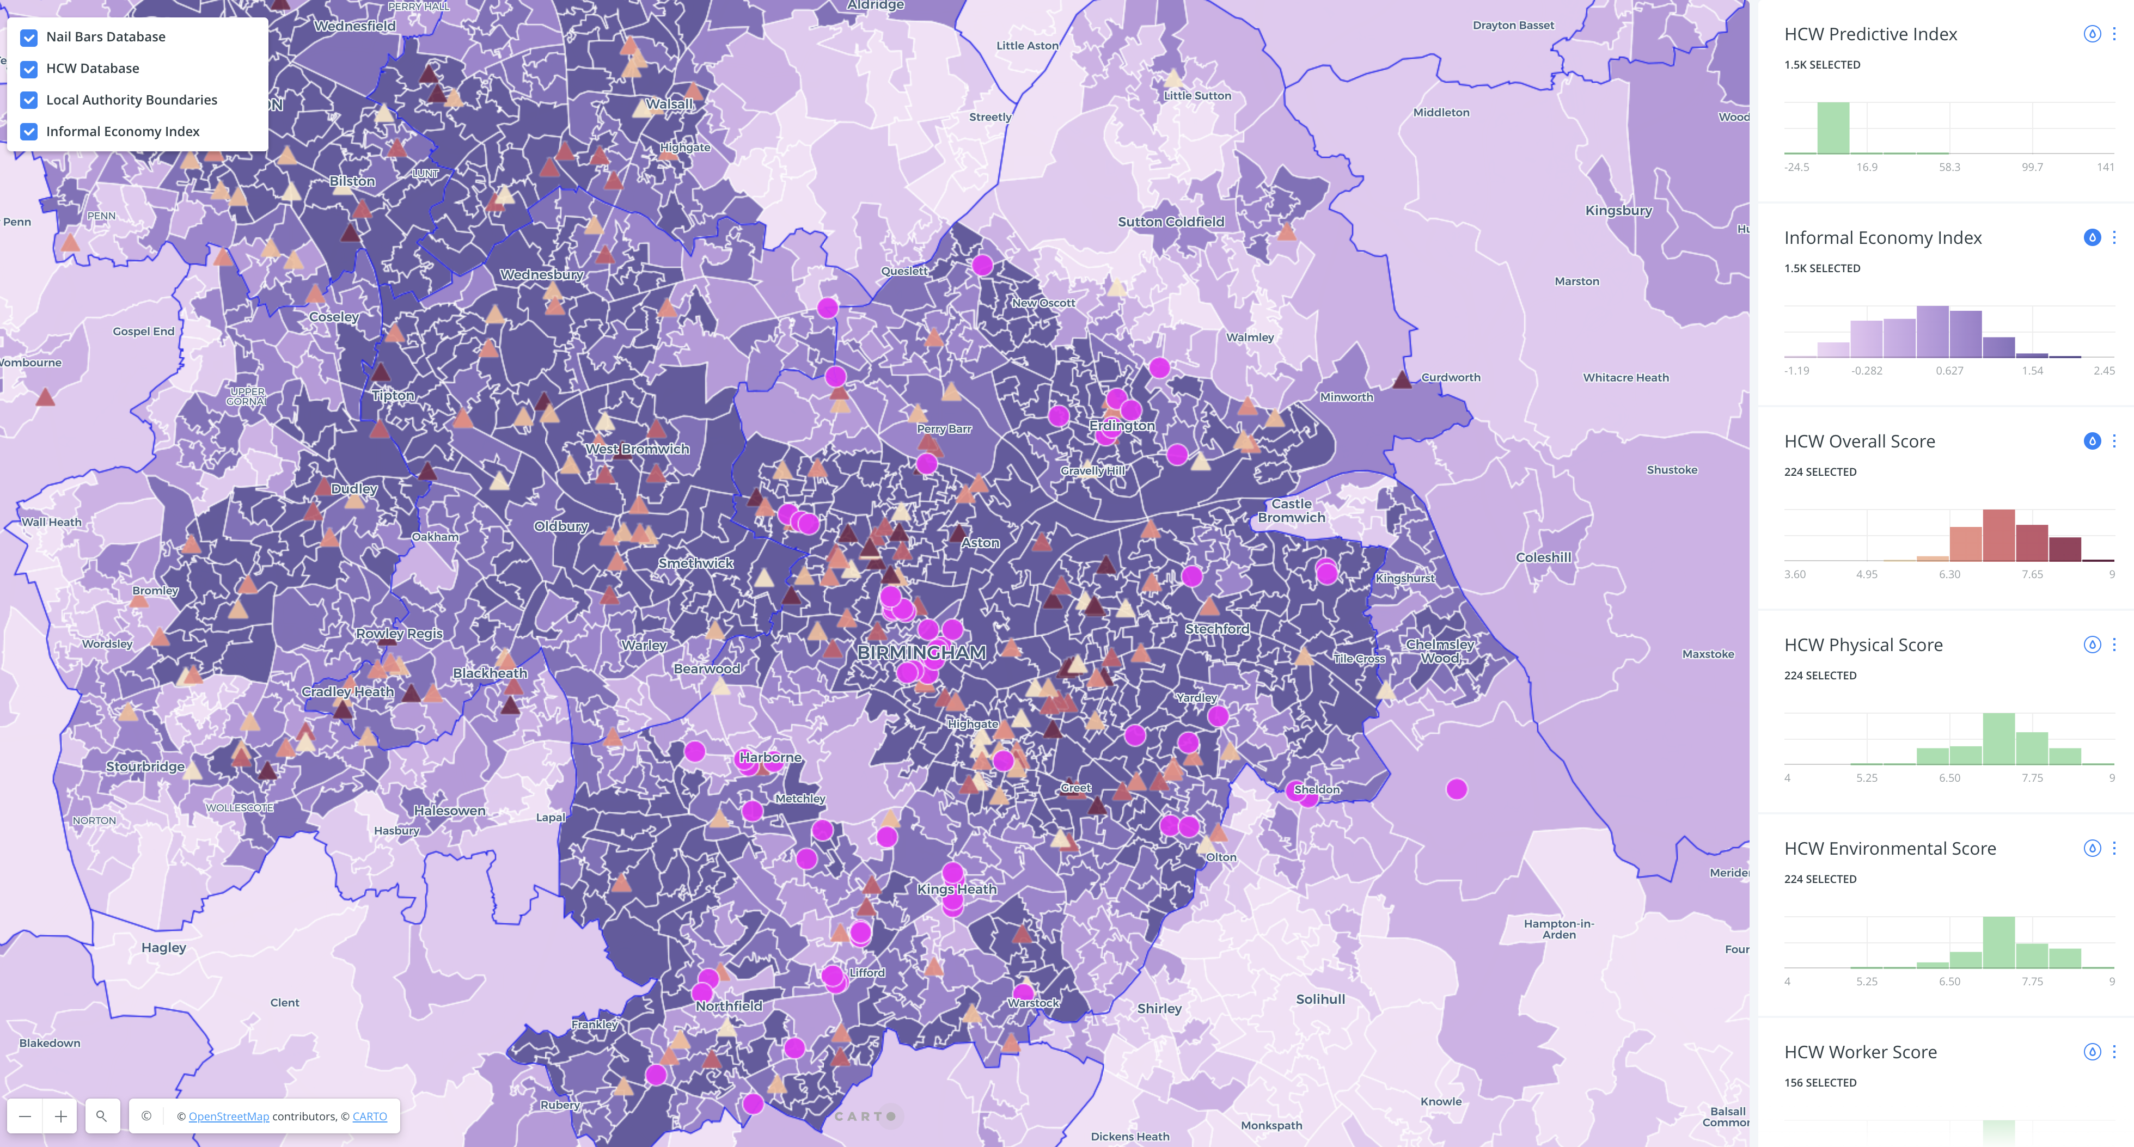
Risk classification of HCWs and location of nail bars in West Midlands urban conurbation
Predictive Informal Economy Index

Slide 12
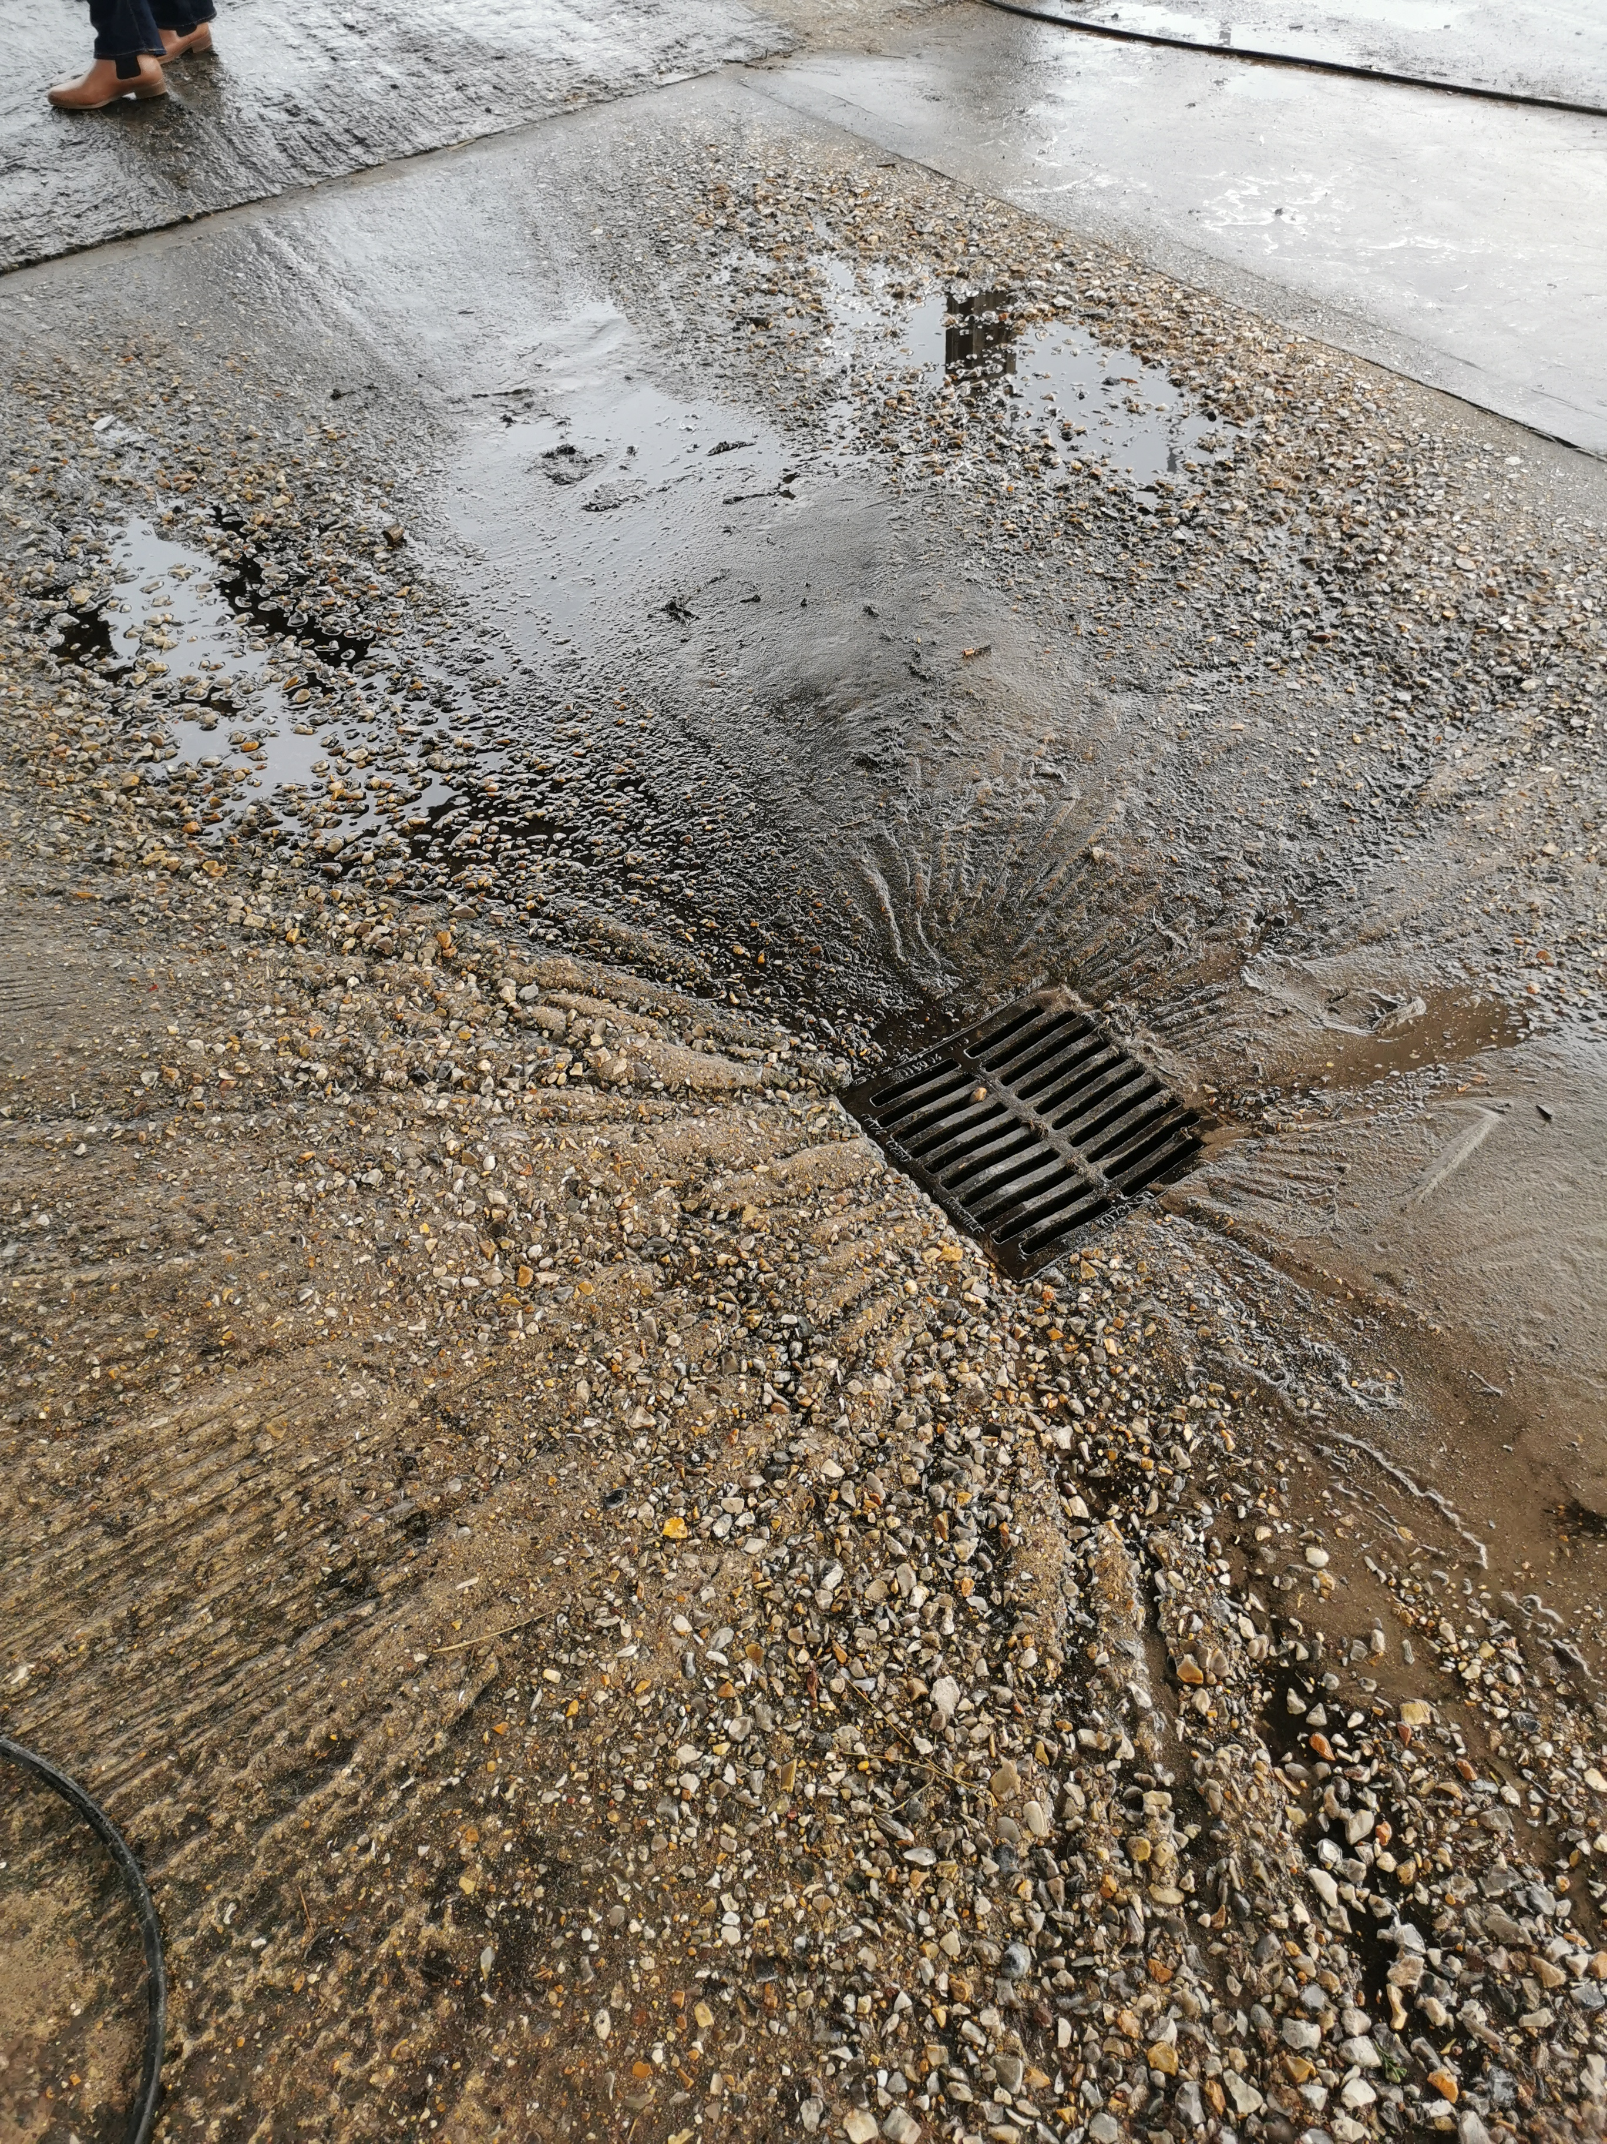
What next?
Our research is ongoing and beginning to broaden to other sectors. We are interested to hear how our applied research can play a role in strategic and operational activity. We are discussing how our insights can support the work of the NCA and we have already supported work by HMRC NMW, GLAA and GMCAs Programme Challenger.
Future research aims to focus on new sectors and the interplay between the various agencies that cover the labour exploitation spectrum.
We are supporting a PhD study on the role of county lines and employ two Research Fellows who are developing their own research focuses to broaden and deepen our research.

Slide 13
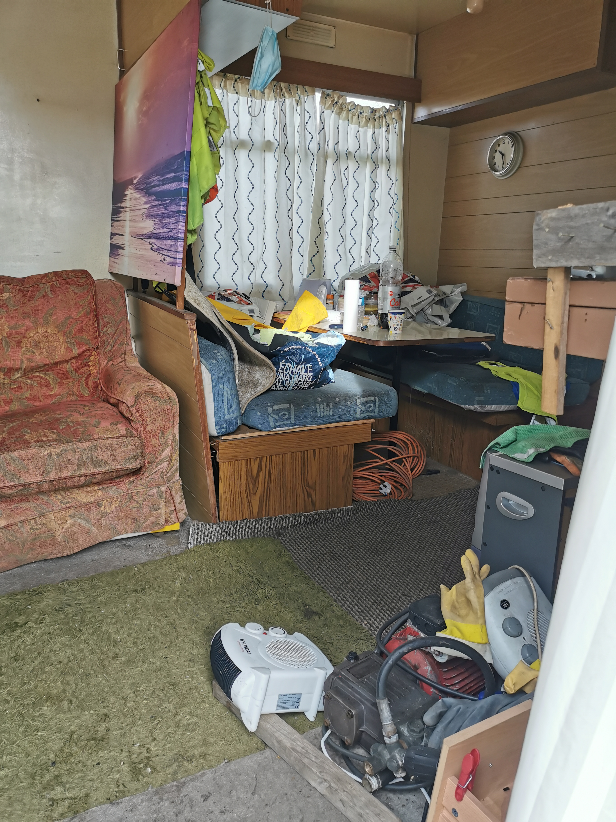
Why is this important to you?
Hand Car Washes and Nail Bars continue to be flagged as sites of concern related to labour abuse, exploitation and modern slavery with workers left out of pocket ands working in poor conditions as a minimum issue. What support and monitoring is occurring for at-risk individuals and communities in your region?
The NCA and other agencies have continued to highlight the links between both hand car washes and nail bars to Serious Organised Criminality. How would a hand car wash with no formal ability to secure furlough pay manage to reopen following 2 years of economic distress? Which sites should you be monitoring?
According to anecdotal evidence from our work with the RCWS we are already seeing the impact of migration rules changes in the UK affecting hand car wash businesses. This will either make these businesses more likely to improve conditions and pay for workers or to seek more at-risk workers to exploit. Which do you think will be more likely across the SW?
These data sets help indicate areas of focus when considering the informal economy and illegal activity within in. How might it connect with your strategic and operational plans?

