Slide 1

Access to Healthcare: Community Health Promotion and Education in Uganda
Dr Linda Gibson
Dr David Musoke
Henry Bugembe
Mariam Nakirija
Dr Jody Winter
Dr Deborah Ikhile
Grace Lubega

Slide 2
Housekeeping
Please ensure that your microphone is muted​.
Please ensure that your camera is turned off​.
The meeting will be recorded, and your name may be visible as an attendant. If you do not want your name appearing, please email NTUGlobal@ntu.ac.uk.​
If you would like to comment or ask a question during the session, please raise your hand or use the chat function.

Slide 3
Setting the context- Dr Linda Gibson
Uganda health system and the NTU-MAK – Dr David Musoke
Section title
Section title
Section title
Section title

Slide 4
Section title in Cambria Bold

Slide 5
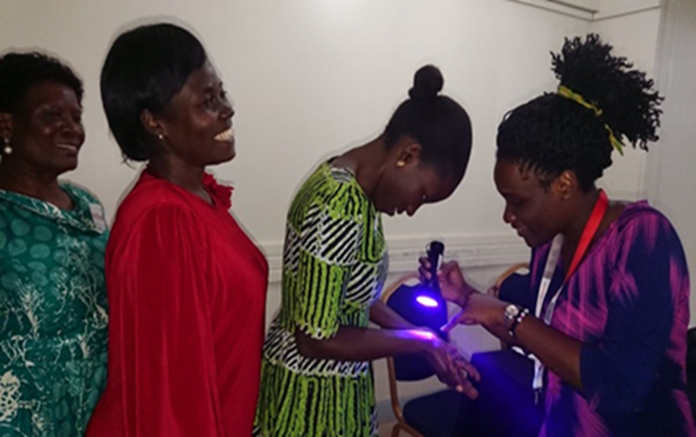
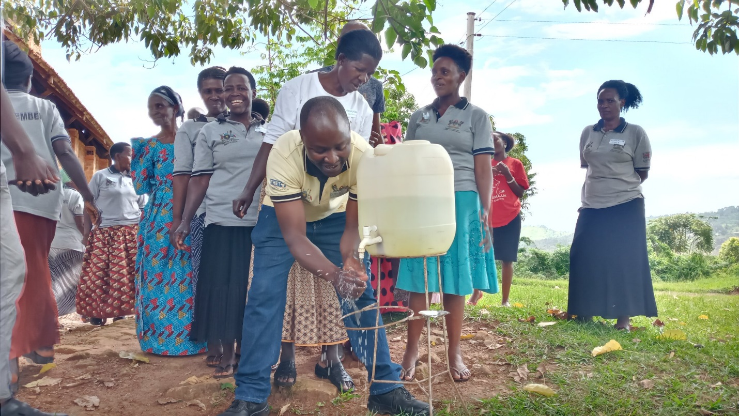
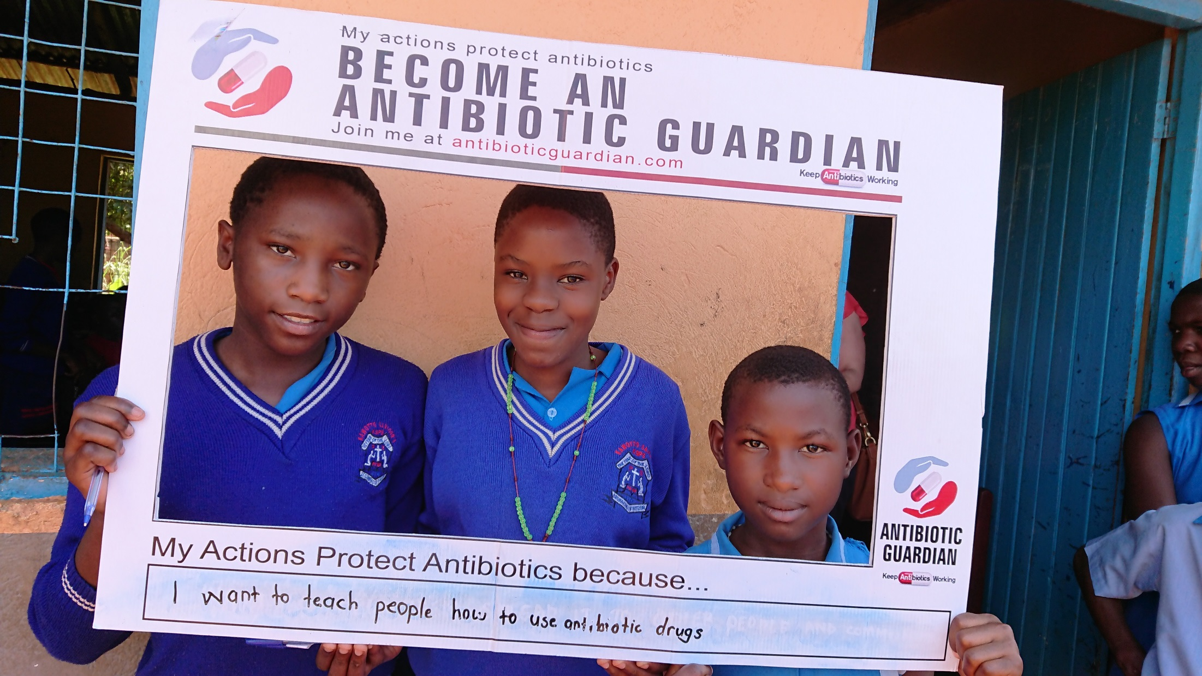
  Key achievements
Antimicrobial resistance (AMR), antimicrobial stewardship (AMS) and infection prevention & control (IPC) training and awareness raising
86 health practitioners (human and animal health)
227 CHWs
300+ primary schools
University students
Sustainability supported by:
Medicines & Therapeutic Committee established at Entebbe Regional Referral Hospital
Online communities of practice established
Data collected to support further research & targeted interventions:
Global Point Prevalence Survey of antimicrobial drug use at Entebbe RRH
Community surveys of antimicrobial drug use, knowledge & attitudes around AMR & AMS
Pre and post training questionnaires for health practitioners to measure training impact

Slide 6
  Key achievements

Slide 7

The Vision of Alma Ata
300+ primary schools
University students
40 years of the Alma Ata Declaration on primary healthcare (PHC) which emphasised the importance of Community Health Workers (CHWs) in ensuring its vision of Health for All.
The Role of Community Health Workers (CHWs)in Primary Care Systems in low resource countries: a core component of the global health workforce
Debates about realizing the vision still central in Global Health today e.g. Primary health care towards universal health coverage. In Seventy-second World Health Assembly, 1 April 2019. Geneva: World Health Organization; 2019. Available from: http://apps.who.int/gb/ebwha/pdf_files/WHA72/A72_12-en.pdf
Bhutta Zulfiqar A, Atun Rifat, Ladher Navjoyt, Abbasi Kamran. Alma Ata and primary healthcare: back to the future BMJ 2018; 363 :k4433

Slide 8
  Key achievements
Antimicrobial resistance (AMR), antimicrobial stewardship (AMS) and infection prevention & control (IPC) training and awareness raising
86 health practitioners (human and animal health)
227 CHWs
300+ primary schools
University students
Sustainability supported by:
Medicines & Therapeutic Committee established at Entebbe Regional Referral Hospital
Online communities of practice established
Data collected to support further research & targeted interventions:
Global Point Prevalence Survey of antimicrobial drug use at Entebbe RRH
Community surveys of antimicrobial drug use, knowledge & attitudes around AMR & AMS
Pre and post training questionnaires for health practitioners to measure training impact

Slide 9
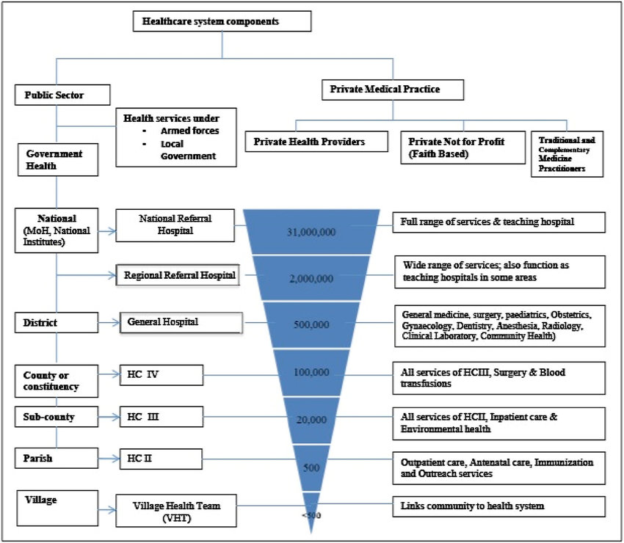

Slide 10
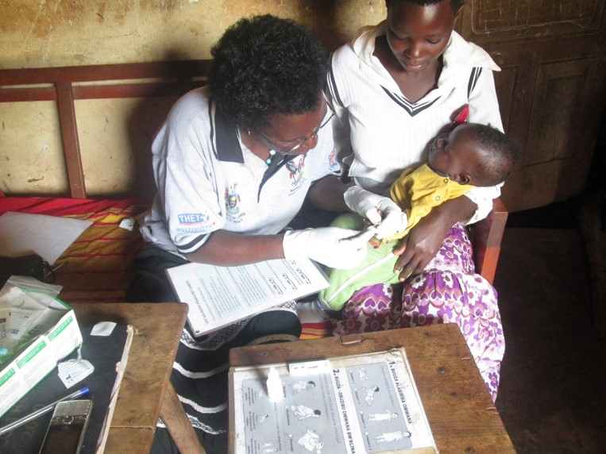
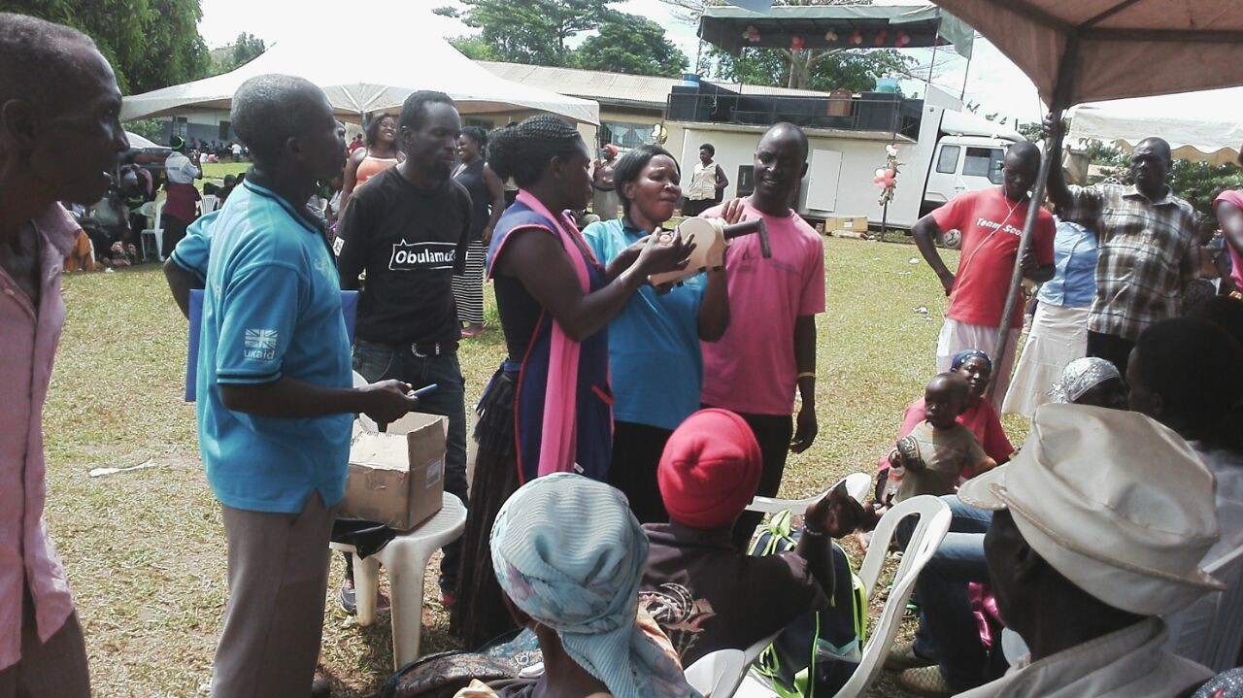
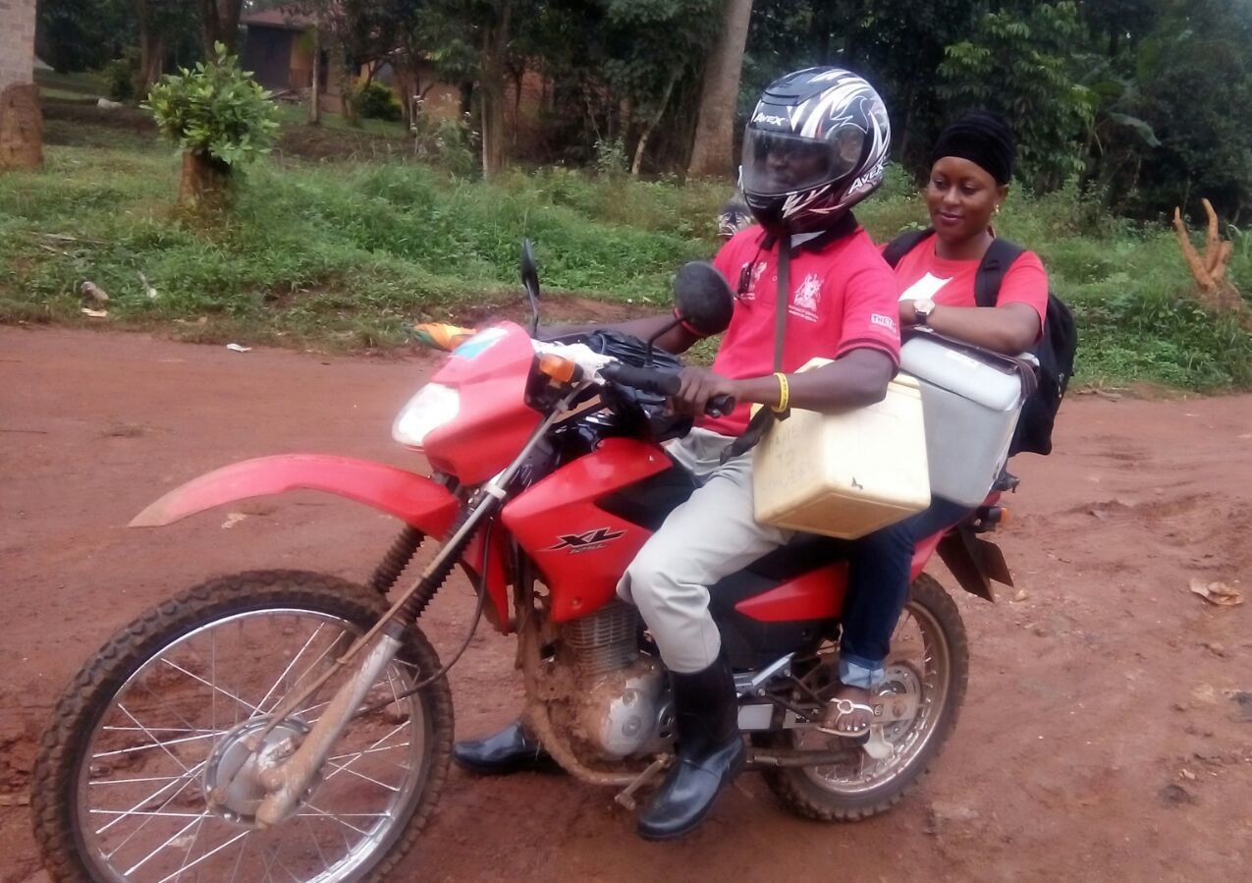
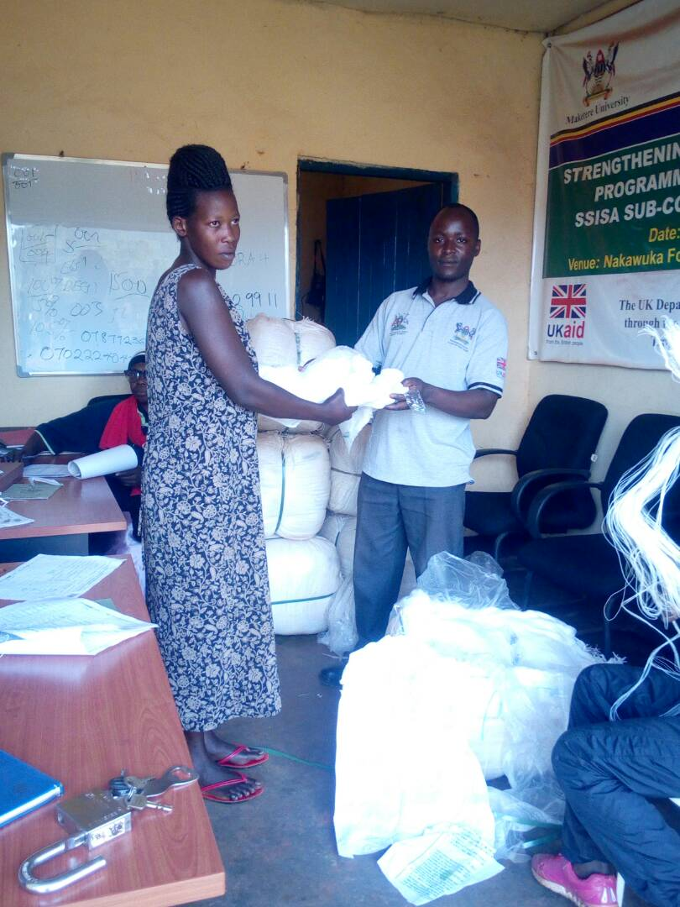

Slide 11
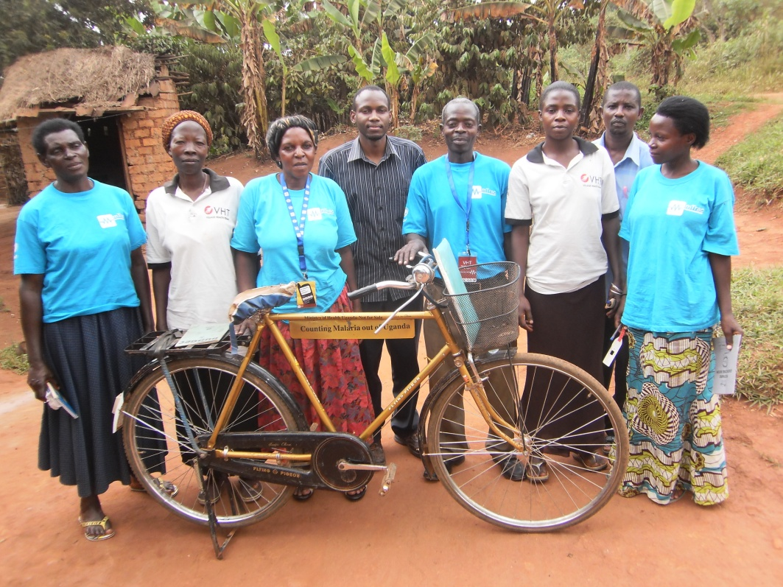

Slide 12
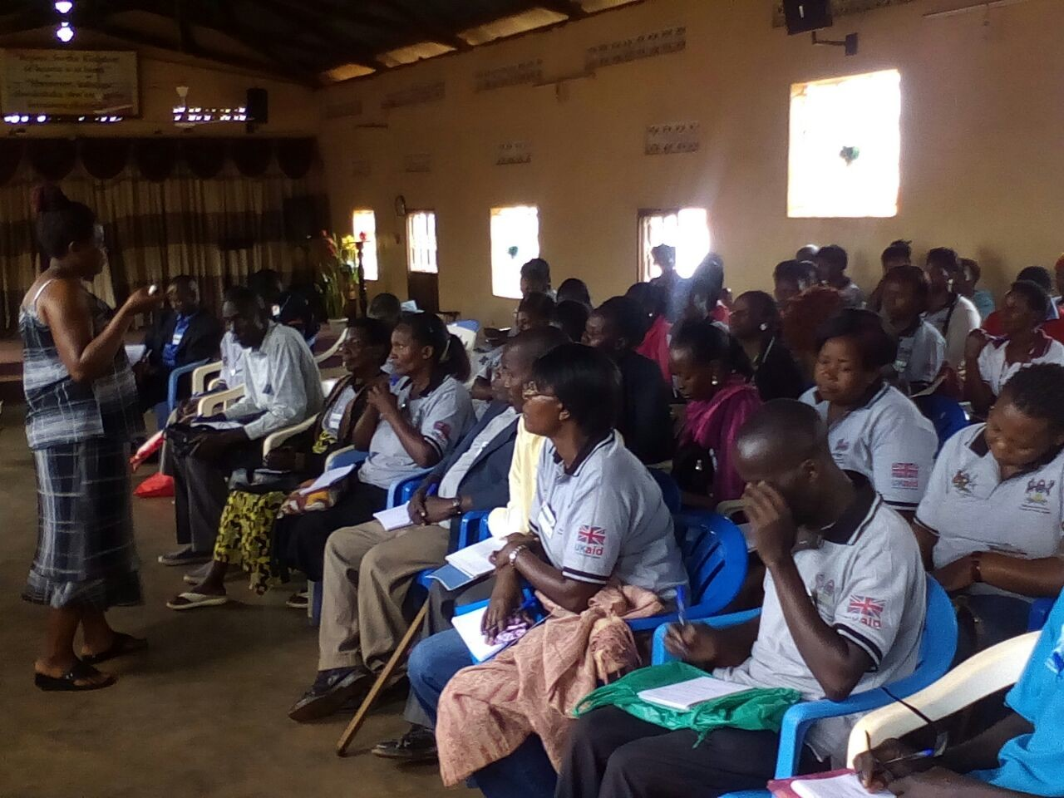
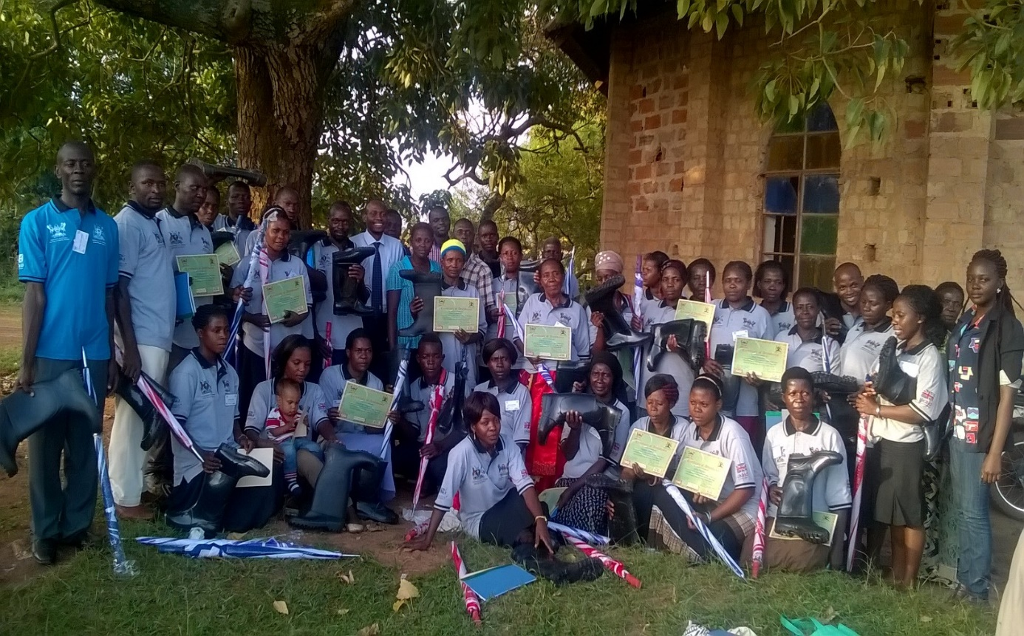
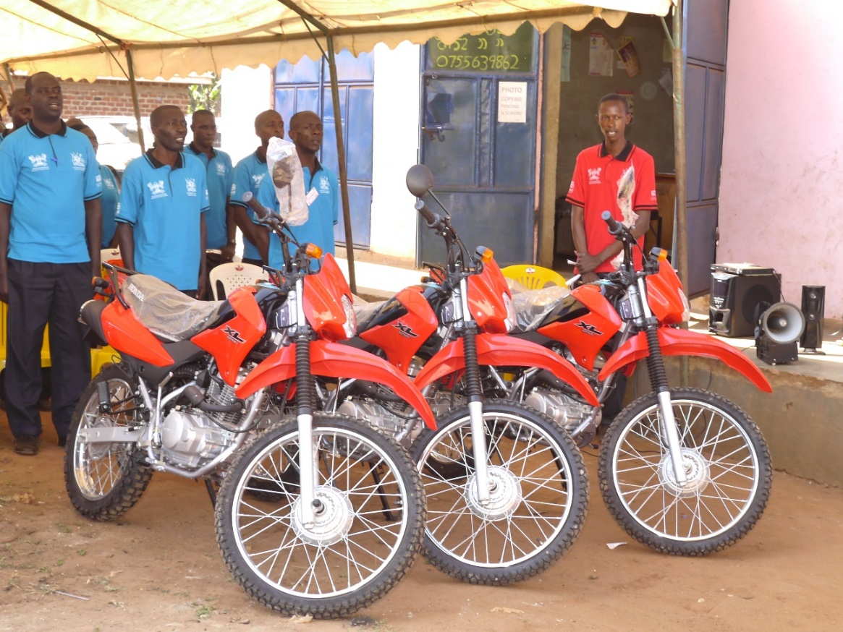
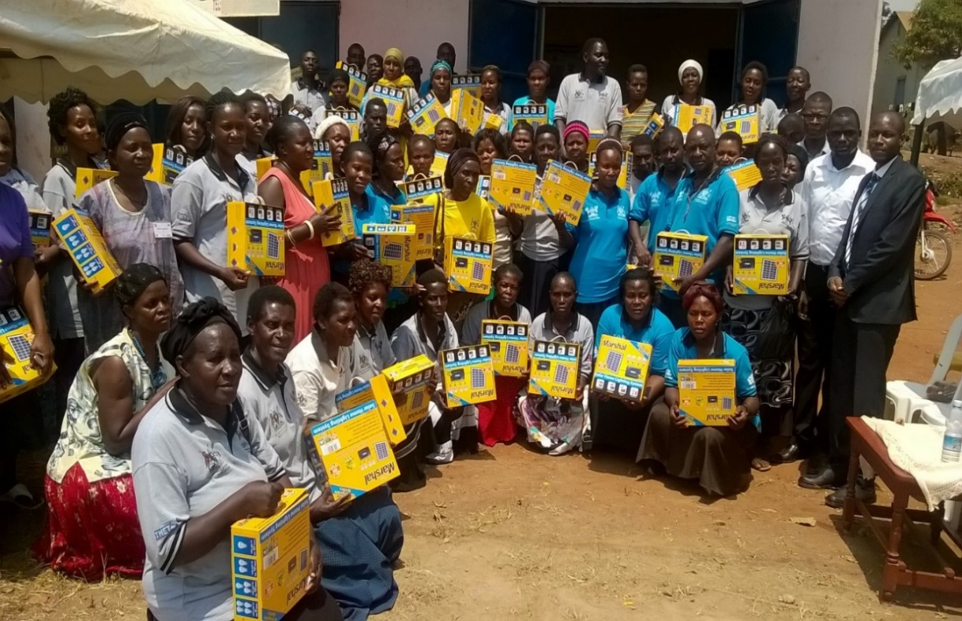

Slide 13






Commonwealth Partnerships for Antimicrobial Stewardship
(CwPAMS) project

Slide 14

Project partnership
Linda Gibson, NTU Social Sciences
Claire Brandish & team, BHT hospital infection pharmacists
David Musoke, Makerere University School of Public Health
AROM group, NTU
ARES, NTU
Freddy Kitutu, Mak. School of Pharmacy
Pharmacy Dept, Ministry of Health
Ismail Kizito, Hospital Pharmacist, Entebbe
Henry Kajambula, Chair Med Micro @ Mak & NAP adviser
Lawrence Mugisha, Mak Veterinary Medicine

Slide 15
  Key achievements
Antimicrobial resistance (AMR), antimicrobial stewardship (AMS) and infection prevention & control (IPC) training and awareness raising
86 health practitioners (human and animal health)
227 CHWs
300+ primary schools
University students
Sustainability supported by:
Medicines & Therapeutic Committee established at Entebbe Regional Referral Hospital
Online communities of practice established
Data collected to support further research & targeted interventions:
Global Point Prevalence Survey of antimicrobial drug use at Entebbe RRH
Community surveys of antimicrobial drug use, knowledge & attitudes around AMR & AMS
Pre and post training questionnaires for health practitioners to measure training impact

Slide 16
Dissemination and Knowledge Exchange Activities
Dr Deborah Ikhile

Slide 17
How do we ensure our work has wider impacts beyond the Uganda health system?
To maximise impacts
Academic
Policy
Practice

Slide 18
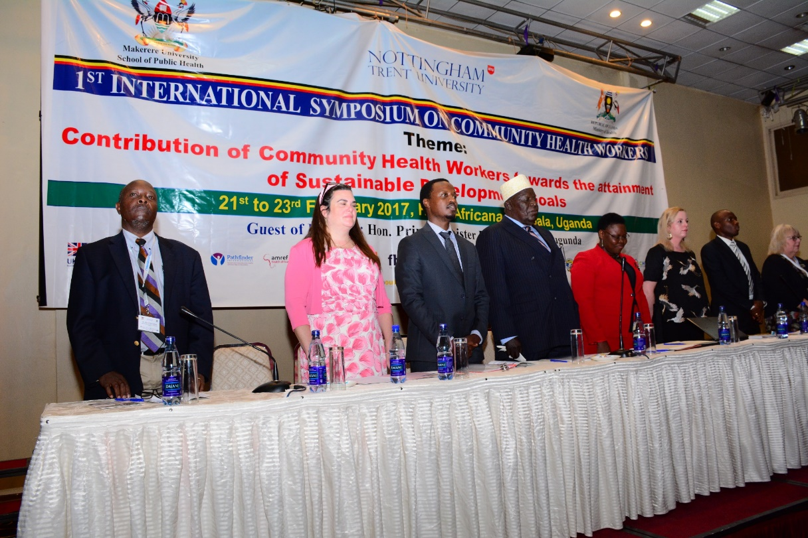
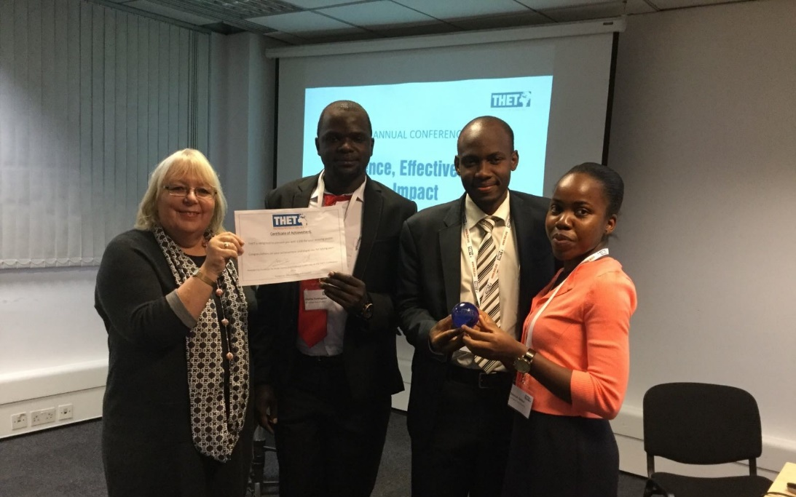
Publications
Symposium
Conferences
Webinars

Slide 19
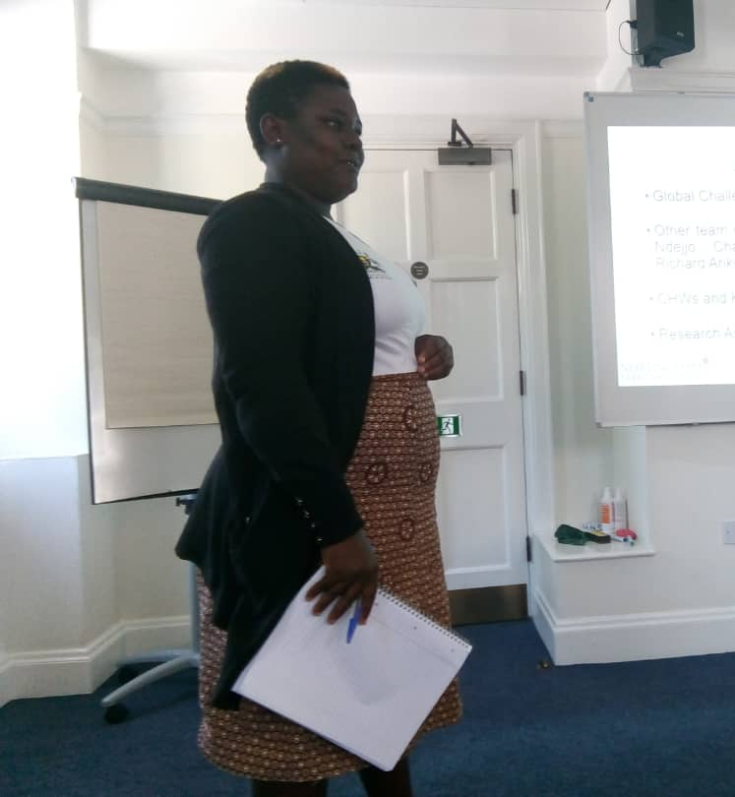
CHWs Mobility and Knowledge Exchange
Amplifying the voices and recognition of CHWs involved in our projects
Facilitate knowledge exchange between community based organisations in the UK and Uganda

Slide 20
@NTU_MAK

Slide 21
Capacity building for early career researchers
Grace Biyinzika Lubega, BEHS
MA Public Health – School of Social Sciences, Nottingham Trent University
Orcid ID: https://orcid.org/0000-0003-0657-7903

Slide 22
  Skills gained / Experiences Challenges
Office work - writing of minutes, official letters and reports, budgeting.
Stakeholder engagement and negotiation
Effective communication and flexibility
Actual implementation of project activities
Itinerary planning and execution – for exchange visits between Uganda and UK
Grant application, manuscript and writing and referencing
Multi-tasking and time management
Late nights – to beat deadlines
Time zone differences
Decision making processes can be dragging
Managing team members expectations
Stirring away from set objectives

Slide 23
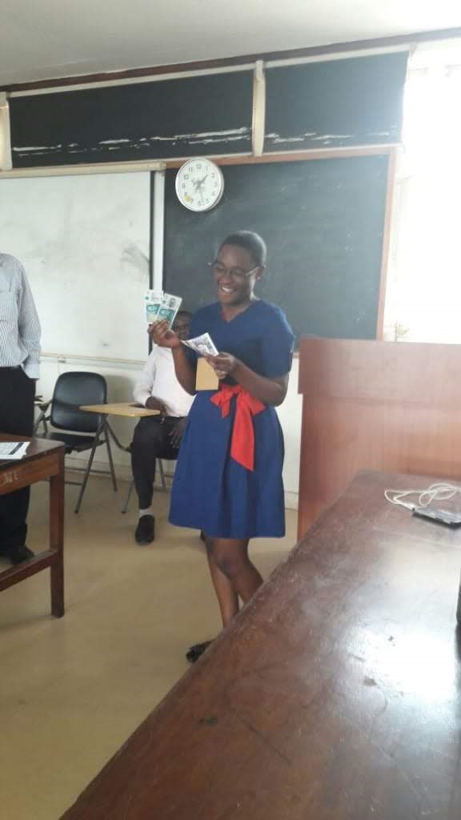
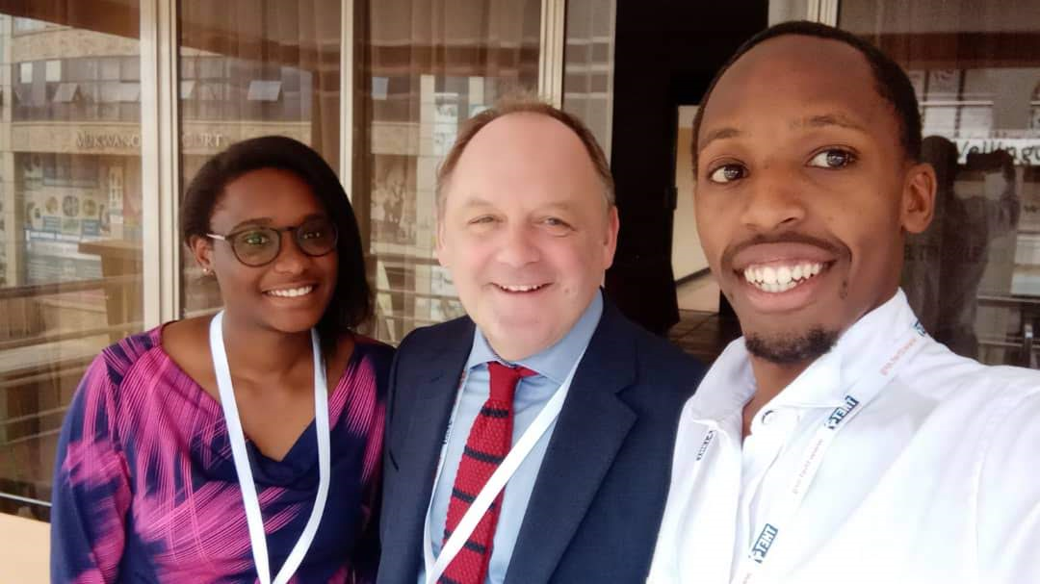
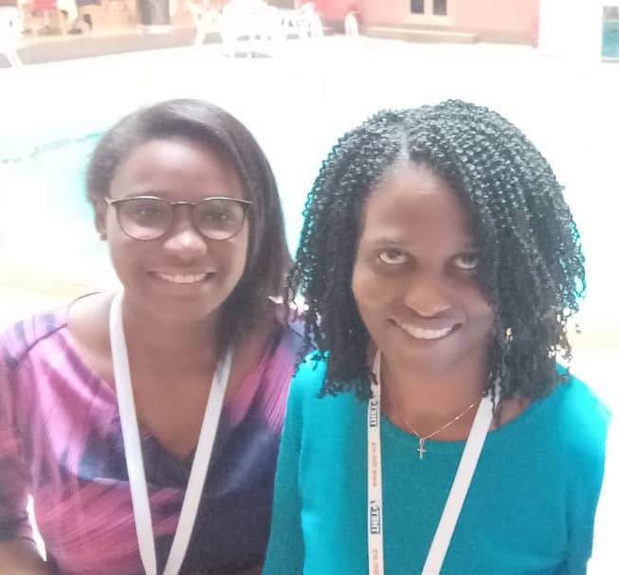
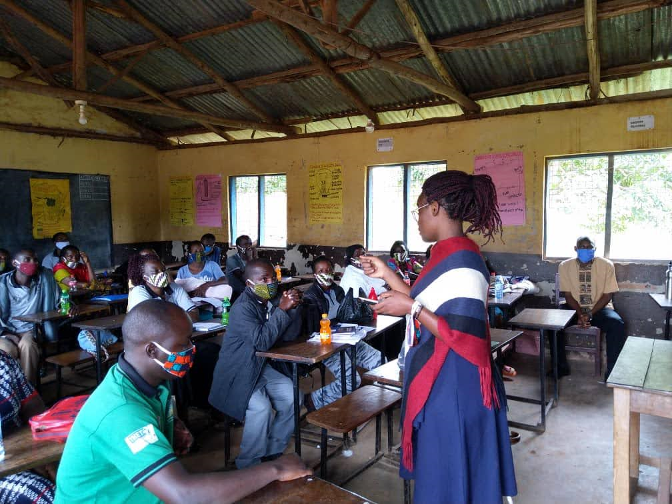
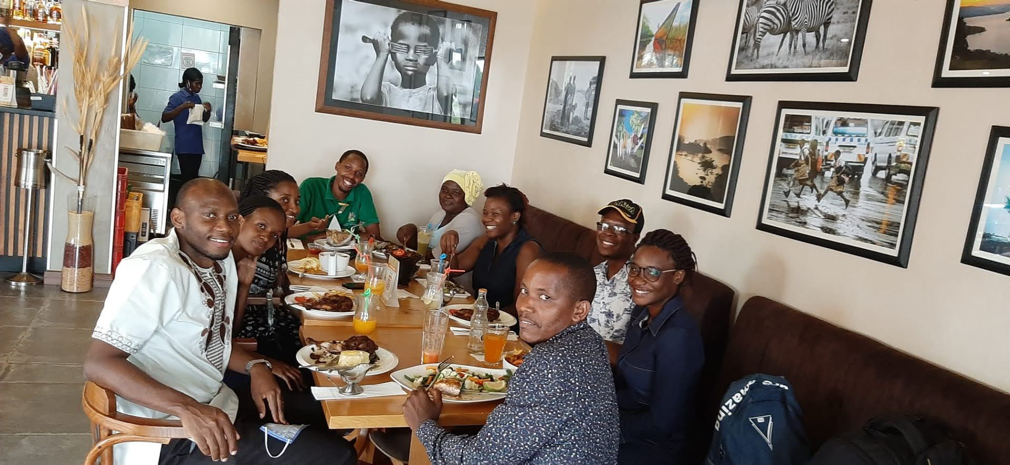
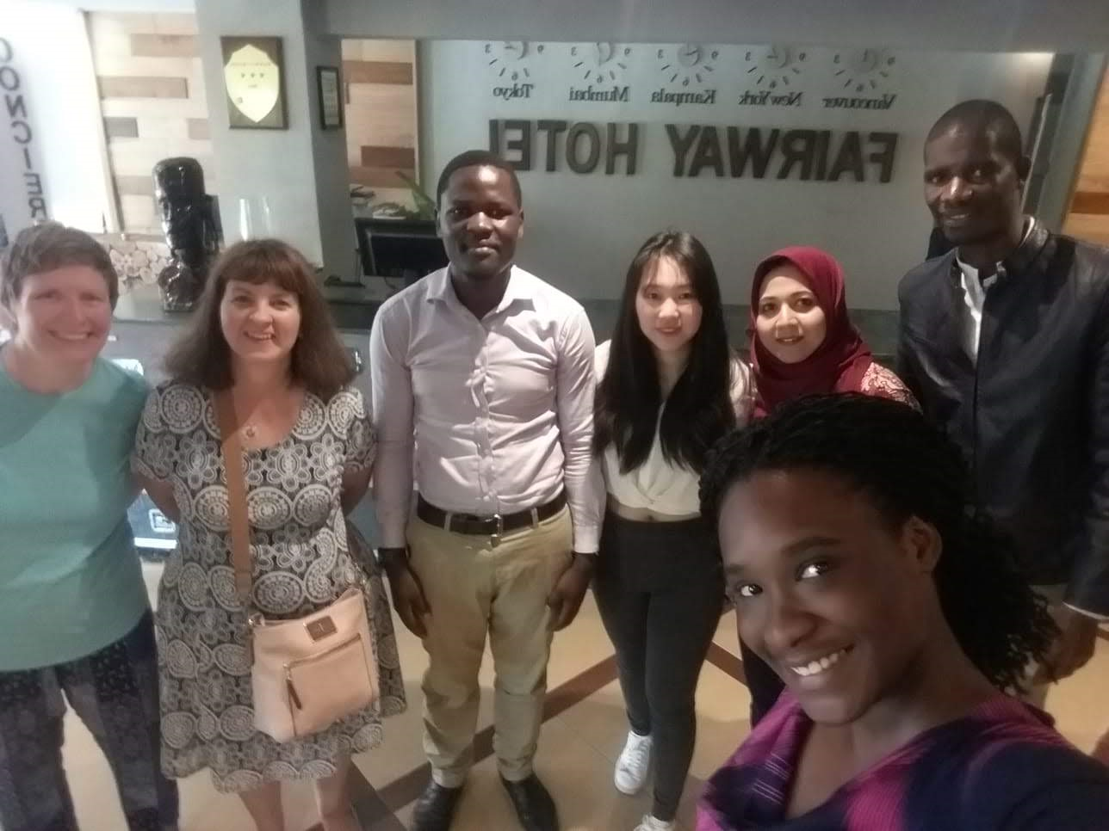

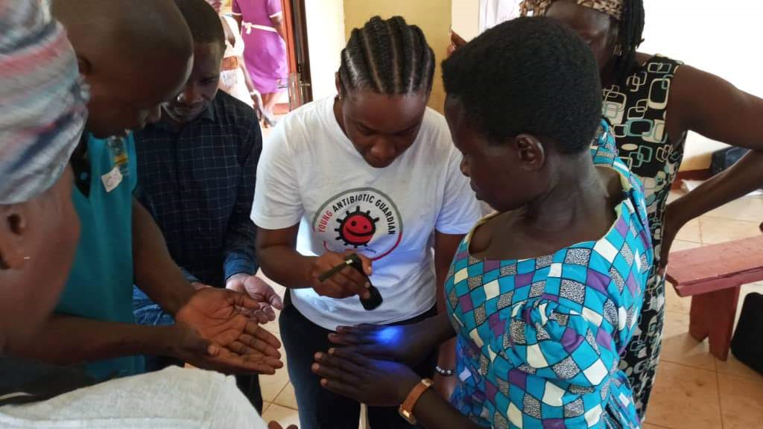
Why NTU MAK partnership?
Challenges

Slide 24
Office work - writing of minutes, official letters and reports, budgeting.
Stakeholder engagement and negotiation
Effective communication and flexibility
Actual implementation of project activities
Itinerary planning and execution – for exchange visits between Uganda and UK
Grant application, manuscript and writing and referencing
Multi-tasking and time management
Late nights – to beat deadlines
  Heading level 1
Large bullet point like this
Large bullet point like this

