Slide 1


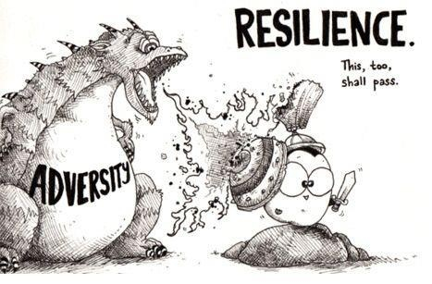

Governmental Financial Resilience
RoundTable Discussion on the Toolkit
Thursday, 09 December 2021
Ileana Steccolini, University of Essex, UK
Andre Lino, University of Essex, UK
Bernard Kofi Dom, Nottingham Trent University and University of Essex, UK
Jeffery Matsu, CIPFA UK
Omicron?
Project funded by ESRC- Impact Acceleration Account, at the
Hosted by:
Notes:
Rebecca

Slide 2
Agenda
Welcome & Introductions – (5 mins)
The Financial Resilience Model – A short Review (15 mins)
The Financial Resilience Toolkit (10 mins)
Responding to the Toolkit (10 mins)
Discussions (45 mins)
How would you use this Toolkit in your Local Government (Organisation)?
How would you adapt this toolkit in making decision from a UK LG context?
Next Steps: Developing the Toolkit
How can we develop this toolkit to be used in future?
Would you be interested to or know someone who’d participate in testing the Toolkit in your Organisation/in other organisations?
Closing remarks (5 mins)

Slide 3
The conceptual model on financial resilience
Tools and capabilities to (better) identify and manage vulnerabilities and to recognize shocks in advance
Tools and capabilities to understand the nature, likelihood, timing, scale and potential impact of shocks
Scanning (awareness) and interpretation of the crisis (threat, opportunity)
Staff’s emotional reaction and mental framing
Retrospective interpretation (perception of controllability, powerlessness, and dependence on decisions by others)
Prospective interpretation (estimate of the organization’s future condition and possible sources of negative impact)
Anticipatory Capacities
Sensemaking
Financial
Shock
Vulnerability
Patterns of Resilience
  Perceived level of exposure to external shocks that may affect organizazional finances
  External and internal factors contributing to the level of vulnerability
Coping Capacities
  Resources and abilities that enable local governments to face shocks and manage their vulnerabilities
  These capacities lie dormant in times of order and become visible in times of disruption (shock) through coping strategies
  Three main types of CCs: Buffering, Adapting, Transforming
Adapted from Carmela Barbera, Martin Jones, Sanja Korac, Iris Saliterer, Ileana Steccolini, “Governmental financial resilience under austerity in Austria, England and Italy: How do local governments cope with financial shocks?”, Public Administration, DOI: 10.1111/padm.12350
Notes:
Ileana
The survey you have filled out is
the self-assessment part of the toolkit
a further development of the Financial Resilience Toolkit
developed and refined based on qualitative and quantitative research,
in an international collaborative effort,
Partly funded by CIMA Charitable Trust Fund
Sensemaking thus involves not merely interpretation and meaning production but the active authoring of the situations in which reflexive actors are embedded and are attempting to comprehend
People engage in partially overlapping processes in which they construct ‘realities’ and then retrospectively make sense of them in a continuing dialogue of discovery and invention. Sensemaking occurs in three sets of interweaving processes: (i) the perception of cues (noticing), (ii) making interpretations and (iii) engaging in action (Maitlis & Christianson, 2014)

Slide 4
Responding to crises, patterns of resilience and capacities
Bouncing back Bouncing forward
Bouncing back
reduced existing services
deferred/reduced investments
increased fees and charges for services
liquidated assets in order to raise capital
eliminated some services
Bouncing forward
changed the way it delivers services
changed the priorities of traditional activities
changed its internal structure
extended its existing services
established new services
Notes:
We also looked at the consequences of GFR and here we were particularly interestid in exploring how different dimensions of the resilience framework influence the strategies local governments used for reposnding to schocks and ciris..
Here we differentiated between bouncing bakc and bouncing forward strategies. While bouncing back strategies is about XYZ, bounicng forward strategies …….

Slide 5
Why does Governmental Financial Resilience matter?
  Higher financial vulnerability encourages bouncing back strategies and discourages bouncing forward strategies
  Anticipatory capacities (especially information exchange) encourage bouncing forward strategies, and have no association with bouncing back strategies
Bouncing back
Vulnerability
Bouncing forward
Bouncing back
Anticipatory Capacities
Bouncing forward
Barbera et al 2019, https://journals.sagepub.com/eprint/FFZPNHMNTV7ZGYVKV3Z5/full
Barbera et al 2018, Local government financial resilience: Germany, Italy and UK compared, CIMA executive report www.cimaglobal.com/FinancialResilienceToolkit
Notes:
For exploring this issue In the next step we send out a survey to Italy, Germany and the UK for exploring the role that external shocks, AC and V play in affecting different organizational strategies/responses. Using data from over 500 responses we found that while all types of shocks encourage both bouncing back and bouncing forward strategeis, a high level of financial vulnerability ecourages bouncing back strategeis while discouraging bouncing forward strategies. Moreover, we also found that while AC, and here in particular information exchange) facilitate tie adoption of bouncing forward strategies, they have no association with bouncing back strategies

Slide 6
The relevance of capacities for resilience for government performance
  Perceived Financial vulnerability makes a difference in financial performance
  Some anticipatory and coping capacities affect financial performance (monitoring, info sharing, rapidity of action)
  Anticipatory and coping capacities make a difference for non-financial performance…
Vulnerability
Anticipatory Capacities
Financial Performance
Coping Capacities
Anticipatory Capacities
Non-financial Performance
Coping Capacities
Barbera et al 2019, https://journals.sagepub.com/eprint/FFZPNHMNTV7ZGYVKV3Z5/full
Barbera et al 2018, Local government financial resilience: Germany, Italy and UK compared, CIMA executive report www.cimaglobal.com/FinancialResilienceToolkit
Notes:
Using the same dataset we also looked at the relationship of vulnerabilites and capacities with the performance of local governments. Here we differentiated between financial and non-financial performance. I turned out that financial vulnerability makes a real difference in explaining financial performance. However, only some anticpatory and coping capacities affected this performance dimension, namely monitoring, informaitn sharing and rapditiy of action). Moving further to the non-financial performance dimension this picture changes. Here we found a comparatievely lower impact of financial vulnerability while the whole range of ac and cc turned out to make a real difference in explaining the non-financial performance of local governments

Slide 7
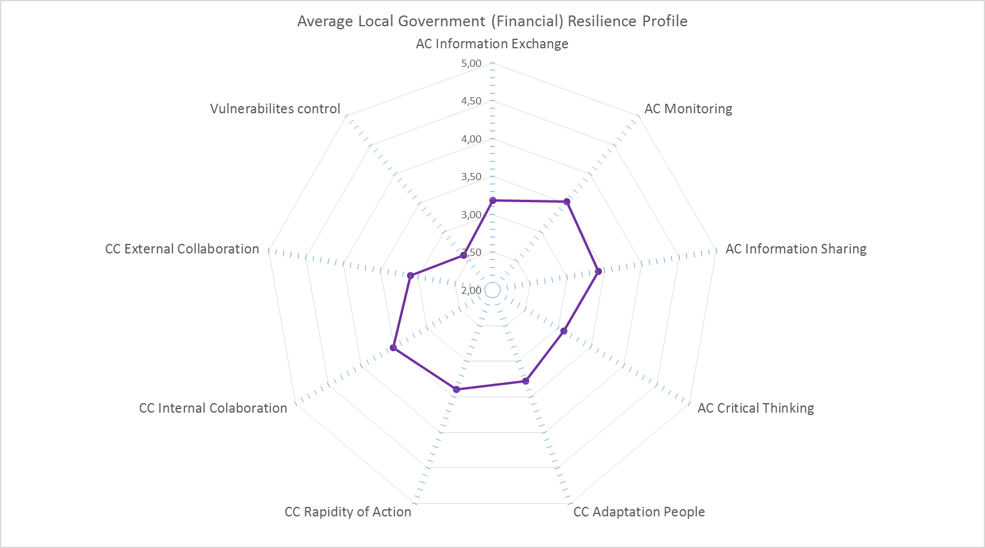
The Financial Resilience Toolkit
Translating the findings of our research (and our framework) into a tool to be used as a support for
  Assessing anticipatory and coping capacities, and perceived vulnerability
  Identifying possible critical areas or strengths
Vulnerability
Anticipatory Capacities
Financial resilience
Coping Capacities

Slide 8
Completing the Toolkit
Please click the link in the chatbox to complete the Financial Resilience Toolkit
Please bear the following discussion points in mind whilst completing the Toolkit.
Useability of the Toolkit by LG practitioners
Adaptability of the Toolkit in decision making to stay resilient and less vulnerable
(Possible) Next steps of the current version of this Toolkit

Slide 9
Discussion - Broad Theme 1: Useability
How would you adapt this toolkit in making decision from a UK LG context?
Vulnerability
Anticipatory Capacities
In an LG context, who is this likely to be most useful to?
How will you expect them to use it?
What other similar tools are used to measure financial resilience in your organisation?
Sensemaking
Different patterns of Financial resilience
Coping Capacities
Carmela Barbera, Martin Jones, Sanja Korac, Iris Saliterer, Ileana Steccolini, 2018, Local government financial resilience: Germany, Italy and UK compared, CIMA executive report www.cimaglobal.com/FinancialResilienceToolkit
Notes:
Bernard
Please leave your answers in the chat box, while we listen to contributions from other participants.

Slide 10
Discussion - Broad Theme 2: Adaptability
How would you adapt this toolkit in making decision from a UK LG context?
Vulnerability
Anticipatory Capacities
Local Governments
Policy makers (including CIPFA, LGA)
Government
Sensemaking
Different patterns of Financial resilience
Coping Capacities
Carmela Barbera, Martin Jones, Sanja Korac, Iris Saliterer, Ileana Steccolini, 2018, Local government financial resilience: Germany, Italy and UK compared, CIMA executive report www.cimaglobal.com/FinancialResilienceToolkit
Notes:
Bernard
Please leave your answers in the chat box, while we listen to contributions from other participants.

Slide 11
Discussion - Broad Theme 3: Next Steps
  How can we work on this in the future?
Are you interested in continuing this conversation?
(How) would you like to be involved?
  A «control room» for developing the toolkit further?
  Next meetings?
  Providing feedbacks and
  inputs in developing the
  toolkit further
  …
Vulnerability
Anticipatory Capacities
Sensemaking
Different patterns of Financial resilience
Coping Capacities

