Slide 1

Climate action: what does this mean for the occupational psychology curriculum and OP practice? –Second presentation
Dr Petra Molthan-Hill
Professor of Sustainable Management and Education for Sustainable Development
and Co-Chair UN PRME Working Group on Climate Change & the Environment,
Nottingham Business School, Nottingham Trent University, UK

Slide 2
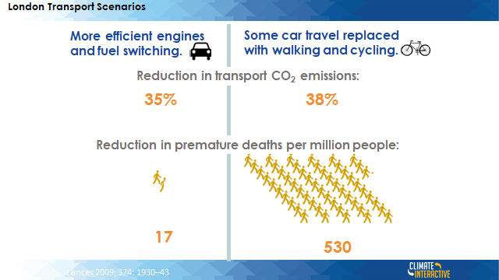
Added benefits of climate solutions

Slide 3
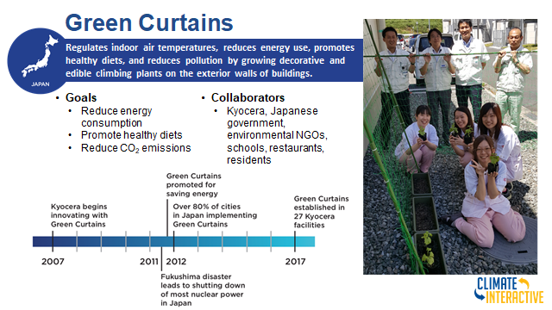

Slide 4
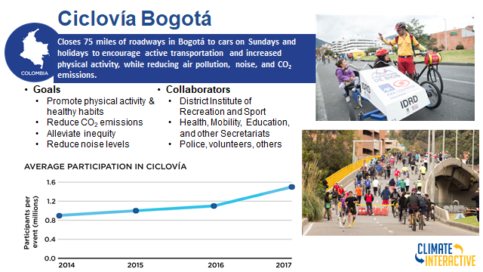

Slide 5
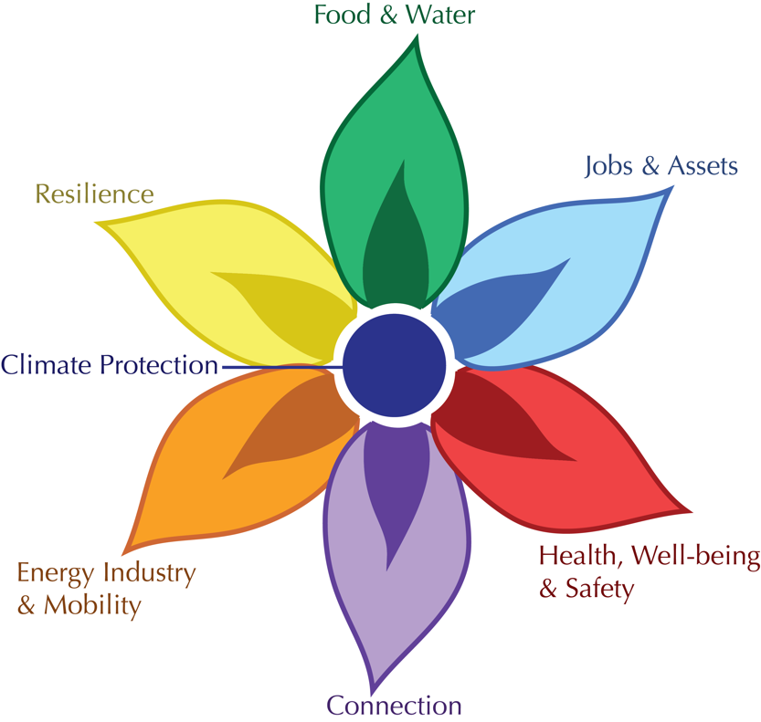
FLOWER is The Framework for Long-Term, Whole-System, Equity-based Reflection
                Using the Flower Framework Video https://www.youtube.com/watch?v=byxgfQT8doI&feature=youtu.be

Slide 6
To get started….
Psychology | Wellbeing and mental health. Attitudes, beliefs and behaviours. | Address eco-anxiety, build resilience and empower individuals and communities to take action. Facilitate change in attitudes, beliefs and behaviours. | Projects that can be used as teaching resources: The Climate Communication Project (n.d.). Key scholarly texts on psychology and climate change: Mathers (2020); Clayton and Manning (2018). Psychology CCE research: Maier et al. (2018).
Clayton S, Manning C (2018) Psychology and climate change: Human perceptions, impacts and responses. Academic Press, London
Maier KJ, Whitehead GI, Walter MI (2018) Teaching psychology and climate change: One way to meet the call for action. Teaching of Psychology 45(3):226-234. https://doi.org/10.1177/0098628318779261

Slide 7
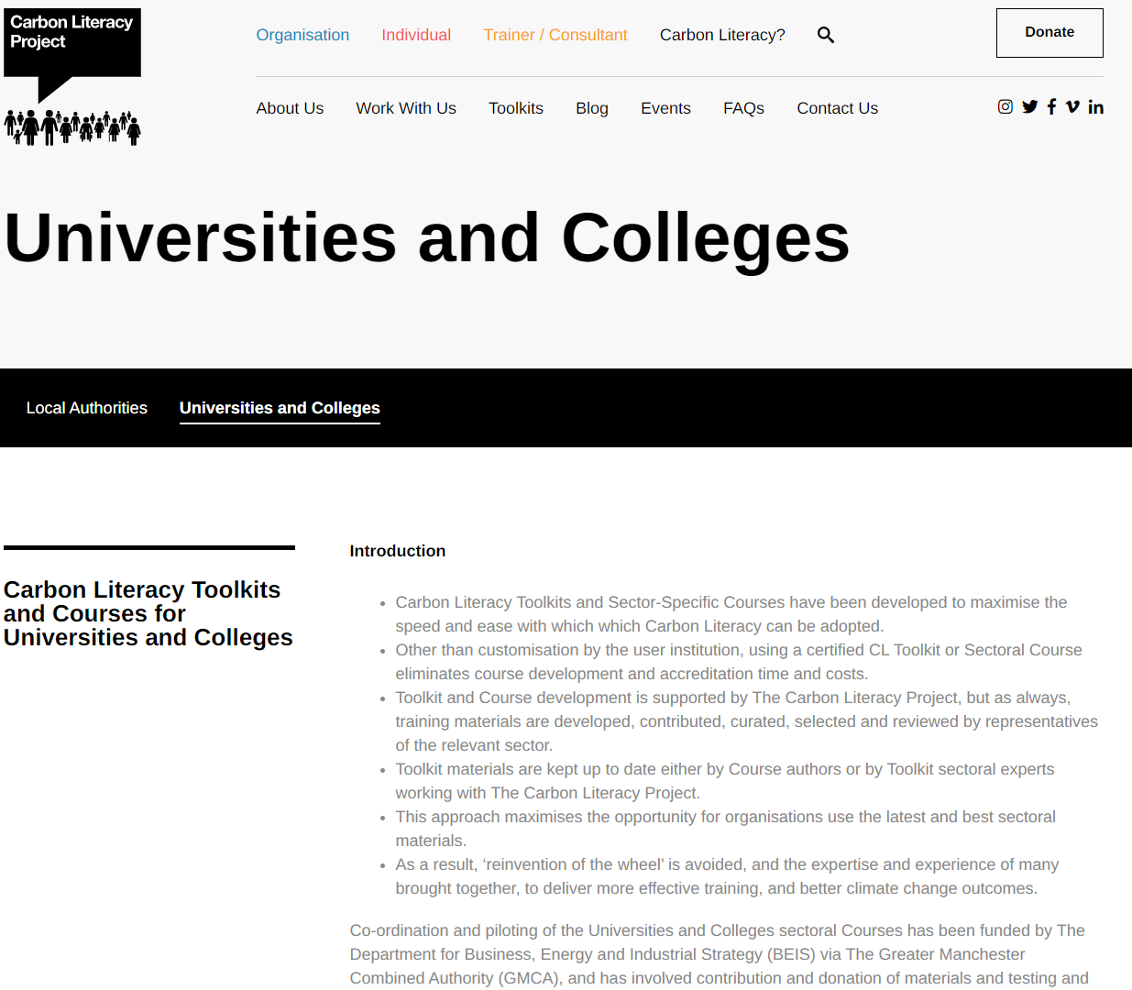
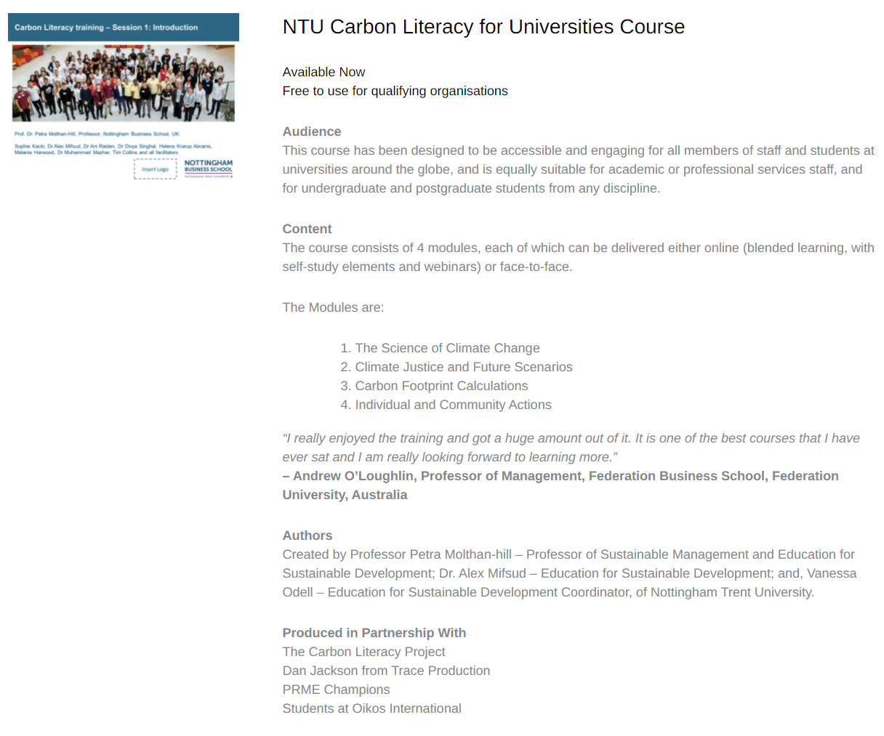
NTU Carbon Literacy Training Course
Please contact education@carbonliteracy.com to request this toolkit.
www.ntu.ac.uk
Notes:
And if you are interested in the wider perspective on how to get everyone in the university carbon literate, NTU has made one of the two open-source tool kits for all staff and students at universities. Lots of information about the resources via https://carbonliteracy.com/toolkits/universities-colleges/. Email education@carbonliteracy.com to request the toolkit.

Slide 8
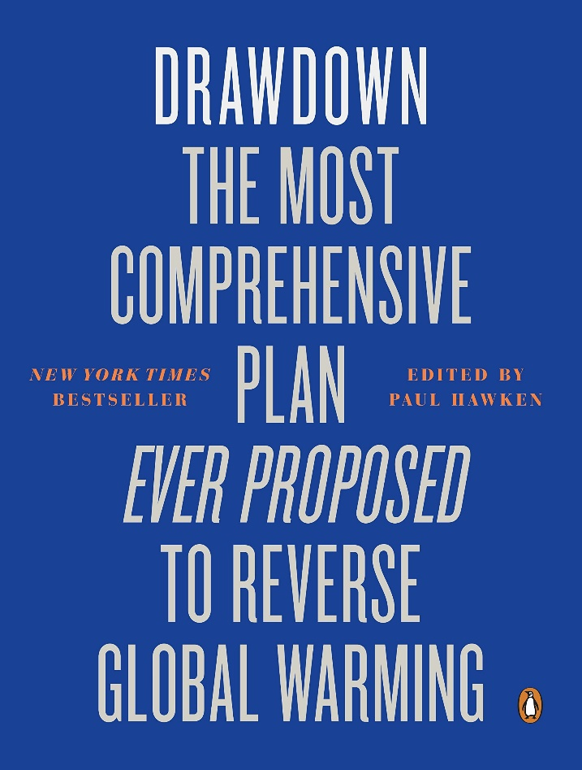
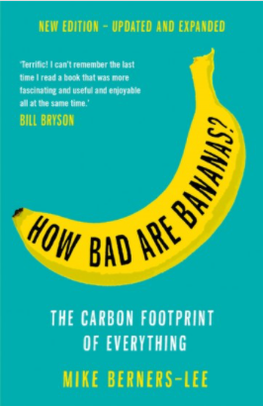
Solutions: A lot to know…
https://profilebooks.com/how-bad-are-bananas.html
https://www.drawdown.org/
Notes:
Knowing these climate change mitigation tools and strategies will allow them to judge, whether Bill Gates is suggesting good solutions in his new book or whether Mark Carney got it right.

Slide 9

Prof Dr Petra Molthan-Hill
petra.molthan-hill@ntu.ac.uk

