Slide 1

Climate action: what does this mean for the occupational psychology curriculum and OP practice?
Dr Petra Molthan-Hill
Professor of Sustainable Management and Education for Sustainable Development
and Co-Chair UN PRME Working Group on Climate Change & the Environment,
Nottingham Business School, Nottingham Trent University, UK

Slide 2
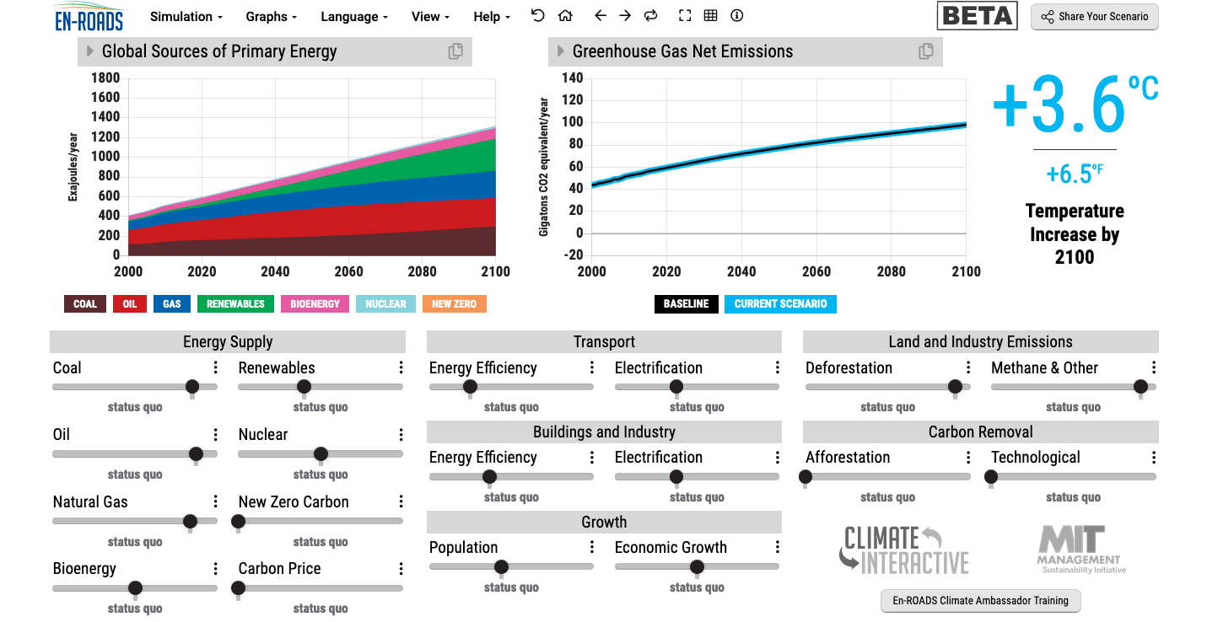
En-ROADS is a cutting-edge simulation model used to test climate solutions and generate climate scenarios for the future.
Notes:
This is our current situation as demonstrated by En-ROADS which was developed by MIT Climate Interactive so that everyone can understand the high impact solutions and which impact they would have.

Slide 3


Solutions: A lot to know…
https://profilebooks.com/how-bad-are-bananas.html
https://www.drawdown.org/
Notes:
Knowing these climate change mitigation tools and strategies will allow them to judge, whether Bill Gates is suggesting good solutions in his new book or whether Mark Carney got it right.

Slide 4

Inspired by Carbon Literacy Training in:
Chapple, W., Molthan-Hill, P., Welton, R., Hewitt, M.
Lights Off, Spot On: Carbon Literacy Training Crossing Boundaries in the Television Industry.
J Bus Ethics 162, 813–834 (2020).
https://doi.org/10.1007/s10551-019-04363-w

Slide 5



Carbon Literacy Training for Business Schools
What if every recruit into corporations from the world’s business schools was qualified as Carbon Literate?
This training was developed by Nottingham Business School (Nottingham Trent University) in collaboration with the UN PRME Champions, Oikos International and the Carbon Literacy Project.
The aim of this project is to get academics, students and others Carbon Literate within a short time frame and to get as many people as possible actively involved in embedding climate solutions in their own life and work. In order to do so we have chosen a train-the-trainer approach, so we will offer regional events inviting all the universities and business schools in the vicinity to train academics and students there so that they can become trainers in their own institution and/or get involved in training others in other regions of the world.
Notes:
In our Carbon Literacy Training for Business Schools we have a strong focus on these high impact solutions so that everyone in a business school, whether in teaching, research or operations would know the best actions to take.

Slide 6
1. Climate Change Science Education
Knowledge and understanding of a broad range of scientific concepts and processes related to climate change (e.g. climate, deforestation, habitat loss, water cycle, soil erosion, air pollution), its causes and its consequences, ecologically, socially, economically and politically.
Knowledge and understanding of the dynamics of climate change impact across time and space (e.g. delayed consequences, reducing the quality of life, security and development options of future generations).
Awareness of strategies and technologies to address the negative impacts of climate change (e.g., reducing carbon consumption, encouraging low-carbon development, reducing deforestation through sustainable forest management, improving water and waste management).
Ability to distinguish critically between certainties, uncertainties, projections and risks associated with climate change, and evaluate messages about and public interpretations of climate change science.
This table will be published in: Molthan-Hill, P et al (2021), Climate change education at universities: Relevance and strategies for every discipline. in: Handbook of Climate Change Adaptation and Mitigation (3rd edition), Springer: Cham, Switzerland, forthcoming. Adapted from definitions provided by Mochizuki Y, Bryan A (2015) Climate change education in the context of education for sustainable development: Rationale and principles. Research 9(1): 4-26.
Notes:
We need to distinguish between three areas of climate change education, the first one is the science: Every Graduate need to understand the climate change science enough to make informed decisions and integrate high impact solutions into their life and work. This basic understanding is also necessary for anyone studying business.

Slide 7
2. Climate Change Mitigation Education
Developing values, knowledge and skills required to make choices and decisions that minimize the use of natural resources, emissions, waste and pollution; while contributing to the development of new solutions to the climate crisis (e.g., rethinking the way we live, buy and consume, how our daily lives are organized, how we socialize, exchange, share, educate and build identities).
Taking individual and/or collective action with the potential to have immediate, direct impact (e.g., reducing energy consumption, using non-polluting and renewable energy sources, environmental conservation, re-forestation and re-greening).
Contributing to policy development with long-term positive impact on societal behaviour by examining economic systems, social structures, cultural patterns, lifestyle expectations, consumerism, wealth distribution, aspirations and value systems and their underlying responsibility for excessive greenhouse gas production.
This table will be published in: Molthan-Hill, P et al (2021), Climate change education at universities: Relevance and strategies for every discipline. in: Handbook of Climate Change Adaptation and Mitigation (3rd edition), Springer: Cham, Switzerland, forthcoming. Adapted from definitions provided by Mochizuki Y, Bryan A (2015) Climate change education in the context of education for sustainable development: Rationale and principles. Research 9(1): 4-26.
Notes:
The second one is Climate Change Mitigation Education: Every Graduate needs to know how to best mitigate climate change- what are the best strategies and tools in operations, supply chain management, economics, investment to reduce carbon emissions?

Slide 8
3. Climate Change Adaptation Education
Building capacity to apply these strategies in future situations, when the delayed impacts of climate change make themselves felt.
Knowledge and understanding of tools and methodologies to respond promptly and effectively in areas that have been negatively impacted by climate change, including Disaster Risk Reduction (DRR) strategies such as community disaster committees, community evacuation and rescue plans, and local first-aid training.
Knowledge and understanding of tools and methodologies to rebuild and restore areas that have been negatively impacted by climate change (e.g., seashores, flood prevention measures).
Implementing measures that reduce the vulnerability of natural and human systems to the impacts of climate change.
Advocating for appropriate channelling of resources at a global level to protect negatively affected natural and human systems in a just and equitable way.
This table will be published in: Molthan-Hill, P et al (2021), Climate change education at universities: Relevance and strategies for every discipline. in: Handbook of Climate Change Adaptation and Mitigation (3rd edition), Springer: Cham, Switzerland, forthcoming. Adapted from definitions provided by Mochizuki Y, Bryan A (2015) Climate change education in the context of education for sustainable development: Rationale and principles. Research 9(1): 4-26.
Notes:
In many countries Graduates need to learn how to adapt to climate change now, however in the UK and other high emitting countries the focus should be on mitigation: Is it not better to mitigate against the flooding of London so that major floods will not happen in the near future than to build higher flood defences now?

Slide 9
Climate Change Education in Psychology
“In February 2020, the American Psychological Association released findings from a recent survey which revealed that half of US adults are unsure where to start to make a difference in response to climate change, whereas slightly under one-third do not feel sufficiently motivated to take action (APA 2020). At the same time, however, concern about climate change appears to be impacting negatively on people’s health and well-being, with younger adults aged 18–34 affected disproportionately by eco-anxiety. According to the APA (2020), education has substantial potential to lead to behavioural change. With younger adults making up a substantial proportion of university students, climate change education at universities, both on psychology-focused courses and on courses which draw on psychology research insights, has substantial potential to develop impactful solutions to the climate emergency.” (Molthan-Hill et al 2021:page 28)
MOLTHAN-HILL, P., BLAJ-WARD, L., MBAH, M.F. and LEDLEY, T.S., 2021. Climate change education at universities: relevance and strategies for every discipline. In: M. LACKNER, B. SAJJADI and W.-Y. CHEN, eds., Handbook of climate change mitigation and adaptation. New York: Springer, pp. 1-64. ISBN 9781461464310
Notes:
In many countries Graduates need to learn how to adapt to climate change now, however in the UK and other high emitting countries the focus should be on mitigation: Is it not better to mitigate against the flooding of London so that major floods will not happen in the near future than to build higher flood defences now?

Slide 10
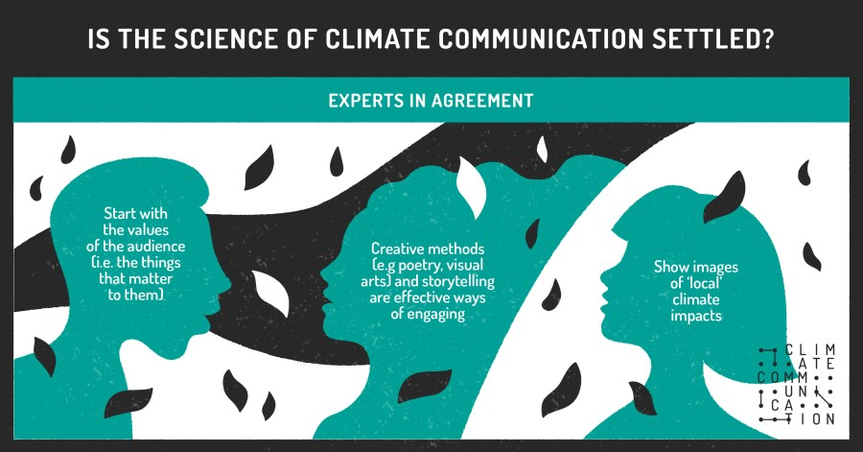
The Climate Communication Project
https://theclimatecommsproject.org/climate-communication-in-practice/
https://www.bps.org.uk/sites/www.bps.org.uk/files/Member%20Networks/Divisions/DOP/Capstick%20BPS%20June%2028.pdf

Slide 11
NTU Carbon Literacy Training Course
Climate change mitigation focused on solutions
Interactive teaching material
MIT Sloan & Climate Interactive Simulation tool
Certificates for you and your students
Please contact petra.molthan-hill@ntu.ac.uk for more info on this or the more specific training for business schools mentioned earlier.
www.ntu.ac.uk
Notes:
And if you are interested in the wider perspective on how to get everyone in the university carbon literate, NTU has made one of the two open-source tool kits for all staff and students at universities.

Slide 12
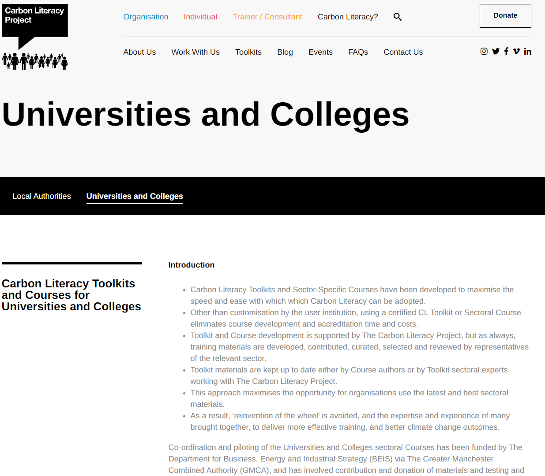
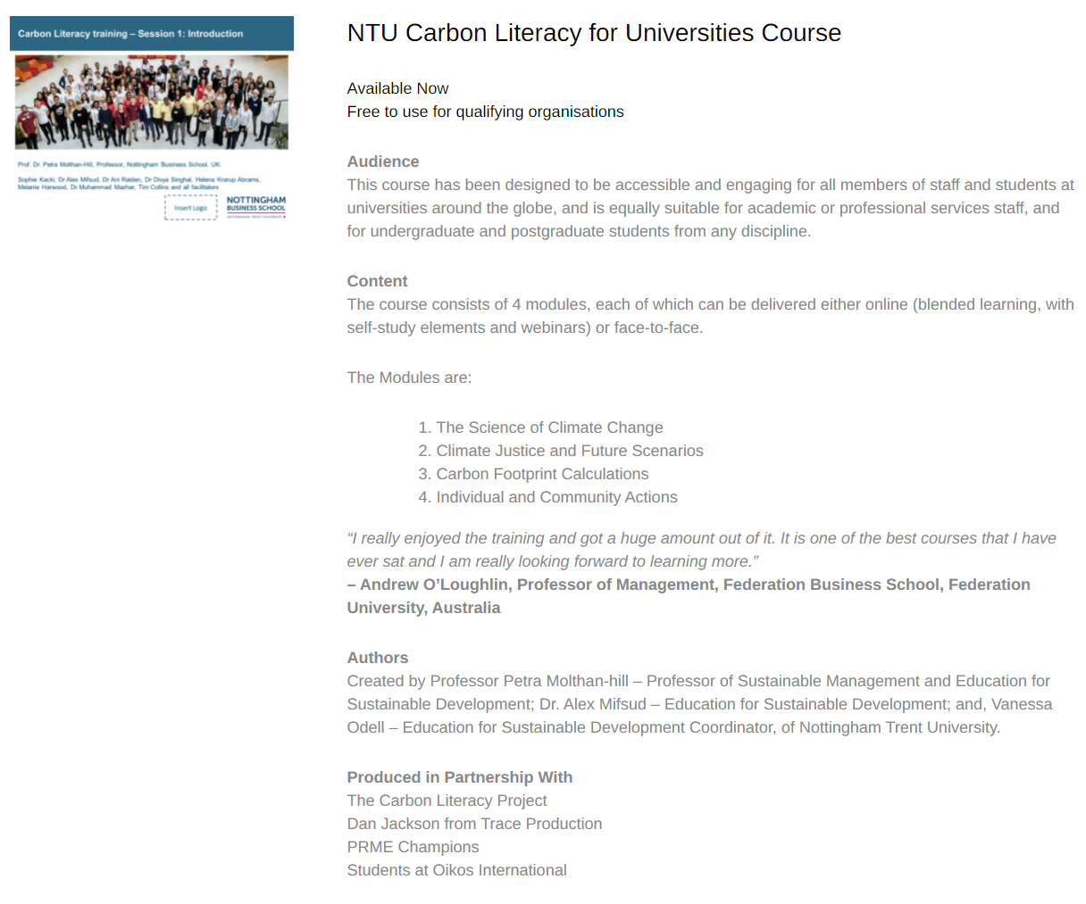
NTU Carbon Literacy Training Course
Please contact education@carbonliteracy.com to request this toolkit.
www.ntu.ac.uk
Notes:
And if you are interested in the wider perspective on how to get everyone in the university carbon literate, NTU has made one of the two open-source tool kits for all staff and students at universities. Lots of information about the resources via https://carbonliteracy.com/toolkits/universities-colleges/. Email education@carbonliteracy.com to request the toolkit.

Slide 13

Pass it on

Slide 14

Want to adapt any of our projects to your university?
Please contact Prof Dr Petra Molthan-Hill
petra.molthan-hill@ntu.ac.uk

