Slide 1






Governmental Financial Resilience
– A European Perspective
PICPA Not-for-Profit & Government Accounting Conference Webcast
12-13 July 2021
Sanja Korac - University of Speyer, GER
Iris Saliterer - University of Freiburg, GER
Carmela Barbera - University of Bergamo, IT
Bernard Kofi Dom - Nottingham Trent University | University of Essex, UK
Céline Du Boys - Aix-Marseille University, FR
Martin Jones - Nottingham Business School | Nottingham Trent University, UK
Ileana Steccolini - University of Essex, UK
Notes:
Welcome to the Module „Governmental Financial Resilience – A European Perspective“ at the PICPA Nof-for-Profit & Government Accounting Conference Webcast and thank you for your interest.
My name is Sanja Korac and I am professor of public management at the University of Speyer in Germany. Together with my colleague Iris Saliterer, I have been part of the international research team working on governmental financial resilience for several years now. It is a great pleasure to walk you through our approaches, research steps, and empirical results, and to present our findings on financial resilience of European local governments also on behalf of our colleagues mentioned on this slide.

Slide 2
AGENDA
Research on Governmental Financial Resilience
The Framework and Dimensions of Governmental Financial Resilience
Patterns and Consequences of Governmental Financial Resilience
Reflections
Notes:
I will begin the presentation with a short glance on why the concept of financial resilience may be worth your while and will report on the research on governmental financial resilience that we have conducted so far, before I go more into detail on the framework and the dimensions of governmental financial resilience. Some results from our latest empirical study will complement the more general description of the respective dimensions.
Iris will then take over to discuss the patterns and organizational consequences of governmental financial resilience before providing some reflections on what we have learned so far.

Slide 3
1. Research on Governmental Financial Resilience
The management of shocks, crises, unexpected events - increasingly becoming ‘routine’ for governmental entities
During crises and austerity, governments are prompted to
  reset priorities, cut back expenditures, restructure service delivery
Responses to the global financial crisis
  resurgence of “old-fashioned” cutback & austerity measures (and rhetoric)
Focus on decline and cutback management may cause scholars to miss an important opportunity for adopting a long-term, strategic view (Bozeman 2010)
  capturing ‘life cycle’ of governmental entities
  emphasizing the role of internal capacities and looking at the interplay of different dimensions
Notes:
Governments are no strangers to dealing with unforeseen events negatively affecting their finances. As disruptive events become more common, the management of shocks, crises, and unexpected events increasingly turn into ‘routine’ for governmental entities.
During crises and austerity, governments are prompted to reset priorities, cut back expenditures, and restructure service delivery strategies in order to deliver services in a stable, uninterrupted manner, meeting their citizens’ demands.
Even though academic interest in decline and cutback management seemed to have peaked in the 1970s and 1980s, governmental responses to the global financial crisis have led to a resurgence of „old-fashioned“ cutback and austerity measures and also the respective rhetoric at the national levels.
While this has led to an impressive accumulation of contextual knowledge on fiscal and organizational response strategies, there have also been warning calls that the focus on decline and cutback management may cause scholars to miss an important opportunity (Bozeman 2010) for adopting a longitudinal and strategic view on the whole life cycle of public organizations, one that emphasizes the role of internal capacities and looks at the interplay of different dimensions beyond fiscal responses.

Slide 4
1. Research on Governmental Financial Resilience
Need for alternative conceptual lenses and frameworks to explore and understand
  how governments face unexpected events and crises
  whether and why responses are different across countries and organizations
  what lessons can be learned to be ready to face future shocks
Resilience as the capacity to deal with shocks/uncertainty
  capacity to react to crises/absorb shocks (bouncing back)
  capacity to cope with the unexpected and adapt to new and complex situations (bouncing forward)
how governments „keep operating even in adverse, ‚worst case‘ conditions and adapt rapidly in a crisis“ (Hood 1991, 14)
Notes:
This highlighted the need for alternative conceptual lenses and frameworks that could integrate a financial management as well as an organizational view in order to explore and understand how governments „keep operating even in adverse, ‚worst case‘ conditions and adapt rapidly in a crisis“ (Hood 1991, 14); which means investigating
how governments face unexpected events and crises
whether and why responses are different across countries and organizations
what lessons can be learned to be ready to face future shocks
In this endeavor, our research team has applied the general concept of resilience as the conceptual lens for our research.
In short, we can say that resilience is the capacity to deal with shocks or uncertainty. There are two different approaches to resilience:
The first is understanding resilience as the capacity to react to crisis efficiently or to absorb shocks. The main aim here is on bouncing back to „normal“ or to a situation as of before the crisis.
The second understanding of resilience follows an evolutionary approach where organizations thrive through crisis and bounce forward by anticipation and quick adaptation to new challenges.

Slide 5
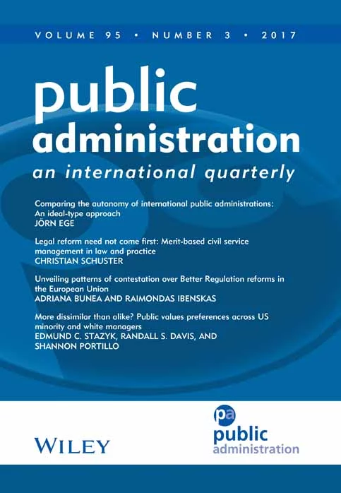
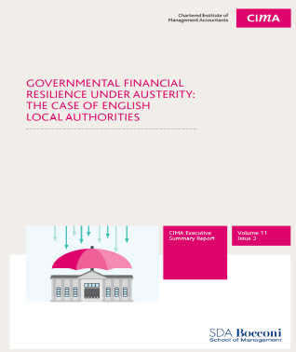
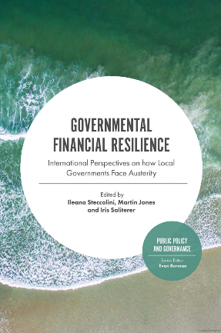
1. Research on Governmental Financial Resilience
Exploring how local governments in Italy, England and Austria (2012-2015) were facing the consequences of the global financial crisis
  Focus on England: www.cimaglobal.com/FinancialResilience
  Focus on Italy, England and Austria: Governmental financial resilience under austerity in Austria, England and Italy: https://onlinelibrary.wiley.com/doi/full/10.1111/padm.12350
Colleagues from 11 countries (Australia, Austria, England, France, Germany, Greece, Italy, the Netherlands, Sweden, US, Brazil) joined to study the cases of 45 municipalities
  Governmental Financial Resilience - International Perspectives on How Local Governments Face Austerity: https://books.emeraldinsight.com/page/detail/Governmental-Financial-Resilience/?k=9781838679279
Multiple Case Study Design – incl. Interviews
Notes:
In our first empirical studies on governmental financial resilience, we explored how local governments in Italy, England and Austria were facing the consequences of the global financial crisis. The findings have been published in a practitioner report for England and as a scholarly article in one of the leading academic journals in the field.
Soon after, colleagues from 11 countries worldwide (Australia, Austria, England, France, Germany, Greece, Italy, the Netherlands, Sweden, US, Brazil) joined to study the cases of 45 local governments.
Conducted in a multiple case study design including interviews and an extensive analysis of archival data, these studies have contributed substantially to further defining and better understanding the dimensions of governmental financial resilience.

Slide 6
1. Research on Governmental Financial Resilience
In 2017-2018: Survey of > 500 local governments in Germany, Italy, UK on governmental financial resilience
  Local government strategies in the face of shocks and crises: the role of anticipatory capacities and financial vulnerability: https://journals.sagepub.com/eprint/FFZPNHMNTV7ZGYVKV3Z5/full
In 2020-2021: Survey of > 600 local governments in France, Germany, Italy, UK in light of the COVID-19 pandemic
Quantitative Research Design - Surveys
Notes:
In more recent studies, we have therefore been able to apply a quantitative research design using surveys. In 2017 and 2018, we have collected questionnaires from more than 500 local governments in Germany, Italy, and the UK. Using statistical analyses, we have been able to look at how anticipatory capacities and financial vulnerabilities affected the strategies that local governments have applied in light of shocks and crises.
Our latest study – of course – has addressed the most topical crisis for governments – the COVID-19 pandemic. Data from more than 600 local governments in France, Germany, Italy, and the UK show that even though a first grasp of the impact of the pandemic may feel similar across the globe, local governments in different national contexts face the crisis with different financial resilience (patterns).

Slide 7
2. The Framework and Dimensions of
Governmental Financial Resilience
“…a government’s ability to anticipate, absorb and react to shocks affecting its finances as well as service delivery….”
Anticipatory Capacities
Sensemaking
Financial
Shock
Vulnerability
Coping Capacities
Notes:
The insights gained during multiple case studies helped us to better understand governmental financial resilience; that is, a government’s ability to anticipate, absorb and react to shocks affecting its finances as well as service delivery.
The financial resilience model and its dimensions are based on research evidence and can be translated into a financial resilience toolkit (which we will introduce later in the presentation)
Rather than being a certain state, governmental financial resilience was the result of a dynamic combination of different dimensions – namely a financial shock which acts as a ‘triggering event’ that uncovers particularly internal capacities; (perceived) vulnerability, and anticipatory as well as coping capacities
(((The financial resilience toolkit can be used by organizations to assess their ac and cc as well as their perceived vulnerabilities so as to identify possible critical areas or strengths and to build, sustain and maintain their financial resilience))

Slide 8
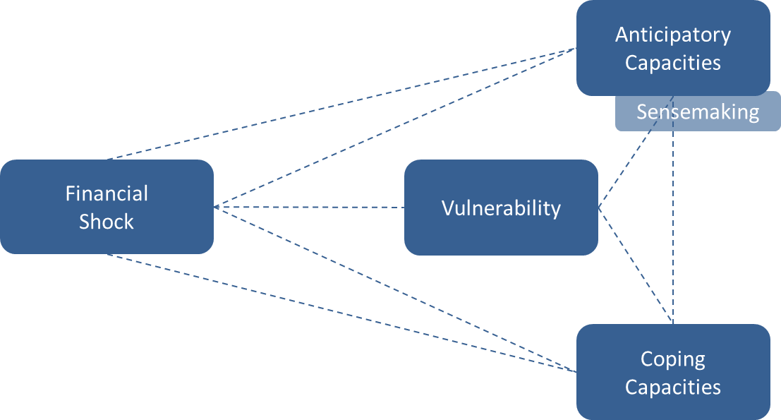
2. The Framework and Dimensions of
Governmental Financial Resilience
Financial Shock
Unexpected external or internal events with
significant and/or long-lasting impact on finances and
consequently service delivery
  direct (e.g. reduction in transfer payments or taxes,
  failure of PPP/PFI)
  indirect (e.g. demographic changes, natural disasters, government policy)
e.g. Global Financial Crisis, refugee influx, regulations, BREXIT, COVID-19
“Today we have lower revenues from building permits… this is the consequence of the economic crisis.” (BO, I4)
“….our savings target overnight went up from £127 to £157 million over a 5 year period and that I would say was a shock.” (CFO, E3)
“The big change was certainly the financial crisis in 2008 [financial crisis].” (CFO, A4)
Notes:
A financial shock is an unexpected external or internal event with significant and/or long-lasting impact on a government‘s finances and consequently, its service delivery for citizens. The impact may be direct such as a dip in transfer payments or taxes, or a failure of a public private partnership of public finance initiative. However, a financial shock may also be indirect, emerging from sudden demographic changes, natural disasters or unexpected government policies or regulations.
The financial shocks in the focus of our research so far have been the global financial crisis, refugee influx, regulations, BREXIT, as well as of cource COVID-19.

Slide 9
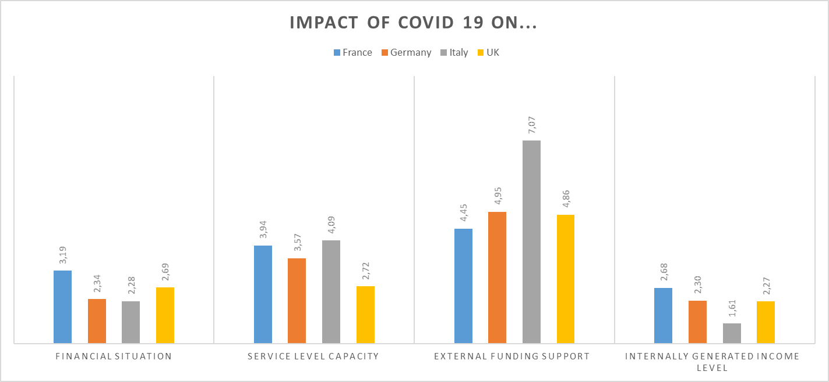
2. The Framework and Dimensions of
Governmental Financial Resilience
Financial Shock: “The COVID-19 crisis affected…”
Negative 1 – 3
Neutral 4 – 6
Positive 7 – 9
Notes:
In our latest survey, when we asked French, German, Italian and UK local governments how the COVID-19 crisis had affected their financial situation but also service level capacity, we see that
While in the UK, COVID-19 does not seem to have affected external funding support, Italian local government appear to have experienced a positive effect in terms of the central government having provided extensive transfer payments.
Across countries, we observe a severe negative impact on internally generated income like local taxes, property taxes, sales, fees and charges.
The impact on the overall service level capacity appears rather neutral in Italy - where the impression is that local governments were able to provide services despite the crisis. In contrast, the impact appears negative in the UK.

Slide 10
2. The Framework and Dimensions of
Governmental Financial Resilience
Vulnerability
Perceived level of exposure to a specific shock
  external and internal factors contributing to vulnerability
  (e.g. dependence on uncertain revenue bases, diversification of income,
  rigidity of expenditure, uncertain/decreasing transfers)
  vulnerability levels and sources before and after shock/crisis, and their evolution over time
  more important than a specific level of vulnerability: the sense of ‘owning’ or being able to control one’s vulnerability (i.e. being able to manage it and/or influence its sources)
“During the last crisis, in 2008, we lost revenue shares, but we handled the situation well. As it seems to be getting better now, we have to start building up a financial buffer again.” (CEO, A)
“If you look at our balance sheet you will see that it is extremely healthy in terms of sitting on reserves and cash levels.” (CFO, E1)
“We … are one of the Italian Municipalities with the lowest level of debt.’”(CFO, I1)
Notes:
In general terms, vulnerability represents the exposure to shocks and is
the result of both external spurces (e.g., dependence on grants) as well as internal sources (e.g., debt financing, reserves).
While we have looked at different levels and sources of vulnerability before as well as after shocks and crises, thus capturing their evolution over time, it turned out that it is rather the perceived vulnerability that is central in understanding financial resilience. The question of whether governments‘ (and governmental actors) have a sense of ‚owning‘ their vulnerabilities or whether they feel able to control it - by for instance influencing vulnerability sources - affected way in which the shocks and crises and the resulting impacts were interpreted, and determined the attention they received.

Slide 11
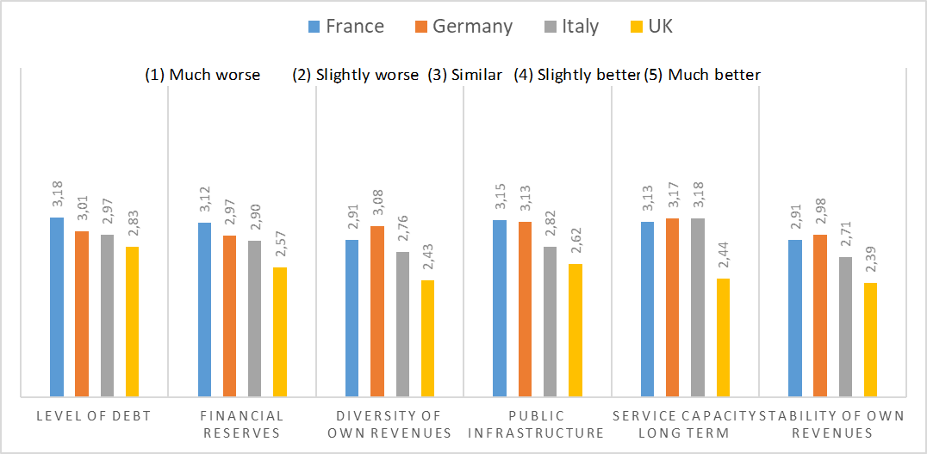
2. The Framework and Dimensions of
Governmental Financial Resilience
Vulnerability (before COVID-19): "How do you compare the aspects of your local government to other peer local governments?"
Notes:
With European local governments facing the COVID-19 crisis, we see that local governments in the UK are the most vulnerable in all aspects of financial vulnerability, followed by local governments in Italy, while their German and French counterparts are in rather similar positions.

Slide 12
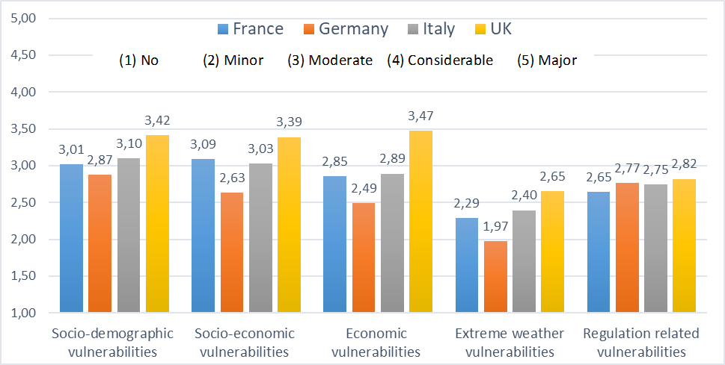
2. The Framework and Dimensions of
Governmental Financial Resilience
Context-related Vulnerability (before COVID-19): "How do you rate the following vulnerabilities of your local government?”
Notes:
Turning to context-related vulnerability, our results show that local governments in all countries were most vulnerable to the first three factors – socio demographic vulnerabilities such as low education, ageing of population, socio-economic vulnerabilities such as poverty and income deprivation, and economic vulnerabilities such as local jobs and attractiveness to businesses and residents.
Overall, UK local governments considered themselves most vulnerable to these factors.
With the other factors, namely extreme weather vulnerabilities like forest fires, and floods and regulation related vulnerabilities like frequently changing regulations represented minor vulnerabilities, local governments in the UK were most vulnerable across all aspects. Interestingly, during our empirical research following the global financial crisis, we saw that Italian local governments felt notably vulnerable to rapidly changing regulations by the central government level. This vulnerability source however seems to play only a moderate role more recently.

Slide 13
2. The Framework and Dimensions of
Governmental Financial Resilience
Anticipatory Capacities
the ability to identify and manage vulnerabilities,
to recognize (potential) shocks in an early stage, and to
understand their impact
  tools that are used to monitor the environment and help to identify and manage vulnerabilities (can exist or be built up internally driven, or externally driven, e.g., instruments required by upper governmental levels)
  actors’ mental processes of knowing, including awareness, perception, reasoning and judgment - sensemaking
“In terms of risks itself I think it is very important that you have a very realistic and very focused risk management system what’s the top 20 risks the organisation faces…we regularly look at those risks, revise the lists and you update them.” (CEO, E2)
“Most people hadn’t anticipated but we had. We have also put £10 million aside 14/15 for any residual on […] the appeals side” (CFO, E1)
“The economic crisis […] it caught us unprepared because we did not recognize its dimension.” (CFO, A2)
13
Notes:
Anticipatory capacities refer to the availability of tools and capabilities that enable organisations to better identify and manage their vulnerabilities and to recognise potential financial shocks before they arise.
These tools and capabilities either may already be in place, or, they may be built up incrementally over time to strengthen anticipatory capacities.
In addition to tools such as risk assessment or medium-term financial planning, we also identified sensemaking
to be key to being prepared.

Slide 14
2. The Framework and Dimensions of
Governmental Financial Resilience
Sensemaking
Action-oriented cycle of acquisition and reflection to
integrate experiences into one’s understanding of the
world - sensemaking informs action
Active authoring of situations (Weick 1995)
  Scanning: how information is gathered, which external and internal
  information is integrated into the scanning process
  Interpretation: perceived positive and negative effects, perception of controllability of impact
  Action: what action is taken based on the scanning and interpretation
Immediate context influences
  how actors notice and extract cues from the environment
  how these cues are interpreted
Notes:
Sensemaking is an ongoing action-oriented cycle of acquisition and reflection that people go through to integrate experiences into their understanding of the world, and which furthermore informs their action (Kolko 2010; Maitlis et al. 2013).
Sensemaking is about active authoring of situations and involves scanning, interpretation, as well as action.
Sensemaking does not take place in isolation but in a specific context. The immediate context influences how actors notice and extract cues from the environment, and how these cues are interpreted.

Slide 15
2. The Framework and Dimensions of
Governmental Financial Resilience
Anticipatory Capacities
Information exchange: Monitoring external activities:
„We constantly exchange information…“ „We constantly monitor…“
Notes:
In light of the COVID-19 crisis, we see that local governments across all four countries seem to exchange information with external service providers, but UK local governments (in orange) seem more likely to constantly exchange information with their peers. When it comes to monitoring their environment, French local governments (in green) score higher then their counterparts in the other three countries, with Italy (in red) scoring lower in all four aspects observed.

Slide 16
2. The Framework and Dimensions of
Governmental Financial Resilience
Anticipatory Capacities
Vulnerability Assessment: Critical thinking:
„We regularly…“ „Employees are encouraged to …
Notes:
In case of regular vulnerability assessment, we see that UK local governments score notably higher than their continental counterparts in all four aspects. This is a result that confirms earlier findings on UK central government policies and requirements strengthening their local governments‘ risk assessment and risk management approaches.
In contrast, when it comes to a routine strengthening actors‘ sensemaking, namely critical thinking, the differences are more modest, but in all four aspects, UK local governments seem to foster more critical thinking in employees, followed by German and French local governments, with their Italian counterparts seemingly putting no particular focus on this aspect of anticipatory capacities.

Slide 17
2. The Framework and Dimensions of
Governmental Financial Resilience
Sensemaking: COVID-19 as Threat or Opportunity?
Threat Opportunity
Notes:
Looking at COVID-19, UK local governments seem to, on the one hand, more often perceive this as a major threat than their counterparts in the other three countries. On the other hand, they also perceive COVID-19 as a major or considerable opportunity much more often than local governments in the other countries. In contrast, many Italian local governments perceive it as a moderate or considerable threat, and almost a third of them see no opportunity in this crisis whatsoever.

Slide 18
2. The Framework and Dimensions of
Governmental Financial Resilience
Coping Capacities
Resources and abilities that allow shocks to be faced and
vulnerabilities to be managed
  dormant in times of order, become visible in
  times of disruption (shock) → coping strategies
Three types of coping capacities
  Buffering capacity: ability to absorb the impact of a shock without changes in its structure or function (e.g. use of reserves, virement, slack resources)
  Adapting capacity: ability to implement incremental changes to extant structures and functions without changing underlying principles, culture, values
  Transformative capacity: ability to implement radical changes, characterized by new ‘rules of the game’, i.e., changes in the structure, function, goals and values of the LG
“When the crisis came in 2007/2008, we immediately tried to reduce our spending […] to defer investments or maintenance.” (CFO, A3)
“What we are trying to do is move our budget setting process to being more outcome based, and trying to refocus the money left on our most vulnerable within the town, on the services we have to provide for those who can’t provide for themselves.” (CFO, E2)
“I would say our goals have kind have turned around that we are trying to make sure we are generating income and that we are self-sufficient.” (CFO, E2)
Notes:
Coping capacities refer to resources and abilities that allow shocks to be faced and vulnerabilities to be managed.
These capacities lie dormant in times of order and become visible in times of disruption (shock) through coping strategies
We differentiate between three different types of coping capacities.
Buffering capacity (or, the ability to absorb shocks) represents more traditional budget management techniques such as the use of reserves, virement and slack resources to absorb short-term, one-off and minor financial shocks. It may also include increases in tax revenues or short-term reductions in programme expenditures or deferring expenditures to later periods.
Adaptive capacity (or, the ability to implement incremental changes) represents latent competences and experiences that are used to adjust activities, while not jeopardising the overall status quo. These include the ability to innovate around the edges or find new ways of doing the same or similar things.
Transformative capacity (or, the ability to take paths of more radical changes) represents a higher order capacity and may not be present at the start of a crisis, but become a feature afterwards.

Slide 19
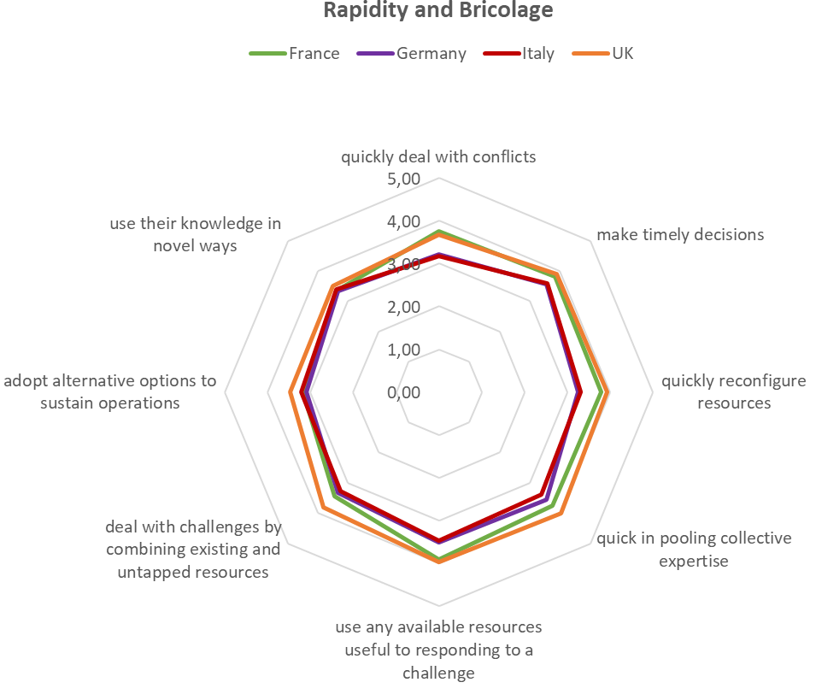
2. The Framework and Dimensions of
Governmental Financial Resilience
Coping Capacities
Notes:
Let‘s take a look at some of the capacities that, in particular, are needed for adapting and transformation. Looking at the rapidity of actions and bricolage, we see that Italian local governments score lower than their counterparts in several aspects, especially compared with UK local governments

Slide 20
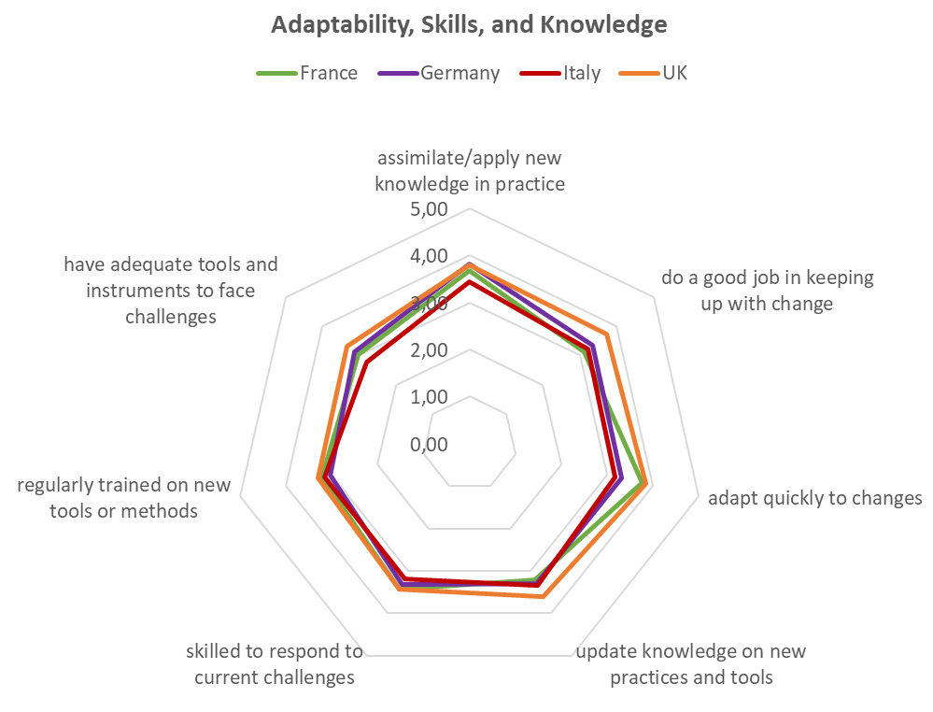
2. The Framework and Dimensions of
Governmental Financial Resilience
Coping Capacities
Notes:
When it comes to the adaptability, skills, and knowledge needed to respond to challenges and unexpected events, in some aspects like in the lower left we see no notable difference across the countries, but UK and French local governments, for instance, seem to be better able to adapt quickly to changes, while it is UK local governments that are more likely to do a good job in keeping up with change.

Slide 21
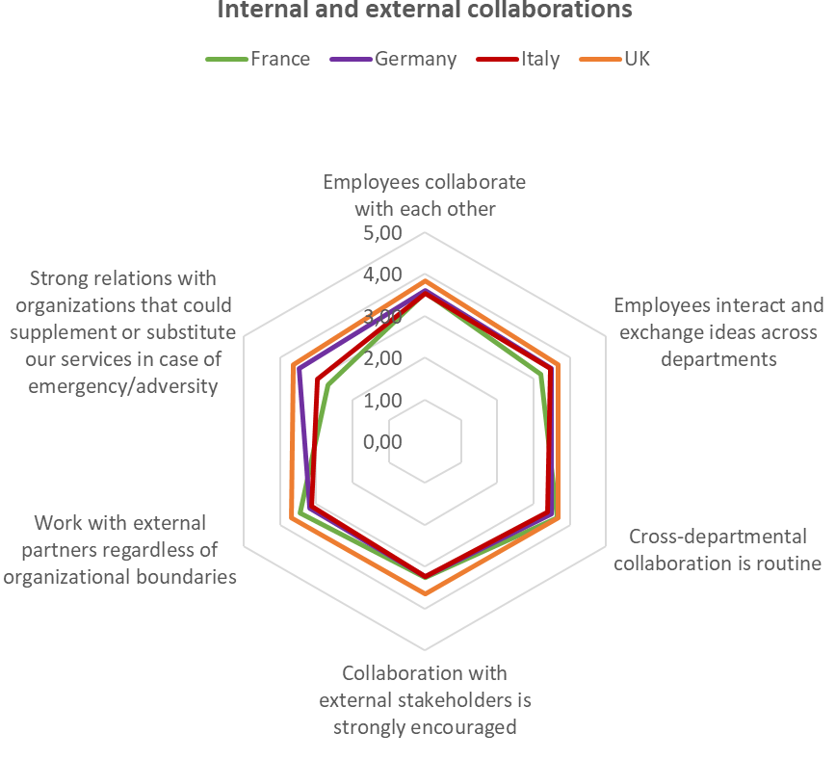
2. The Framework and Dimensions of
Governmental Financial Resilience
Coping Capacities
Notes:
Turning to internal and external collaborations, UK local governments again appear to foster these more than local governments in the other three countries. Interestingly, French – but also Italian local governments seem to haver largely missed out on building strong relations with organizations that could supplement or subsitute their services in case of emergency and adversity.
And now, over to Iris.

Slide 22
3. Patterns and Consequences of
Governmental Financial Resilience
Patterns of Governmental Financial Resilience
Anticipatory Capacities
Financial Resilience Patterns
Sensemaking
Financial
Shock
Vulnerability
Coping Capacities
Notes:
Our international research on local governments has shown that there is no single way to be financially resilient. rather there are different ways in which local governments can be financially resilient. And these different financial resilience patterns will result from a dynamic combination of financial shocks, vulnerabilities, anticipatory capacities and coping capacities. over time

Slide 23
3. Patterns and Consequences of
Governmental Financial Resilience
Self-regulation/Pro-active Adaptation
Shocks as opportunities
Ready to adapt or transform, reconfigure service delivery, find alternative sources of income
Able to internally develop and employ full range of coping capacities
Good anticipatory and coping capacities in place before the crisis, understanding relative vulnerability
Ability to manage internal capacities, and to use and shape external environment to create opportunities
Notes:
Self-Regulation/Pro-Active Adaptation
The local governments showing this pattern of behaviour are able to look at shocks as opportunities for improvement, and thus appear proactive in responding to them. This includes adopting wide-ranging measures and being
ready to adapt or transform to reduce expenditure, reconfigure service delivery and find alternative sources of income.
In short, these local governments appear to be able to internally develop, over time, the full range of coping capacities.
These cases already had good anticipatory and coping capacities in place before the crisis, which in turn resulted in a good understanding of their relative vulnerability leading to lower levels of vulnerability when crises unfolded.
What makes this group distinctive is a belief in their ability to manage not only their internal capacities, but to also their ability to use and shape the external environment to generate opportunities for income creation, demand management, and service delivery.

Slide 24
3. Patterns and Consequences of
Governmental Financial Resilience
Self-regulation/Pro-active Adaptation
Shocks as opportunities
Ready to adapt or transform, reconfigure service delivery, find alternative sources of income
Able to internally develop and employ full range of coping capacities
Good anticipatory and coping capacities in place before the crisis, understanding relative vulnerability
Ability to manage internal capacities, and to use and shape external environment to create opportunities
Reactive Adaptation
Acceptance of need to adapt to changed environment
Implementation of adaptive actions
Need trigger to activate deployment or building of capacities
Varying levels of vulnerability and anticipatory capacity
Strengthen anticipatory capacity after crisis
Wide range of coping capacities
Notes:
Reactive Adaptation
Local governments in this group are characterised by both an acceptance of the need to adapt to changing circumstances
as well as the implementation of actions to do so.
In contrast to the constrained or self-regulative/proactive adaptive types, they seem to need triggers to activate the deployment or building of capacities.
Local governments with this pattern entered the crisis period with varying levels of vulnerability and anticipatory capacity.
Rather than having a strong set of anticipatory capacities from the start, the impact of the crisis took some in this group by surprise, while even negating early warnings. They tend to have strengthened anticipatory capacities in the aftermath of the crisis.
and deploy coping capacities that go beyond simple buffering, resulting in either adaptive or possibly moves towards transformative capability. In fact, there are a wide range of coping capacities displayed across this group with some focusing on retrenchment (buffering/
downsizing) while others seek to reposition themselves in more comprehensive ways.
This characteristic perhaps also reflects the typical experience of Swedish local governments, which had already been through a major trauma earlier in their lifecycles
that left them better prepared to respond to the recent global financial crisis.

Slide 25
3. Patterns and Consequences of
Governmental Financial Resilience
Self-regulation/Pro-active Adaptation
Shocks as opportunities
Ready to adapt or transform, reconfigure service delivery, find alternative sources of income
Able to internally develop and employ full range of coping capacities
Good anticipatory and coping capacities in place before the crisis, understanding relative vulnerability
Ability to manage internal capacities, and to use and shape external environment to create opportunities
Reactive Adaptation
Acceptance of need to adapt to changed environment
Implementation of adaptive actions
Need trigger to activate deployment or building of capacities
Varying levels of vulnerability and anticipatory capacity
Strengthen anticipatory capacity after crisis
Wide range of coping capacities
Constrained Adaptation
Unable or not yet in a position to control own destiny
Constantly and proactively adapting, but constrained by external forces
Shocks as opportunities
Have a range of capacities in place or develop them
Threat of slipping into fatalistic mode / opportunity of seeking more self-regulating path in future
Notes:
Constrained Adaptation
This smaller group differs from the self-regulatory/proactive adaptation group as local governments herein are either unable to control their own destiny or have not yet reached a position where they are able to do so.
They are constantly and proactively adapting, but are constrained by external forces, usually exerted by upper levels of government.
These local governments see shocks also as opportunities
and have in place, or are able to develop, a range of capacities that allow them to continually change and adapt.
However, there is a danger that under prolonged periods of financial strain, and as perceptions regarding their long-term vulnerability worsen, there could be a tendency to slip into a more fatalistic mode. Alternatively, this group may try to break free of the constraints and attempt to seek a more self-regulating path in the longer term.

Slide 26
3. Patterns and Consequences of
Governmental Financial Resilience
Self-regulation/Pro-active Adaptation
Shocks as opportunities
Ready to adapt or transform, reconfigure service delivery, find alternative sources of income
Able to internally develop and employ full range of coping capacities
Good anticipatory and coping capacities in place before the crisis, understanding relative vulnerability
Ability to manage internal capacities, and to use and shape external environment to create opportunities
Reactive Adaptation
Acceptance of need to adapt to changed environment
Implementation of adaptive actions
Need trigger to activate deployment or building of capacities
Varying levels of vulnerability and anticipatory capacity
Strengthen anticipatory capacity after crisis
Wide range of coping capacities
Constrained Adaptation
Unable or not yet in a position to control own destiny
Constantly and proactively adapting, but constrained by external forces
Shocks as opportunities
Have a range of capacities in place or develop them
Threat of slipping into fatalistic mode / opportunity of seeking more self-regulating path in future
Powerlessness
Crisis exceeds capacities
Fatalist mode, externally driven and constrained by external pressures
Anticipatory capacity expected to increase
Reliance on buffering capacity prevails
Less willing to take ownership of changes
Poor understanding of vulnerabilities
Notes:
Powerlessness
Here, the financial crisis seemingly exceeds the threshold of local governments’ existing capacities, leading to a perception of powerlessness
and forcing them into a fatalist mode, that is a day-by-day management of emergencies, leaving them highly reliant on buffering capacities, externally driven and constrained by external pressures.
Although the anticipatory capacity may be expected to increase over time, such cases respond with rather passive behaviour, they may be less willing to take ownership of necessary changes, deflecting issues back onto national governments and postponing solutions.
The lack of both anticipatory and coping capacities leads to a poor understanding of their vulnerabilities, leaving them highly vulnerable at the beginning of the crisis
and remaining vulnerable at the end. Such an approach is not sustainable against deep and enduring financial cuts, and there is a risk that such an approach is not merely fatalist, but fatal.

Slide 27
3. Patterns and Consequences of
Governmental Financial Resilience
Self-regulation/Pro-active Adaptation
Shocks as opportunities
Ready to adapt or transform, reconfigure service delivery, find alternative sources of income
Able to internally develop and employ full range of coping capacities
Good anticipatory and coping capacities in place before the crisis, understanding relative vulnerability
Ability to manage internal capacities, and to use and shape external environment to create opportunities
Reactive Adaptation
Acceptance of need to adapt to changed environment
Implementation of adaptive actions
Need trigger to activate deployment or building of capacities
Varying levels of vulnerability and anticipatory capacity
Strengthen anticipatory capacity after crisis
Wide range of coping capacities
Constrained Adaptation
Unable or not yet in a position to control own destiny
Constantly and proactively adapting, but constrained by external forces
Shocks as opportunities
Have a range of capacities in place or develop them
Threat of slipping into fatalistic mode / opportunity of seeking more self-regulating path in future
Powerlessness
Crisis exceeds capacities
Fatalist mode, externally driven and constrained by external pressures
Anticipatory capacity expected to increase
Reliance on buffering capacity prevails
Less willing to take ownership of changes
Poor understanding of vulnerabilities
Contentedness
Wealthy and less vulnerable before crisis
Weak anticipatory capacities
Relying on absorbing shocks should they occur
Downplay emerging vulnerabilities
No investing in anticipatory and coping capacities
‚Resting on laurels‘
Notes:
Contentedness
This pattern represents local governments that were relatively wealthy and therefore not particularly vulnerable at the onset of the crisis.
They have weak anticipatory capacities as their relative wealth meant they never had to face a significant financial crisis before, or were able to absorb them comfortably.
Their favourable environmental conditions may have encouraged them to downplay emerging and increasing vulnerabilities
and to not invest in building anticipatory and coping capacities as their still wealthy conditions and context offset weaknesses.
Resting on their laurels, they had not anticipated the crisis, and were hoping to weather the storm relying on their buffering capacities. In the long term however, this may translate into increased vulnerability and the need to take stronger actions.

Slide 28
3. Patterns and Consequences of Governmental Financial Resilience
Anticipatory Capacities
Sensemaking
Organizational Consequences
Financial
Shock
Vulnerability
Performance
Coping Capacities

Slide 29
3. Patterns and Consequences of Governmental Financial Resilience
Organizational Consequences
Bouncing back Bouncing forward
Bouncing back
reduced existing services
deferred/reduced investments
increased fees and charges for services
liquidated assets in order to raise capital
eliminated some services
Bouncing forward
changed the way it delivers services
changed the priorities of traditional activities
changed its internal structure
extended its existing services
established new services
Notes:
We also looked at the consequences of GFR and here we were particularly interestid in exploring how different dimensions of the resilience framework influence the strategies local governments used for reposnding to schocks and ciris..
Here we differentiated between bouncing bakc and bouncing forward strategies. While bouncing back strategies is about XYZ, bounicng forward strategies …….

Slide 30
3. Patterns and Consequences of Governmental Financial Resilience
Organizational Consequences
  Higher financial vulnerability encourages bouncing back strategies and discourages bouncing forward strategies
  Anticipatory capacities (especially information exchange) encourage bouncing forward strategies, and have no association with bouncing back strategies
Bouncing back
Vulnerability
Bouncing forward
Bouncing back
Anticipatory Capacities
Bouncing forward
Notes:
For exploring this issue In the next step we send out a survey to Italy, Germany and the UK for exploring the role that external shocks, AC and V play in affecting different organizational strategies/responses. Using data from over 500 responses we found that while all types of shocks encourage both bouncing back and bouncing forward strategeis, a high level of financial vulnerability ecourages bouncing back strategeis while discouraging bouncing forward strategies. Moreover, we also found that while AC, and here in particular information exchange) facilitate tie adoption of bouncing forward strategies, they have no association with bouncing back strategies

Slide 31
3. Patterns and Consequences of Governmental Financial Resilience
Organizational Consequences
  Financial vulnerability makes a difference in financial performance
  Only some anticipatory and coping capacities affect financial performance (monitoring, info sharing, rapidity of action)
  Impact of financial vulnerability comparatively lower
  Anticipatory and coping capacities make a difference for non-financial performance…
Vulnerability
Anticipatory Capacities
Financial Performance
Coping Capacities
Anticipatory Capacities
Non-financial Performance
Coping Capacities
Notes:
Using the same dataset we also looked at the relationship of vulnerabilites and capacities with the performance of local governments. Here we differentiated between financial and non-financial performance. I turned out that financial vulnerability makes a real difference in explaining financial performance. However, only some anticpatory and coping capacities affected this performance dimension, namely monitoring, informaitn sharing and rapditiy of action). Moving further to the non-financial performance dimension this picture changes. Here we found a comparatievely lower impact of financial vulnerability while the whole range of ac and cc turned out to make a real difference in explaining the non-financial performance of local governments

Slide 32
4. Reflections
Shocks affect countries and organizations differently
National policies influence impact and range of responses
  Foster institutionalization of capacities across local governments
  Hamper capacity building
External environment important, but not sufficient in explaining governmental financial resilience patterns
  Local governments interpret, filter and respond differently to such impulses
  Importance of internal (coping, anticipating) capacities and perceptions of vulnerability
Notes:
Moving on to the reflections we can summarize that it turned out over the course of 10 years and looking at a variety of shocks that shocks affected country as well as organizations differently. In this regard national policies turned out to influence the impact and range of responses. While in some countries national policies fostered the Foster institutionalization of capacities across local governments like the VA across UK local authorities.in other countries they really hampered capacities building.
However, while the external environment turned out as important it is not sufficient in explaining governemental resilienc patterns. So it turned out that…Local governments interpret, filter and respond differently to such impulses. So, what really became apparent in our studies was the importance of internal capacities as well as the perception of vulnerability…

Slide 33
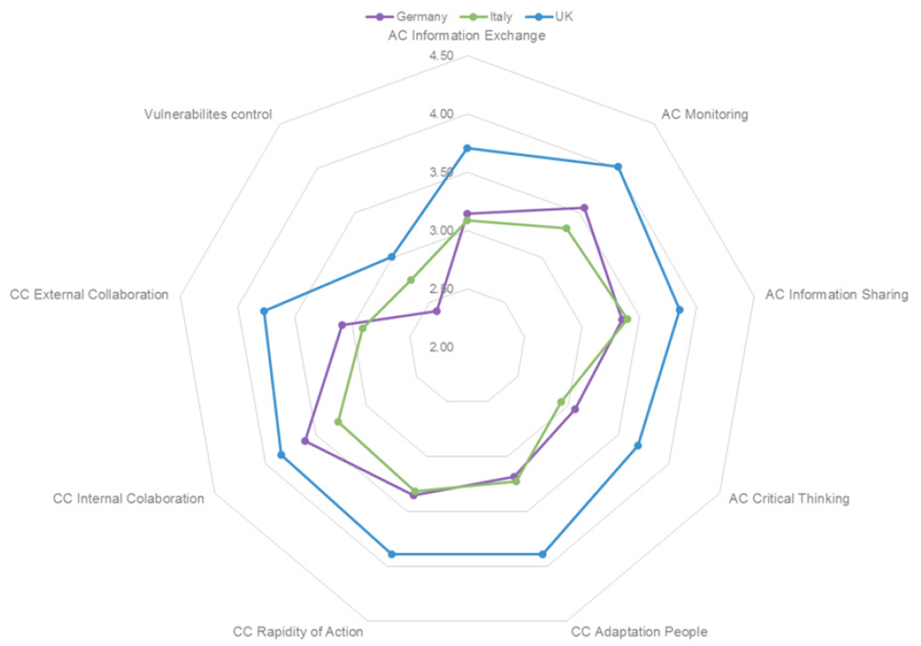
4. Reflections – Governmental Financial Resilience Toolkit
Translating the findings of our research (and our framework) into a tool to be used as a support for
  assessing anticipatory and coping capacities, and perceived vulnerability
  identifying possible critical areas or strengths
Vulnerability
Anticipatory Capacities
Organizational Level
Coping
Capacities
Notes:
The resilience model which has been presented today is based on qualitative as well as quantitative research evidence but has also been translated in a tool which can be used to
While the country comparisions are interesting and can be a useful strating point for discussion… the research focus and well as the toolkit is at the organizational lelvel…
the financial resilienc model is based on research evidence and can be translate into a financial resilience toolkit. The financial resilience toolkit can be used by organizations to assess their ac and cc as well as their perceibed vulnerabilites so as to identify possible critical areas or strengths and to build, sustain and maintain their financial resilience.
The tool-kit consists of key questions across nine sub-dimensions that practitioners can ask themselves about their organisation to help identify their own capacities and vulnerabilities, which in turn can help them to cope with shocks and difficulties affecting their financial condition.

Slide 34
References
Saliterer, I., Korac, S Barbera, C., and Steccolini, I. 2021, “Taking Stock: The Role of the Institutional Context for Local Government Financial Resilience”, https://www.springerprofessional.de/en/taking-stock-the-role-of-the-institutional-context-for-local-gov/19087598
Barbera, C. Jones, M, Korac, S., Saliterer I., and Steccolini, I., 2019, “Local government strategies in the face of shocks and crises. The role of anticipatory capacities and financial vulnerability”, International Review of Administrative Sciences, https://journals.sagepub.com/eprint/FFZPNHMNTV7ZGYVKV3Z5/full
Barbera, C. Jones, M, Korac, S., Saliterer I., and Steccolini, I., 2018, Local government financial resilience: Germany, Italy and UK compared, CIMA executive report www.cimaglobal.com/FinancialResilienceToolkit
Steccolini I, Jones M, Saliterer I, ed. Governmental financial resilience: how local governments face global crises and austerity. Emerald Publishing Limited, 2017.
Barbera, C. Jones, M, Korac, S., Saliterer I., and Steccolini, I., 2017 “Governmental financial resilience under austerity in Austria, England and Italy: How do local governments cope with financial shocks?”, Public Administration, DOI: 10.1111/padm.12350
Barbera, C., Guarini, E., Steccolini, I., 2016, “Italian Municipalities and the fiscal crisis: Four strategies for muddling through”, Financial Accountability & Management, 32 (3), 335-36
Barbera, C., Jones, M., Steccolini, I., 2015, Governmental Financial Resilience Under Austerity. The case of English Local Authorities, CIMA Executive Report, www.cimaglobal.com/FinancialResilience
Bracci E., Humphrey C., Moll J., Steccolini, I., 2015, “Public sector accounting and accountability in an era of austerity: new directions, challenges and deficits”, Special issue in Accounting, Auditing and Accountability Journal, Vol. 28, No. 6.
Bracci E., Humphrey C., Moll J., Steccolini, I., 2015, “Public Sector Accounting, Accountability and Austerity: More than Balancing the Books?”, Accounting, Auditing and Accountability Journal, Vol. 28, No. 6, 878-908.
Notes:
Thank you for your attention and we hope that you enjoyued the presentaion…On this slide you can find the referencens to our work as well as link to the lates finacnial resilience survey. You can fill and and ….. How you score on the various dimensions…

Slide 35
Comments
Questions
korac@uni-speyer.de
iris.saliterer@vwl.uni-freiburg.de

