Slide 1
High impact climate solutions:
We can do it!
Dr Petra Molthan-Hill
Professor of Sustainable Management and Education for Sustainable Development
and Co-Chair UN PRME Working Group on Climate Change & the Environment,
Nottingham Business School, Nottingham Trent University, UK

Slide 2

Inspired by Carbon Literacy Training in:
Chapple, W., Molthan-Hill, P., Welton, R., Hewitt, M.
Lights Off, Spot On: Carbon Literacy Training Crossing Boundaries in the Television Industry.
J Bus Ethics 162, 813–834 (2020).
https://doi.org/10.1007/s10551-019-04363-w

Slide 3



Carbon Literacy Training for Business Schools
What if every recruit into corporations from the world’s business schools was qualified as Carbon Literate?
This training was developed by Nottingham Business School (Nottingham Trent University) in collaboration with the UN PRME Champions, Oikos International and the Carbon Literacy Project.
The aim of this project is to get academics, students and others Carbon Literate within a short time frame and to get as many people as possible actively involved in embedding climate solutions in their own life and work. In order to do so we have chosen a train-the-trainer approach, so we will offer regional events inviting all the universities and business schools in the vicinity to train academics and students there so that they can become trainers in their own institution and/or get involved in training others in other regions of the world.
Notes:
In our Carbon Literacy Training for Business Schools we have a strong focus on these high impact solutions so that everyone in a business school, whether in teaching, research or operations would know the best actions to take.

Slide 4
Join our next Carbon Literacy Training
All times 11:00am – 1:00pm EDT (16:00 – 18:00 BST)
Register to receive Zoom links:
  https://waynestate.az1.qualtrics.com/jfe/form/SV_5gpDLIHcrlw8GmG
September 10, 2021
September 17, 2021
September 24, 2021
October 1, 2021

Slide 5
1. Climate Change Science Education
Knowledge and understanding of a broad range of scientific concepts and processes related to climate change (e.g. climate, deforestation, habitat loss, water cycle, soil erosion, air pollution), its causes and its consequences, ecologically, socially, economically and politically.
Knowledge and understanding of the dynamics of climate change impact across time and space (e.g. delayed consequences, reducing the quality of life, security and development options of future generations).
Awareness of strategies and technologies to address the negative impacts of climate change (e.g., reducing carbon consumption, encouraging low-carbon development, reducing deforestation through sustainable forest management, improving water and waste management).
Ability to distinguish critically between certainties, uncertainties, projections and risks associated with climate change, and evaluate messages about and public interpretations of climate change science.
Table published in: Molthan-Hill, P et al (2021), Climate change education at universities: Relevance and strategies for every discipline. in: Handbook of Climate Change Adaptation and Mitigation (3rd edition), Springer: Cham, Switzerland. Adapted from definitions provided by Mochizuki Y, Bryan A (2015) Climate change education in the context of education for sustainable development: Rationale and principles. Research 9(1): 4-26.
Notes:
We need to distinguish between three areas of climate change education, the first one is the science: Every Graduate need to understand the climate change science enough to make informed decisions and integrate high impact solutions into their life and work. This basic understanding is also necessary for anyone studying business.

Slide 6
2. Climate Change Mitigation Education
Developing values, knowledge and skills required to make choices and decisions that minimize the use of natural resources, emissions, waste and pollution; while contributing to the development of new solutions to the climate crisis (e.g., rethinking the way we live, buy and consume, how our daily lives are organized, how we socialize, exchange, share, educate and build identities).
Taking individual and/or collective action with the potential to have immediate, direct impact (e.g., reducing energy consumption, using non-polluting and renewable energy sources, environmental conservation, re-forestation and re-greening).
Contributing to policy development with long-term positive impact on societal behaviour by examining economic systems, social structures, cultural patterns, lifestyle expectations, consumerism, wealth distribution, aspirations and value systems and their underlying responsibility for excessive greenhouse gas production.
Table published in: Molthan-Hill, P et al (2021), Climate change education at universities: Relevance and strategies for every discipline. in: Handbook of Climate Change Adaptation and Mitigation (3rd edition), Springer: Cham, Switzerland. Adapted from definitions provided by Mochizuki Y, Bryan A (2015) Climate change education in the context of education for sustainable development: Rationale and principles. Research 9(1): 4-26.
Notes:
The second one is Climate Change Mitigation Education: Every Graduate needs to know how to best mitigate climate change- what are the best strategies and tools in operations, supply chain management, economics, investment to reduce carbon emissions?

Slide 7
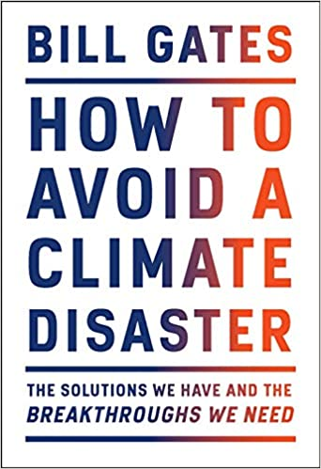

Just published
Notes:
Knowing these climate change mitigation tools and strategies will allow them to judge, whether Bill Gates is suggesting good solutions in his new book or whether Mark Carney got it right.

Slide 8

The training contains two parts:
Possible future scenarios
Part 1: The problem
Explore the challenge of climate change, how it affects the planet and how it can be prevented.
Part 2: The solutions
Discuss the ways that we are already taking action as individuals and in organizations.
Make a commitment to change something as an individual and within the context of your discipline or/and your work.
Climate Justice
Science behind it
Solutions
Individual Strategies
Group Strategies
Notes:
Multiple disciplines – what are they for business schools? All use part 1, but potentially different part 2
This session is covering part 1 so not the whole CL standard

Slide 9


Climate Solutions: Project Drawdown
Please do the quiz and make a note of the solutions which are new for you.
https://edition.cnn.com/interactive/2019/04/specials/climate-change-solutions-quiz/
After going through the set of 8 questions, identify one ‘right now’ solution that:
you can take; and
your organisation can take.
Please write your answer into the Chat Box.

Slide 10
Rank these solutions (Project Drawdown)
Use water more efficiently
Build with greener ‘cement compounds’
Increase household recycling
Clean up chemicals in our refrigerators and air conditioners

Slide 11
Rank these solutions (Project Drawdown)
Clean up chemicals in our refrigerators and air conditioners – this would be similar to taking 673 million cars of the road
Build with greener ‘cement compounds’- this would be similar to taking 50.1 million cars of the road
Use water more efficiently – this would be similar to taking 34.6 million cars of the road
Increase household recycling- this would be similar to taking 20.8 million cars of the road

Slide 12


Solutions: A lot to know…
https://profilebooks.com/how-bad-are-bananas.html
https://www.drawdown.org/
Notes:
Knowing these climate change mitigation tools and strategies will allow them to judge, whether Bill Gates is suggesting good solutions in his new book or whether Mark Carney got it right.

Slide 13


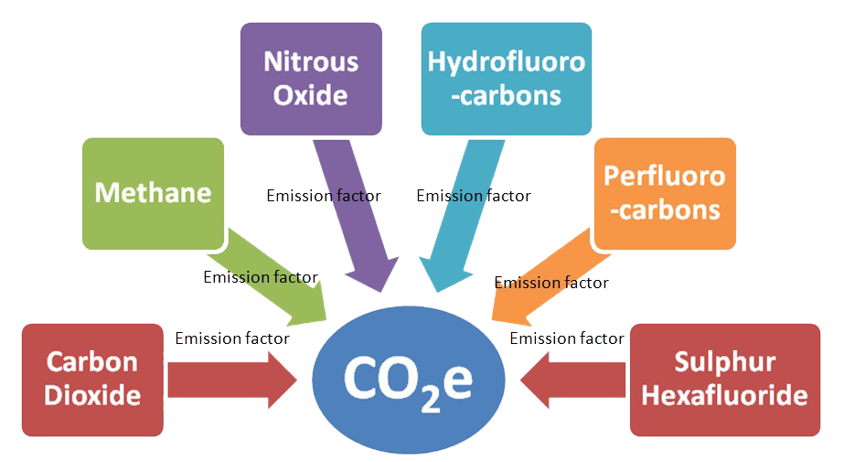
Carbon Dioxide Equivalent
Notes:
Carbon Dioxide equivalent gives us a level playing field to understand the effects of various activities

Slide 14
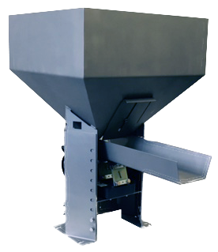
Activity = Carbon Dioxide Equivalent
Human Activity
CO2e
Notes:
We can talk about climate change in human terms by using CO2e as a benchmark

Slide 15
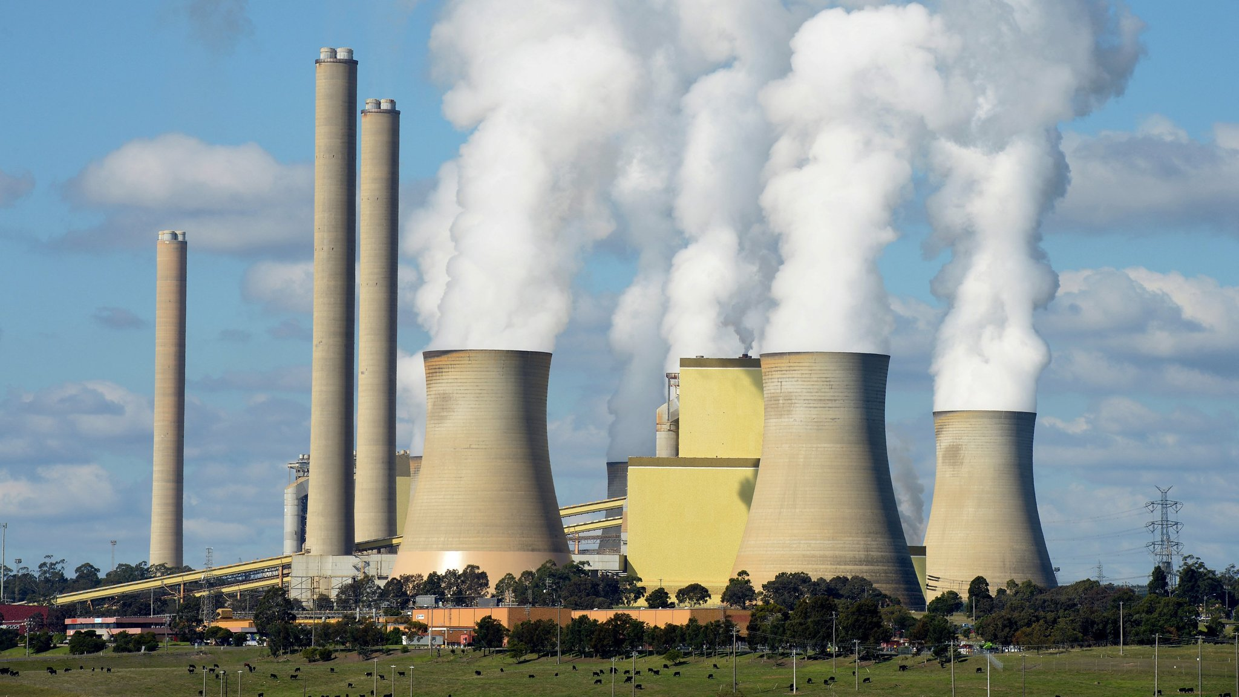

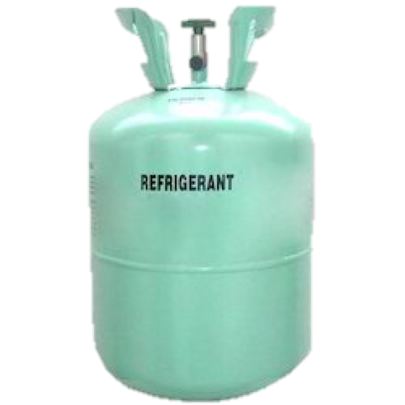

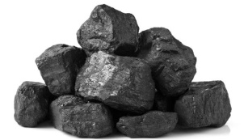

Sources of Greenhouse Gasses
Coal
Oil
Gas
Refrigerant ‘F’ gas
Air conditioning
Notes:
Past generations are responsible for getting us to where we are now
Present leaders are undecided and divided – Trump reneging on Paris Climate deal
You are the future leaders – what will you do?

Slide 16


Food and Workplace Solutions Activities: Learning Outcome
Learning Outcome:
You will learn about daily solutions that will reduce your carbon footprint by using carbon calculators for food and work related activities.
Resources:
BBC Food Carbon Footprint Calculator
https://www.bbc.co.uk/news/science-environment-46459714
Vegan Society Carbon Calculator
https://www.vegansociety.com/take-action/campaigns/plate-planet/carbon-calculator

Slide 17
Each of these activities contributes more than two millions tonnes per year, which of them has the highest annual emissions?
A new coal mine
The Cloud and world’s data centre
The Football World Cup
Cryptocurrencies

Slide 18
Each of these activities contributes more than two millions tonnes per year, which of them has the highest annual emissions?
The Cloud and world’s data centre (160 million tonnes Co2e)
Cryptocurrencies (68 million tonnes Co2e)
A new coal mine (8.4 million tonnes Co2e)
The Football World Cup (2.2 million tonnes Co2e; 74% transport)

Slide 19
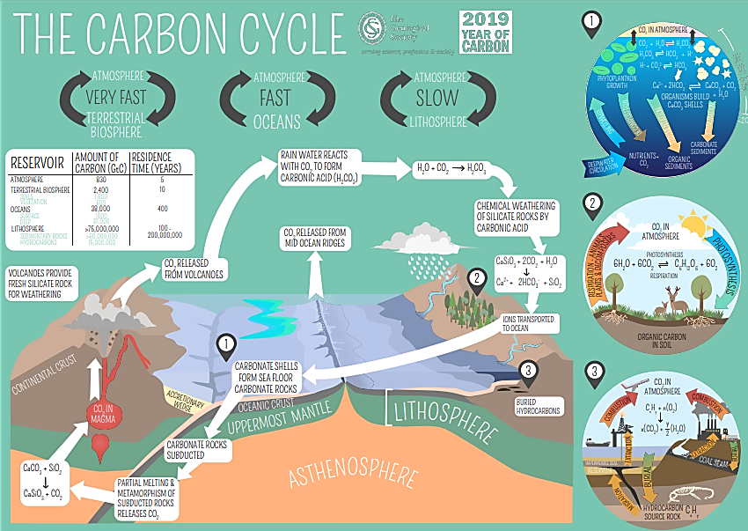
Natural Carbon Cycle And Sinks: More solutions
Notes:
https://youtu.be/dXBzFNEwoj8
geolsoc.org.uk/~/media/shared/documents/education%20and%20careers/Resources/Posters/Carbon%20cycle%20poster.pdf?la=en
p.7-8 https://www.geolsoc.org.uk/~/media/shared/documents/education%20and%20careers/Resources/Posters/Year%20of%20Carbon%20Images.pdf?la=en

Slide 20
Breakout Rooms – in every session; Action Groups at the end, for example:
Integrating CLT into teaching materials (also state your discipline)
Integrating CLT into university or business school strategy
Using CLT to create new courses
Extra-curricular/co-curricular uses
Research around climate literacy
Application to business organizations
KTP work
Influence government/governments
Other:

Slide 21
NTU Carbon Literacy Training Course
Climate change mitigation focused on solutions
Interactive teaching material
MIT Sloan & Climate Interactive Simulation tool
Certificates for you and your students
Please contact petra.molthan-hill@ntu.ac.uk for more info on this or the more specific training for business schools mentioned earlier.
www.ntu.ac.uk
Notes:
And if you are interested in the wider perspective on how to get everyone in the university carbon literate, NTU has made one of the two open-source tool kits for all staff and students at universities.

Slide 22
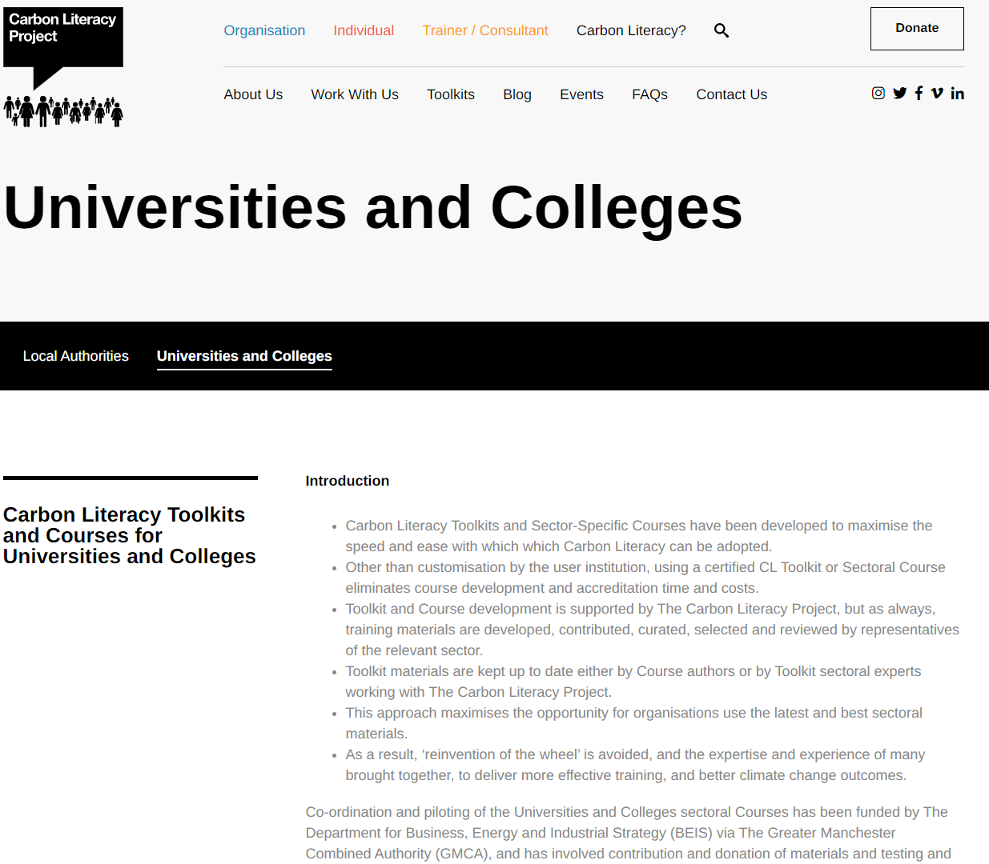
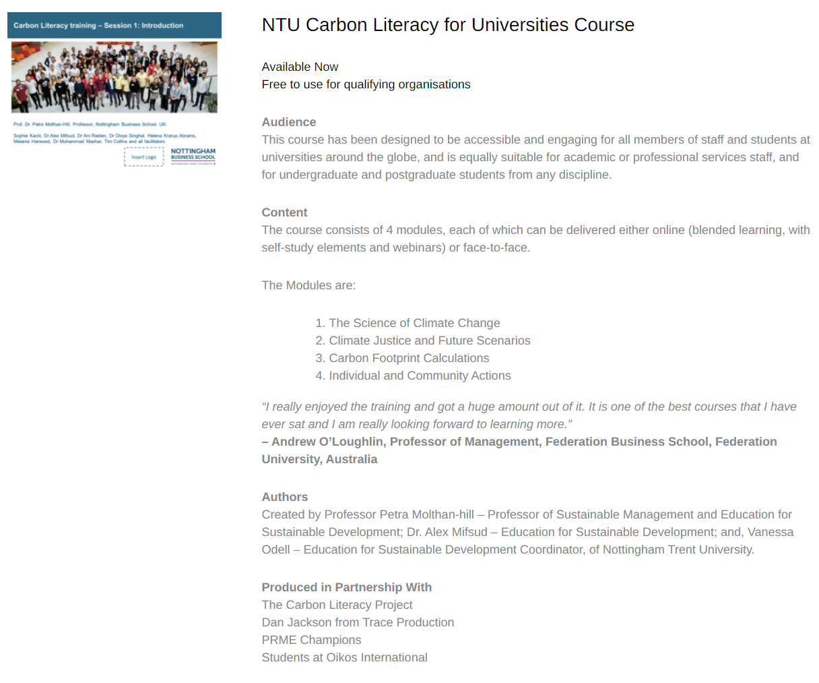
NTU Carbon Literacy Training Course
Please contact education@carbonliteracy.com to request this toolkit.
www.ntu.ac.uk
Notes:
And if you are interested in the wider perspective on how to get everyone in the university carbon literate, NTU has made one of the two open-source tool kits for all staff and students at universities. Lots of information about the resources via https://carbonliteracy.com/toolkits/universities-colleges/. Email education@carbonliteracy.com to request the toolkit.

Slide 23
Read about the Carbon Literacy Training
https://link.springer.com/referenceworkentry/10.1007/978-1-4614-6431-0_154-1

Slide 24
International work-related experience
Take part in a virtual international work-related experience. This opportunity is open to XXX to take part in Carbon Literacy training and work with XXXX As a part of this project you’ll learn about adapting to the culture in XXX in order to do this work and about climate solutions in general and especially for this part of the world. You’ll be fully trained as Carbon Literacy Trainers and receive an external work experience certificate by eduCCate Global https://www.educcateglobal.org/. If you decide to do the assessment form afterwards and pass it, you will also get an external Certificate by the Carbon Literacy Project in Manchester. Time Commitment: Takes place end of November – mid-December (you need to be available every Monday from 15.30-18.00 GMT on 30 November, 7 December, 14 December, 21 December) to take part in the actual virtual delivery to the teachers in XXX and every Thursday from 15.00-17.00 GMT to prepare the session virtually and to reflect on cultural diversity and different approaches (26 November, 3 December, 10 December 17 December). You might need 1-3 hours to prepare yourself in your own time depending on which task you choose as your responsibility. Total: Hours: 5 – 8 hours per week (over 4 weeks) Support: The Green Academy Team at NTU and NBS Professor Petra Molthan-Hill (an experienced Carbon Literacy Trainer) will support you as well as the CEO of eduCCate Global - Melanie Harwood. https://www.educcateglobal.org/ and https://www.ntu.ac.uk/about-us/sustainability/sustainability-in-education/carbon-literacy-training XXX Contact person if you are interested: GreenAcademy@ntu.ac.uk

Slide 25
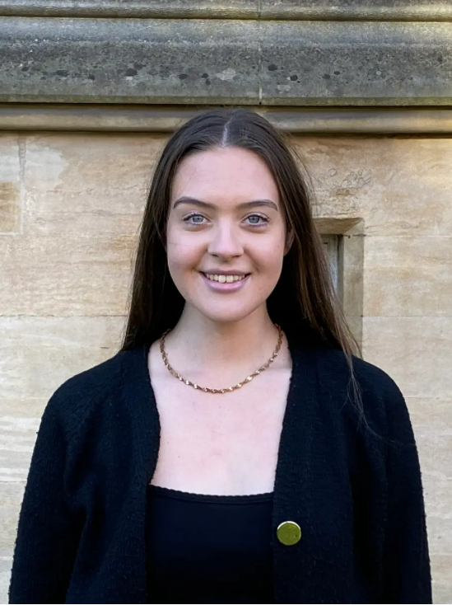



Watch our students talking about …
Sophie Adams
Watch Video Here
Connor Davey
Watch Video Here
Chloe Bottomley
Watch Video Here
Justyna Cuglewska
Watch Video Here

Slide 26
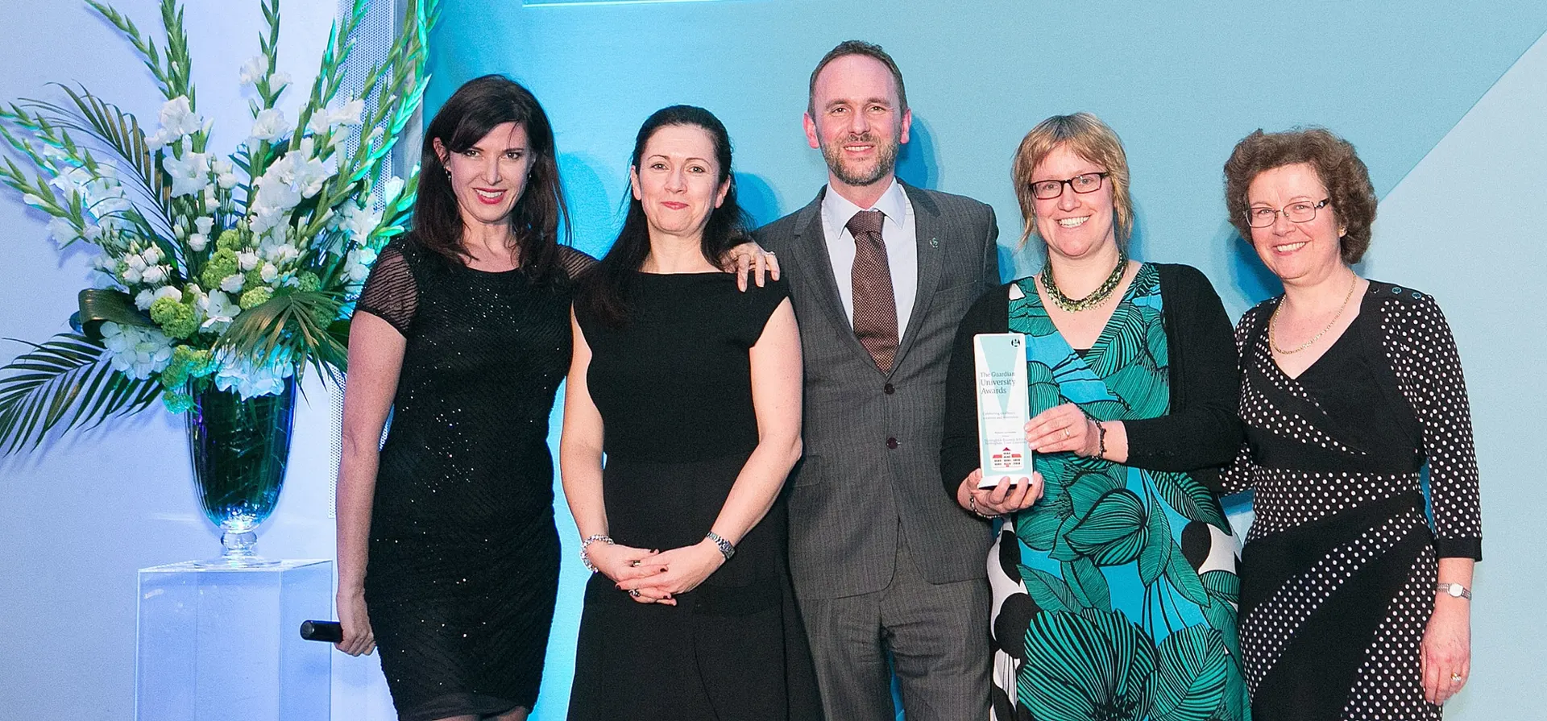
Students changing organisations as part of the core curriculum
Guardian Award 2015
MOLTHAN-HILL, P., ROBINSON, Z.P., HOPE, A., DHARMASASMITA, A. and MCMANUS, E., 2020. Reducing carbon emissions in business through Responsible Management Education: influence at the micro-, meso- and macro-levels. International Journal of Management Education, 18 (1): 100328. ISSN 1472-8117
https://www.theguardian.com/higher-education-network/gallery/2015/mar/19/guardian-university-awards-2015-winners-in-pictures

Slide 27
Join our next Carbon Literacy Training
All times 11:00am – 1:00pm EDT (16:00 – 18:00 BST)
Register to receive Zoom links:
  https://waynestate.az1.qualtrics.com/jfe/form/SV_5gpDLIHcrlw8GmG
September 10, 2021
September 17, 2021
September 24, 2021
October 1, 2021

Slide 28

Pass it on

Slide 29
Want to adapt any of our projects to your university?
Please contact Prof Dr Petra Molthan-Hill
petra.molthan-hill@ntu.ac.uk

