Slide 1
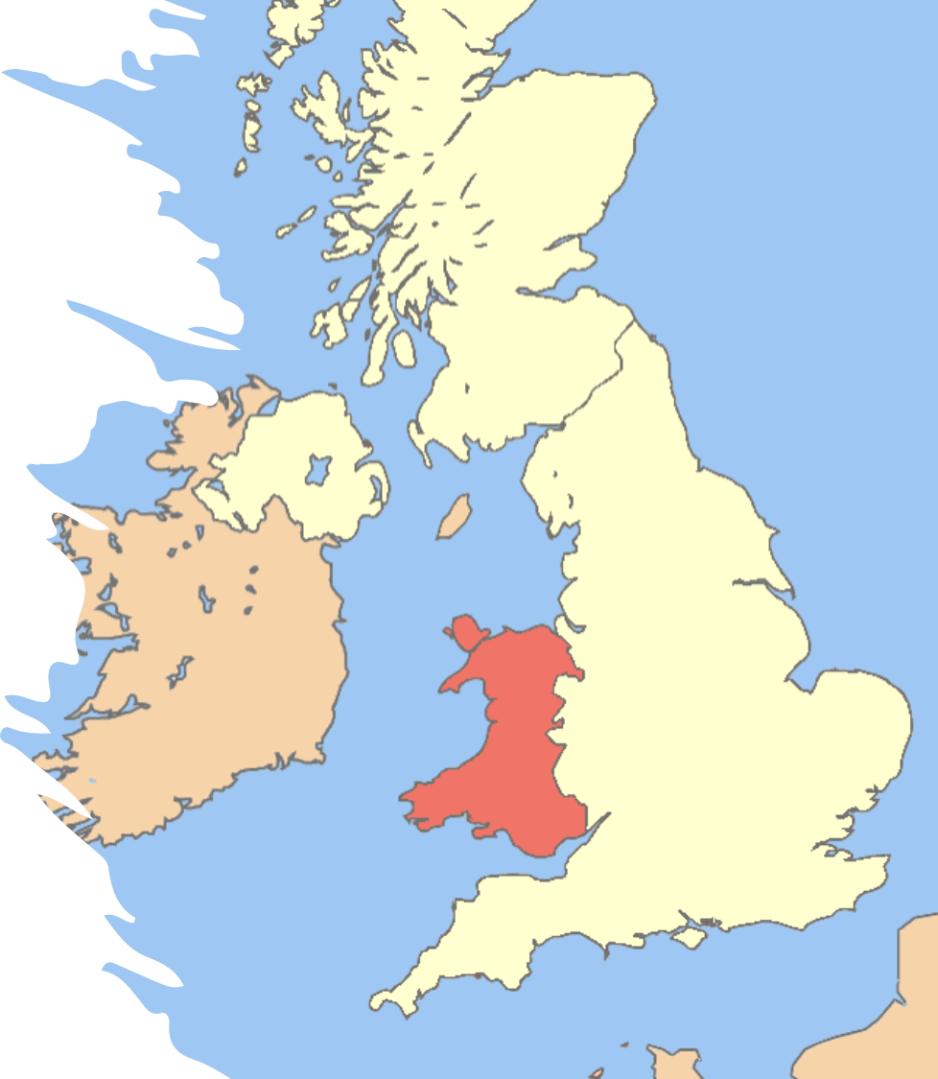
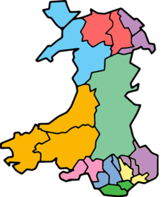
JUC PAC Annual Conference
The 8th Annual Public Management and Administration Doctoral Workshop
How Place Matter? Leadership, Governance and Public Administration
6th September 2021
Impacts of Austerity on Welsh Local Government Funding: Cuts to the Bone?
Bernard Kofi Dom
Supervisors
Dr. Martin Jones, Prof. Alan Collins, Prof. Peter Murphy
Nottingham Business School,
Nottingham Trent University.

Slide 2
RQ: How have Austerity policies affected the scale of reductions in revenue income for Welsh Local Authorities?
Why Welsh LAs?
A devolved administration, offering an opportunity to study phenomena in a national context.
Unlike England, all 22 LAs in Wales are unitary authorities, which makes them more easily comparable.
Welsh LAs have some similarities (and differences) with their English counterparts, which will ultimately allow for comparison between them at a later date.
This study forms part of a wider body of work looking at UK LA responses to austerity and the context of financial resilience (Barbera et al. 2017).
Research Aims
To investigate the scale of the cuts (reductions) - where there have been reductions in Welsh LAs’ funding over the time series (from 2005/06 to 2019/20)
To understand the changing trends in the principal sources of revenue to Welsh LAs by groups from 2005/06 to 2019/20
To examine decisions that Welsh LAs made to enhance financial resilience from 2005/06 to 2019/20

Slide 3



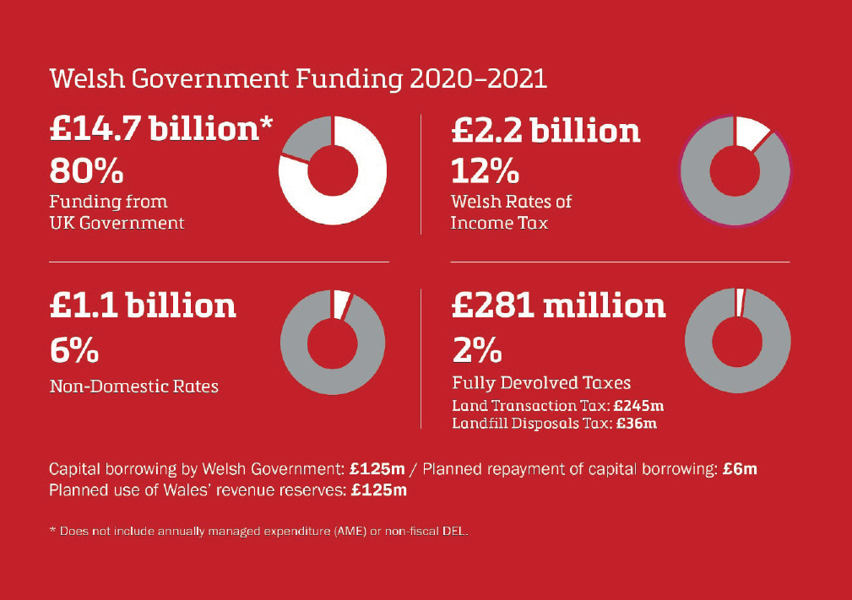
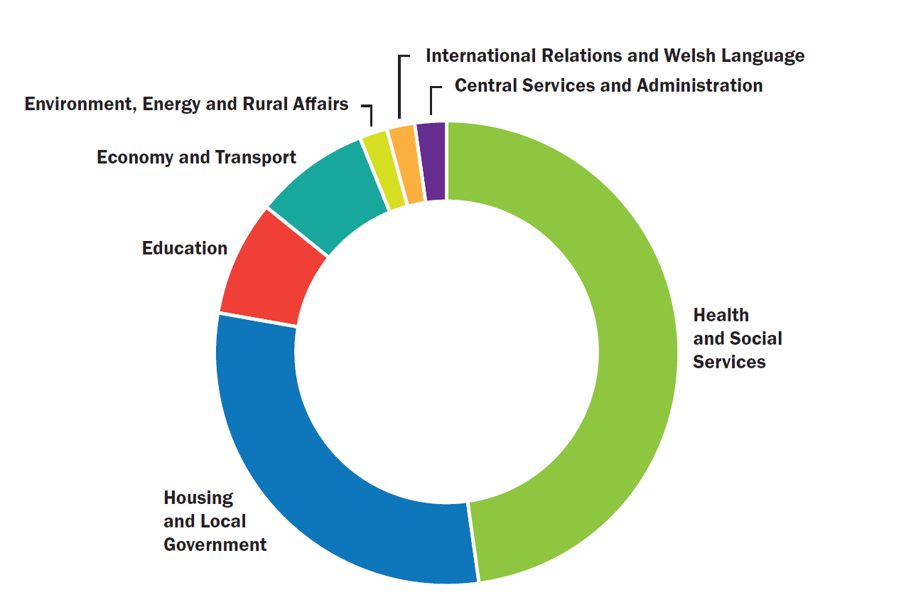
Context – Welsh Government Income & Expenditure
RSG (£3.3 Bn) and NDR (£1 Bn)
Barnett Formula £14.7 Bn
Other public expenditure

Slide 4
Welsh LA context
Studies have explored the state of Local Government Finance in Wales:
Often practice-oriented (Ogle et al. 2017; Ifan and Sion 2019; Downes and Taylor-Collins, 2019), but a few academic-oriented (Dollery and Wijeweera, 2010)
22 unitary authorities providing eight similar services
Barnett formula postponed the onset of austerity (HM Treasury 2010)
Austerity was not as severe in Wales as in England (Ogle et al. 2017; Downes and Taylor-Collins, 2019)
Some similarities with England, but also some differences (Education/NDR)
Good relationship between LAs and Welsh Government (Hay and Martin 2014; Ferry et al. 2017)
But ….. difficult decisions still to be taken at the local level – efficiency, investment and retrenchment (Downes and Taylor-Collins, 2019)
Increases in council tax were not sufficient to meet the funding gap (Ifan and Sion, 2019)
Notes:
Education, Social Care, Council Fund Housing& Housing benefits, Environment, Roads and Transport, Culture and related services, Planning and economic development, Other revenue expenditure
The Valleys (9), The southern Cities (3), The East of Wales (3), The Rest of Wales (7)

Slide 5
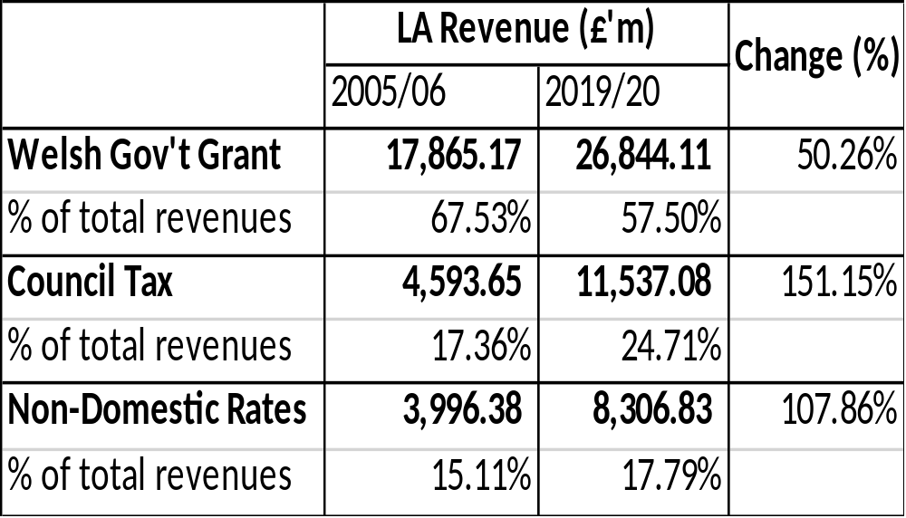
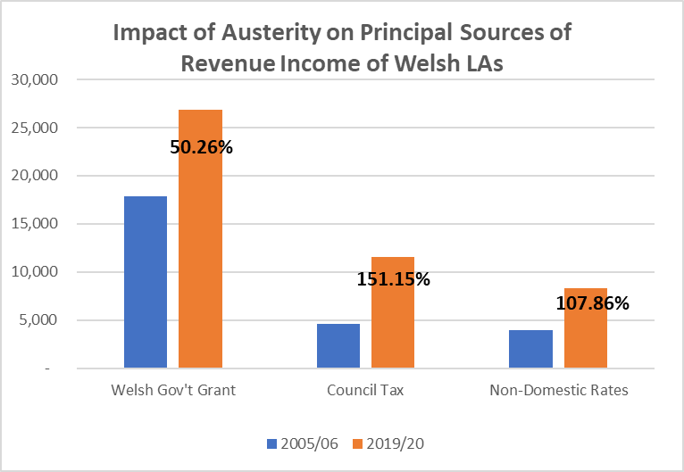
Context - Welsh LA Income
Council tax is an increasingly important source of income for councils….. Around the time of our interviews, the 2018-19 council tax rates had just been announced, with increases ranging from 3.3-12.5%. Discussion centred on whether councils were prepared to or had gone above the notional 5% ‘cap’ set by Welsh Government. Some councils told us that they couldn’t afford to keep below the cap, while others were critical of councils which had broken it. (Downe & Taylor-Collins, 2019)

Slide 6
Methodology and Methods
Exploratory approach – quantitative analysis (data disaggregation of RS/RO Forms)
The chapter investigated how austerity policies affected the revenue income of Welsh LAs’ and examined the decisions made to stay resilient during the time series (2005/06 to 2019/20).
LAs were grouped into four distinct regions, by similar characteristics, as used by Crawford et al. (2012);
Classified the longitudinal time series into three distinct eras:
  pre austerity (2005/6 to 2009/10)
  early austerity (2010/11 to 2014/15)
  post austerity (2015/16 to 2019/20)
The chapter analysed the principal sources of revenue income (Welsh Government Grants, Council Tax, and Business rates), which were converted to real term values, using the GDP deflator, with 2010/11 as the base year (widely regarded as the year that austerity started to bite in UK local government finance settlements).
Two analysis frames:
  a trend analysis was conducted to gain insights of how the various revenue types were affected in the time series – focus of presentation
  a proportionate analysis was made to examine how Welsh LAs have (re)prioritised the revenue sources in response to the increasing funding pressures during the time series.
Notes:
Aim: to investigate whether or not, LA regions (re)prioritised similar services for each era throughout the time series.

Slide 7
Results and Findings: Impacts of Austerity on Principal Income of Welsh LAs (2005/06 – 2009/10)
Year-on-Year Trends

Slide 8
Results and Findings: Trend Analysis on revenue sources for Welsh LAs by group - Pre-Austerity (2005/06 – 2009/10)

Slide 9
Results and Findings: Trend Analysis on revenue sources for Welsh LAs by group – Early Austerity (2010/11 – 2014/15)

Slide 10
Results and Findings: Trend Analysis on revenue sources for Welsh LAs by group – Late Austerity (2015/16 – 2019/20)

Slide 11
Significance of Findings
Scale of the cuts (reductions) - where are the reductions?
Reduction in WGGs but increases in CT and NDR
  Rebalancing of proportions, but WGGs still dominates
  Increases in CT and NDR insufficient to alleviate the need for cuts
Changing trends in the principal sources of revenue for Welsh LAs by groups
TV and TSC mobilised more business rates than council taxes in PA and EA Eras
  NEW and RoW mobilised more council taxes than NDRs (Business rates) in all Eras
Decisions
  Austerity had compelled Welsh LAs to adopt proactive and anticipatory approaches to enable financial resilience.
Notes:
Scale: The study found a continuous decline in government grants to Welsh LAs, although not as significant as it may be with English LAs. The decline compelled Welsh LAs to mobilise more council tax, and caused a continuous year-on-year (annual) increase in council tax mobilised by Welsh LAs, which resulted in positive trends in all three eras.
Decisions: It was evident that the implementation of austerity had compelled Welsh LAs to adopt proactive and anticipatory approaches to enable financial resilience. The strategies adopted in responding to pressures emerging from austerity continue to have a ripple effect on the ability, capacity, and capability of Welsh LAs to respond to future shocks and uncertain events/incidents. Hence, there are concerns of the continuous use of council tax increases as a permanent measure to enhance resilience in the long term.

Slide 12
References
Barbera, C., Jones, M., Korac, S., Saliterer, I. and Steccolini, I., 2017. Governmental financial resilience under austerity in Austria, England and Italy: how do local governments cope with financial shocks? Public Administration 95(3): 670-697.
Crawford, R., Joyce, R. and Phillips, D., 2012. Local government expenditure in Wales: recent trends and future pressures.
Dollery, B. and Wijeweera, A., 2010. An assessment of rate-pegging in New South Wales local government. Commonwealth Journal of Local Governance, pp.56-76.
Downes, J. and Taylor-Collins, E., 2019. At the tipping point? Welsh local government and austerity. June 2019.
Ferry, L. and Eckersley, P., 2011. Budgeting and governing for deficit reduction in the UK public sector: act one 'the Comprehensive Spending Review'. The Journal of Finance and Management in Public Services, 10(1), pp.14-23.
Ferry, L., Coombs, H. and Eckersley, P., 2017. Budgetary stewardship, innovation and working culture: Identifying the missing ingredient in English and Welsh local authorities’ recipes for austerity management. Financial Accountability & Management, 33(2), pp.220-243.
Hay, R. and Martin, S., 2014. Controlling local government spending: the implementation and impact of capping council taxes. Local Government Studies, 40(2), pp.224-239.
HM Treasury. 2010. Spending Review 2010. London, HM Treasury.
Ifan, G. and Sion, C. 2019. Cut to the bone? An analysis of Local Government finances in Wales, 2009-2010 to 2017-18 and the outlook to 2023-24. Cardiff, Wales Fiscal Analysis.
Ogle, Joseph, Daria Luchinskaya, and Michael Trickey. 2017. Austerity and Local Government in Wales: an analysis of income and spending priorities, 2009-10 to 2016-17. Cardiff: Wales Public Services 2025. Accessed December 02, 2018. Available at: http://www.walespublicservices2025.org.uk/2017/11/23/austerity-and-localgovernment-in-wales-an-analysis-of-income-and-spending-priorities-2009-10-to-2016-17/

