Slide 1

From Fire and Rescue Authorities to Police Fire and Crime Commissioners
A comparative study of governance and accountability arrangements in
English Fire and Rescue Services
8th Public Management and Administration Postgraduate Conference
6th September 2021
Katarzyna Lakoma
Supervisory team: Dr Pete Eckersley, Prof Pete Murphy, Dr Nestor Valero-Silva,

Slide 2
Governance
Governance - regimes of laws, rules, judicial decisions, and administrative practices that constrain, prescribe, and enable the provision of publicly supported goods and services (Lynn et al. 2001, p.7)
Governance - the process of steering society and the economy through collective action and in accordance with common goals (Torfing et al. 2012, p.14)
Inadequacies of traditional public sector provision
New Public Management and New Public Governance
Proliferation of new forms of public governance, e.g. networks, partnerships and collaborative arrangements (Klijn 2008)
Focus on exchange of resources, negotiations, and trust (Rhodes 2000, Ostrom and Walker 2003, Klijn et al. 2010).
Undermined democratic quality due to the influence of non-public actors, which could create power asymmetries (Papadopolulos 2003, Klijn and Skelcher 2007).

Slide 3
Accountability
“A chameleon-like concept” - various meanings to different people (Sinclair 1995)
A principal- agent relationship between the agent and the principal who can hold the agent to account for its behaviour and activity (Mayston 1993, Gailmard 2014).
The principal-agent theory is too formalistic due to its emphasis on hierarchical control and formal sanctions (Willems and Van Dooren 2012).
Multiple, different, changing, and often conflicting expectations within and outside public sector organisations (Acar et al. 2008, Willems and Van Dooren 2011, Glennon et al. 2019).
Thee constitutional and democratic functions of accountability have been sacrificed in the name of performance in the public sector resulting in an accountability gap (Barberis 1998)
Notes:
The primary purpose of accountability in this mode is to prevent agency drift through managing information asymmetry and moral hazard between the agent and the principal (Schillemans and Busuioc 2014)

Slide 4
The impact of governance on accountability
A better-governed world = more governance and more accountability (Pollitt and Hupe 2011).
Organisations largely enact their accountability through governance structures (March and Olsen 1983).
Traditional hierarchical governance models provide clear lines of accountability (Hirst 2000)
In new forms of governance accountability arises from the interplay of many actors, some of whom are not in hierarchical relationships.
It becomes increasingly challenging to establish who is accountable to whom and for what because decision-making is shared among multiple actors (Bevir 2009).
Notes:
Governance and accountability have been among the most-used concepts in the public administration literature. Previous studies have almost exclusively focused on the concepts separately
Previous research has shown that organisations largely enact their accountability through governance structures (March and Olsen 1983). The literature demonstrates that accountability tends to be considered in the context of governance, and that it can have different meanings under different governance models.

Slide 5
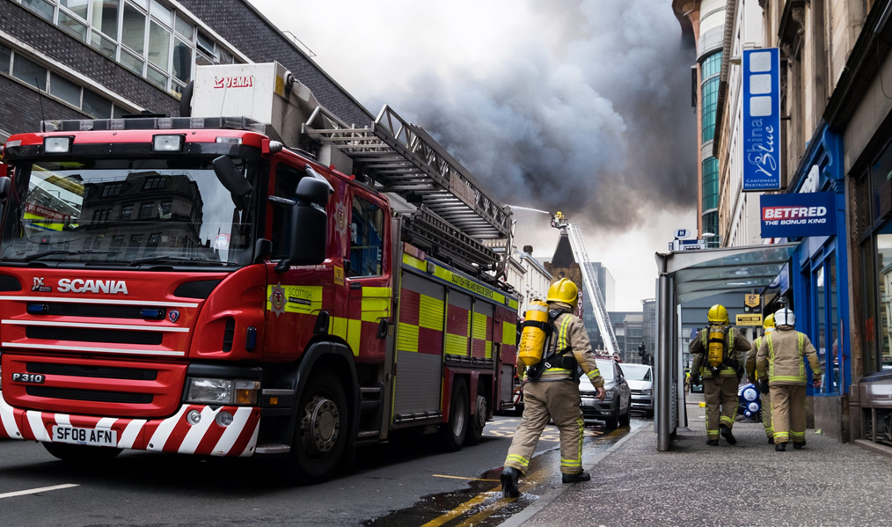
Research context
Under-researched public service – fire and rescue service
Traditional long-standing governance model of the local fire and rescue authority, made up of local councillors
Since 2017, an alternative governance model to improve accountability in practice
  Police and Crime Commissioners (PCCs) have been able to make a case to assume responsibility for the governance of fire and rescue services within their force areas and become Police, Fire and Crime Commissioners (PFCCs)
A patchwork of governance arrangements throughout England

Slide 6
Research Problem and Research Question
The relationship between governance and accountability has not been clearly presented in the literature and remains relatively vague
Little is known about the impact of the new governance models on perceptions of accountability within the fire service. Immaturity of the new governance arrangements (Murphy et al. 2019)
RQ: How do key stakeholders within the Fire and Rescue Services understand the notions of accountability and their implementation in the context of the traditional governance arrangements and the new PFCC arrangements introduced by the Policing and Crime Act 2017?

Slide 7
Research Design
Interpretivist epistemological approach | Uncovering the social construction of governance models and accountability that individuals create and are constrained by (Overman and Schillemans 2021)
Qualitative approach | Understanding the concepts from the individuals’ viewpoints (Bevir 2009)
Multiple case studies | A comparative multiple case study of governance models within fire and rescue services (Yin 2015)
Sampling | 6 out of 45 services Purposive sampling, “most different systems” design (Teune and Przeworski 1970)
Data collection | 38 semi-structured interviews with senior management, 5 focus groups with firefighters, publicly available online data
Data analysis | Thematic coding. A constant interplay between the data and the coding process to refine the themes and their subthemes.

Slide 8
Findings: traditional FRA arrangements
Decision-making is shared across FRA members (collective source of accountability)
“with the fire authority, at least you have a collective balance within the decision making, it’s not just the decision making of one person you know which could be you know at either end of a kind of spectrum“ (Case 1)
Limited scrutiny from the FRA
“So it was very difficult to distil an actual answer out of that fire authority because the elected officials, you know they were butchers and bakers and candlestick makers and now all of a sudden they were being talked to by the person who’s the chief fire officer” (Case 2)
Formal control is not seen as much of a priority with greater freedom given to the CFO
“The FRA defer to Chief Fire Officer as the subject matter expert and won’t challenge his strategic recommendations” (Case 1)
Less prone to conflicts with the CFO
“The chief fire officer gets relatively little direct scrutiny of their performance or their organisation’s performance” (Case 4)

Slide 9
Findings: New governance (PFCC) arrangements
Rapid decision-making (single source of accountability)
“Meetings become more structured, more detailed, there is the advantage that I’m experiencing over time of … on most parts decisions are made quicker, so there’s a bit more decisiveness having that single accountable person.” (Case 3)
An additional level of scrutiny from the PFCC
“We now have a commissioner that is very, very focused, switched on, asked some very difficult and awkward questions but quite rightly so because you know they drive efficiencies, they drive us to focus on particular areas of interest.“ (Case 4)
Greater control over the CFO
“You have a chief fire officer who’s giving professional advice at the moment to a PFCC who doesn’t take that advice… there is an example whereby, we’ve advised on a certain function of the fire and rescue service not being transferred to the police and that advice was not taken. So you know the PFCC overruled the chief fire officer and made that decision.” (Case 3)
Can become fractious because of conflict of interest between the PFCC and the CFO
“my main concern is still this whole operational independence for the chief fire officer, and obviously legislation hasn’t caught up with that, where we see how the chief constable has that operational independence from the commissioner, but we don’t. And there’s that conflict at times” (Case 2)
However, in one case the PFCC-CFO relationship quickly established a level of trust. This is because both the PFCC and the CFO sought to create a symbiotic and trusting relationship based on truth and honesty via informal accountability mechanisms.

Slide 10
Early Findings
Traditional fire authority governance
decision-making is shared across FRA members (collective source of accountability)
less prone to conflicts with the CFO
high level of trust
limited scrutiny from the FRA
formal control is not seen as much of a priority with greater freedom given to the CFO
New governance (PFCC governance)
rapid decision-making (single source of accountability)
can become fractious because of conflict of interest between the PFCC and the CFO
relatively low level trust
greater level of scrutiny
greater control over the agent = formal accountability arrangements
However, in one case the PFCC-CFO relationship quickly established a level of trust. This is because both the PFCC and the CFO sought to create a symbiotic and trusting relationship based on truth and honesty via informal accountability mechanisms.

Slide 11
Provisional conclusions
New accountability arrangements for Fire and Rescue Services in England are significantly more complex than the traditional arrangements.
Principal-agent relationships play a strong role in the fire and rescue service governance landscape.
Conflict is more likely when low levels of trusts are apparent, hence, more sophisticated control systems are in operation in such relationships. Similarly, if high levels of trusts are apparent, looser control systems are in place, and the conflict is less likely (Broadbent et al. 1996).
Clearer separation of responsibility between strategic governance by the elected politicians and operational decision-making by the chief fire officer is needed in the fire sector (however, it might blur accountability in some respects) (Davies and Johnson 2016).
Next step is to fully understand the implications of the 2017 Act (the new external inspectorate for fire and rescue services as well as the introduction of a duty to collaboration with other emergency services) on governance and accountability arrangements.
Notes:
Overall, the findings demonstrate that new accountability arrangements for Fire and Rescue Services in England are significantly more complex than the traditional arrangements. This is because many more governance structures and accountability mechanisms have been put in place, and it is not always clear to the internal stakeholders how roles and responsibilities are distributed across this landscape
If there is little trust and dialogue between two parties, formal accountability mechanisms will be more apparent as the principal will try to exert greater control over the agent and may lead to additional formal accountability mechanisms.

