Slide 1




POTENTIAL UNLOCKED: Examining the role of hope in the journey of desistance
DR VICTORIA KNIGHT (De Montfort University), DR SUSIE ATHERTON (University of Gloucestershire), Dr BEN CARPENTER VAN BARTHOLD (Nottingham Trent University)

Slide 2
Overview
Aims and ethos of Soft Touch Arts project
Relationship between role of practitioner and artist
Narratives of participants show importance of co-productive relationship in penal setting
The work continues……evolving relationships, the role of arts in penal reform.
Notes:
Encourages hope as well as creativity
Co production and different forms of hope

Slide 3
UNLOCKED: Research Focus
Interviews with people in the criminal justice system (prison and community) and key staff/stakeholders
The framework deployed in the analysis was the CHIME model (Leamy et al, 2011) – used in recovery-orientated research and practice:
(C) Connectedness
(H) Hope and optimism about the future
(I) Identity
(M) Meaning in life
(E) Empowerment
Aims to document different phases of artists journeys in prison and community settings, contribution of arts to their desistance.
Notes:
Clear focus on hope – an important aspect to this analysis, as a primary resource for change among prisoners, along with the social contagion affect which can occur in arts-based practices (Blumer, 1939; McPhail, 1989).

Slide 4
‘Outcomes’ of arts interventions
Brewster (2014) – USA research - increasing prisoners’ ability to self-regulate their emotions and work collaboratively with others.
Music-based education programme at HMP Dovegate and HMP Grendon - increase engagement with education through ‘Good Vibrations’ (Wilson et al, 2008).
Graham and White’s (2016) ‘forms of innovation’ - amelioration and accommodation’
Engage prisoners in activities alleviating harmful experiences of prison, while advocating for incremental changes to the regime
Re-examining the role of arts projects in prisons
Notes:
Good Vibrations - uses gamelan percussion music from Indonesia to empower people through creative involvement; also - improvements in communication and social skills, better relationships with staff and decreased levels of self-reported anger.
Benefits of the programme were specific to participating in creative activity and producing music, with staff being there to facilitate learning and include prisoners in this process (co-production of public performance)

Slide 5
Hope in the penal landscape
‘…hope is fueled by the perception of successful agency related goals.’ (Snyder et al 1991)
Imprisonment and community sanctions create ‘goal interference’ (ibid) by disrupting life course trajectories.
Limited agency and opportunities - hopelessness, diminished self-efficacy and optimism
Warr (2016) - confined become ‘frustrated at their lack of progress and feel despair towards an unknown and unknowable self.’ (p13)
‘Deprivation of certitude’ and loss of hope for the future.

Slide 6
Valuing facilitation and choice
Participant artists valued ethos – not seeking to teach or instruct, but to facilitate and co-produce – shift from formal social controls of prison regime (Behan, 2014).
Benefits - participants are brought together and learn about different styles of art, including digital, the artists appreciated this choice
Importance of choice for artists was clear, to develop their own approach based on their own preferences and abilities.
I’ve never been in a prison where this has been on offer. Drawing but digital is something else to the table… I’ve never been to a jail that has had this…
Notes:
Note the reference to prisoners as artists - changing their identity alongside providing new skills (crucial to desistance journey) and to encouraging participation, shift from the more oppressive controls they would experience day-to-day (Cheliotis and Jordanska, 2016).
Two important elements – the way in which this project was run - a safe space for novel activities – and creativity, but also cited as important, as was the sense of purpose and meaning these activities had to the artists (Hacking et al, 2008).

Slide 7
Hope As Self Care
All of the respondents both in prison and community settings noted the value of arts practice as a mechanism for self-care and coping:
Creative outlets initiated by the project lingered past the time spent with tutors – leading to positive social interactions and therapeutic relief to the monotonous prison regime:
When you are in your cell banged up, without creativity you can feel quite depressed and even suicidal, and you just want to get out so the creative side helps you to feel relaxed for a few hours a week….we all need to exercise our creative side
But the people who come here are carefree - it is very friendly because people are being creative. For the hour or two with the art class it is relaxing and we are encouraged to be creative. It’s the best way to kill time. Anything to make time go by and when you are in the moment you are not in prison - in yourself spiritually…. It’s a relief to come here.

Slide 8
Hope As Self Care
Hope as a protective feature, defined by deprivation (Warr, 2016), triggering positive emotional and behavioural changes:
Being here has helped me to stay positive. It has definitely helped my well-being. Right now, I have been learning to play the guitar and I never thought I could do that. It was a fixed closed mindset. ……..The staff on the wing - I now have a good rapport. I was angry at the system for this extra sentence. But now I have mellowed.
Also, changes in self-confidence:
Had a lot of low times ……I was single cell for a long time. I have ideas in my head and you are unsure…it’s different when you work with people. Makes you feel a lot more confident and somebody to go to….the support you get here is more personalized and makes you feel like a person. ….Different to the wing-person
Notes:
Value of the project in helping artists navigate prison life and manage their emotions, shifting from their ‘criminal past’ (Maruna, 2001; King 2012).
Importance of goal setting in sentencing planning - planning ahead an important outcome and evidence of working towards sustainable change and desistance (Wilson et al, 2008; Cheliotis and Jordanska, 2016).
Does not diminish the challenges which can lie ahead, including barriers to meaningful employment, secure housing and income security, all of which factor into desistance (Brandling and House, 2009; King, 2013).
Value of self-care is well documented in prison studies (e.g. Liebling 1999; Graham and White, 2016) - distinctiveness of the outcomes for the Soft Touch project is the recognition of the presence of hope, alongside valuing social interaction in a creative space.

Slide 9
Hope as aspiration
Community setting creating a space for hope and aspiration:
This is a creative place and creative people will come. When I leave here I realize how and I go back into society I realize how slave dead the mentality is - people get up and go to work- that is not living that’s existing. …….We are all creative and we could all be doing something. I have loads of positive feedback. My confidence and self-esteem has improved. Soft Touch is so valuable.
All of the respondents made a connection to their own wellbeing and ‘goal-setting behaviour’ (Snyder et al 1991):
I have calmed down since being here…........I am thinking of things I could do. Now I have confidence in myself. I feel more creative. I was good at art as a kid and now doing this the art and the music has calmed the beast in me. I’d like to think I could contribute somewhere. ….It gives you hopes and dreams and frees you from fears.
Notes:
Snyder et al (1991) state that ‘hope is fueled by the perception of successful agency related goals…the perceived availability of successful pathways related to goals’ (p570); individuals are able to see themselves (their agency) being able to do something and that the environment (pathways)
Helping artists to realize their own potential, presence of hope helps them overcome their fears, shifting from the prison space as solely a place of oppression and hopelessness (Liebling, 1999; Warr 2016).
Amelioration of these deprivations (Graham & White, 2016) are clear, and go beyond simply providing a change of setting.
Also aspiration for entirely different careers, such as construction and property development, starting a business, engaging with education and training.

Slide 10
Hope as aspiration
One artist was impressed by the project’s distinctiveness:
Never been into a workshop like this before, its just being here and its amazing. Being kind, being friendly, give them your help. I am good at making. I am really creative. Making stuff that I have never made before. I am more calmer, not getting any more trouble. Being safe. It’s not getting me into any more trouble. I have not had the police knocking on my door. Hopefully I am growing and growing. This place has helped me a lot, make friends and working up something I want to do and have an impact in the world. I want to get probation behind me.
Process of internal change and maturation (Maruna, 2001) as part of the desistance journey
Valuing safety and security and having a purpose.
Disrupts negative patterns of self-identity and hope serves as a crucial mechanism for transformation.

Slide 11
Hope as a mechanism for change
Accessing the project after release was also valued:
I feel positive about my release but apprehensive at the same time. When I leave I want to be able to use art in my free time and meet positive people in the area. Then I am not forced into old social circles until I am strong enough. They are not a negative influence but seeing those options is a big red flag to me. If I am around different people I will have their support.
The value placed on the project is propelled through hope instilled through engagement and interaction:
It’s keeping me out of trouble and focusing on my skills. Doing a lot more spraying and not illegally. I’d rather learn a skill now. I think of ideas for artwork. …… I could make a career of it easily. I’d still come to this if I wasn’t on probation. …. It’s not probation that keeps me here. Probation keeps me on probation. I have thought about getting into graphics.
Notes:
This reference to staying out of trouble reflects a clear process of change linking to desistance, becoming a person to contributes to society and being open to new opportunities.

Slide 12
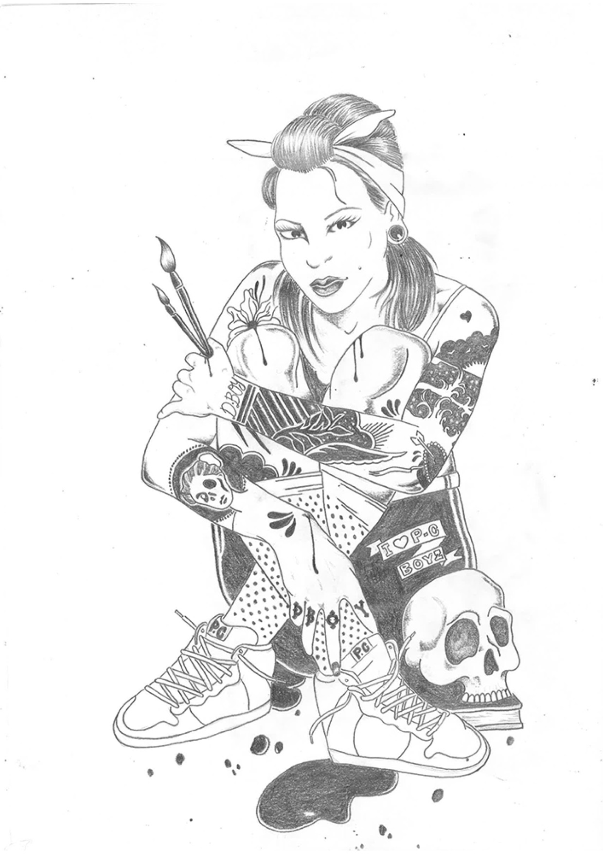
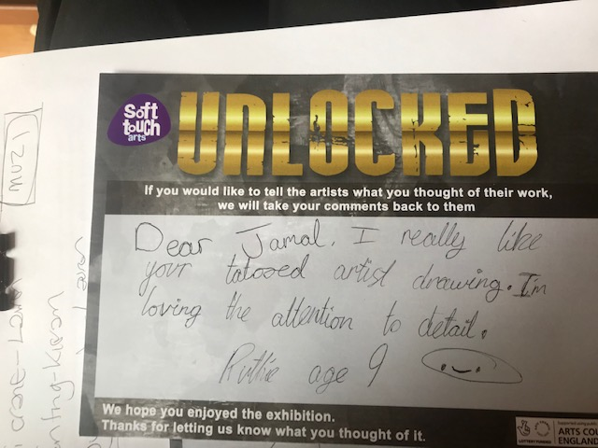
Notes:
The public display of their work and opportunity to get feedback demonstrates the emotional resilience built up among participants, who were able to show their creative skills and value other’s opinions (Wilson et al, 2008; Brewster, 2014).

Slide 13
Extending Hope - transference
Much like the prison experience of the arts project the value of the experience in the community was deemed extremely valuable:
Probation put me in touch with this place. Without that I wouldn’t have a life changing opportunity. That has now opened doors to go into schools to promote the knife crime project. Creativity – my hunger to progress. An opportunity to express my skills. Gave me confidence. An opportunity to create something that lasts a long time after I have gone. To work with genuine people.
Value of accessing a creative outlet, which as in prison, mitigated against the challenges they faced reintegrating into the community
Sustaining their changing self-identity, sense of hope and belonging (Stickley and Hui, 2012).

Slide 14
Extending Hope - transference
In prison, participants wanted more sessions and recognized rehabilitative impact:
Work in the prison shouldn’t stop them going to the art work. This is rehabilitation- it’s weird. An agreement should be set up to make sure people get here. They can’t hold people back. You should let people come.

Slide 15
The work continues…
  Moving from outcomes to process
  Focussing on the nature of creative exchange in prisons

Slide 16
An Anatomy of Art in Prisons
Art as punishment

Slide 17
An Anatomy of Art in Prisons
Art as punishment
Art as exploitation

Slide 18
An Anatomy of Art in Prisons
Art as punishment
Art as exploitation
Art as campaign

Slide 19
An Anatomy of Art in Prisons
Art as punishment
Art as exploitation
Art as campaign
Art as co-creation

Slide 20
An Anatomy of Art in Prisons
Art as punishment: done to prisoners
Art as exploitation: done from prisoners
Art as campaign: done for prisoners
Art as co-creation: done with prisoners

