Slide 1

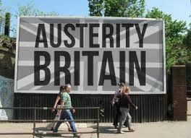
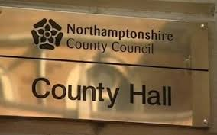

European Group for Public Administration
Conference
Queen’s University, Belfast – 11th - 13th September, 2019.
Perceiving Financial Vulnerability: Investigating Northamptonshire County Council through the Lens of Financial Resilience
Martin JONES, Bernard Kofi DOM and Peter MURPHY
Nottingham Business School, Nottingham Trent University

Slide 2

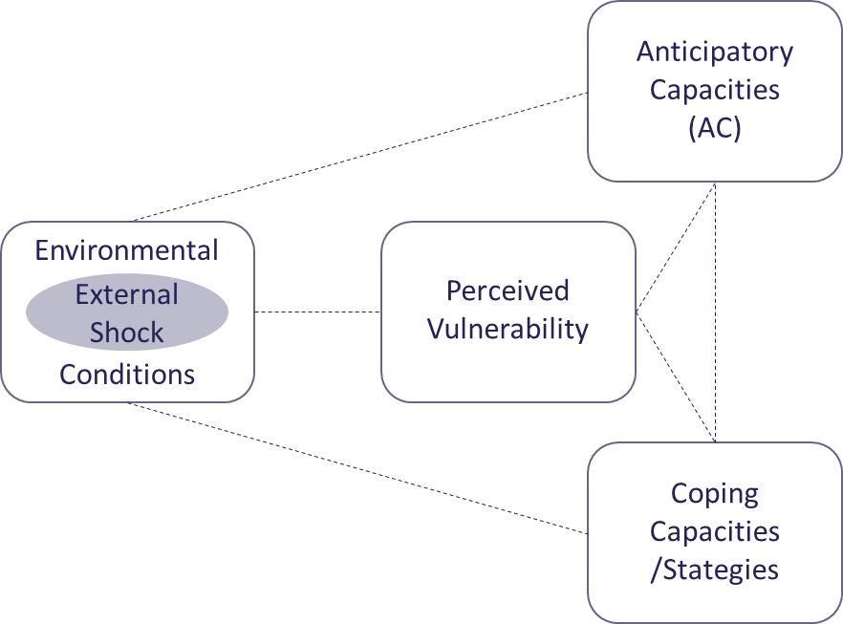
Overview
Outline
Positioning Perceived Financial Vulnerability
Literature
Methodology
Why Northamptonshire?
The Northamptonshire Case
Initial Findings
Next steps

Slide 3
Outline
NCC’s case presents an opportunity for research related to financial resilience and perceived financial vulnerability
The issuing of two Section 114 notices in quick succession indicated a potential misunderstanding within the organisation of its financial position
Not the first signs of financial management problems with the Council
It was possible to investigate the public record back to 2002
In view of this background, this paper will utilise the lens of financial resilience to examine how Northamptonshire County Council perceived its financial vulnerability during the years leading up to February 2018
Aim - to better understand the process of perceiving financial vulnerability and how this informs decision making

Slide 4
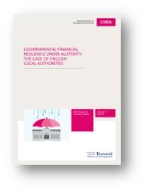
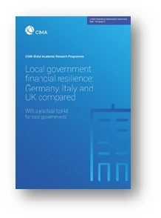
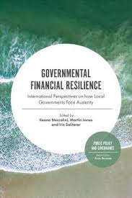
Local Government Financial Resilience
Barbera C, Jones M and Steccolini I (2015) Governmental Financial Resilience Under Austerity: The Case of English Local Authorities. CIMA Executive Summary Report.
Barbera, C., Jones, M., Korac, S., Saliterer, I., & Steccolini, I. (2017). Governmental financial resilience under austerity in Austria, England and Italy: how do local governments cope with financial shocks? Public Administration, 1–38.
Steccolini I, Jones M and Saliterer I (eds) (2017) Governmental Financial Resilience: International Perspectives on how Local Governments Face Austerity. Bingley: Emerald Group Publishing.
Barbera, C., Jones, M., Korac, S., Saliterer, I. & Steccolini, I., (2019). ‘Local Government Strategies in the Face of Shocks and Crises: the Role of Anticipatory Capacities and Financial Vulnerability. International Review of Administrative Sciences. ISSN 0020-8523.
Barbera, C., Jones, M., Korac, S., Saliterer, I. & Steccolini, I., (2019). Local government financial resilience: Germany, Italy and UK compared CIMA Executive Summary Report.

Slide 5
Positioning Financial Vulnerability
Anticipatory Capacities
(AC)
Self-regulators
Constrained Adapters
Reactive Adapters
Contented Fatalists
Powerless Fatalists
Environmental
Conditions
Perceived Vulnerability
External Shock
Patterns of Financial Resilience
Coping Capacities
/Stategies
(Carmela Barbera, Martin Jones, Sanja Korac, Iris Saliterer, Ileana Steccolini, “Governmental financial resilience under austerity in Austria, England and Italy: How do local governments cope with financial shocks?”, Public Administration, DOI: 10.1111/padm.12350)

Slide 6
Positioning Financial Vulnerability
Anticipatory Capacities
(AC)
Self-regulators
Constrained Adapters
Reactive Adapters
Contented Fatalists
Powerless Fatalists
UK LGs found to be Self-regulators or Constrained Adaptors
Environmental
Conditions
Perceived Vulnerability
External Shock
Patterns of Financial Resilience
Coping Capacities
(CC)
(Carmela Barbera, Martin Jones, Sanja Korac, Iris Saliterer, Ileana Steccolini, “Governmental financial resilience under austerity in Austria, England and Italy: How do local governments cope with financial shocks?”, Public Administration, DOI: 10.1111/padm.12350)

Slide 7
Conceptualising ‘Perceived Vulnerability’
What we know
Vulnerability - the level of exposure to shocks (McManus et al., 2007)
The interface between the Environment and the Organisation (Barbera et al, 2019)
The sense of being able to control vulnerability and/or influence its sources affects the way shocks are interpreted (Barbera et al., 2017)
Local government sources of financial vulnerability are both:
  External (Grants, regulations, environmental conditions..)
  Internal (Debt financing, reserves, history, capability and capacity..)
  (Barbera et al, 2019)

Slide 8
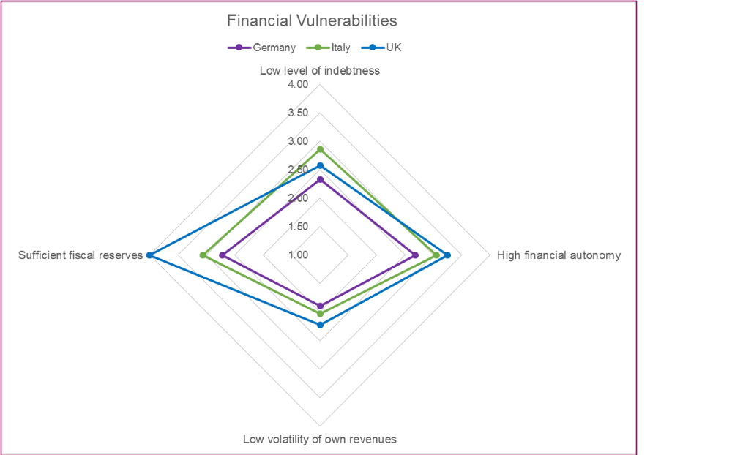
Perceived Vulnerability
Responses of 600 LGs in Germany, Italy and UK
Overall, UK LGs appear to view themselves as less vulnerable than their German and Italian counterparts
Medium position for level of debt and volatility of own revenues
Strong view of level of reserves and financial autonomy
Barbera, C., Jones, M., Korac, S., Saliterer, I. & Steccolini, I., (2019). Local government financial resilience: Germany, Italy and UK compared CIMA Executive Summary Report.

Slide 9
Conceptualising ‘Perceived Vulnerability’
Bouncing back and bouncing forward strategies are explained by different factors.
Bouncing back strategies (buffering, retrenchment etc) are likely to be found in the presence of high levels of perceived financial vulnerability.
Conversely, bouncing forward strategies (transformation and adaptation) appear to be positively associated with the presence of strong anticipatory capacities and to be hindered by high levels of financial vulnerability.
Perceptions of high financial vulnerability are central in explaining reliance on bouncing back strategies.
Hence, LGs perceiving their financial conditions as being difficult will be less likely to embark on bouncing forward actions.
Barbera, C., Jones, M., Korac, S., Saliterer, I. & Steccolini, I., (2019). ‘Local Government Strategies in the Face of Shocks and Crises: the Role of Anticipatory Capacities and Financial Vulnerability. International Review of Administrative Sciences. ISSN 0020-8523.

Slide 10
Conceptualising ‘Perceived Vulnerability’
What we want to develop……
Health/Psychology Related Models? – linked to contracting illnesses
Precautionary behavior is linked to perceived vulnerability to developing a health problem – cost/benefit
But....
Perception is a cognitive combination of likelihood & potential consequences
Bias occurs due to:
  …. availability/prominence of information….
  .… and motivational factors leading to denial and ignoring information
Perception of vulnerability is a necessary pre-cursor for change but does not necessarily induce change

Slide 11
Conceptualising ‘Perceived Vulnerability’
What we want to develop……
Perceived Vulnerability – Linked to Unrealistic Optimism:
  Tendency to underestimate own vulnerability
  Optimistic biases lead to less protective action or higher risks
  Representative Heuristic (stereotyping) – “it doesn’t apply to my group”
  Availability Heuristic (publication) – “I’ve not heard of that happening before”
  Causal attributions (controllability) – “I’m in control of this”
  Protecting self-esteem (exaggeration) – “I’ve got out of worse situations…”
  (Weinstein in Lek and Bishop, 1995)

Slide 12
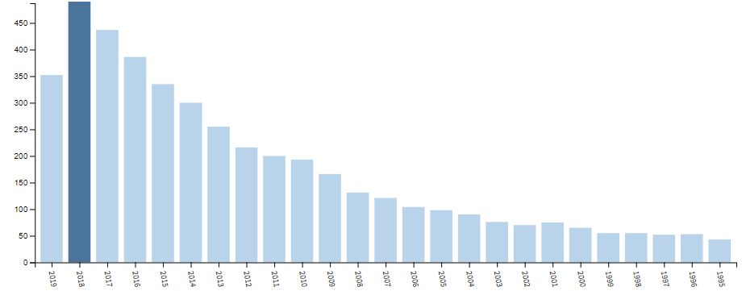
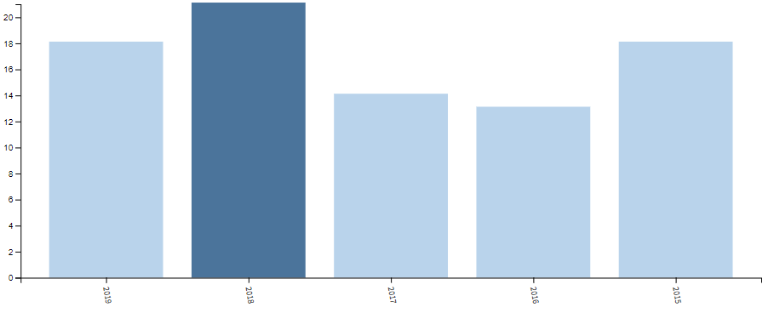
Initial Systematic Review of Literature – Web of Science
Perceived Vulnerability – some 4,500 responses
By subject/discipline 203 papers, around 50% since 2015
– Management (61), Business (54), Economics (50), Social Studies (21), Public Administration (17)
2019
2018
2017
2016
2015

Slide 13
Methodology and Methods
Longitudinal case study – 2002 to 2019
“Deviant Case” analysis (Gerring, 2008)
  Goes against previous findings
  what can we learn from this?
  Can findings be re-applied in a wider financial resilience context?
Qualitative document analysis; Largely deductive, but scope for inductive
Using archival data from :
Financial data held by the UK government – RO/CO returns etc
External audit and other inspection reports
NCC’s published accounts
NCC’s peer assessments and other council reports (CPA/CAA reports & LGA)
Best Value Inspection report – Max Caller Report 2018
Published proceedings from the council’s meetings
Press coverage – especially public sector financial press

Slide 14
Why Northamptonshire County Council (NCC)?
First English Authority to issue a section “114 notice” in two decades
  Section 114 of Local Government Finance Act 1988 – unlawful expenditure
Not only one but two Section 114 notices within 6 months
We have a suspicion that NCC may not have perceived their financial vulnerability correctly…………..

Slide 15
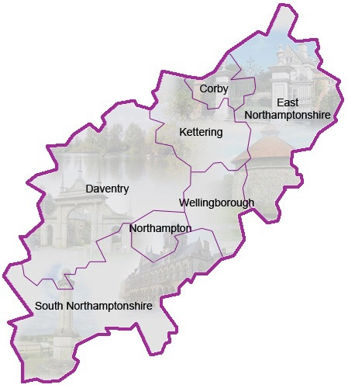
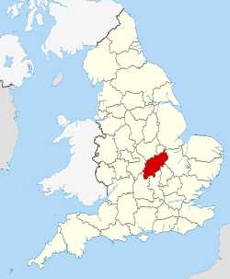

NCC Local Government: Organisational Capacity
Northamptonshire is a key part of Milton Keynes/South Midlands Growth Area
Lowest average CPA scores of any county group of districts
Highest proportion of small councils in any county (6 out of 7)
Northampton Borough Council (largest district council in the country) and Corby DC were both ‘poor’ and subject to government intervention between 2003 and 2008

Slide 16
Contextual Issues – A Deviant Case?
Previous poor performance under CPA – since 2002
History of failed strategic/structural change implementation
LGSS – A shared service model where all finance staff were outside the council except the section 151 officer
"Next Generation Model" - outsource all services and create new bodies covering child protection, care of vulnerable adults, health provision and "improving the county". Owned by the authority but charge a fixed fee for services. Subsequently brought back in house.
Low council tax rates and a policy of not increasing them
Claim to be poorly funded from central government due to floored population statistics

Slide 17
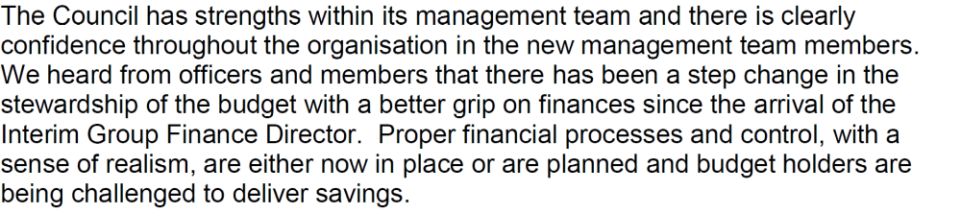
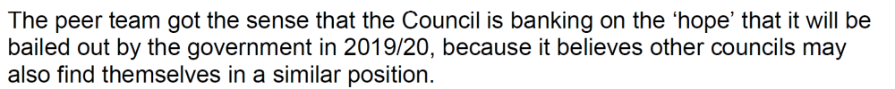
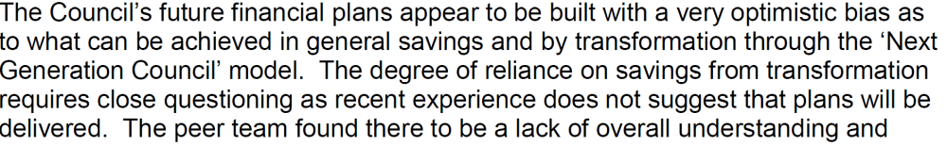
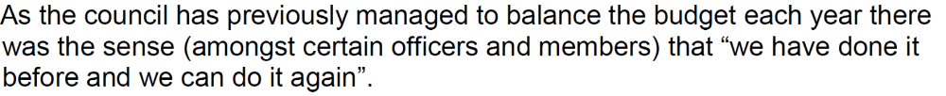
LGA Peer Inspection 2017

Slide 18
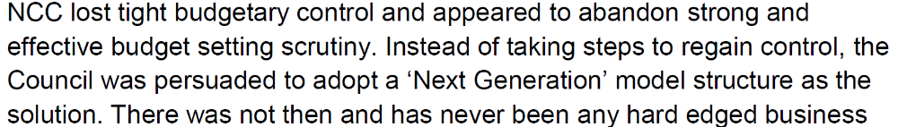
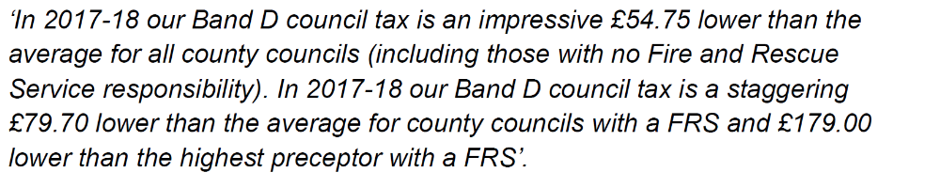
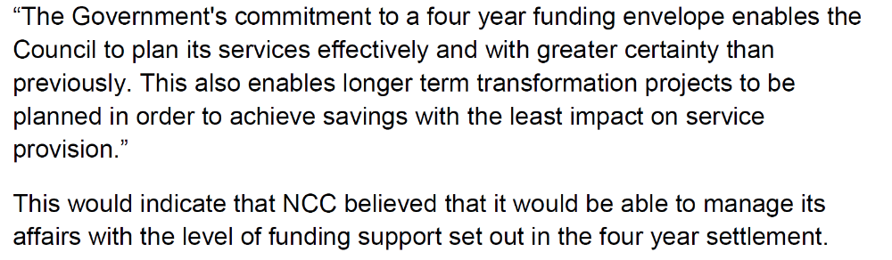
Best Value Inspection - 2018

Slide 19
Brief Summary of NCC Timeline
Pre-Section 114 Issue
The Northamptonshire County Council’s (NCC’s) financial failure was not a shock
Poor CPA performance since 2002 – including use of resources
Poor Financial Management – KPMG
LGA peer review findings
Gov’t’ Intervenes: Communities Secretary sends Special Inspectors to NCC for an internal scrutiny – subsequent Best Value review – not delivering Best Value
Section 114 notice issued – February 2018 (first in 2 decades)
Core service budget put in place
However……. The outgoing chief finance officer reported
“Services were asked…to come up with meaningful further in-year savings proposals.
“No realistic proposals, other than the mitigation of existing pressures, were provided and so I must assume that this process is unlikely to yield additional savings.”
He added that the council “has no financial resilience” and that the budget target of using £30.9m of capital receipts as revenue funding under government transformational expenditure rules was “unlikely to be achieved in full”.
Second Section 114 notice issued – July 2018

Slide 20
Pre-recession Era (2002 to 2010)
2002 - NCC provided ‘weak’ services at a slow improvement pace
2003 - NCC had an improved ‘financial control and management’ score which suggested a better financial positioning, but systems were still weak
2004 - NCC provided slightly improved services that were rated ‘fair’
2005 - NCC had the 14th lowest score out of the 150 Single Tier and County Councils (STCCs) and struggled to improve its priority services.
2007 - Poor programme, and performance management led to a further review of NCC’s Integrated Change Programme (ICP)
2008 - NCC made some progress by implementing improvement plans to sustain efficiency in service delivery
2009 - NCC adopted governance structures and leadership processes that proved unsuccessful, rated them 2 out of 4 for Use of Resources
2010 - NCC’s external auditors (KPMG) issued “an unqualified” audit verdict - referred to NCC’s financial reporting processes as “unrecognisable compared to 2007/08” but still included 17 significant adjustments (valued at £107m) to balance the books

Slide 21
Post-recession Era (2010 to 2016/17)
2010 - Reduced Revenue Service Grants (RSGs) affected NCC’s (and most English LAs’) spending on core services
2011 - KPMG reported that NCC had failed to address issues outlined in previous audits
2012 - KPMG reported that NCC lacked expertise in financial reporting and management, which affected the quality of specific accounting areas
2014 - NCC confirmed an £8.5m unadjusted audit error, which remained unadjusted and NCC failed to correct it
2015 - NCC faced challenges in meeting service demands due to a budget deficit of £415m
2015/16 - NCC developed a ‘New Generation Model’ (NGM) to avoid escalating costs and produce savings of £96.7m
2017 - An LGA peer Review highlighted that NCC engaged in retrenchment to solve long-term problems - due to the excessive use of earmarked reserves
2018 – All services were brought back in-house after the NGM failed to materialise

Slide 22
Council Use of Reserves since 2015

Slide 23
Section 114 Notice(s) and to date
January 2018 – Communities secretary sends inspector to investigate the NCC’s financial management
February 2018 – NCC issues first Section 114 after depleting limited reserves led to an unlawful budget
July, 2018 – NCC issues second Section 114 with a budget deficit of £70m
January 2019 – NCC gets green light to raise council tax by 5% in 2019/20
May 2019 – NCC makes ‘unprecedented’ in-year turnaround budget surplus of £1m
July 2019 – NCC declares a budget surplus of £4.5m
2018/2019 – Flexible use of capital Receipt strategy to support future medium term savings -enable cost avoidance on demand led services and improve the effectiveness of service delivery
  Not used powers to convert capital receipts to revenue
  Rebuilding reserves
  NCC & seven lower-tier districts will be replaced by two unitary authorities in April 2021

Slide 24
Emerging Findings
Section 114 notice was a consequence of longer-term accumulated weaknesses of NCC
Early warning signs that continual retrenchment not adequate for NCC in the long run
Weak financial position due to financial mismanagement by NCC’s Leadership – KPMG
The potential of retrenchment had virtually become exhausted ……………….
………………….leading to unsustainable levels of reserves.
NCC had high levels of external vulnerability in line with other council during austerity
Embarked on ambitious transformations more suited to strong internal capacities and realistic understanding of perceived vulnerabilities IRAS and PA links
Coping capacities Buffering/Adapting/Transforming – misapplied due to misperception?
Lack of transparency of information to key decision makers masked problems
Optimism bias appears to be a factor

Slide 25
Next steps
Finalise methodology
  Documents only?
  Interviews – NCC/Oversight Bodies/Key Stakeholders?
Settle on conceptual framework
  Is there one out there we can borrow…….
  Strategy……
  Social sciences…….
Single case or comparative study?

Slide 26


Slide 27
Other References
Lek Y and Bishop G (1995) Perceived Vulnerability to Illness Threats: The Role of Disease type, risk factor perception and attributions, Psychology and Health, Vol 10, pp205-217
McManus S, Seville E, Brunsden D, and Vargo J (2007) Resilience management: a framework for assessing and improving the resilience of organisations. Report, Resilient Organisations Programme, New Zealand.

Slide 28
Sources of Financial Vulnerability
INTERNAL | EXTERNAL
Northamptonshire clearly had high levels of external vulnerability in line with other council during austerity
Embarked on ambitious change programmes/transformations more suited to strong internal capacities which it did not have and misunderstood…. IRAS and PA links
Coping capacities Buffering/Adapting/transforming – were misapplied?
Lack of transparency of information to key decision makers masked problems
Optimism bias appears to be a factor

Slide 29
Sources |  | Perception Based
Internal | External | Optimism Bias | ?? | ?? Buffering Adapting Transforming

