Slide 1
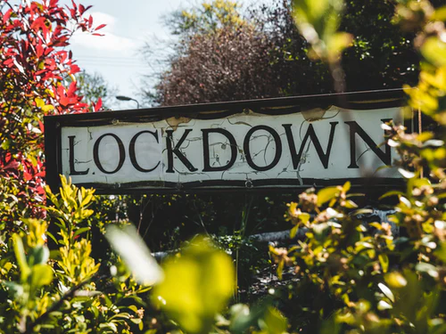
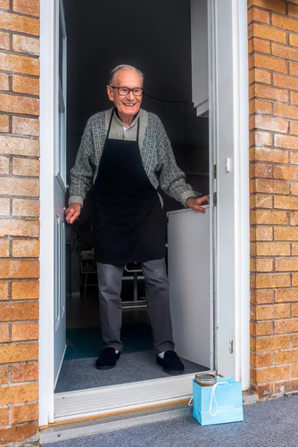
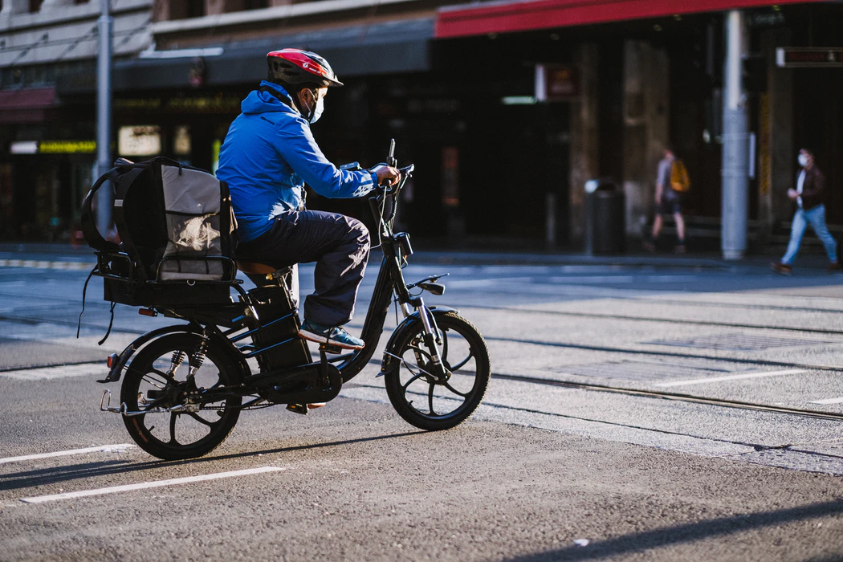
Mhairi Bowe, Juliet R.H. Wakefield, Blerina Kellezi, Clifford Stevenson, Niamh McNamara, Bethany A. Jones, Alex Sumich, & Nadja Heym (2021)
Journal of Community and Applied Social Psychology
The mental health benefits of community helping during crisis: Coordinated helping, community identification, and sense of unity during the COVID-19 pandemic

Slide 2
Statement of Relevance
The study presented in this article reveals the relationships between engagement in organised community helping, increased well-being, and reduced depression and anxiety during the COVID-19 pandemic. The study uses the Social Identity Approach to Health to illustrate how the sense of social connection resulting from helping other community members during the pandemic is related to increased community connection in the form of increased identification with the community and a sense of unity with others. In turn, these increases in psychological connection are linked with positive mental health outcomes. These findings suggest taking part in coordinated community helping not only helps vulnerable community members, but can also help community volunteers by providing valuable social connection during a period of crisis characterised by physical separation.

Slide 3
Community Volunteering and Mental Health
There are well-established links between volunteering, increased well-being, and reductions in mental ill-health, but existing research has typically understood volunteering and its outcomes in individualistic terms, e.g., relating to personality predictors or personal motives.
Our recent research shows that volunteering can be motivated by existing commitment to the community but it can also help build and strengthen a sense of ‘identification’ with one’s community: a sense of belonging to the community and psychological connection with other community members.
The Social Identity Approach to Health or ‘Social Cure’ Theory argues that identification with meaningful groups can improve health by unlocking valuable psychological resources such as perceived support.
In line with this, our previous research shows that community volunteering that operates in relation to shared group identities (communities or voluntary organisations) is connected with better well-being and intentions to remain a volunteer in the future.
This study explored whether these processes can occur during the unique circumstances resulting from the COVID-19 pandemic, to respond to calls for research to promote the health and well-being of community members during lockdown and to guide sustainable aid delivery solutions.

Slide 4
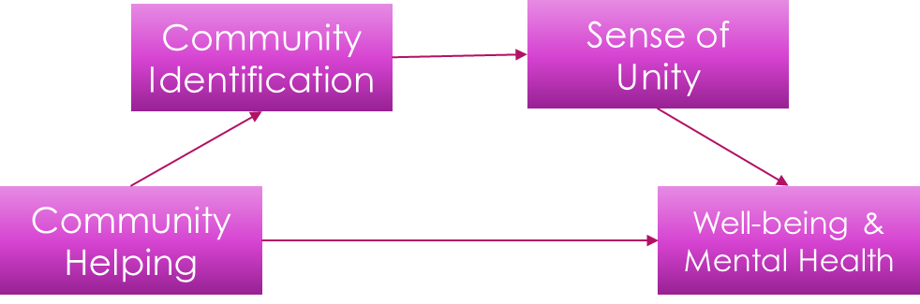
Our results
A survey of community members conducted in the UK in June 2020 showed that:
Taking part in pandemic-related, coordinated community helping was linked with a greater sense of identification (belonging and connection) with the participants’ community
This sense of community identification was linked with an increased sense of unity during the pandemic
The expected connection between voluntary helping during the pandemic and increased well-being, reduced depression and reduced anxiety was fully explained by increases in these feelings of community social connection and unity

Slide 5

Implications for communities and voluntary responses to crisis
Community-based volunteering activities bond individuals with fellow volunteers and community members benefiting their health and well-being, as well as providing a resource to aid those in need within the community
These coordinated community responses are vital to management of crises such as the COVID-19 pandemic
They are also critical for maintaining supportive and resilient communities beyond the pandemic
Community members should therefore be supported to take part in volunteering and made aware of the potential benefits
Local and national government bodies should work to support and resource existing community volunteering organisations and novel groups, e.g., mutual aid groups, and work in collaborative partnerships with them
Volunteering groups and organisations should work towards fostering a sense of belonging and shared group membership between volunteers to enhance the rewards of taking part and encourage sustained and satisfying volunteering behaviours

