Slide 1

Suicide risk after prison or recall

Slide 2
Suicide risk under supervision
There is some evidence in the UK that there is a raised risk of suicide after imprisonment (although not consistent in every country)
Those under probation supervision have higher rates of suicide than the general population and also higher than those in prison custody (Jones and Maynard, 2013; Phillips et al., 2018).
Probationers are at heightened risk of suicide in the early weeks after leaving prison (Sattar, 2001; Pratt et al., 2006).
We know from our own data that about 1 in 3 of self-inflicted deaths are apparent suicides and this is probably over 100 every year.

Slide 3
Recall/Breach and Suicide
Interviews with 0ffenders on probation who had attempted suicide, identified key times which raised their risk – including if they were about to be recalled to prison because of a breach of probation conditions or had reached the end of their probation sentence (MacKenzie et al., 2018)
Another study looking at suicides in offenders under supervision (across London), found that 64% (of the 28 cases) were recorded as receiving one or more enforcement warning letters following missed appointments during the supervision period, or were returned to court for failing to meet the requirements of their sentence.
Furthermore, 54% of the deaths took place within a month of warnings or breaches, with half of these actually within a week or less. (Borrill, Cook and Beck, 2017).

Slide 4
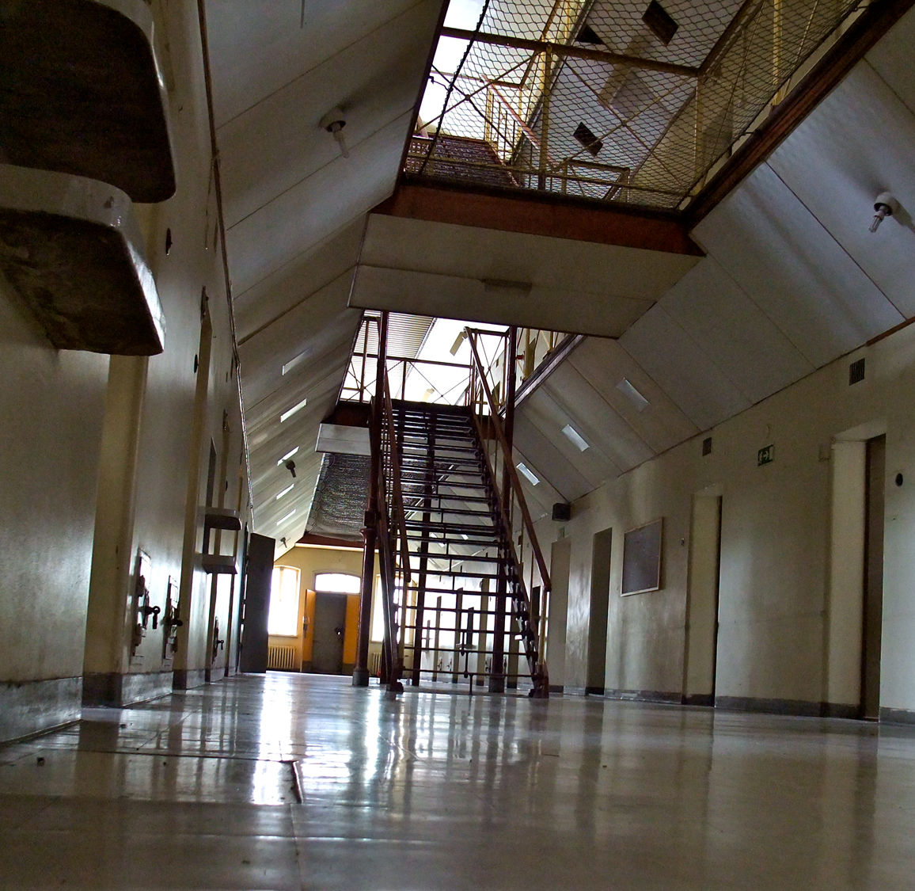
Recall and Suicide
(in prison)
It has also been recently identified that recall prisoners are at a greater risk of suicide/SID whilst in prison
“Recall to prison after a breach of licence was a noticeable characteristic of several of the deaths within the first few weeks in prison. Recall is an inevitably distressing experience and is a known risk factor for suicide and self-harm. However, we found cases where little information about their recall was provided to recalled prisoners, increasing their distress even further “ (Prison and Probation Ombudsmen, Learning Lessons, 2016)
In context:
18% of the most recent SIDs are recall prisoners
Compared with 7.6% of the prison population being recall prisoners (MoJ, June 2018) – so SIDs are disproportionately high in this group.

Slide 5
What is ‘relevant information’
A two-way street!
We often hear about passing on ‘relevant information’. In suicide and self-harm management this includes:
Any knowledge of suicide and self-harm events at any age – in particular more serious events or where lethal methods were used (e.g. ligature, trains, falling from height) as we know these especially raise the current and lifetime risk.
Knowledge of any relevant risk factors for suicide or self-harm
The current situation with the Service-user or resident with your service e.g. current needs, treatment/intervention and engagement and any upcoming ‘endings’
The current circumstances with the resident which may be difficult or bring about a change (even if seems positive e.g. birth of a child).
Knowledge of ways of coping and helpful things to support the individual

Slide 6
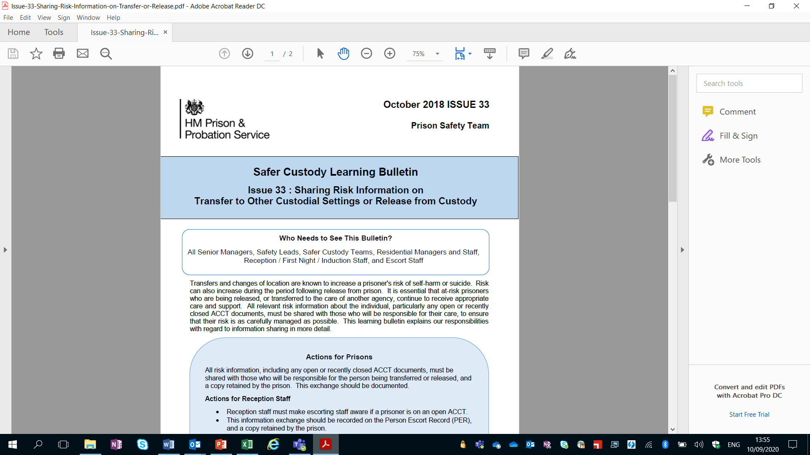

Slide 8
Who to ask or tell other than POM?
Healthcare
To gain all medical and health information including community plans
Be mindful that healthcare staff may not have access to the ACCT form or have the full picture of suicide/SH risk where no injury occurred. Healthcare should have records of any major injuries.
Safety Custody
This is the department in the prison who has the brief to oversee suicide and self-harm management. They will have the best knowledge of who to talk to, if they can’t assist directly.
Orderly Officer or Duty Governor
At all times there will be an orderly officer on duty and either a present/on-call Duty Governor so if the request or passing on of information is urgent, then you can contact them.

