Slide 1

Why do people die by suicide?
Dr Karen Slade & Louise Carter
HMP Nottingham September 2019
Notes:
Intros
Encourage open honest disclosure, acknowledge that there may be some non pc views!
Well being signpost – people likely to have been involved in deaths

Slide 2
Introduction
Introductions of attendees
Encourage open honest disclosure
We are not looking for the ‘right’ answer and we want to hear what you think or else we can’t move forward.
Most of us will have been involved in deaths or suicidal behaviours and we should be mindful of this. It can be difficult and may stir up emotions and memories
Notes:
Louise

Slide 3
Self-protection
Everyone is pre-programmed for self-protection. Therefore high priority and urgency are given to this ‘as standard’ – its not under our control.
When we experience difficult, threatening or uncertain situations there is a menu of possible automatic responses.
These are designed to protect us and damage limitation

Slide 4
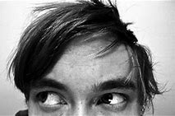



Automatic protective behaviours
Stop – hyper alert - to predict threat early
Flight – prevent exposure to the threat
Fight – exert control over others to protect or deter
Hiding and camouflage – cut off or turning away from the situation or person
Demobilise – ‘play dead’ or just stop doing anything
Help-seeking or needing to be around others
Submission – comply or ‘nothing can be done’

Slide 5
Protective ways of thinking
‘Better safe than sorry’ requires rapid decisions:
Selective attention – focussing only on the threat
Only using some of the information to make the decision
Dichotomous thinking – ‘yes/no’
Over-generalising
Disqualifying the positive or contradictory information

Slide 6
Looking after ourselves and each other
The extreme becoming normal
How does working with extreme behaviours and high risk impact on people?
What differences have you noticed about your views towards self harm between when we started work in this environment and now
It’s a difficult topic and its important to look after each other
  How do people cope with working within this area?
Notes:
Louise
Developing empathy is different to being told to be empathic
Why cant we be empathic = they are in threat mode, traumatised, desensitised – need to acknowledge this and the importance of looking after yourself
How do you look after yourself?
Its not a weakness to be affected by this
How are we going to look after each other in here.
Confidence / competence

Slide 7
1. What is suicidal behaviour?

Slide 8
Question: What do you think a suicidal person looks or acts like?
What are you looking for?
What do you expect?
What tells you that its not serious?
There are no checklists to tell you if someone is – it’s a complex balance but we will guide you through some of the most important elements.
Notes:
This slide is to explore any templates that they hold and to develop an understanding that there are many different ways in which someone who is suicidal looks like.

Slide 9
Self-harm or suicidal behaviour?
Self-harm without wanting or thinking about dying (no intent)
Harm with low intent/some ambivalence
Harm with some intent but also other meaning(s)
Harm/Suicide with strong intent
Harm with Ambivalence (including ‘not worried if I die’)
Notes:
Use as explanation of the changing intent and the mixed ‘messages’ which occur when anybody is suicidal. It is not clear-cut and
Explain that people are changing their mind (want to live / want to die) ALSO – people don’t need to have a clear wish to die to engage in life-threatening behaviour – if you ONLY look for suicidal ideation then you will miss those who are ambivalent about dying.
Draw back to what staff see and how they may (mis) interpret it – ambivalence doesn’t mean manipulative, it just means they will swing in and out of the decision (relate maybe to giving up chocolate!)
How serious? They get so far but they aren’t sure and may change their mind– buts its still serious as it can just as easily swing back the other way a short time later! (challenge the assumption that its only serious if they are cut down).
Karen – checking the obs book on d wing and ligatures were being recorded yet didn’t result in acct

Slide 10
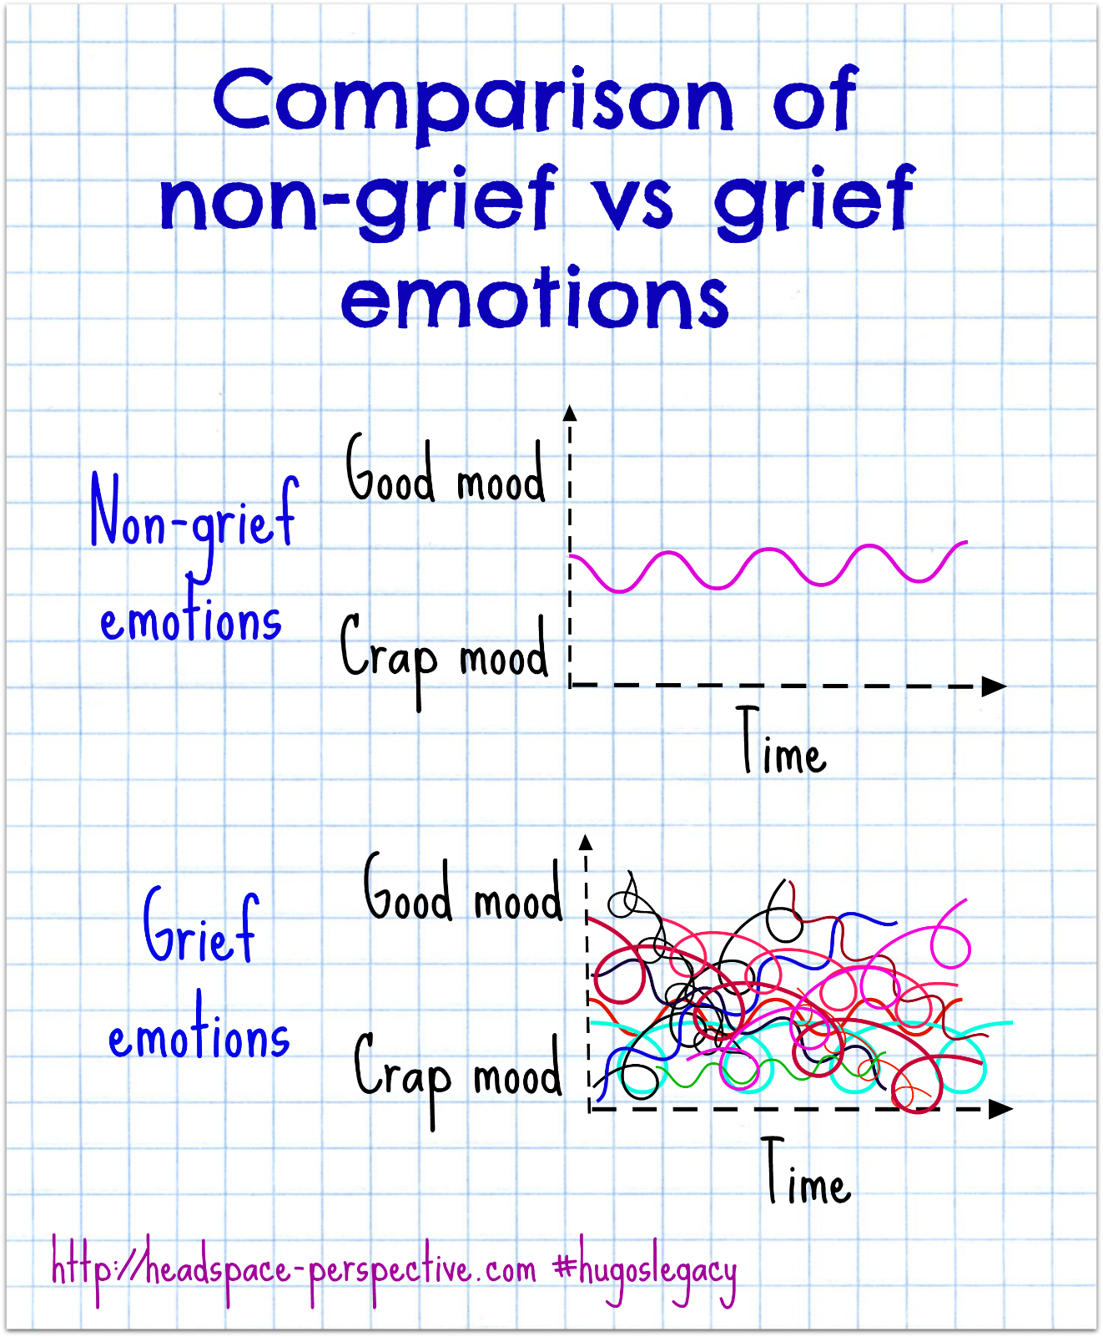
Notes:
This slide is designed to demonstrate the massive moving about of mood that comes generally with grief and distress of differing types can all have this – we expect the top, ordered and a single line – it is not.

Slide 11

Major or minor?
The development of suicide risk could be:
One major problem which overwhelms
Or a series of smaller minor issues which build up, none on their own enough, but eventually tip the balance.
Notes:
Tell rather than explore

Slide 12
Is it suicidal or is it self-harm?
Half of all suicides (in prison and in the community) have previous self-harm
Half of all suicides have NO history of ever having self-harmed.
Ever having a serious injury or EVER trying a lethal method like ligaturing massively increases the risk for the rest of their lives.
Less than 1 in 5 people who die by suicide told a professional or staff member but 2/3rds said to a family member.
On average, the planning stage for suicide is under 30 minutes.
In the DIC at Nottingham in 2017 and 2018, over half of the men who died had ligatured previously, often recently. Most had ACCTs closed at first review.
Many people have thoughts of suicide, some often, some come and go and some only once.
If a person ends up in the same situation, same feelings or thoughts then the suicidal thinking returns and can often come back stronger than last time.
Notes:
Karen

Slide 13
Previous suicidal behaviour and life-threatening self-harm
Why are you asking about previous self harm? What are you trying to learn?
What is important about that previous behaviour? What else do you need to know?
Notes:
Use the acct assessment boxes to encourage reflection and how to use this information by each of the different people.

Slide 14
Exercise: suicide intent at nottingham?
A recent study looked at how the men here at Nottingham who had suicidal intent to their behaviour differed from those who didn’t in what was reported in their ACCTs.
Higher or lower?
Notes:
Louise

Slide 15
Frustration or anger
Wanting to be left alone
Being punished
Experiencing loss
Anxiety or concerns
Feeling ignored
Conflict with others
Mental health issue (not PD)
Releasing emotions
Low Mood
Trying to get something to be different or asking for help
Not feeling safe
Notes:
Louise

Slide 16
SUMMARY
Might suggest that suicide risk is higher:
Being punished and mental health
Frustrations/anger and Anxiety/concerns
Experiencing loss and wanting to be left alone
What might be equally suicidal or self-harm risk:
Wanting to release emotions
Trying to get something to be different or asking for help
Not feeling safe
Feeling ignored by the prison or CJS more widely
Notes:
Louise

Slide 17
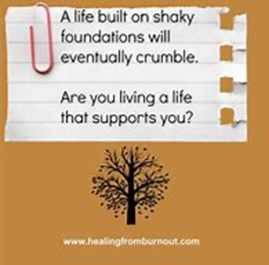
2. The relevance of risk factors

Slide 18
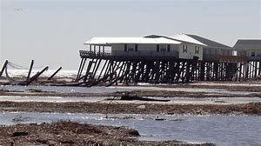

Current situation
Entering prison; leaving prison; on recall/remand.
Bullied, robbed, segregated, placed on Basic or isolated
Background
Poor social and family support; no partner
unemployment, excluded from society, homeless, Imprisonment
Childhood (abuse, neglect, parent psychological, MH or substance issues)
Excluded from school
Seeing self-harm by others
Personality disorder,
psychiatric disorder, substance disorder
Self-harm, suicide attempts, violent behaviour
Not getting medications; unable to call family
Losing a loved one; unable to contact children
Notes:
The risk factors that we have in our lists’ create the shaky foundations which make us more vulnerable to fall – think about the game JENGA, the removal of each block which holds us up makes us more vulnerable.
Those who have experienced a lot of early difficult experiences, but without the benefit of the balance are built on shaky foundations. This background makes them more likely to respond to their current situation and find it difficult to rebalance.

Slide 19
3. The meaning of experience
We make meaning from multiple events in our lives and generate multiple meanings
Our expression of distress also has multiple outlets

Slide 20
How do people usually respond and/or express their distress, discontent, grief and unhappiness?
Example: Bereavement
Showing externally
Going on internally
Notes:
Louise
(trying to get them to see people everywhere struggle and see the usual patterns)
maybe use bereavement or a loved one leaving as an example for them to consider both sides? also longitudinal - the ups and downs.

Slide 21
Why do people respond like that?
Threat & Meaning
Response to the threat
(thoughts, emotion)
Expression of distress (behaviour)
What is happening- Trigger or current situation

Slide 22
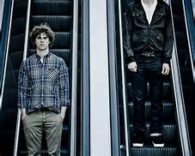

How does the suicide/SH develop?
Background & Their History
Feeling Defeated
Risk is helped or hindered by:
Able to cope with the emotions
Rumination
Focussing on unhelpful things
Ability to solve the problem
Suicide Ideation
Move to behaviour ius helped/ hindered by:
Overcoming fear of pain/death
Impulsive
Suicide Plan
Access to method
What learnt from others
Feeling Trapped
Risk is helped/hindered by:
Feeling a burden
Not feeling you belong/connect
Not seeing a positive future
Attitudes to suicide
Having future goals
Feeling supported
Suicidal behaviour
Current environment
Life events
Vulnerabilities (shaky foundations)
Based on the IMV model O’Connor (2011)
Notes:
Karen

Slide 23
4 meanings related to suicide
Feeling a burden on those you love
  Causing your family strain and unable to help them or ‘They would be better off without me’
Feeling you have lost your place, worth, purpose or value to the world/those that matter
  feel humiliated or deep shame or worthless
Feeling like you have lost control of your life
  You have no real choices
Feeling unable to change anything and no-one will really help you
  Future won’t get better and no-one cares
Notes:
Karen

Slide 24
Which of the meanings which might result from these events? Use the sheet
Hearing your partner start crying whenever you call
You’re told that your kids are getting bullied because their dad is in prison
Sitting in an ACCT review with lots of strangers telling you what to do
Your mum tells you that she is struggling financially and your dad has a terminal illness.
Shamed in public by family, friends or the press
Restrained because you lost your temper with an officer who hadn’t done what he said he would.
Losing your role as a father (e.g. due to public protection)
You tell someone who are struggling and the ACCT is closed at first review
Coming to prison and losing your job and home
You hear that your parole has been rejected
Having your TV removed because you desperately wanted to use the phone and wouldn’t lock up
Put on an ACCT even though you said repeatedly that you really didn’t want it
Asking and asking but nothing seems to happen
Your partner tells you they have left you as you are not worth the hassle
Notes:
Karen
This is the learning part – we start them at the beginning and move them forward through the process.
Use a visual or same handout (FC or hand out)
Family will understand what the meaning is far better than staff can.

Slide 25
What might people do or say?
What unhelpful responses?
What are signs of giving in to that meaning?
What might they say if they felt that?
What helpful responses might there be?

Slide 26
How might people try to make themselves feel better (unhelpful) or give in to them?
Feeling a burden on those you love
Feeling you have lost your place, worth, purpose or value to the world/those that matter
Feeling like you have lost control of your life or your mind
Feeling unable to change what matters and no-one will really help you
Not tell your family that things are bad
Try and make money to send out?
Gain status through other means – feel ‘big’ or that you matter in here, if not outside
Seek constant reassurances
Compensate by taking drugs
Try to take control of something/someone
Give in and stop trying
Ask to see the mental health services
Self-harm to try and communicate or to get something to change
Desperately trying to solve the problem in any way possible
Withdrawing or not bothering to engage anymore.
Notes:
Based on the previous linkages, we give them the situ and the meaning, they need to think about what is the threat they are feeling and what they might do if they really believe them and give in to them:? (all signs of the meaning)
We get them ot brainstorm the answers and then think about what that means - we have our list to help encourage them,/

Slide 27
4. Behaviours and their meaning
Notes:
Dual harm info slides
7 out of 12 DIC were dual harmers

Slide 28
Starting at the real beginning for us: the behaviours
The suicidal meaning might not reflect only into what you think is ‘suicidal’ behaviour e.g.
Netting due to desperate need to be transferred
Unprovoked assault on another prisoner
Making a ligature but not using it
Saying they will kill themselves and next day saying they are fine
Not turning up for appointments
Pressing the cell-bell repeatedly asking to use the phone
Refusing to attend or engage in their ACCT review
Smashing up their cell
Notes:
Karen
In reality we start with the behaviour…… ☺ so we will move backwards through the process.
Same handout / FC

Slide 29
How do we find out the meaning?
What do you currently do?
Who might be able to help you find out?
Where might information be kept which might give an idea?
Notes:
Karen
Choosing the situations above and asking them these questions.
Asking them to reflect on : talking and listening and exploring
The different stages of our processes and the different people and information sources.

Slide 30
Trying to work back
Threat & Meaning
Response to the threat
(thoughts, emotion)
Expression of distress (behaviour)
What is happening- Trigger or current situation
Notes:
For this exercise: Using one (or more of the behaviours in the list) – ask them what order would you go in to find out the pathway/meaning?
Maybe think here about demonstrating a role-play of what the conversation would look like

Slide 31
The things people say….and what they really mean
What is on the surface
What lies beneath
What you say matters
Notes:
Louise

Slide 32
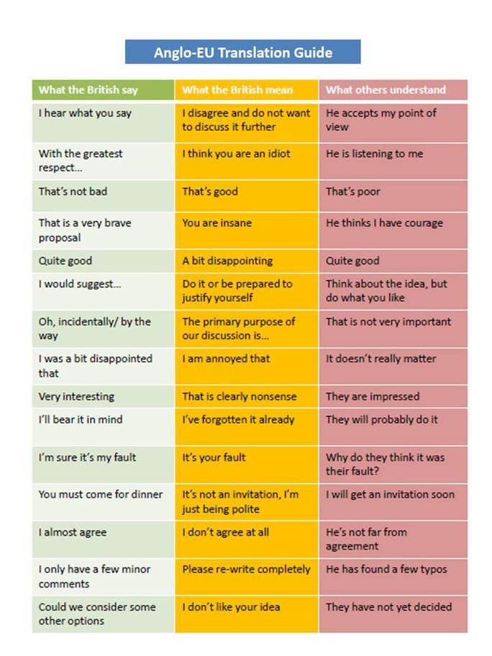
Notes:
Louise

Slide 33
What people say | What do you hear? | What might they mean?
I want to move wing
Give me my TV back or I will cut myself.
I am embarrassed by what I have done. I can’t believe I did that again.
I don’t know why I did it
I can’t go back there, there’s a price on my head.
I am just F###ing asking you, its your job!
You said it would happen last time and it didnt.
Notes:
Louise
Put in the answers from above – saying and hearing
What might staff say – what do they mean – what might be heard?

Slide 34
What staff say | What do they mean? | What might be heard?
Yeh, I’ll get to it in a second.
Why have you done that again?
There isn't anything I can do, they aren't answering the phone.
He’s threatening to cut up again, he was given basic earlier
Crack on, I’m on a late shift
This is what he does...
He made a ligature but he didn't use it.
Notes:
Put in the answers from above – saying and hearing
What might staff say – what do they mean – what might be heard?

Slide 35
Dual Harm: Suicide links with violence
Violence has a very strong link with both suicide and self-harm
Dual harm prisoners make up 11% of the population at Nottingham but account for over 50% of our suicides.
They are also far more likely to attempt suicide and use ligatures.
Notes:
Karen

Slide 36
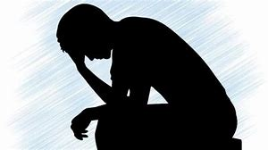
Dual harm and disruption
Across our prison
The 11% of men who dual harm accounted for over the majority (56%) of incidents they had on record.
Notes:
Karen

Slide 37
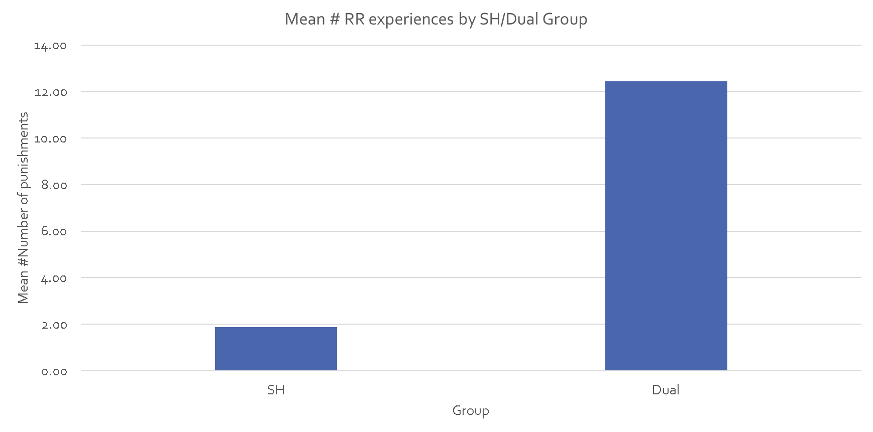
Notes:
Karen

Slide 38
The challenge
Often those who have been violent will evoke our protective responses.
Bearing in mind the suicide risk, how should we respond to someone who has been violent? Or repeatedly disruptive?
If they say they are suicidal or they self-harm, how might we respond?
Notes:
Hand out the recent dual harm guide from HMPPS about single case management etc.

Slide 39
5. Using the knowledge

Slide 40
Undertaking suicide prevention
In addition to what you already do:
What are we looking for in someone at risk of suicide?
What additional questions could we ask to explore whether someone is on the pathway to suicide?
When do we need to ask about suicide?
Notes:
Louise?

Slide 41
Example questions

Slide 42
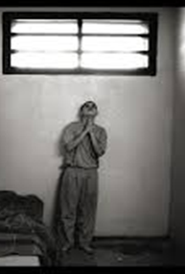
What we are trying to achieve
To reduce distress and stress
To improve feelings of control
To improve feelings of defeat or trapped in a situation
To improve a sense of hope for the future
To develop social support and feelings of esteem by others
To consider alternative ways of meeting needs
To consider how to manage alongside the broader risks and needs e.g. violence or segregation?

Slide 43
How can we do this?
Exercise – go with the flow
Reception & First Night
ACCT opening and assessment
ACCT Caremap and reviews
Special Units & safer custody
Notes:
Karen to set up – both to support
For this exercise, think about what each step needs to know – how to find it and how to pass it on. Set actions and
This can then go into the safety strategy

Slide 44
Exercise – who knows and can help?
Emotions and how you feel
Things happening in your mind
Behaviours
Recent (external) events
Thoughts & Beliefs
Activities and things they are doing during the day
Relationships and how relating to other people
Personality
Previous Life events
Previous suicidal behaviours and self-harm
Mental health and substance use
What can encourage helpful responses
Threats and triggers
Notes:
Louise
Change terminology to more accessible
How does this make your life easier?
So far we have considered how these aspects contribute to the person’s likelihood to undertake suicidal or life-threatening behaviour
How would you know about them / where would you get this info?
The purpose of this is to emphasise the MDT

Slide 45
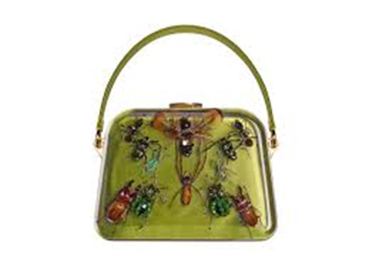
Key Points
Don’t assume the meaning: find out if it may reflect suicide risk and base your actions on that.
Help the client to feel in control of what is happening but also supported.
Work as a team to understand and manage risks
Revisit caremaps regularly; and after crisis has passed (its just below the surface for many).
Critically review the environment and the impact that may be having.
Think long-term in your careplan decisions – building up those shaky foundations.
Talk to others about your decisions and be open to feedback.

Slide 46
“Previously it had felt inevitable ….but [we] gave this prison hope that we could stop it”

