Slide 1
Integrating sustainability into business schools: How can we prepare future business leaders to solve real world problems?
Dr Muhammad Usman Mazhar
Senior Lecturer and Sustainability Coordinator
Nottingham Business School, Nottingham Trent University, UK
14 September, 2018

Slide 2
About me

Slide 3
Outline
Nottingham Trent University (NTU)
Sustainability at NTU
Role of business schools
Students’ demand
Nottingham Business School (NBS)
How NBS is integrating sustainability?
Lessons learnt and way forward
Questions/comments

Slide 4


Slide 5
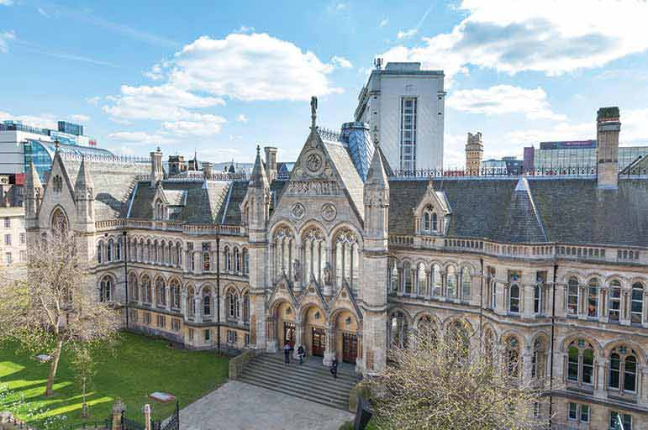

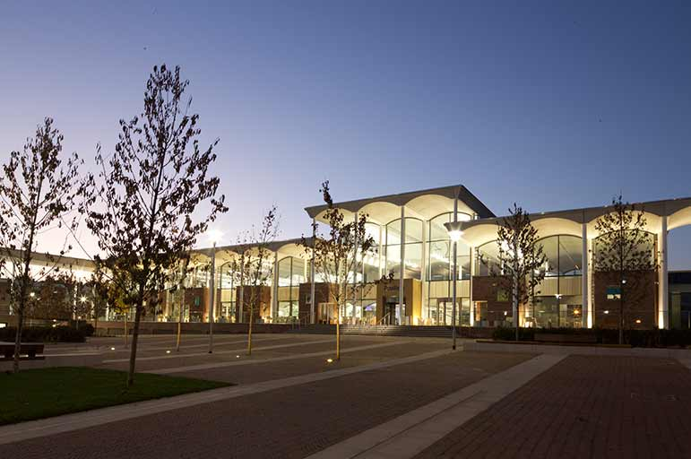

Nottingham Trent University (NTU)
30,000 Students
4 Campuses
CIRCA 200,000m2 of estate
8 Academic Schools
Offer over 500 courses

Slide 6

NTU Strategic Plan
Core Strategic Themes
Creating Opportunity
Valuing Ideas
Enriching Society
Connecting Globally
Empowering People
Notes:
Ambition:

Slide 7
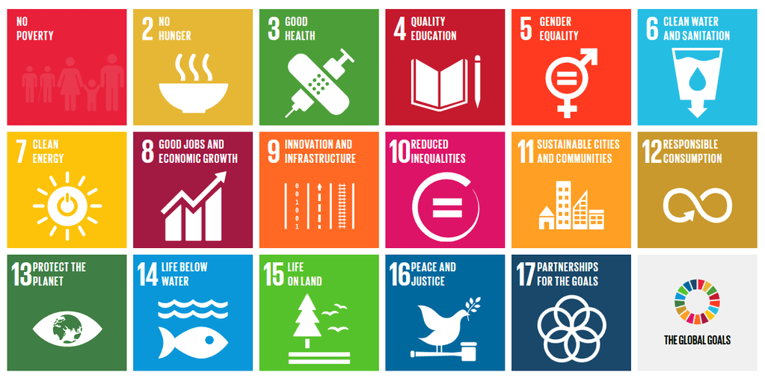
UN Sustainable Development Goals (SDGs)

Slide 8
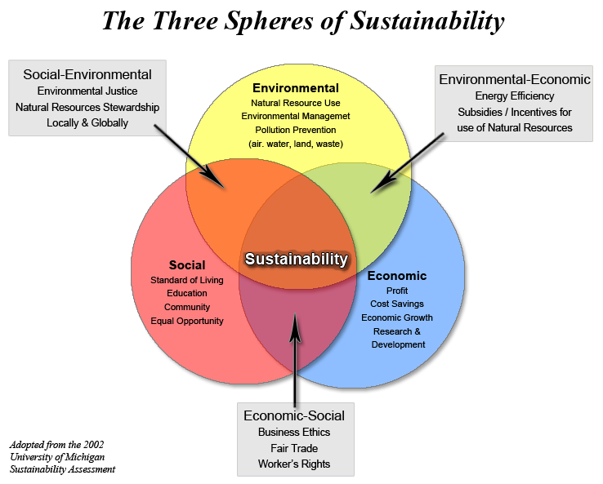
What is Sustainability?

Slide 9
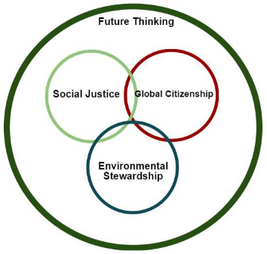

Strategic Plan & Curriculum Refresh
Seven ‘future thinking’ principles (F1 - F7)

Slide 10








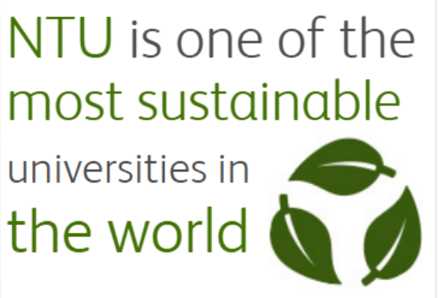

We practice what we preach
Notes:
Eco

Slide 11

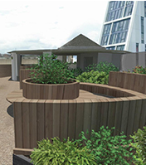
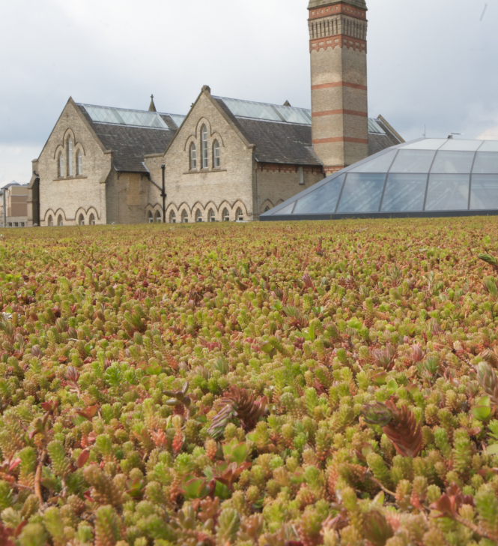

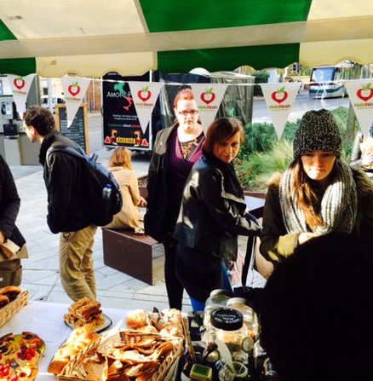
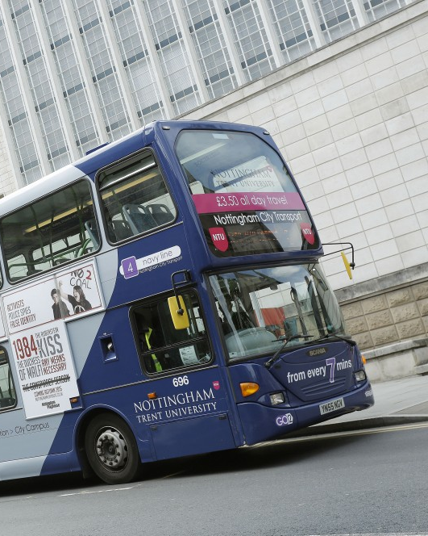

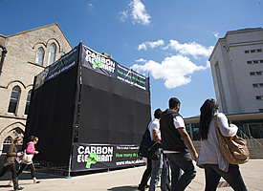
Biodiversity
Green Spaces
Waste
Sustainable Construction
Carbon emissions
Engagement
Transport
Education

Slide 12
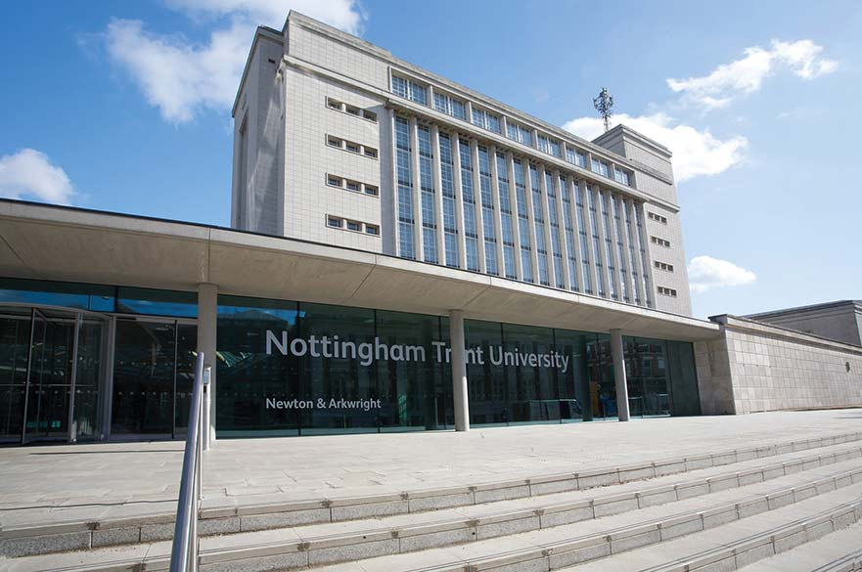
Nottingham Business School (NBS)

Slide 13




Leading the way
Fewer than 1% of business schools worldwide have both EQUIS and AACSB accreditation

Slide 14
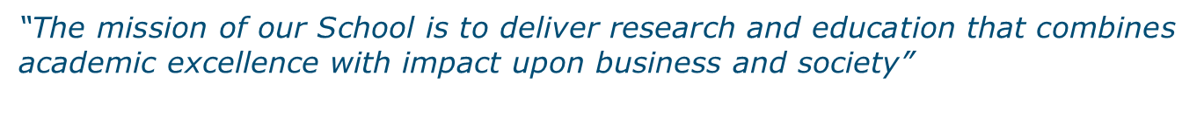
NBS Mission
“We will develop the capabilities of students to be future generators of sustainable value for business and society at large and to work for an inclusive and sustainable global economy”.

Slide 15
Role of business schools
Sustainability has now become a key strategic issue for businesses.
Organisations are increasingly embedding sustainability practices into business operations.
The role of business leaders and managers is paramount.
Necessary to equip students with knowledge and understanding of sustainability and develop capabilities.
Notes:
https://www.theguardian.com/sustainable-business/live-discussion-role-business-schools-sustainability

Slide 16
Paul Hawken – impacts of business
First, business takes too much from the environment and does so in a harmful way; second, the products it makes require excessive amounts of energy, toxins and pollutants; and finally, the method of manufacture and the very products themselves produce extraordinary waste and cause harm to the present and future generations of all species including humans (Hawken, 1996)

Slide 17
Business Students’ demand (Yale Study, 2016)
96% think businesses should be leading efforts to address climate change.
64% want environmental sustainability integrated into both core curricula and career services/counselling at business schools.
79% of students say they feel only “moderately” to “not at all” knowledgeable about how to make business more environmentally sustainable
Yale, CBE, GNAM, WBCSD, 2016. Rising Leaders on Environmental Sustainability and Climate Change: A Global Survey of Business Students.
http://cbey.yale.edu/files/Rising%20Leaders%20on%20Environmental%20Sustainability%20and%20Climate%20Change%20Nov_2015.pdf

Slide 18
How NBS is integrating sustainability?
Sustainability is at the heart of its teaching, research, operations and engagement activities.
Driven by NTU strategies and policies.
Sustainable Development Academic Forum
Partnership with NTU Green Academy
Senior management buy in
Resource allocation
Key leadership role

Slide 19


Curriculum Refresh
The SDGs are embedded in the university-wide course evaluation process Curriculum Refresh
NTU and the Sustainable Development Goals blog
www.ntu-sdgs.blog
Student Outreach
Seeking feedback from students on how they would like to embed the SDGs in their courses
Future Thinking Learning Room
An online resource library containing resources, estate and community case studies and examples of good practice, all linked to the SDGs
Staff development
The SDGs are introduced in staff workshop to clarify the sustainable development concept
Global Responsibility Week
Getting students to attend a week of sustainability lectures and workshops

Slide 20
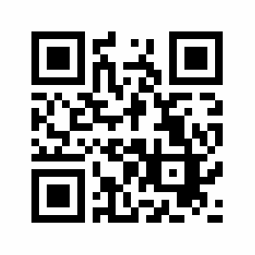
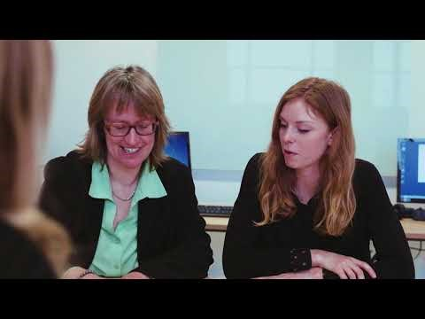
NBS and the integration of SDGs
https://www.youtube.com/watch?v=Rg1g7Khv_20

Slide 21




Sustainability in Practice (SiP)
Online optional module available to all students and staff at NTU and NBS
4 online sessions followed by assessment:
    Personal connections with sustainability
    Discipline connections with sustainability covering over 96 disciplines from Astrophysics to Sociology to business etc.
    Multidisciplinary collaborations
    Global and local solutions
Themed on the SDGs with three topics to choose from
Tailored versions offered to all courses & modules such as ‘Transformational Leadership in Practice’ in NBS
Recognised on undergraduates’ Higher Education Achievement Record (HEAR)

Slide 22
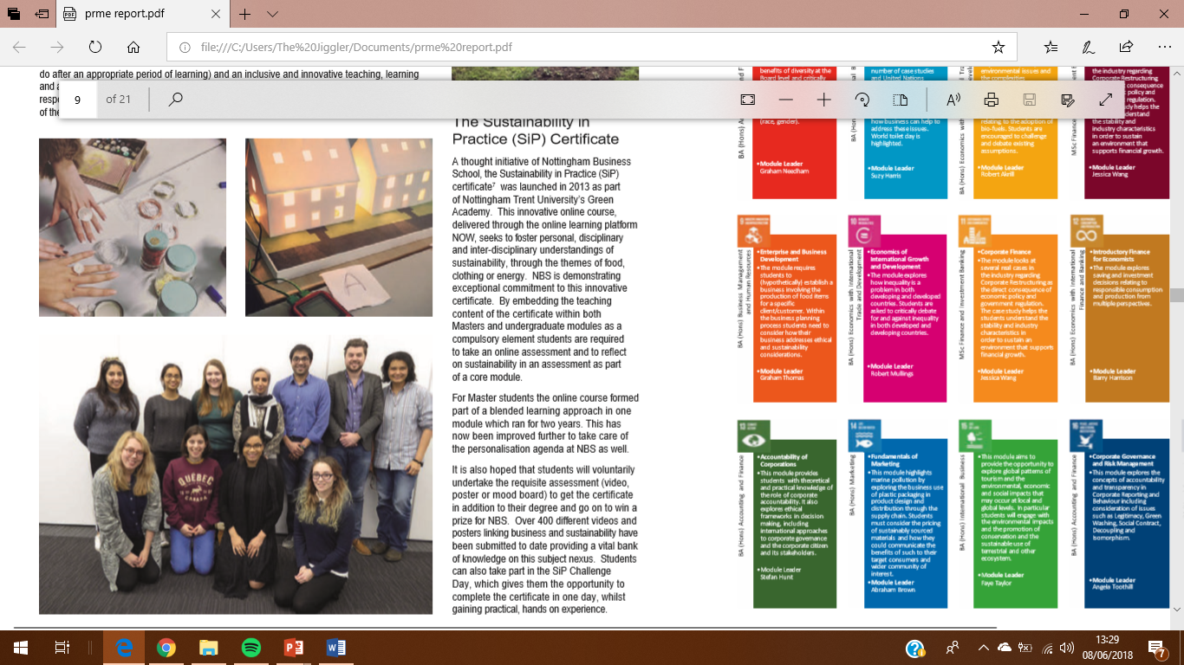
Sustainability in Practice (SiP) Challenge Days
Practical experience in sustainability
Collaborating with new people
Interactive workshops including practice COP 21 Negotiations, upcycling and sustainable food growing on the allotment.

Slide 23

Futureproof your career
Leadership & Employability module for all 1,200 business undergraduates
Greenhouse gas management project
Self-reflection on being responsible leaders in the future
Covering ethical and sustainability issues they may encounter in their future careers
Notes:
Now postgraduate version
https://www.ntu.ac.uk/about-us/news/news-articles/2017/11/NTU-wins-national-awards-for-commitment-to-sustainability

Slide 24
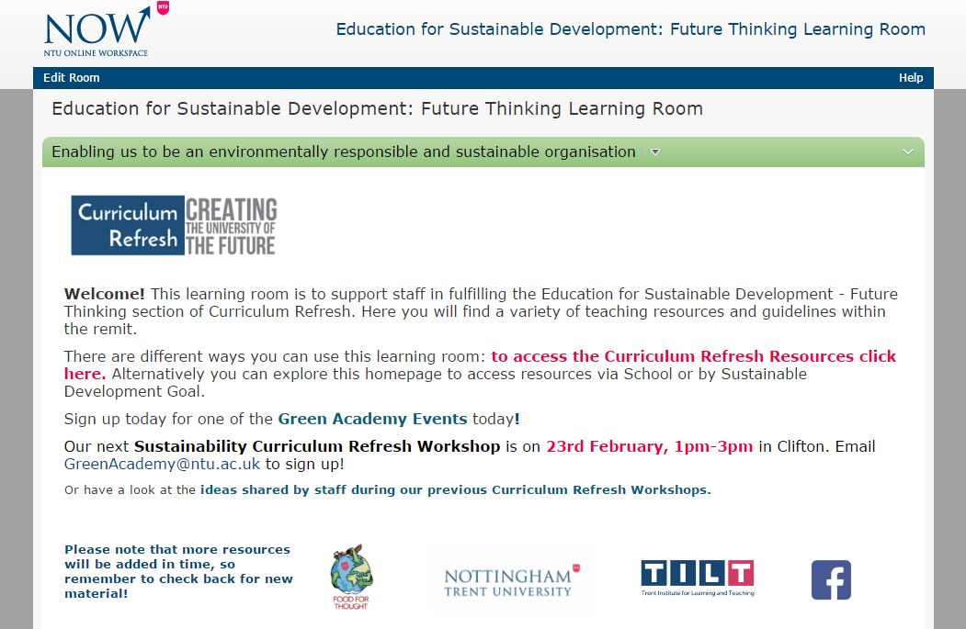
Support offered

Slide 25
Structure
Deputy Vice Chancellor
Sustainability/PRME Lead
Sustainability Coordinator
PRME Coordinator
Sustainability Representatives for each department
  Management
  Marketing
  Accounting and Finance
  Human Resource Management
  Economics

Slide 26
‘Sustainable Futures’ research theme
Sustainable Consumption and Production
Ecosystem Sustainability
The Built Environment
Sustainable Mobility
Behaviour, Values and Norms
Leadership, Governance, Participation and Policy

Slide 27
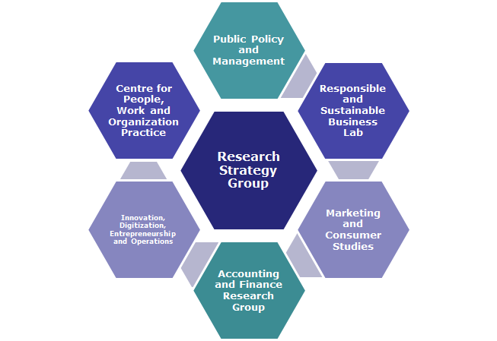
Research at NBS

Slide 28

Vision for the Future

Slide 29
Carbon Literacy Training for Business Schools
PRME Champions project
CL is a certified framework for a day’s worth of action based climate change learning
Recognised as globally unique at COP21
Three steps
1. Climate Change, Business and You (developed now)
2. Seven new modules will be developed in three Business Schools (NBS, Kedge Business School and University of Valencia); linking climate change mitigation to one Business School discipline: Carbon Literate Accounting, Design Entrepreneurship, Economics, Marketing, Operations and Organizational Behaviour.
3. Carbon Literate Action
Parallel ‘Carbon Literate Executive Leadership’-Module

Slide 30
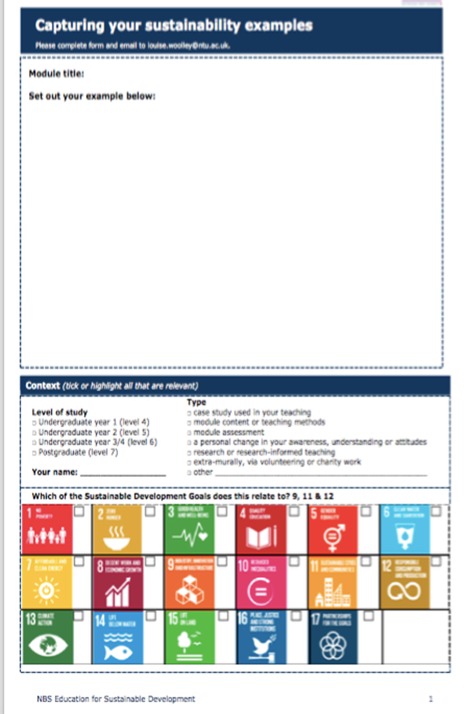
SDGs mapping

Slide 31
Lessons learnt and way forward
NBS offers a good practice model for integrating sustainability into business schools
Replication potential
Build on what you are doing already
Incremental change
Senior leadership
Engagement with the colleagues
Sharing best practice
Share what works and what doesn’t and why

Slide 32
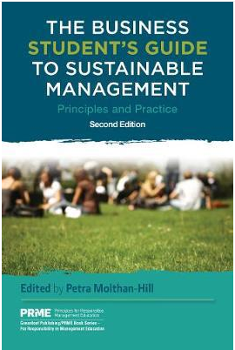
Ideas for you?
https://www.routledge.com/The-Business-Students-Guide-to-Sustainable-Management-Principles-and/Molthan-Hill-Molthan-Hill/p/book/9781783533190

Slide 33

Overview of all areas: NBS PRME report
http://www4.ntu.ac.uk/nbs/document_uploads/193908.pdf

Slide 34
Go and Do it
“I didn’t realise how much I was already doing with regards to sustainability in my teaching”

Slide 35



Thank you
Any Questions/Comments?
Email: muhammadusman.mazhar@ntu.ac.uk
@u_mazhar
@NBS_Susty
NTU Sustainability
ntu_sustainability

