Slide 1

A view from both sides of the academic/policy divide
Professor Peter Murphy
Nottingham Business School, Nottingham Trent University
November 2019

Slide 2



Introduction:
Some key drivers and challenges
Research Excellence Frameworks – an increasingly international phenomenon
The rise of ‘impact’ - its increasing importance in the REF (institutional; long term and case studies)
Journal rankings ABS and others
Open Access publishing
Social media publishing

Slide 3





Local Government
(Always combined multiple roles)
CEO of private company and CEO of third sector (charity)
Over 30 Non-Executive Directorships Public/Third Sector
Professional Bodies: RTPI. TCPA. POS. ILAM/Cimpsa. Solace.
Part time teaching in University and FE sectors
Parliamentary returning Officer/Advisor to Government
Public Inquiries, Tribunals and National Reviews

Slide 4
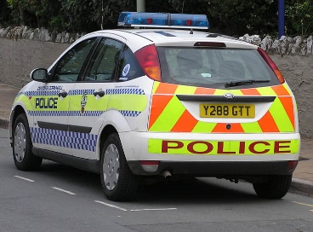

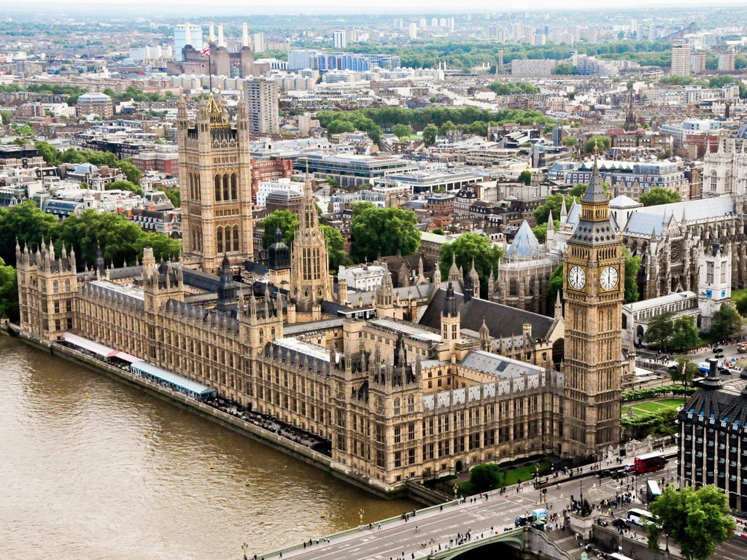

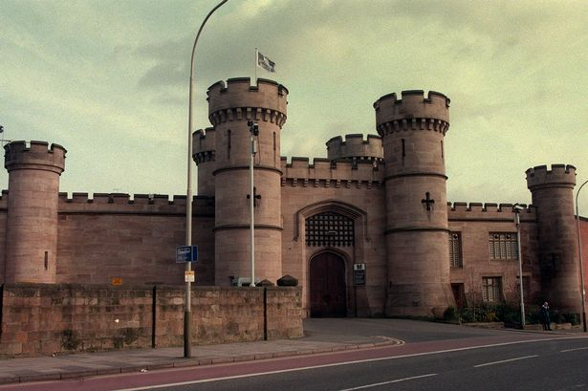

Central Government
(4 Departments- and a Regional Government Office but essentially 3 roles)
Policy Areas: Public service reform/performance management regimes (Strategy Unit/Audit Commission)
Delivery Specialist: Strategic intervention and turnaround of “failing” public services and organisations
Cross Cutting: No10/HMT Reviews of major government programmes in danger of failing
Department of Environment, Transport and Regions (DETR)
Department of Transport, Local Government, and the Regions (DTLR)
Office of the Deputy Prime Minister (ODPM)
Department of Communities and Local Government (DCLG)
Notes:
Department of Environment Transport and Regions
The Local Government Modernisation
Continuous Improvement, Best Value, Service Inspection and Performance Indicators
Power of Wellbeing
Governance – new political structures - executive and scrutiny arrangements
Community Strategies and Engagement
Partnerships LPSAs and LSPs
E-government
Department of Transport, Local Government, and the Regions
Within DTLR
Liaison with the Audit Commission
Designing/testing/commissioning the CPA regime
Piloting Intervention in failing authorities
Introduction to Cross-Government
Public Service Agreements and Spending Review
HMT, The Cabinet Office, No.10 Strategy Unit
PRINCE2, OGC Gateway Reviews
Office of the Deputy Prime Minister
Cross Government
Inspection/Inspectorates/Intervention
Performance Management regimes in Health and Social Care, Criminal Justice, Regional Development Agencies, National Parks
OGC Major Projects
Cabinet Sub-Committees and Select Committees
Within ODPM
Public Service Agreements and Spending Review
Community Strategies, CPAs, and LAAs
Government Office for the East Midlands
Communities and Local Government
Cross Government
Regional and national emergencies
Implementing CAAs/LAAs/MAAs
HMT Major Projects
Interventions for other government departments
Within DCLG
Government Office for the East Midlands
Long term local government Interventions

Slide 5
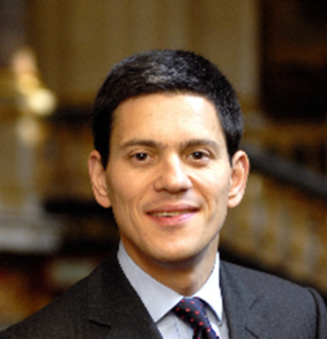

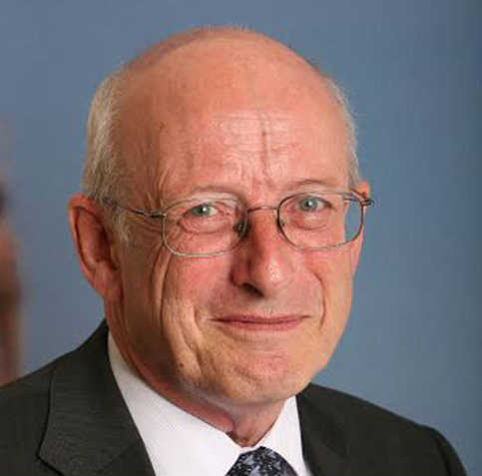
Secretary’s of State Ministers of State
John Prescott (2000-2001)
Stephen Byers (2001 – 2002)
John Prescott (2002-2005)
David Miliband (2005-2006)
Ruth Kelly (DCLG 2006 -2007)
Hazel Blears (DCLG 2007-2009)
Hilary Armstrong (DETR & DTLR)
Beverley Hughes (DETR)
Sally Keeble (DTLR)
Lord Faulkner (DTLR)
Nick Raynsford (DETR, DTLR & ODPM)
Phil Hope (DETR & ODPM)
Chris Leslie (ODPM)
Jim Fitzpatrick (ODPM)
Phil Woolas (ODPM & DCLG)
Yvette Cooper (ODPM & DCLG)
Notes:
Main Roles – Central Government
Public Service Reform and Policy Development – in particular on Performance Management
Direct intervention in failing public services and organisations
Review of Major Government Programmes (across government) in danger of failing to deliver or running significantly over budget

Slide 6
Early initiatives to close the policy/researcher gap
‘Evidenced-based policy making’ and ‘what matters is what works’ encouraged engagement with academics (and practitioners)
Senior Civil Servants encouraged to engage with non-traditional audiences
Policy teams across Whitehall drafted in delivery ‘experts’
Long-term policy and scrutiny agendas published (NAO, Audit Commission, Policy Monitor)
Encouraging greater range of academic contributions to select committee;
Meta-evaluation of the local Government Modernisation agenda

Slide 7
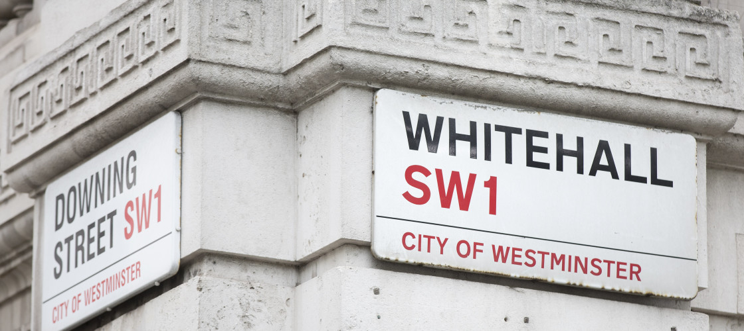
Some Key Challenges
Civil Service Commissioners
Time horizons Policy/Practice/Academic
The world of Whitehall is Westminster centric
Select Committee evidence
Academic attitudes to pure and applied research
‘Publication’ differences in Arts, Sciences and Social Sciences

Slide 8
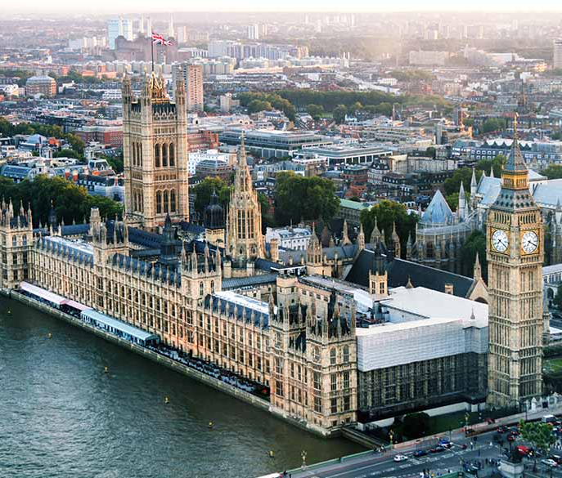


Public Policy & Management
Research units and programmes
Local Government
Accountability, Transparency and Public Assurance
Operational and Financial Performance Management
Central Government
Health
Patient flows through A&E
Hospital discharges – reducing delays
Integrated Care Systems
Emergency Services
Local, Community, Regional and National Risks
Operational and Financial Performance Management
Emergency Service Collaboration

Slide 9
National Frameworks
The context, the parameters, the agencies and the relationships operating within the three domains of policy development, service delivery and public assurance in public services
Central Government (Spending Reviews and PSAs)
Local Authorities (Best Value, CPA, CAA, SLI)
Schools and Education (Ofsted CPA Safeguarding)
Health and Social Care (Standards 4 Better Health)
National Parks (National Assessments Peer Reviews)
Regional Development Agencies
Criminal Justice HMIC and HMICFRS
Universities Research Excellence Framework 2021

Slide 10
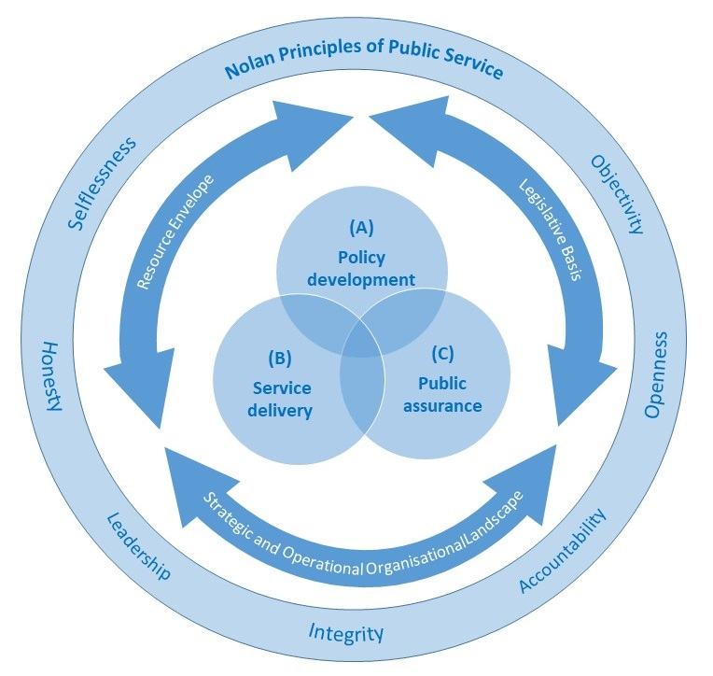
A model for national frameworks and performance regimes
Principles of Public Service
  7 ‘Nolan’ Principles
Situational or contextual constraints
  Legislative framework
  Resource Envelope
  Organisational Landscape
Core areas or domains
  Policy development,
  Service delivery
  Public assurance

Slide 11

REF 2014 Case Study : From Buildings to People
Designing, implementing and disseminating a new risk assessment for the performance management framework for Fire and Rescue Services
Demonstrated the benefits of a new people-centered approach to risk assessment
NFRS commissioned Murphy and Greenhalgh to assist the re-configuration of its ‘fire cover’ based on the new approach.
New frameworks for Scotland, Wales, and Ireland followed

Slide 12
Why it might work?
Knowledge, experience and access to both the policy and the delivery communities.
FRS is a universal service with potential local, regional, national and international dimensions.
The Integrated Risk Management Plan process of the 2004 Act was ‘virtually untried’.
IRMP had and clear potential impacts on communities and NBS had an established collaboration with NFRS.
Little academic engagement with FRS suggested a potential ‘niche’ academic market.

Slide 13
Our case study: in simple terms
IRMP - if the pattern of risk changes so must the response, and hence the redeployment of resources and planning and mitigation
The IRMP approach was rapidly being promoted and adopted nationally and internationally.
NTU were therefore able to demonstrate impact at local, national and international levels

Slide 14
A Comparative Review of
Financial Sustainability, Accountability and Transparency;
Local Public Service Bodies in England under Austerity.
This report has been commissioned and (part) funded by the NAO. Any errors or omissions are the responsibility of the author(s), and the NAO does not necessarily endorse the findings of the work.

Slide 15
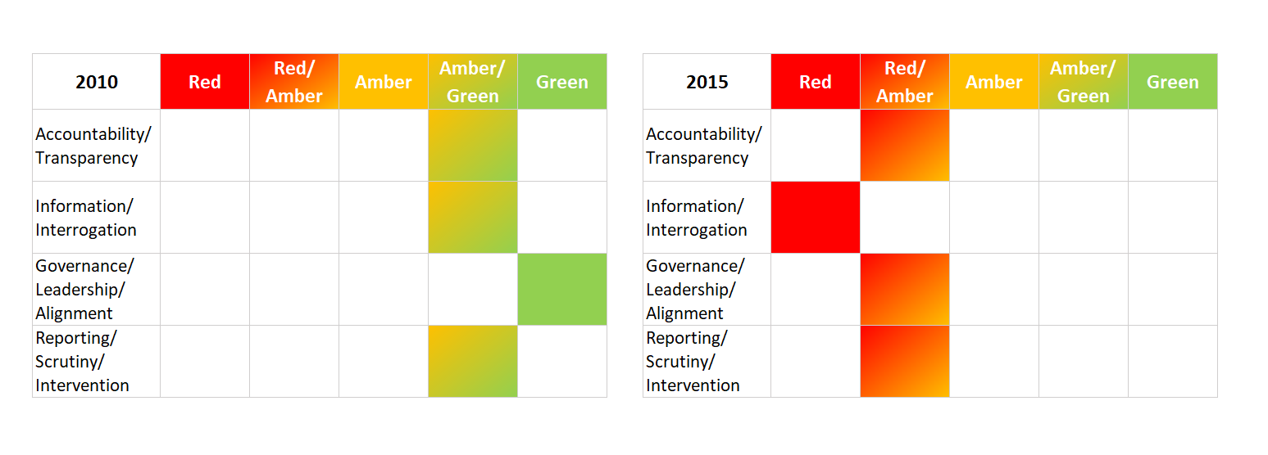
Local Authorities

Slide 16
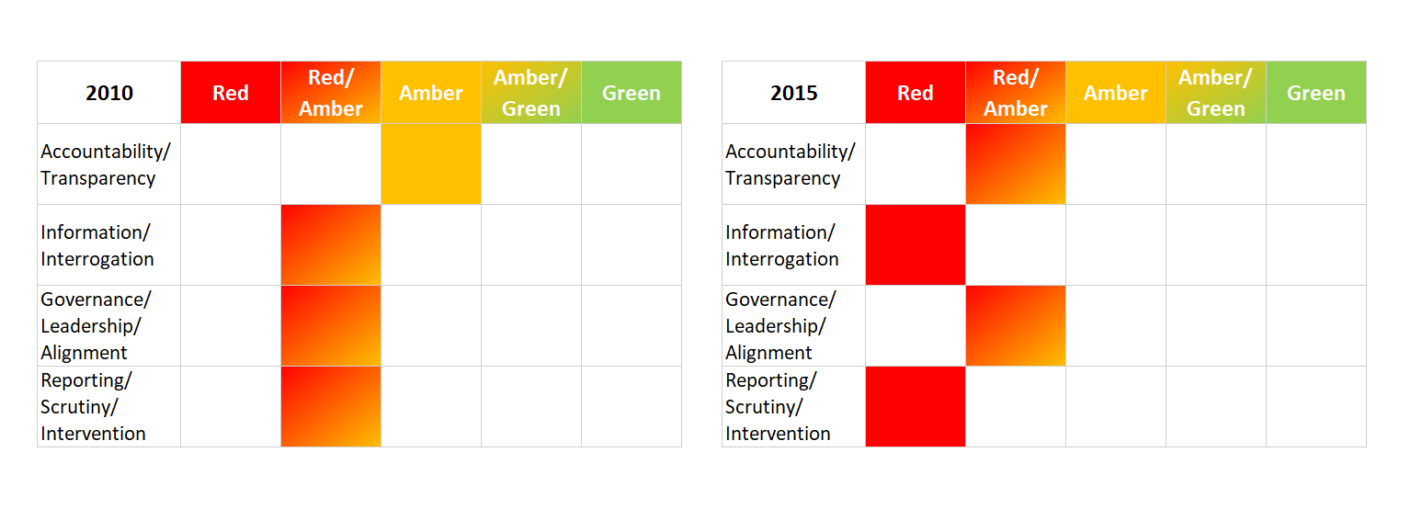
Fire and Rescue Services

Slide 17



Journals in the era of ‘impact’
Perspectives in Public Health
Research Outreach
The Conversation

Slide 18


Books and monographs
Policy press Policy press shorts

Slide 19
Questions?
Thank you for listening

