Slide 1

Dual Harm
Towards an understanding of those who harm both themselves and others
Dr Karen Slade
Associate Professor in Applied Forensic Psychology
Nottingham Trent University

Slide 2
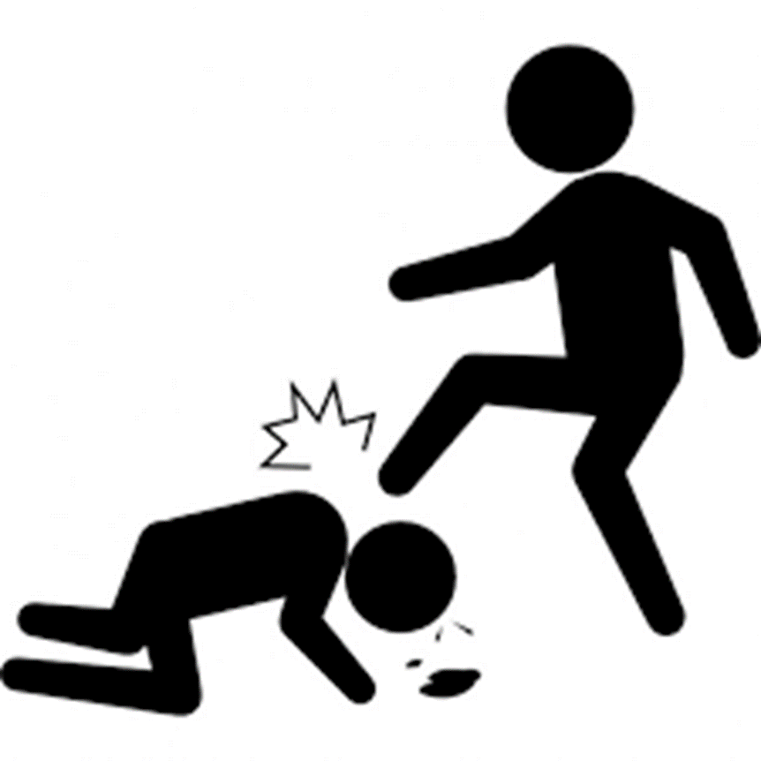
The link between violence and self-harm or suicidal behaviour
Community Violence
Exposure to violence increases risk of SH and suicide ideation (Vermeiren, et al. 2002)
Systematic review ‘Evidence suggests that aggression and SH frequently co-occur’ with most patients who engaged in self-harm engaged in aggression (74%), whereas most patients who engaged in aggression did not engage in self-harm (20%) (O’Donnell, House and Waterman, 2015).
‘Violent offences have consistently been the most serious offence associated with the deceased person’s detention (53%)’ (Australian Government, 2015)
BUT conducting repeated violence is a stronger risk of suicidal behaviour (Jordan & Samuelson, 2015)
Prison Violence
Relationship between violence and SH in prisoners has, so far, largely been correlating SH with violent convictions (Static) with few institutional studies.
Those who engage in institutional physical violence has been demonstrated to be linked with suicide and self-harm behaviour (e.g. lifetime link: Mann et al., 1999)
USA study (Young et al, 2006) suggested that prisoners in healthcare units who self-harmed were 8 times more likely to assault a staff member.
USA: Lanes (2011) demonstrated that male prisoners who self-harm were more likely to be violent and be in segregation.
UK: Women Kottler et al. (2018) Very recently confirmed that 40% of women who self-harmed were also violent with higher incidence of ligature and firesetting.

Slide 3



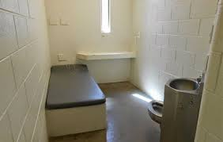
Service issue: Underlying Assumptions and Response
Zero Tolerance
Punishment
Individualised Supportive Care
Segregation or Care Suite?

Slide 4
Aims
Between sole self-harm, sole assault and dual harm prisoners:
To consider demographic or offence differences
To review differences in incident rates and types
To consider whether dual prisoners may be unduly affected by punishment (segregation or Basic regime).

Slide 5

Exploring Sole and Dual Harm
Locations
Prison A: Medium (Cat B) Remand + Low/Med (Cat C) Resettlement:
Study 1: 1 or more harmful incident at the prison
  Prison B: Medium (Cat B) Long-term (4+ years violent offenders):
Study 2: All in-prison assaulters
Study 3 : Random sample
Prison C: Medium (Cat B) Remand and early stage:
Study 4: Full prison sample.
Groups
(based only on in-prison incidents)
Sole Assault (physical assault)
Sole Self-harm (physical harm to self)
Dual Harm: Both assault and self-harm
No incidents
No harm (incidents but not physical harm)

Slide 6
Method
Data: Routinely gathered detailed incident, location and demographic data from electronic database system
Each participant had demographic, current offence, dates of segregation dates, incident dates and incident types recorded
Limitation: The reason for segregation was not recorded.

Slide 7
Definitions
Assault: Assaults in prison custody cover a wide range of physically violent incidents including fights between prisoners.
Self-harm: Any act where a prisoner deliberately harms themselves irrespective of the method, intent or severity of any injury.
Reportable Incident: Any incident, as outlined in HM Prison Service Order 1400, which requires staff to report it onto the PNOMIS electronic computer system. These include: assault, self-harm, damage to property, fire, drugs, mobile phone possession, death of a prisoner, miscellaneous, incidents at height, tool possession and barricade.

Slide 8
Samples
 | Study 1:Prison A N (%) | Study 2: Prison B N (%) | Study 3: Prison B N (%) | Study 4: Prison C N(%)
Self-Harm Only | 65 (36) | n/a | 9 (9.2) | 70 (7.3)
Dual Harm | 48 (27) | 42 (29.6) | 15 (15.3) | 105 (10.9)
Assault Only | 65 (36) | 100 (70.4) | 22 (22.4) | 223 (23.1)
No Harm | n/a | n/a | 24 (25.5) | 86 (8.9)
No Incidents | n/a | n/a | 27 (27.6) | 481 (49.8)
Total | 178 | 142 | 98 | 965
Prison A: 1 or more incidents: Local/Early stage – Resettlement
Prison B Study 1: Assaulters only: Long-stay violent
Prison B Study 2: All incidents: Long stay violent
Prison C: Full Population : Local/Early stage

Slide 9
Summary of Dual Harm Risk
Amongst the full offender population: Dual Harm ≈ 11%, rising slightly within violent offender prison.
Amongst an in-prison assault population: 30-40% also have a self-harm incident in prison
Amongst an in-prison self-harm population: 40-60% also have an assault in prison.
This is a similar pattern to that reported in the systematic review of O’Donnell, House and Waterman, 2015

Slide 10

Practice implications
Dual harm is prevalent amongst offenders
When managing one risk, there is a high probability that you will be managing both.
Services may wish to reflect on exclusion criteria for violence/aggression

Slide 11

Chicken or Egg?
Which came first

Slide 12
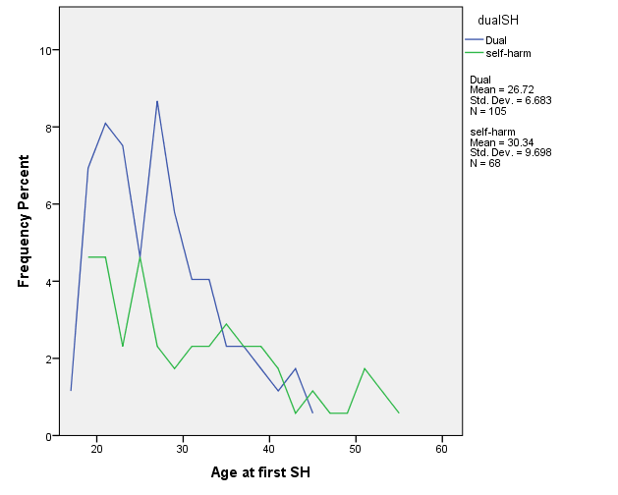
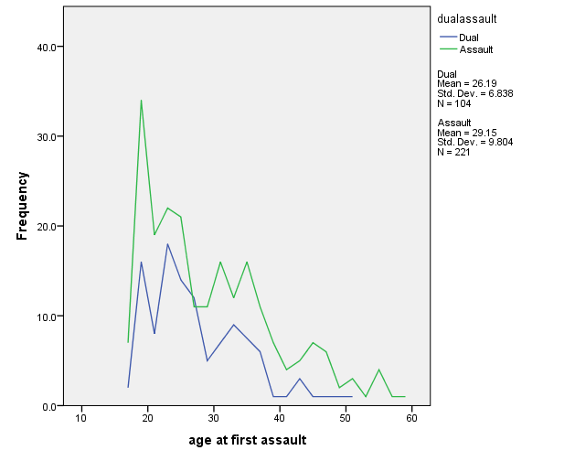
Self-harm or assault?
 | Study 4, Prison C
Assault first | 63%
Self-harm first | 37%
Mann-Whitney U Test reveals that significantly earlier Mean age for dual than self-harm only group (U = 4237, z = 2.077, p = .038)
Mann-Whitney U Test reveals that significantly earlier Mean age for dual than assault only group (U = 9925, z = -1,985, p = .047)

Slide 13
Wider Incidents

Slide 14
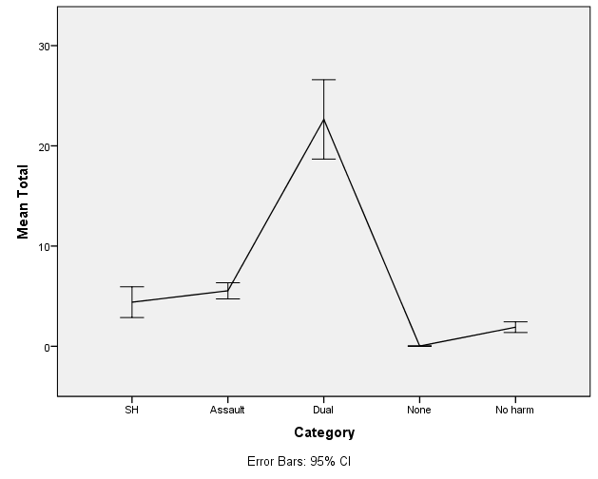
Total Incidents
4C : Kruskal-Wallis test revealed that there was a significant difference between the groups, X² (4, 965) = 870, p <.001. Dual Harm was significantly higher than all other groups (p <.001 for all comparisons)

Slide 15
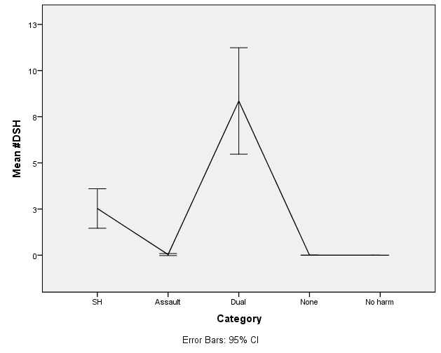
#Self-harm
Kruskal-Wallis test confirmed that Dual harm have greater number of self-harm incidents than self-harm only group, p =.05

Slide 16
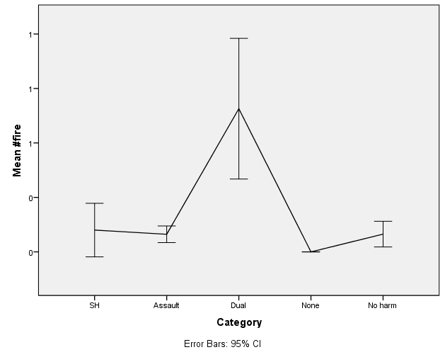
#fire
Kruskal Wallis confirmed that Dual harm have far greater number of fire incidents than any other group, p <.0001 for all comparisons.

Slide 17
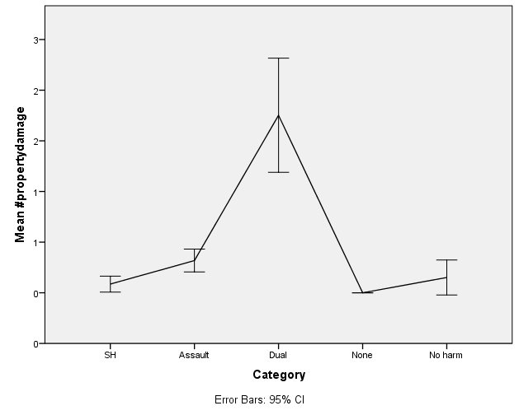
#property damage
Kruskal-Wallis tests revealed that Dual harm have far greater number of damage incidents than all other groups, p <.0001 for all comparisons.

Slide 18
Additional figures
Around 29-39% of Dual harm prisoners will have a Fire or Property Damage incident in their history.
Out of all set fires, Dual harm prisoners account for up to ¾ of them.

Slide 19
Practice implications
Dual harm offenders will be resource intensive
Those who harm at an earlier age in prison may be somewhat more likely to dual harm.
You will be managing not just two, but often a range of behaviour at once.
How often do you check in on multiple concerns (especially firesetting)- some of which have not yet emerged?

Slide 20

Segregation
Prison A: Study 1
Prison B: Study 3
Prison C: Study 4

Slide 21
The impact of segregation
The good news
Research has repeatedly shown that segregation, per se, is not consistently detrimental to mental health (e.g. O’Keefe et al., 2013) and those with mental disorder are not more likely to experience segregation after adjudication (e.g.Coid et al., 2003)
The not-so-good news
Suicidal ideation and behaviour are more prevalent in segregation
Those who have suicide ideation and anticipated stress in segregation are: more likely to have mental health issues, historical suicidal behaviour and current hopelessness (Bonner, 2006)

Slide 22
Good news and not so good news
Good news
Although many prisoners who self-harm experience segregation (around 40%), ‘self-harm only’ persons are not repeatedly being held there nor for extended periods relative to violence only or dual harm prisoners.
The not-so-good news
Self-harming prisoners are much more likely to experience segregation than prisoners with non-violent incident types (around 15-20%).
Up to 78% of prisoners who dual harm will experience segregation which is a higher rate as violence only prisoners (around 67%).

Slide 23

Self-harm in, or within 1 month, of segregation
Group | Study 1 (N = 9) | Study 3 (N = 4) | Study 4 (N = 40) | Combined Group
SH around segregation in history | 9/46 = 20% | 4/16 = 40% | 40/104 = 38% | 32%
Self-harm only | 1 (3%) | 0 | 4 (7%) | 4%
Dual harm | 8 (17%) | 4 (29%) | 36 (35%) | 29%
Summary:
32% of individuals who self-harm will have at least 1 episode near segregation
Of these, 90% are in the dual harm group.
29% of the Dual Harm group compared with 4% of SH group will harm around segregation

Slide 24
Self-harm in or within 1 month post-segregation
Post segregation self-harm
Study 1 (9 cases)
Study 3 (4 cases) Study 4 (40 cases) TBC
Methods post-segregation
64% with ligatures (compared with 15% generally)
2 ‘near miss’ and required resuscitation
Accounted for 50% of resuscitations (4) amongst 262 incidents
General
100% of those whose 1st self-harm occurred with 1 month had every other self-harm related to a (subsequent) segregation
1 x cutting, 1 x hanging, 1 x bag over head and 1 x self-strangulation
100% had attempted hanging, self-strangulation or suffocation, with 2 with ‘near-miss’.
Again, accounted for 50% of the sample (4 resusitation) out of 190 incidents
Study 4 : Almost all had (at some point) ligatured, overdosed or set fire to self with 4 requiring resusitation or hospital (out of 25 so far).

Slide 25
Dual Harm
When coupled with SH near segregation -account for 50% of all resuscitations
90% of all self-harm in or shortly after segregation are in this group
1 in 3 of the Dual group will SH in this timespan, and most have a history of high lethal methods.
Over 80% will experience segregation (and 97% experience Basic regime)
11-15% of population – BUT up to 60% of those who self-harm
High Risk for Firesetting, Propery Damage and incidents at height (accounted for 29% of fires)

Slide 26

Dual Harm
Function and context

Slide 27
Why do offenders harm in prison?
Reviewed 148 ACCT interviews and documents to identify what the 67 prisoners said, at the time, about their self-harm behaviour
To capture the reasons ‘in the moment’
To consider the interaction between individual factors and the prison environment
To identify any differences for those reporting those who dual harm

Slide 28
Dynamic and recent factors
Family
12% mentioned a recent death of close family member or prisoner
Difficulties
Levels of current punishment regimes are high with 30% currently on a punishment regime (Basic or segregation).
Emotion
Anxiety or Panic reported in 32% of incidents
16% reported current concerns about family health
Level of peer threat and victimisation are high, with 30% reporting this.
16% mentioned hearing voices which they found difficult with 20% reporting persistent and intrusive suicidal or violent thoughts.
Anger or frustration reported in 29% of incidents
Feeling low in 35%.
Interpretations
Apathetic Others – people not listening, not caring, not acting, breaking ‘promises’, even after asking for help.
Unable to meet responsibilties e.g. supporting or protecting family
Out of Control – feeling overwhelmed, impotent and life being out of control.
There were serious issues with lost connections with loved ones in 24%.

Slide 29

Suicide Intent
There was a high level of Suicide Intent to their self-harm behaviour across both groups.
16.3% of SH episodes specifically state suicide intent
With each group, at least one episode being reported with a clear ‘wish to die’
Dual Harm (33.3%) vs Sole SH (30%)

Slide 30

Dual harm: Similarities
No greater reporting around SH due to:
Their reported emotions (anxiety, anger or low mood)
The functions/purpose are pretty much the same.

Slide 31
Dual Harm: differences
There are some emerging differences in relation to their reported triggers and concerns:
Self-harm
Dual Harm
Awaiting contact with MH service or medication issue
To feel the absence of a cellmate
To feel anxious about trial or sentencing
Under threat from other prisoners
Compliance with Medication
To feel anxious about release

Slide 32
Tentative Conclusions
The emotion and function of the behaviour does not differ based on whether they are also violent; but there are differences in the triggers and context.
  Self-harm only prisoners: self-harm due to more anxious about the early stages of prison, feeling the absence of a cell mate and awaiting mental health input
  Dual harm prisoners: self-harm higher within the context of anxiety around threats and release.
Generally in prisoners the leading concerns are related to:
  Bereavement and losing connection with loved ones including inability to fulfil supportive roles
  Under threat by other prisoners and not feeling safe
  Punishment regimes which some find more difficult
  Persistent and intrusive thoughts
  Anxiety, anger and feeling low in equal measure.

Slide 33

What can we do?
We can remain mindful that risk of violence is related to risk of harm to self, & together there is a link to firesetting.
There is much similarity in the emotions and purpose of the self-harm so similar interventions targeting these aspects may well be appropriate.
We could provide additional assessment and support:
  Stronger safeguards around punishment regimes (particularly Basic regime).
  Enhancing responses to bereavement
  Consider innovative ways across the service to support family connection
  More robust response to reported peer threat.
  Front end support to the early days through trial and sentencing.
  Some differentiation in the timing of support for different groups of prisoners

Slide 34
Paper (covers studies 1 and 2)
Slade, K. (2017) Dual Harm: An exploration of the presence and characteristics for dual violence and self-harm behaviour in prison. Journal of Criminal Psychology (online).
Please contact me if you’d like the slides, papers or interested in research avenues: karen.slade@ntu.ac.uk

