Slide 1

Dual Harm: Prevalence and characteristics amongst male prisoners
Dr Karen Slade
Associate Professor in Applied Forensic Psychology
Nottingham Trent University

Slide 2
What we know about the link from violence to self-harm (community)
Exposure to violence increases the risk of self-harm and thoughts of suicide (Vermeiren, et al. 2002)
Perpetrating violence increases the risk further
The greatest risk of suicidal behaviours from those conducting repeated violent acts (Jordan & Samuelson, 2015)
Around 20-30% of various populations (including community samples) who engage in violence will also self-harm (O’Donnell, House and Waterman, 2015).

Slide 3
Self-harm to violence
The relationship appears even stronger in this direction
In the community, up to 50% of persons who self-harm will be aggressive (O’Donnell et al, 2015).
A population study in Sweden (Hanna et al, 2017) showed that:
were still twice as likely even when controlled for psychiatric disorders and socio-economic factors.
those who requires medical treatment for self-harm were 5-times more likely to be convicted of a violence crime
Vaughn et al, 2015 in USA also showed (in wider population) that SH was related to a range of violent behaviours including IPV, weapon use, cruelty to animals and robbery.

Slide 4
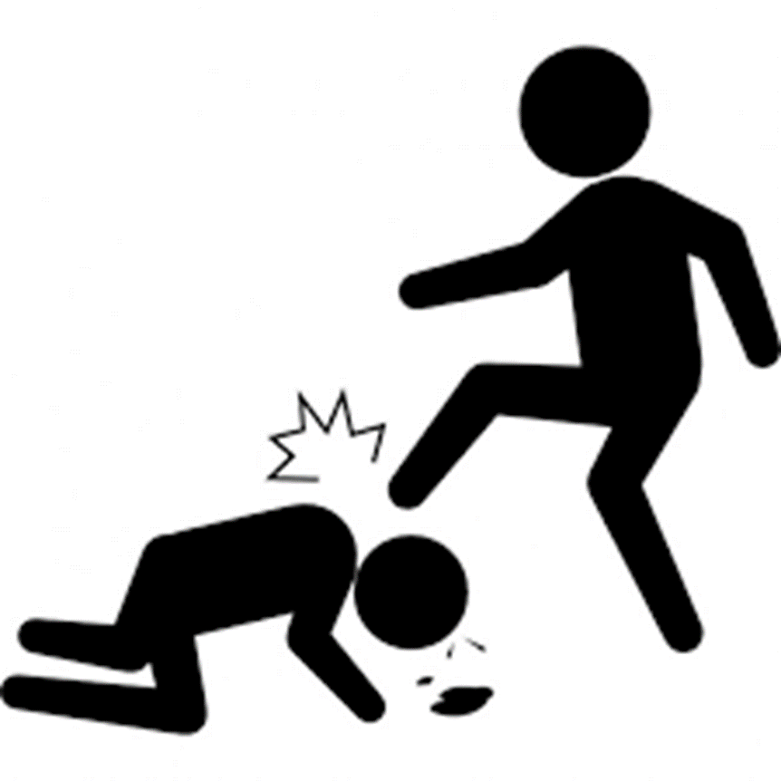




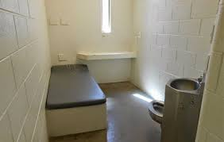
Service issue: Underlying Assumptions and Response
Zero Tolerance
Punishment
Individualised Supportive Care
Segregation or Constant Supervision?

Slide 5
Aims
To explore risk factors for dual harm prisoners.
This study will compare sole self-harm, sole assault and dual harm prisoners:
To explore demographic variables and offence types
To explore incident rates, incident types and (where applicable) rates of restrictive punishment regimes.
To explore any differences in methods or lethality of self-harm.

Slide 6

Exploring Sole and Dual Harm
Location
Medium Security (Cat B) Remand and early stage prison in England
Groups
(based on in-prison incidents)
Sole Assault (physical assault)
Sole Self-harm (physical harm to self)
Dual Harm: Both assault and self-harm
No incidents
No harm (incidents but not physical harm)

Slide 7
Method
Data: Routinely gathered detailed incident, location and demographic data from prison electronic database system
Each participant had demographic, current offence, incident dates and incident types, dates of placement under a punishment regime.
Details on method of self-harm behaviour was also gathered.

Slide 8

Definitions
Assault: Assaults in prison custody cover a wide range of physically violent incidents including fights between prisoners.
Self-harm: Any act where a prisoner deliberately harms themselves irrespective of the method, intent or severity of any injury.
Wider Incident: Any incident, as outlined in HM Prison Service Order 1400, which requires staff to report it. These include: damage to property, fire, drugs, mobile phone possession, incidents at height, tool possession and barricade.
Self-inflicted death: any death of a person who has apparently taken their own life, irrespective of intent.
Lethal methods of self-harm: Does not assume suicide intent and reflects the risk to life.

Slide 9
Sample
 | N(%)
Sole Self-Harm | 70 (7.3)
Dual Harm | 105 (10.9)
Sole Assault | 223 (23.1)
No Harm | 86 (8.9)
No Incidents | 481 (49.8)
Total | 965

Slide 10
Rate of wider incidents
(per person year)

Slide 11
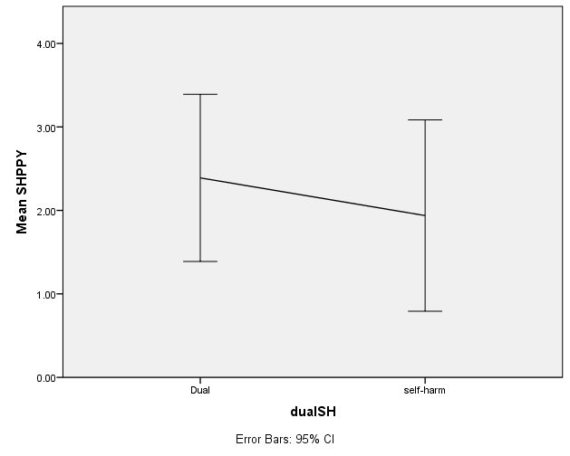
Self-harm PPY
Kruskal-Wallis test confirmed that there was no significant difference in the number of self-harm incidents between the dual and sole self-harm group, p =.361

Slide 12
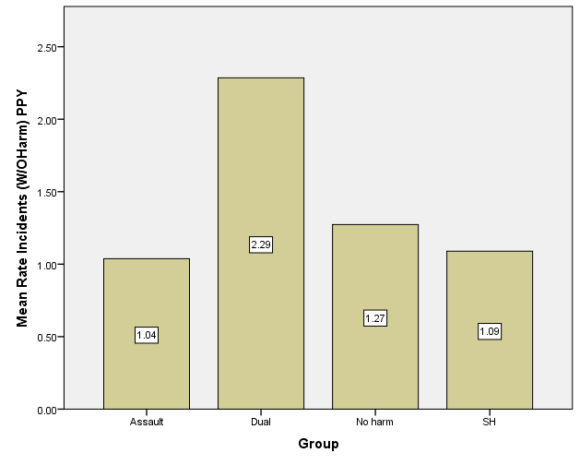
Rate of Other Incidents
(per person year)
All other incidents (not including self-harm or assault) per person year.
Dual harm had far significantly higher rate than all other groups p < .001.

Slide 13
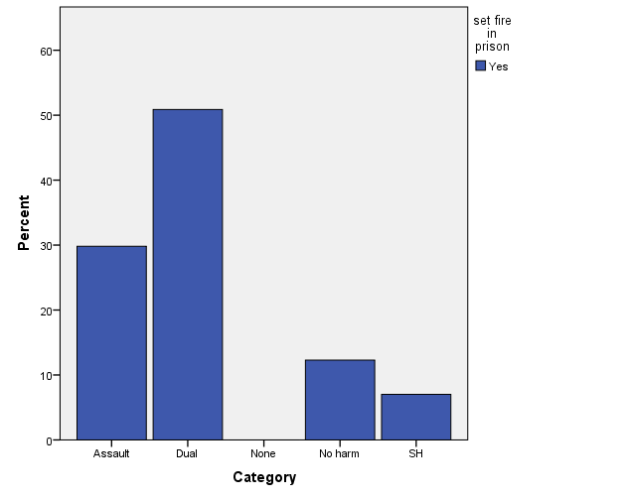
Fire PPY
Dual harm have far number of fire incidents than all other group, p <.0001 for all comparisons (Kruskal-Wallis).
28% of dual harm have set a fire within last 5 years and account for 50% of all fire setting in prison. Compared with under 8% within all other groups.
The risk of dual harm prisoners ever setting a fire in prison was calculated:
Dual vs SH: 5 x as likely
Dual vs Assault: 3-4x as likely
However SH and Dual harmers have a similar annual rate of firesetting with a small number accounting for multiple events.

Slide 14
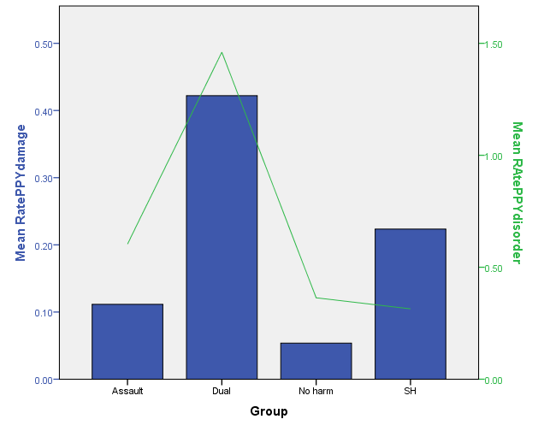
property damage or disorder PPY
Kruskal-Wallis tests revealed that Dual harm also have greater rate of damage and disorder incidents than all other groups, p <.001 for all comparisons.

Slide 15

Dual Harm
Lethal methods of self-harm

Slide 16
Method of self-harm
90+% of SIDs in prison are via ligature/SS (MoJ, 2018)
Type of self-harm | All self-harm N = 175 N (%) | Self-harm only (N = 70) N (%) | Dual (N =105) N (%) | p | OR (95% CI)
Ligature/Self-strangulation | 68 (38.9) | 20 (28.6) | 48 (45.7) | .024 | 2.1 (1.1 –3 .014)
Cuts | 127 (72.6) | 50 (71.4) | 77 (73.3) | .782 | 1.1 (.56 – 2.16)
Overdose | 39 (22.3) | 10 (14.3) | 29 (27.6) | .041 | 2.29 (1.03 – 5.07)
Headbanging | 10 (5.7) | 5 (7.1) | 5 (4.8) | .509 | .65 (.18 – 2.33)
Punched wall or self | 13 (7.4) | 2 (2.9) | 11 (10.5) | .079 | 3.98 (.85 – 18.53)
Swallowed item | 14 (8) | 3 (4.3) | 11 (10.5) | .152 | 2.61 (.70 – 9.73)
Other (insertion, burns, kicking, set fire, NPS) | 11 (6.3) | 3 (4.2) | 8 (7.6)
Odds Ratio indicates the risk of ligature or overdose is x2 those in the Sole SH group

Slide 17
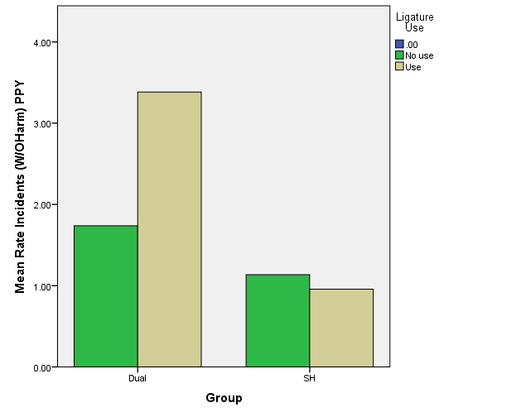
Interaction
The relationship is affected by the interaction between incident rates and dual harm.
Logistic regression
p = .005; OR =1.5 (95% CI 1.13-1.99)
Those within the dual harm group with the most non-harm incidents are also most likely to have used ligatures (all other relationships non-significant).

Slide 18
Number of SH Methods (max of 7)
Methods | Dual % | Self-harm %
1 | 55 | 79
2 | 24 | 14
3 | 11 | 4
4 | 8 | 1
5 | 2 | 1
6 | 1 | 0
Mann Whitney U-test confirmed that Dual Harm (Mdn = 1.66) used a greater range of methods of SH than Sole self-harm (Mdn = 1.24)
U = 2,769, p = .001
Dual: 22% use 3 + methods
SH: 6% use 3+ methods

Slide 19
Punishment regimes

Slide 20
Restrictive (punishment) regimes
Segregation
Segregation involves a prisoner being removed from their wing and being put on the segregation unit. There, prisoners will be isolated from the rest of the prison, with a much reduced regime and often only half an hour or so out of their cells each day.
NB some additional self-harm risk management exist (MH check, ‘defensible decision’ for those considered self-harm risk)
Basic level
Prisoners are placed on basic level because they have failed to meet local criteria for admission to standard and enhanced levels. (PSI 30/2013)
“Basic level is deliberately designed to be a miserable way of life. Prisoners are forced to wear prison-issue clothing, are denied most personal possessions and are usually not permitted to rent a small portable TV set. In addition, in many prisons inmates on Basic aren't permitted much time out of their cells (for association with other prisoners) and, unless they have a job or are participating in an education course, can find themselves 'banged up behind their doors' (locked in their cells) for up to 23-hours a day”. http://prisonuk.blogspot.co.uk/2014/07/the-iep-system-one-of-biggest-changes.html
NB No additional self-harm risk management

Slide 21
Restrictive Punishment Regime (RR) experience
 | Basic regime experience % | Segregation experience %
Assault Only | 83 | 49
Dual | 98 | 80
Incident but no harm | 78 | 37
Self-harm | 64 | 27
p (Dual vs the rest) | <.001 | <.001

Slide 22
Dual Harm: emergence of SH

Slide 23
SH emergence
One in Five had their first ever recorded SH whilst under their first or second experience of RR. If unrelated, it should be less.
Relationship with emergence of lethal methods
Of those with RR experience:
One quarter had used ligature as their first ever recorded SH.
Almost half (43%) of these first ligatures had occurred whilst under first/second RR.
Of those without RR experience:
Only one in twenty had used ligature as their first recorded SH.
Analysis confirmed a significant relationship between the first ever SH occurring under RR and this first SH using a ligature.
(Logistic regression; p < .05, Exp (B) = 2.039, 95% CI –1 -4.15)
What does this mean?
That if the first self harm occurs under either punishment regime, it is twice as likely to be using a ligature.

Slide 24

Dual harm is prevalent and meaningful across all populations but especially in relation to violent offending. Risk not limited to one behaviour, but a range of harmful behaviours.
Have far greater experience of punishments, including segregation, basic regime but also in prison and being recalled or serving an indeterminate/life sentence. They have less access to positive influence and community. The high levels of both incident and punishment and restrictive regime seeming to have little effect.
No difference in rates of self-harm or assault, but higher rates of fire setting, property damage and disorder. These group into more reactive and expressive behaviour. The greater use and swifter emergence of lethal methods suggest heighted risk of self-inflicted death.
The greater variability of behaviours suggests they are adaptable (if ineffective). This variability includes SH methods so presentation and risks will change over time and across spheres.
Managing one risk at a time or restrictive punishments may be unlikely to result in lasting impact on overall risk of harm. They may show changing behaviour patterns so single case management is recommended across services.

Slide 25

Previous paper:
Slade, K. (2017) Dual Harm: An exploration of the presence and characteristics for dual violence and self-harm behaviour in prison. Journal of Criminal Psychology (8 (2), pp. 97-111.
Please contact me if you’d like the slides, papers or interested in research avenues: karen.slade@ntu.ac.uk

